Slide 1
Some considerations on the CEPC booster Design
Zhang Chuang, Cui Xiao hao
2015.08.28

Slide 2
Requirement of the Booster
Similar layout with the main collider
Stability at low and high energy

Slide 3
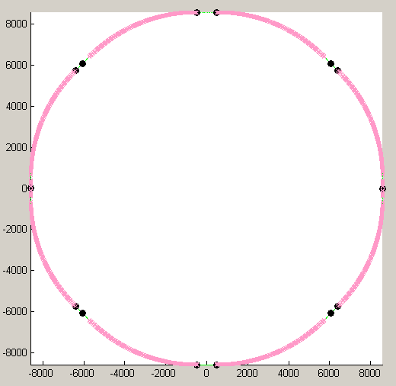
Lattice designed by Prof. Zhang Chuang
Same Arc sections with main collider
Bypass at the IPs
Tunes are changed to [191.8,191.7]

Slide 4
Main Parameters
Low Energy | 6 GeV
Hign Energy | 120 GeV
Damping time at 6 GeV | 115.5967s(642200Turns)/57.79843s(321100Turns)
Damping time at 120 GeV | 1.444960E-2s(80 Turns)/ 7.224803E-3(40Turns)

Slide 5
Dynamic Aperture
Due to the weak damping at Low Energy, electrons in the booster should be stable at least during the time ramping to 120 GeV, 5s(30000Turns).
On axis injection is adopted, Consider a 3σ stable area, then the stable area should be 10mm in the horizontal, and 2mm in the vertical. (Linac beam emittance: 0.3 mm.mrad, 1% coupling)
Energy Acceptance: 0.5% ?

Slide 6
Dynamic Aperture
DA for 240 Turns
DA for 5000 Turns -- No Energy Deviation

Slide 7
Dynamic Aperture
DA for 5000 Turns -- 0.5% Energy Deviation

Slide 8
FMA for the booster --- with AT

Slide 9
FMA for the booster --- with Elegant

Slide 10
FMA for the booster --- Not crossing half integer

Slide 11
DA for 80000 turns

