Slide 1
Study on CEPC double beam pipe scheme
XIAO Ming, GENG Huiping, XU Gang, WANG Dou, BAI Sha , GAO Jie
August 28,2015

Slide 2
Separators (LEP style * 20)

Slide 3
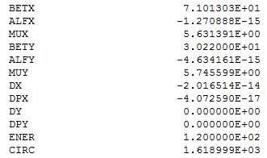
_

Slide 4
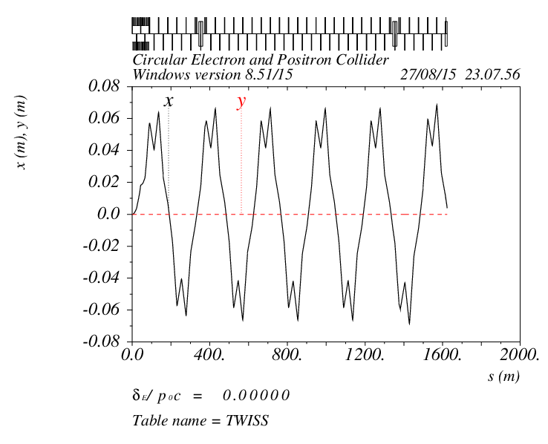

Slide 5
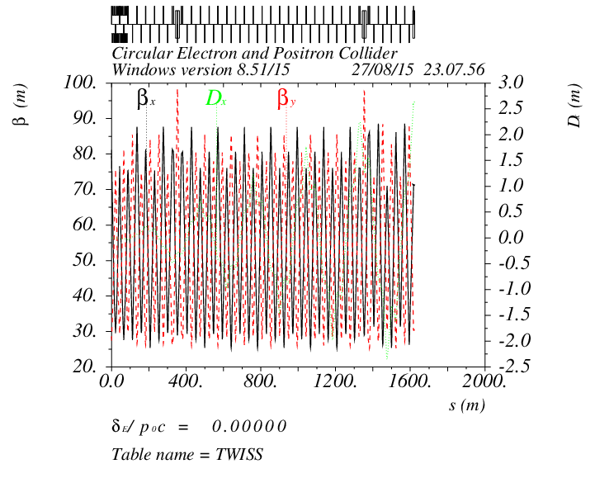

Slide 6
Separator replaced by dipoles

Slide 7
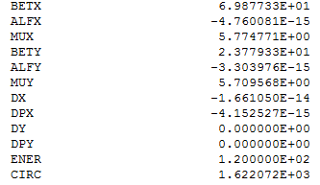
_

Slide 8
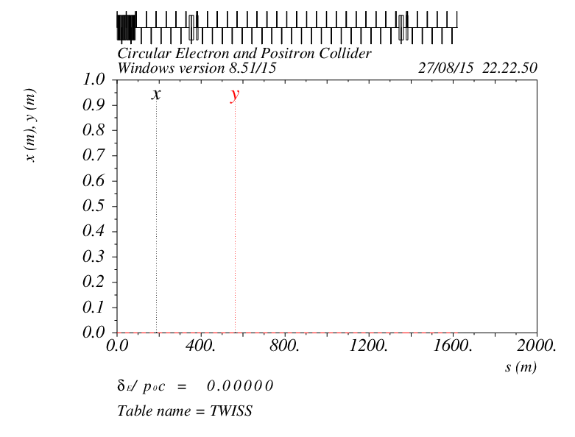

Slide 9
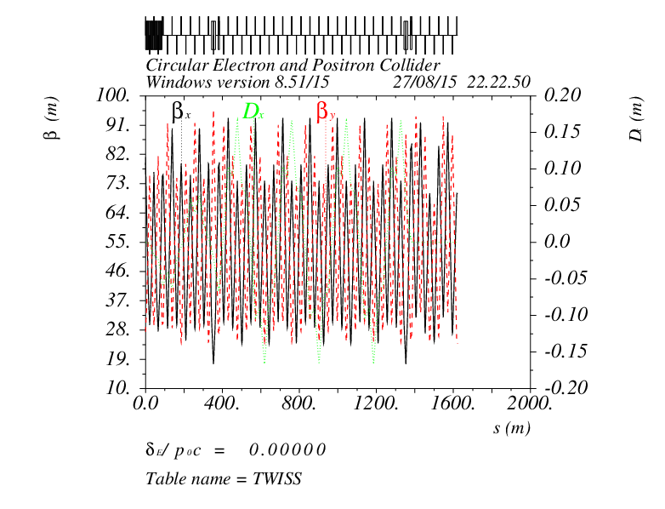
separators
dipoles

Slide 10
