Slide 1
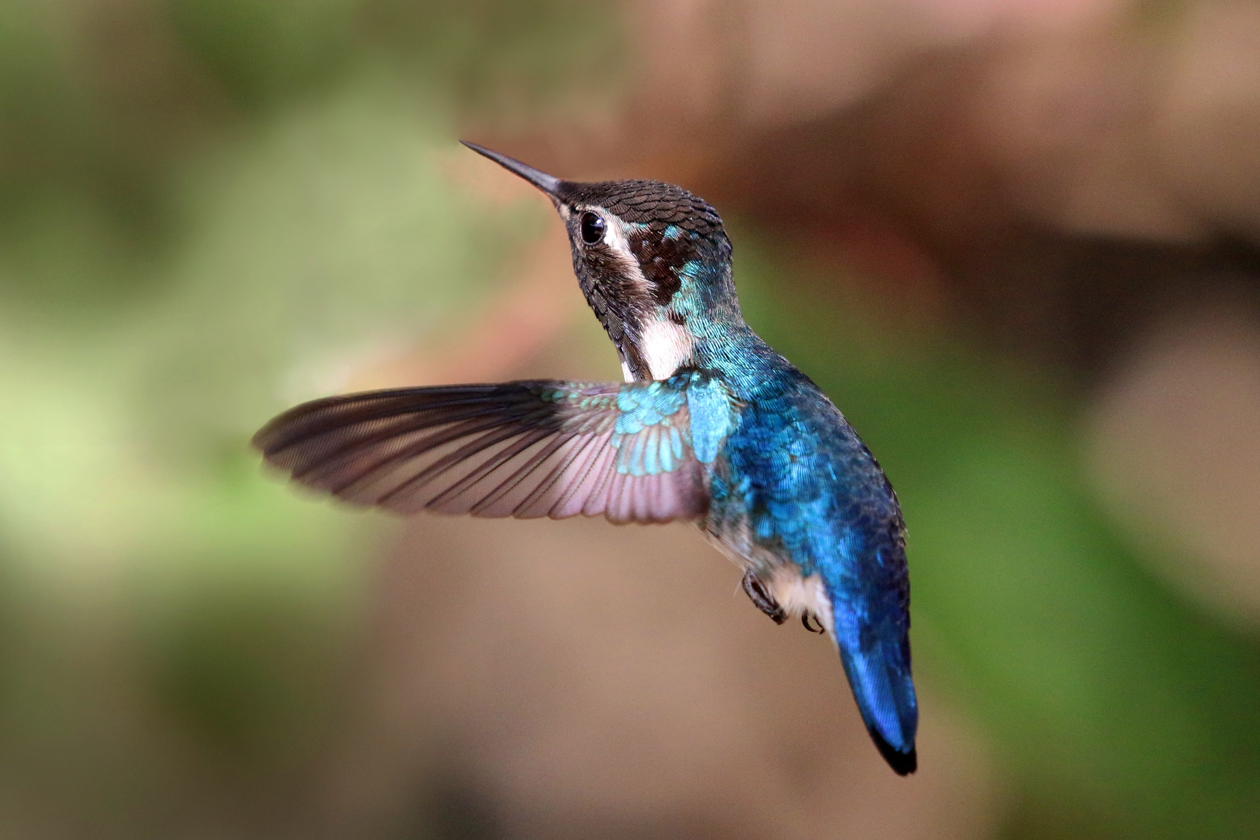
CC-BY-SA 4.0 by Charlesjsharp on Wikimedia Commons

Slide 2
SCOAP³: Free Open Access for all articles in arXiv hep-* categories
2015 Impact Factor 3.761
Ranked Q2 for both Particle and Nuclear Physics
Subscriptions at 2800 institutions worldwide
Average time to 1st decision 30 days
Fast-track publication for selected articles
Sponsored by IHEP and IMP, Chinese Academy of Sciences
Published by CPS and IOP Publishing
Free English editing on all accepted articles

Slide 3
cpc.ihep.ac.cn iopscience.org/cpc

