Slide 1
DA study progress
Yiwei Wang, Yuan Zhang, Dou Wang,
Sha Bai, Huiping Geng, Jie Gao
CEPC AP meeting
25 Sep 2015

Slide 2
Optimise DA with more families of sextupoles in ARC
Firstly, try to optimize ARC only
Consider DA only non-interleaved scheme preferred
non-interleaved scheme applied on present lattice (ph=60 degree)

Slide 3
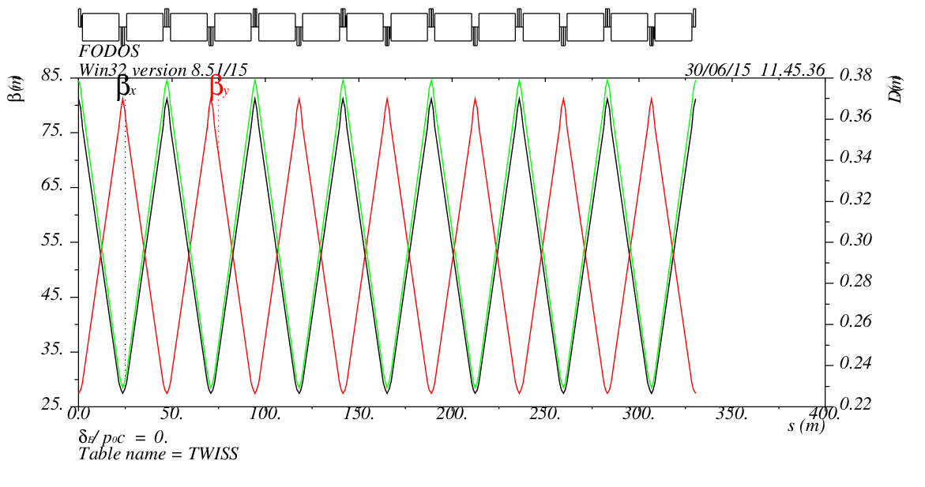
Interleaved and non-interleaved scheme
Non-interleaved scheme
separate the transverse problems from the chromatic ones*
by cancelling the transverse nonlinearities from sextupoles with –I matrix
much smaller transverse nonlinearities
larger high-order chromaticities
as good as interleaved one if sufficient sextupole families are applied
From interleaved to non-interleaved
7SF, 7SD -> 2SF, 2SD in each 7 FODO cells
*K. Oide et al. PRE Vol. 47, No. 3 (1993)
-I
-I
SF1
SF2
SD1
SD2

Slide 4
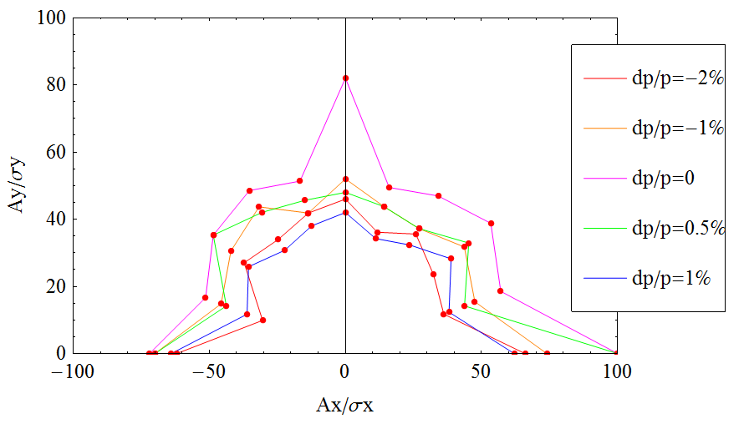
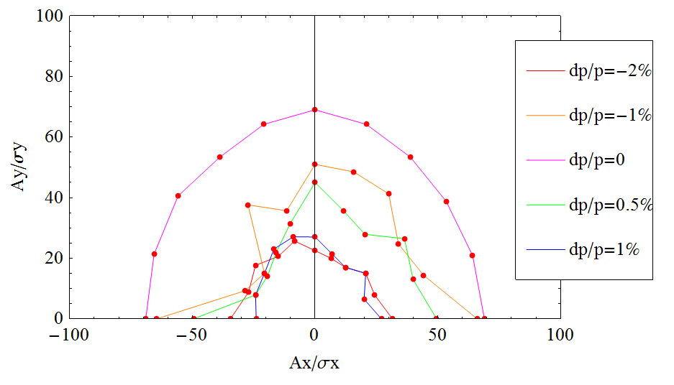
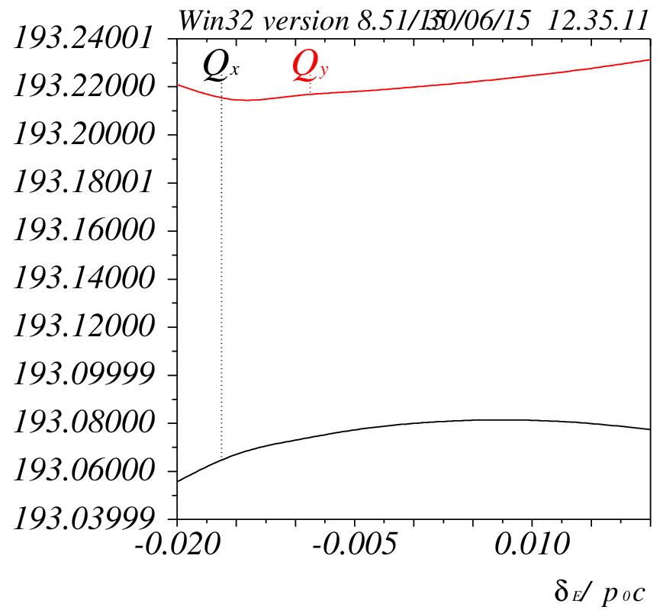
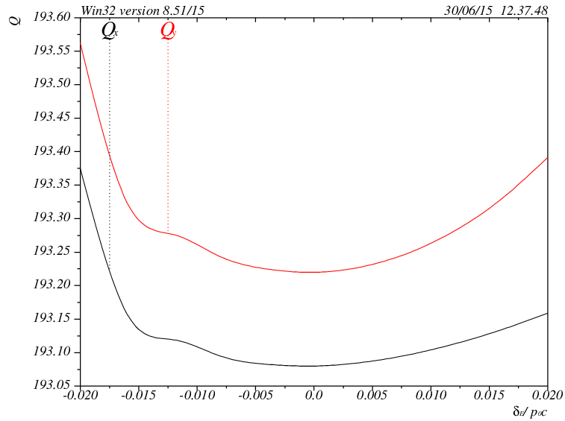
Dynamic aperture
DA for on-momentum particles increased significantly
High order chromaticities increased as well
only 2families used
need to optimize with more families (17*2 families under working)
Interleaved
ARC only
εy= εx used
Non-interleaved
ARC only
εy= εx used
Interleaved
ARC only
Non-interleaved
ARC only

Slide 5
Non-interlaced + more families
Four-fold symmetry retained
17*2=34 families of sextupoles
Try to optimize Q, β, α, Dx vs δ (under going)
ARC1
ARC1
ARC2
ARC2
ARC2
ARC2
ARC1
ARC1

Slide 6
Conclusion
Non-interlaced sextupoles increase the dynamic aperture for on-momentum particles
Next step
try with more families 17*2
For the lattice with IR, estimate beam lifetime

