Slide 1
CEPC Partial Double Ring Lattice
SU Feng WANG Dou XIAO Ming GAO Jie
GENG Huiping XU Gang DUAN Zhe
BAI Sha BIAN Tianjinan
Key Laboratory of Particle Acceleration Physics and Technology
Institute of High Energy Physics
Chinese Academy of Sciences
2015.10.16

Slide 2
Outline
Layout
Orbit
Parameter
Next to do

Slide 3
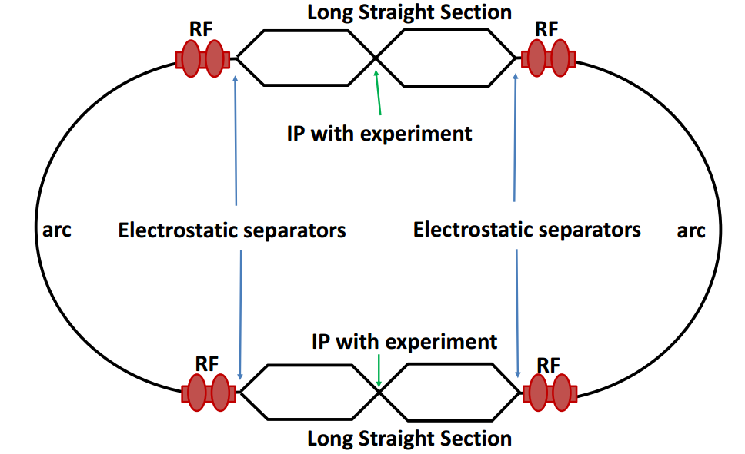
Local double beam pipe
_
The synchrotron radiation power of CEPC is as high as 50MW and its goal is to deliver a peak luminosity greater than 1×10^34cm−2s−1 per IP. The baseline design is a single beam-pipe electron positron collider, which has to adopt pretzel orbit scheme. And it is not suitable to serve as a high luminosity Z factory.
Advantages
No pretzel
More bunches
Challenges
Crossing angle & crab waist design.
Electron cloud issues.
Bunch train operation introduces an uneven load to the RF system.
Xiao Ming 2015.7.6

Slide 4
CEPC Partial Double Ring Layout
RF
IP1_ee
RF
3Km
1/2RF
1/2RF
IP4_pp
IP2_pp
1/2RF
1/2RF
C=54710.4m
RF
IP1_ee/IP3_ee, 3Km
IP2_pp/IP4_pp, 1132.8m
4Straights, 849.6m
4Long ARC, 120*FODO, 5852.8m
4Short ARC, 100*FODO, 4908.8m
IP3_ee
RF
SU Feng
2015.10.12

Slide 5
CEPC Partial Double Ring Layout
B2
B3
BDSL1
BDSL2
B1
15mrad
10.5FODOSTRIP
502.6m
Full crossing angle 30mrad
IP
7.7877m
B6
11FODOSTR
519.2m
BDSR2
BDSR1
B4
B5
10FODOSTR
472.0m
1683.25m
Version0.0
2015.10.12

Slide 6
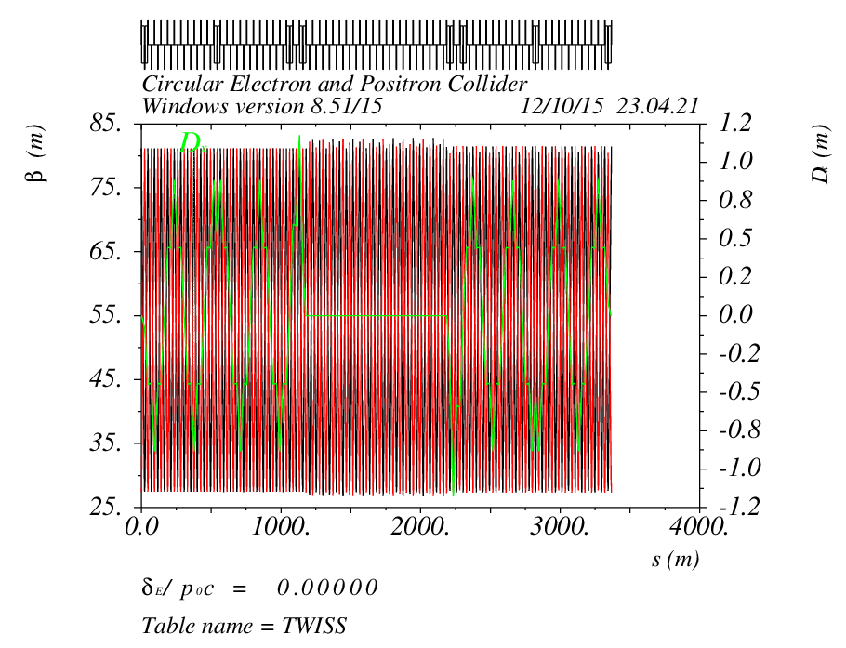
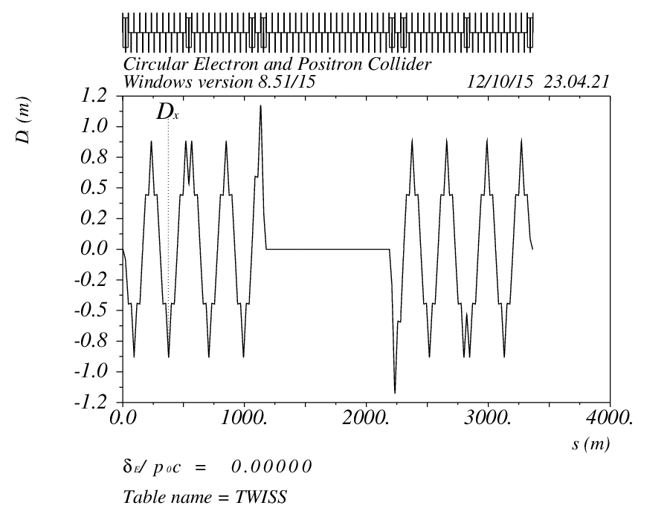
Orbit (DR_RING_e1) Version0.0

Slide 7
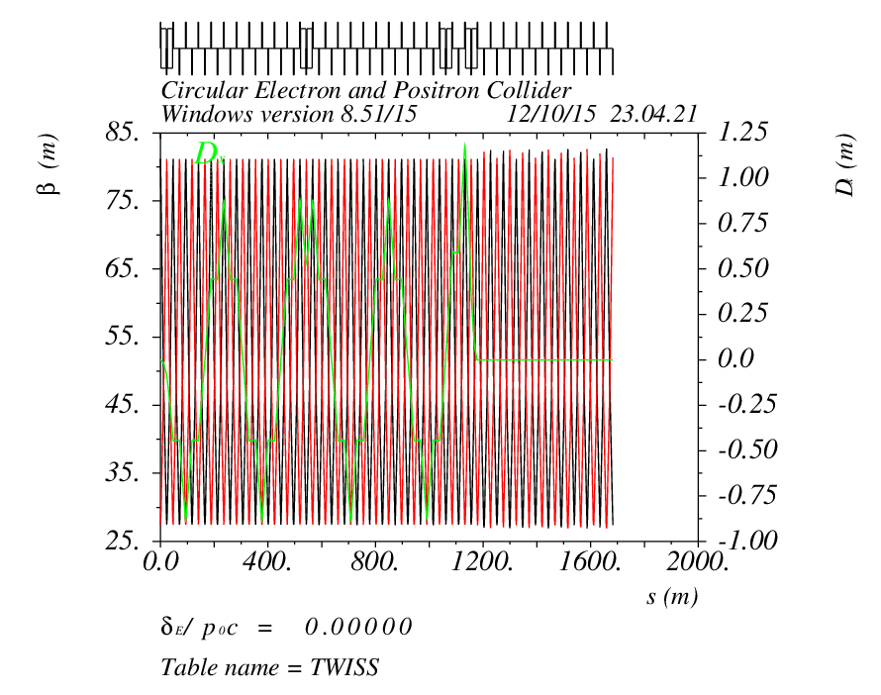
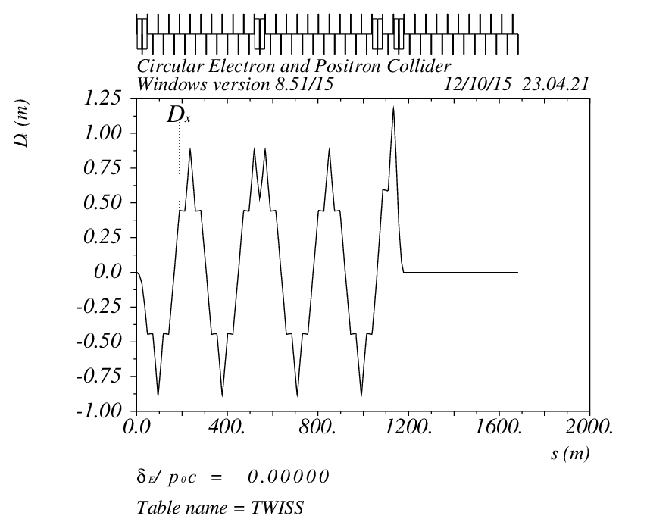
Orbit ( DR_RING_e1hL_IP) Version0.0

Slide 8
Dipole Strength Version0.0
 | Angle(mrad) | L(m) | Rho(m) | Brho(E0/c) (T/m) | B(T) | Ek(KeV) | KeV/m
B0 | 3.506 | 19.6 | 5590.42 | 400 | 0.07155 | 685.173 | 34.9578
B1 | -7.5 | 19.6 | 2613.33 | 400 | 0.15306 | 1465.71 | 74.7813
B2 | 7.5 | 19.6 | 2613.33 | 400 | 0.15306 | 1465.71 | 74.7813
B3 | 2.499894 | 19.6 | 7840.33 | 400 | 0.05102 | 488.551 | 24.9261
BDSL1 | -19.865386 | 19.6 | 986.641 | 400 | 0.40542 | 3882.26 | 198.075
BDSL2 | 29.865598 | 19.6 | 656.273 | 400 | 0.60950 | 5836.59 | 297.785
BDSR2 | -29.865598 | 19.6 | 656.273 | 400 | 0.60950 | 2836.59 | 297.785
BDSR1 | 19.865686 | 19.6 | 986.641 | 400 | 0.40542 | 3882.26 | 198.075
B4 | -2.499894 | 19.6 | 7840.33 | 400 | 0.05102 | 488.551 | 24.9261
B5 | -7.5 | 19.6 | 2613.33 | 400 | 0.15306 | 1465.71 | 74.7831
B6 | 7.5 | 19.6 | 2613.33 | 400 | 0.15306 | 1465.71 | 74.7831

Slide 9
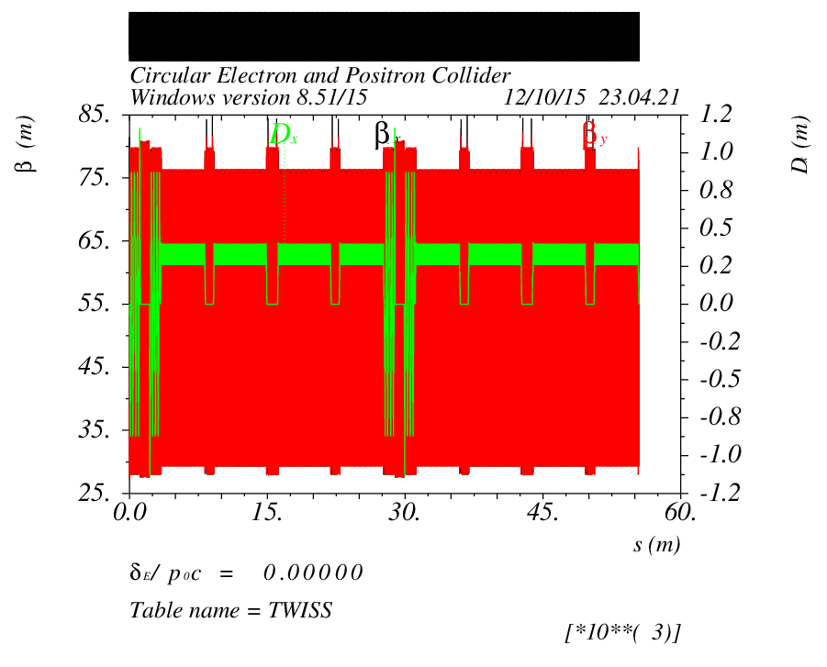
Survey Ring Version0.0

Slide 10
CEPC Partial Double Ring Layout
B2
B3
B2DSL1
B2DSL2
B3DSL1
B1DSL1
B1DSL2
B3DSL2
①
③
①
B6
②
①
④
Full crossing angle 30mrad
15mrad
B1
IP
8.4957m
B4DSL2
B6DSL2
B6DSL1
B4DSL1
B5DSL2
B4
B5DSL1
B5
1443.43m
: 141.6m (3FODO)
: 424.8m (9FODO)
: 94.4m (2FODO)
: 502.6m (10.5FODO)
Version0.1
2015.10.13

Slide 11
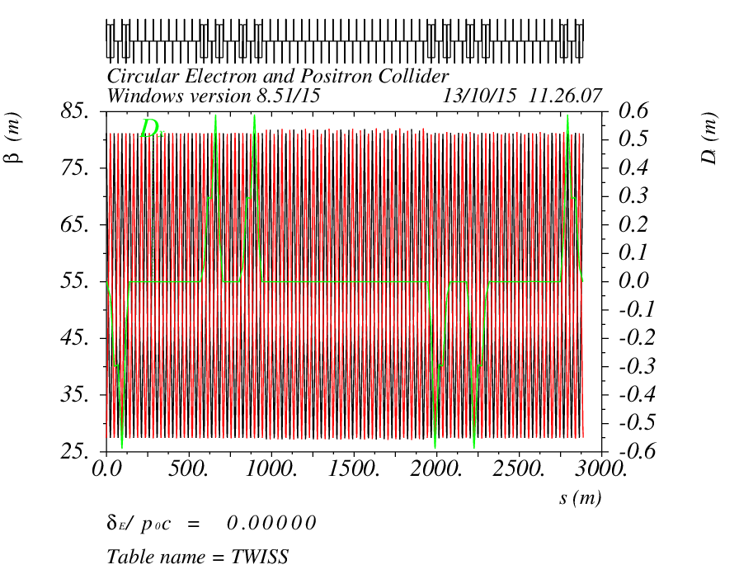
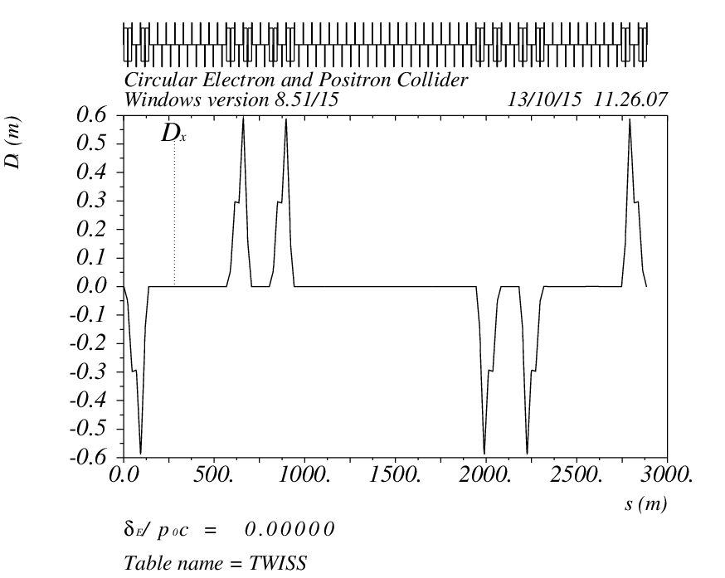
Orbit (DR_RING_e1) Version0.1

Slide 12
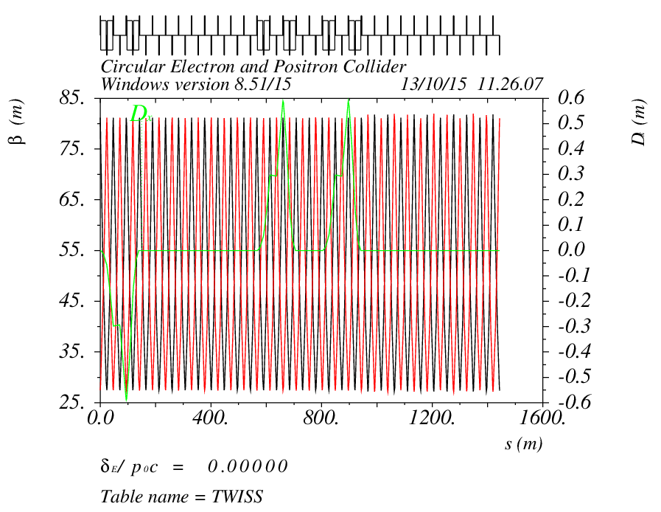
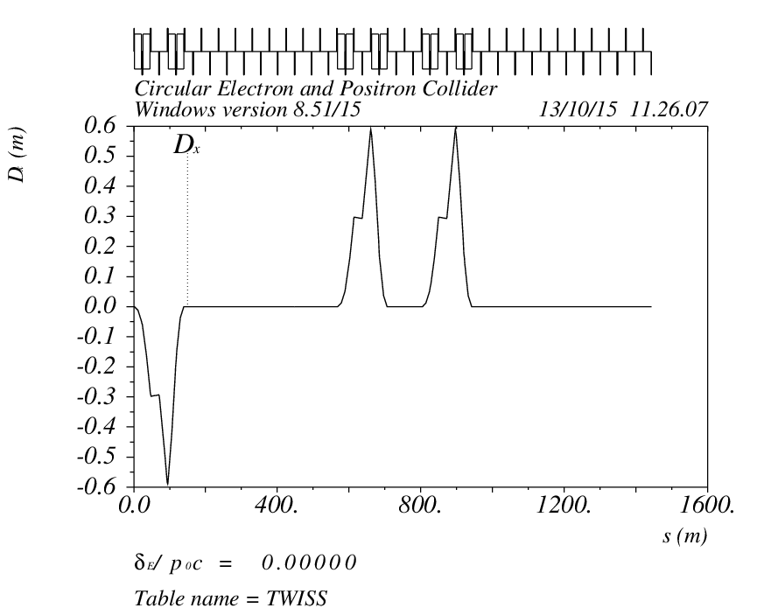
Orbit ( DR_RING_e1hL_IP) Version0.1

Slide 13
Dipole Strength Version0.1
 | Angle(mrad) | L(m) | Rho(m) | Brho(E0/c) (T/m) | B(T) | Ek(KeV) | KeV/m
B0 | 3.506 | 19.6 | 5590.42 | 400 | 0.07155 | 685.173 | 34.9578
B1 | -5.0 | 19.6 | 3920.0 | 400 | 0.10204 | 977.143 | 49.8542
B1DSL1 | 9.9336755 | 19.6 | 1973.09 | 400 | 0.20273 | 1941.32 | 99.0417
B1DSL2 | -14.93323 | 19.6 | 1312.51 | 400 | 0.30476 | 2918.38 | 148.897
B2 | 5.0 | 19.6 | 3920.0 | 400 | 0.10204 | 977.143 | 49.8542
B2DSR1 | -9.933058 | 19.6 | 1973.09 | 400 | 0.20273 | 1941.32 | 99.0417
B2DSR2 | 14.93292 | 19.6 | 1312.51 | 400 | 0.30476 | 2918.38 | 148.897
B3 | 5.0 | 19.6 | 3920.0 | 400 | 0.10204 | 977.143 | 49.8542
B3DSR1 | -9.93336 | 19.6 | 1973.09 | 400 | 0.20273 | 1941.32 | 99.0417
B3DSR2 | 14.93323 | 19.6 | 1312.51 | 400 | 0.30476 | 2918.38 | 148.897

Slide 14
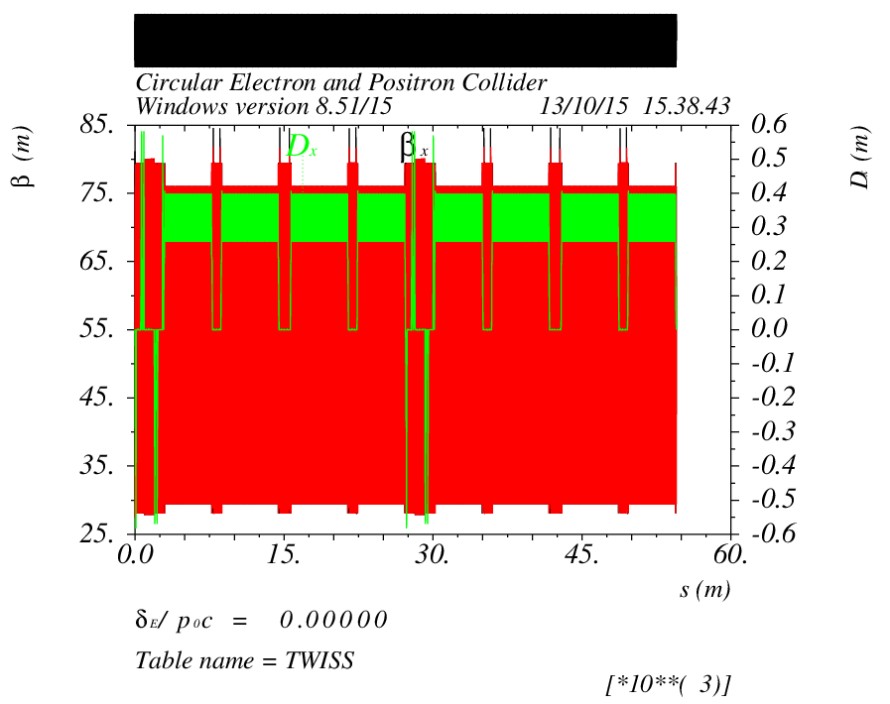
Survey Ring Version0.1

Slide 15
CEPC Partial Double Ring Layout
B2
B3
B2DSL1
B2DSL2
B3DSL1
B1DSL1
B1DSL2
B3DSL2
①
③
①
B6
②
①
④
Full crossing angle 30mrad
15mrad
B1
IP
8.4957m
B4DSL2
B6DSL2
B6DSL1
B4DSL1
B5DSL2
B4
B5DSL1
B5
1443.43m
: 141.6m (3FODO)
: 424.8m (9FODO)
: 94.4m (2FODO)
: 502.6m (10.5FODO)
Version0.1
2015.10.13

Slide 16
CEPC Partial Double Ring Layout
16
62.5urad
4.5m
B2
B3
B1
DIS Dipole
Full crossing angle 30mrad
15mrad
IP
B6
1700m
B4
B5
Seperator
For CEPC 120GeV beam:
Max. deflection per separator is 66μrad.
Using Dipole after seperator to acquire 15 mrad
Version 0.2
2015.10.15

Slide 17
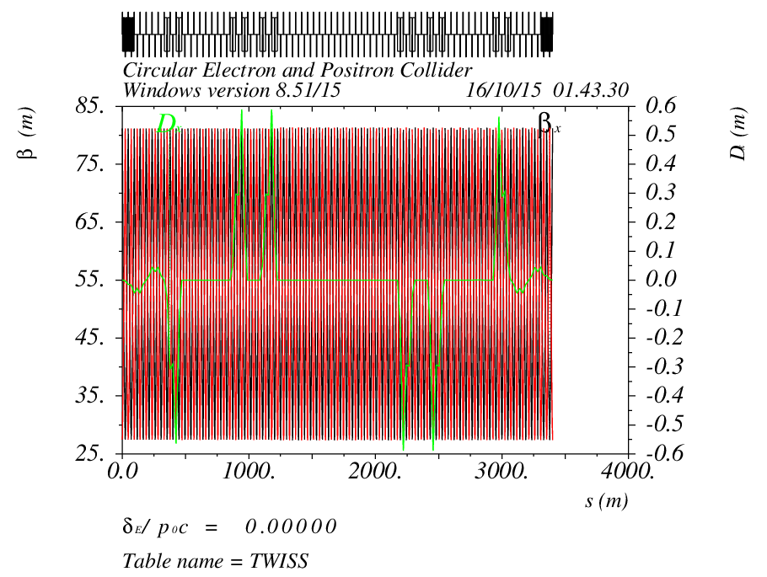
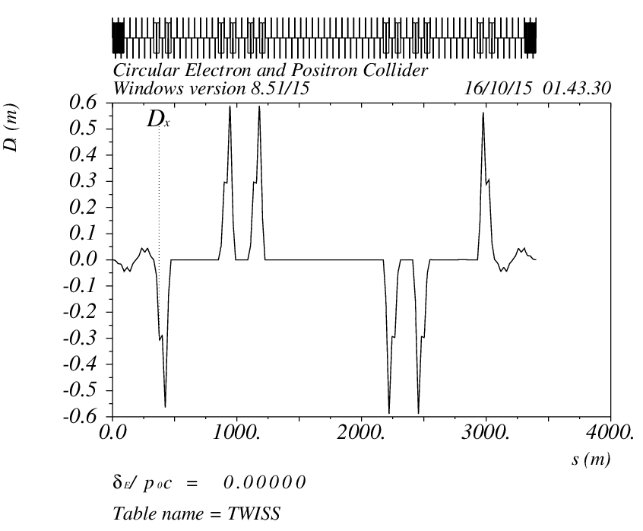
Orbit (DR_RING_e1) Version0.2

Slide 18
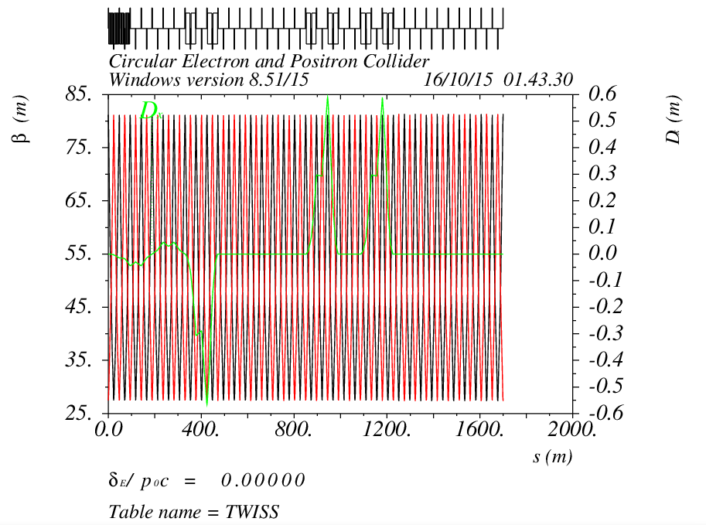
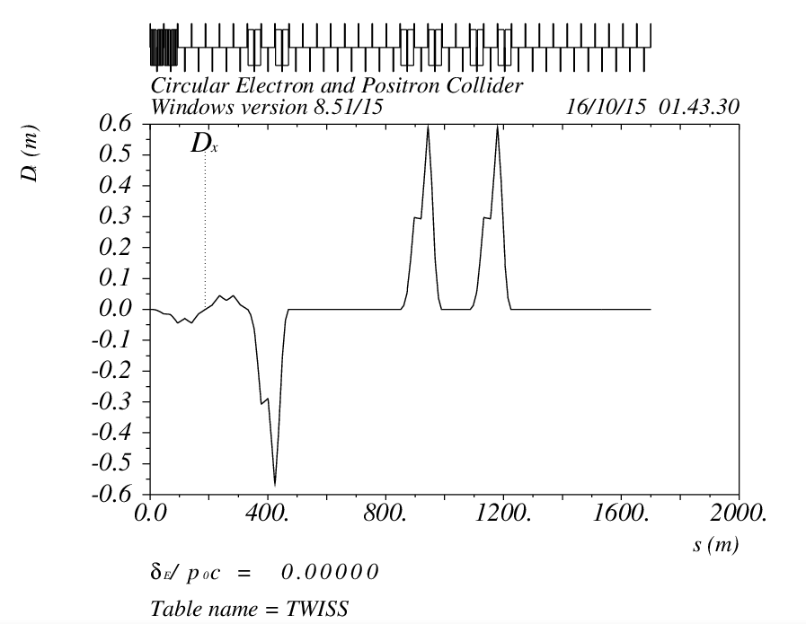
Orbit ( DR_RING_e1hL_IP) Version0.2

Slide 19
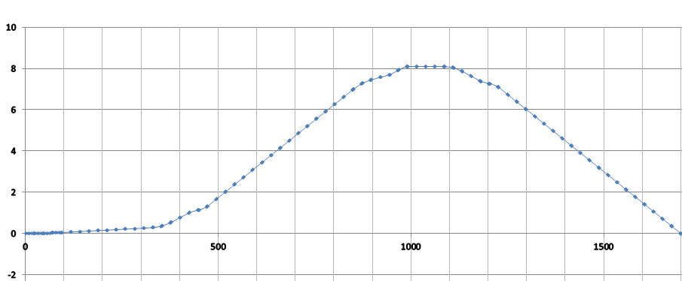
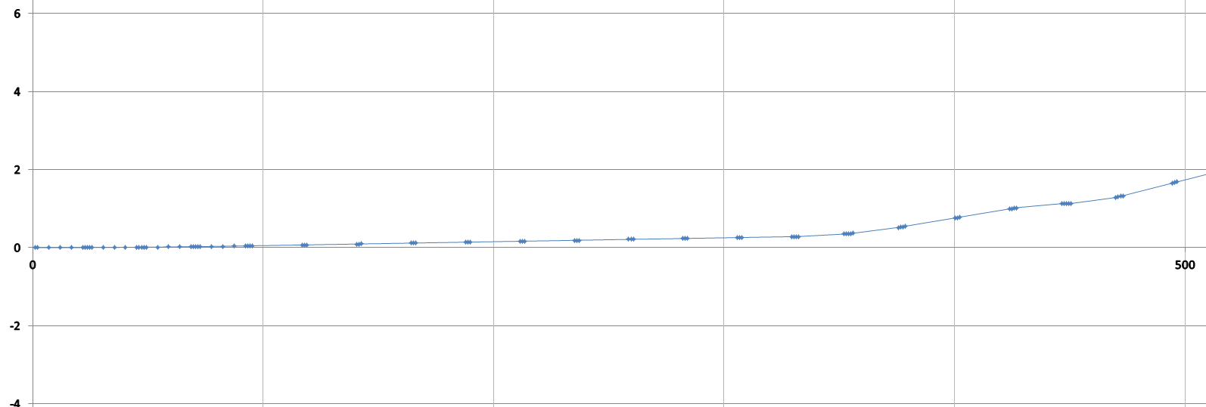
Orbit ( DR_RING_e1hL_IP) Version0.2

Slide 20
Dipole Strength Version 0.2
 | Angle(mrad) | L(m) | Rho(m) | Brho(E0/c) (T/m) | B(T) | Ek(KeV) | KeV/m
B0 | 3.506 | 19.6 | 5590.42 | 400 | 0.07155 | 685.173 | 34.9578
Bsp | 0.0625 | 4.9 | 78400 | 400 | 0.00510 | 48.8571 | 9.97
B1 | -4.416 | 19.6 | 4438.41 | 400 | 0.09012 | 863.031 | 44.031
B1DSL1 | 9.021 | 19.6 | 2172.71 | 400 | 0.18410 | 1962.96 | 89.947
B1DSL2 | -14.187 | 19.6 | 1381.55 | 400 | 0.28953 | 2772.55 | 141.456
B2 | 5.0 | 19.6 | 3920.0 | 400 | 0.10204 | 977.143 | 49.8542
B2DSR1 | -9.933058 | 19.6 | 1973.09 | 400 | 0.20273 | 1941.32 | 99.0417
B2DSR2 | 14.93292 | 19.6 | 1312.51 | 400 | 0.30476 | 2918.38 | 148.897
B3 | 5.0 | 19.6 | 3920.0 | 400 | 0.10204 | 977.143 | 49.8542
B3DSR1 | -9.93336 | 19.6 | 1973.09 | 400 | 0.20273 | 1941.32 | 99.0417
B3DSR2 | 14.93323 | 19.6 | 1312.51 | 400 | 0.30476 | 2918.38 | 148.897

Slide 21
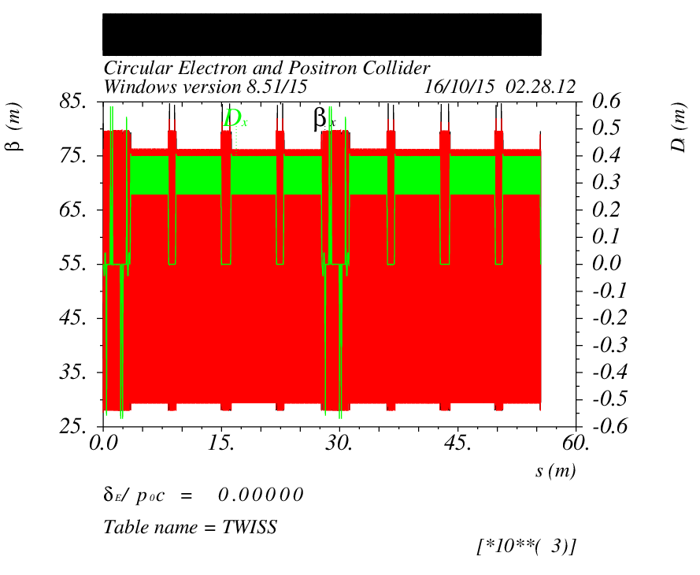
Survey Ring Version 0.2

Slide 22
Next to do
Using Seperator and dipole to acquire 15 mrad
Dynamic Aperture
Add IR

Slide 23
Reference
[1] CEPC-SPPC Preliminary Conceptual Design Report, The CEPC-SPPC Study Group, IHEP-CEPC-DR-2015-01.
[2] J. Gao, IHEP-AC-Note-2013-012.
[3]Xiao Ming et al, CEPC_bunch_train _ 2015-8-28
[4]Oridy, FCC-ee_150917
[5] P. Raimondi, Status on SuperB effort, La Thuile, March 11, 2006
[6]W. Kalbreier, et al, “Layout, design and construction of the electrostatic separation system of the LEP e+e- collider”, CERN, Geneva, Switzerland. [7] R. Martin, et al, “Status of the FCC-ee interaction region design”, HF2014 Workshop, Beijing, China, 9-12 October, 2014

Slide 24
Thank You !

