Slide 1
FMA analysis of CEPC V1 lattice
Dou Wang, Yiwei Wang, Yuan Zhang, Sha Bai, Zhe Duan, Feng Su,
CEPC AP meeting, 20151016

Slide 2
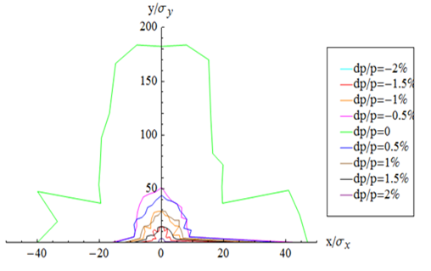
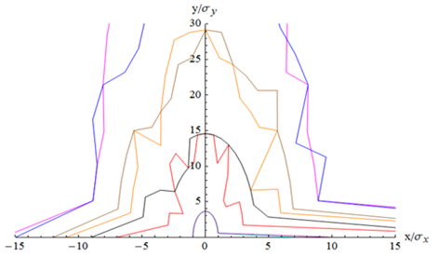
FFS_3.0mm_v1_Mar_2015

Slide 3
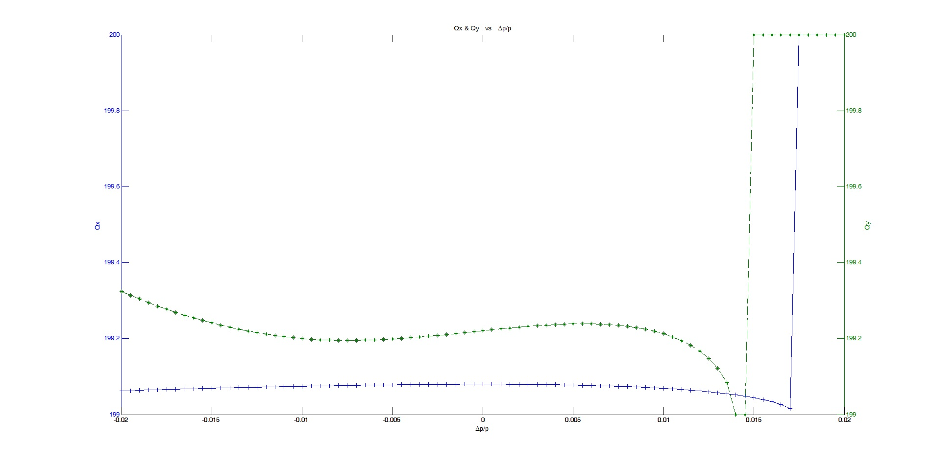
Chromaticity from AT

Slide 4
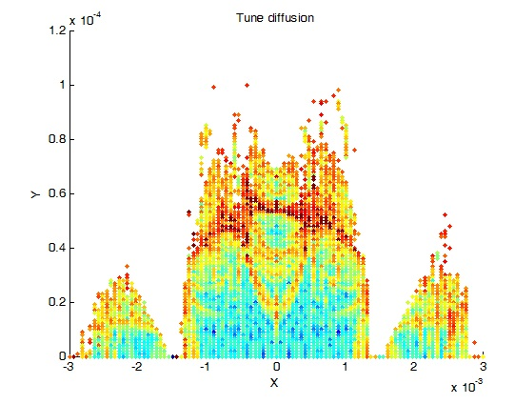
FMA

Slide 5
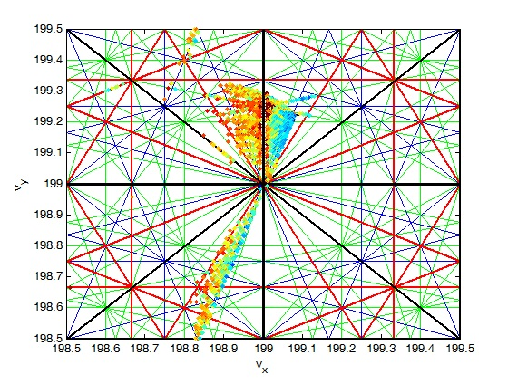
Tune foot

Slide 6
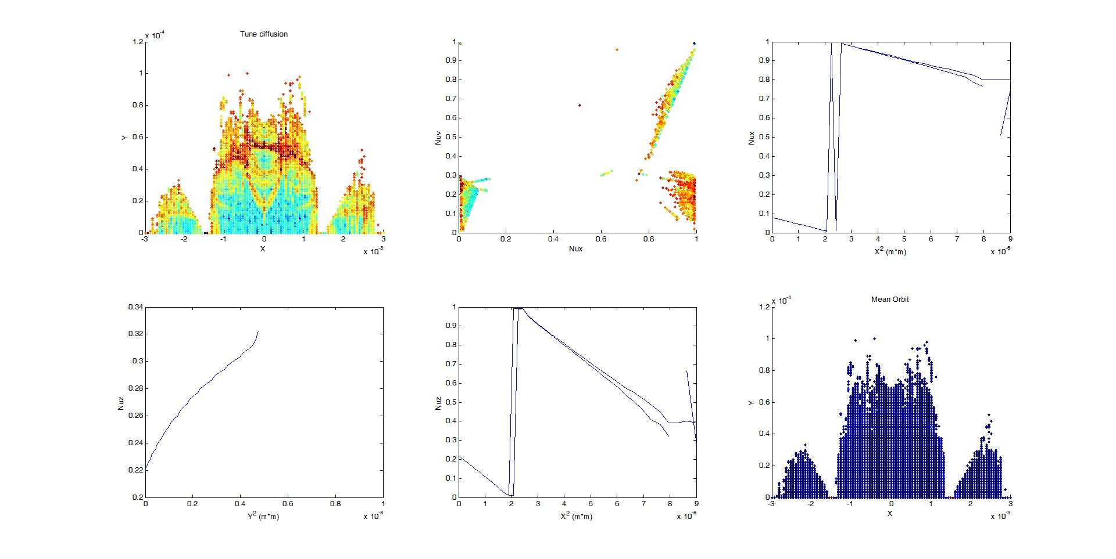
Tune shift with amplitude

