Slide 1
Luminosity reduction due to nonlinearity of lattice
Yiwei Wang, Jie Gao, Dou Wang
Institute of High Energy Physics (IHEP, Beijing)
CEPC AP meeting
16 Oct. 2015

Slide 2
Introduction
$$L∝ξ_{y}∝\frac{1}{{(\frac{A_{y,bb}}{σ_{y}})}^{2}}$$
Luminosity
Dynamic aperture due to the beam-beam and lattice nonlinearity
When $τ_{bb}$=60min, $τ_{damping}$=14ms,$A_{bb}/σ$=3.990
To keep the beam lifetime, we have to work with a larger $A_{bb}/σ$ which will reduce the luminosity.
To calculate the luminosity reduction
Ref: J. Gao, Nucl. Instr. and Methods A463 (2001) 56-61.

Slide 3
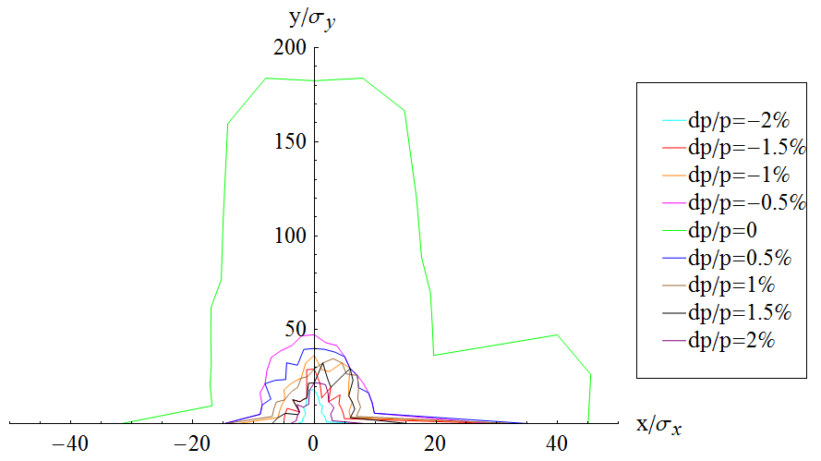
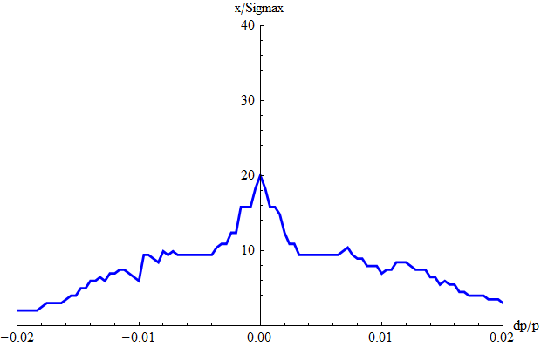
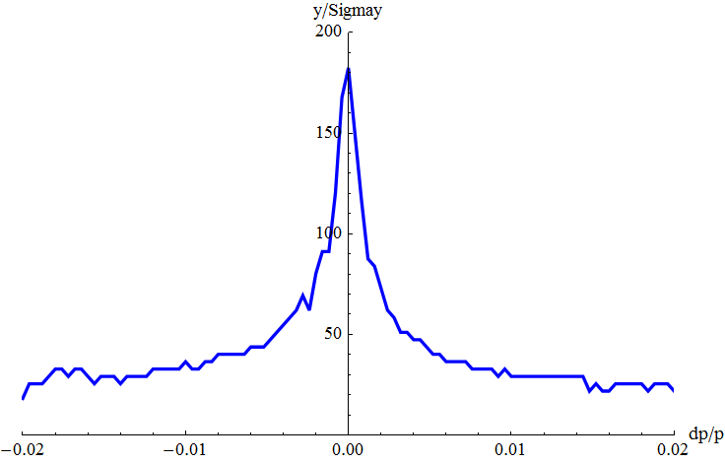
Dynamic aperture of v2.2
Dynamic aperture with FFS_3.0mm_v2.2_Sep_2015, Yiwei Wang
Horizontal DA
got with a non-zero vertical amplitude
mean value of the two directions
20 instead of 40 for on-momentum particle which not real DA

Slide 4
Luminosity reduction
Consider only vertical plane, the luminosity reduction due to a larger $A_{bb}/σ$ seems tiny.
Horizontal plane?
 | Uniform density | Gaussian density $σ_{E}=0.16\%$
$〈A_{lat}/σ〉$ (x/y) | 7.968/ 43.171 | 15.481/ 110.821
$A_{bb}/σ$ (x/y) | 4.609/ 4.007 | 4.129/ 3.992
$$L/L_{0}$$ | 0.991 | 0.999
$$A_{tot}/σ$$ | 3.990
$τ_{tot}$ [min] | 60

Slide 5
Summary
To keep the beam lifetime, we have to work with a larger $A_{bb}$ which will reduce the luminosity.
Consider only vertical plane, the luminosity reduction due to a larger $A_{bb}/σ$ seems tiny.
Horizontal plane?

