Slide 1
Several Big Issues of CEPC
Weiren Chou
for the CEPC-SPPC Study Group
CEPC-SPPC Workshop
April 8-9, 2016, IHEP, Beijing, China

Slide 2
Summary of the Accelerator Sessions
A total of 23 talks, covering a wide range of topics
All talks are well prepared
Impressive progresses have been made since the Pre-CDR
All speakers are from IHEP. We hope next meeting we’ll see presentations from other institutions
It is impossible (and unnecessary) to review all the talks. I will only select a few that are more critical and/or require more attention
Also some slides of my own thinking

Slide 3
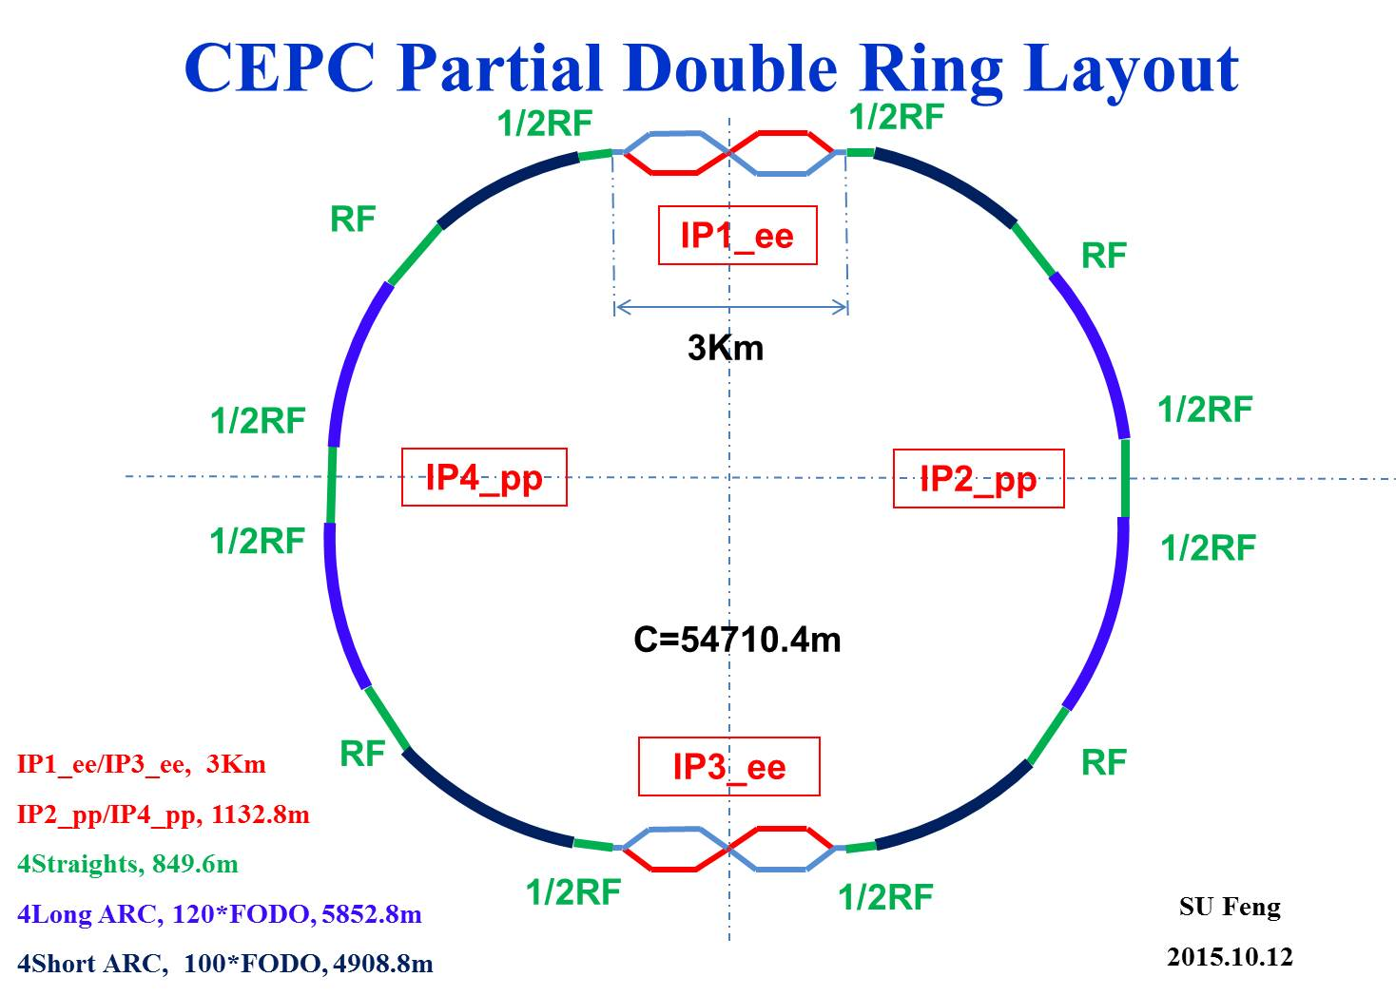
Comment: The SS increases by 4 km while the circumference is kept the same, so the synchrotron radiation power will increase by 9%, unless the current is decreased by the same amount.
Advantage:
Avoid pretzel orbit
Accommodate more bunches at Z/W energy
Reduce AC power with crab waist collision
bypass (pp)
bypass (pp)

Slide 4
Advantages of Crab Waist
For the same vertical beam-beam tune shift, the luminosity is higher
The horizontal beam-beam is lower
Overlapping area of the two beams is shorter. Therefore, longer bunch and larger beta(y)* is allowed
The required rf voltage is lower and HOM loss reduced
Price to pay – a complicated MDI system
It works at low energy at DAFNE
In SuperKEKB and FCC-ee design. We will adopt it for CEPC and hope it will also work at high energy

Slide 5
DA after chromaticity correction
Wang Dou
Arc sextupole: 2 groups
Crab sextupoles - off
DA (on-momentum): 27σ_{x} × 57σ_{y}
DA (±0.5%): 2σ_{x} × 2σ_{y}

Slide 6
CEPC MR SRF Parameters (54 km PDR)
Zhai Jiyuan
Parameters | H (Pre-CDR) | H (High L) | H (Low P) | W | Z
650 MHz cavity (bulk Nb) | 5-cell | 2-cell | 2-cell | 2-cell | 1-cell
Cavity number | 384 | 384 | 384 | 128 | 32
V_{RF} (GeV) | 7 | 3.65 | 3.56 | 0.82 | 0.13
E_{acc} (MV/m) | 15.9 | 20.6 | 20.1 | 13.9 | 17.2
Q₀ @ 2 K | 4E10 | 2E10 | 2E10 | 5E9 | 5E9
Cryomodule number | 96 | 64 | 64 | 32 | 16
Peak power / cav. (MW) | 0.28 | 2.3 | 1.4 | 2.1** | 1.6
Average power / cav.* (kW) | 276 | 990 | 587 | 1102** | 1467
HOM power / cav. (kW) | 3.6 | 0.8 | 0.5 | 0.4 | 0.2
Total RF power * (MW) | 106 | 380 | 225 | 141** | 47
Total cav. wall loss@4.5K eq. (kW) | 22.2 | 30 | 28.5 | 18.2 | 3.5
Assume bunch train length 3.2 km for all PDR operation modes.
* “Perfect” transient beam loading compensation. Filling procedure optimization might reduce the power
** Mismatch extra power due to fixed coupling (optimal for Higgs) not included

Slide 7
Machine Beam Time Structures
Zhai Jiyuan
CEPC-SR (T_{b1}: 0.6~2.7 μs)
LEP, LEP2, BEPC
?
BEPCII (Ion clearing)
LHC (kicker rise time)
ILC
XFEL
CEPC-PDR (assume 6% for all modes and circumferences)
Ring? Large gap.
Linac? High repetition rate.
Injection and extraction: non-periodic transient beam loading

Slide 8
RF-to-Beam Power Efficiency
Zhai Jiyuan
 | CEPC SR-H | LEP 1 55 GeV*** | BEPCII Collision | ILC TDR-500 | CEPC PDR-H-HL
Revolution / Repetition time T₀ (μs) | 182.8 | 89 | 0.8 | 2E5 | 180.1
Bunch charge (nC) | 60.8 | 67 | 7.8 | 3.2 | 45.6
Bunch spacing T_{b} (μs) | 0.6~3.7 | 22.2 | 0.008 | 0.554 | 0.1585
Peak or average current (mA) | 33.3* | 6* | 910 | 5.8 | 268
Cavity time constant τ (μs) | 1157 | 57.8 | 108 | 1322 | 95
Bunch train length T_{p} (μs) | / | / | 0.76 | 727 | 10.7
Gap length T_{g} (μs) | / | / | 0.04 | 1.99E5 | 0.3 ~ 160
T_{b} / τ [max] | 0.003 | 0.38 | 7E-5 | 4E-4 | 0.0017
T_{g} / τ [max] | / | / | 4E-4 | 150 | 1.7
Filling time T_{f} (μs) | / | / | / | 923 | 160
Filling power P_{g1} (kW) | / | / | / | 190 | 823
Flat-top power P_{g} (kW) | 276 | 98 | 123 | 190 | 2274
Peak or average beam power P_{b} (kW) | 276 | 13.1 | 123 | 190 | 2274/268
RF to beam power efficiency ** | 100 % | 13 % | 100 % | 44 % | 27 %
* Two beams
** Not include waveguide loss and control margin
*** Normal conducting cavity with storage cavity
Perfect correction method.
Resonant filling may increase to 37 %

Slide 9
Bai Sha

Slide 10
Bai Sha

Slide 11
Bai Sha

Slide 12
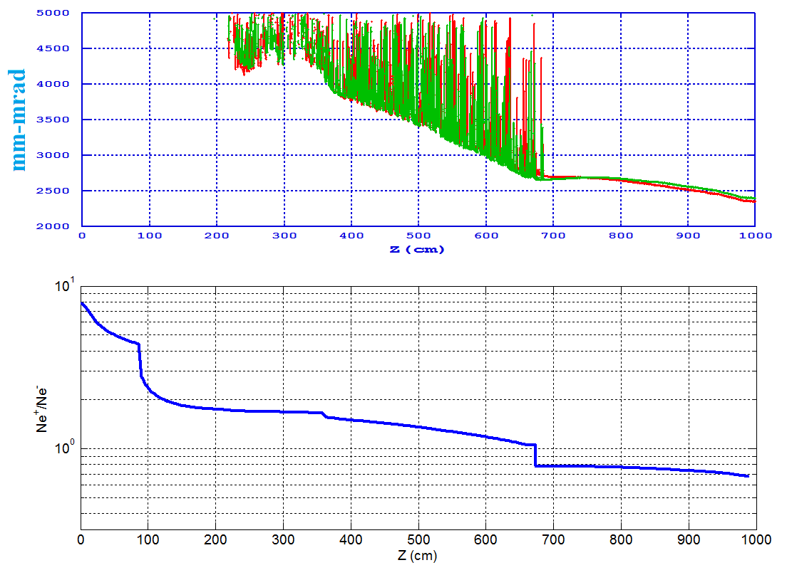
3. Positron linac Emittance
Meng Cai
Chicane
Transport line
Energy spread
BEPC: e+ 0.1 nC, 0.24 mm-mrad at 1.89 GeV
Ne⁺/Ne⁻=0.68
6.8 nC
Emittance.Norm.RMS=2500 mm-mrad
Emittance.RMS@6GeV=0.21 mm-mrad

Slide 13
Kang Wen
4、Field quality of the CEPCB low field magnet
1) Good field region and field uniformity
The distributions of the field at 30Gs, 60Gs, 90Gs, 120Gs and 640Gs in the center of the Lambertson magnet have been measured. It can be seen that the lower the field, the worse the field uniformity. The field uniformity of 32Gs is 10 times worse than that of 640Gs.

Slide 14
Kang Wen
4、Field quality of the CEPCB low field magnet
2) Excitation curve and field reproducibility
Except the first cycle, the curves of the second and the third cycles seem overlapped very well. But when we check the difference point to point between the second and third cycle, the field difference or reproducibility is 0.5% at the low field of 30Gs. And in order to get the field reproducibility of 0.02%, the lowest field of the magnet should be higher than 120Gs. (The lowest field of dipole magnet for LHeC is 127Gs at injection energy of 10GeV.)

Slide 15
Bigger Ring – 80 km
Parameter | 54 km | 80 km
Luminosity for Higgs (normalized) | 1 | 1
RF power (normalized) | 1 | 0.67
Max e+e- energy | 240 GeV | 350 GeV
Max pp energy (20 T) | 70 TeV | 100 TeV
Polarization at W mass | no | yes
Precise measurement of sin²θ_{W} | no | yes
Power consumption (normalized) | 1 | ~0.9
Construction cost (normalized) | 1 | 1.13

Slide 16
(Matthew Reece, 2016 January HK Workshop)

Slide 17
10% polarization:
61 GeV, 27 km
80 GeV, 80 km

Slide 18
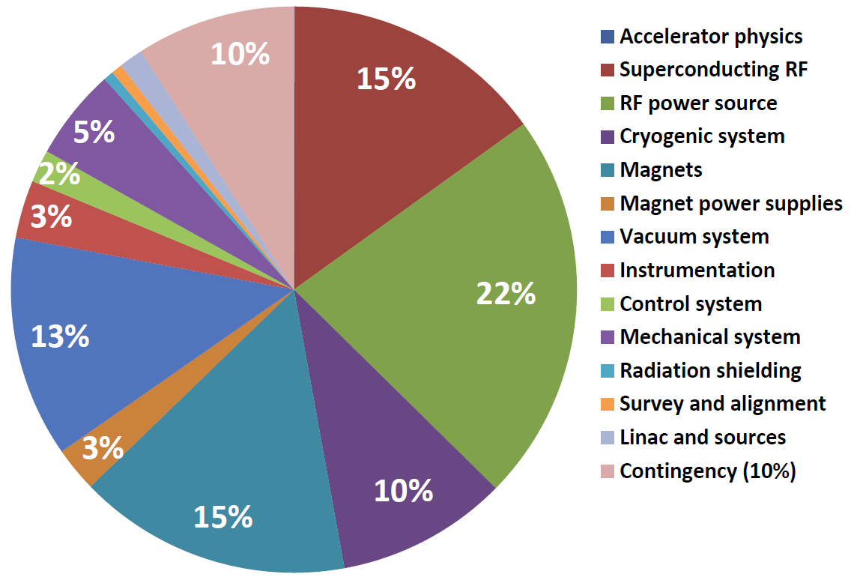
Accelerator Relative Cost
10%
4%
26%
2.4%
10%
2%
12%
19%
12%

Slide 19
Error in Previous Cost Estimate
We have a cost estimate for both 54 km and 100 km ring. The latter is ~40% higher.
However, we made an error in the 100 km estimate:
  We kept the cost of the “big three” (SRF, cryo and power source) unchanged
  While doubled the cost of other accelerator systems (magnet, power supplies, vacuum, instrumentation, control, mechanical, etc.)
But this was incorrect. A fair comparison should be for the same luminosity:
  When the luminosity is beam-beam limited:
  L ∝ I x ξ/β*
  Synchrotron radiation power:
  P_{SR} ∝ I x E⁴/ρ
  Energy loss per turn:
  U ∝ E⁴/ρ
Keeping current I and luminosity L unchanged, synchrotron radiation power P_{SR} and energy loss U will both be reduced by half for 100 km.
Therefore, the cost of the “big three” will be reduced by half.

Slide 20
Cost Estimate for 80 km Ring
Accelerator:
  Assuming 54 km cost is 1 (normalized)
  The cost ratio of the “big three” vs other systems is about 50:50
  From 54 km to 80 km, the radius increase 50%
  Therefore, the cost reduction of the “big three” is 1/3, and the cost increase of other systems is 1/2
  The net increase is 1/12
  In other words, an 80 km accelerator would cost 1.08, or an 8% increase.
Civil:
  Yellow River Co.’s cost estimate from 54 km to 100 km is an increase of 50%
  So for 80 km, the cost increase would be ~30%
Detectors – no change

Slide 21
CEPC Relative Cost
10%
26%
63%

Slide 22
Cost Estimate for 80 km Ring (cont’d)
Put all together, the total cost increase from 54 km to 80 km:
  Accelerator: 63% x 8% = 5%
  Civil: 26% x 30% = 8%
  Detector: 10% x 0% = 0%
  -----------
  Total project cost increase: 13%
Furthermore, this 13% cost increase will be partially offset by the reduced operation cost because of lower power consumption. (For the same luminosity, only 2/3 rf power needed.)

Slide 23
Relative Power Consumption
2%
3%
9%
10%
6%
16%
5%
48%

Slide 24
1-Ring, 2-Ring, Partial 2-Ring
Pre-CDR uses a single ring, similar to LEP. However, the required luminosity is 100 times as high as LEP – a major concern.
If 2-ring, such an increase is possible. Examples:
  BEPC I (1-ring) vs BEPC II (2-ring): L increases 100 times
  Tevatron (1-ring) vs LHC (2-ring): L also increases 100 times
  (but this is not a very fair comparison as Tevatron was also limited by number of pbars; but 1-ring was definitely a restriction)
Partial 2-ring only solves the problem partially (no pretzel, large crossing angle, more bunches)

Slide 25
Problems for Partial 2-Ring
Problems of a partial double ring:
  Lack of flexibility in bunch structure – no bunch train
    LEP tried various bunch patterns and found 4 x 4 worked best
    Tevatron tried various bunch patterns and settled at 4 x 9
  Cannot fill up the whole ring
  Cannot solve the energy saw-tooth problem
  Uneven rf loading – see Jiyuan’s slide
  Difficult for orbit correction
  Difficult for tune control
  Difficult for injection
  Lengthy commissioning time
  Synchrotron radiation damage on the electrostatic separators
  Impedance of the separators
  Not free – need additional ~4 km ring
All these problems go away for double ring. In addition:
  RF sections can be reduced from 8 to 2 because saw-tooth is no longer a problem (easy for maintenance, potential cost saving).

Slide 26
Cost of a Double Ring
The main issue is cost increase.
However, the cost of the “big three” will not change, which represents ~50% of the accelerator cost
The cost increase comes from:
  Magnet and power supply
  Vacuum
  Instrumentation
  Mechanical
  Radiation shielding
Pre-CDR Appendix 2 has a cost comparison between 1-ring and 2-ring. The latter is 30% higher in the accelerator cost.
But it has two over-estimates:
  It does not consider the changes in technical system design
  It does not separate the cost of colliders from booster and linac

Slide 27
Cost for Double Ring (cont’d)
Changes in system design for double ring:
  Magnet size and good field region can be smaller, stored energy lower, reducing the cost of both magnet and power supplies
  Vacuum pipe can be smaller
  One mechanical support can support both magnets
  Shielding will actually be easier because synchrotron radiation on the wall is cut by half
  Only the instrumentation needs to be doubled
System cost for collider only: (w.r.t. the total accelerator cost)
  Magnet: 10.3%
  Power supply: 1.8%
  Vacuum: 9.7%
  Instrumentation: 1.9%
  Mechanical: 2.2%

Slide 28
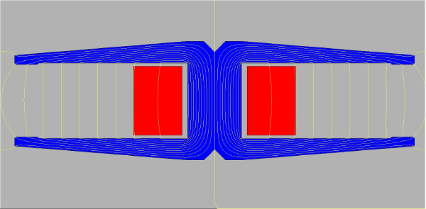
2-in-1 Magnet for Double Ring (courtesy: CERN)
12 cm
40 cm
A first concept for the FCC-ee main dipoles, with an X iron yoke (blue) and two aluminium busbars (red). The dimensions are about 40 cm wide per 12 cm high (Image: CERN).

Slide 29
Pre-CDR Magnet
Quantity | 1984
Maximum field strength (T) | 0.07
Magnetic gap (mm) | 80
Bending angle (mrad) | 3.17
Magnetic Length (m) | 18
Bending radius (m) | 6094
Good field region (mm) | 100
Current (A) | 2250
Conductor cross section (mm) | 60×40, ∅9,r2
Turns per pole | 1
Resistance of the magnet (mΩ) | 0.963
Current density (A/mm²) | 1.0
Operating voltage (V) | 2.25
Power per magnet (kW) | 5.1
Induction per magnet (mH) | 0.33
Number of water circuits per magnet | 2
Water pressure (kg/cm²) | 6
Flow velocity(m/s) | 3.14
Water flux (l/s) | 0.4
Temperature rise(℃) | 4
Core cross section (W×H)（mm） | 450*400
Core center length (m) | 18
Core mass (t) | 9.4
Aluminum Mass (t) | 0.5
W x H = 45 cm x 40 cm

Slide 30
Cost for Double Ring (cont’d)
Based on these analysis, we can do the following cost increase estimate from single ring to double ring:
  Magnet, power supplies, vacuum and mechanical:
  0.6 x (10.3% + 1.8% + 9.7% + 2.2%) = 14.4%
  Instrumentation:
  1 x 1.9% = 1.9%
  Shielding (reduced and ignored)
Put together, the accelerator cost increases by 16.3%
Civil and detector cost unchanged
The total project cost increase:
16.3% x 63% = 10%
A useful reference is the real figures when BEPC II changed from 1-ring to 2-ring for the storage ring:
  1-ring estimate: RMB 207M
  2-ring estimate: RMB 241M
  The increase was 34M, or 16%
  (courtesy: Zhang Chuang)

Slide 31
SRF
650 MHz or lower?
    650 MHz is appropriate
    A harmonic of 1.3 GHz
    Synergy with several other projects:
      IHEP ADS
      Fermilab PIP-2
      BNL eRHIC (first 704 MHz, then 422 MHz, now 650 MHz; one factor for making this change is CEPC’s choice)
2-cell or 5-cell?
    We first need a strategic plan for CEPC program (a scientific program committee or SPC)
    Assuming phase 1 for Super Z, phse 2 for Higgs
    Can use 2-cell for Super Z (small number of cavities)
    5-cell for Higgs

Slide 32
Pre-Booster
Low energy (6 GeV) into the booster is a concern
The problem gets worse for a bigger ring
Several options to increase Booster injection energy:
  More linac
  Synchrotron (Zhang Chuang)
    The linac energy can be lowered to 2 GeV
    The saving in linac can partially offset the cost of a synchrotron
    The new tunnel can later be used for SPPC injector
  Recirculating linac (Zhang Yuhong)
Can be an upgrade of CEPC

Slide 33
Layout of APB (N_{s}=6, N_{B}=144)
e⁻ inj.
e⁺ inj. &
Accu. ×(1-5)
e⁻ ej.
APB
120 GeV
Linac
(e⁻ ej.)
Booater
RF
15 GeV
1382.4 m
(e⁺ ej.)
τ_{x}=8s,
B=76.8 Gs @15GeV
2-2.5 GeV
e⁺ inj. & Accu. ×(5-10)
e⁺ ej.
e⁻ inj.
60ns half-sine wave
e⁺ B cycle
Kicker
B cycle
f_{rep}=50 Hz
e⁻ B
cycle

Slide 34
CepC Injector w/ Recirculation (3x6 GeV)
3.2 nC for e-
10 nC for e+
e-/e+ 3 GeV
e-/e+ 15 GeV
0.2 GeV
1 GeV
1 GeV
1 GeV
e+ damping ring @ 1 GeV
3 GeV e- for e+ production
e-/e+ 12 GeV
1 GeV
1 GeV
1 GeV
e-/e+ 9 GeV
e-/e+ 18 GeV
e-/e+ 6 GeV
0.2 GeV
0.2 GeV 3.2 nC e+
4 GeV 10 nC e- on target
These arcs are in a common tunnel, vertically stacked
These arcs are in a common tunnel, vertically stacked
Zhang Yuhong

Slide 35
Tunnel Size
In the Pre-CDR, the tunnel is big: 6 m wide, 5.4 m high.
Tunnel cost is proportional to the cross section.
To keep both ee ring and pp ring in place is based on political consideration. But we need science justification if we want to keep the tunnel this big.
It is difficult to contemplate the two rings will run together or run in turn.
Once e+e- collider is shut down, it may never run again.
So a possible justification is ep collision. But this would require the two rings of the same size – we may need to switch the location of the two rings in the tunnel: e ring inside, p ring outside.
But this decision is not urgent.

Slide 36
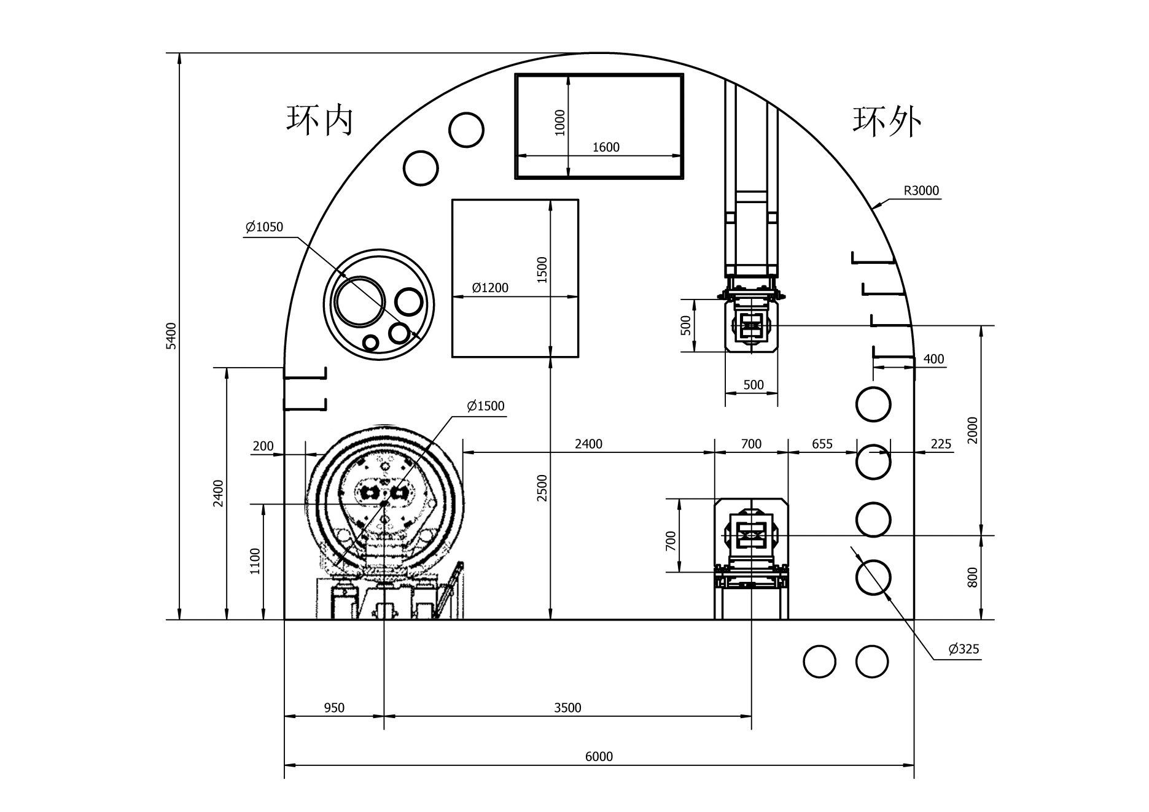
Tunnel Cross Section – SPPC + CEPC Magnets
Drill/Blast Method
Booster magnet
SPPC magnet
CEPC magnet
6 m

Slide 37
Summary
DA remains the most critical issue in AP study
MDI is the second most difficult one
RF beamloading could be a show stopper for partial 2-ring
At the high level, we need to make early decision on the following issues:
  Ring size – it affects everything
  1-ring, 2-ring, or partial 2-ring
  2-cell and/or 5-cell – the most important technical system of CEPC
The decision on pre-booster and tunnel size can wait
A scientific program committee will be very helpful to make a strategic physics program for CEPC.

Slide 38
Pre-CDR International Review (Feb 14-16, 2015)
Excerpt from review committee’s report:
“If CEPC-SPPC gets the go-ahead, it will be the dominant machine for high energy physics in the world for the next 50 years, and no other machine will be built in a similar energy range considering the limited resources given to HEP worldwide. Thus this machine cannot be a second rate project, and must satisfy the physics goals and the aspirations of the majority of the high energy physicists in the world.”

Slide 39
Questions?

