Slide 1
Summary on SPPC Accelerators
Tang Jingyu for SPPC group
April 8-9, 2016,
CEPC-SPPC Symposium, IHEP

Slide 2
Talks on SPPC Accelerators
17 talks, 37 attendees in the parallel sessions
  IHEP, USTC, PKU, THU, …
Young generation is playing a very important role (10/17 talks), especially in accelerator physics studies.
We reported the design work on the accelerator physics for both the collider and injector accelerators, and also technical issues
Good discussions about the key accelerator physics problems and key technical issues

Slide 3
General Progress
Tang Jingyu
Study team continues growing, with more young people (especially students) joining
Maintaining regular monthly meetings
Accelerator Physics studies
  All major problems in the collider: main parameters, lattice, collimation, beam-beam effects, instabilities, longitudinal beam dynamics, injection and extraction, luminosity leveling etc.
  Schematic design on the injector accelerators: main parameters, stage schemes, lattice and layout, etc
Key technology studies
  Design and R&D on high-field superconducting magnets
  Study on beam screen and cryogenic vacuum
  Beam instrumentation and control, machine protection
  Identifying other key technical challenges: beam dump, collimators etc.

Slide 4
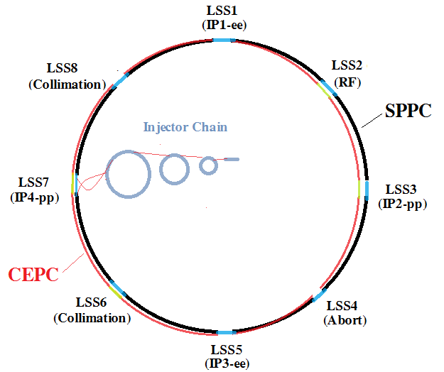
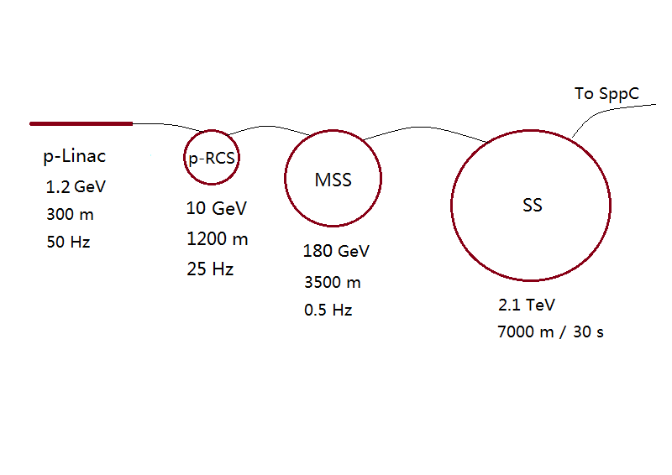
Parameter | Value | Unit
Circumference | 54.3 | km
Beam energy | 35.3 | TeV
Dipole field | 20 | T
Injection energy | 2.1 | TeV
Number of IPs | 2
Peak lumi./IP | 1.2E+35 | cm⁻²s⁻¹
Beta* | 0.75 | m
Circu. current | 1.0 | A
Bunch separation | 25 | ns
Bunch population | 2.0E+11
Arc SR heat load | 56.7 | W/m
Notes:
Left: Whole accelerator complex; Right: injector chain of 4 acceleration stages

Slide 5
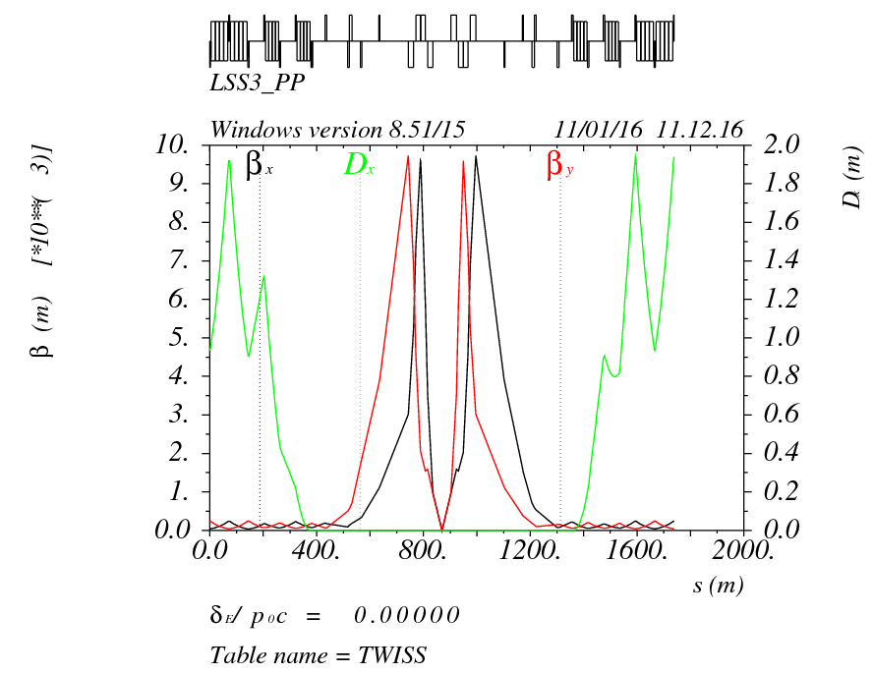
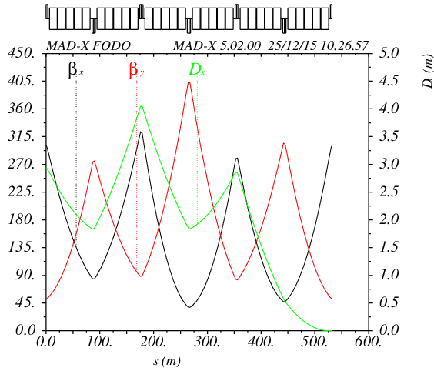
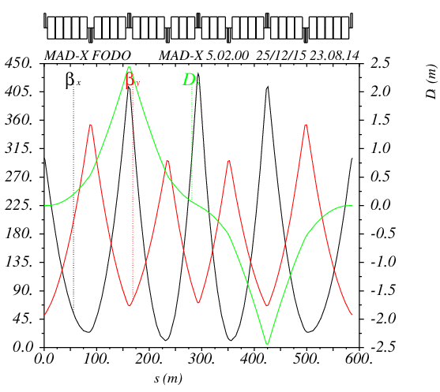
Collider Lattice Design
Su Feng, Chen Yukai, Zhang Linhao
Design work in parallel
  For both 70 TeV and 100 TeV
  Standard arc cells, Dispersion suppression sections, Collision Region, Beam separation and recombination, etc.
  Reasonable lattice structures have been obtained
  Compatible with CEPC partial double ring (3.5 km LSS)

Slide 6
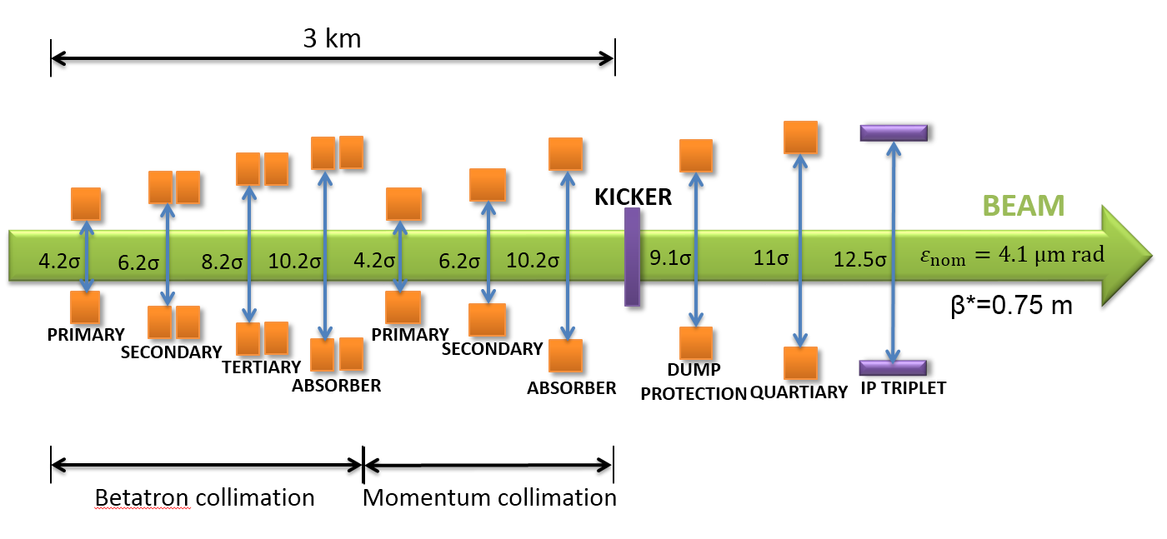
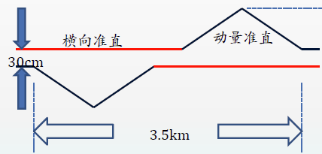
Collimation Studies
Zou Ye, Yang Jianquan
Beam collimation is very important and difficult for SPPC (Stored energy: 6.3 GJ)
  Heavy beam losses: beam-beam interactions, transverse and longitudinal diffusion, residual gas scattering, instabilities and so on (peak loss: hundreds kW)
  Quench protection of SC magnets
  Machine protection
  Hands-on maintenance
  Cleaning of physics debris
  Reducing experiment background
Key issues: lattice, methods, materials
New idea: Transverse and longitudinal collimation in the same LSS

Slide 7
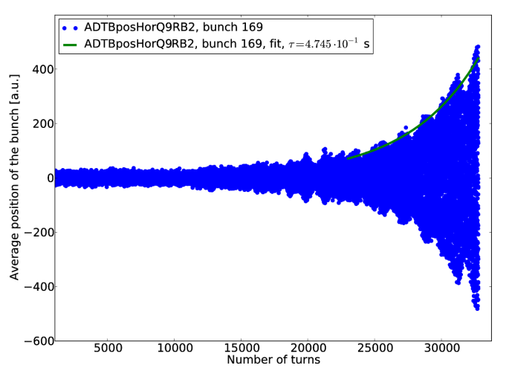
Instabilities
Liu Yudong
Survey on all possible instabilities in large hadron machines (LHC, SPS, PS, Tevatron etc)
  Microwave Instability
  Transverse coupled-bunch instability
  Single-bunch transverse instability
  Head-Tail Instability
  Electron Cloud Instability
Instability Challenges for SPPC
  Challenge in controlling impedance: large number of collimators, injection/extraction magnets, beam screen
  Electron cloud instability
  Modeling and simulations

Slide 8
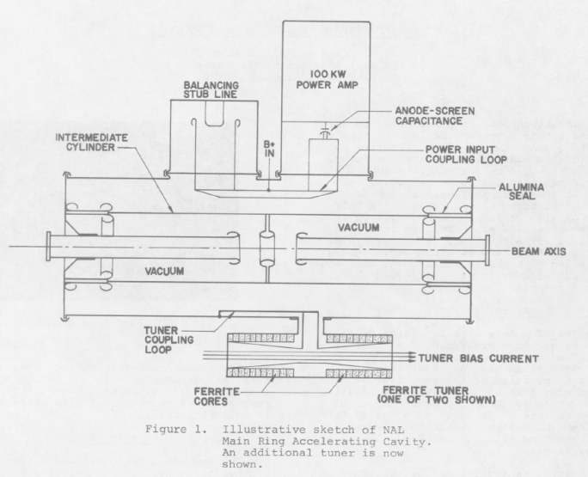
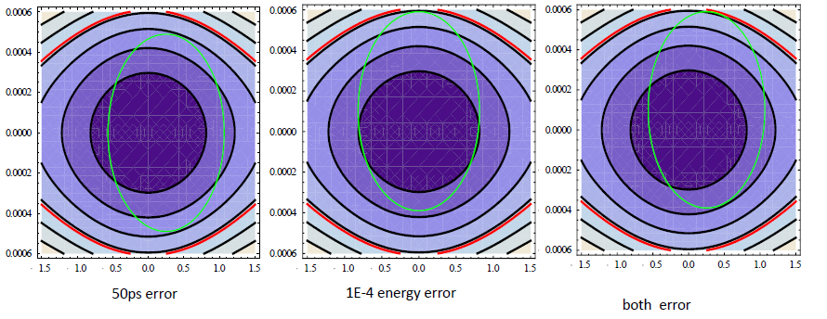
Longitudinal Dynamics and RF Systems
Peng Yuemei, Dai Jianping
Studying IBS effect in SPPC
  Not important for bunch lengthening
RF frequency selection
  Three stages: capture at injection, acceleration, at collision
  Consider: 200 MHz (4MV) and 400 MHz (44 MV)
  Related to lattice design, will be improved.
Sophisticated RF systems for the injector accelerators are also reviewed; SPPC injector rings may follow mixed CERN/FNAL techniques

Slide 9
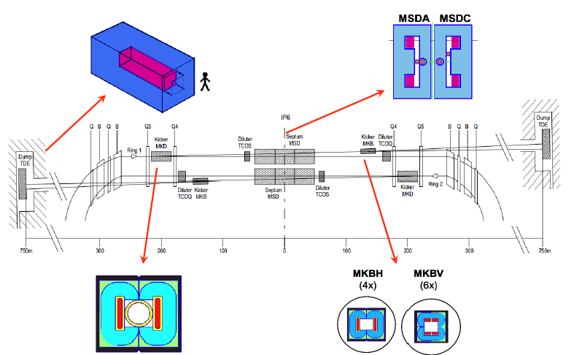
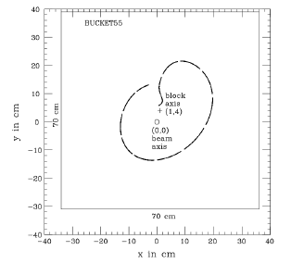
Injection/extraction
Li Guangrui
Injection is important for SPPC turnaround time
Extraction is key for machine protection
The talk is focused on beam dump, including survey on key issues for the beam dump: heat deposit, natural cooling, material selection, etc.
Discussion on scaling to SPPC

Slide 10
Injector Chain General and p-RCS
Tang Jingyu
Injector chain by itself is a very complicated and powerful accelerator system, large enough by a single stage
Rich physics programs for each stage
No close reference accelerators (scaled up by large factors)
  Totally new, different from LHC or Tevatron (building-up by steps)
Design work on each accelerator started: scheme, lattice and even more details
Key technical challenges should be identified, so needed R&D program can be pursued.
Some more details about p-RCS
p-linac: 1.63 MW
p-RCS: 3.4 MW
MSS: 3.7 MW
SS: 90 MJ

Slide 11
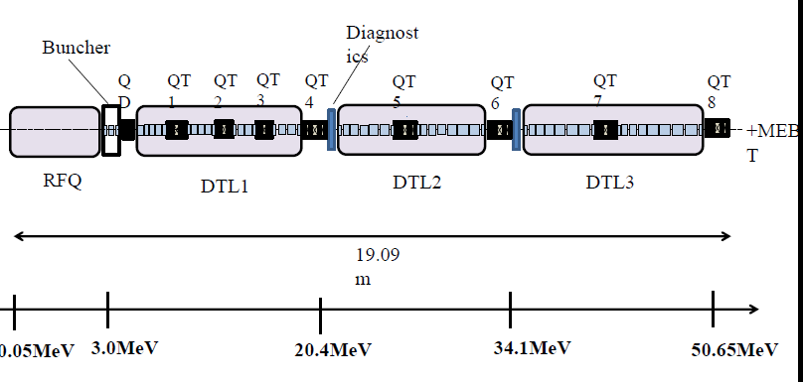
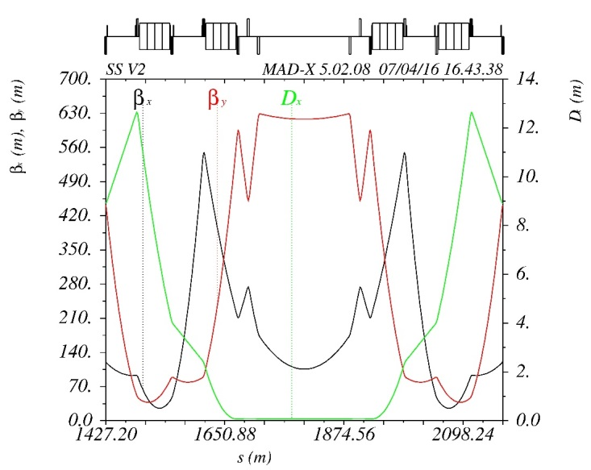
p-linac and SS
Lu Yuanrong, Wang Xiangqi, etc.
Different proton and ion linacs around the world are reviewed, and modern development trends
First design for the low-energy parts of proton and ion linacs presented (based on IH-DTL); Sharing of high-energy part for both proton and ion beams
Race-track lattice is studied for Super-Synchrotron (SS), and injection/extraction also considered ; fast ramping

Slide 12
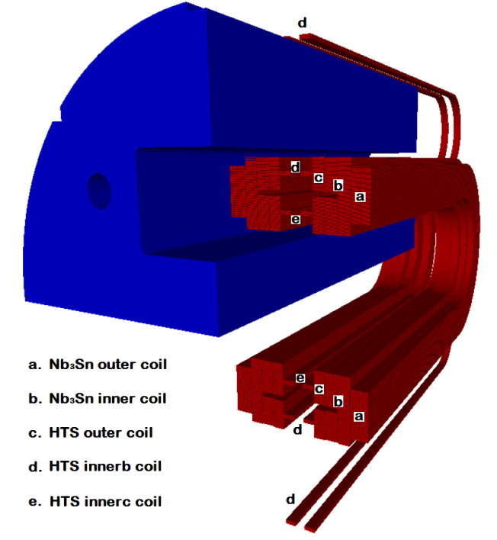
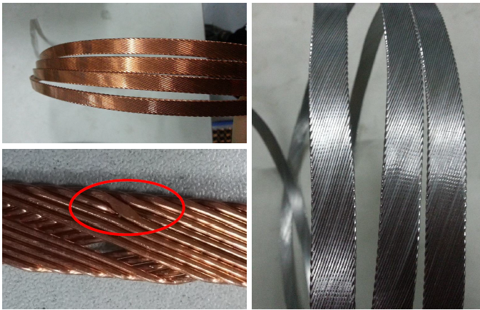
High-field Superconducting Magnets
Xu Qingjin, et al.
High-field superconducting magnets are the most challenging and costly part of the SPPC
Work is focused on:
  Design Study of the SPPC Dipole Magnet
  R&D Steps for the SPPC Dipole Magnet
  Development of Nb3Sn Rutherford Cable
  R&D of High Field ReBCO Tape by SSTC
  R&D of Bi-2212 Superconductor by NIN
  Preparation for the Model Magnet R&D
Workshop on HTS Materials and Applications
will be on April 28-29

Slide 13
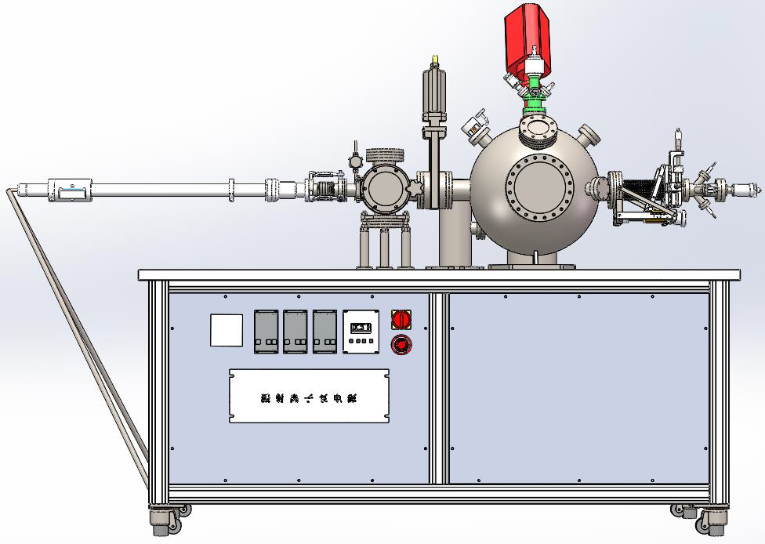
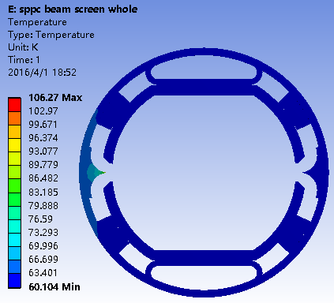
Beam Screen and Vacuum
Zhu Kun, Wang Yong, et al.
Beam screen or cryogenic vacuum is key in tens TeV pp collider, considered as a potential show-stopper.
New ideas are emerging out to tackle the problem.
SPPC proposes to use YBCO coating, to work at higher temperature 60-80K; thermal and mechanical analysis performed (PKU)
SEY test device for different coatings is being set up at USTC

Slide 14
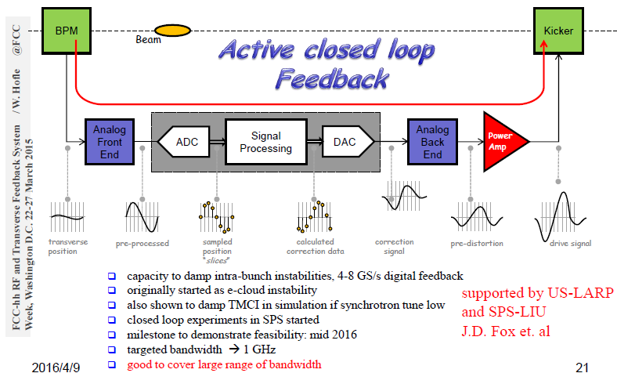
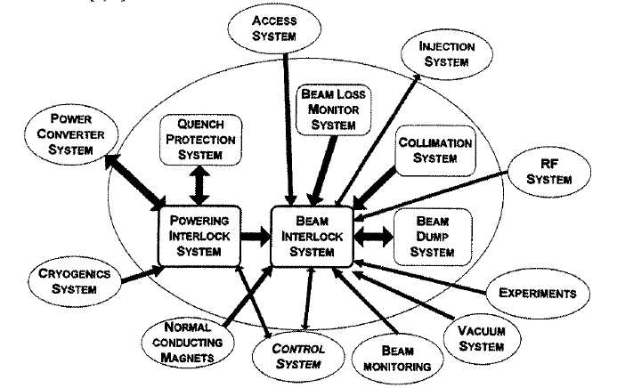
Beam Instrumentation and Control
Machine Protection
Sun Baogeng, Yan Yingbin, Xu Hongliang, et al.
Modern techniques and development trend on beam instrumentation are reviewed: BPM, BLM, Profile, etc.
Advanced BIC is key for both Machine protection and beam manipulation
Challenges for BIC at future pp colliders under study
Machine protection issues are reviewed: power and beam interlocks, dumping, beam cleaning, detector, etc

Slide 15
Discussions
On key problems (accelerator physics, techniques)
On work organization
On future collaboration

Slide 16
Thanks to all the speakers and contributors for the nice work and presentations!

