Slide 1
Machine Protection
Xu Hongliang

Slide 2
Content
1 Machine Interlock
1)Machine Protection and Interlock System
2)Powering Interlock System
3)Beam Interlock System
4) Reliability Issues
2 Beam Dump System
3 Beam Cleaning and Collimation System
4 Detector Protection

Slide 3
1 Machine Interlock System

Slide 4
（1）Machine Protection and Interlock System
The machine interlocks are part of the machine protection and include two systems, the powering interlock system and the beam interlock system.
The energy stored in the SPPC superconducting magnets and in the circulating beams is unprecedented. An uncontrolled release of energy could lead to serious damage of equipment. Major damage of equipment inside the cryostats will result in long repair times, as the equipment is delicate and difficult to acces. So the functions of the machine protection is :
(1)Protect the beam: The system should not generate beam dumps if this is not strictly necessary. Faulty trigger signals that lead to a beam dump should be avoided.
(2)Provide the evidence: In case of beam dump or failure in the powering systems, correct diagnostic messages should get to the operator. In case of multiple alarms when one initial failure.
(3) Assist the operation of the machine: The diagnostics for failures should be easy to understand. The status of the system must be presented clearly to the operator in the control room and should be transparent.

Slide 5
（2）Powering Interlock System
Powering Interlock System ensure:
1）The Powering interlock systems permits powering of magnets if several conditions are met. In the case of a failure, the powering interlock system must ensure a safe stop of powering (“ power abort”) and a discharge of the magnet energy and request a beam dump if necessary.
2) Protection during magnet powering prevents damage to the elements in the electrical circuits, such as magnets, normal conducting and superconducting cables, current leads and power converters. Magnets can be powered independently of beam operation, for example during commissioning and for tests. The full functionality of the protection systems is required for the start of commissioning the magnet powering system.
3）Protection requires dedicated equipment such as the quench protection system, energy extraction system and so on.

Slide 6
Conditions for powering
Cryogenics: correct conditions
1.9K, 4.5K, other conditions
Safety systems ready (AUG – arret urgence general, UPS – uninterruptible power supplies, …)
Power converter ready
Magnet protection system ready
Power converters
Powering Interlock Controller (PIC)
Energy extraction
Operator / Controls: must give permission to start powering
Beam Interlocks
Quench in a magnet inside the electrical circuit
Warming up of the magnet due to quench in an adjacent magnet
Warming up of the magnet due to failure in the cryogenic system
AUG or UPS fault
Power converter failure

Slide 7
(三)Beam interlock system
The beam interlock system permits beam operation.
(1)It permits injection into the SPPC when all system are ready for beam.
(2)With the circulating beam, the beam interlock system transmits any beam dump request from other systems to the beam dumping system. The system that are essential for protection during beam dumping, collimators and beam dilutors and beam monitors and all of these have an interface to the beam interlock system. Other systems with interface to the beam interlocks are the powering interlocks, RF, injection kickers, vacuum system, access safety system, controls system and the LHC experiments.

Slide 9
LHC Machine Interlocks
LHC
Devices
Movable Detectors
Beam Loss
Monitors
BCM
Experimental Magnets
Collimator
Positions
Environmental
parameters
Safe Beam Parameter Distribution
LHC
Devices
LHC
Devices
Safe
LHC
Parameter
Software
Interlocks
Sequencer
Operator Buttons
CCC
LHC
Experiments
Transverse Feedback
Beam
Aperture
Kickers
Collimation
System
SpecialBLMs
Beam Interlock System
Beam
Dumping System
Safe
Beam
Flag
Powering
Interlocks
sc magnets
Powering
Interlocks
nc magnets
Magnet Current Monitor
Beam loss monitors
BLM
Beam
LifetimeFBCM
Access
System
Vacuum
System
Screens / Mirrors
BTV
Injection Interlock
RF
System
Timing System
(Post Mortem Trigger)
Magnets
Power Converters
Monitors
aperture limits
(some 100)
Monitors in arcs
(several 1000)
MPS
(several 1000)
Power
Converters
~800
AUG
UPS
Cryo
OK
Doors
EIS
Vacuum
valves
Access
Safety
Blocks
RF Stoppers

Slide 10
(3)Beam Loss and Strategy for Dumping Beam
The most probable causes for beam losses are failures in the magnet powering system, with about 1000 magnets powered in thousands of electrical circuits with thousands of power converters. However, there could be many other types of failures. There could be also aperture restriction, with two beams circulating through 53km of beam vacuum pipe containing the beam screen, helium feed-throughs, interconnects, RF shielding etc, many vacuum valves and more than 100 collimators jaws could obstruct the beam passage.

Slide 11
The Categories of Beam Losses
The time after a failure at which particle losses become unacceptable was evaluated for many types of failures. This time depends on the failure and several other parameters such as energy, optics and collimator settings and falls into four categories:
1)One turn failures are ultra-fast losses due to a failure during injection or beam dump.
2)Very fast losses in less than 5 ms.
3)Fast losses in more than 5 ms.
4)Steady losses are continuous losses, the lifetime is one second or more.

Slide 12
Reasons and solutions of beam loss
(1)One turn failures could happen during injection and extraction. Protection relies on collimators and dilutors which must be correctly positioned with respect to the beam. The beam interlock system ensures that no beam can be injected if the collimators and dilutors are not correctly positioned.
(2)Very fast losses: The failure of a D1 normal conducting bending magnet in IR1 and IR5 has been indentified as the fastest mechanism for multi-turn failures. The beam moves and could touch a collimator after a few turn. Another very fast beam loss is expected after a quench of a superconducting dipole magnet. In this case the beam is expected to touch collimator jaws after several 10’s of turns. For failures causing very fast beam movements or emittance blow-up, the beam loss close to aperture limitation (collimators, low-beta quadrupoles, etc.) are detected by beam loss monitors. The loss monitors request a beam dump if the beam loss exceeds a pre-defined threshold. It is also planned to detector rapid beam position changes. If beam orbit movement exceed a predefined value of say, ~0.2mm/ms, the beam are dumped.
(3)Fast loss: Beam loss monitors around the machine and signals from equipment in case of hardware failure will be used to generate beam dump request and complement fast beam loss and beam position monitors.
(4)Steady losses: The beam losses and heat load at collimators will be monitored. A beam dump in case of unacceptable lifetime is also being considered.

Slide 13
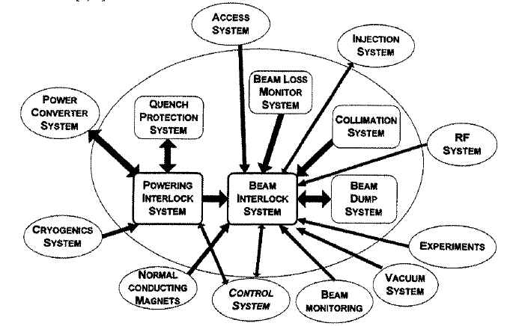

Slide 14
（4）Reliability Issues
The correct functioning of powering and beam interlock system is essential to avoid damage of machine equipment. As such they have to be designed as highly reliable and fail safe systems.

Slide 15
2 Beam Dumping System
The beam dumping system: The function of the beam dumping system will be to fast-extract the beam in a loss-free way from each ring of the collider and to transport it to an external absorber, positioned sufficiently far away to allow for appropriate beam dilution in order nor to overheat the absorber material.

Slide 16
LHC IR6 Beam dumping system layout

Slide 18
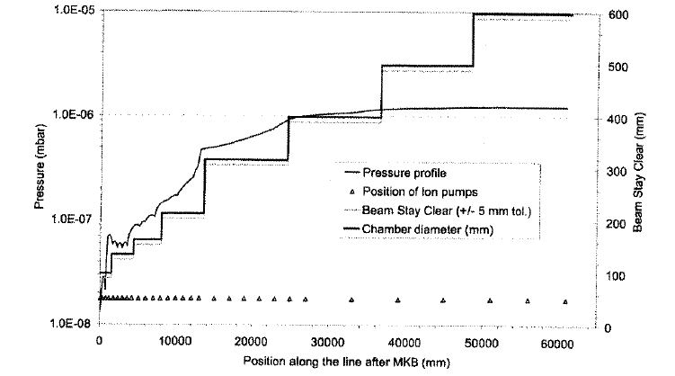
LHC beam dumping line

Slide 19
3 Beam Cleaning and Collimation System

Slide 25
4 Detector Protection

Slide 29
The collaboration work in the future
(1) Physics Design of the Beam Dumping System.
(2)Physics Design of Beam Dumping Line.
(3) The Investigation of Related Physical Topic.

Slide 30
Thank you！

Slide 31
Main dipoles: quench of a magnet
Quench in one magnet: Resistance and voltage drop across quenched zone
Quench is detected: Voltage across magnet exceeds 100 mV for >10 ms
DFB
Magnet 2
Magnet 4
Magnet 152
Magnet 154
DFB
Magnet 1
Magnet 3
Magnet 5
Magnet 153
Energy Extraction: switch closed
Energy Extraction: switch closed
Quench
Detector
Power Converter

Slide 32
Main dipoles: magnet protection
Quench heaters warm up the entire magnet coil: energy stored in magnet dissipated inside the magnet (time constant of 200 ms)
Diode in parallel becomes conducting: current of other magnets through diode
Resistance is switched into the circuit: energy of 153 magnets is dissipated into the resistance (time constant of 100 s for main dipole magnets)
DFB
Magnet 2
Magnet 4
Magnet 152
Magnet 154
DFB
Magnet 1
Magnet 3
Magnet 5
Magnet 153
Energy Extraction: switch open
Energy Extraction: switch open
Quench
Detector
Quench
Heater PS
Power Converter

Slide 33
Magnet and busbar quench detection
To detect a quench: U = R • I (about 1 V need to be detected)
But one needs to substract from U1:
a) U2 = R_{warm} • I
b) During energy ramp: U = dI/dt • L • 154 = 77 • (U3 + U4)
DFB
Magnet 2
Magnet 4
Magnet 152
Magnet 154
DFB
Magnet 1
Magnet 3
Magnet 5
Magnet 153
U2
U3
U4
U1
Power Converter
World FIP - deterministic Fieldbus

