Slide 1
Update on CEPC pretzel scheme design
H. Geng, G. Xu, Y. Zhang, Q. Qin, J. Gao, W. Chou, Y. Guo, N. Wang, Y. Peng, X. Cui, T. Yue, Z. Duan, Y. Wang, D. Wang, S. Bai, F. Su
IHEP, CAS, China
CEPC-SppC 研讨会
April 8-9, 2016

Slide 2
Outline
Principles of pretzel scheme
Modification of the ring lattice since Pre-CDR
Latest pretzel scheme design results
Combination with FFS
Summary

Slide 3
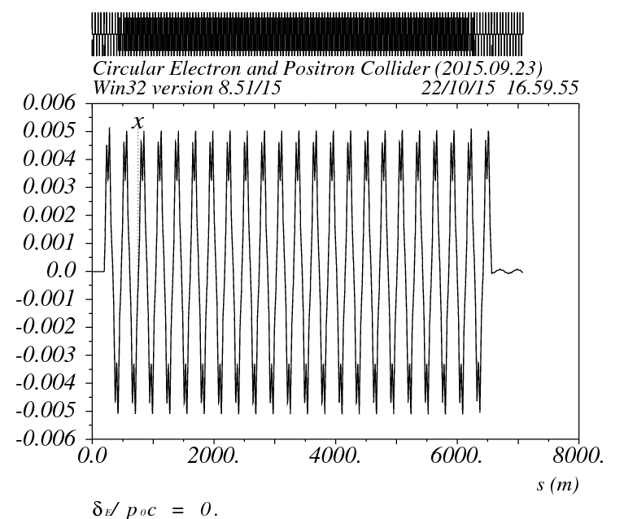
Principles of pretzel scheme
In single ring collider, pretzel orbit is used to avoid the beam collision at positions except for the IPs
For ideal pretzel orbit, the following relationship should be fullfilled:
i.e. the phase advance between parasitic crossing point should be a integer number of 2*Pi, this relation guarantees that if the beam is properly separated at the first parasitic collision point, then it can be automatically properly separated at other parasitic collision points.

Slide 4
Principles of pretzel scheme (cont.)
For our lattice, it is comprised of 60/60 degree FODO cells, every 6 cells have a phase advance of 2Pi, so the relationship can be written as:
For 50 bunches, there are 100 collision points in total, thus the ring circumference must be
For a ring with circumference of ~50km, N=2, which means there is one collision point every 4Pi phase advance. The exact length of the ring is 56640m.

Slide 5
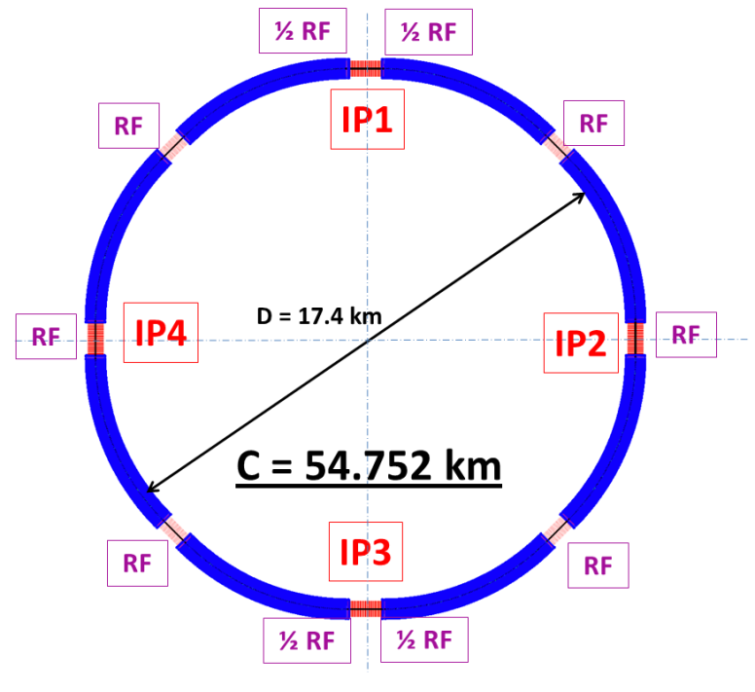
Modifications to ring lattice
To make pretzel scheme works for 50 bunches, a few modifications need to be made to the ring lattice
Two options(assuming phase advance per cell keeps constant):
Change the cell length, which will result in the change of emittance, circumference etc.
Change the circumference
In the following, we take the easy way, i.e. we change the circumference to make the ring lattice works for pretzel orbit of 50 bunches.

Slide 6
Changes made
ARC length:5852.8m
Short straight: 18 FODO cells, 849.6m
Long straight: 34 (was 20) FODO cells, 1604.8m (was 1132.8m)
Circumference: 56.640km
After making this change, every nearest parasitic collision points will have a phase advance of 4Pi.

Slide 7
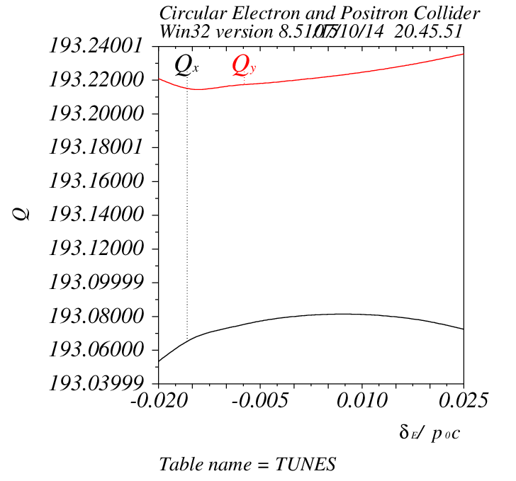
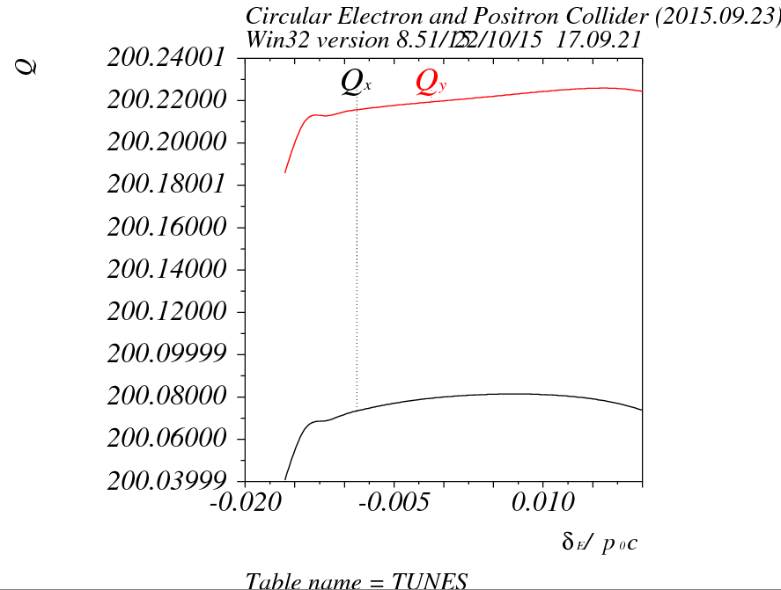
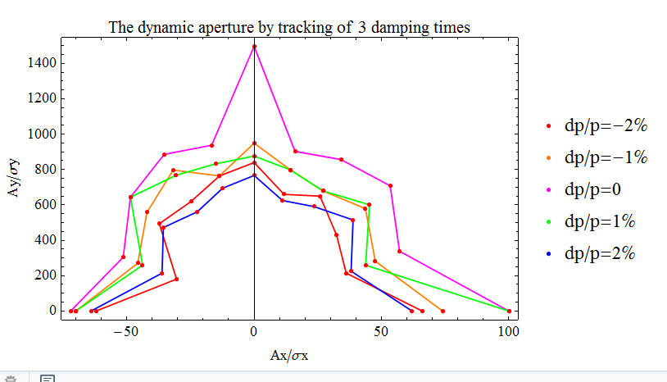
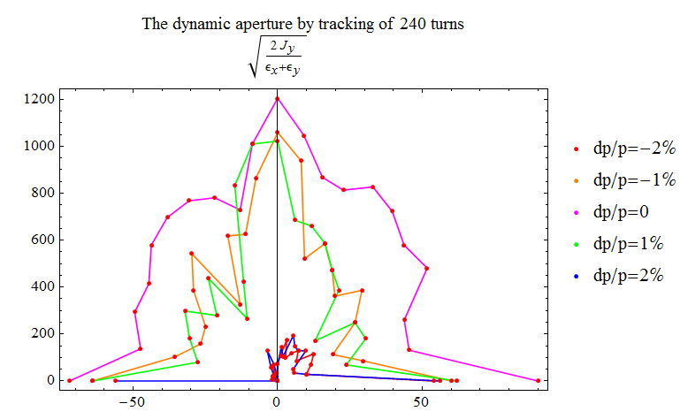
Comparison of DA results before adding pretzel
New version
v20150923
With same working point and chromatic correction scheme
Dramatic drop of DA at ±2% momentum spread

Slide 8
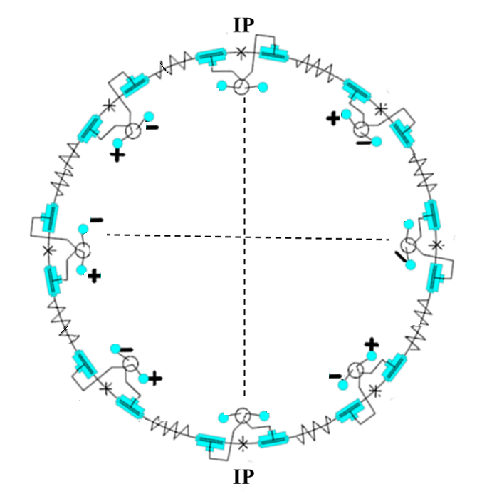
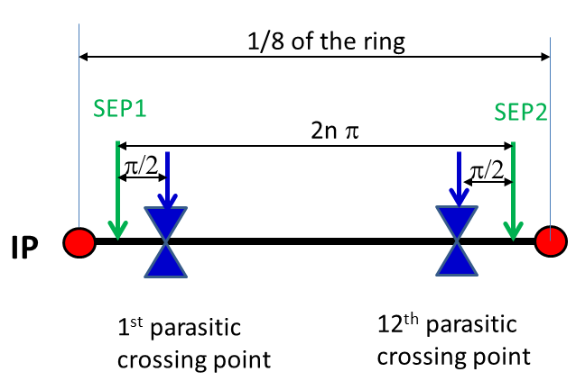
Pretzel orbit design
Designed for 50 bunches/beam, every 4pi phase advance has one collision point
Horizontal separation is adopted to avoid big coupling
No off-center orbit in RF section to avoid beam instability and HOM in the cavity
One pair of electrostatic separators for each arc

Slide 9
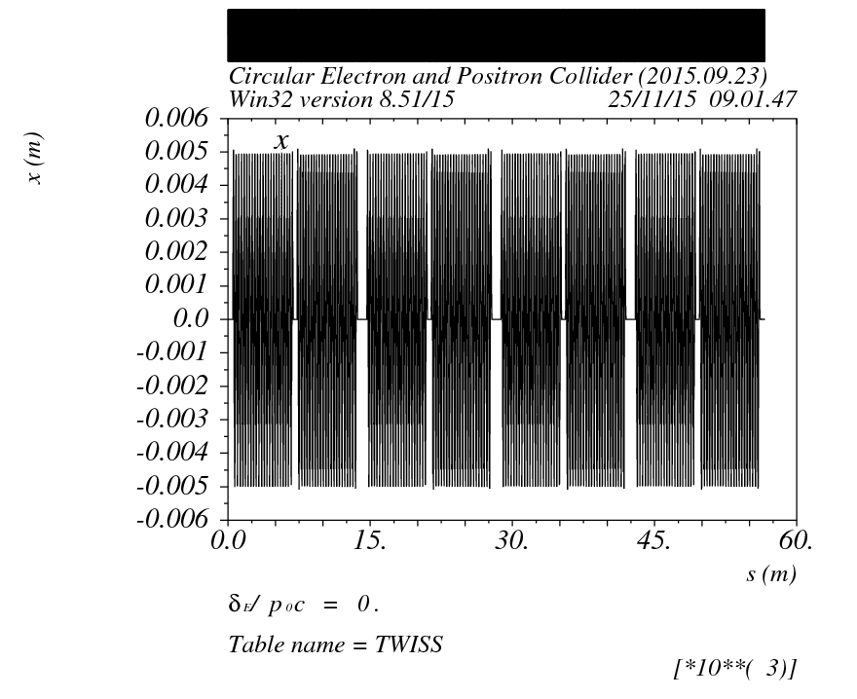
Pretzel orbit design (cont.)
Separation distance: ~5 σx for each beam (10 σx distance between two beam)
Maximum separation distance between two beams is : ~10 mm

Slide 10
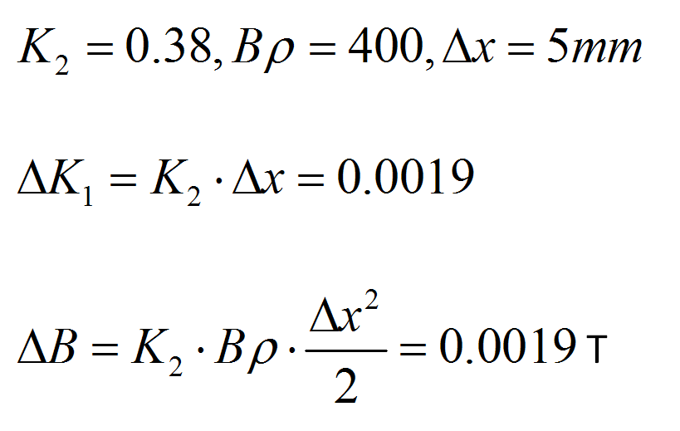
Issues with pretzel orbit
Estimation of dipole field strength in quadrupole
Dipole field of the ring 0.066T.
Estimation of quadrupole field strength in sextupole
Quadrupole field of the ring K₁=0.022.
Dipole field of the ring 0.066T.
This causes the beta function, especially the dispersion function to oscillate as can be seen in the following slide.

Slide 11
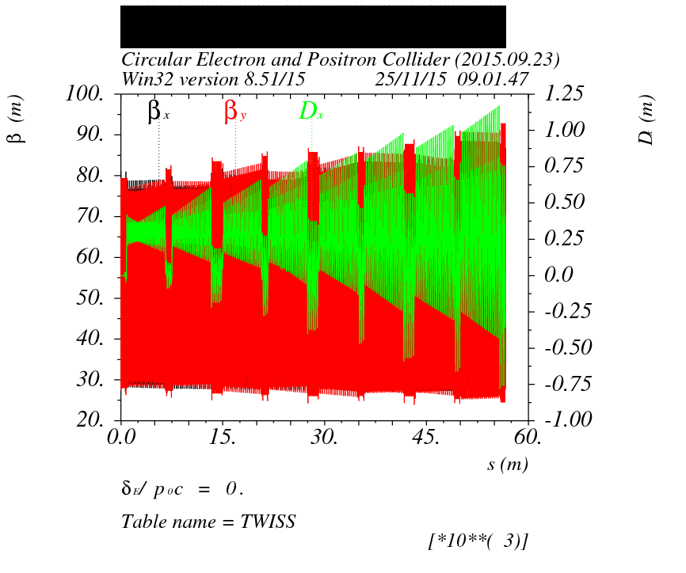
Issues with pretzel orbit
Beta function and dispersion function will oscillate due to pretzel orbit, in which the off-center particles see extra fields in magnets

Slide 12
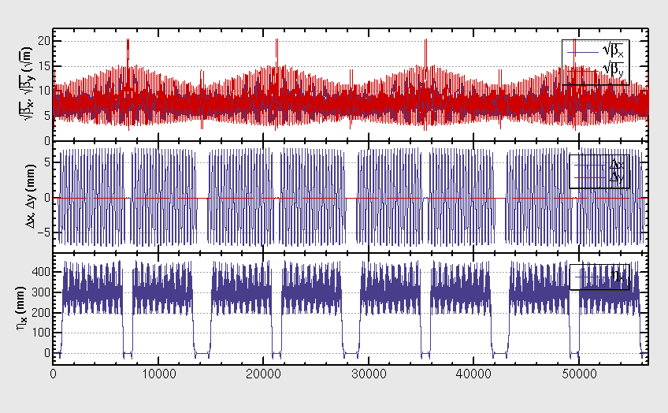
Correction of pretzel orbit effects
The distortion of pretzel orbit effects on beta functions and dispersions can be corrected by making quadrupoles individually adjustable
Every 12FODO cells where regrouped as a new period with a phase advance of 2Pi, both quadrupoles and sextupoles are adjustable

Slide 13
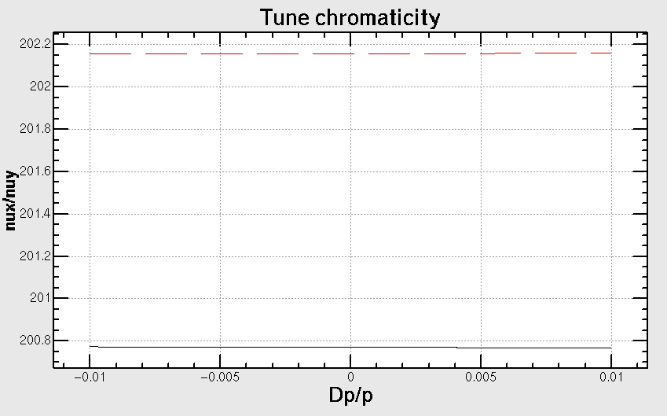
Chromatic properties
Tune is quite stable within ± 1.0% momentum spread
The working point is (.79/.15) in horizontal and vertical planes
.79/.15

Slide 14
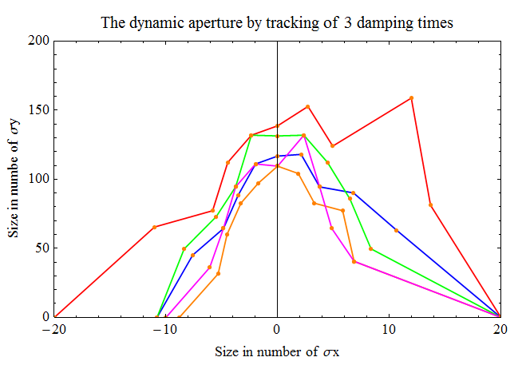
DA with pretzel (no FFS)
DA tracking is done with SAD
240 turns (or 3 times transverse damping time ) is tracked
The DA is (10 σx*110σy) at ± 1.0% momentum spread
.79/.15

Slide 15
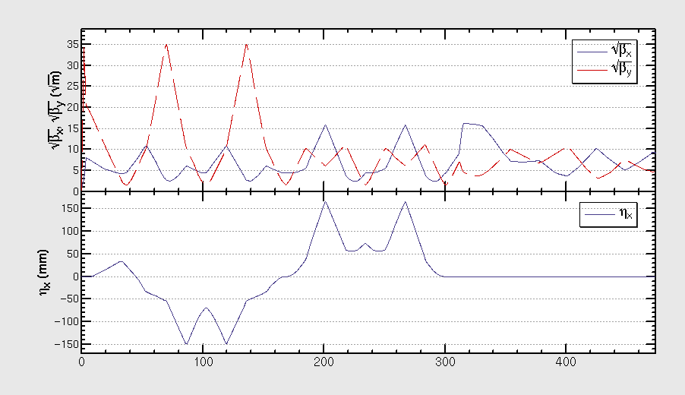
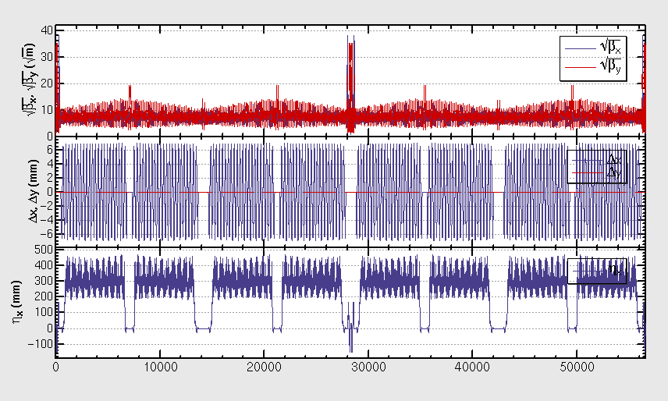
Combination with FFS
One version of FFS (which has been optimized for the ring without pretzel orbit) is inserted to the lattice with pretzel
The betatron and dispersion functions of the FFS are shown in the left plot
The whole lattice of the ring is shown in the right plot
Courtesy of Yiwei Wang, βy*=3mm

Slide 16
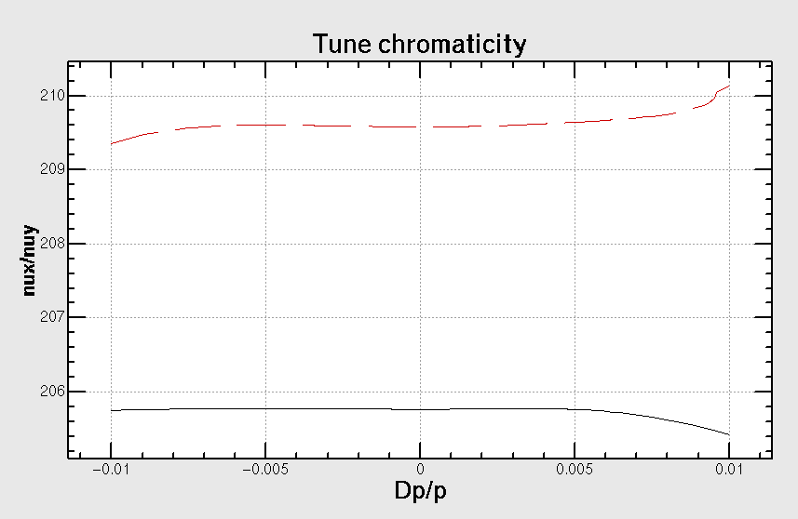
Chromatic properties
Tune is quite stable within ± 0.5% momentum spread, but nonlinear chromaticity is quite clear up to ±1.0% momentum spread

Slide 17
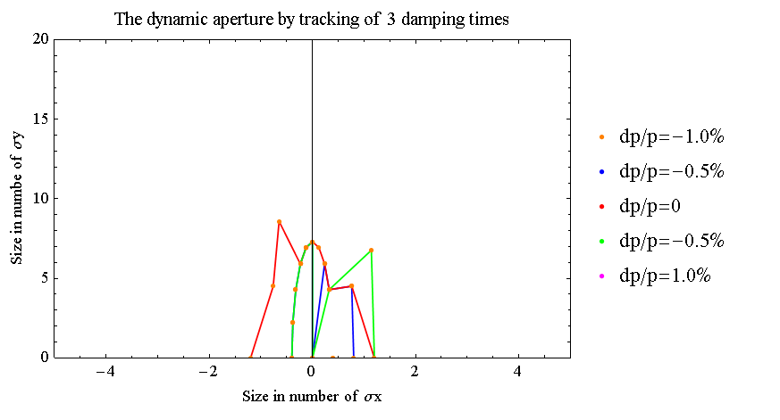
DA with pretzel and FFS
DA tracking is done with SAD
240 turns (or 3 times transverse damping time ) is tracked
The DA is (1 σx*7σy) for on momentum particles

Slide 18
Summary
A ring lattice is developed for accommodating 50 bunches with pretzel orbit
A primary design of pretzel orbit is done
The DA tracking result shows a is (10 σx*110 σy) at ± 1.0% momentum spread
The FFS has be implemented to the lattice with pretzel orbit
The primary result shows a small on momentum DA only
Further optimization will be carried out……

Slide 19
Thank you !

