Slide 1
DA Study for the CEPC Partial Double Ring Scheme
Yiwei Wang, Feng Su, Dou Wang, Yuan Zhang, Huiping Geng, Jie Gao
8 April 2016, CEPC workshop

Slide 2
Outline
CEPC parameters
Lattice design
arc, interaction region, partial double ring
Dynamic aperture study
Summary

Slide 3
CEPC primary parameter （wangdou20160325）
 | Pre-CDR | H-high lumi. | H-low power | W | Z
Number of IPs | 2 | 2 | 2 | 2 | 2
Energy (GeV) | 120 | 120 | 120 | 80 | 45.5
Circumference (km) | 54 | 54 | 54 | 54 | 54
SR loss/turn (GeV) | 3.1 | 2.96 | 2.96 | 0.59 | 0.062
Half crossing angle (mrad) | 0 | 15 | 15 | 15 | 15
Piwinski angle | 0 | 2.5 | 2.6 | 5 | 7.6
N_{e}/bunch (10¹¹) | 3.79 | 2.85 | 2.67 | 0.74 | 0.46
Bunch number | 50 | 67 | 44 | 400 | 1100
Beam current (mA) | 16.6 | 16.9 | 10.5 | 26.2 | 45.4
SR power /beam (MW) | 51.7 | 50 | 31.2 | 15.6 | 2.8
Bending radius (km) | 6.1 | 6.2 | 6.2 | 6.1 | 6.1
Momentum compaction (10⁻⁵) | 3.4 | 2.5 | 2.2 | 2.4 | 3.5
β_{IP} x/y (m) | 0.8/0.0012 | 0.25/0.00136 | 0.268 /0.00124 | 0.1/0.001 | 0.1/0.001
Emittance x/y (nm) | 6.12/0.018 | 2.45/0.0074 | 2.06 /0.0062 | 1.02/0.003 | 0.62/0.0028
Transverse σ_{IP} (um) | 69.97/0.15 | 24.8/0.1 | 23.5/0.088 | 10.1/0.056 | 7.9/0.053
ξ_{x}/IP | 0.118 | 0.03 | 0.032 | 0.008 | 0.006
ξ_{y}/IP | 0.083 | 0.11 | 0.11 | 0.074 | 0.073
V_{RF} (GV) | 6.87 | 3.62 | 3.53 | 0.81 | 0.12
f _{RF} (MHz) | 650 | 650 | 650 | 650 | 650
Nature σ_{z} (mm) | 2.14 | 3.1 | 3.0 | 3.25 | 3.9
Total σ_{z} (mm) | 2.65 | 4.1 | 4.0 | 3.35 | 4.0
HOM power/cavity (kw) | 3.6 | 2.2 | 1.3 | 0.99 | 0.99
Energy spread (%) | 0.13 | 0.13 | 0.13 | 0.09 | 0.05
Energy acceptance (%) | 2 | 2 | 2
Energy acceptance by RF (%) | 6 | 2.2 | 2.1 | 1.7 | 1.1
n_{γ} | 0.23 | 0.47 | 0.47 | 0.3 | 0.24
Life time due to beamstrahlung_cal (minute) | 47 | 36 | 32
F (hour glass) | 0.68 | 0.82 | 0.81 | 0.92 | 0.95
L_{max}/IP (10³⁴cm⁻²s⁻¹) | 2.04 | 2.96 | 2.01 | 3.09 | 3.09

Slide 4
ARC lattice
60 ° /60° FODO cell
n=6
All 3rd RDT due to sextupoles cancelled
All 4th RDT except 2Qx-2Qy due to sextupoles cancelled
90 ° /60 ° FODO cell
n=12
All 3rd RDT due to sextupoles cancelled
All 4th RDT except 4Qx due to sextupoles cancelled
90 ° /90 ° FODO cell
n=4
All 3rd RDT due to sextupoles cancelled
4th RDT except 4Qx, 2Qx+2Qy, 4Qy, 2Qx-2Qy due to sextupoles cancelled
Should be non-interleaved sextupole scheme

Slide 5
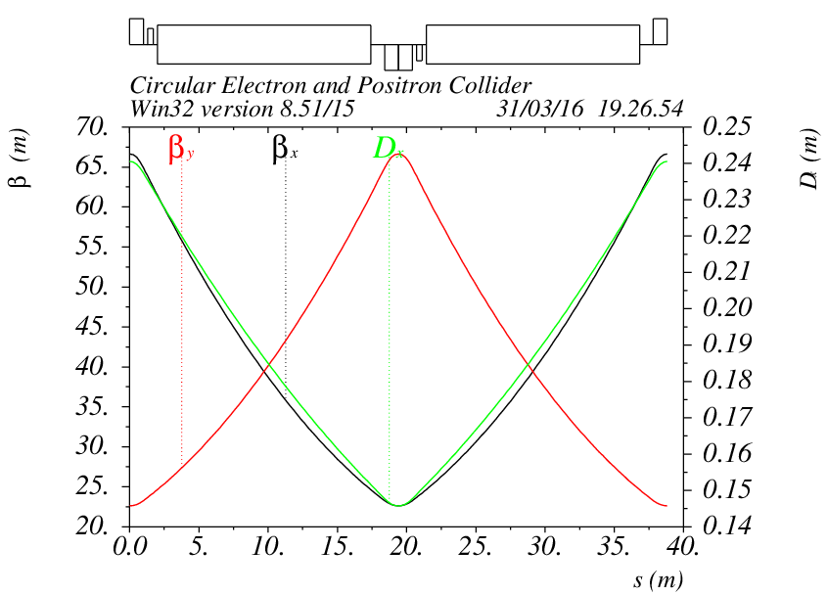
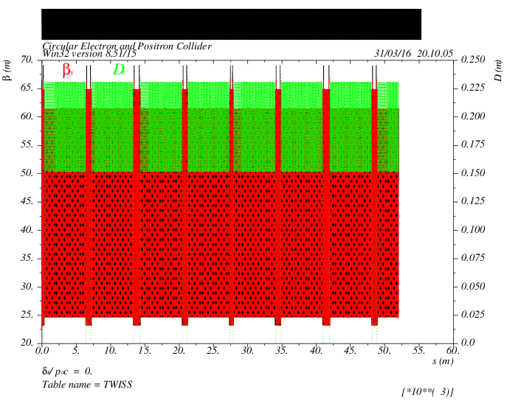
ARC lattice
60/60 degree FODO cell
156=26*6 cells in each section to make resonance driving terms cancellation
Length of ARC: 55km

Slide 6
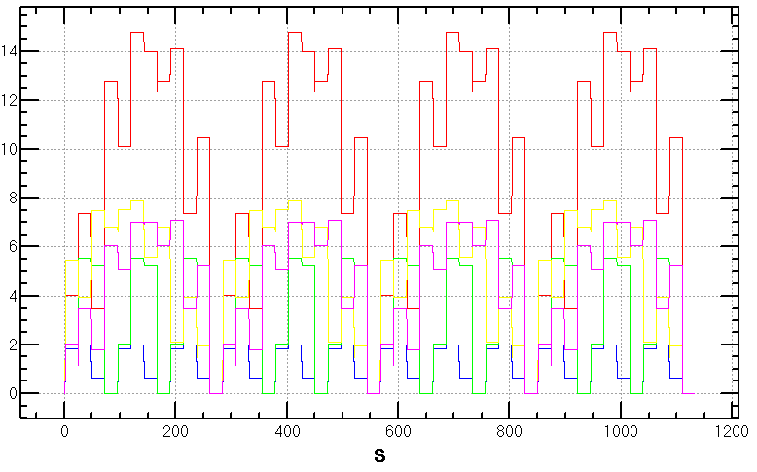
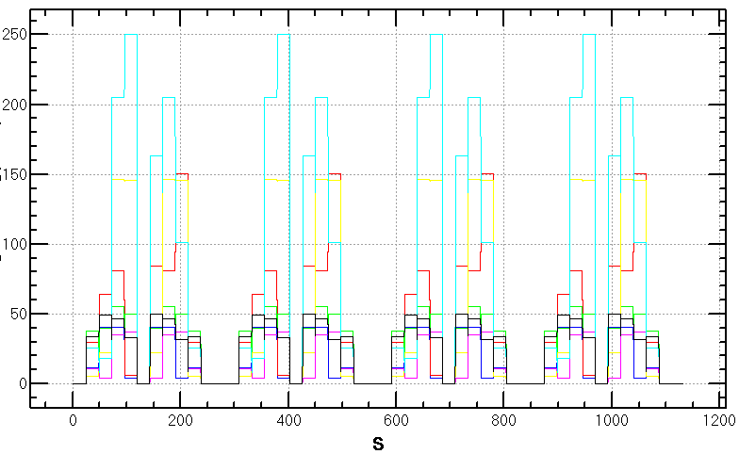
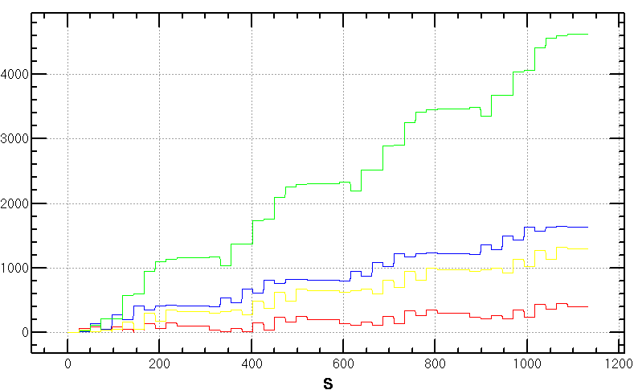
RDT in ARC
Resonance driving terms (RDT) of ARC lattice
With 2 families of sextupoles in 6 cells
All 3rd RDT due to sextupoles cancelled
All 4th RDT except 2Qx-2Qy due to sextupoles cancelled
Amplitude-dependent tune shift dQx/dJx, dQy/dJy, dQx/dJy accumulated in FODO cells which can be further optimized
3rd RDT
4th RDT
dQx/dJx, dQy/dJy, dQx/dJy
2Qx-2Qy

Slide 7
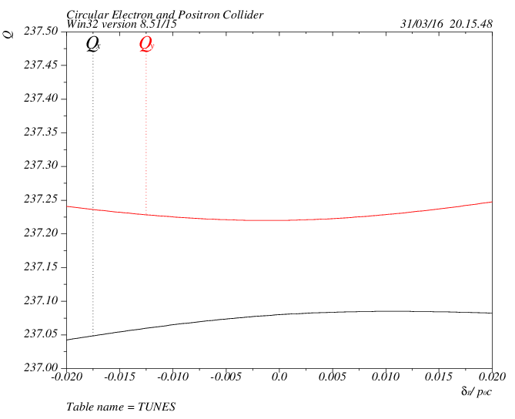
Tune shift
tune vs. dP/P
Second order chromaticity arise due to stronger focusing
2 families in ARC

Slide 8
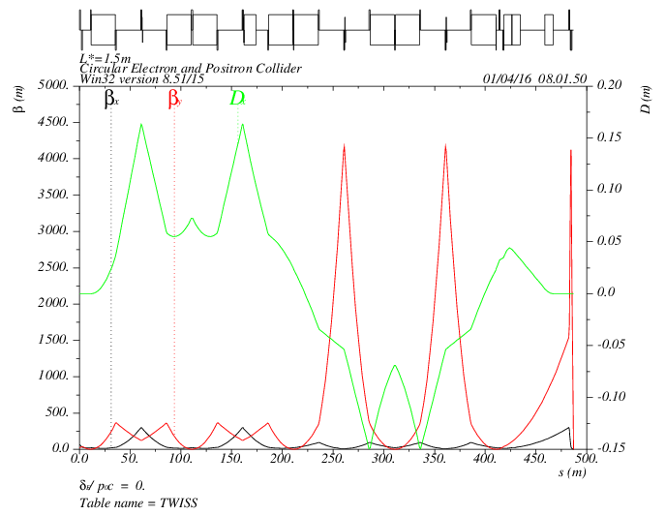
IR lattice
IR lattice design with local chromaticity correction
Additional sextupole for 3rd order chromaticity
MT
CCY
CCX
FT
IP
L*= 1.5m
βx*= 0.22mm
βy*= 1mm
GQD0= -200T/m
GQF1= 200T/m
LQD0=1.69m
LQF1=0.90m

Slide 9
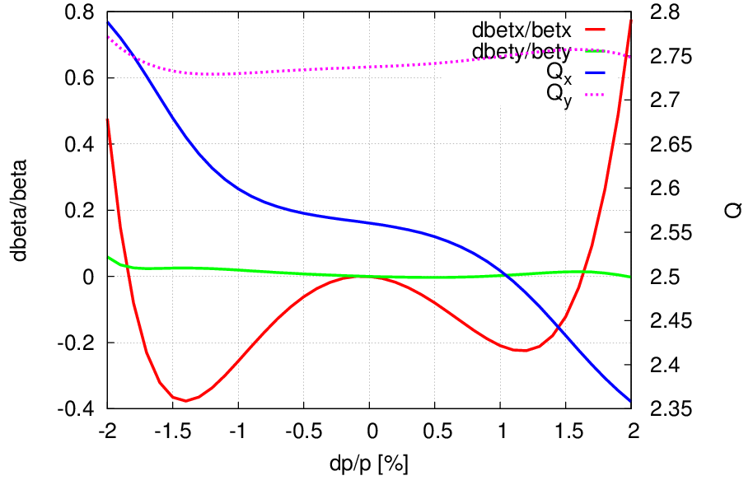
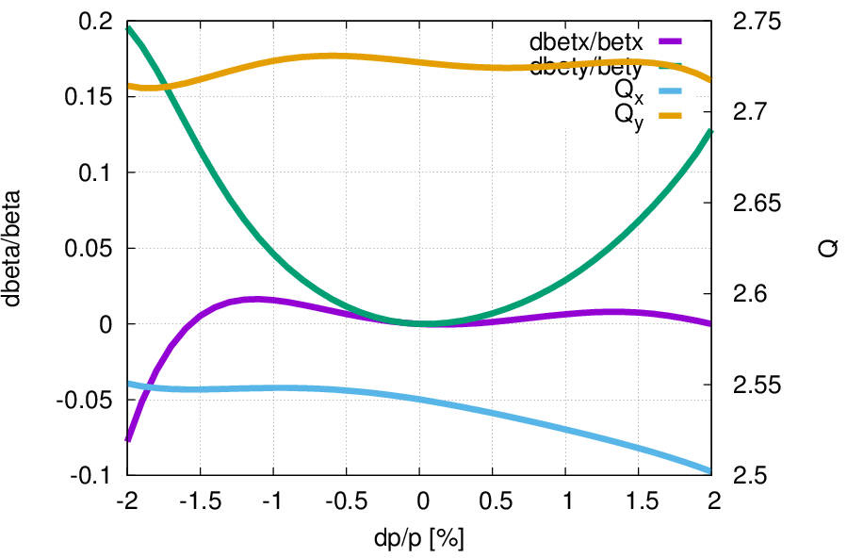
Chromaticity correction
3rd order vertical chromaticity
3rd order vertical and horizontal chromaticity
Preliminary result
to be further optimized with whole ring

Slide 10
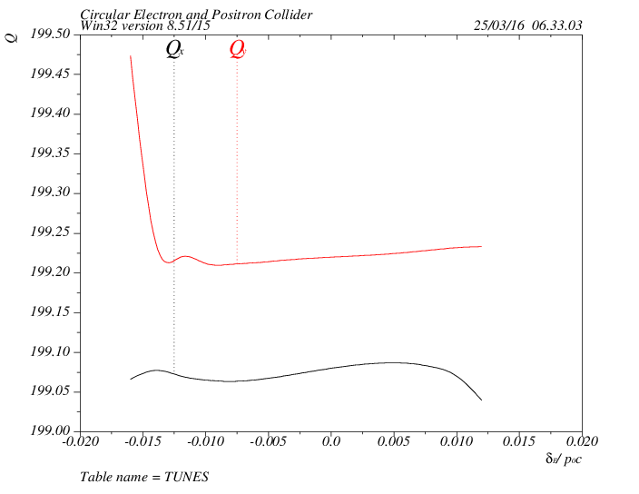
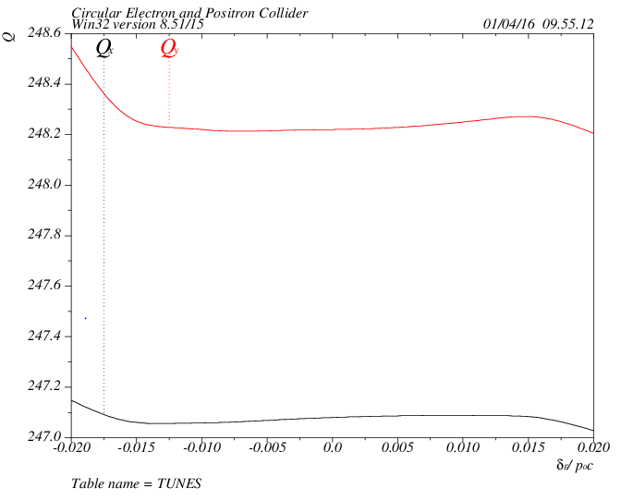
Check chromaticity with ARC+IR
ARC 6.28nm
3rd order vertical chromaticity
ARC 2.9nm
3rd order vertical and horizontal chromaticity
4 families in IR
2 families in ARC
Preliminary result
to be further optimized with whole ring

Slide 11
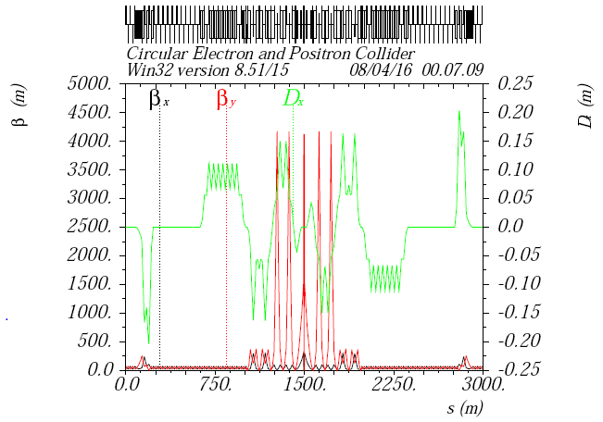
Partial double ring
Separator: 12*62.5 urad=0.75 mrad
Septum: 4.25 mrad
Exit of septum X=0.028875m

Slide 12
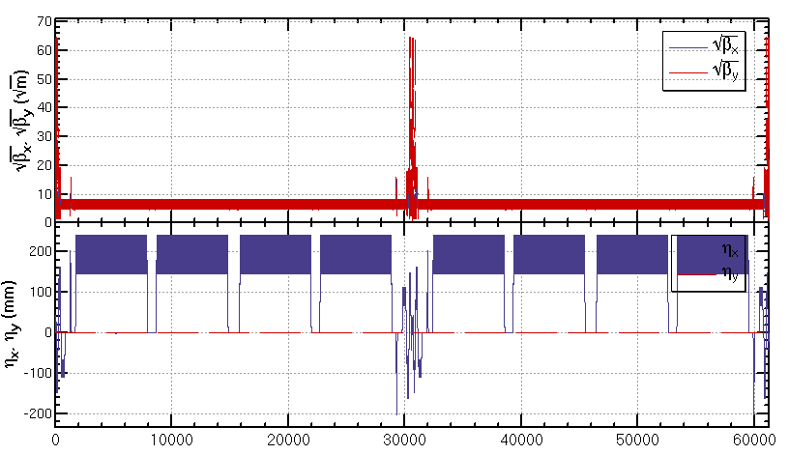
Whole ring
Circumference=61km, Emittance 3.19nm
High order chromaticity correction with whole ring is under going.
To get a ring around 54km, the PDR should be included into the ARC

Slide 13
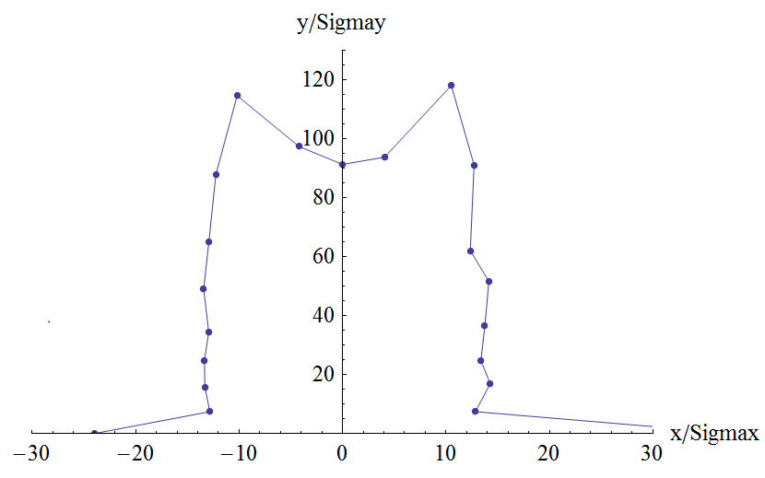
Dynamic aperture
W/O error of the magnets
Synchrotron motion and radiation damping included
Tracking with 240 turns
Coupling factor κ=0.003 for εy
Preliminary result of dynamic aperture for on momentum: (13σx, 90 σy)
High order chromaticity correction and other aberration analysis is under going

Slide 14
Summary
A preliminary lattice designed for CEPC partial double ring scheme
ARC: 60/60 degree FODO cell
IR: L*=1.5m, βy*= 1mm, θc=15mrad
PDR: 3km
Local chromaticity correction for IR
Preliminary result of dynamic aperture
on momentum
High order chromaticity correction and other aberration analysis with whole ring is under going

Slide 15
PDR lattice
The bending angle in PDR is small compare with its length
If scale bending angle with (6km/54km)*2π/4=175 mrad
Actually: Left PDR 0.75mrad+14.25mrad-15mrad-15mrad
Actually: Right PDR +15mrad +15mrad-14.25mrad-0.75mrad
Present PDR almost doesn’t contribute to the emittance
The PDR should be included into the ARC, otherwise
the total length will be 55km+6km

