Slide 1
Beam-Beam Simulation
&
Dynamic Aperture Optimzation
ZHANG, Yuan
CEPC-SPPC Symposium，IHEP，2016 Apr. 08-09
Thanks: Dimitry Shatilov, Kahuzitio Ohmi, Demin Zhou,
Yiwei Wang, Huiping Geng, Dou Wang

Slide 2
Part I.
Code Development(ibb)
Pretzel Scheme
Crosstalk between beam-beam and lattice nonlinearity
Check of new partial double ring parameters

Slide 3
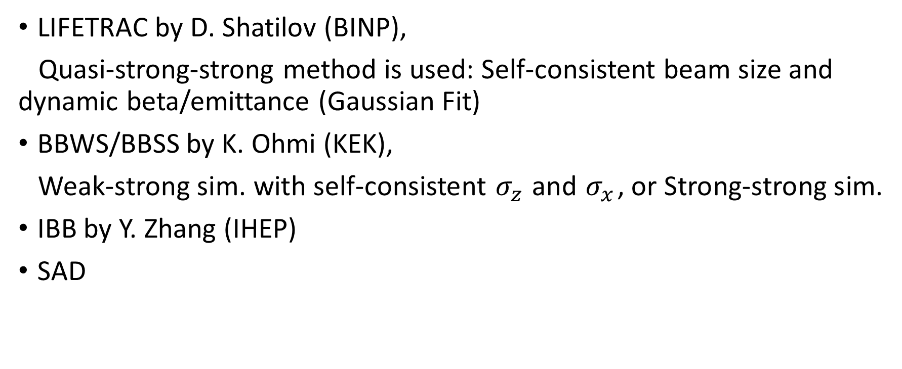
Simulation Codes
LIFETRAC by D. Shatilov (BINP),
Quasi-strong-strong method is used: Self-consistent beam size and dynamic beta/emittance (Gaussian Fit)
BBWS/BBSS by K. Ohmi (KEK),
Weak-strong sim. with self-consistent $σ_{z}$ and $σ_{x}$, or Strong-strong sim.
IBB by Y. Zhang (IHEP)
SAD

Slide 4
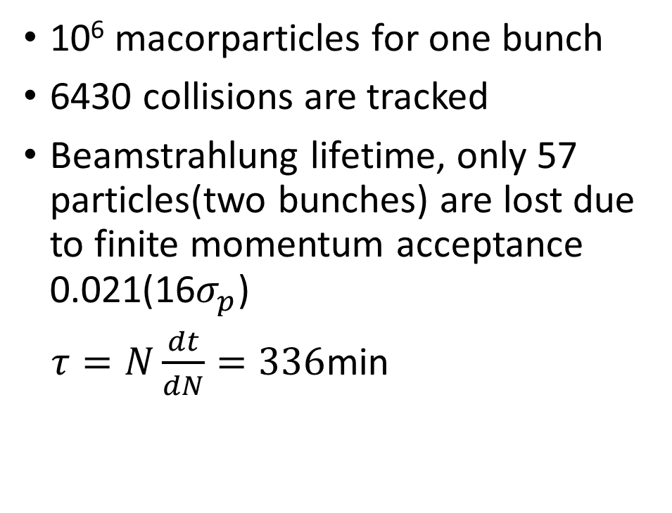
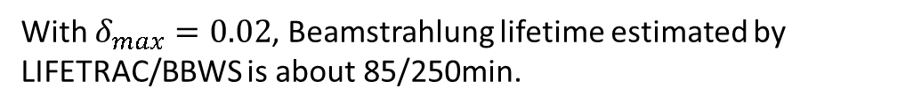
Strong-Strong Simulation by IBB3 (preliminary)
10⁶ macorparticles for one bunch
6430 collisions are tracked
Beamstrahlung lifetime, only 57 particles(two bunches) are lost due to finite momentum acceptance 0.021(16$σ_{p}$)
$τ=N\frac{dt}{dN}=336$min
With $δ_{max}=0.02$, Beamstrahlung lifetime estimated by LIFETRAC/BBWS is about 85/250min.

Slide 5
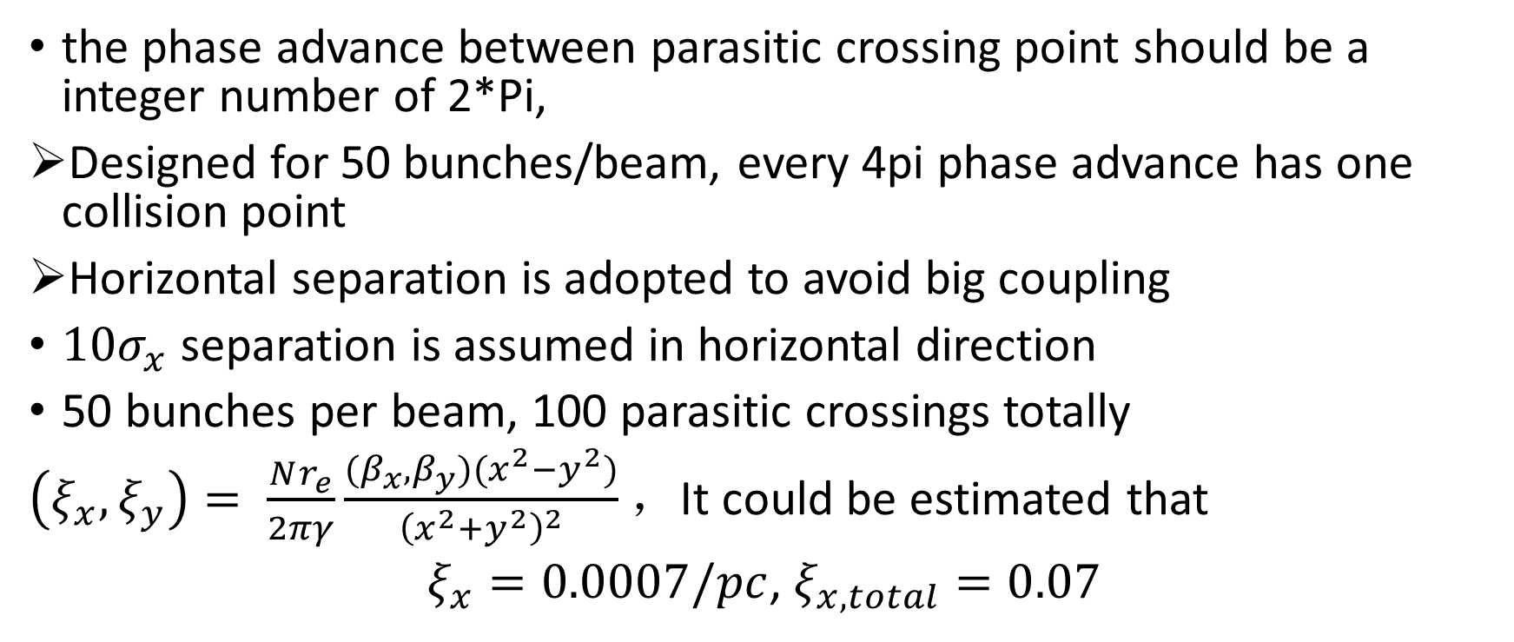
Pretzel scheme (PRE-CDR)
the phase advance between parasitic crossing point should be a integer number of 2*Pi,
Designed for 50 bunches/beam, every 4pi phase advance has one collision point
Horizontal separation is adopted to avoid big coupling
$10σ_{x}$ separation is assumed in horizontal direction
50 bunches per beam, 100 parasitic crossings totally
$\left(ξ_{x}, ξ_{y}\right)= \frac{Nr_{e}}{2πγ}\frac{(β_{x},β_{y})(x^{2}−y^{2})}{{\left(x^{2}+y^{2}\right)}^{2}}$ ，It could be estimated that
$ξ_{x}=0.0007/pc$, $ξ_{x,total}=0.07$

Slide 6
Number of PC (with lifetrac)
Lifetime reduction due to transverse aperture
Could this effect mitigated by different working point, or different phase advance between PCs?
The result need to be checked by other codes.

Slide 7
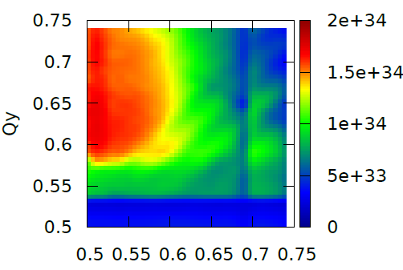
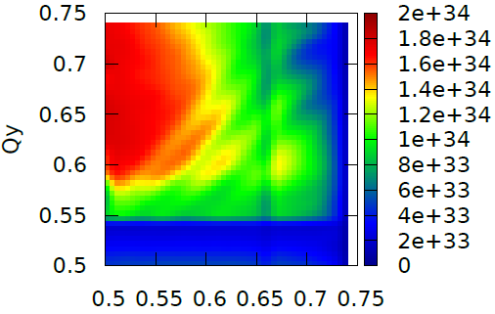
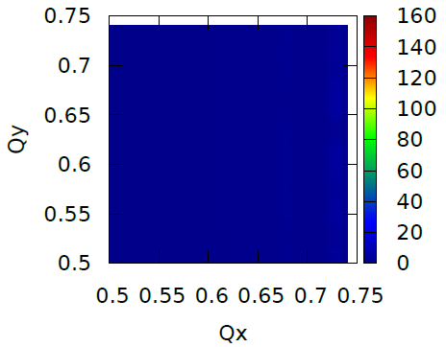
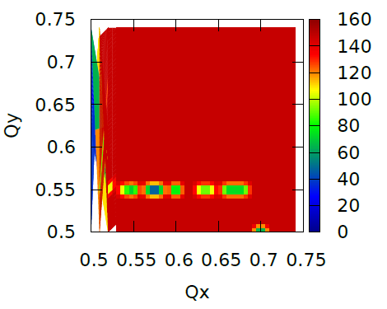
Tune Scan with PCs on/off
Luminosity
Lifetme

Slide 8
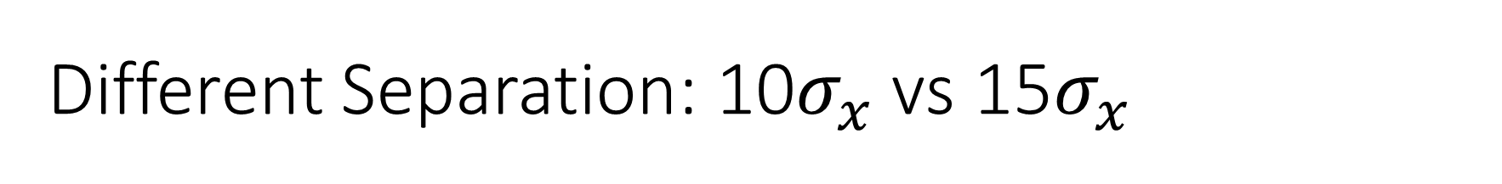
Different Separation: 10$σ_{x}$ vs 15$σ_{x}$
Luminosity
Lifetime

Slide 9
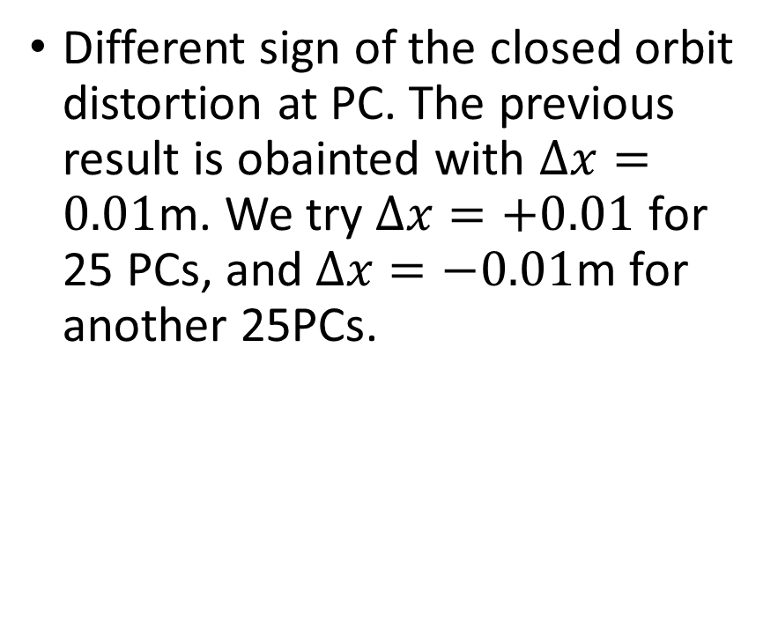
The sign of COD at PC
Different sign of the closed orbit distortion at PC. The previous result is obainted with $Δx=0.01$m. We try $Δx=+0.01$ for 25 PCs, and $Δx=−0.01$m for another 25PCs.

Slide 10
Dispersion at PC
The PCs are positioned at finite dispersion region. We try to set the dispersion 0.

Slide 11

More on Parasitic Crossings
Different phase advance between PC and IP. The previous result is obtained with $Δφ_{x}=0,Δφ_{y}=0$ for all 50 PCs in half ring. We also try $Δφ_{x}=0,Δφ_{y}=0$ for 25 PCs and $Δφ_{x}=\frac{π}{4},Δφ_{y}=\frac{π}{4}$ for another 25 PCs. It does not help.
Notes:
可以扫描

Slide 12
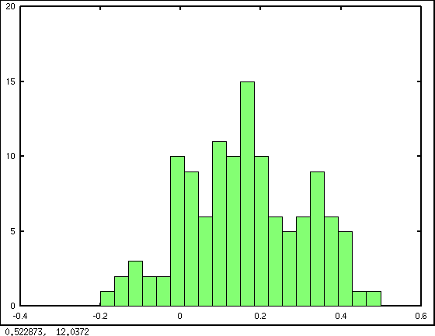
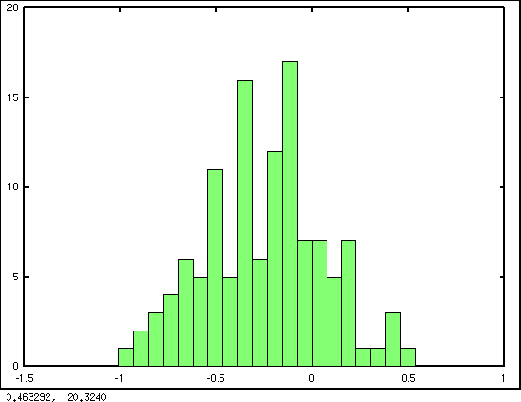
CEPC: Dynamic Aperture Optimization with 240 sextupoles in ARC (v1-IR)
SF
SD

Slide 13
Weak-Strong Simulation with Lattice (240sext)

Slide 14
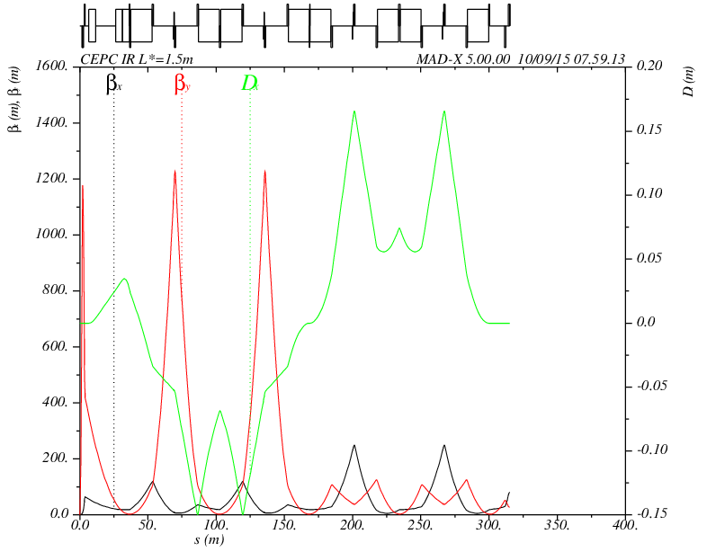
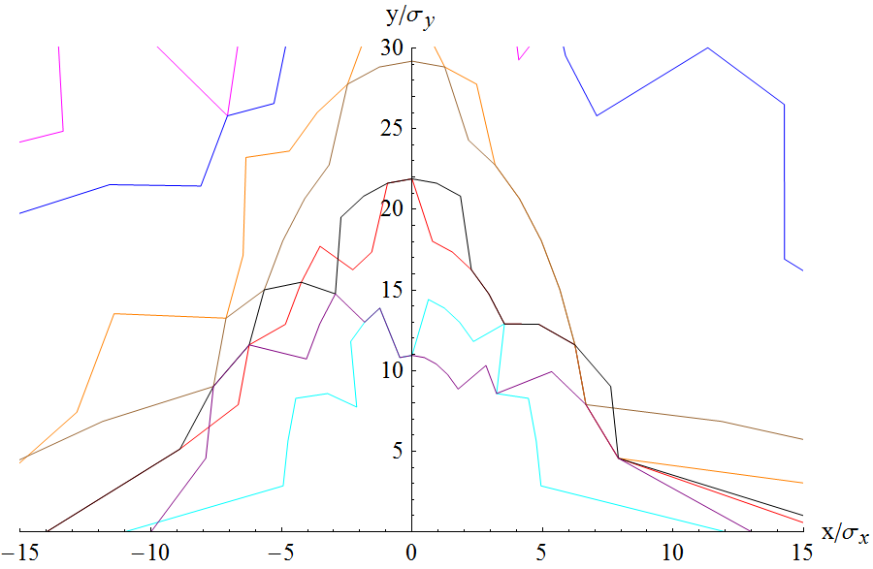
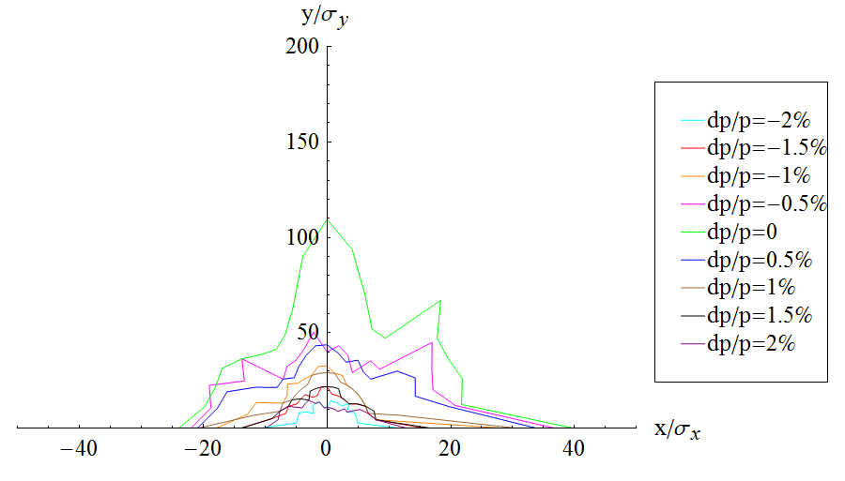
CEPC: Dynamic Aperture Optimization with sextupoles in IR (v3.0)
Courtesy of Yiwei Wang
FFS_3.0mm_v3.0_Nov_2015
L*=1.5m
βy*=3mm
1
2
3
4
5
6
7
8
9
10
-I
-I
+(2,3,4,5,6,7,8,9,10) sextupoles

Slide 15
Weak-Strong Simulation with Lattice (IRsext)

Slide 16
Primary parameter for CEPC double ring
（wangdou20160325）
 | Pre-CDR | H-high lumi. | H-low power | W | Z
Number of IPs | 2 | 2 | 2 | 2 | 2 | 2
Energy (GeV) | 120 | 120 | 120 | 80 | 45.5 | 45.5
Circumference (km) | 54 | 54 | 54 | 54 | 54 | 54
SR loss/turn (GeV) | 3.1 | 2.96 | 2.96 | 0.59 | 0.062 | 0.062
Half crossing angle (mrad) | 0 | 15 | 15 | 15 | 15 | 15
Piwinski angle | 0 | 2.5 | 2.6 | 5 | 8.5 | 7.6
N_{e}/bunch (10¹¹) | 3.79 | 2.85 | 2.67 | 0.74 | 0.46 | 0.46
Bunch number | 50 | 67 | 44 | 400 | 1100 | 1100
Beam current (mA) | 16.6 | 16.9 | 10.5 | 26.2 | 45.4 | 45.4
SR power /beam (MW) | 51.7 | 50 | 31.2 | 15.6 | 2.8 | 2.8
Bending radius (km) | 6.1 | 6.2 | 6.2 | 6.1 | 6.1 | 6.1
Momentum compaction (10⁻⁵) | 3.4 | 2.5 | 2.2 | 2.4 | 3.5 | 3.5
β_{IP} x/y (m) | 0.8/0.0012 | 0.25/0.00136 | 0.268 /0.00124 | 0.1/0.001 | 0.08/0.001 | 0.1/0.001
Emittance x/y (nm) | 6.12/0.018 | 2.45/0.0074 | 2.06 /0.0062 | 1.02/0.003 | 0.62/0.002 | 0.62/0.0028
Transverse σ_{IP} (um) | 69.97/0.15 | 24.8/0.1 | 23.5/0.088 | 10.1/0.056 | 7/0.046 | 7.9/0.053
ξ_{x}/IP | 0.118 | 0.03 | 0.032 | 0.008 | 0.005 | 0.006
ξ_{y}/IP | 0.083 | 0.11 | 0.11 | 0.074 | 0.084 (Fl=3) | 0.073 (Fl=2.6)
V_{RF} (GV) | 6.87 | 3.62 | 3.53 | 0.81 | 0.12 | 0.12
f _{RF} (MHz) | 650 | 650 | 650 | 650 | 650 | 650
Nature σ_{z} (mm) | 2.14 | 3.1 | 3.0 | 3.25 | 3.9 | 3.9
Total σ_{z} (mm) | 2.65 | 4.1 | 4.0 | 3.35 | 4.0 | 4.0
HOM power/cavity (kw) | 3.6 | 2.2 | 1.3 | 0.99 | 0.99 | 0.99
Energy spread (%) | 0.13 | 0.13 | 0.13 | 0.09 | 0.05 | 0.05
Energy acceptance (%) | 2 | 2 | 2
Energy acceptance by RF (%) | 6 | 2.2 | 2.1 | 1.7 | 1.1 | 1.1
n_{γ} | 0.23 | 0.47 | 0.47 | 0.3 | 0.27 | 0.24
Life time due to beamstrahlung_cal (minute) | 47 | 36 | 32
F (hour glass) | 0.68 | 0.82 | 0.81 | 0.92 | 0.95 | 0.95
L_{max}/IP (10³⁴cm⁻²s⁻¹) | 2.04 | 2.96 | 2.01 | 3.09 | 3.61 | 3.09

Slide 17
Case: H-high lum
IBB: Strong-Strong Beam-Beam Code
with Beamstrahlung effect
Developed by Y. Zhang@IHEP
Lifetime: 118 min

Slide 18
Case: H-low power
IBB: Strong-Strong Beam-Beam Code
with Beamstrahlung effect
Developed by Y. Zhang@IHEP
Lifetime: 97 min

Slide 19
Case Z-1
IBB: Strong-Strong Beam-Beam Code
with Beamstrahlung effect
Developed by Y. Zhang@IHEP

Slide 20
Case Z-2
IBB: Strong-Strong Beam-Beam Code
with Beamstrahlung effect
Developed by Y. Zhang@IHEP

Slide 21
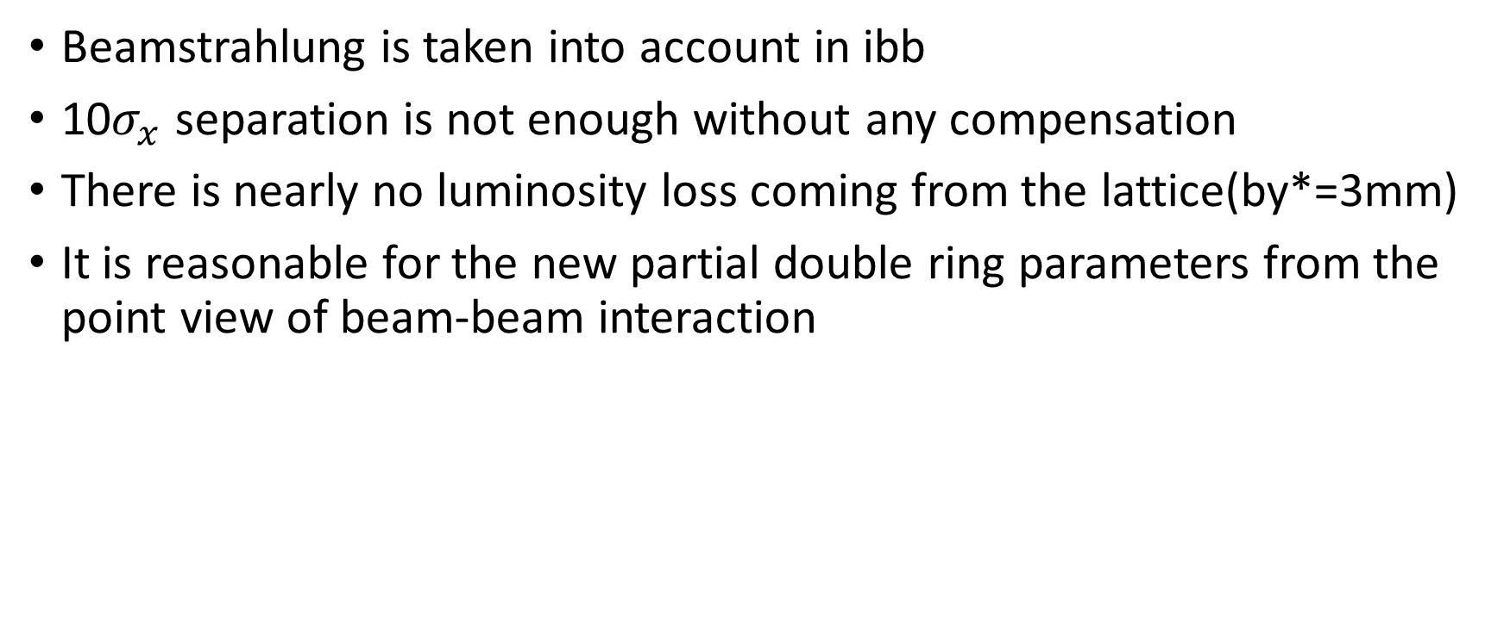
Summary of Beam-Beam Simulation
Beamstrahlung is taken into account in ibb
10$σ_{x}$ separation is not enough without any compensation
There is nearly no luminosity loss coming from the lattice(by*=3mm)
It is reasonable for the new partial double ring parameters from the point view of beam-beam interaction

Slide 23
Part II.

Slide 24
Introduction
This work was firstly excited by Oide’s talk.
K. Oide, “A design of beam optics for FCC-ee”, 2015-09
“255 sextupole pairs per half ring”
Downhill Simplex is a local optimization algorithm
We use a global optimization algorithm: Diffential Evolution (Suggested by Ji Qiang@LBNL)
Other popular algorithm: Genetic Algorithm, Particle Swarm

Slide 25
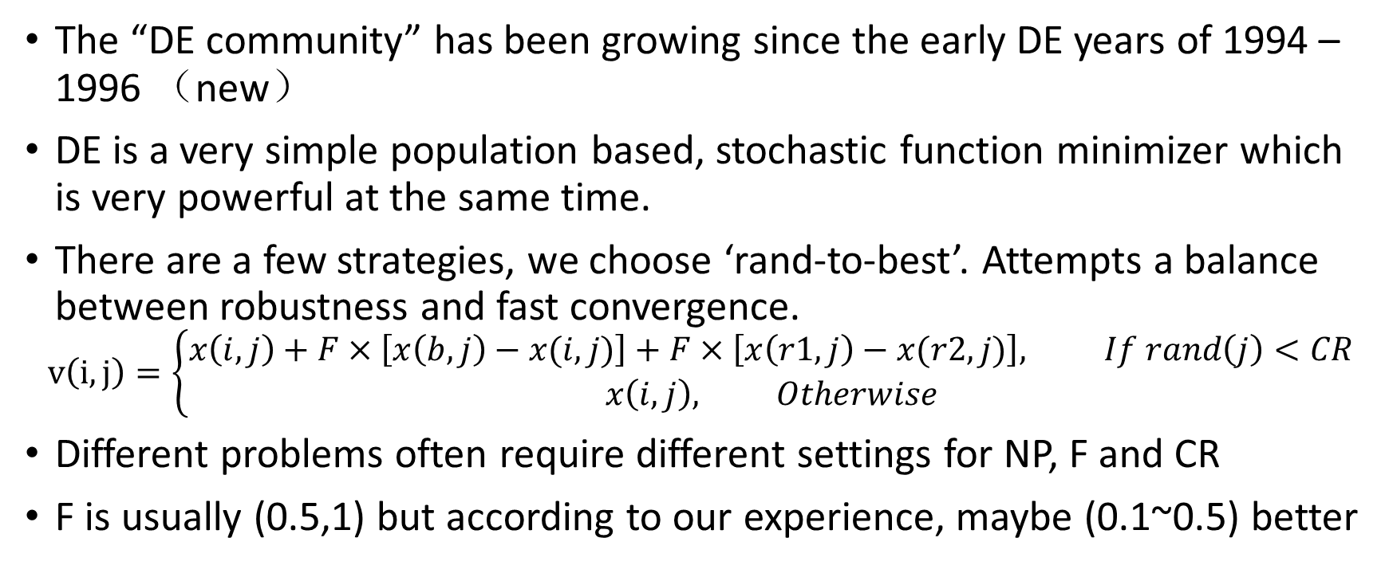
Differential Evolution
The “DE community” has been growing since the early DE years of 1994 – 1996 （new）
DE is a very simple population based, stochastic function minimizer which is very powerful at the same time.
There are a few strategies, we choose ‘rand-to-best’. Attempts a balance between robustness and fast convergence.
$$v\left(i,j\right)=\left\{\begin{matrix}x\left(i,j\right)+F×\left[x\left(b,j\right)−x(i,j)\right]+F×\left[x\left(r1,j\right)−x(r2,j)\right], If rand\left(j\right)<CR \\ x\left(i,j\right), Otherwise\end{matrix}\right.$$
Different problems often require different settings for NP, F and CR
F is usually (0.5,1) but according to our experience, maybe (0.1~0.5) better

Slide 26
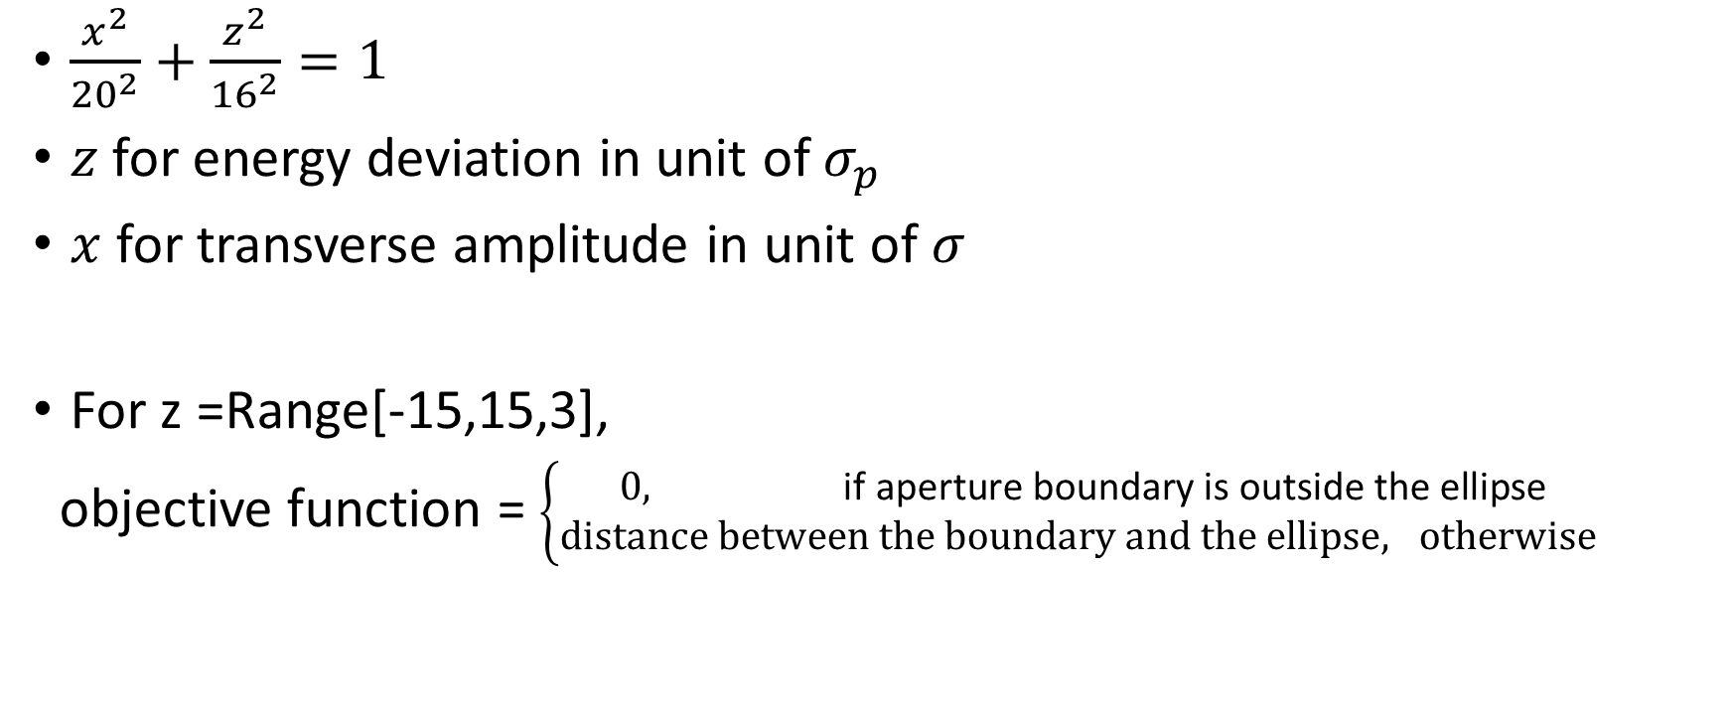
Optimization with Algorithm
- Objective function
$\frac{x^{2}}{{20}^{2}}+\frac{z^{2}}{{16}^{2}}=1$
$z$ for energy deviation in unit of $σ_{p}$
$x$ for transverse amplitude in unit of $σ$
For z =Range[-15,15,3],
objective function = $\left\{\begin{matrix}0, \text{if} \text{aperture} \text{boundary} \text{is} \text{outside} \text{the} \text{ellipse} \\ distance between the boundary and the ellipse, otherwise \end{matrix}\right.$

Slide 27
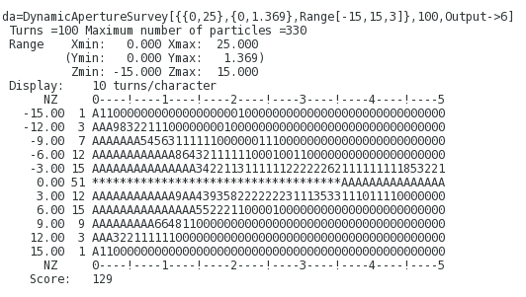
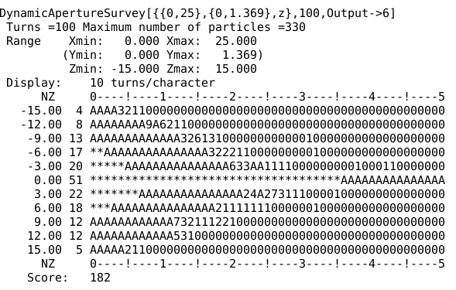
The first test, with 240 sextupoles, 100turns
V1, 100 turns

Slide 28
CEPC: Dynamic Aperture Optimization with 240 sextupoles in ARC (v1-IR)

Slide 29
CEPC: Dynamic Aperture Optimization with 240 sextupoles in ARC (v1-IR), Sextupole Strength
SF
SD

Slide 30
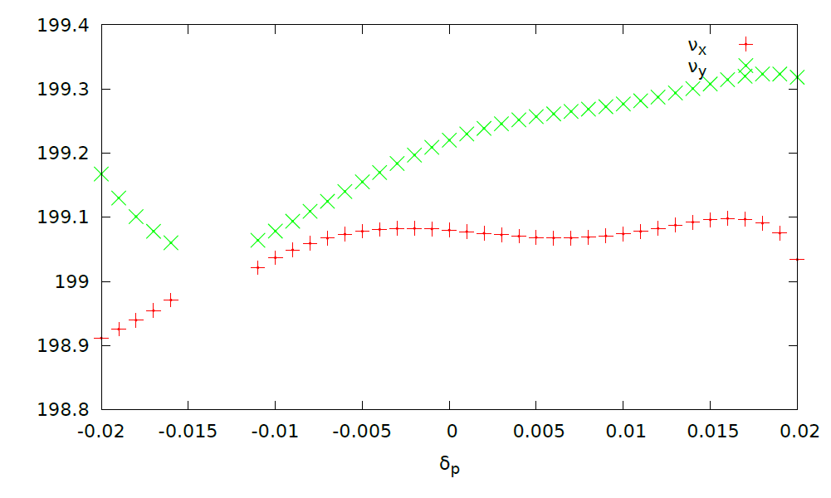
Tune

Slide 31
The multiple objective algorithm based on differential evolution is implemented referencing J. Qiang, IPAC’13.
Yongjun Li, IAS Program on HEP Conference, 2016

Slide 32
More Objective in CEPC test
DA with PhaseX->0,PhaseY->0
DA with PhaseY->Pi/2, PhaseY->Pi/2
Qx in [0, 0.5]
Qy in [0, 0.5]

Slide 33
A solution

Slide 34
DA with Radiation Damping
Damping Off
Damping On

Slide 35
DA with Radiation Damping and Sawtooth orbit
Damping
Damiping & Sawtooth Orbit

Slide 36
Summary
A multi-objective optimization code based on differential evolution has been developed
The MODE is just a tool, no physics. Physics exist in the definition of objective function.
The tool could only help us find the ‘ceiling’ of a design. But the ‘ceiling’ is determined by the design itself.

