Slide 1
Injector Chain General and more about p-RCS
Tang Jingyu
3nd CEPC-SPPC Study Group Meeting
April 8-9, 2016, IHEP

Slide 2
Main topics
Updating the schemes and main parameters
Works under going
More about p-RCS
Summary

Slide 3
Updating schemes
p-Linac: max. beam power 1.63 MW, with no chopping when not serving p-RCS (other physics programs); two chopping systems for injection into p-RCS
p-RCS: max. beam power 3.4 MW, more particles accumulated when not serving for SPPC injection (clearly within SCE limit)(also useful for future SPPC upgrade), favoring high RF frequency (36-40 MHz)
MSS: perhaps no need for bunch splitting initially (high RF in p-RCS, 25 ns bunch spacing; still needed for 5 ns)
SS: larger ring circumference 7200 m (7000 m), race-track lattice to save space and long straight section for extraction, lattice design under way

Slide 4
Major parameters for the injector chain
 | Value | Unit |  | Value | Unit
p-Linac |  |  | MSS
Energy | 1.2 | GeV | Energy | 180 | GeV
Average current | 1.4 | mA | Average current | 20 | uA
Length | ~300 | m | Circumference | 3500 | m
RF frequency | 325/650 | MHz | RF frequency | 40 | MHz
Repetition rate | 50 | Hz | Repetition rate | 0.5 | Hz
Beam power | 1.63 | MW | Beam power | 3.67 | MW
p-RCS |  |  | SS
Energy | 10 | GeV | Energy | 2.1 | TeV
Average current | 0.34 | mA | Accum. protons | 2.55E14
Circumference | 900 | m | Circumference | 7000 | m
RF frequency | 36-40 | MHz | RF frequency | 200 | MHz
Repetition rate | 25 | Hz | Repetition period | 30 | s
Beam power | 3.4 | MW | Protons per bunch | 2.0E11
 |  |  | Dipole field | 8 | T

Slide 5
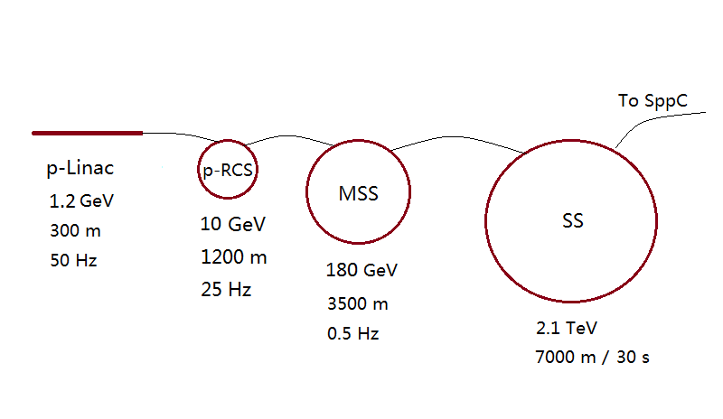
Injector chain
(for proton beam)
p-Linac: proton superconducting linac
p-RCS: proton rapid cycling synchrotron
MSS: Medium-Stage Synchrotron
SS: Super Synchrotron
Ion beams have dedicated linac (i-Linac) and RCS (i-RCS)

Slide 6
Works under going
p-Linac and i-Linac first design: (Lu Yuanrong)
p-RCS: just started (Tang Jingyu)
MSS: a student studying lattice (with Tang Jingyu)
SS: (Wang Xiangqi and USTC students)
Ion acceleration: i-RCS, MSS and SS (to be started)

Slide 7
More about p-RCS
p-RCS will serve not only medium-stage acceleration for colliding beams at SPPC, but also other physics programs.
  It is designed to work with high-duty factor
  The continuous beam power from p-RCS is 3.5 MW. No other similar accelerators have been built or studied in details.
High repetition rate of 25 Hz will shorten the beam filling time in the MSS.
  Only a fraction of this power is needed to fill the MSS. Thus most of the beam pulses from the p-RCS could be used for other physics programs.
p-RCS will use mature accelerator technology but be on a larger scale than existing rapid-cycling proton synchrotrons.
  Examples: CSNS/RCS, J-PARC/RCS, ISIS/RCS, FNAL/Booster, NF/RCS

Slide 8
Summary of International high power RCS
 | Type | Energy (GeV) | Inj. Energy (GeV) | f_rep (Hz) | Accu Part. (10^13) | I_ave (mA) | P_ave (MW) | Status
IPNS | RCS | 0.45 | 0.05 | 30 | 0.3 | 0.167 | 0.0075 | Closed
ISIS | RCS | 0.8 | 0.07 | 50 | 3.75 | 0.3 | 0.24 | Upgraded
J-PARC/RCS | RCS | 3.0 | 0.4 | 25 | 8.3 | 0.333 | 1.0 (0.5) | Operation
J-PARC/MR | Synch. | 50 | 3.0 | 0.3 | 33.2 | 0.015 | 0.75 | Operation
FNAL/BS | RCS | 8 | 0.4 | 15 | 7.5 | 0.014 | 0.12 | Operation
FNAL/MI | Synch. | 120 | 8 |  |  | 0.004 | 0.52 | Operation
PIP-II/MI | Synch. | 120 | 8 | 0.83 | 7.5 | 0.01 | 1.2 | 2025
BNL/BS | RCS | 1.5 | 0.2 | 7.5 | 1.5 | 0.018 | 0.027 | Operation
CSNS-I | RCS | 1.6 | 0.8 | 25 | 1.56 | 0.065 | 0.1 | 2018
CSNS-II | RCS | 1.6 | 0.25 | 25 | 7.8 | 0.325 | 0.5 | ?
ISNS | RCS | 1.0 | 0.1 | 25 | 2.4 | 0.1 | 0.1 | ?
NF | RCS | 3 | 0.2 | 50 | 5 | 0.4 | 1.2 | ?
SPPC/p-RCS | RCS | 10 | 1.2 | 25 | 8.5 | 0.19 | 3.4 | ?

Slide 9
Key features
  Very high beam power (3.5 times scaled up from J-PARC/RCS)
  Space charge effect very important
  Beam loss and collimation very important
  Probably adopt FNAL/Booster RF system to increase Q value and bunch frequency, dual harmonics
  Magnet/PS technology similar to CSNS/RCS
  Vacuum technology similar to CSNS/RCS

Slide 10
Emittance and physical acceptance
  E: 40 πmm-mrad (4*rms, Geo.) or 3.6 (normalized)
  A: 100 πmm-mrad (compared to 540 for CSNS/RCS)
  Largely reduce magnet sizes and cost
Laslett tune shift: -0.09 (at injection)
  Still consider high, to be decreased
RF voltage: 4-5 MV
  About 100 MA cavities (if low frequency), 80 Ferrite cavities (if high frequency) [compared to 20 at FNAL/BS]
  Will see if dual-harmonic RF is needed
Additional chopping system at linac to create a bunch gap for extraction (if high RF frequency)
Individual techniques exist, but design and assembling look challenging due to very high beam power. Machine protection very important similar to the collider.

Slide 11
Some thoughts
Although lower priority than the collider, it is still very interesting to investigate the design concepts. Especially, they do not have close reference accelerators (scaled up by large factors)
  Totally new, different from LHC or Tevatron (building-up by steps)
General parameters: forming general parameter group consisting of conveners for each stage of the accelerator complex: p-Linac/i-Linac, p-RCS/i-RCS, MSS, SS and SPPC. (still under course)
Each convener leads the preliminary concept design of the accelerator, with the goal to produce a list of main parameters, write the subsection in the CDR report, and identify key technical challenges by late 2016.
Starting by the first version lattice or layout design, and maintain a parameter list.
Conveners should report the progress in monthly SPPC meetings.

Slide 12
Summary
Injector chain by itself is a very complicated and powerful accelerator system, large enough by a single stage
Work on the injection chain continues, and more volunteers (both experts and students) are needed.
We hope to obtain a preliminary concept design for the whole chain by late 2016.
Key technical challenges should be identified, so R&D program can be pursued.
Collaboration and coordination are needed.
Beam applications or physics programs of each stage will be discussed.

Slide 13
Thanks!

