Slide 1
Jet-veto Resummation for Gauge boson Pair
Yan Wang
Based on Phys. Rev. D 88, 114017 (2013),
arXiv:1504.00509 (submit to PRD)
2015-10-30
Notes:
Hello everyone, very glad to have a report here.
Thanks Professor Lou to give me the chance and
thanks Hongbo and moxin to arrange the report.
Today, I will talk about jet-veto resummation for gauge boson pair production at the LHC.
This report is based on two works, one is published before, and one is submitted to PRD.

Slide 2
OUTLOOK
Introduction to resummation
Introduction to gauge boson pair
Jet-veto resummation effects
Notes:
This is the outlook,
First I will tell you what is the resummation,
and then introduce what happened on the gauge boson pair in the experiment.
And how can we explain the experiment on the gauge boson pair by resummation.

Slide 3
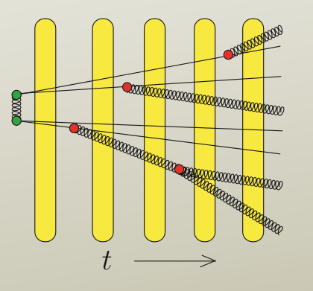
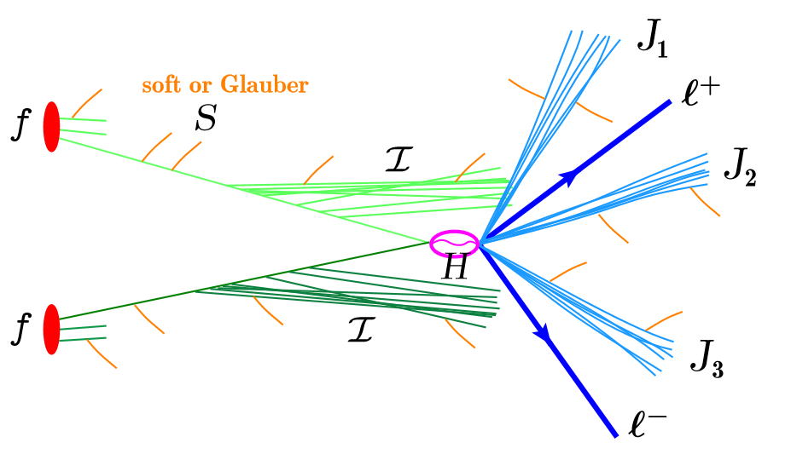
What Is Resummation
Parton shower
POWHEG+PYTHIA
Notes:
Well, you may think that resummation is a strange noun, may be you never hear it before.
But, actually, you are all very familiar with resummation. Especially for those student who have done analysis at the LHC.
Because LHC is the proton proton collider, the QCD is very important here. There are many gluons radiation from the initial states and final states. And these gluons also radiate other gluons, which is called the Parton Shower.
And there is also soft and collinear divergence here.
In order to deal with such situation. We always use some software to do that in practice.
The most common one is the POWHEG+PYTHIA.
I believe that many of you have heard this software.

Slide 4
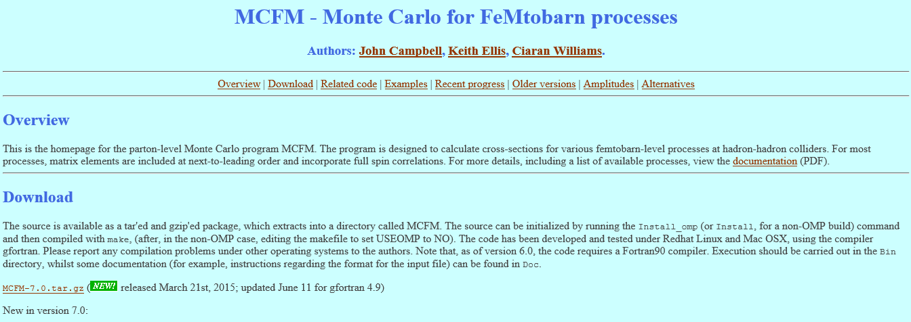
MCFM
http://mcfm.fnal.gov/
Benchmark
For most processes, matrix elements are included at next-to-leading order and incorporate full spin correlations.
Only provide accurate predictions for inclusive quantities
Notes:
First I will introduce to you a software MCFM, this is the website where you can download it.
The advantage for this software is that for most SM process, it can calculate the LO and NLO. And the speed is fast.
Its results are always recognized as the benchmark cross section. So if you want to check some cross section of the SM process, you should use this software.
However, since the presence of soft and collinear divergences in the final state means that
any computation performed at NLO can only provide accurate predictions for inclusive quantities.
On the other hand, for exclusive quantities, we should use POWHEG

Slide 5
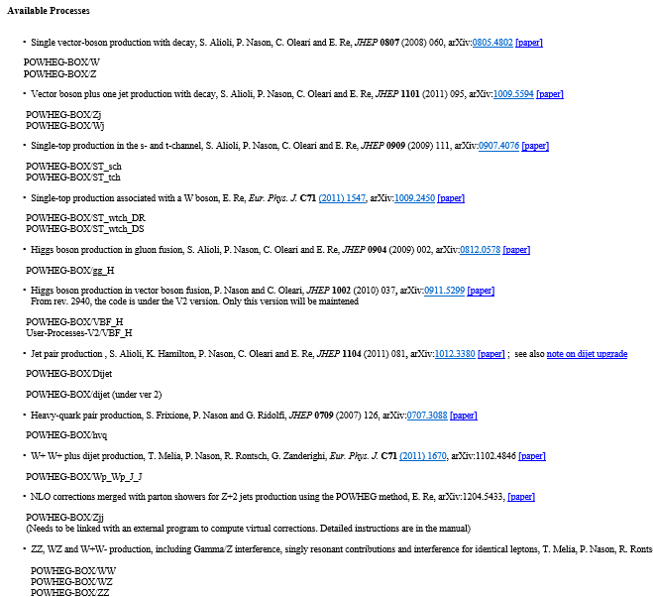
POWHEG
http://powhegbox.mib.infn.it/
pwgevents.lhe pwgNLO.top
Notes:
Let’s come back to the powheg.
This is the POWHEG website. You can download the main program here.
And it contain many process, for example, WW ZZ Higgs and so on. You can download each process independently.
And then if you want to use it, you should compile the program firstly.
It well generate three executable files.
Second, you should set the parameter, and run pwhg_main file, and it will generate NLO lhe file, without Pythia.
If you want to shower, then run

Slide 6
POWHEG NLO file
pwgevents.lhe pwgNLO.top
The total cross section $σ_{POWHEG}=σ_{MCFM}$
Notes:
And then it will generate such two files. The first one contains the four momentum of the particles,
and the second one contains histogram like the pt distribution and invariant mass distribution and so on.
The total cross section of POWHEG and MCFM can be the same, if we set some parameters.
However, although it contains the character NLO, but But please note that,, but it is not exact the NLO results.

Slide 7
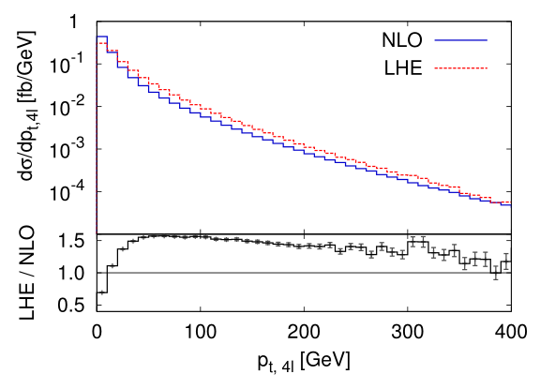
POWHEG NLO file
pwgevents.lhe pwgNLO.top
ZZ production
zoom in
MCFM
$p_{T}^{1}>20 GeV, p_{T}^{123}>10 GeV, \left|η\right|<2.5$, $anti−k_{t}$ algorithm, R=0.6
T. Melia et.al. arXiv: 1107.5051 [hep-ph]
Notes:
For example, we compare the distribution.
We take ZZ production for example. this is the transverse momentum distribution.
The x axis is the pt of the bound of the four leptons.
The red curve is generated by this lhe file.
The blue curve is coming from the MCFM.
We can see that the two curves are obviously different. In the small pt region, the NLO curve is much larger than the LHE result.
Note that it is the logarithmic coordinate. And we have set cut for the final states.
And in the large pt region, POWHEG result is much higher.
This makes the total cross section is the same.

Slide 8
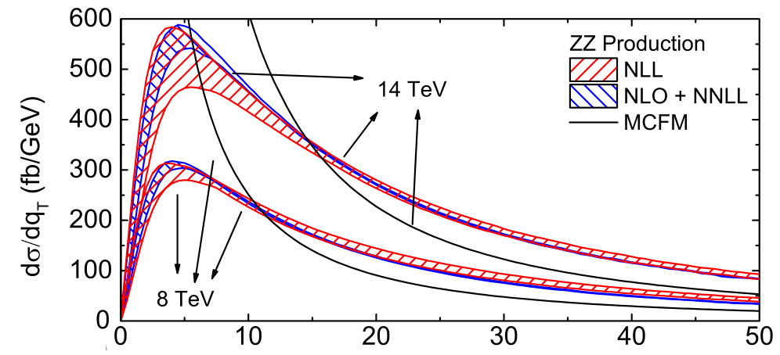
In the small pt region
$$p_{T}$$
YW, Chong Sheng Li, Ze Long Liu, Ding Yu Shao and Hai Tao Li, Phys. Rev. D 88, 114017 (2013)
Notes:
So we Zoom in the small pt region, we can see the details here.
The black line is the MCFM NLO result, when pt goes to 0, the NLO result goes to infinity, because the soft and collinear divergence.
And the blue band and red band is similar as POWHEG result It’s the higher order resummation result. We will talk about the details later. You may think that it is POWHEG result. , it goes to zero.
Obviously, NLO is wrong, because it goes to infinity, and in the real world, everything must be convergent.
But how this curve become like this?

Slide 9
Form factor in POWHEG
$$σ_{POWHEG}=$$
$∫dΦ_{B} \overline{B}$($Φ_{B}$)
$$[Δ\left(μ,μ_{0}\right)$$
+$\int_{μ_{0}}^{μ}{d Φ_{1}}R(Φ_{B}×Φ_{1})/B\left(Φ_{B}\right)$]
$$Δ_{ }^{ }\left(q_{T},Q\right)=\exp{\{−\int_{q_{T}^{2}}^{Q^{2}}{ }\frac{dq^{2}}{q^{2}}\frac{α_{s}\left(q^{2}\right)}{2π}[A\log{\frac{Q^{2}}{q^{2}}}+B] \}}$$
LL
Resummation
M.H. Seymour, Comp.Phys.Commun.90:95-101,1995
Notes:
Because in POWHEG, besides the NLO cross section, it also contain a form factor, it is an exponent term and there is the Sudakov double log term in the exponent.
This form is the resummation at Leading logarithm.
So when pt goes to zero, the Sudakov term goes the negative infinity, and the form factor goes to zero, which makes the cross section is zero.
This form factor is the effects of LL resummation.

Slide 10
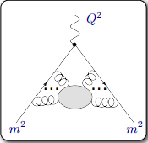
What Is Resummation
large logarithms $L=ln\frac{Q}{m}$, arising from hierarchy between small variable m and large scale Q, so the convergence is poor and the fixed order predictions are unreliable.
Thus, these logarithms should be resumed to all order.
a short-distance scale Q
a long-distance scale m
$p_{T}$ distribution
$$Log(\frac{p_{T}}{M})$$
Drell-Yan hard function
$${\left|C_{V}\left(−M_{Z}^{2},μ\right)\right|}^{2}=1+\frac{C_{F}α_{s}\left(μ_{h}\right)}{2π}Re(−Log^{2}\left(−\frac{M_{Z}^{2}}{μ_{h}^{2}}\right)+3Log^{ }\left(−\frac{M_{Z}^{2}}{μ_{h}^{2}}\right)−8+\frac{π^{2}}{6} )$$
Notes:
So in brief, what is resummation?
Resummation is if there are two different scales, in the fix-order calculation, there will be logarithms, that is the ratio of the two scales.
For example, in the pt distribution, we showed just now, the logarithm is pt over m.
And in the hard function, the log can be the renormalization scale over the invariant mass.
When one scale approach to zero, there will be divergence. So we have to resum them to all order and put them on to an exponent.

Slide 11
How to Resum
LO
NLO
NNLO
NNNLO
$$σ=σ_{0}[1 +{ A_{1}α}_{s}L^{2} +A_{2}α_{s}^{2}{ L}^{4} +A_{3}α_{s}^{3} L^{6} + …$$
$+{ B}_{1}α_{s}L +{B_{2}α}_{s}^{2} L^{3} +B_{3}α_{s}^{3} L^{5} + …$
$+{ C_{1}α}_{s} +C_{2}α_{s}^{2}L^{2} +C_{3}α_{s}^{3}L^{4} + …$
$+ α_{s}^{2}L + α_{s}^{3}L^{3} + …$
$+{ α}_{s}^{2} +{ α}_{s}^{3}L^{2} +…$
$+ α_{s}^{3}L +… ]$
Resummation
LL
NLL
NNLL
NNNLL
…
Fixed order
$${\left|C_{V}\left(−M_{Z}^{2},μ\right)\right|}^{2}=1+\frac{C_{F}α_{s}\left(μ_{h}\right)}{2π}Re(−Log^{2}\left(−\frac{M_{Z}^{2}}{μ_{h}^{2}}\right)+3Log^{ }\left(−\frac{M_{Z}^{2}}{μ_{h}^{2}}\right)+\frac{π^{2}}{6}−8 )$$
The RG evolution equation of the hard function
${\frac{dC_{V}\left(−M_{Z}^{2},μ\right)}{d\ln{ }μ}}^{ }=[Γ_{cusp}^{F}\left(α_{s}\right)\ln\left(\frac{−M_{Z}^{2}}{μ^{2}}\right)+2γ^{q}\left(α_{s}\right)]$ $C_{V}\left(−M_{Z}^{2},μ\right)$
Notes:
This is how to resum.
In the column, it is the fix order result. The L is said just now, it depends on the what you want to considered. For example, the drell-yan hard function is this, and L is this.
So in the NLO, fix-order result contains L square, L and finite term.
In the NNLO, the power of L will be 4 3 2 1
and in NNNLO, the power of L will be 6 5 4…
If we rearrange them like this, and sum them to all orders, it is the resummation.
If we only sum the first row, it is the leading logarithm resummation,
If we sum the first and second row, it is the next-to LL resummation.
But, how to resum them to all orders？ We should use renormalization group evolution equation.

Slide 12
How to Resum
POWHEG：NLO+LL
NLO+NNLL---We will do
LO
NLO
NNLO
NNNLO
$$σ=σ_{0}[1 +{ A_{1}α}_{s}L^{2} +A_{2}α_{s}^{2}{ L}^{4} +A_{3}α_{s}^{3} L^{6} + …$$
$+{ B}_{1}α_{s}L +{B_{2}α}_{s}^{2} L^{3} +B_{3}α_{s}^{3} L^{5} + …$
$+{ C_{1}α}_{s} +C_{2}α_{s}^{2}L^{2} +C_{3}α_{s}^{3}L^{4} + …$
$+ α_{s}^{2}L + α_{s}^{3}L^{3} + …$
$+{ α}_{s}^{2} +{ α}_{s}^{3}L^{2} +…$
$+ α_{s}^{3}L +… ]$
LL
NLL
NNLL
NNNLL
…
Resummation
The RG equation
${\frac{dC_{V}\left(−M_{Z}^{2},μ\right)}{d\ln{ }μ}}^{ }=[Γ_{cusp}^{F}\left(α_{s}\right)\ln\left(\frac{−M_{Z}^{2}}{μ^{2}}\right)+2γ^{q}\left(α_{s}\right)]$ $C_{V}\left(−M_{Z}^{2},μ\right)$
$A_{2}, A_{3} ….$ Can be predict by $A_{1}$
$B_{2}, B_{3} ….$ Can be predict by $B_{1}$
$C_{2}, C_{3} ….$ Can be predict by $C_{1}$
Notes:
With this RG equation, we can predict the coefficient from the lower order.
We should not that : These coefficient in the RG equation should also be calculated order by order.
For example, if we have NLO result, we can get A1 B1 C1, so we can know A2 A3 ..to An and B2 B3 …C2 C3
So if we have the NLO fix-order result, and we have NLO RG equation.
We can resum the first three row. It is the NLO+NNLL.
The POWHEG equivalent to NLO+LL

Slide 13
What Is Resummation
The solution to the RG equation
$${\left(\frac{M_{Z}^{2}}{μ_{h}^{2}}\right)}^{−2a_{Γ}(μ_{h},μ)}$$
$${\left|C_{V}\left(−M_{Z}^{2},μ\right)\right|}^{2}=$$
$$\exp\left[4S\left(μ_{h},μ\right)−4a_{γ}^{ }(μ_{h},μ)\right]$$
$${\left|C_{V}\left(−M_{Z}^{2},μ\right)\right|}^{2}$$
Form factor in POWHEG
$$σ_{POWHEG}=$$
$∫dΦ_{B} \overline{B}$($Φ_{B}$)
$$[Δ\left(μ,μ_{0}\right)$$
+$\int_{μ_{0}}^{μ}{d Φ_{1}}R(Φ_{B}×Φ_{1})/B\left(Φ_{B}\right)$]
$$\{−\int_{q_{T}^{2}}^{Q^{2}}{ }\frac{dq^{2}}{q^{2}}\frac{α_{s}\left(q^{2}\right)}{2π}[A\log{\frac{Q^{2}}{q^{2}}}+B] \}$$
$$Δ_{g/q}^{ }\left(q_{T},M_{H}\right)=\exp{ }$$
Notes:
In order to make it clearly. We put the analytical expression together and compare them.
If we integrate this hard function, it is the cross section like this.
The exponent term like this
The sudakov double log term and single log correspond to these
And this term correspond to other initial radiation, that I donot present here.
The difference is the coefficient is not the same. And there is an extra term, it only appears in the high order and in SCET theory.

Slide 14
When Resum ?
Soft and collinear
gluon radiation
threshold
divergence
resummation
Introduce a scale
logarithms
divergence
Notes:
Next is when should we do resummation.
In general, there are two way to consider this question.
The first one is if there is soft and collinear gluon radiation, and you want to check exclusive observables,
it will approach some threshold in the phase space, like pt goes to zero or invariant mass approach to center-of-mass energy. And there will be divergence.
But sometimes, we can also consider in another way,
if we introduce an extra scale, there will generate a logarithms. Like we consider the pt distribution, actually is we introduce a pt scale, there is logarithms of the ratio of the two scales. When one scale goes to zero, there is also divergence.

Slide 15
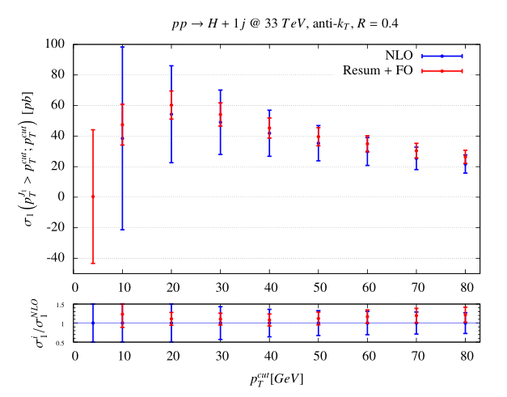
The Effects of Resummation ?
Cancel divergence
Decrease scale uncertanties
More accurate result--- and approximate higher fix-order prediction
LO
NLO
NNLO
NNNLO
$$σ=σ_{0}[1 +{ A_{1}α}_{s}L^{2} +A_{2}α_{s}^{2}{ L}^{4} +A_{3}α_{s}^{3} L^{6} + …$$
$+{ B}_{1}α_{s}L +{B_{2}α}_{s}^{2} L^{3} +B_{3}α_{s}^{3} L^{5} + …$
$+{ C_{1}α}_{s} +C_{2}α_{s}^{2}L^{2} +C_{3}α_{s}^{3}L^{4} + …$
$+ α_{s}^{2}L + α_{s}^{3}L^{3} + …$
$+{ α}_{s}^{2} +{ α}_{s}^{3}L^{2} +…$
$+ α_{s}^{3}L +… ]$
Resummation
LL
NLL
NNLL
NNNLL
…
Approximate NNLO
Fixed order
R. Boughezal, et.al. PRD.90.053001 (2014)
Notes:
Then, what is the effect of resummation?
First, it can cancel divergence like we said just now.
Second, it decrease the scale uncertanties. In the right figure, we can see the uncertanties of the resummation is much smaller than NLO results.
Third, the resummation result provide more accurate results. And we have NLO+NNLL resummation, we have already predicted the A2 B2 C2 coefficients, so when we discard the remnant terms. We can get approximate NNLO prediction.

Slide 16
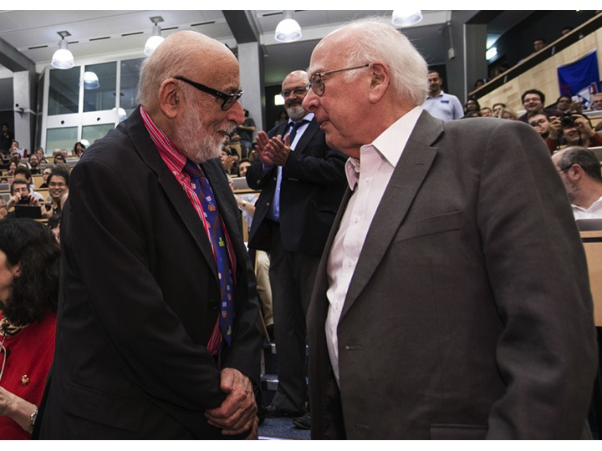
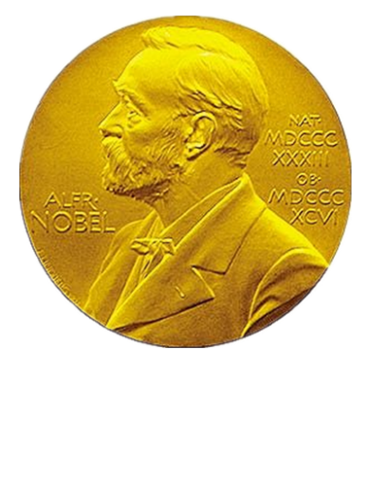
Standard Model (SM)
2013
Notes:
Then we turn to the gauge boson pair production. We all know that SM are confirmed when 2013 Englert and Higgs won Noble Price.

Slide 17
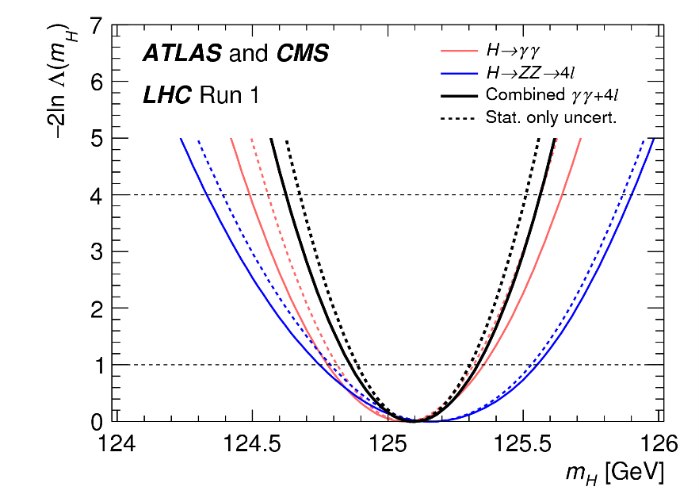
Higgs Boson
$m_{H}$ = 125.09$±$0.21 (stat.)$±$0.11(syst.) GeV
PRL 114, 191803 (2015)
Notes:
It is very hard to find Higgs boson, the signal cross section is very small, and the background is very complex.
You are the expert. So I donot talk too much about it.
The newest mass of the Higgs boson is 1 hundred and twenty five.

Slide 18
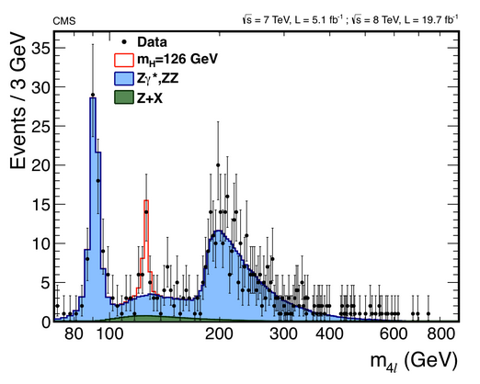
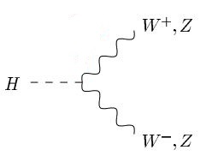
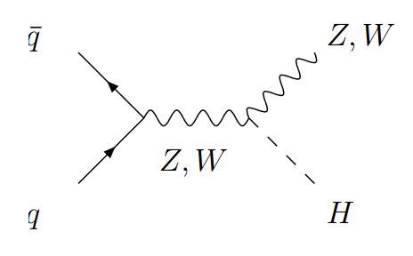
Irreducible Background
Irreducible background for Higgs boson, models such as Supersymmetry and extended Higgs sectors and so on.
Notes:
When searching for the Higgs, the gauge boson pair is the irreducible background. At the same time, if we want to search other heavy New physics particles, we also need to consider gauge boson pair as background.

Slide 19
SM diboson production
W/
W/
W/
W/
Notes:
In SM, diboson production can produce by first three diagram. At the NLO, there is also contributions from gluon initial state.

Slide 20
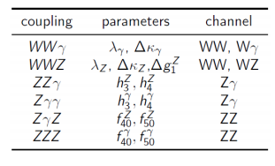
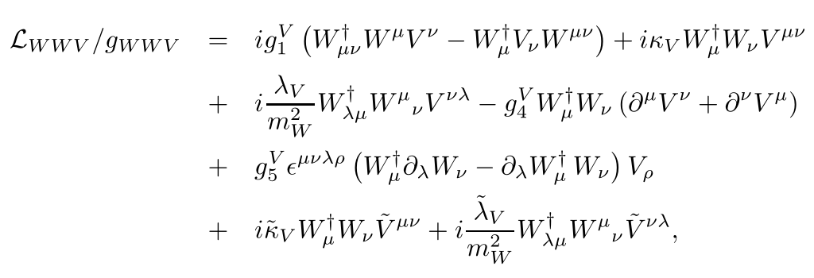
Testing Standard Model (TGCs)
TGCs ---- fundamental predictions of the non-Abelian SU(2)×U(1) gauge structure of electroweak theory.
In SM, no neutral TGCs vertex at LO.
Charged TGCs vertex at LO are only
$λ_{γ}=λ_{Z}=0$
$g_{Z}^{1}=κ_{γ}=κ_{Z}=1$
G. J. Gounaris, et. al. Phys. Rev. D 62, 073013 (2000).
K. Hagiwara, et. Al. NPB 282 253 (1987).
Notes:
We can also use gauge boson pair to test SM and tri-gauge boson couplings.
We use high-dimension effective operator as I collected here. In SM, there is no neutral TGC vertex at LO, the charged TGC vertex is very simple.
So if we find some excess between the experiment and the SM theory, we can fit the experimental data with the coupling of effective operator.

Slide 21
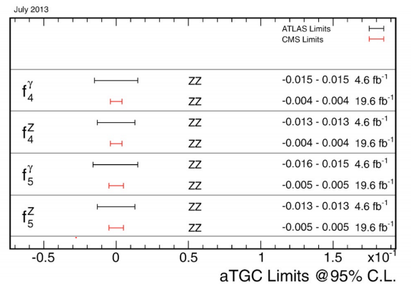
Testing Standard Model
At the one-loop level, fermion
triangles generate nTGCs : ${10}^{−4}$,
G. J. Gounaris, et. al. PRD 62, 073013 (2000).
Many new physics models predict
values of nTGCs :${10}^{−4}$ ~ ${10}^{−3}$.
J. Ellison and J.Wudka, Annu. Rev. Nucl. Part.
Sci. 48,33 (1998).
interesting region
Notes:
At present at the LHC, the precision of the experiment has almost reach the same level as the LEP， which is about ten to the minus 2 or minus 3.
And the QCD NLO correction and the New physics effects also give an increment of order ten to minus 3 or minus four. So the experiment reach an interesting region.

Slide 22
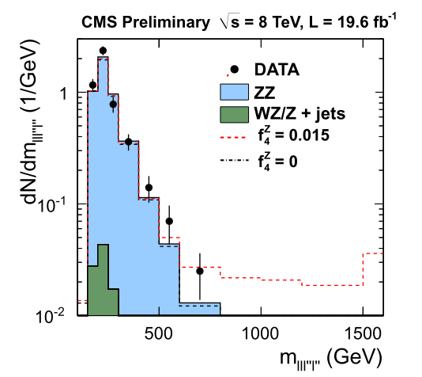
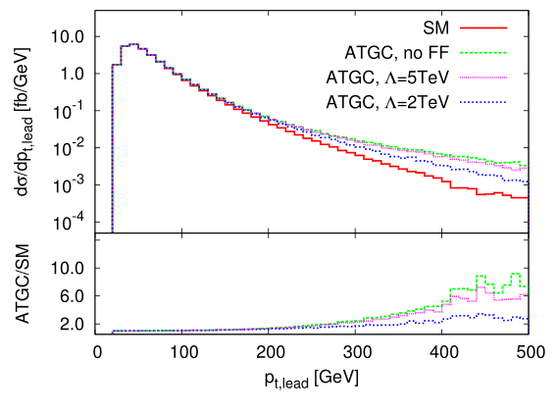
The Effects of aTGCs
T. Melia et.al. arXiv: 1107.5051 [hep-ph]
aTGC effects: often increase cross sections at high invariant mass ($M_{VV}$) and its proxies ($p_{T}$)
U. Baur et. al. PRD 53, 1098 (1996)
Notes:
And we can distinguish the effects from the SM QCD high order correction from the New physics by the experiments now.
Because the manifestation of them are different. The anomalous TGC vertex often increase cross sections at high invariant mass ($M_{VV}$) and high $p_{T}$ region.
QCD effect often affect small pt or peak of the invariant mass.

Slide 23
The theoretical predictions Gauge Boson Pair Production
Beyond QCD NLO
G. Chachamis, M. Czakon, and D. Eiras, JHEP 12 (2008) 003.
F. Campanario and S. Sapeta, Phys. Lett. B 718, 100 (2012).
M. Grazzini, JHEP 01, 15 (2006)
R. Frederix, M. Grazzini, PLB 662, 353 (2008)
S. Dawson, I.M. Lewis, and M. Zeng, Phys. Rev. D 88, 054028 (2013).
P. Meade, H. Ramani, and M. Zeng, Phys. Rev. D 90, 114006 (2014)
QCD NNLO
WW production: T. Gehrmann, et al., Phys.Rev.Lett. 113, 212001 (2014)
ZZ production: F. Cascioli, et al., Phys.Lett. B 735, 311 (2014)
Notes:
high order QCD calculation of the gauge boson pair has been pursued for a long time.
The QCD NLO has been combined into MCFM package.
And beyond QCD NLO, there are some paper discussing resummation effects and approximate NNLO in some limits, such as in high transverse momentum or infinite mass approximation.
And the QCD NNLO results are published in the last year. WZ results are not been reported yet.

Slide 24
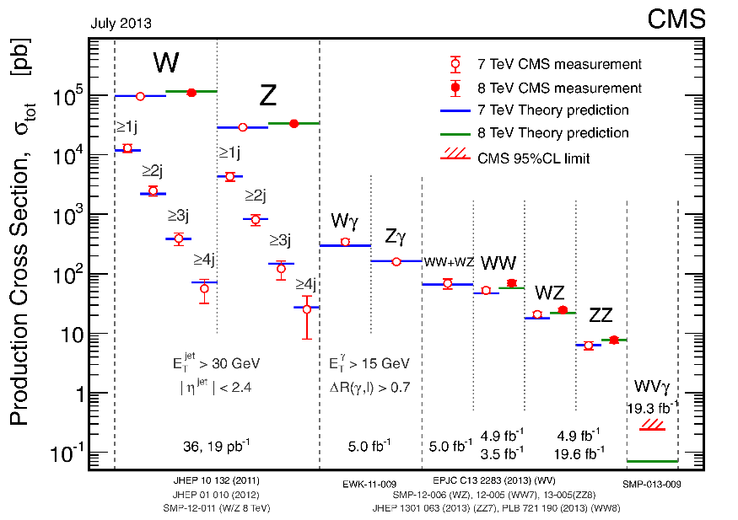
Total Cross Section in 2013
S. Dawson, et. al, PRD 88, 054028 (2013).
T. Gehrmann, et al., PRL. 113, 212001 (2014)
NLO | $54.7_{−1.0}^{+1.4}$ (pb)
NNLL | $57.3_{−1.6}^{+2.3}$ (pb)
NNLO | ${59.8}_{−1.1}^{+1.3}$ (pb)
Exp(CMS) | $69.9±2.8±5.6±3.1$ (pb)
Exp(ATLAS) | $71.4{{ _{−1.2−4.0−2.1}^{+1.2+5.0+2.2}}^{ }}^{ }$(pb)
$$σ_{WW}^{fiducial}$$
(MSTW2008 PDF)
P. Monn, G. Zanderighi 1410.4745
Notes:
So we can see the Table, the NLO results are calculated by MCFM,
The NNLL refers to the Dawson’s NNLL+NLO threshold resummation results, and
NNLO is Gehrmann’s NNLO paper,
all these results are calculated with MSTW2008 PDF.
We can see that the QCD high order effects only provide about 10% increment.
However, in 2013, the ATLAS and CMS collaboration both publish their measurement and found that the experimental data had exceeded the theoretical prediction a lot.
How does this happened? These authors found that if we only compare the fiducial cross section,
which means we only consider the WW decay to 4leptons with cuts for final leptons and without any jets, we don’t unfolded it into WW total cross sections, and there is no excess in the measurements compared to the NLO QCD predictions

Slide 25
How to measure in the experiment
$$σ_{WW}^{fiducial}=\frac{N_{data}−N_{bkg}}{C_{WW}×∫L dt}$$
$$σ_{WW}^{total}=\frac{σ_{WW}^{fiducial}}{A_{WW}×BR}$$
$C_{WW}$ Is the ratio of the number of events satisfying all offline selection criteria to the number of events produced in the fiducial phase space and is estimated from simulation
$A_{WW}$ Is the kinematic and geometric acceptance from the total phase space to the fiducial phase space
${BR}_{ }$ Is the branching ratio for both W bosons decaying into $eν$ or $μν$ (including decays through $τ$ leptons with additional neutrinos)
Notes:
What is the fiducial cross section? That is almost the cross section we measured directly in the experiment.
We have to divide Branch ratio and acceptance to get the total cross section.
A_WW represents the extrapolation from the fiducial phase space to the total phase space,
C_WW represents detector effects, such as lepton trigger and identification efficiencies
we know the Number is measured, the luminosity is established,
And from the comparison here, the C_WW is correct and BR is fixed.
So the discrepancy most likely result from A_WW.

Slide 26
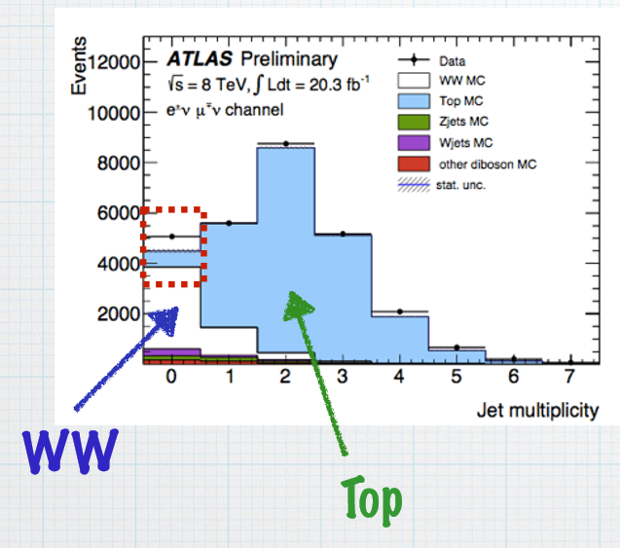
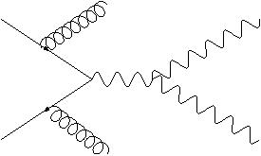
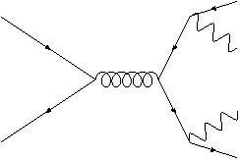
Jet Veto
$t\overline{t}$ production is an irreducible background with additional energetic jets to the VZ associated production at hadron colliders.
Required $p_{T}<p_{T,veto}$
$$b$$
$$W$$
To suppress the unwanted backgrounds ($t\overline{t}$), a jet veto procedure $p_{T,veto}∼30 GeV$ should be considered.
$$W$$
$$b$$
Notes:
How can such thing happened. I mean How can A_WW be wrong?
The main difference between a fiducial cross section and the total cross section is that fiducial cross section only consider the 4-lepton final states without any jets. It, actually, equivalent to the cross section for jet veto. And we don’t include the cross section for WW+1jet and WW+2jets and so on.
And we will introduce a scale, which is the veto scale of the transverse momentum of jets, which is often set at 25 GeV or 30 GeV.
Such technique is often used in the experiments, and the benefit is that it can reduce the background .
For Example, ttbar is the irreducible background for WW production,
but if we classify them by jet number, and we can see from the figure that the background of WW+0jet bin is very small, while it suffer a very large background in other bins.
We classify them though the scale of pt_veto, which means if the jet’s pt larger than pt_veto, we discard the events.

Slide 27
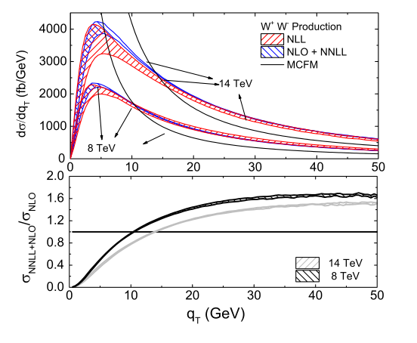
Transverse Momentum Distribution
extrapolate the measured fiducial cross section to total cross section
$$\frac{σ_{\exp{ }}^{veto}}{σ_{exp}^{total}} = \frac{σ_{theo}^{veto}}{σ_{theo}^{total}}$$
Veto efficiency:
simulated by software,
often POWHEG+PYTHIA
YW, Chong Sheng Li, Ze Long Liu, Ding Yu Shao and Hai Tao Li, Phys. Rev. D 88, 114017 (2013)
Notes:
we can extrapolate the measured fiducial cross section through data driven Monte Carlo (MC) acceptances to gain the inclusive cross section.
The method is if the experiment and theory are both correct, we will get the equation here.
The sigma_veto is measured in the experiments and what’s on the right can be simulated by MC generator.
So the sigma_total is what reported in the experiment paper And we believe the cuts for leptons and detector resolution will not affect the final conclusion.
Now we know that sigma_veto is the same with QCD NLO predictions, but sigma_total is larger than the prediction. So the problem is most likely happened on the right side, which is simulated by the software, and CMS and ATALS use POWHEG+PYTHIA here.
So in order to check whether the POWHEG give the right simulation, we study the NLO+NNLL resummaiton for the transverse momentum distribution for gauge boson pair. We calculated WW, WZ and ZZ case

Slide 28
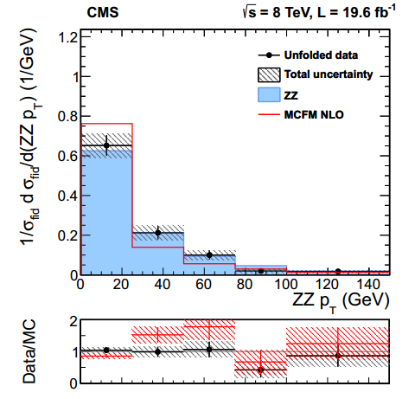
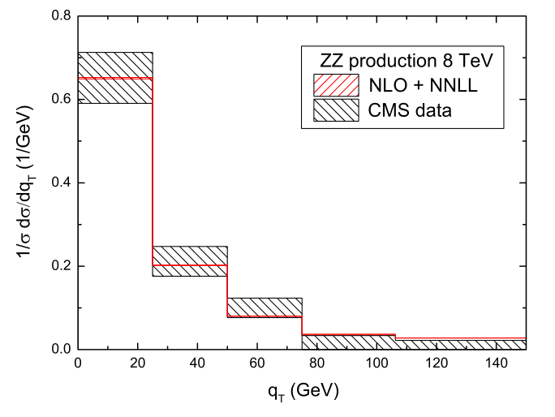
Transverse Momentum Distribution
YW, Chong Sheng Li, Ze Long Liu, Ding Yu Shao and Hai Tao Li, Phys. Rev. D 88, 114017 (2013)
$$σ_{exp}^{total}=\frac{σ_{\exp{ }}^{veto}}{\frac{σ_{veto}}{σ_{total}}}$$
Notes:
Then we will check whether POWHEG give the wrong prediction
However, at that time, there is no excess experiment for WW cross section. So we only compare the ZZ case in the paper.
But the situation for ZZ and WW is very similar. So we can have the same conclusion for them.
In this two figures, the first one is given by the experiment and the blue area is POWHEG+PYTHIA results, which is still a little different from the experimental data. The second one is our resummation results, which improve the POWHEG results and is completely agree with the experiment.
So we can find that the POWHEG results underestimate the sigma_veto, so give a larger total cross section.

Slide 29
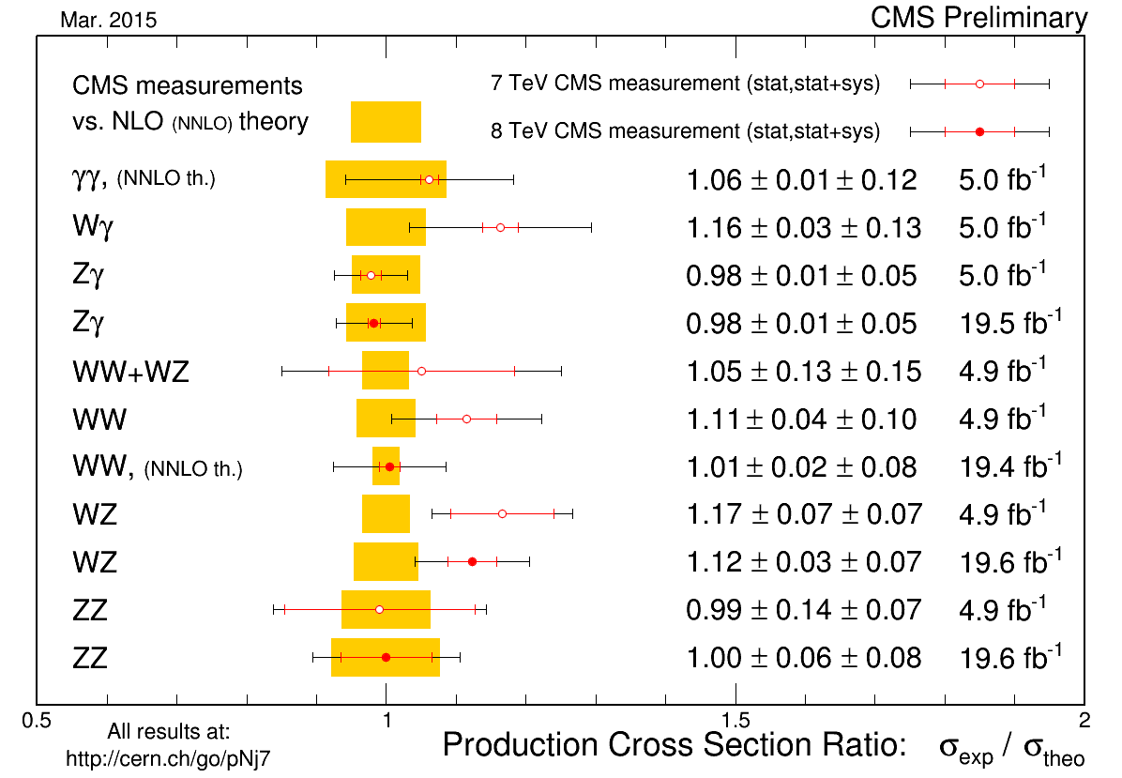
Total Cross Section in 2015
CMS PAS SMP-14-016
The simulated POWHEG events are reweighted by the NNLL transverse momentum resummation predictions.
Notes:
Then in this year, the CMS collaboration then use the NNLL transverse momentum resummation predictions to reweight the POWHEG results, and gain the new experimental total cross section, it decreases a lot compared to the former results, and is consistent with the NNLO predictions.

Slide 30
The Total Cross Section For WZ And ZZ Production
lumi.
exp.
NLO
The measurements for ZZ production is consistent with
NLO predictions, But $\frac{σ_{NNLO}}{σ_{NLO}}=1.12$ when √s=8 TeV
CMS PAS SMP-13-005
F. Cascioli, et al., PLB 735, 311 (2014)
There are about 2$σ$ discrepancies for WZ productions in the CMS measurements
CMS PAS SMP-12-006
Notes:
And there is also an excess in CMS experiment for WZ process. And the ATLAS results is consistent with NLO predictions. And for ZZ production, though measurements agree with NLO predictions, But the NNLO corrections for ZZ production increase the NLO result by 12% when √s=8 TeV. So we also need to check these two process.

Slide 31
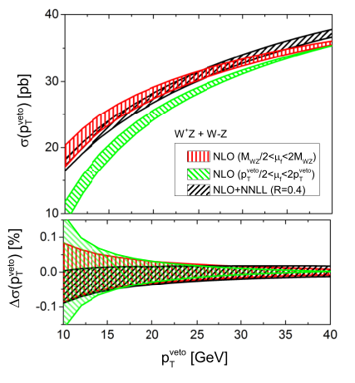
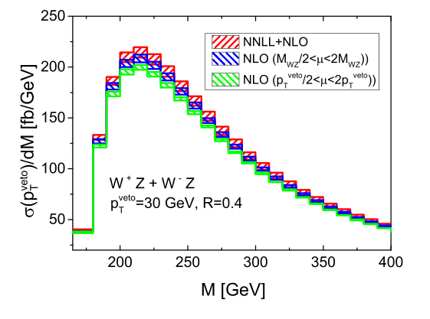
Resummed Prediction
WY, Chong Sheng Li, Ze Long Liu, arXiv:1504.00509 [hep-ph]
$$α_{s}^{n}{\ln^{k}({\frac{p_{T}^{veto}}{Q})}}^{ }$$
The comparison of the jet-veto NLO and jet-veto NLO+NNLL resummation
The invariant mass distributions
Notes:
This time we study the jet veto cross section in an analytical way, not integrate the pt distribution, but gain the jet-veto cross section directly. This is the logarithm we want to resumed.
At the beginning, I present some details.
First is the comparison of the NLO and NLO+NNLL resummation, including the jet-veto cross section and invariant mass distribution.
The variables will changed a lot if we consider the resummation.

Slide 32
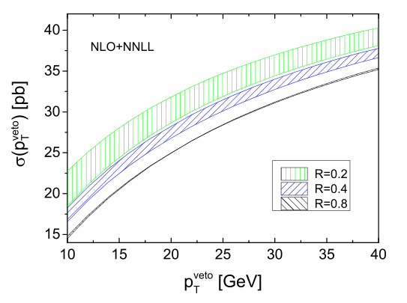
Resummed Prediction
The NLL and NNLL jet-veto with different jet veto $p_{T}^{veto}$
and jet radius R.
Notes:
Here is the Jet radius R, which has the form of this. So the cross section decrease when R become larger. And the uncertainties also goes down.
(Another thing I don’t show here is when center-of-mass energy increase the theoretical uncertainties also goes down, the tendency is more obvious than the NLO prediction.)

Slide 33
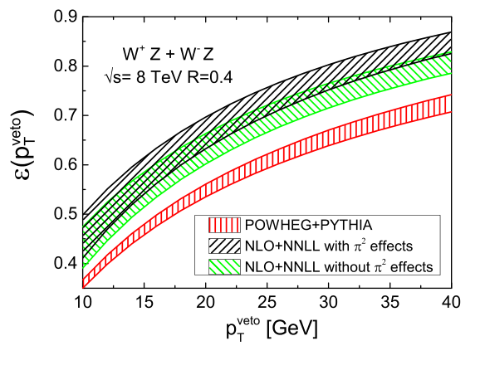
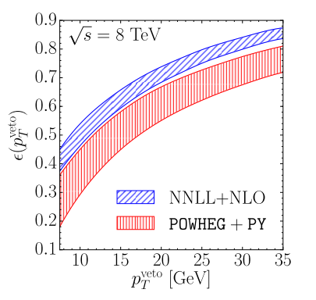
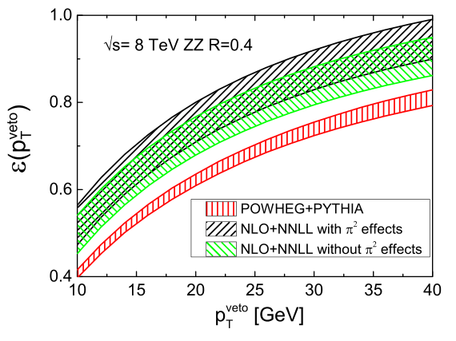
Compare With POWHEG+PYTHIA
$$ε=\frac{σ_{veto}}{σ_{total}}$$
P. Jaiswal, T. Okui, PRD.90.073009
WY, C-S. Li, Z-L. Liu, arXiv:1504.00509
Notes:
Here is main conclusion, in their paper and our works, we compare the jet-veto resummation results with POWHEG+PYTHIA and in the next page is comparison with aMC@NLO+PYTHIA. The y axis is the efficiencies which is defined as sigma_veto over sigma_total. For WW case, the POWHEG results is a little different because they use a different way to calculate the uncertainties , that is combine the uncertainties of 0jets and events larger than 1jets together. But the center value is almost at the same position with ours.

Slide 34
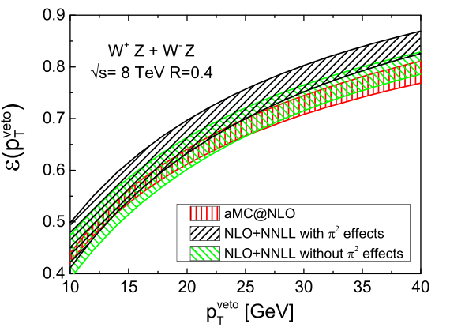
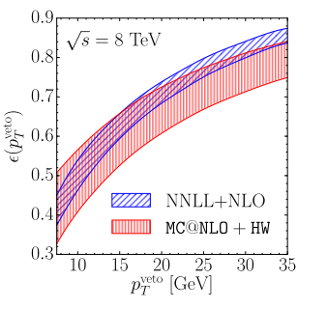
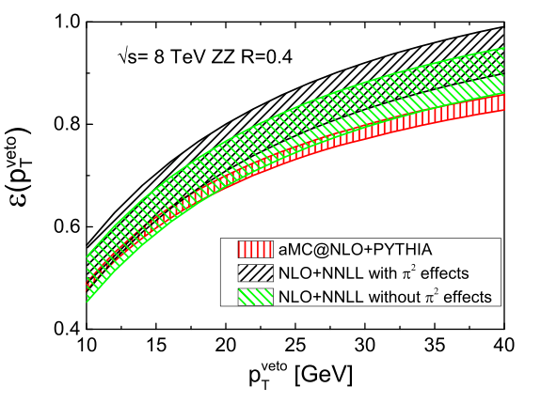
Compare With aMC@nlo+PYTHIA
Notes:
the POWHEG give a more lower efficiency. Not only compare to the NLO+NNLL resummation but also to the aMC@NLO. So it give a much higher cross section in the experiments.

Slide 35
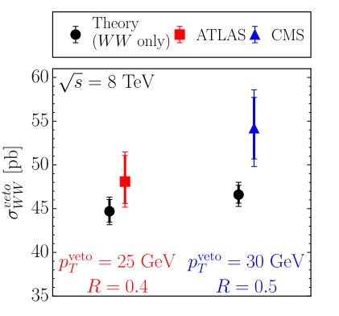
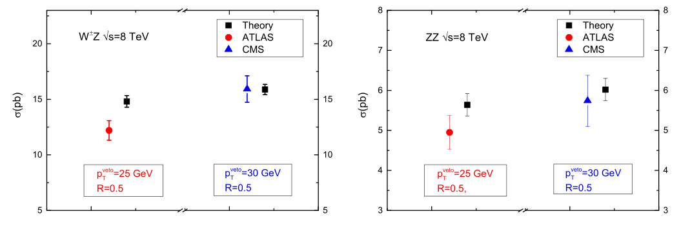
Compare With Exp.
$$σ_{\exp{ }}^{veto}=σ_{exp}^{total}×ε$$
Notes:
If we only compare the experiment veto cross section with our prediction, We will find they are more consistent than before.
There is some discrepancy, like for WW production, however in CMS newest report, they use their own analysis to make the measurement agree with NNLO, as stated before. For WZ ATLAS result, there maybe also the same things happened.

Slide 36
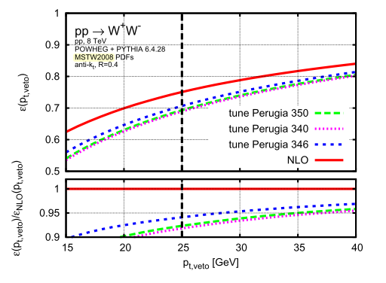
Tunes in POWHEG+PYTHIA
P. Monn, G. Zanderighi arXiv:1410.4745
Notes:
Because we use the default setting in POWHEG+PYTHIA, in this paper they said there at least 3 to 5 percent difference when choosing different parameters.

Slide 37
CONCLUSION
NLO + NNLL jet-veto resummation for gauge boson pair
POWHEG+PYTHIA underestimate NLO cross section
Reweight the cross section
Notes:
What can enlighten us is that high order correction is important not for the theoretical consideration, but for experimental measurement at least in this case, And the effects for high order correction should be considered process-by-process and observable-by-observables. At least, threshold resummation and resummation for jet final states are important at CEPC. I can’t make a assertion now.

Slide 39
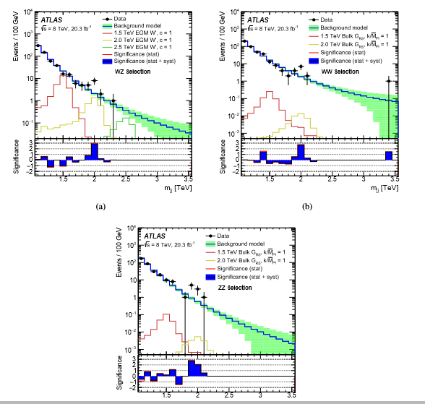

Slide 40
Notes:
They use a model to fits the dijet mass distributions backgrou.d

