Slide 1
Parameter study and IR design for CEPC local double ring scheme
Dou Wang, Jie Gao, Feng Su, Yuan Zhang, Ming Xiao, Yiwei Wang, Zhe Duan, Bai Sha, Tianjian Bian
CEPC AP meeting, 20151023

Slide 2
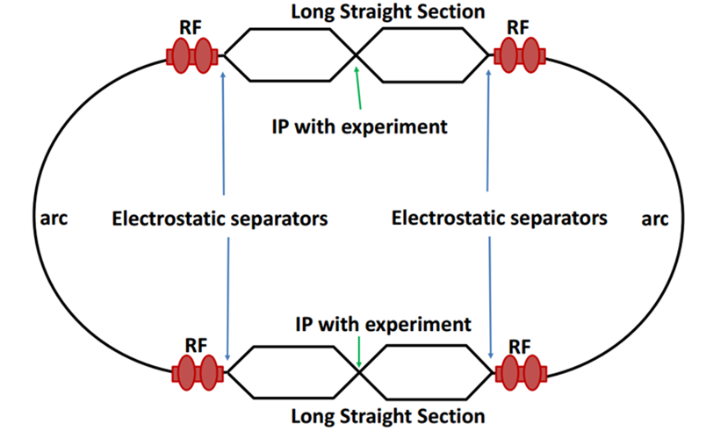
Machine constraints / given parameters
Energy E₀
Circumference C₀
N_{IP}
Beam power P₀
β_{y}*
R=σy/σx
Emittance coupling factor κ_{ε}
Bending radius ρ
Piwinski angle Φ
luminosity enhancement by crab waist F_{l} ~1.5
Energy acceptance (DA)
Phase advance per cell (FODO)
A=δ₀/δ_{BS} (A>~3)

Slide 3
Parameter choice – step 1
Beam-beam limit:
F_{l}: luminosity enhancement by crab waist
*J. Gao, emittance growth and beam lifetime limitations due to beam-beam effects in e+e- storage rings, Nucl. Instr. and methods A533（2004）p. 270-274.

Slide 4
Parameter choice – step 2

Slide 5
Parameter choice – step 3
BS life time: 30 min
ξy:
μ-- phase advance/cell, ϕ-- bending angle/cell.
Estimate :

Slide 6
Parameter choice – step 4

Slide 7
Parameter choice – step 5
Effective bunch length: overlap area of colliding bunches
Hour glass effect:

Slide 8
Parameter choice – step 6
V_{rf} , φ_{s}
Energy acceptance from RF:

Slide 9
Parameter choice – step 7
Beam lifetime due to radiative Bhabha scattering
Beam lifetime due to Beamstrahlung
*V.I. Telnov, "Issues with current designs for e+e- and gammagamma colliders“, PoS Photon2013 (2013) 070. https://inspirehep.net/record/1298149/files/Photon%202013_070.pdf

Slide 10
Primary parameter design
 | Pre-CDR | Local double ring（crab waist）
Number of IPs | 2 | 2
Energy (GeV) | 120 | 120
Circumference (km) | 54 | 54
SR loss/turn (GeV) | 3.1 | 2.96
Half crossing angle (mrad) | 0 | 13
Piwinski angle | 0 | 2
N_{e}/bunch (10¹¹) | 3.79 | 3.75
Bunch number | 50 | 50
Beam current (mA) | 16.6 | 16.9
SR power /beam (MW) | 51.7 | 50
Bending radius (km) | 6.1 | 6.2
Momentum compaction (10⁻⁵) | 3.4 | 3.1
β_{IP} x/y (m) | 0.8/0.0012 | 0.265/0.0012
Emittance x/y (nm) | 6.12/0.018 | 3.55/0.01
Transverse σ_{IP} (um) | 69.97/0.15 | 30.7/0.11
ξ_{x}/IP | 0.118 | 0.04
ξ_{y}/IP | 0.083 | 0.11
V_{RF} (GV) | 6.87 | 3.6
f _{RF} (MHz) | 650 | 650
Nature σ_{z} (mm) | 2.14 | 3.5
Total σ_{z} (mm) | 2.65 | 4.7
Energy spread (%) | 0.13 | 0.13
Energy acceptance (%) | 2 | 2
Energy acceptance by RF (%) | 6 | 2
n_{γ} | 0.23 | 0.5
Life time due to beamstrahlung_cal (minute) | 47 | 77
F (hour glass) | 0.68 | 0.71
L_{max}/IP (10³⁴cm⁻²s⁻¹) | 2.04 | 2.91

Slide 11
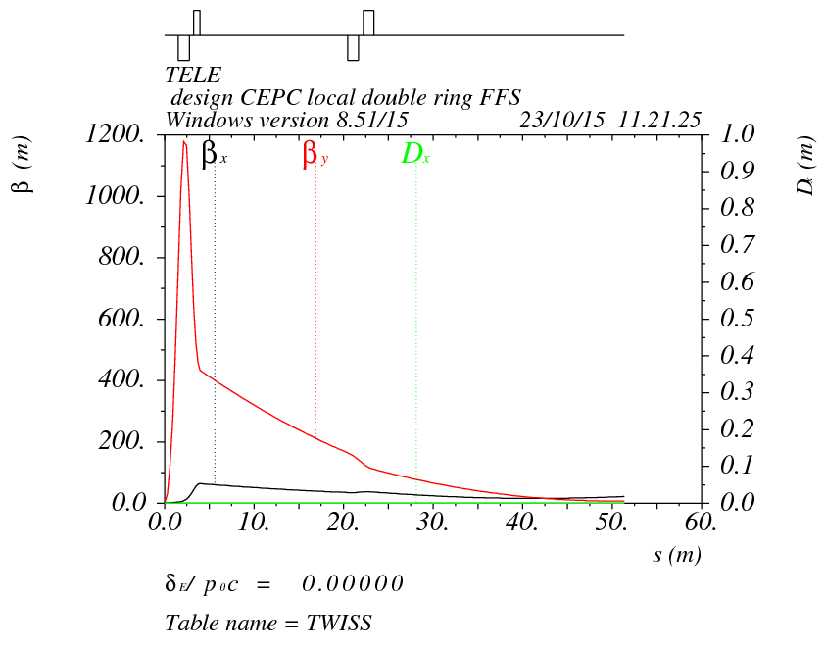
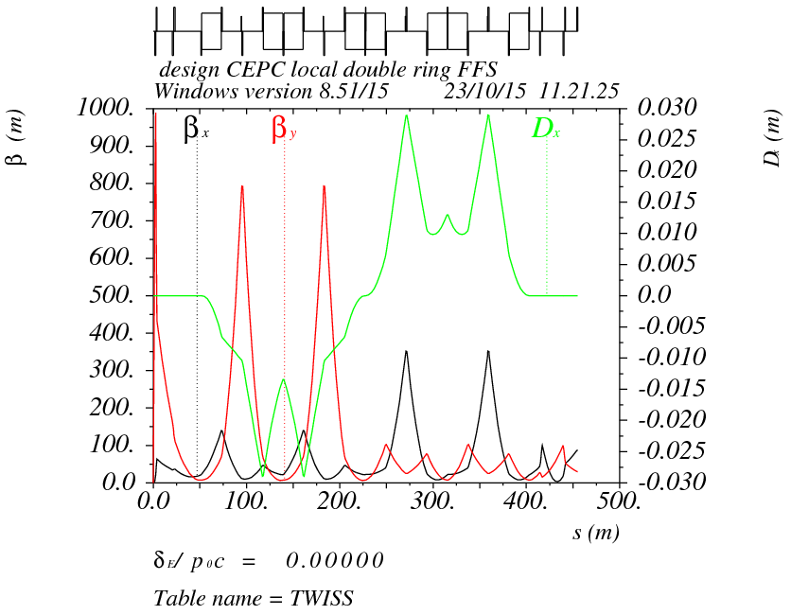
Double ring FFS design
Final transformer telescope
Ec=110 keV
Betax=0.8m
Betay=0.003m

Slide 12
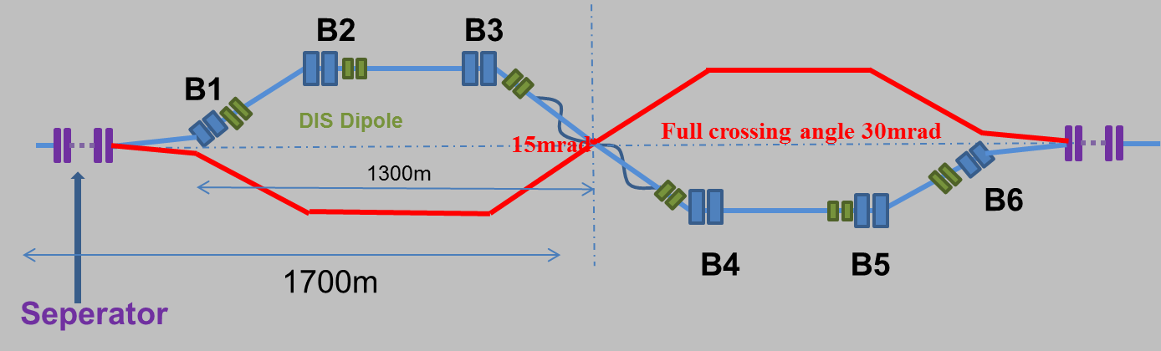
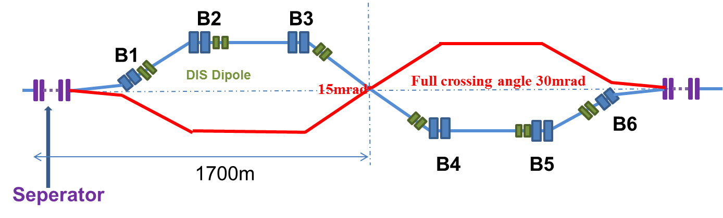

Combine with local double ring lattice
Choice 1
Choice 2

Slide 13
summary
A consistent calculation method for CEPC parameter choice with carb waist scheme has been created.
The first edition of carb waist parameter was shown. We got larger luminosity with this parameter. L=2.91*10³⁴cm⁻²s⁻¹/IP
The key differences compared with Pre-CDR parameters are:
half crossing angle: 13 mrad (Pinwinski Φ=2)
emittance: 3.55 nm
beam-beam limit ξy: 0.11
bunch length(nature): 3.5 mm
RF voltage: 3.6 GV
Two crab sextupoles should be designed soon.
Local double ring lattice and IR design are ready. Next step: connect two part to make a whole ring.

