Slide 1

CEPC Partial Double Ring
Lattice
SU Feng WANG Dou XIAO Ming GAO Jie
GENG Huiping XU Gang DUAN Zhe
BAI Sha BIAN Tianjinan
Key Laboratory of Particle Acceleration Physics and Technology
Institute of High Energy Physics
Chinese Academy of Sciences
2015.10.23

Slide 2
Outline
Layout
Orbit
Parameter
Next to do

Slide 3
CEPC Partial Double Ring Layout
RF
IP1_ee
RF
3Km
1/2RF
1/2RF
IP4_pp
IP2_pp
1/2RF
1/2RF
C=54710.4m
RF
IP1_ee/IP3_ee, 3Km
IP2_pp/IP4_pp, 1132.8m
4Straights, 849.6m
4Long ARC, 120*FODO, 5852.8m
4Short ARC, 100*FODO, 4908.8m
IP3_ee
RF
SU Feng
2015.10.12

Slide 4
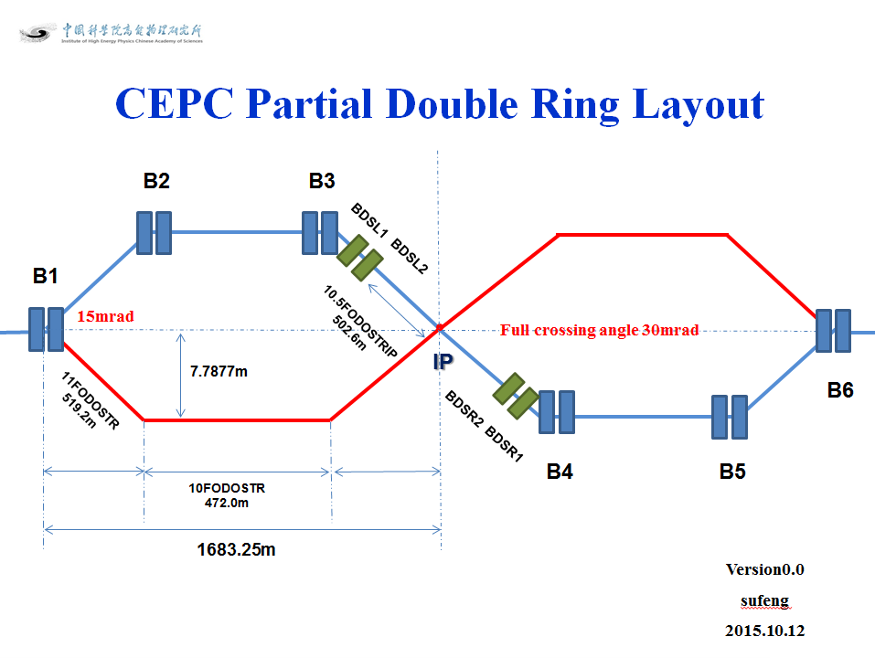
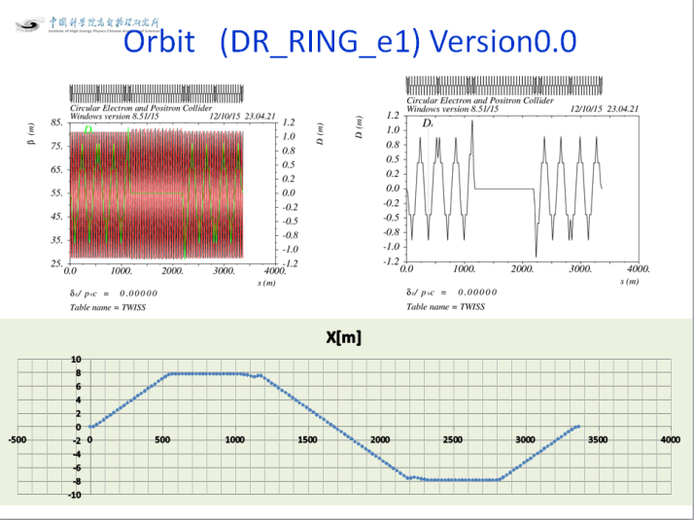
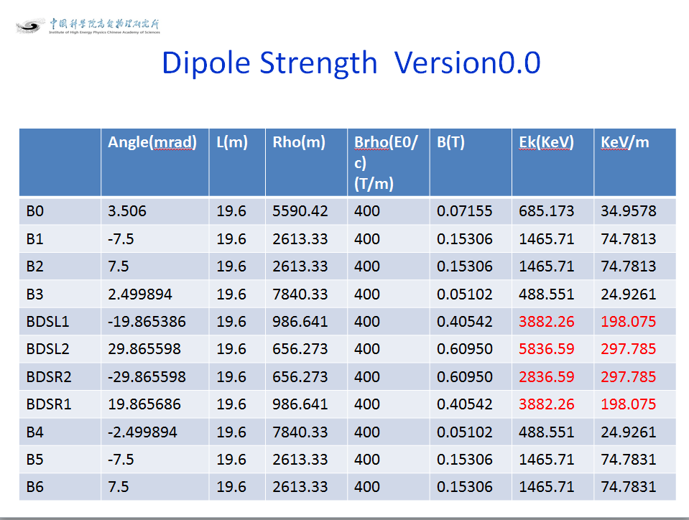
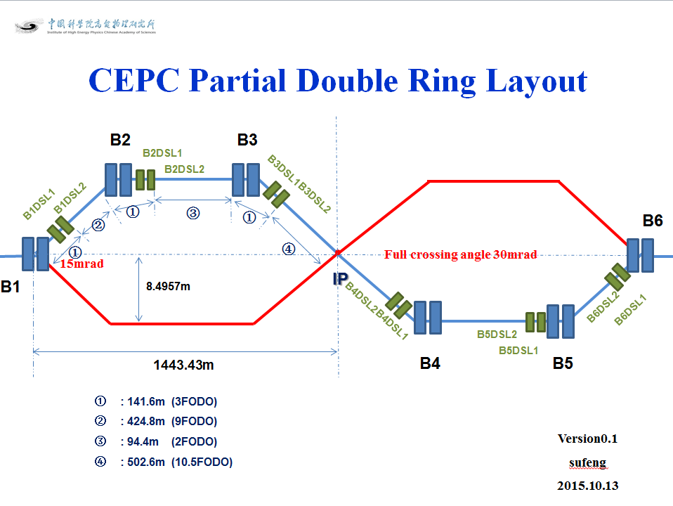
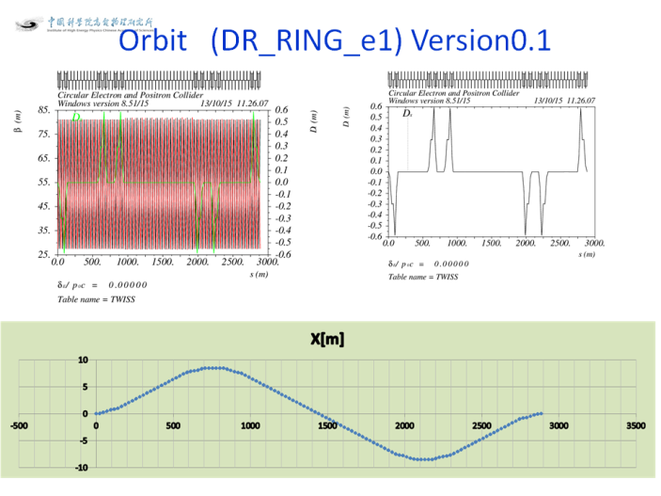
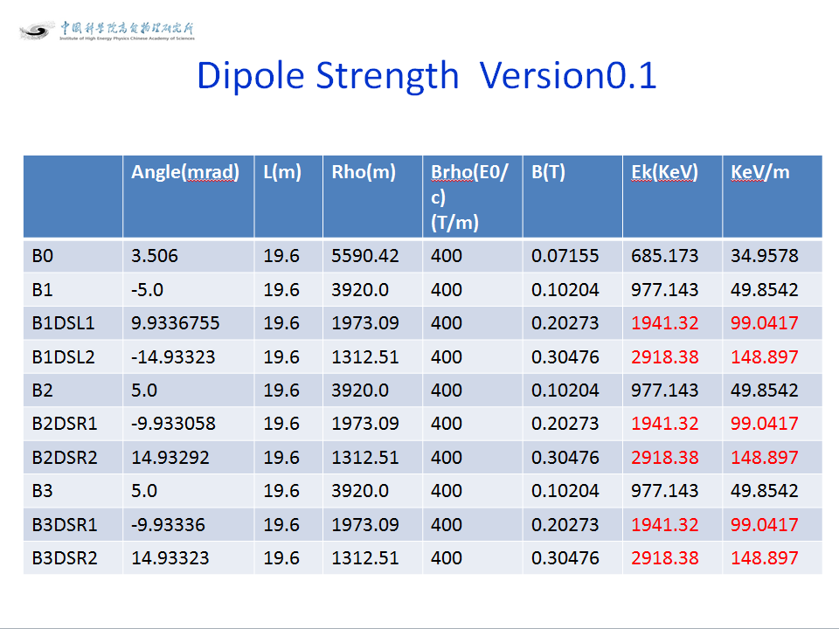
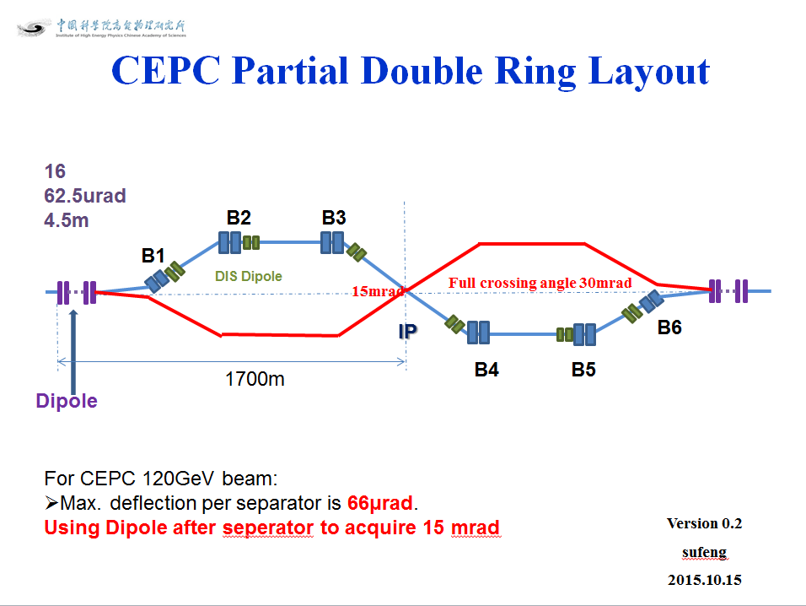
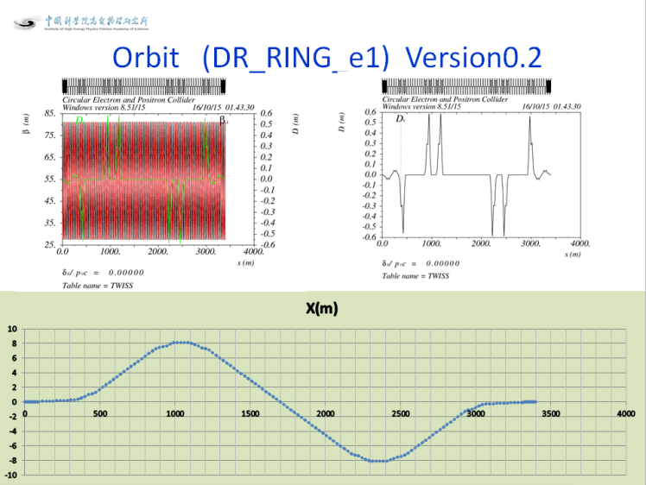
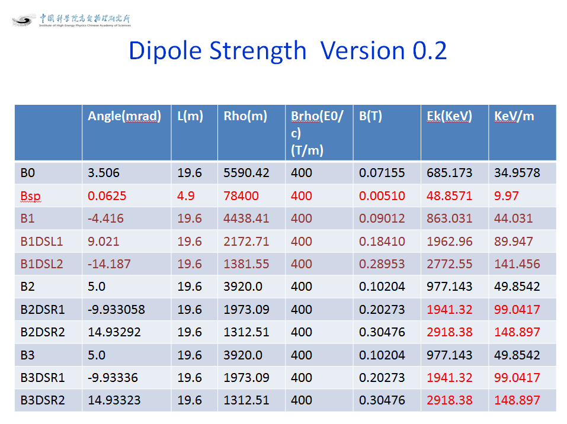

Slide 5
CEPC Partial Double Ring Layout
16
62.5urad
4.5m
B2
B3
B1
614.4m
462.1m
111.03m
256m
307.2m
Full crossing angle 30mrad
15mrad
8.852m
IP
B6
Dipole
2000.6m
B4
B5
Version 0.3
sufeng
2015.10.20
For CEPC 120GeV beam:
Max. deflection per separator is 66μrad.
Using Dipole after seperator to acquire 15 mrad

Slide 6
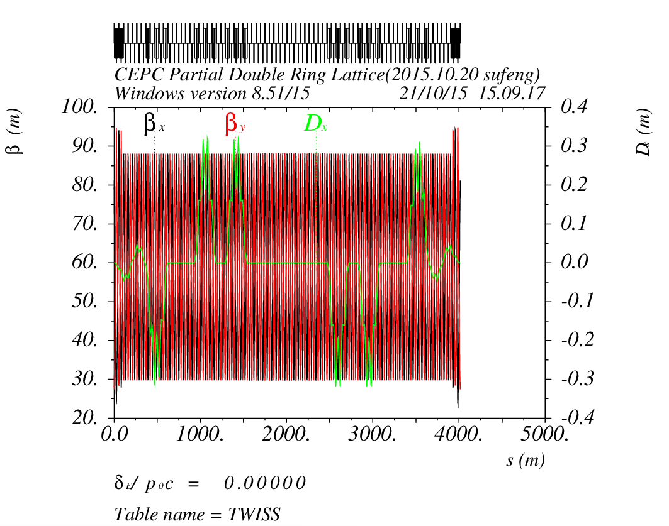
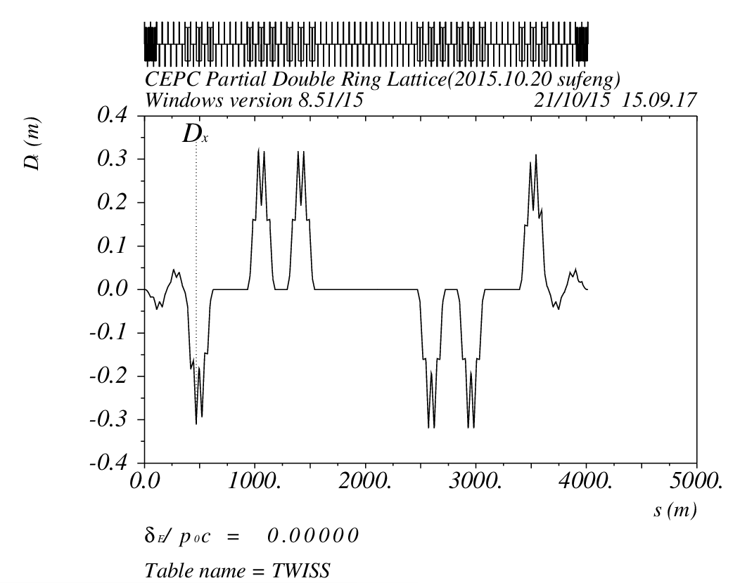
Orbit (DR_RING_e1) Version0.3

Slide 7
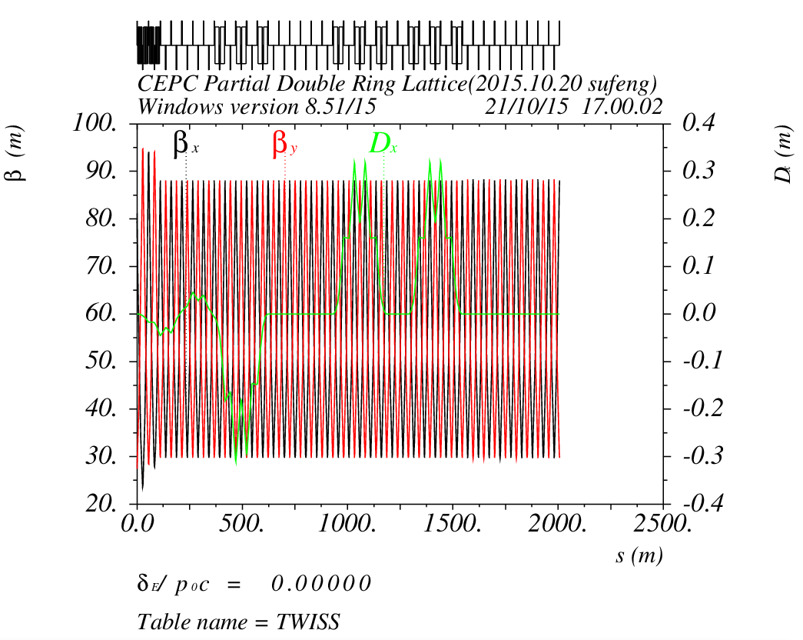
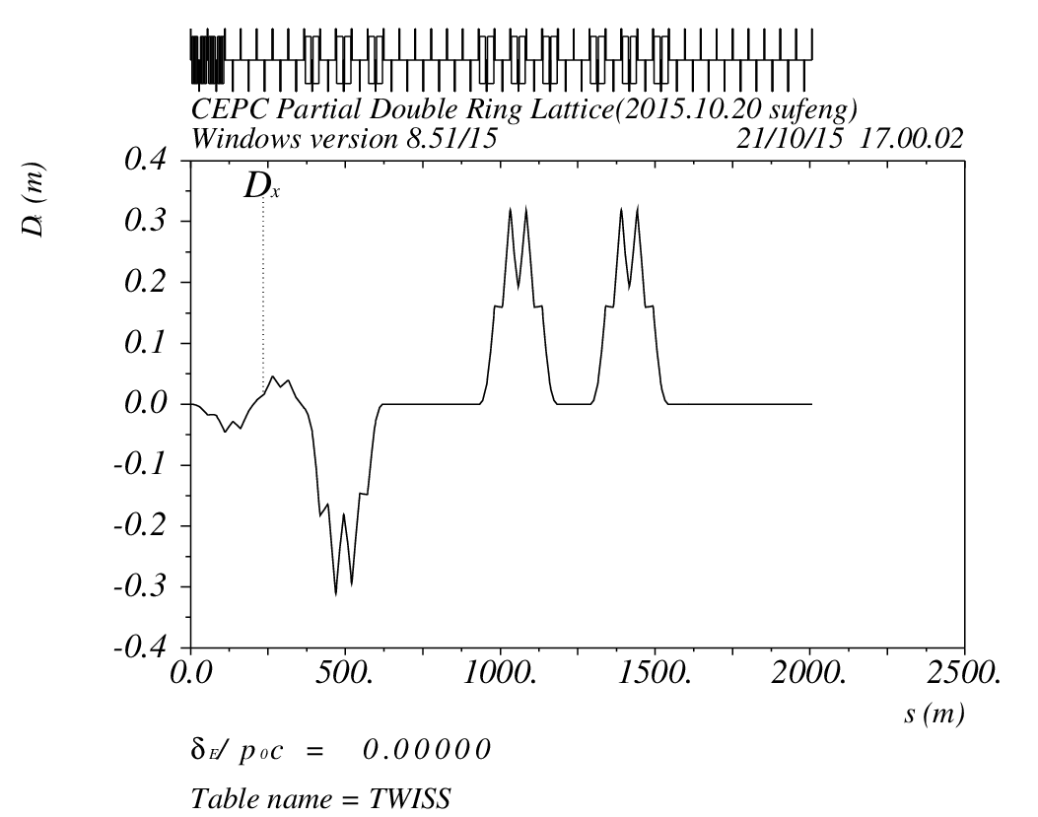
Orbit (DR_RING_e1L) Version 0.3

Slide 8
Dipole Strength Version 0.3
 | Angle(mrad) | L(m) | Rho(m) | Brho(E0/c) (T/m) | B(T) | Ek(KeV)
B0 | 3.506 | 19.6 | 5590.42 | 400 | 0.07155 | 685.173
Bsp | 0.0625 | 4.9 | 78400 | 400 | 0.00510 | 48.8571
B1a | 2.13 | 19.6 | 9201.88 | 400 | 0.04347 | 416.263
B1b | 2.57 | 19.6 | 7626.46 | 400 | 0.05245 | 502.251
B1c | 2.30 | 19.6 | 8521.74 | 400 | 0.04694 | 449.486
B2 | 2.5 | 19.6 | 7840 | 400 | 0.05102 | 488.571
B3 | 2.5 | 19.6 | 7840 | 400 | 0.05102 | 488.571

Slide 9
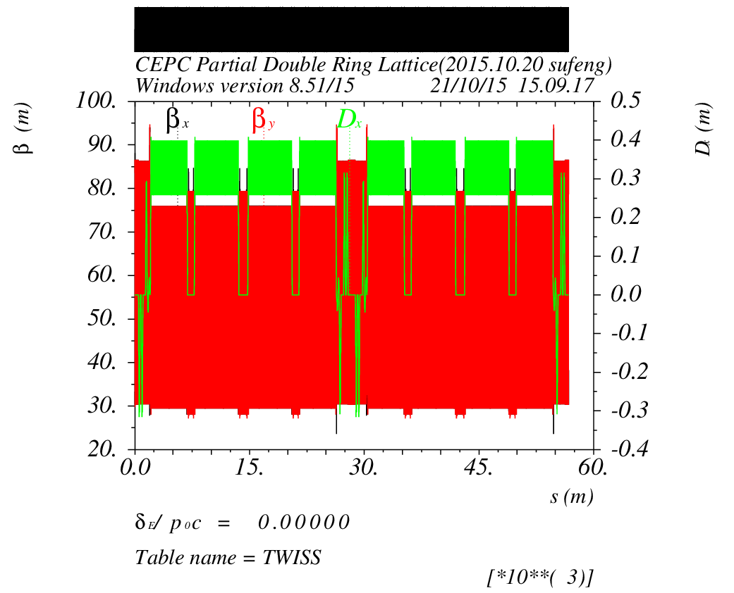
Survey & Dynamic Aperture （Version 0.3）

Slide 10
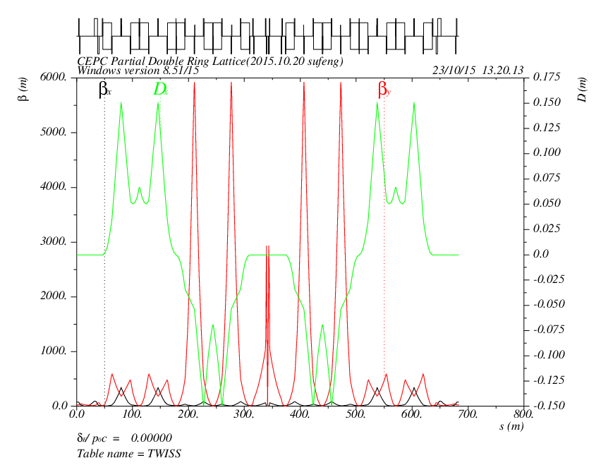
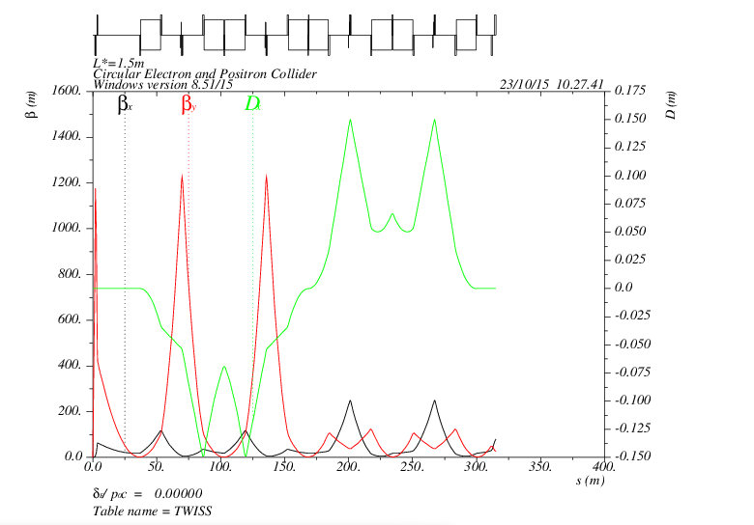
Version 0.3 + FFS
L=340m
L*=1.5m
Betax=0.03m
Betay=0.8m

Slide 11
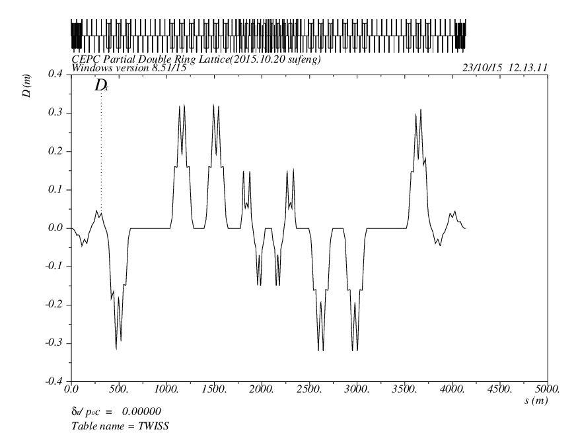
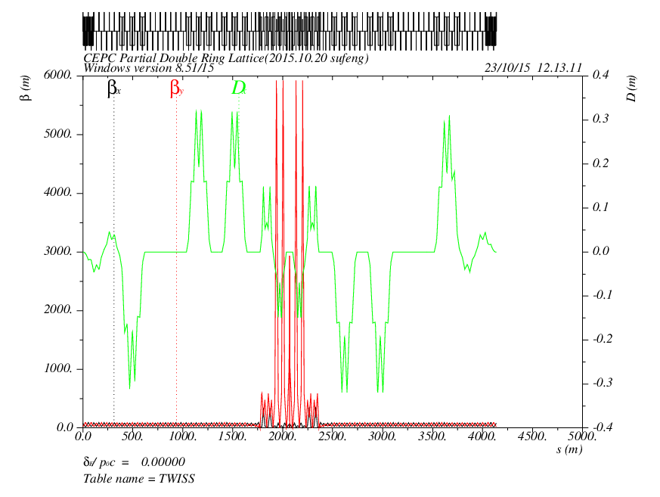
Version 0.3 + FFS
?

Slide 12
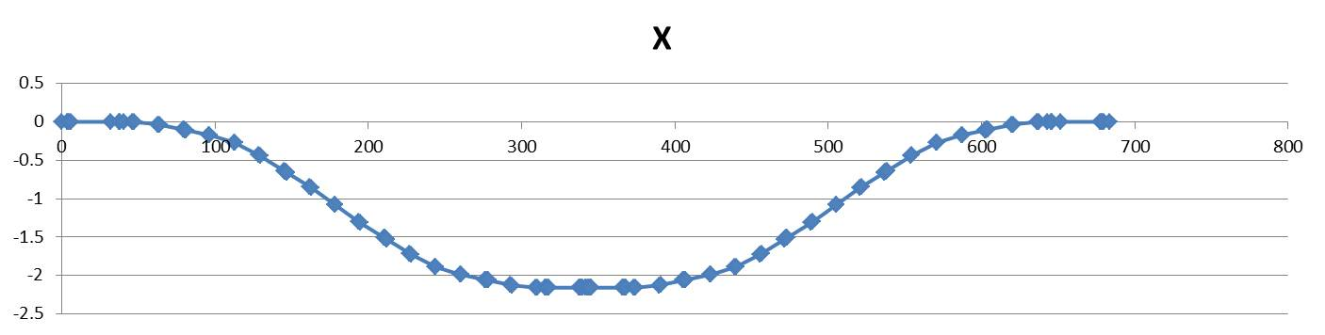

Slide 13
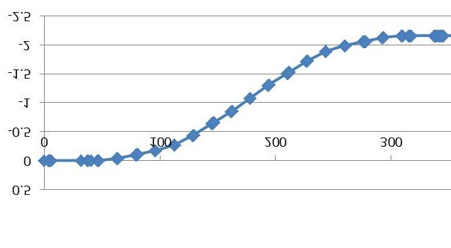
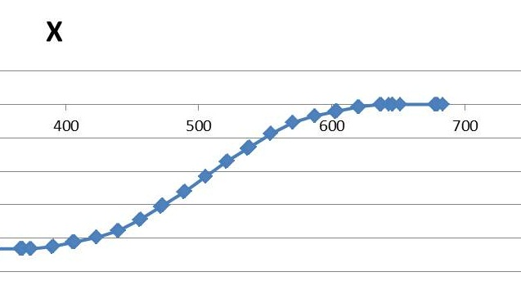

Slide 14
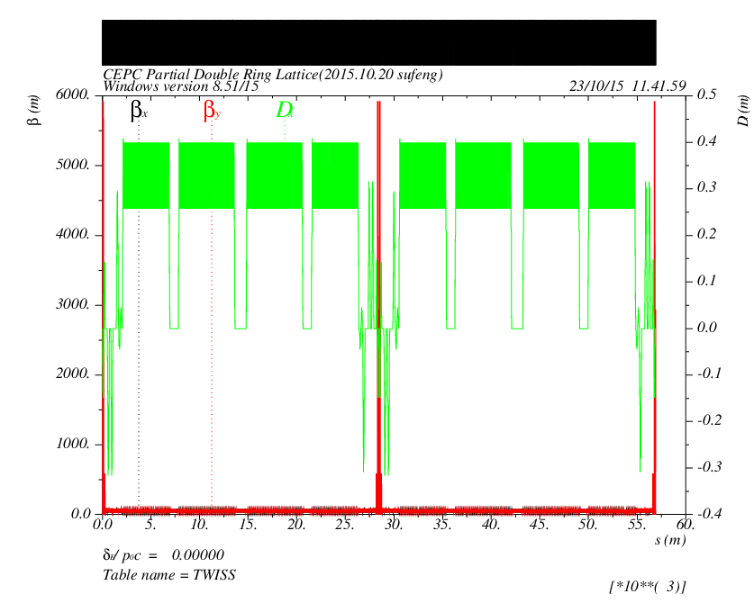
Survey & Dynamic Aperture （Version 0.3 +FFS）
DA?

Slide 15
CEPC Partial Double Ring Layout
16
62.5urad
4.5m
B2
B3
B1
614.4m
462.1m
111.03m
256m
307.2m
Full crossing angle 30mrad
15mrad
8.852m
IP
B6
seperator
2000.6m
B4
B5
Version 0.4
sufeng
2015.10.21
For CEPC 120GeV beam:
Max. deflection per separator is 66μrad.
Using Dipole after seperator to acquire 15 mrad

Slide 16
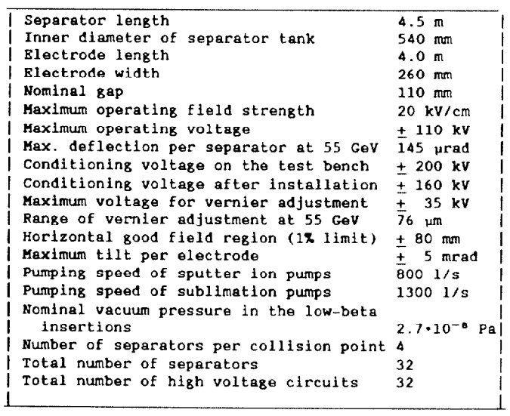
Electrostatic Separator in LEP
L=4.5m
Lelectrode=4.0m
Efield=2MV/m
E=55GeV
Angle=145urad

Slide 17
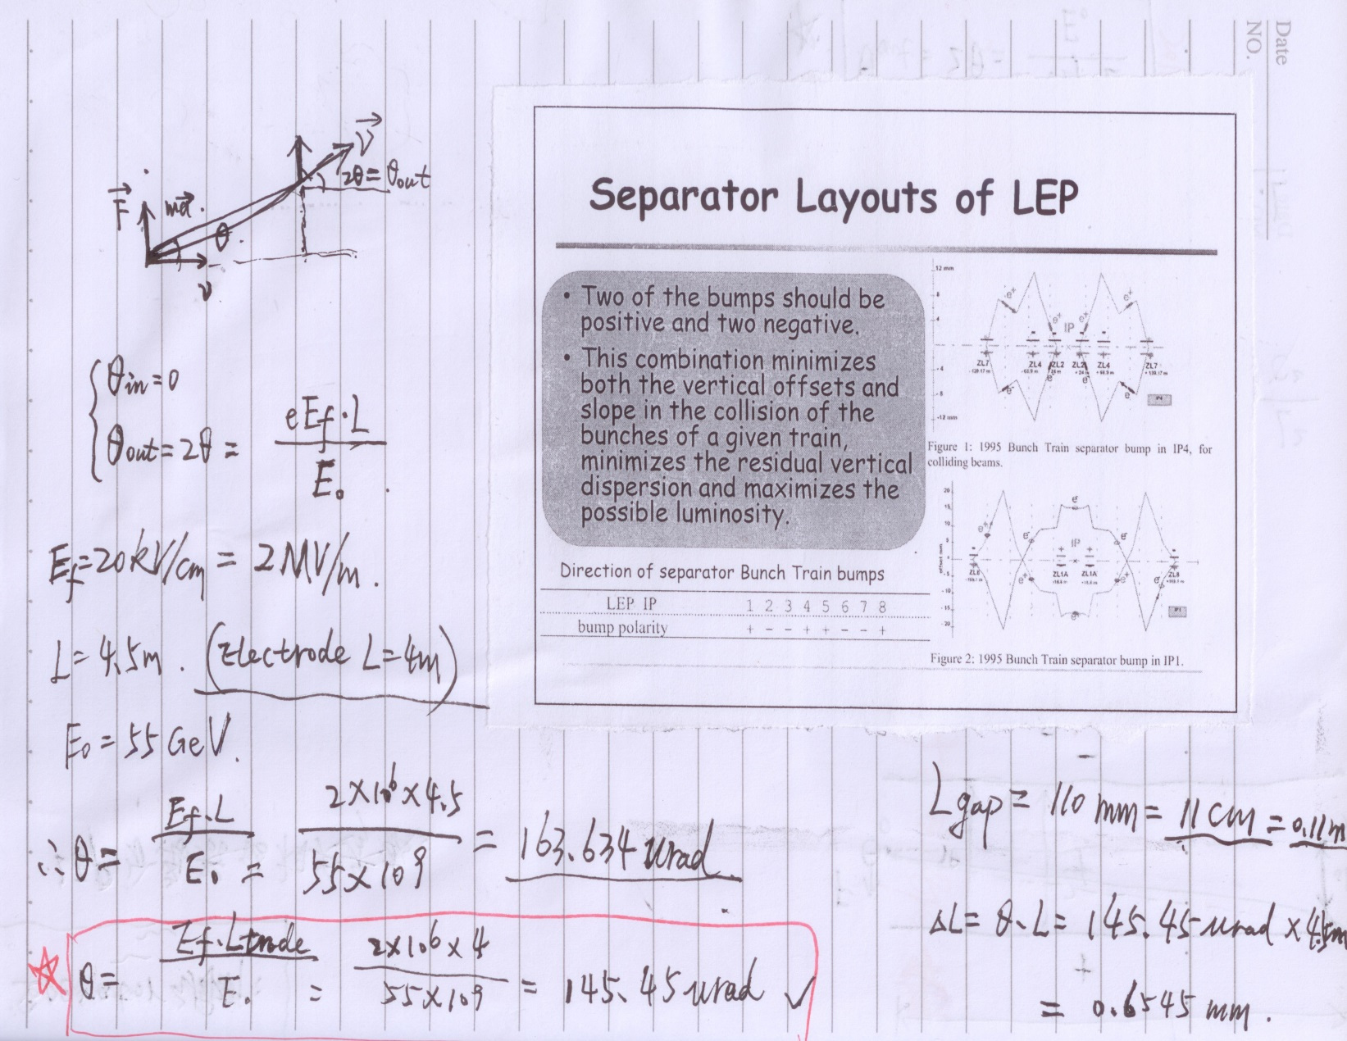
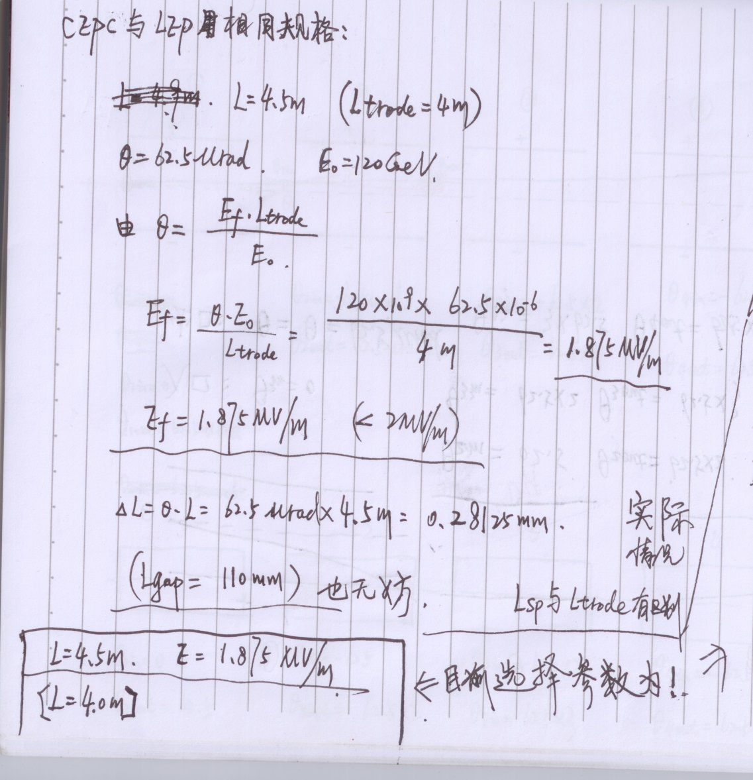
Electrostatic Separator

Slide 18
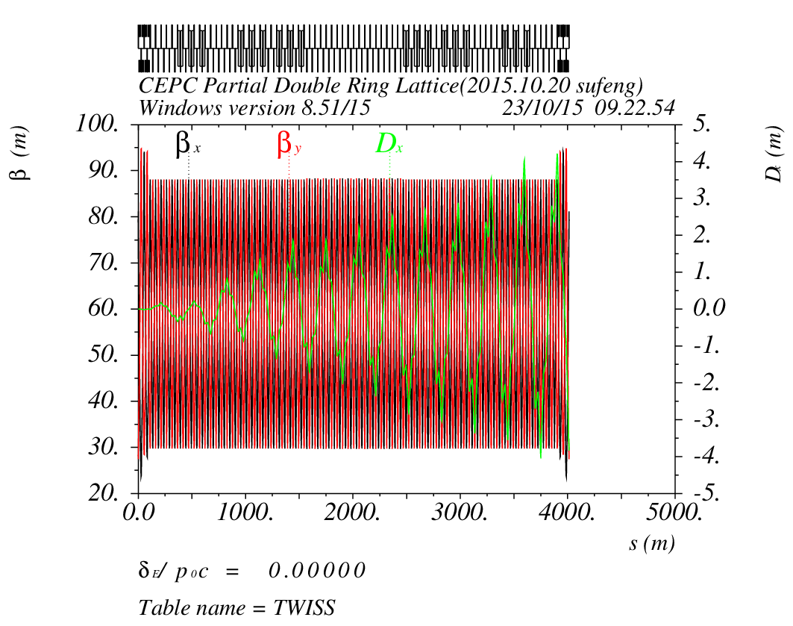
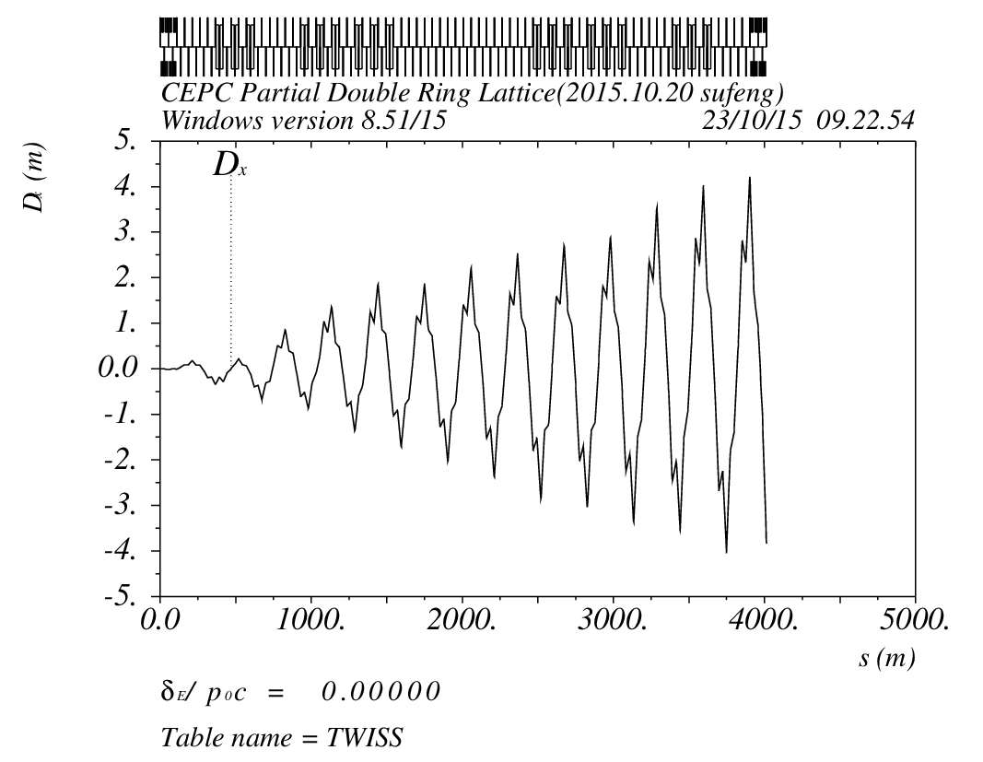
Orbit (DR_RING_e1) Version0.4
Electrostatic Seperator

Slide 19
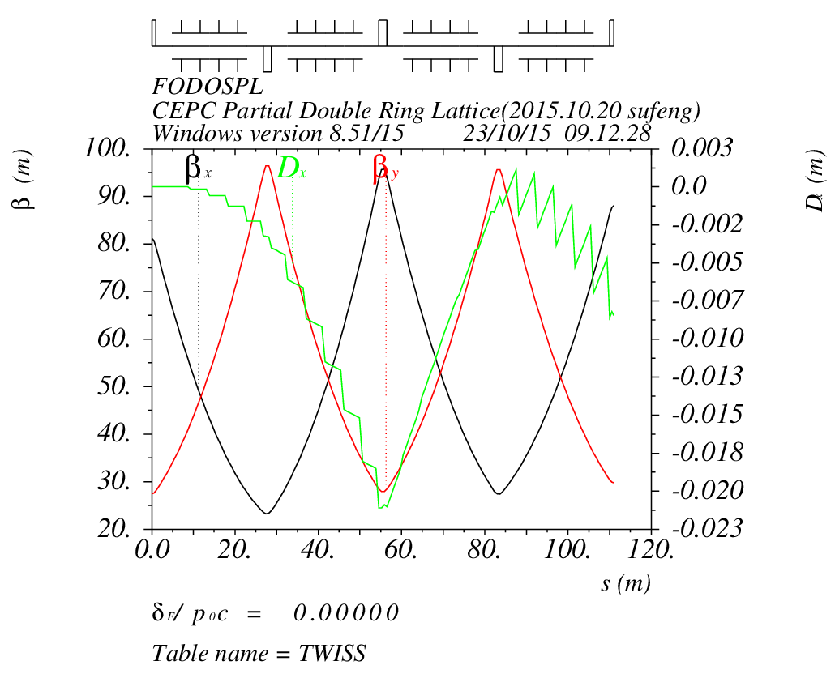
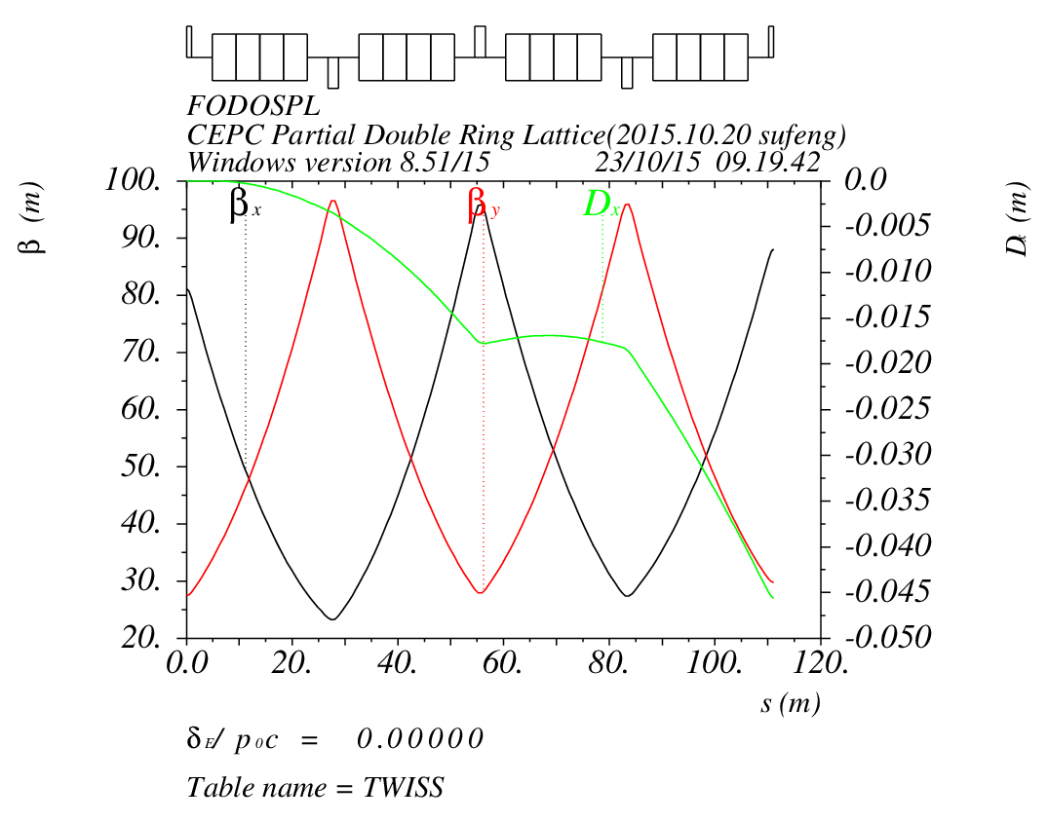
Electrostatic Separator & Dipole
Seperator :
n=16
L=4.5m
angle=62.5urad
Dipole:
n=16
L=4.5m
angle=62.5urad

Slide 20
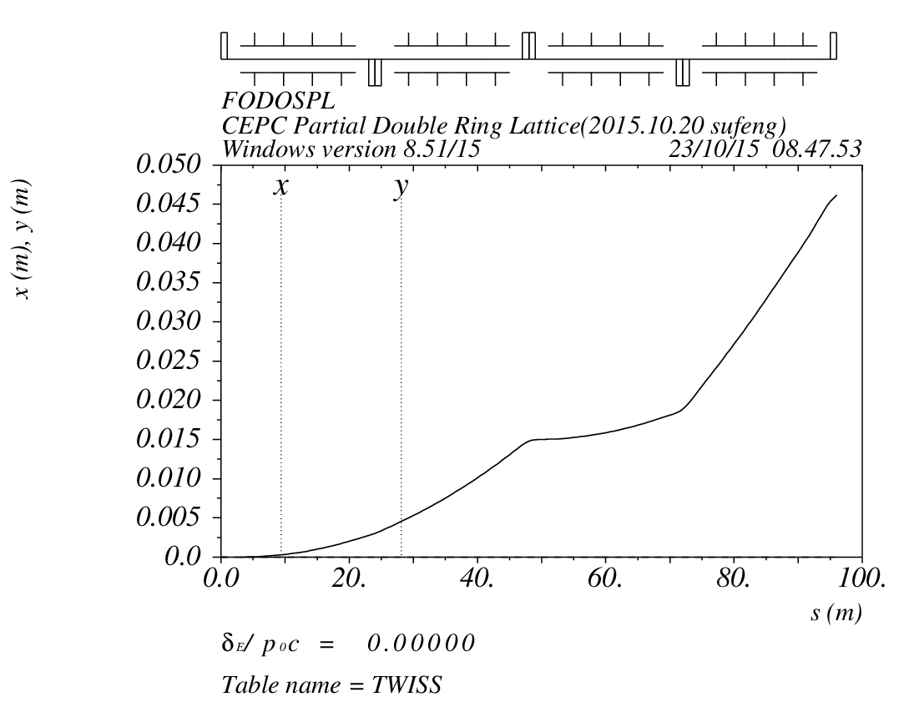
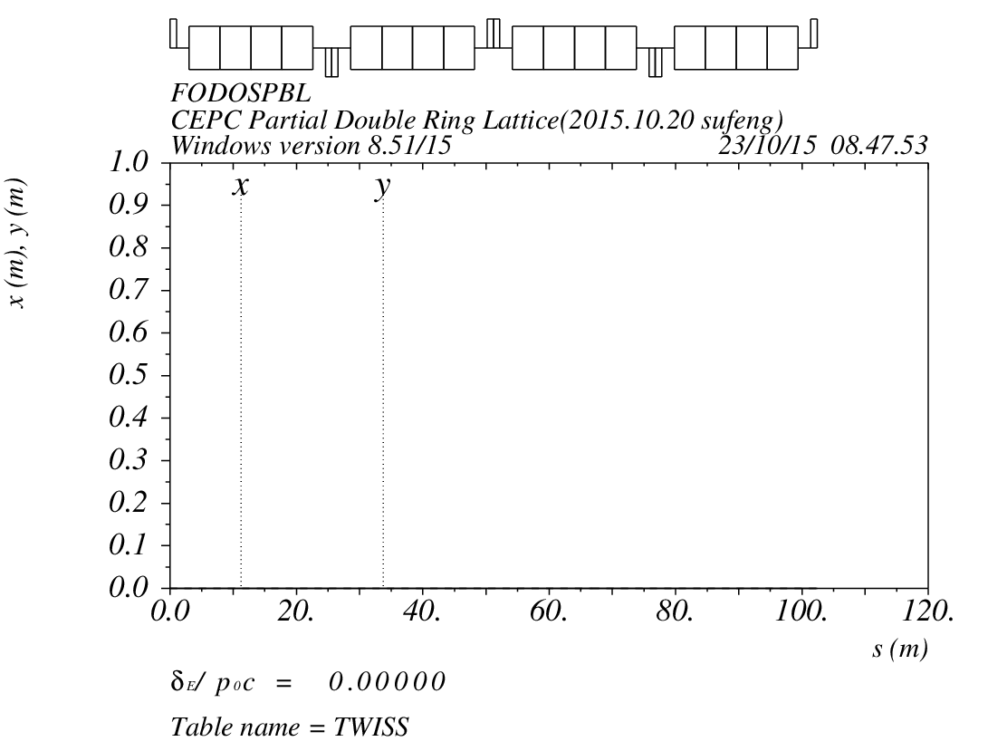
Electrostatic Separator & Dipole
Seperator :
n=16
L=4.5m
angle=62.5urad
Dipole:
n=16
L=4.5m
angle=62.5urad

Slide 21
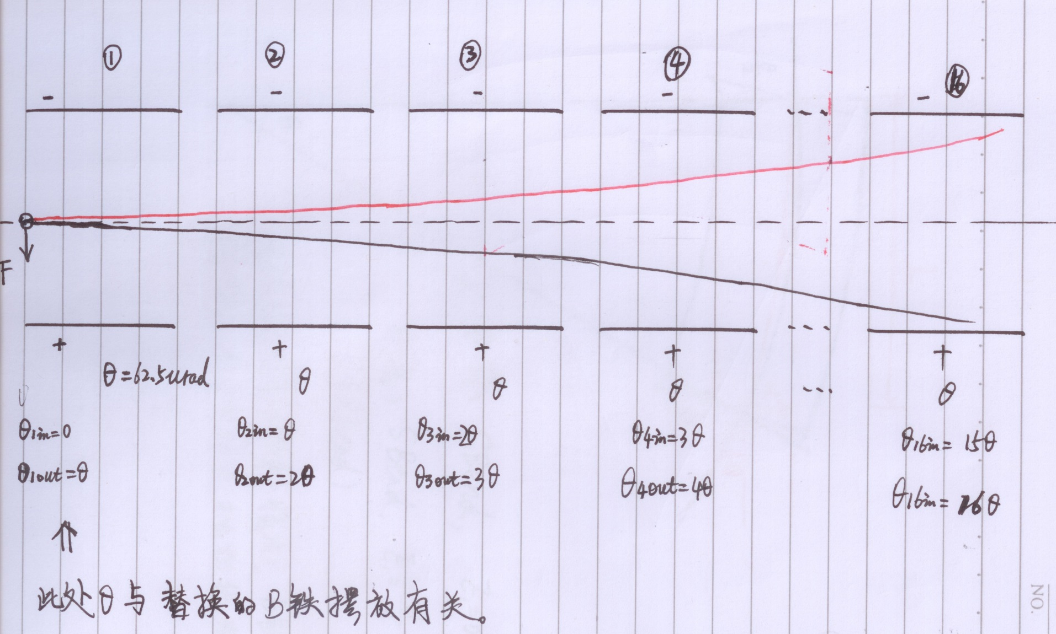
Electrostatic Separator

Slide 22
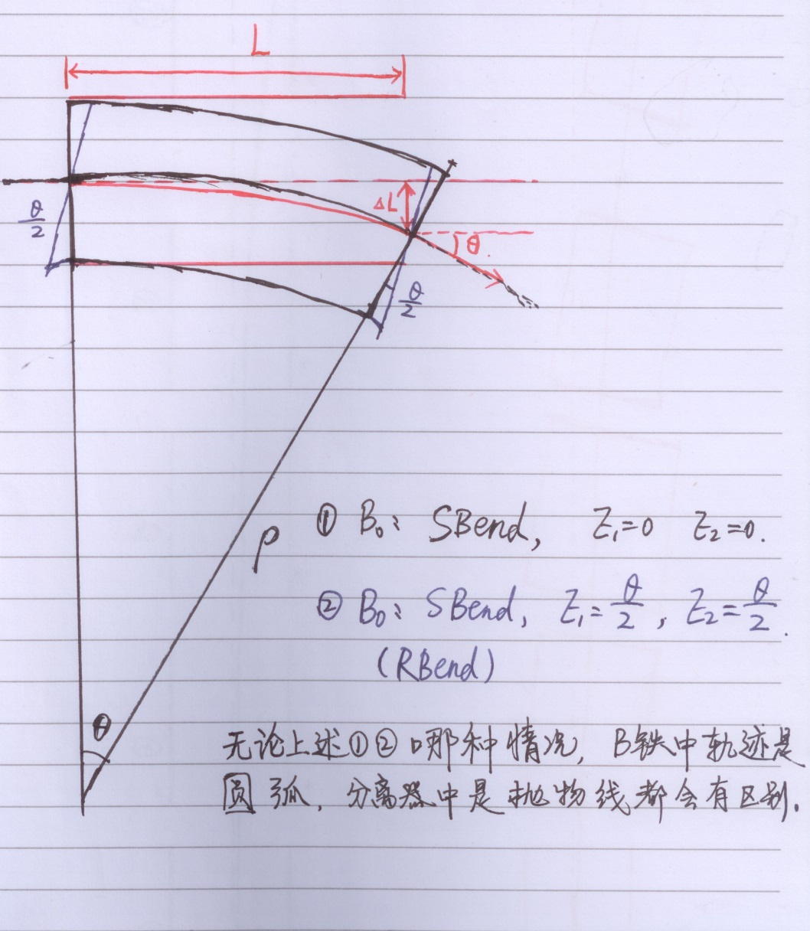
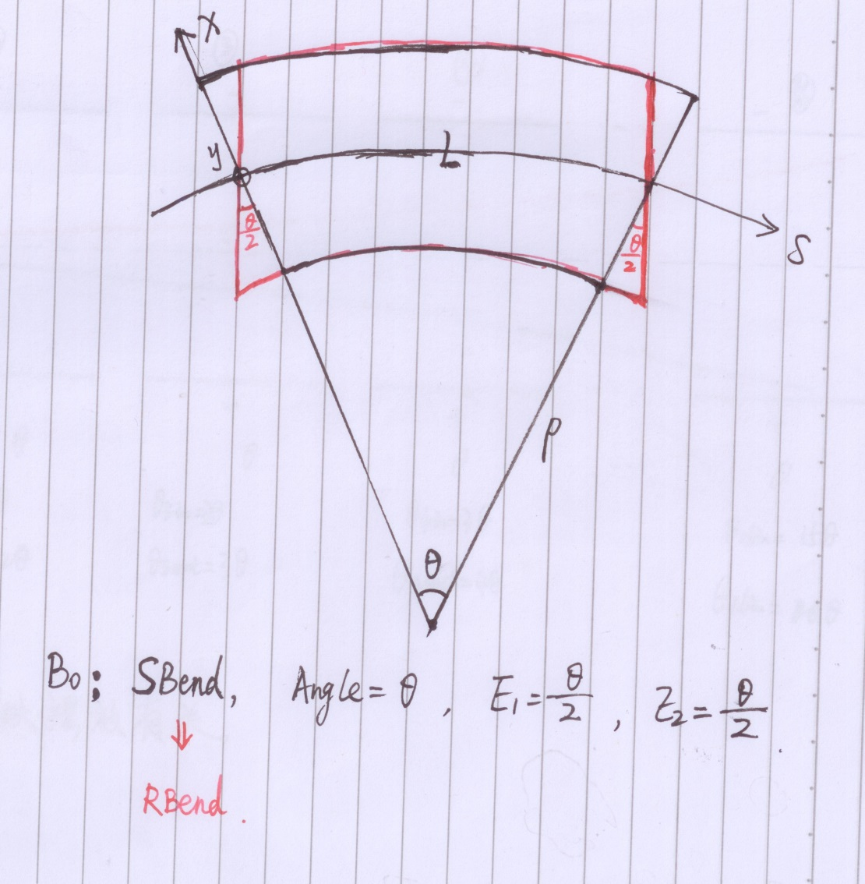
Electrostatic Separator

Slide 23
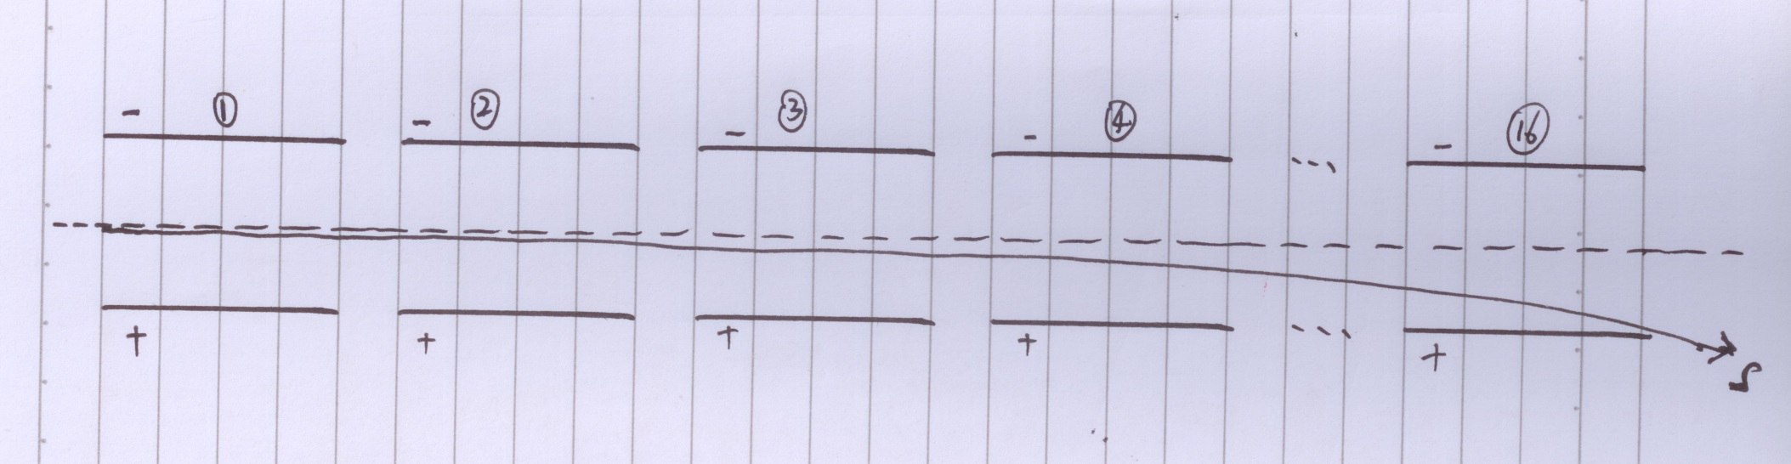
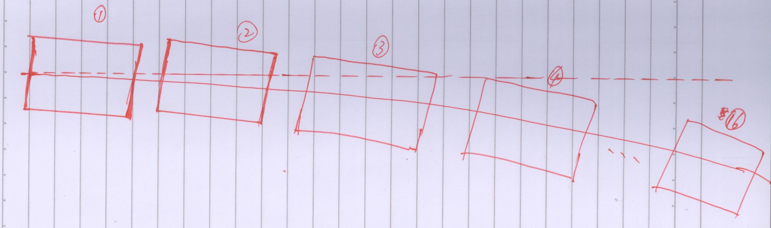
Electrostatic Separator

Slide 24
Electrostatic Separator
存在的问题：
Electrostatic Separator的特点，参数指标和性能进一步调研
如何安装
Orbit
色散

Slide 25
Next to do
Electrostatic Separator 调研，安装，匹配
Add IR（FFS）
Dynamic Aperture
Optimization

Slide 26
Reference
[1] CEPC-SPPC Preliminary Conceptual Design Report, The CEPC-SPPC Study Group, IHEP-CEPC-DR-2015-01.
[2] J. Gao, IHEP-AC-Note-2013-012.
[3]Xiao Ming et al, CEPC_bunch_train _ 2015-8-28
[4]Oridy, FCC-ee_150917
[5] P. Raimondi, Status on SuperB effort, La Thuile, March 11, 2006
[6]W. Kalbreier, et al, “Layout, design and construction of the electrostatic separation system of the LEP e+e- collider”, CERN, Geneva, Switzerland.
[7] R. Martin, et al, “Status of the FCC-ee interaction region design”, HF2014 Workshop, Beijing, China, 9-12 October, 2014

Slide 27
Thank You !

Slide 28
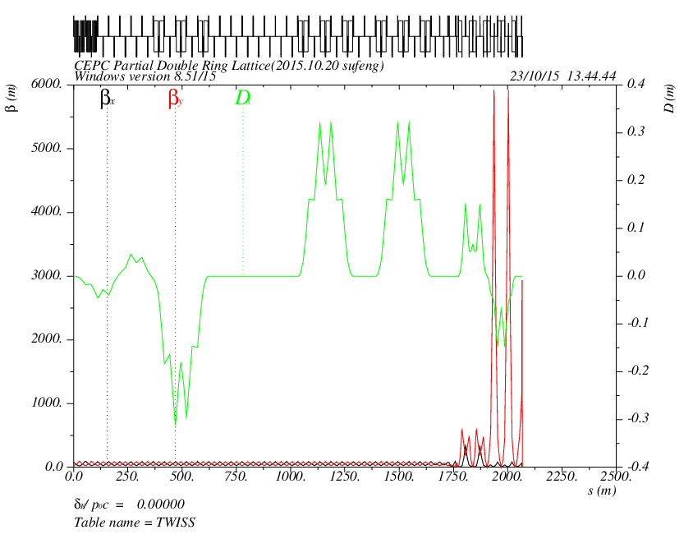
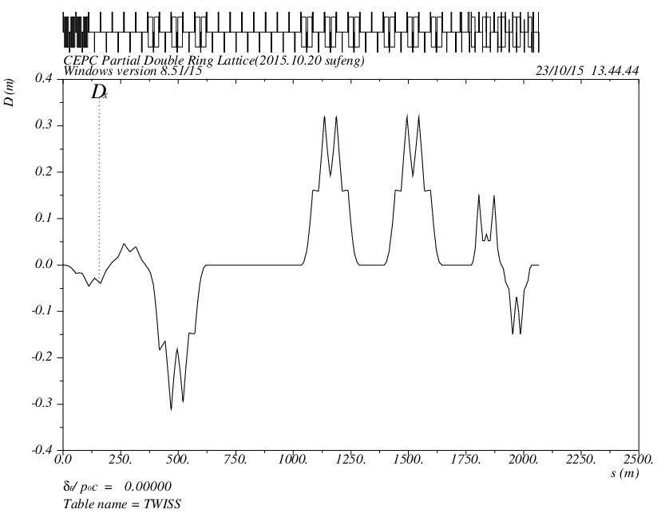
Version 0.3 + FFS

