Slide 1
Bunch Lengthening of CEPC
Hongjuan Zheng, Jie Gao
2015-10-23

Slide 2
Outline
Theory used-----” Gao’s theory”.
Different models used to calculate bunch lengthening and energy spread for the main ring.
Only RF cavities and resistive wall are considered.
Scaled KEKB LER.
Bunch lengthening and energy spread for booster.
Summary

Slide 3
Theory used
The analytical expression that describes the wake potential of a storage ring is[1]:
The bunch lengthening equation is as follows[1]:
Energy spread is:
[1] J. Gao, On the single bunch longitudinal collective effects in electron storage rings, Nuclear Instruments and Methods in Physics Research A 491(2002) 1-8.

Slide 4
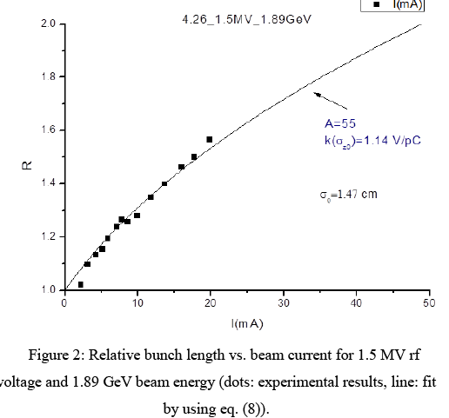
Gao theory has been used to get the longitudinal loss factor of BEPCII[2]. The experimental results are fit by using the Gao equation, estimation for longitudinal loss factor basically agrees with the impedance budget from design report.
[2] WANG Dou, LI Yong, et al. Longitudinal Single Bunch Instability Study on BEPCII , arXiv preprint arXiv:1304.2822 (2013).

Slide 5
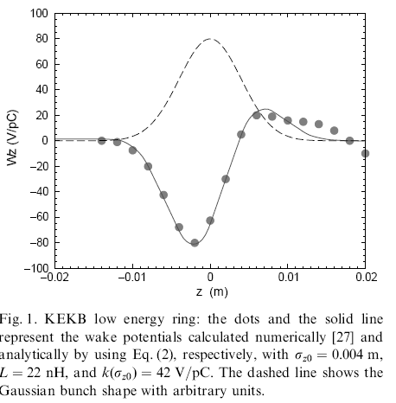
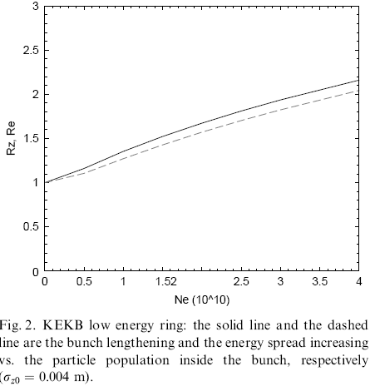
The theory also used to estimate the instability of KEKB LER. The analytical calculation fits well with the numerical simulation.

Slide 6
CEPC main ring. (σz0=2.65mm )
Bunch lengthening with CEPC RF cavities and resistive wall.
(V/pC)
(m)
Total longitudinal loss factor of 384 cavities and resistive wall are 1205.1V/pC, total inductance is 126.8nH [4].
When bunch current is 0.332mA, bunch lengthening R_{z}=1.329, energy spread R_{e}=1.231.
N. Wang, et al. Impedance and collective effects of CEPC, 55th ICFA Advanced Beam Dynamics Workshop on High Luminosity Circular e+e- Colliders – Higgs Factory (HF2014), Oct. 11, 2014.

Slide 7
CEPC main ring. (σz0=2.65mm )
Bunch lengthening with scaled KEKB LER parameter----according to the proportion of RF cavities and resistive wall.
The scaling factor is Cir (CEPC)/Cir(KEKB).
Loss factor is scaled by SPEAR scaling law.
(V/pC)
Total longitudinal loss factor of the ring is 2921V/pC, total inductance is 365.418nH.
When bunch current is 0.332mA, bunch lengthening R_{z}=1.842, energy spread R_{e}=1.708.
(m)

Slide 8
CEPC booster. (σz0=2.66mm E=120GeV)
Bunch lengthening with CEPC RF cavities and resistive wall.
Total longitudinal loss factor of 256 cavities and resistive wall are 2270.786V/pC, total inductance is 167nH[4].
When bunch current is 0.0175mA, bunch lengthening R_{z}=1.008, energy spread R_{e}=1.003.

Slide 9
Summary
We can see from the calculations above that the bunch lengthening is a serious problem for CEPC main ring. When only consider cavities and resistive wall, bunch lengthening is 32.9%. This will affect the luminosity of the machine.
The scale is reasonable.

