Slide 1
Pretzel orbit design with asymmetric lattice (v20140930)
Huiping Geng
CEPC Accelerator Physics regular meeting
2015.10.23

Slide 2
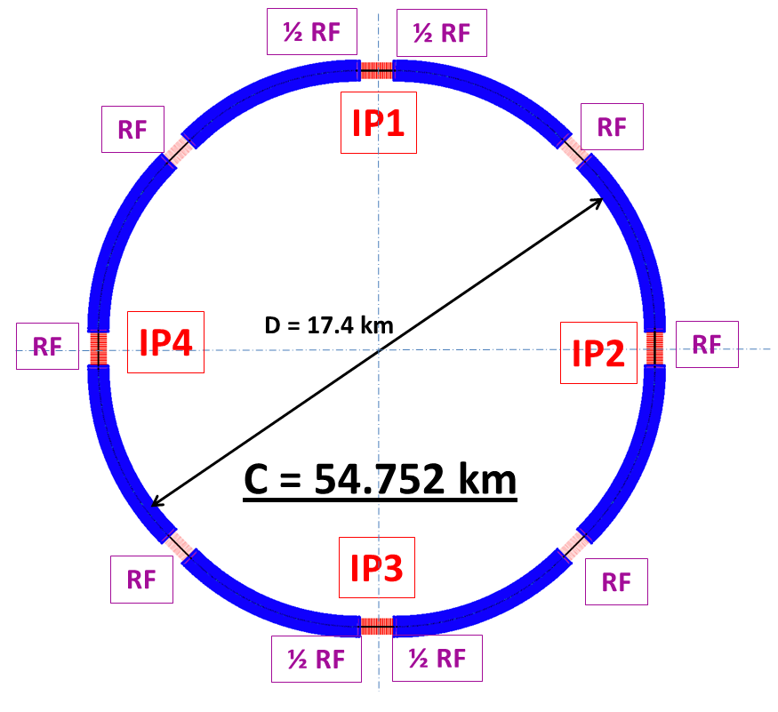
Review of asymmetric lattice (v20140930)
Circuference: 54.752 km
FODO cell length: 47.2 m
Phase advance per cell: 60/60 degrees
ARC length:5852.8m= (2+120+2)*47.2
Short straight: 18 FODO cells, 849.6m
Long straight: 24 FODO cells, 1132.8m
Results reported in HF2014 are using this lattice.

Slide 3
Issues with pretzel orbit
For ideal pretzel orbit, the following relationship should be fullfilled:
i.e. the phase advance between parasitic crossing point should be a integer number of 2*Pi.
For our lattice, it is comprised of 60/60 degree FODO cells, so the relationship can be written as:
But for this asymmetric lattice, as for 50 bunches case:
This is why we say pretzel orbit is not working for this lattice version.

Slide 4
To make it work
Two options(assuming phase advance per cell keeps constant):
Change the cell length, which will result in the change of emittance, circumference etc.
Change the circumference
In the following, we take the easy way, i.e. we change the circumference to make the lattice work for pretzel orbit of 50 bunches

Slide 5
Changes made
ARC length:5852.8m
Short straight: 18 FODO cells, 849.6m
Long straight: 34 FODO cells, 1604.8m
Circumference: 56.640km
After making this chang, every nearest parasitic collision points will have a phase advance of 4Pi.

Slide 6
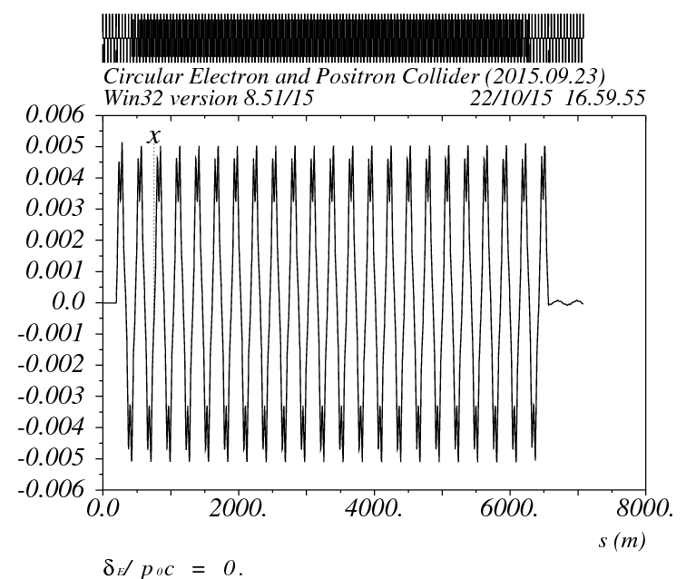
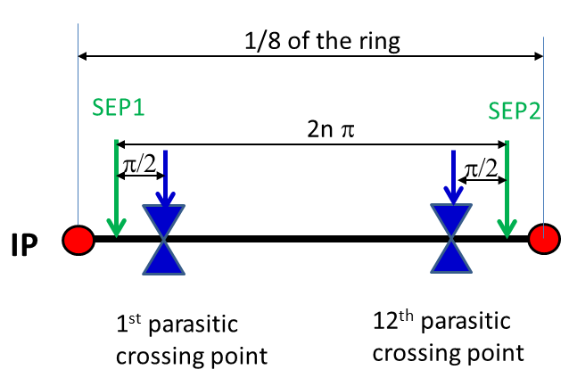
Pretzel orbit design
Find proper positon and strength of static electric separators, then the pretzel orbit can be well generated.

Slide 7
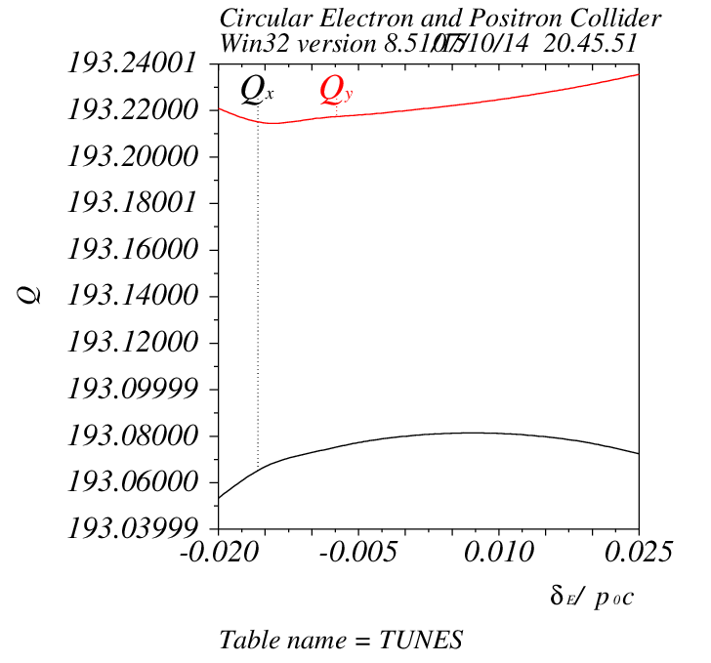
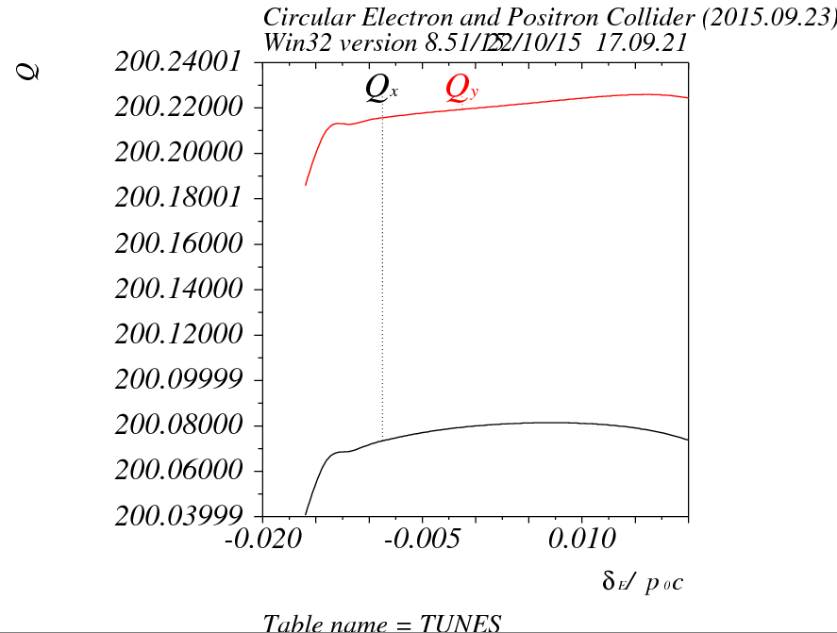
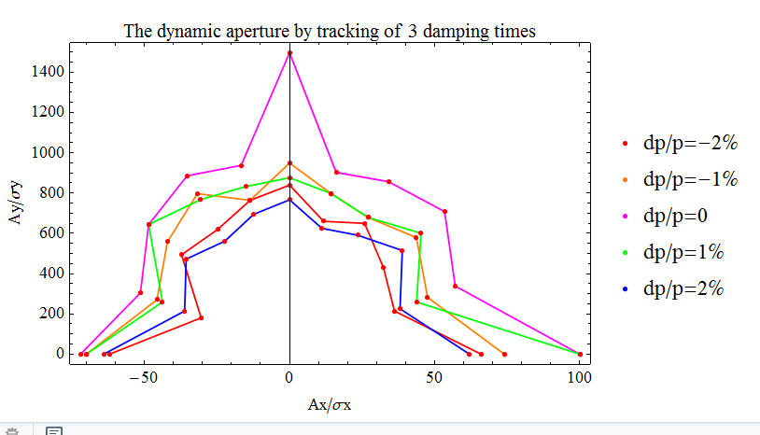
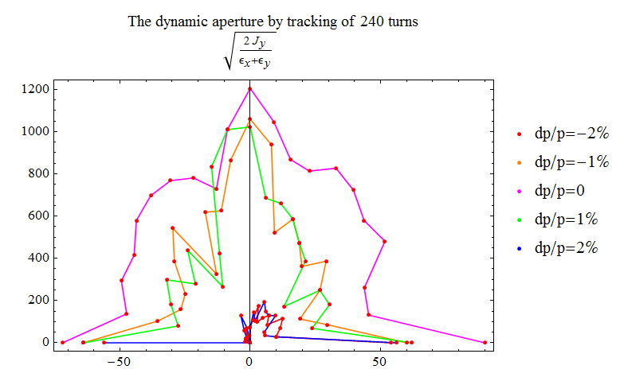
Comparison of results before adding pretzel
v20140930
New version
v20150923

Slide 8
Summary
Pretzel orbit issue could be fixed by changing the circumference of the ring
But the change of drift space length will have a big effect on dynamic aperture (as we have already noticed), which will need further study.

