Slide 1
Update of study on DA optimization and luminosity reduction due to lattice nonlinearity
Yiwei WANG, Yuan Zhang, Dou Wang,
Huiping Geng, Demin Zhou, Jie Gao
CPEC AP meeting, 30 Oct. 2015

Slide 2
Outline
Luminosity reduction due to lattice nonlinearity
Update of dynamic aperture study

Slide 3
Introduction
$$L∝ξ∝\frac{1}{{(\frac{A_{bb}}{σ})}^{2}}$$
Luminosity
Dynamic aperture due to the beam-beam and lattice nonlinearity
When $τ_{bb}$=60min, $τ_{damping}$=14ms,$A_{bb}/σ$=3.990
To keep the beam lifetime, we have to work with a larger $A_{bb}$ which will reduce the luminosity.
To calculate the luminosity reduction
Ref: J. Gao, Nucl. Instr. and Methods A463 (2001) 56-61.

Slide 4
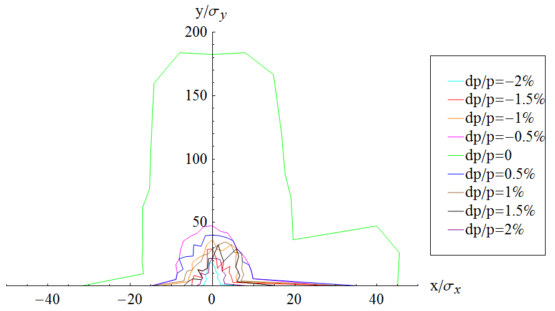
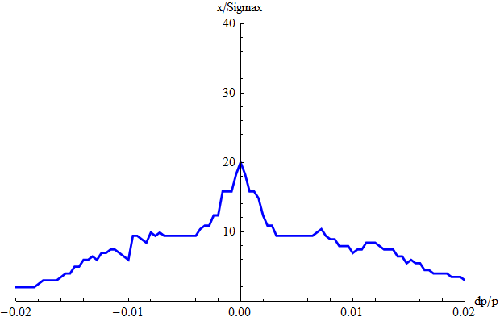
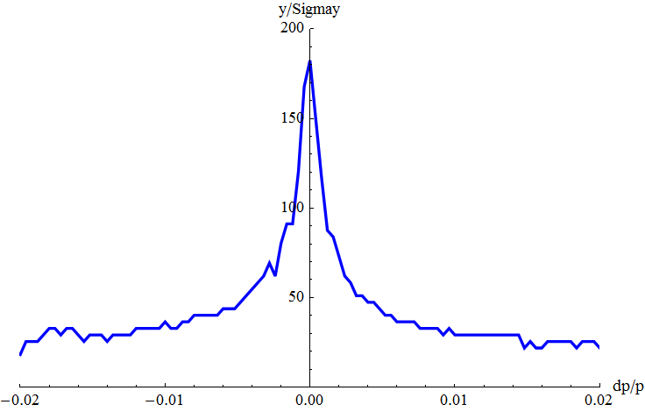
Dynamic aperture of v2.2
Dynamic aperture with FFS_3.0mm_v2.2_Sep_2015, Yiwei Wang
Horizontal DA
got with a non-zero vertical amplitude
mean value of the two directions
20 instead of 40 for on-momentum particle which not real DA

Slide 5
Luminosity reduction
 | Uniform density | Gaussian density $σ_{E}=0.16\%$
$〈A_{lat}/σ〉$ (x/y) | 7.968/ 43.171 | 15.481/ 110.821
$A_{bb}/σ$ (x/y) | 4.609/ 4.007 | 4.129/ 3.992
$$L/L_{0}$$ | 0.749/0.991 | 0.934/0.999
$$A_{tot}/σ$$ | 3.990
$τ_{tot}$ [min] | 60

Slide 6
Luminosity reduction
elptical model assumed for Alat vs. dp/p
 | Uniform density | Gaussian density $σ_{E}=0.16\%$
$$〈A_{lat}/σ〉$$ | 17.092(on 20,off 10) 16.1134(on 20, off 5) | 19.9518(on 20,off 10) 19.9397(on 20, off 5)
$$A_{bb}/σ$$ | 4.10309 4.11796 | 4.07198 4.07208
$$L/L_{0}$$ | 0.945512 0.938692 | 0.960013 0.959964
$$A_{tot}/σ$$ | 3.990
$τ_{tot}$ [min] | 60

Slide 7
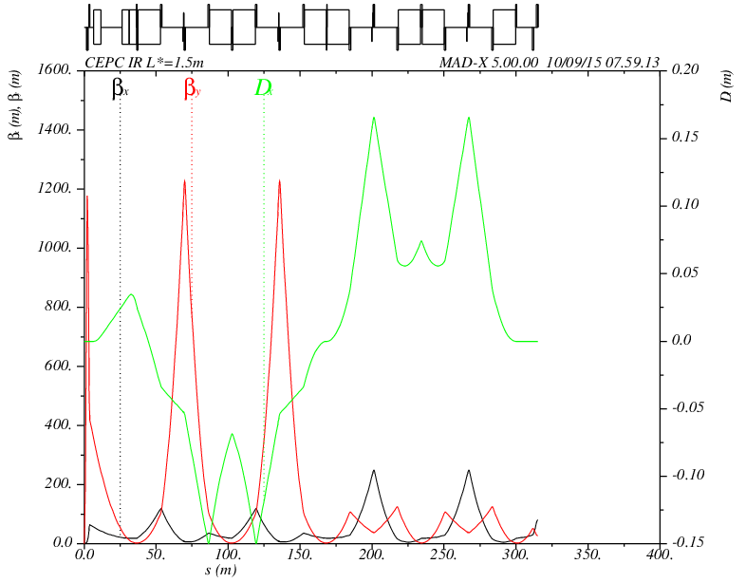
Lattice of interaction region v2.2
Beam-beam simulation show that the luminosities of CEPC are almost the same when βy* increased from 1.2 mm to 3 mm.
IR design with local chromaticity correction
IP
FT
CCY
CCX
MT
L*=1.5m
βy*=3mm
-I
-I

Slide 8
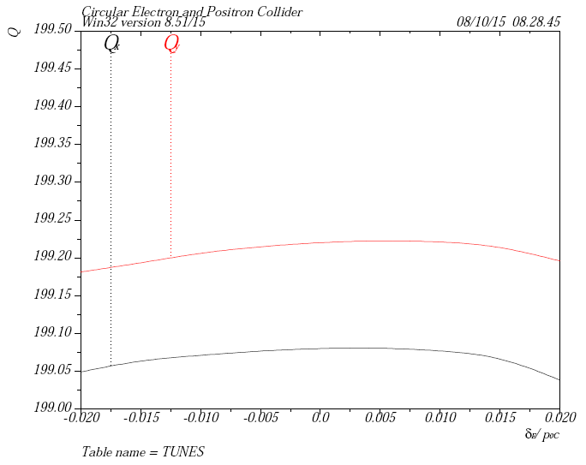
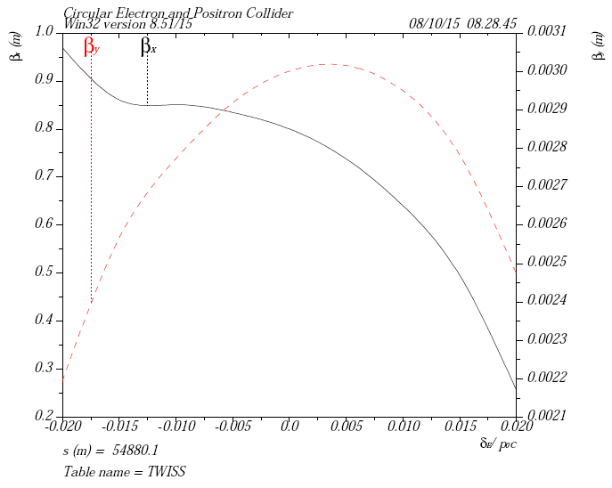
Chromaticity of the ring
Adjust the tune to be .08/.22 (νx/νy)
determined by beam-beam study
match Q’ to be ~0.5 with the sextupoles in the ARC
5 families in IR + 2 families in ARC

Slide 9
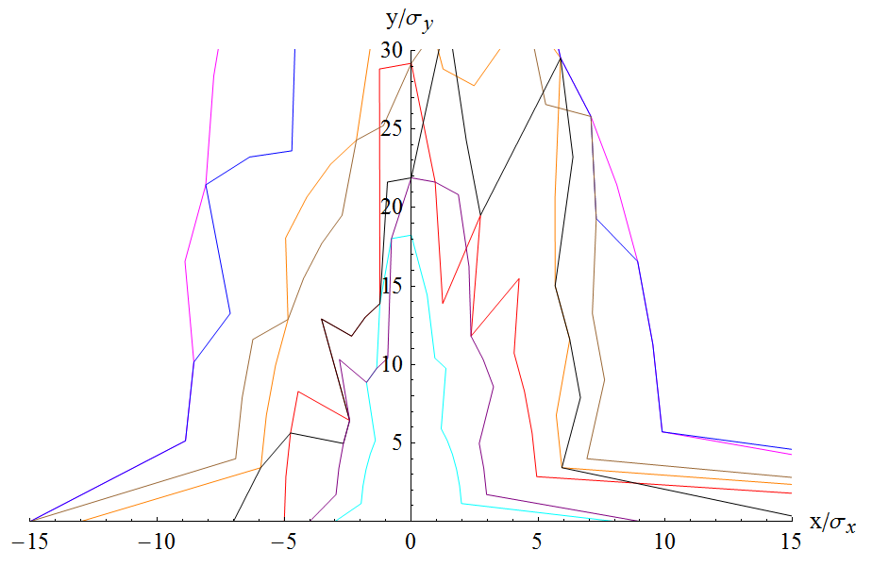
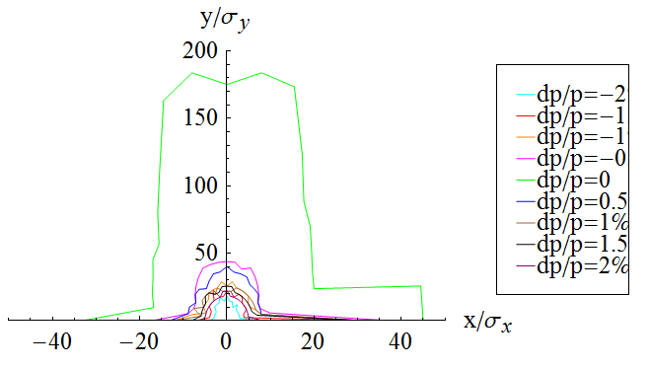
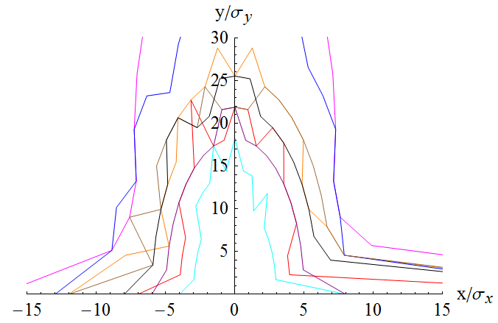
Dynamic aperture with FFS v2.2
SF =(L= 0.400000 K2= 0.15991 )
SD =(L= 0.400000 K2= -0.244761 )
DA optimised directly
SF=(L =.4 K2 =.156997 )
SD=(L =.4 K2 =-.236104 )

Slide 10
Summary
To keep the beam lifetime, we have to work with a larger $A_{bb}$ which will reduce the luminosity.
Analytical estimation with Prof. Gao’s formula(elptical model Alat vs. dp/p)
With a uniform density, the luminosity decreased to 93.87% (x/y)
With a gaussian density, the luminosity decreased to 96.00% (x/y)
Optimise DA directyly works
Work With More families are going

Slide 11
Reserved

Slide 12
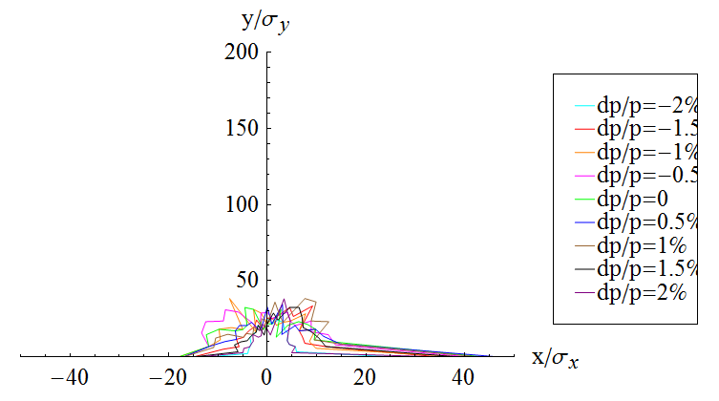
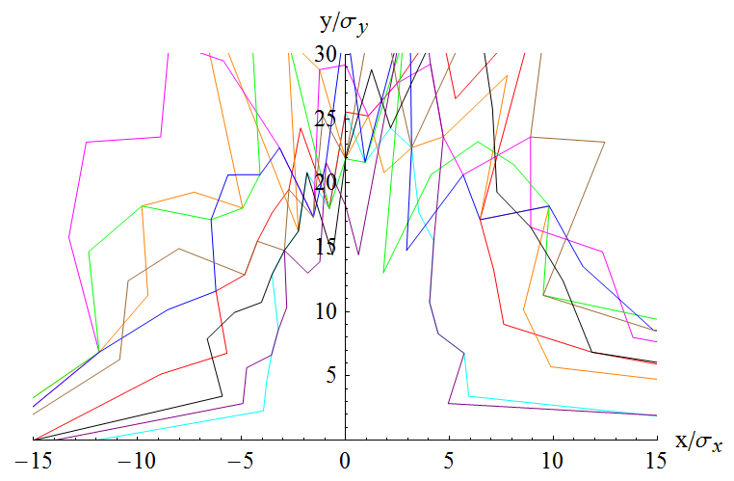
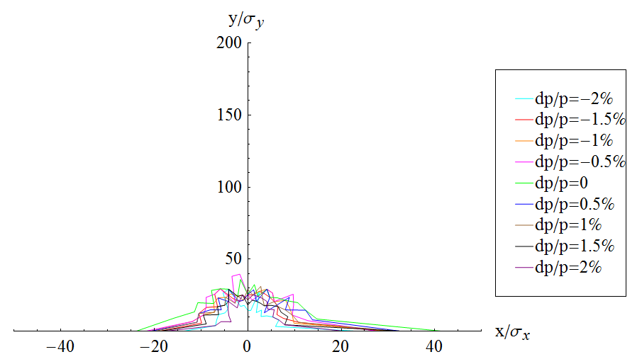
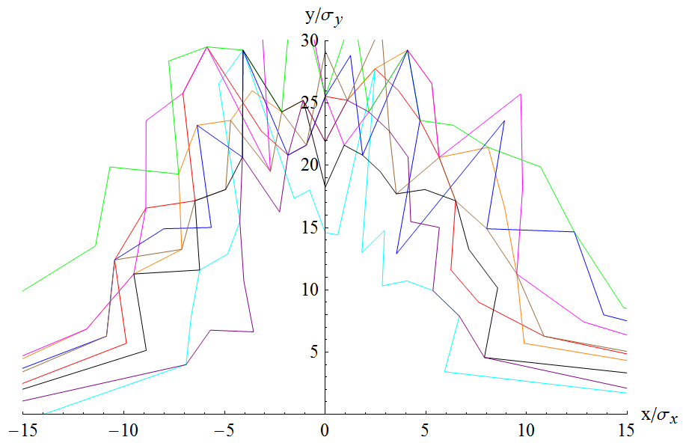
Dynamic aperture (w damping)
SF =(L= 0.400000 K2= 0.15991 )
SD =(L= 0.400000 K2= -0.244761 )
SF =(L =.4 K2 =.156997 )
SD =(L =.4 K2 =-.236104 )
DA optimised directly

