Slide 1
CEPC 动力学孔径优化 in progress
张 源、王毅伟、耿会平、王逗
2015-10

Slide 2
Outline
Wangyw-V1 review
  Optics plot (madx sad)
  Nonlinearity (anhx)
  Dynamic Aperture (sad)
What limit DA?
  ANHX (add in sad)
  Resonance (spectrum)
Chromatic Optimization
  But DA not optimized
  Try to suppress gnfu for off-momentum

Slide 3
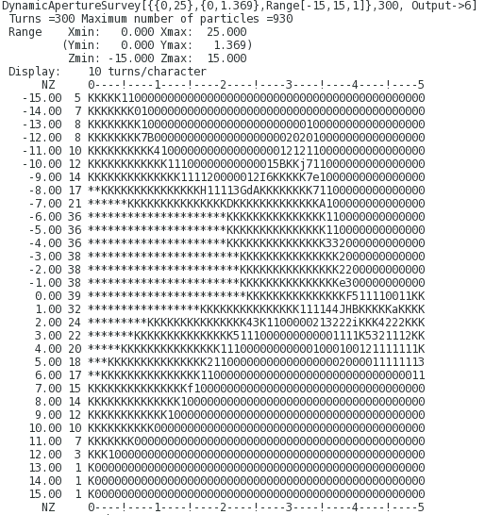
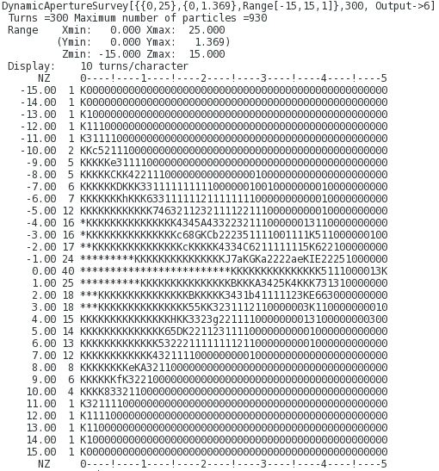
V1，DAPWIDTH=15, NORFSW vs RFSW

Slide 4
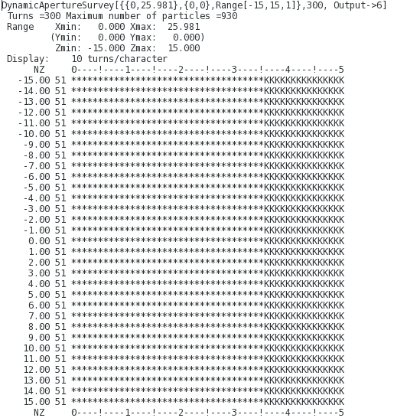
V1，DAPWIDTH=15, NORFSW(0.3% vs 0)

Slide 5
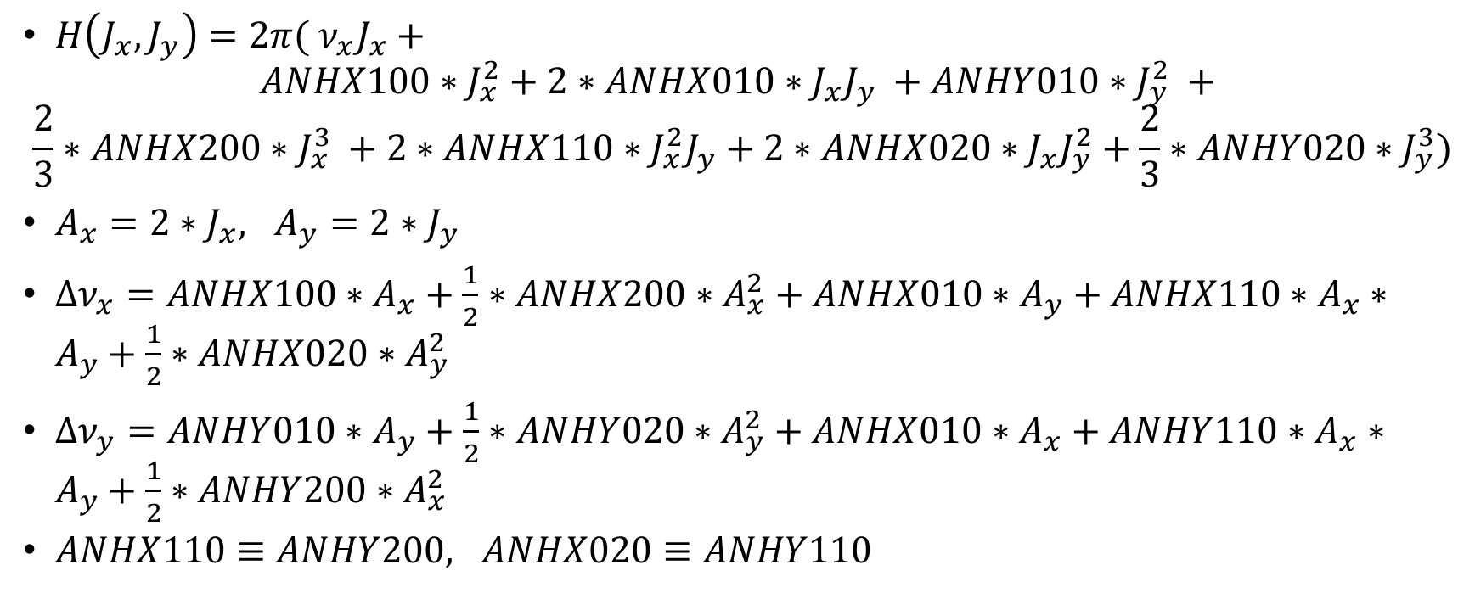
MADX tune shift calculation
$H\left(J_{x}, J_{y}\right)=2π( ν_{x}J_{x}+$
$$ANHX100∗J_{x}^{2}+2∗ANHX010∗J_{x}J_{y} +ANHY010∗J_{y}^{2} +$$
$$\frac{2}{3}∗ANHX200∗J_{x}^{3} +2∗ANHX110∗J_{x}^{2}J_{y}+2∗ANHX020∗J_{x}J_{y}^{2}+\frac{2}{3}∗ANHY020∗J_{y}^{3})$$
$A_{x}=2∗J_{x}, A_{y}=2∗J_{y}$
$Δν_{x}=ANHX100∗A_{x}+\frac{1}{2}∗ANHX200∗A_{x}^{2}+ANHX010∗A_{y}+ANHX110∗A_{x}∗A_{y}+\frac{1}{2}∗ANHX020∗A_{y}^{2}$
$Δν_{y}=ANHY010∗A_{y}+\frac{1}{2}∗ANHY020∗A_{y}^{2}+ANHX010∗A_{x}+ANHY110∗A_{x}∗A_{y}+\frac{1}{2}∗ANHY200∗A_{x}^{2}$
$ANHX110≡ANHY200, ANHX020≡ANHY110$

Slide 6

Tune shift vs amplitude (on-momentum)
19$σ$

Slide 7


Tune shift vs amplitude (-2$σ_{p}$)
1$8σ$

Slide 8

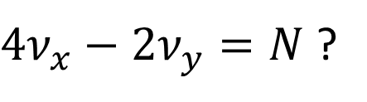

Tune shift vs amplitude (+2$σ_{p}$)
1$2σ$
$4ν_{x}−2ν_{y}=N$ ?

Slide 9
We want to answer what limit the dynamic aperture. But it seems the cause is not clear
One method is to control the tune shift well, and constrain the geometric terms at the same time. It is expected we could find a solution.

Slide 10
Different pattern
Non-interleave sextupole, same between arc1 and arc2, 120 sextupoles
Non-interleave sextupole, 240 sextupoles
Interleave sextupole, 68 sextupoles
No good solutions yet.

Slide 11
It will be very complicated by suppressing the limiting factor of DA one by one
It is very slow to calculate the nonlinear parameters
It seems it will be more efficient to optimize the DA directly.
I’ve tried to use Mathematica’s optimize function. But it is not easy to parallelize it.
Maybe it is easier to implement a parallel optimize algorithm, and use it to call sad.

Slide 12
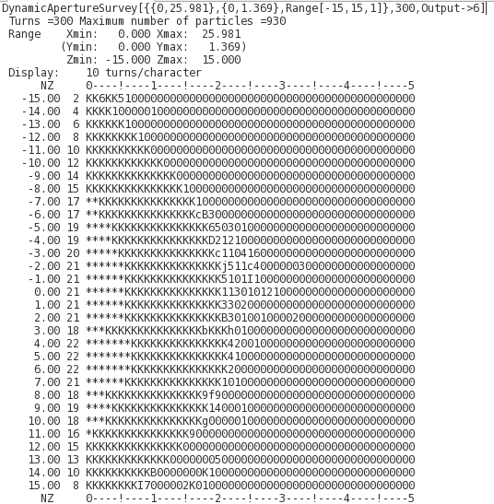
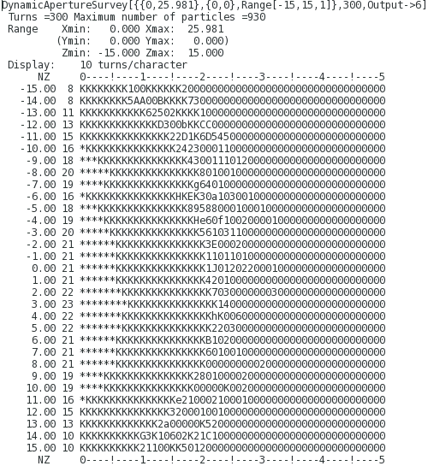
Higher multipoles – Decapole
Interleave Decapole (F/D), (dec-10281914)
DA limitation comes from oscillation in X

Slide 13
Tuneshift, decapole

Slide 14
Tuneshift check, v1

Slide 15
Tuneshift, decapole, anhx300 included

