Slide 1

CEPC Partial Double Ring
Lattice Design
SU Feng WANG Dou DUAN Zhe GAO Jie
GENG Huiping XU Gang BAI Sha
BIAN Tianjinan XIAO Ming
Key Laboratory of Particle Acceleration Physics and Technology
Institute of High Energy Physics
Chinese Academy of Sciences
2015.10.30

Slide 2
Outline
Layout
Orbit
Parameter
Next to do

Slide 3
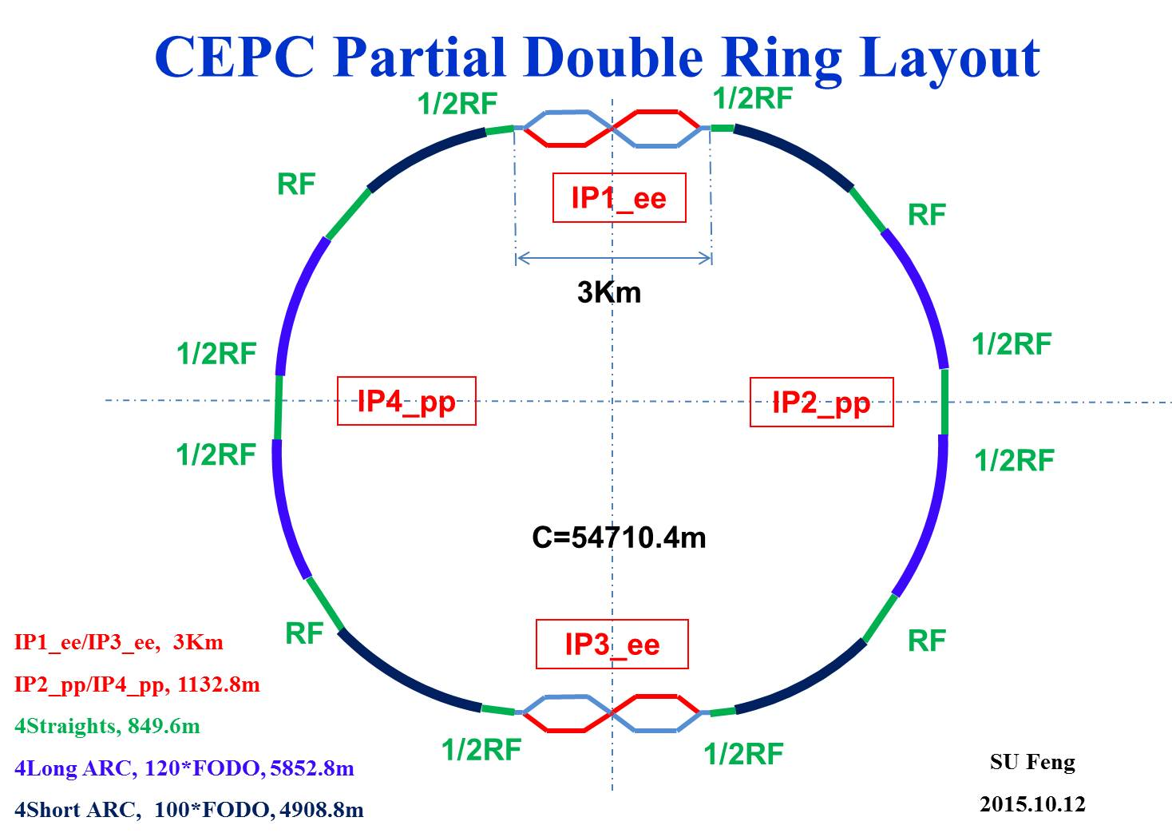
CEPC Partial Double Ring Layout
RF
IP1_ee
RF
3Km
1/2RF
1/2RF
IP4_pp
IP2_pp
1/2RF
1/2RF
C=54710.4m
RF
IP1_ee/IP3_ee, 3Km
IP2_pp/IP4_pp, 1132.8m
4Straights, 849.6m
4Long ARC, 120*FODO, 5852.8m
4Short ARC, 100*FODO, 4908.8m
IP3_ee
RF
SU Feng
2015.10.12

Slide 4
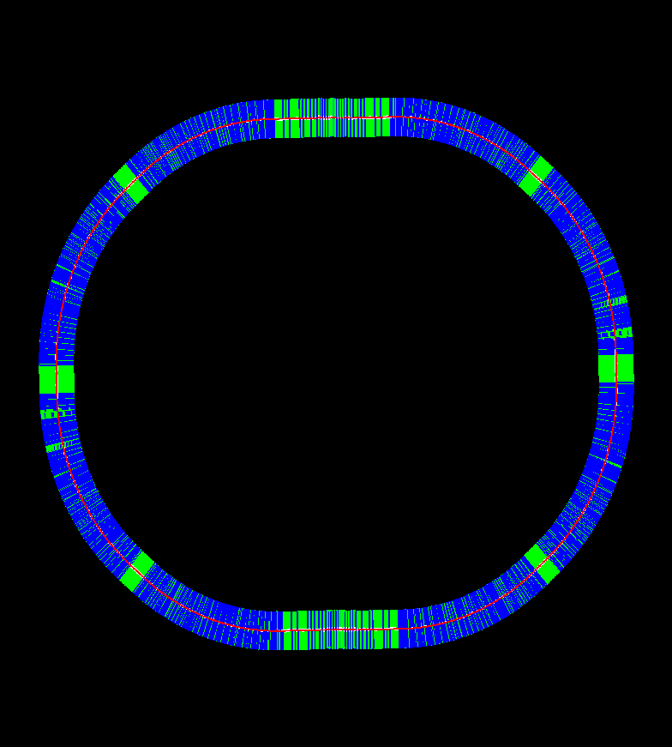

Slide 5
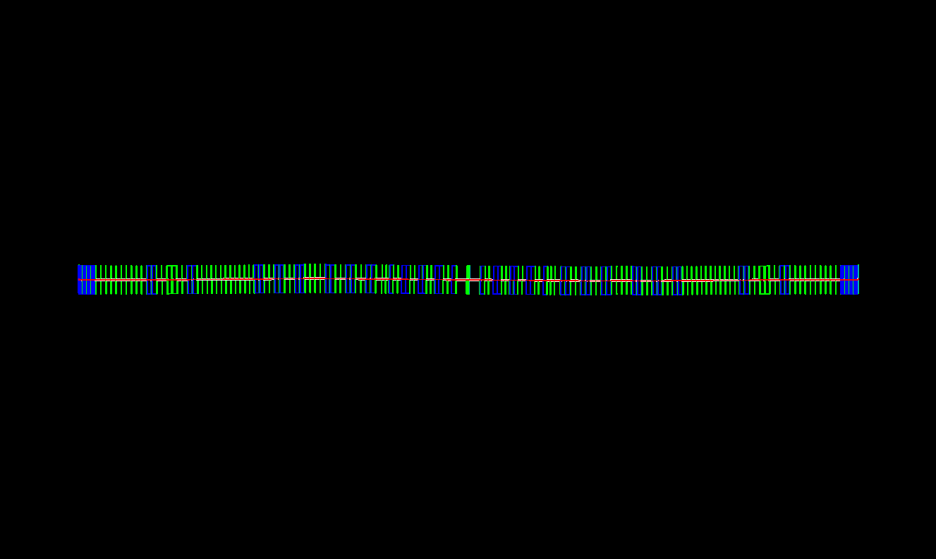

Slide 6
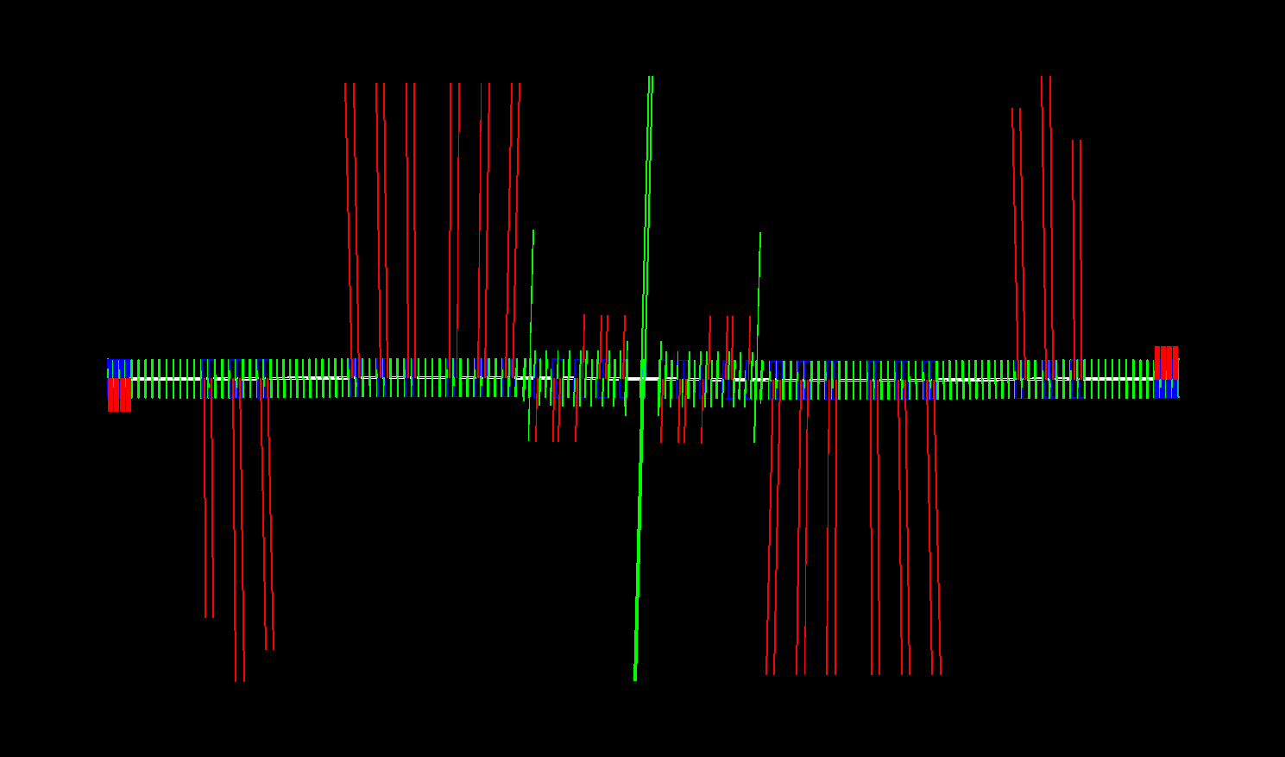

Slide 7
CEPC Partial Double Ring Layout
16
62.5urad
4.5m
B2
B3
B1
614.4m
462.1m
111.03m
256m
307.2m
Full crossing angle 30mrad
15mrad
8.852m
IP
B6
Dipole
2000.6m
B4
B5
Version 0.3
sufeng
2015.10.20
For CEPC 120GeV beam:
Max. deflection per separator is 66μrad.
Using Dipole after seperator to acquire 15 mrad

Slide 8
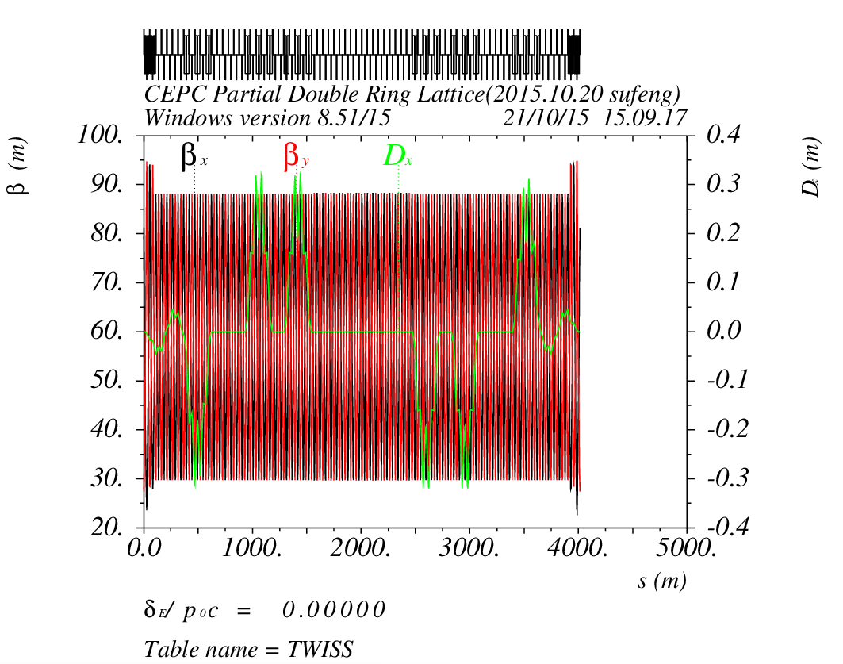
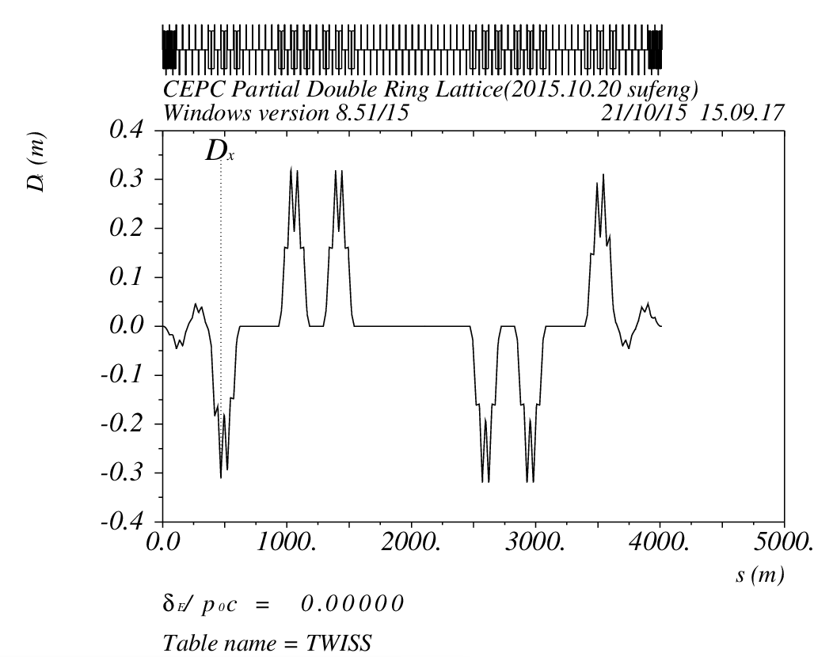
Orbit (DR_RING_e1) Version0.3

Slide 9
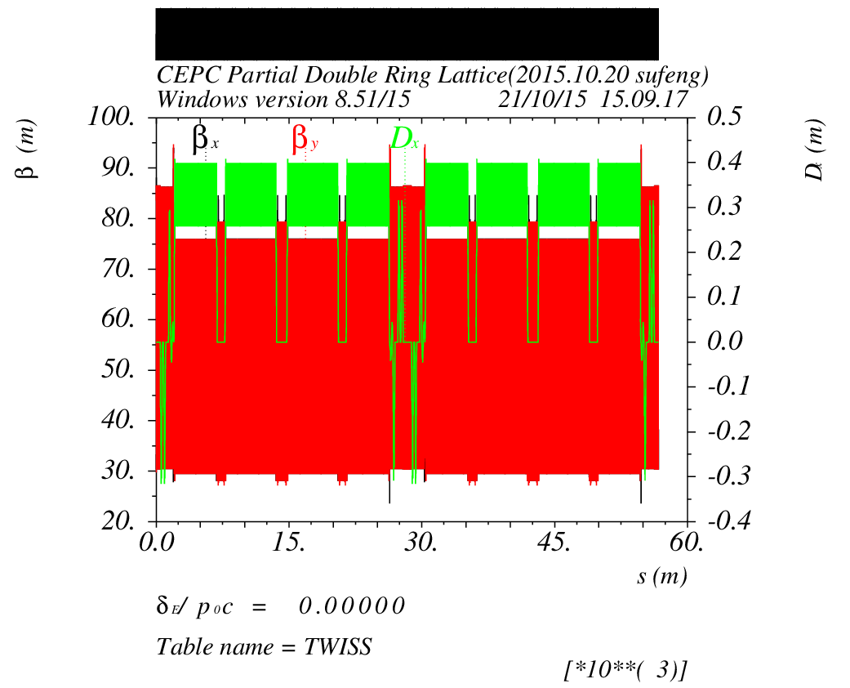
Survey & Dynamic Aperture （Version 0.3）
0: 33σx 760σy
0.01：13σx 320σy
0.02：10σx 170σy

Slide 10
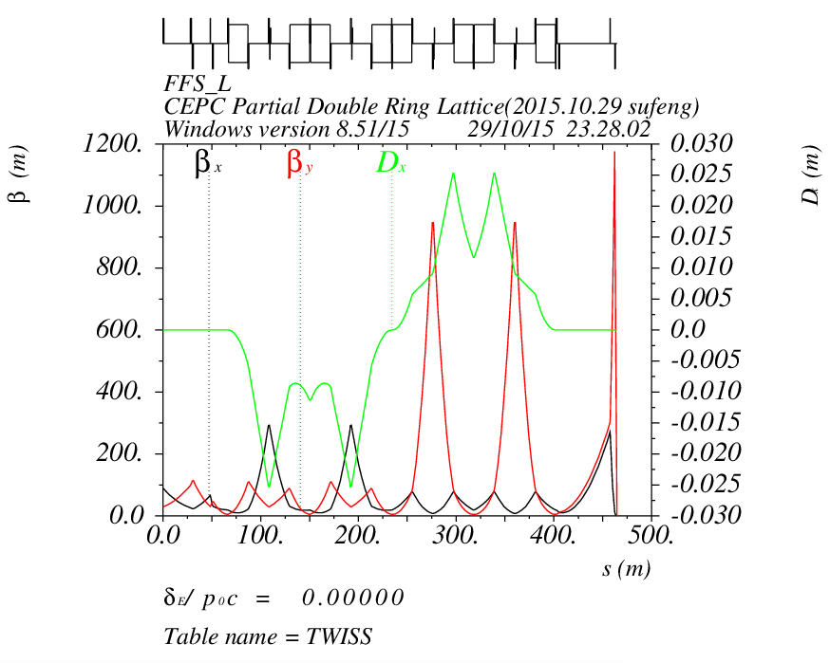
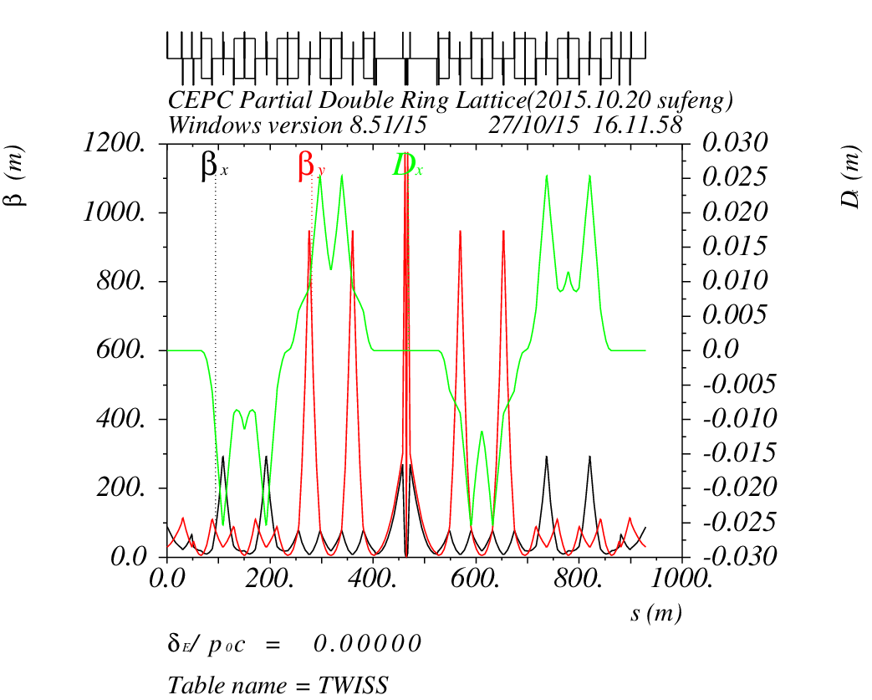
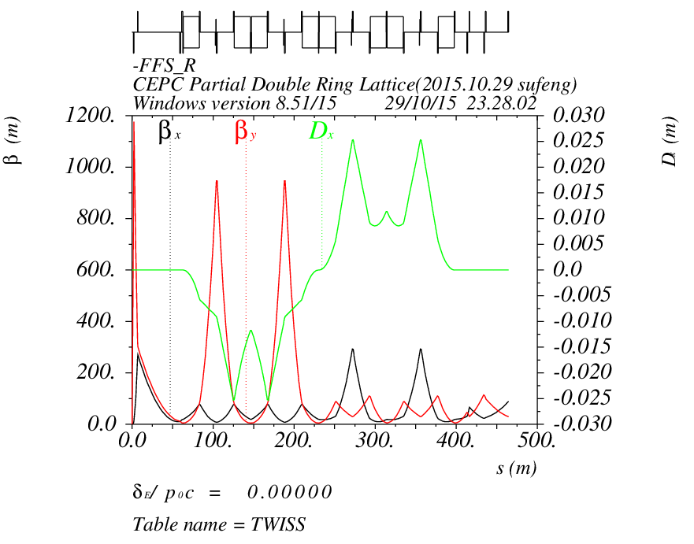
FFS Orbit （Version20151027-Dou）

Slide 11
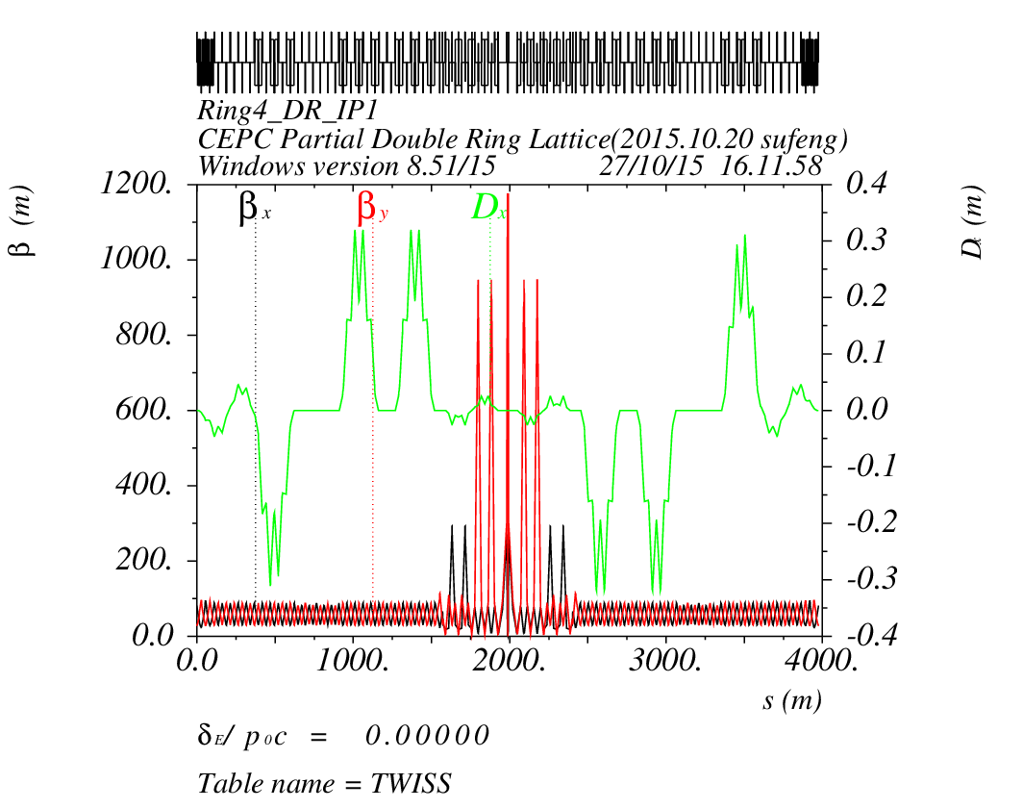
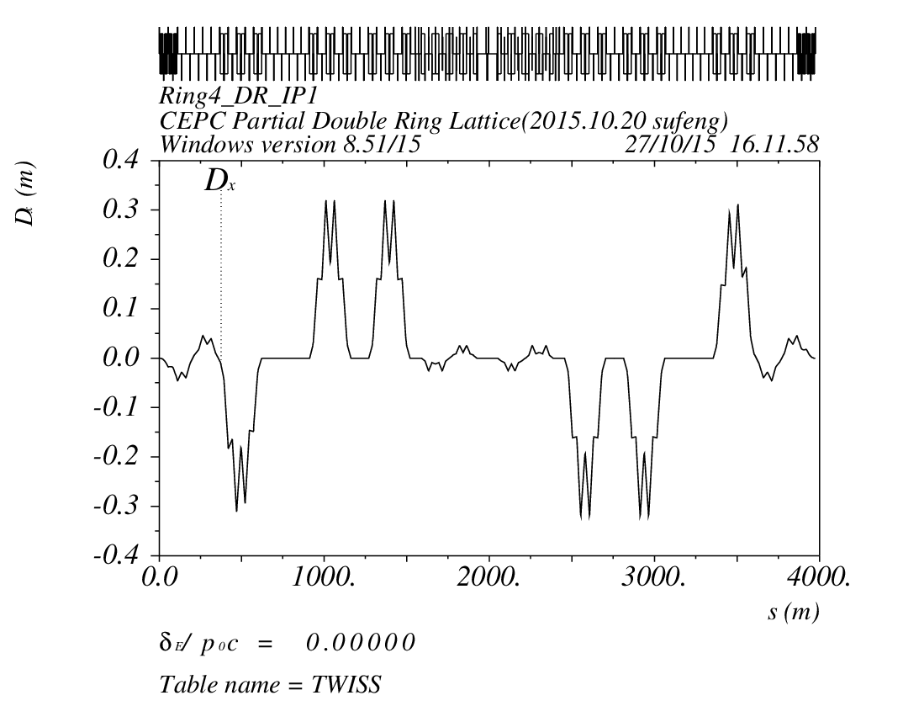
Orbit (RING3_DR_IP1) Version 0.3 + FFS(Version20151027-Dou)

Slide 12
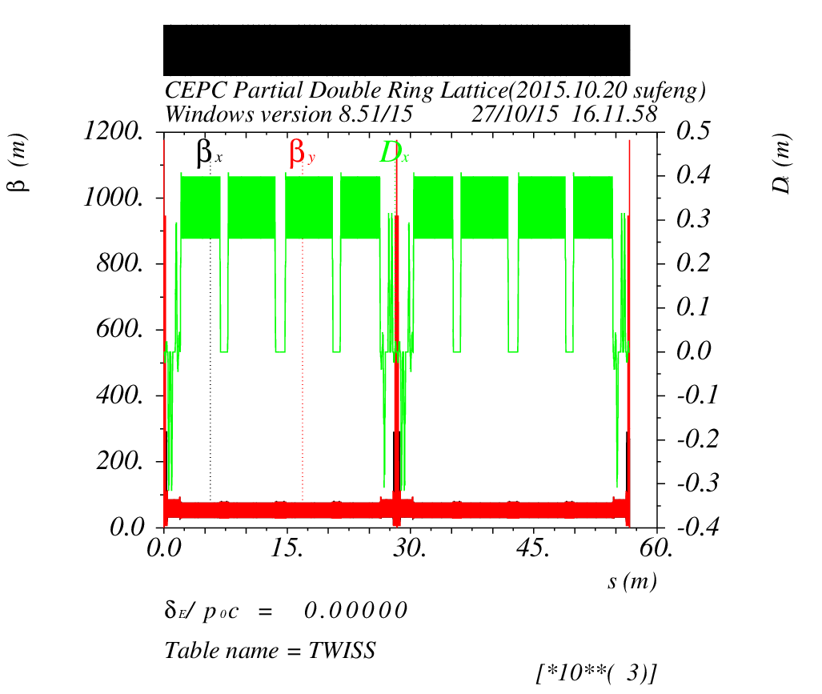
Survey & Dynamic Aperture
（Version 0.3 +FFS20151027-Dou）
0: 13σx 58σy
0.01：1σx 4σy
0.02：

Slide 13
Survey & Dynamic Aperture
（Version 0.3 +FFS20151027-Dou）
Without FFS
With FFS
0: 33σx 760σy
0.01：13σx 320σy
0.02：10σx 170σy
0: 13σx 58σy
0.01：1σx 4σy
0.02：
Without Sex
in FFS
0: 8σx 93σy
0.01：
0.02：
Without
all Sex
0: 15σx 93σy
0.01：
0.02：

Slide 14
Dipole Strength Version 0.3
 | Angle(mrad) | L(m) | Rho(m) | Brho(E0/c) (T/m) | B(T) | Ek(KeV)
B0 | 3.506 | 19.6 | 5590.42 | 400 | 0.07155 | 685.173
Bsp | -0.0625 | 4.9 | 78400 | 400 | 0.00510 | 48.8571
B1a | -2.13 | 19.6 | 9201.88 | 400 | 0.04347 | 416.263
B1b | -2.57 | 19.6 | 7626.46 | 400 | 0.05245 | 502.251
B1c | -2.30 | 19.6 | 8521.74 | 400 | 0.04694 | 449.486
B2 | 2.5 | 19.6 | 7840 | 400 | 0.05102 | 488.571
B3 | 2.5 | 19.6 | 7840 | 400 | 0.05102 | 488.571
BMHffs_L | -0.55 | 20 | 36363.64 | 400 | 0.011 | 105.336
BMVffs_L | 0.55 | 20 | 36363.64 | 400 | 0.011 | 105.336
BMHffs_R | 0.55 | 20 | 36363.64 | 400 | 0.011 | 105.336
BMVffs_R | -0.55 | 20 | 36363.64 | 400 | 0.011 | 105.336

Slide 15
CEPC Partial Double Ring Layout
16
62.5urad
4.5m
B2
B3
B1
614.4m
462.1m
111.03m
256m
307.2m
Full crossing angle 30mrad
15mrad
8.852m
IP
B6
seperator
2000.6m
B4
B5
Version 0.4
sufeng
2015.10.21
For CEPC 120GeV beam:
Max. deflection per separator is 66μrad.
Using Dipole after seperator to acquire 15 mrad

Slide 16
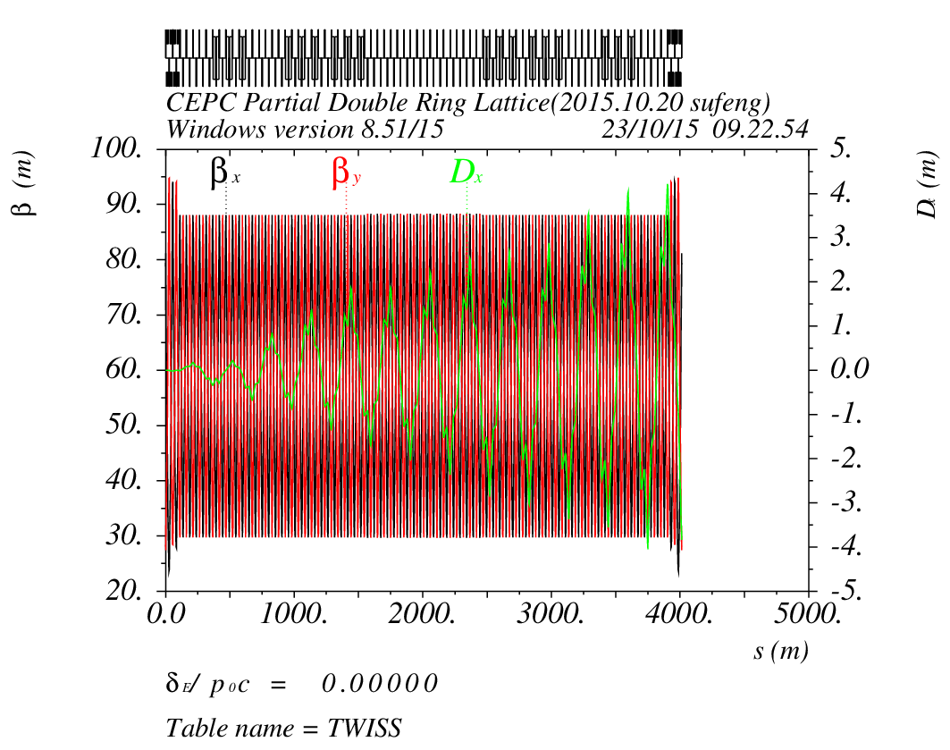
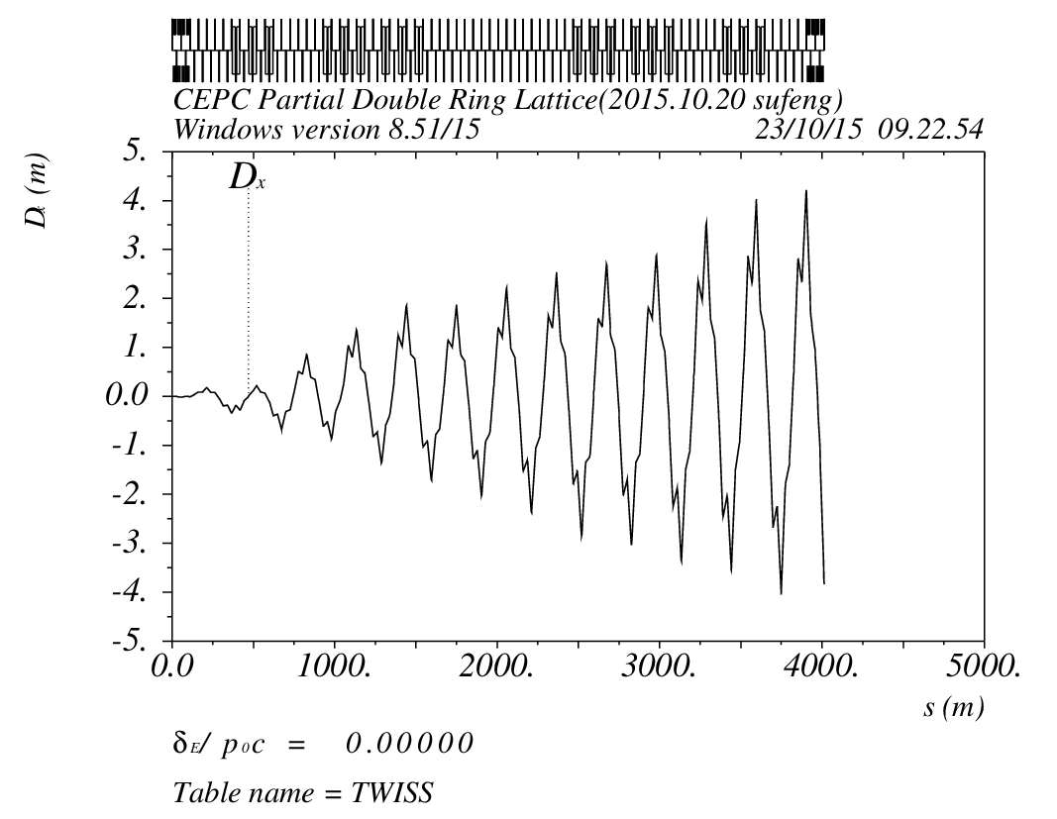
Orbit (DR_RING_e1) Version0.4
Electrostatic Seperator
目前还没有解决

Slide 17
Next to do
Electrostatic Separator 调研，安装，匹配
IR（FFS）match and Optimization
Dynamic Aperture

Slide 18
Reference
[1] CEPC-SPPC Preliminary Conceptual Design Report, The CEPC-SPPC Study Group, IHEP-CEPC-DR-2015-01.
[2] J. Gao, IHEP-AC-Note-2013-012.
[3]Xiao Ming et al, CEPC_bunch_train _ 2015-8-28
[4]Oridy, FCC-ee_150917
[5] P. Raimondi, Status on SuperB effort, La Thuile, March 11, 2006
[6]W. Kalbreier, et al, “Layout, design and construction of the electrostatic separation system of the LEP e+e- collider”, CERN, Geneva, Switzerland.
[7] R. Martin, et al, “Status of the FCC-ee interaction region design”, HF2014 Workshop, Beijing, China, 9-12 October, 2014

Slide 19
Thank You !

Slide 20
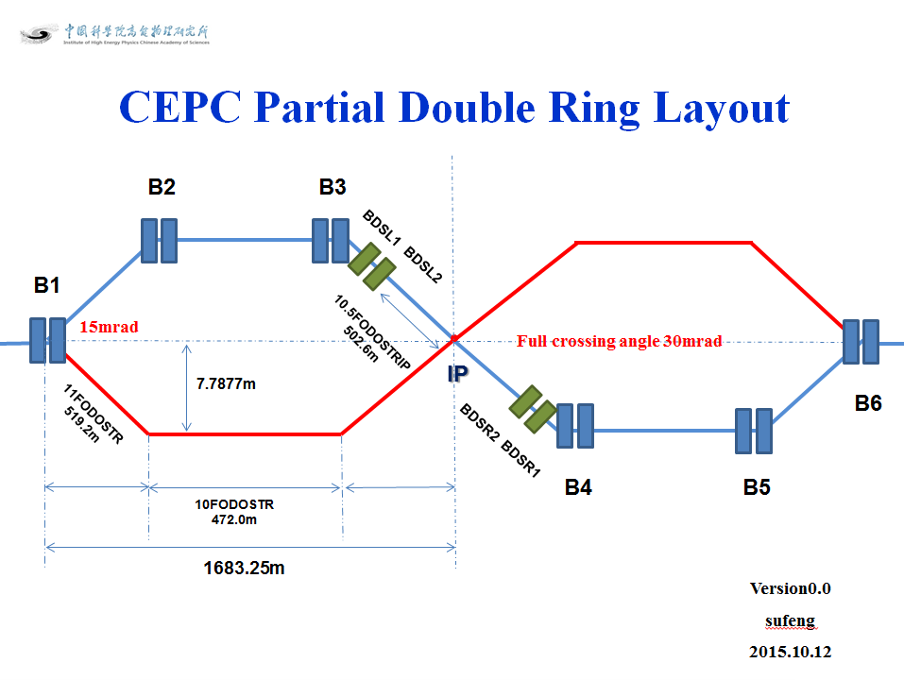
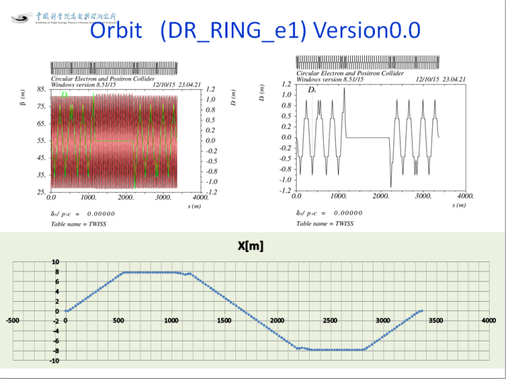
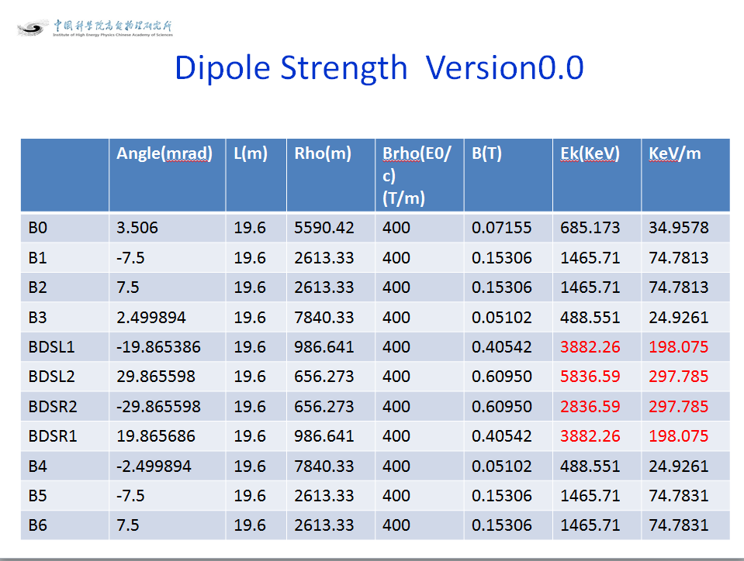
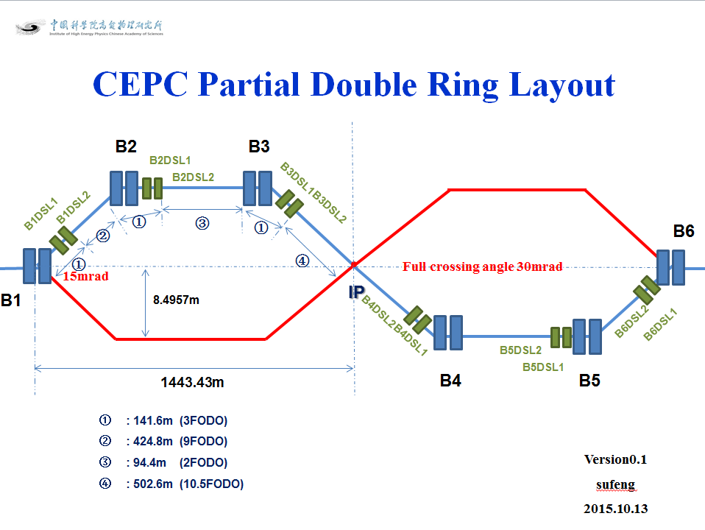
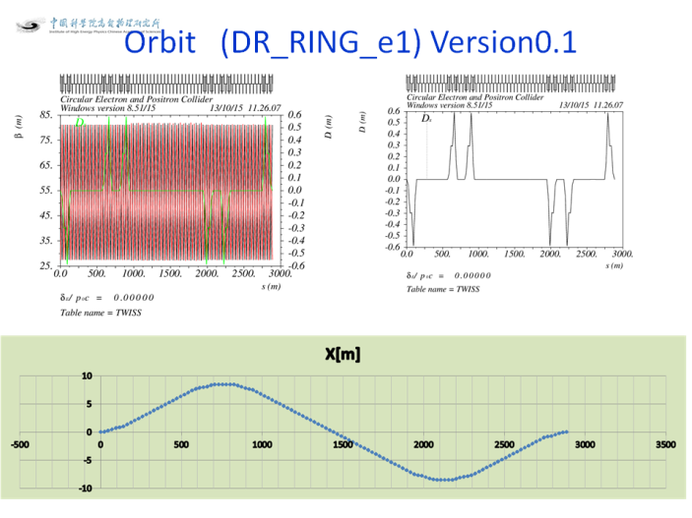
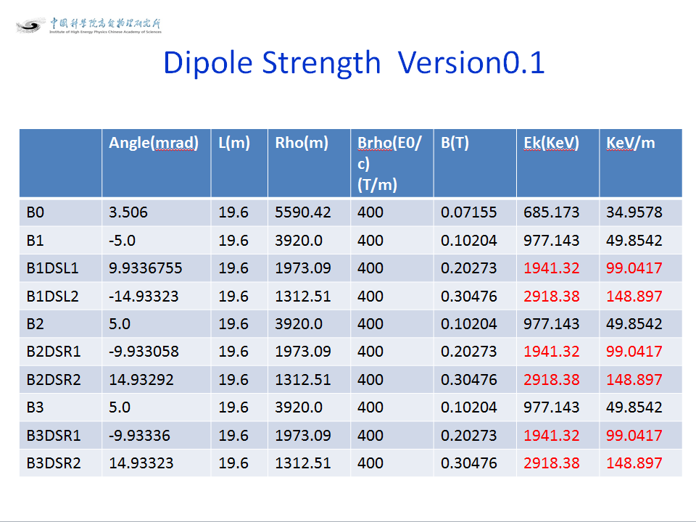
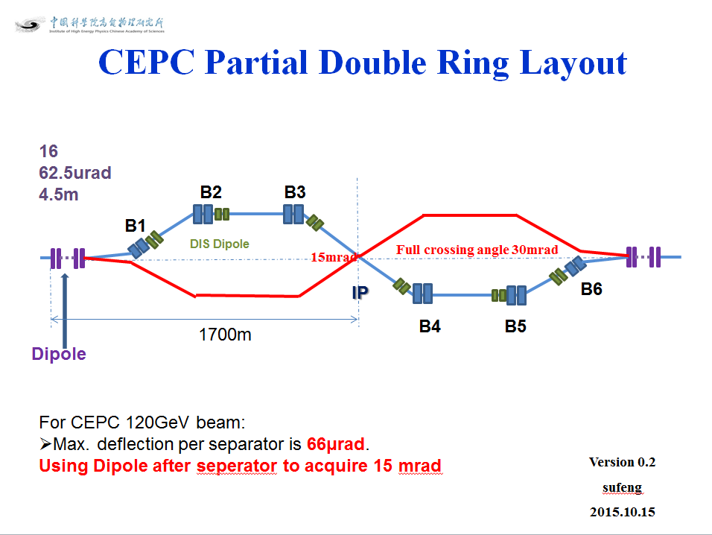
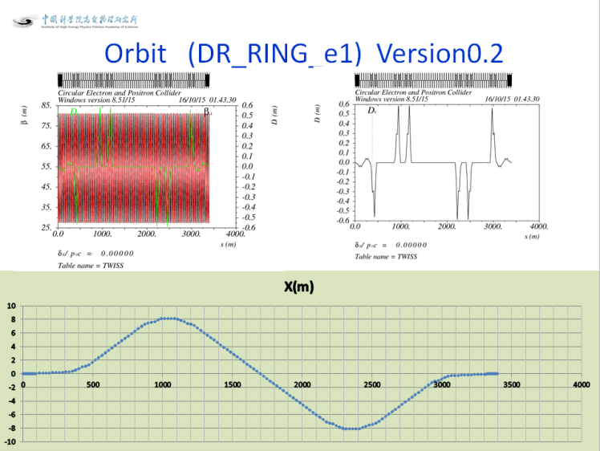
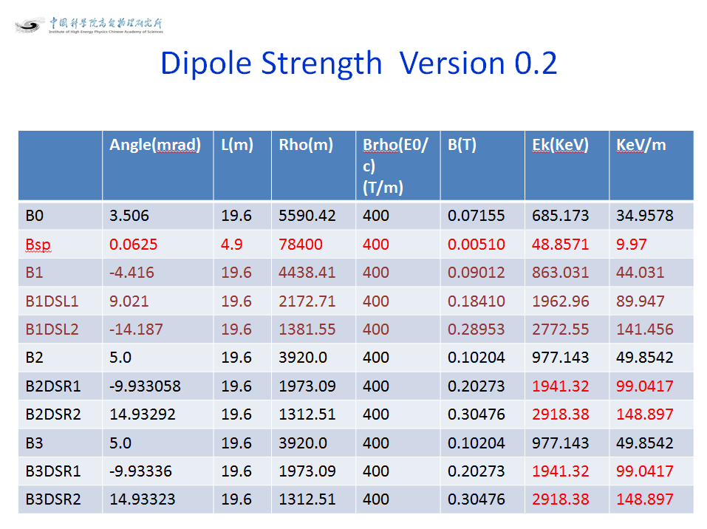

Slide 21
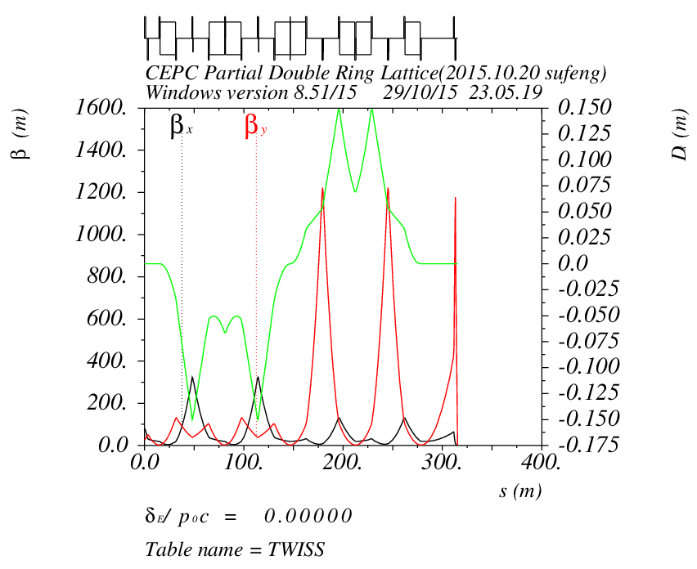
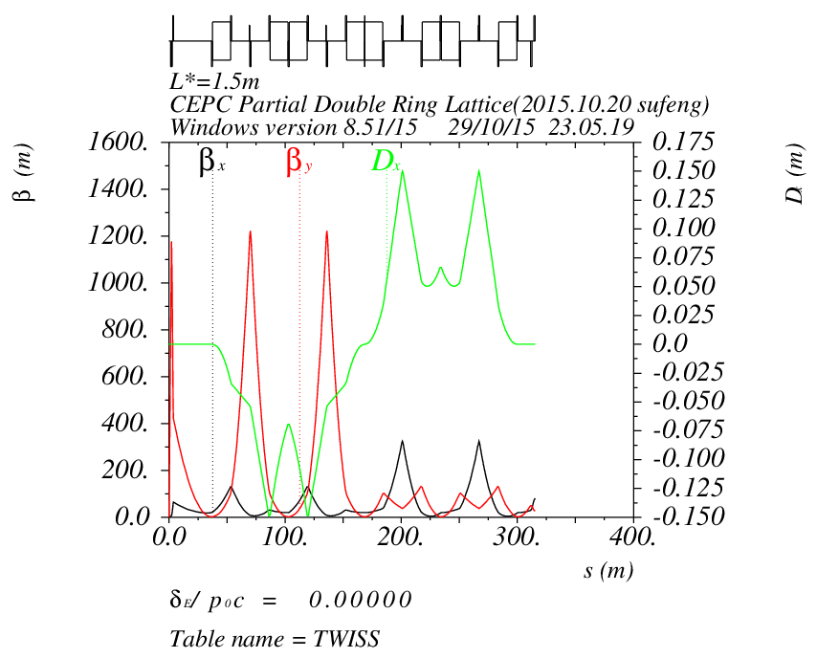
FFS Orbit （V1- Yiwei Wang）

Slide 22
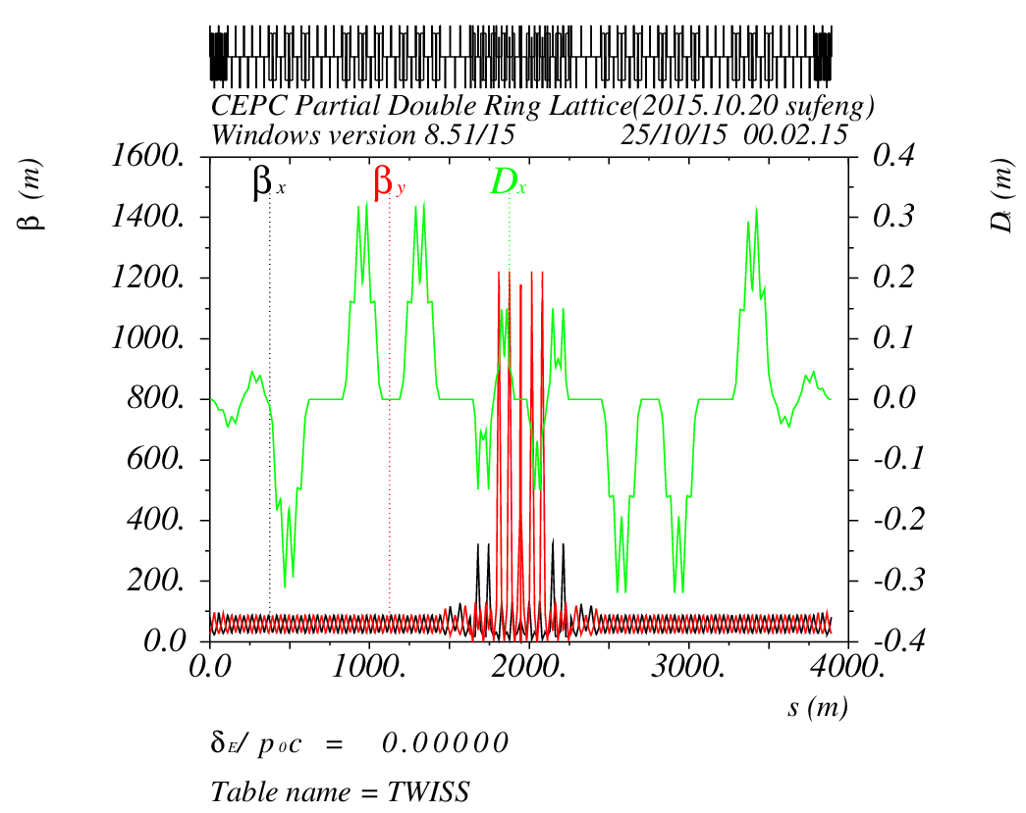
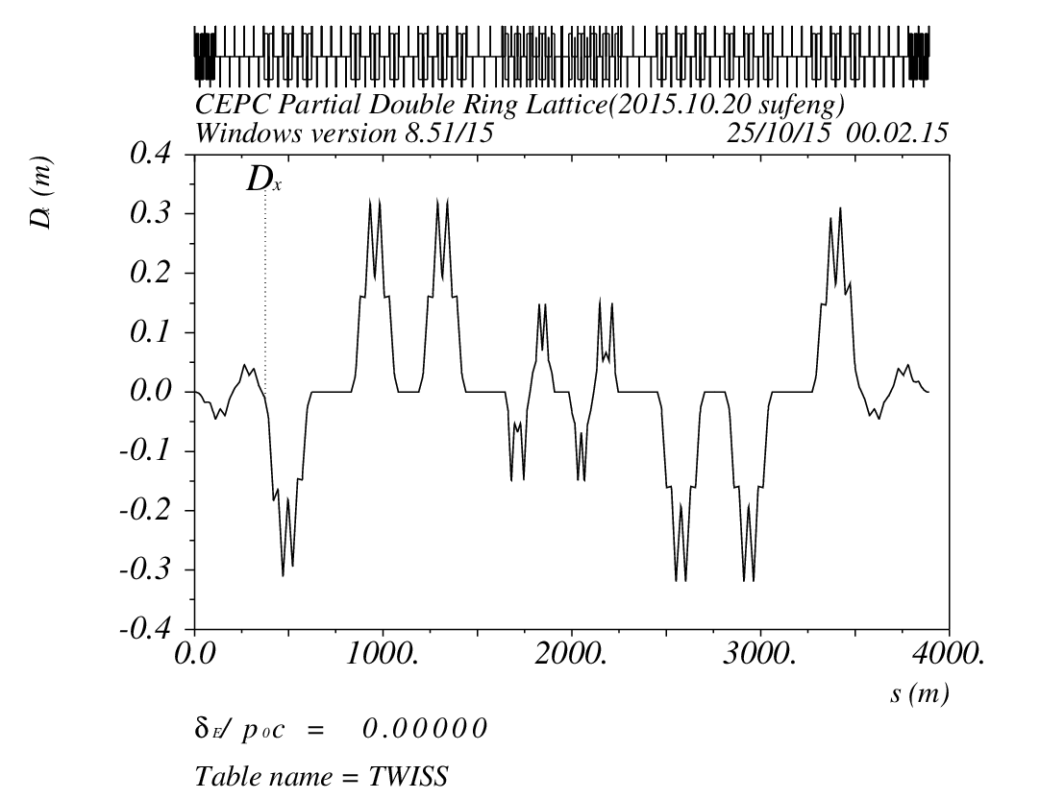
Orbit (RING3_DR_IP1) Version 0.3 + FFS(V1- Yiwei Wang)

Slide 23
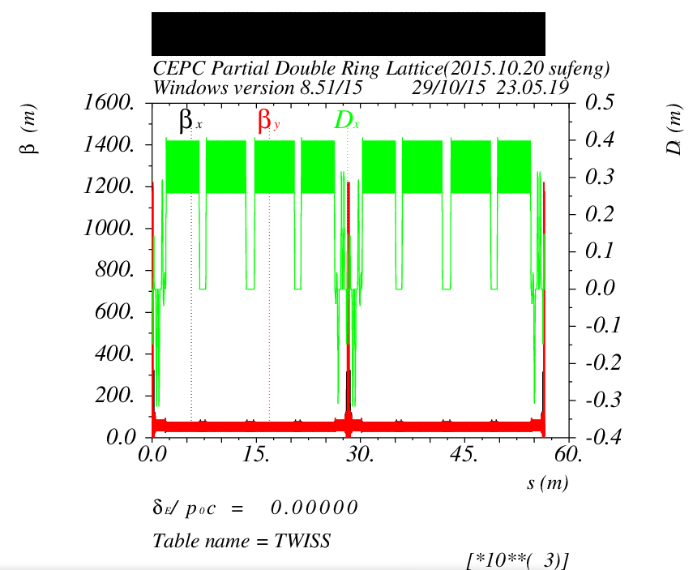
Survey & Dynamic Aperture （Version 0.3 +FFS V1- Yiwei Wang ）

Slide 24
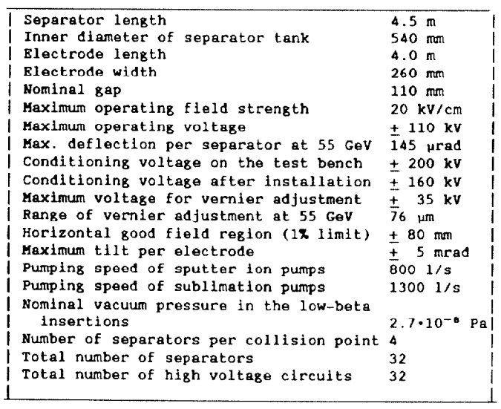
Electrostatic Separator in LEP
L=4.5m
Lelectrode=4.0m
Efield=2MV/m
E=55GeV
Angle=154urad

Slide 25
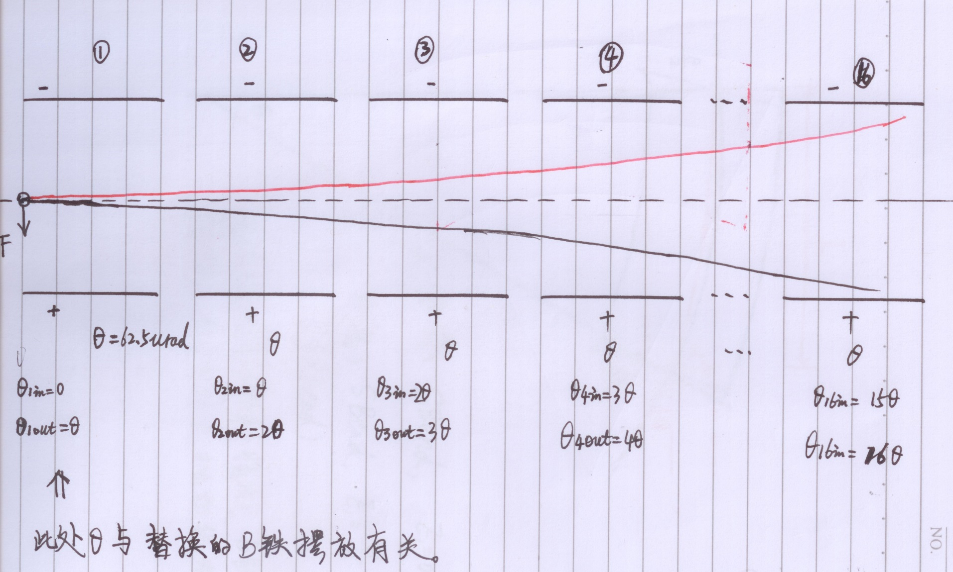
Electrostatic Separator

Slide 26
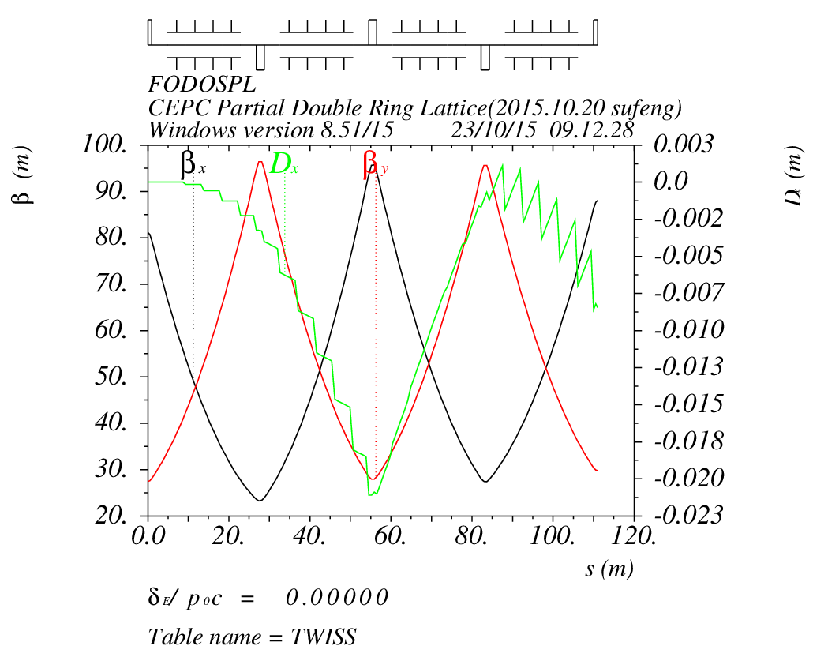
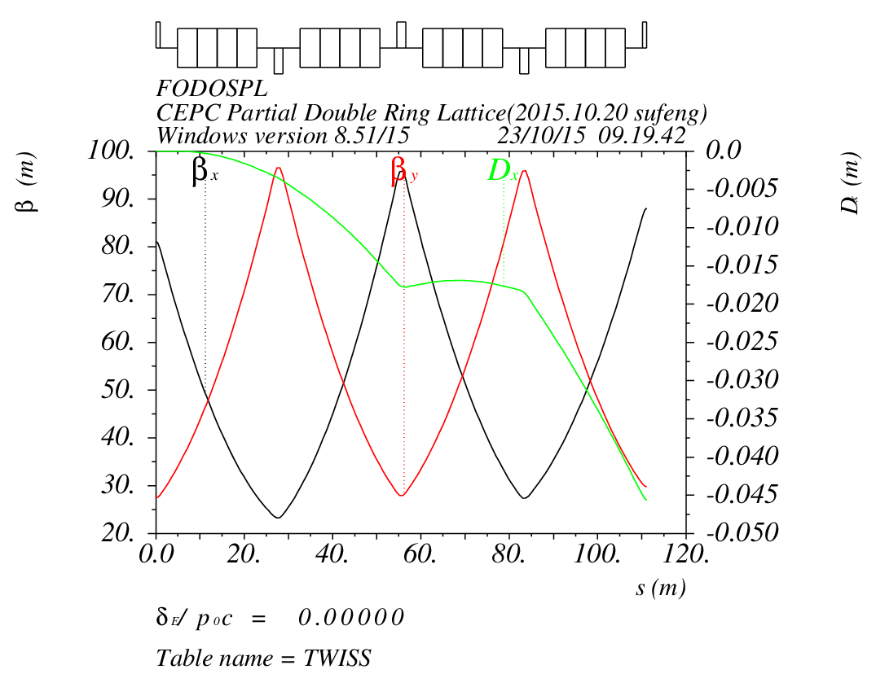
Electrostatic Separator & Dipole
Seperator :
n=16
L=4.5m
angle=62.5urad
Dipole:
n=16
L=4.5m
angle=62.5urad

Slide 27
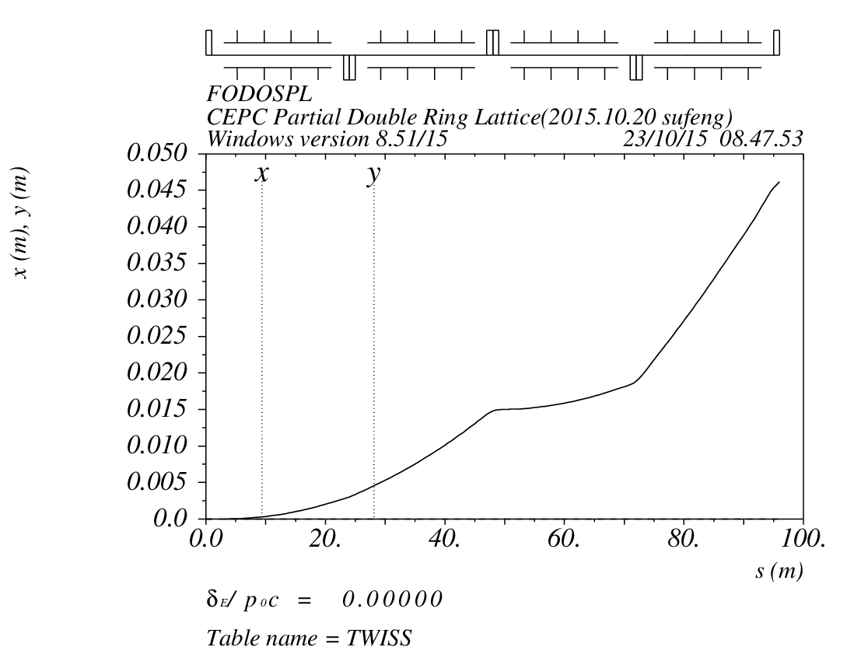
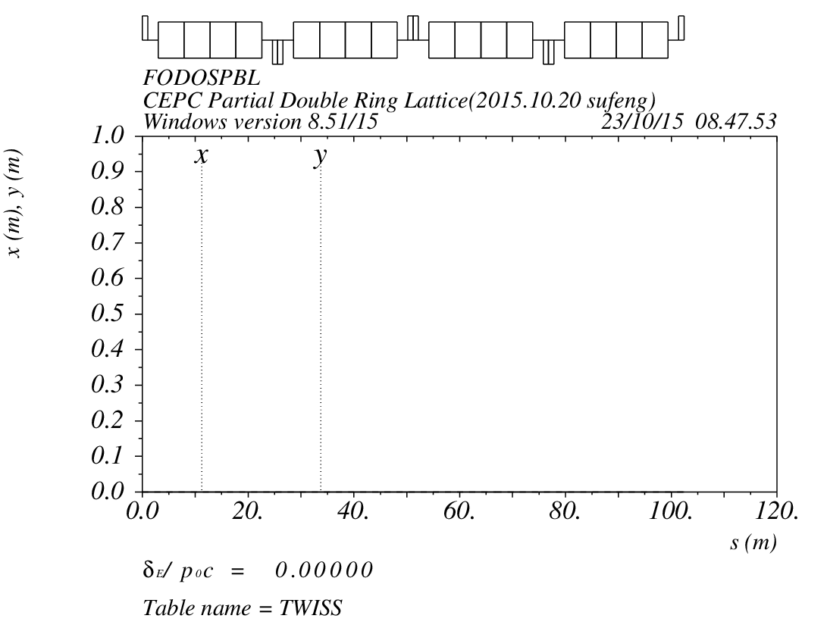
Electrostatic Separator & Dipole
Seperator :
n=16
L=4.5m
angle=62.5urad
Dipole:
n=16
L=4.5m
angle=62.5urad

Slide 28
Electrostatic Separator
存在的问题：
Electrostatic Separator的特点，参数指标和性能进一步调研
如何安装
Orbit
色散

