Slide 1
High Energy Physics Analysis in Cloud
Yaodong Cheng, CC-IHEP, CAS
chyd@ihep.ac.cn

Slide 2
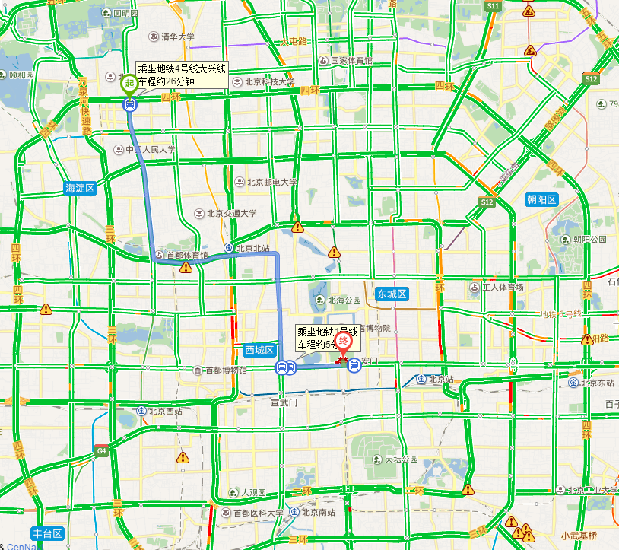
Kingsoft kuaipan
Cloud computing is all around us!

Slide 3
Contents
Introduction to cloud technology
Cloud for scientific computing
Computing model transition in HEP
IHEP Cloud
Notes:
Is cloud suitable for scientific computing?

Slide 4
Contents
Introduction to cloud technology
Cloud for scientific computing
Computing model transition in HEP
IHEP Cloud
Notes:
Is cloud suitable for scientific computing?

Slide 5
A Golden Era in Computing
Powerful multi-core processors
General purpose graphic processors
Superior software methodologies
Virtualization leveraging the powerful hardware
Wider bandwidth for communication
Proliferation of devices
Intel Many Integrated Core Architecture

Slide 6
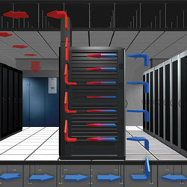
A Lot of Servers/Machines
The data-center is FULL
Full of under utilized servers (<10%)
Complicate in management
Power consumption
Greater wattage per unit area than ever
Electricity overloaded
Cooling at capacity
IT now represents around 10 per cent of the world's electricity generation
Second place after Aviation Industry
Environmental problem
Green IT

Slide 7
Virtualization
Virtualization – improve the utilization of server
the abstraction of computer resources.
Virtualization hides the physical characteristics of computing resources from their users
This includes making a single physical resource (such as a server, an operating system, an application, or storage device) appear to function as multiple virtual resources
one → multiple
It can also include making multiple physical resources (such as storage devices or servers) appear as a single virtual resource
multiple → one

Slide 8
Virtualization -- a Server for Multiple OS
Applications
Application
Application
Application
Application
Applications
Operating
System
Operating
System
Operating
System
Operating
System
Operating
System
Operating
System
Hypervisor
Hardware
Hardware
Hypervisor is a software program that manages multiple operating systems (or multiple instances of the same operating system) on a single computer system.
The hypervisor manages the system's processor, memory, and other resources to allocate what each operating system requires.
Hypervisors are designed for a particular processor architecture and may also be called VMM (Virtual Machine Manager).

Slide 9
Virtualization ≠ clouds
A cloud computing environment can provide one or more of these requirements for a cost
platform (PaaS),
software (SaaS),
infrastructure (IaaS),
Services-based application programming interface (API)
Pay as you go model of business
When using a public cloud the model is similar to renting a property than owning one.
An organization could also maintain a private cloud and/or use both.

Slide 10
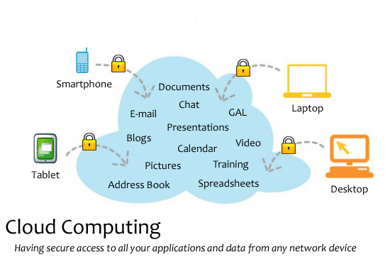

Slide 11
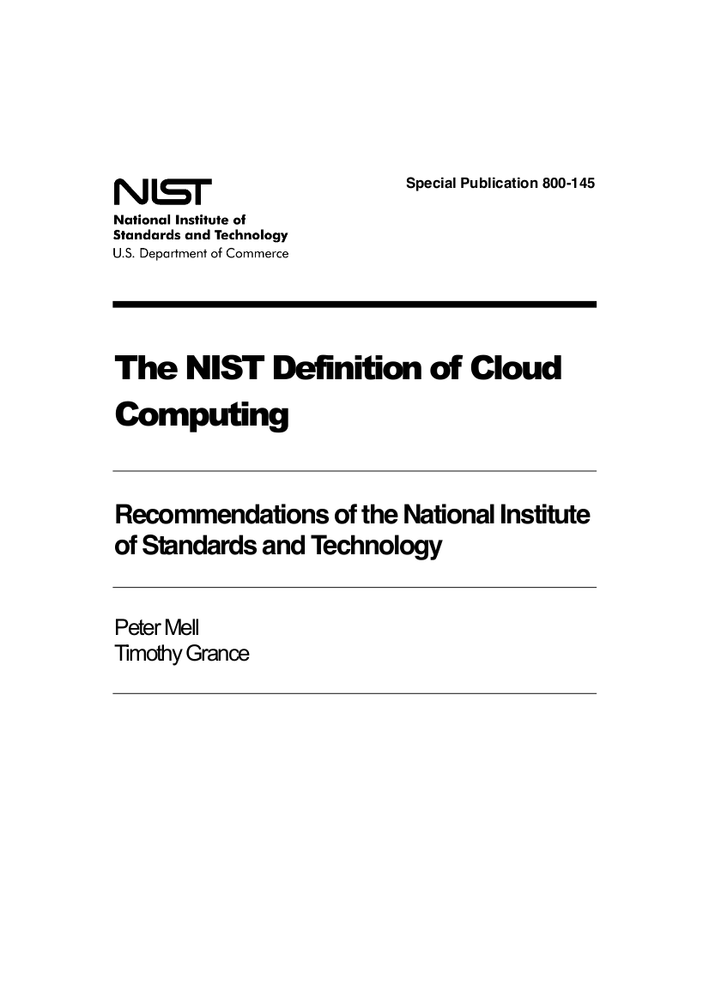
What is Cloud?
NIST: Best Definitions
Essential characteristics (5)
On-demand self-service
Broad network access
Resource pooling
Rapid elasticity
Measured service
Service models (3)
IaaS, PaaS, SaaS
Deployment models (4)
Public, private, community, hybrid
http://csrc.nist.gov/publications/nistpubs/800-145/SP800-145.pdf

Slide 12
Service Models
What functionality does a cloud provide to users?

Slide 13
SaaS: Software as a Service
Software as a Service (Saas)
End-users
Platform as a Service (Paas)
Infrastructure as a Service (Iaas)
Advantages
Disadvantages
Simple use: web interface; no software installation
Very accessible: laptop, smartphone, …
Data questions: access, ownership, reliability, etc.
Integration (mash-up) is often difficult

Slide 14
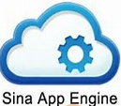
PaaS: Platform as a Service
Software as a Service (Saas)
Developers
Platform as a Service (Paas)
Infrastructure as a Service (Iaas)
Advantages
Disadvantages
Programmers can forget about low-level plumbing
Load balancing; automatic failover, etc.
Restricted number of languages
Applications not portable between different providers
Notes:
Usually, PaaS deliver service through API method.

Slide 15
Google App Engine
This is more a web interface for a development environment that offers a one stop facility for design, development and deployment Java and Python-based applications in Java, Go and Python.
Google offers the same reliability, availability and scalability with Google’s own applications
Interface is software programming based
Comprehensive programming platform irrespective of the size (small or large)
Signature features: templates and appspot, excellent monitoring and management console

Slide 16
Windows Azure
Enterprise-level on-demand capacity builder
Fabric of cycles and storage available on-request for a cost
You have to use Azure API to work with the infrastructure offered by Microsoft
Significant features: web role, worker role , blob storage, table and drive-storage

Slide 17
IaaS: Infrastructure as a Service
Software as a Service (Saas)
Service Providers
Platform as a Service (Paas)
Infrastructure as a Service (Iaas)
Advantages
Disadvantages
Full control over machine; access as “root”
Customized environment, down to operating system
No std. machine format
Difficult to migrate between different providers

Slide 18
Amazon EC2
Amazon EC2 (Elastic Compute Cloud) is one large complex web service.
EC2 provided an API for instantiating computing instances with any of the operating systems supported.
It can facilitate computations through Amazon Machine Images (AMIs) for various other models.
Signature features: S3 (simple storage service), Cloud Management Console, MapReduce Cloud, Amazon Machine Image (AMI)
Excellent distribution, load balancing, cloud monitoring tools

Slide 19
Service model stack
Infrastructure
(as a service)
Platform
(as a service)
software
(as a service)
User Manage
Applications
Applications
Applications
User Manage
Runtimes
Runtimes
Runtimes
Security & Integration
Security & Integration
Security & Integration
Managed by vendor
Managed by vendor
Databases
Databases
Databases
Servers
Servers
Servers
Managed by vendor
Virtualization
Virtualization
Virtualization
Server HW
Server HW
Server HW
Storage
Storage
Storage
Networking
Networking
Networking

Slide 20
Deployment Models
Who are the targeted users?

Slide 21
Deployment Models: Private
private
community
public
Single administrative domain, limited number of users
Informal resource allocation via ‘hallway conversations’
E.g. running cloud for site services, managed by group of system administrators

Slide 22
Deployment Models: Public
private
community
public
People outside of cloud provider’s institute; aimed at the general public
Resource allocation by payment
E.g. Amazon Web Services (EC2, S3, …)
Notes:
EC2: Elastic Computing Cloud
S3: Simple Storage Serivce

Slide 23
Deployment Models: Community
private
community
public
Different institutes but with common interests and procedures
‘Horse trading’ used to allocate resources between individuals and groups
E.g. bioinformatics community in France

Slide 24
Contents
Introduction to cloud technology
Cloud for scientific computing
Computing model transition in HEP
IHEPCloud
Notes:
Is cloud suitable for scientific computing?

Slide 25
Deployment Models: Hybrid
private
community
public
hybrid
Combination of other deployment models
Used for redundancy and/or peaks in demand
E.g. “Sky” computing, brokered federation, bursting, …

Slide 26
Traditional Scientific computing
Login Node
Login Node
(UI)
Submit
Job
Submit
Job
result
result
Cluster Job Mngt. server
Grid Job Mngt. server
Dispatch Job
to grid site
Dispatch
Job
Grid Site
Grid Site
Grid Site
Dispatch
Job
computing Node
Cluster Job
Mngt. Server
LSF
computing Node
Cluster
Grid: Cluster of Cluster

Slide 27
Barriers for Adoption of Grid Model
High degree of heterogeneity (software & hardware)
High operational costs
Isolate and partition amount of resources contributed to the Grid
Specific environment requirements for different VOs
Grids are difficult to maintain, operate and use

Slide 28
Virtualization
Separation of Virtual Machine from Physical Infrastructure
A VM is an isolated runtime environment (guest OS and applications)
Applications
VM
Applications
VM
Applications
VM
Guest OS
Guest OS
Guest OS
Virtualization Platform (Xen, KVM, VMware…)
Physical Box
Benefits of Virtualization Platforms
Natural way to deal with the heterogeneity of the infrastructure
Allow partitioning and isolating of physical resources
Execution of legacy applications

Slide 29
VM Manager
VM Manager creates a distributed virtualization layer
decouple the VM from the physical location
Transform a distributed physical infrastructure into a flexible and elastic virtual infrastructure
Centralized management
Balance of workload
Server consolidation
Dynamic resizing of the infrastructure
Dynamic cluster partitioning
Support for heterogeneous workloads
On-demand provision of VMs
Application
…
Application
Guest OS
…
Guest OS
VM Manager
hypervisor
…
hypervisor

Slide 30
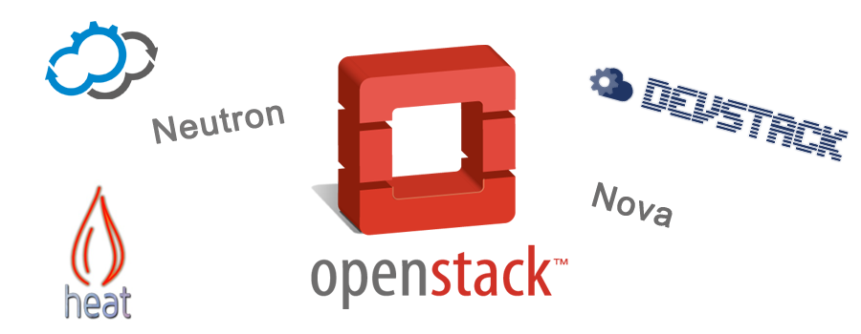
Openstack
a popular VM manger, also called cloud operating system
Controls large pools of compute, storage, and networking resources throughout a data center
Hundreds of the world’s largest brands rely on OpenStack to run their businesses every day
Austin (2010.1)
Bexar (2011.1)
Cactus (2011.2)
Diablo (2011.3)
Essex (2012.2)
Folsom (2012.2)
Grizzly (2013.1)
Havana (2013.2)
Icehouse (2014.1)
Juno (2014.2)
Kilo (2015.1)
Liberty (2015.10)
Mitaka (Under Dev)
Openstack release

Slide 31
Virtualization of a Computing Cluster
New virtualization layer between the service and the infrastructure layers
Seamless integration with the existing middleware stacks.
Completely transparent to the computing service and end users
PBS
Virtualized PBS nodes
Virtual machines
Openstack
Dedicated SGE working physical nodes
VMM
VMM
VMM
VMM
Physical machines

Slide 32
Integration of a Virtualized Cluster within a Grid
Grid Applications
Grid interfaces (DRMAA...)
Applications
GridWay
Dynamic scheduling
Fault detection & recovery
Virtual resources are exposed by Gridway
MDS
GRAM
GridFTP
Grid Middleware
Cluster Frontend (PBS)
Local computing resources
Local Computing Infrastructure
Openstack
Grid and central services virtualization
Coexist with other services
VMM
VMM
VMM
Physical Infrastructure Layer
Notes:
Distributed Resource Management Application API

Slide 33
Benefits of Virtualization for Grid
The virtualization of the local infrastructure provides:
Easy support for VO-specific worker nodes
Reduce gridification cycles
Dynamic balance of resources between VO’s
Fault tolerance of key infrastructure components
Easier deployment and testing of new middleware distributions
Distribution of pre-configured components
Cheaper development nodes
Simplified training machines deployment
Performance partitioning between local and grid services
Solve many of the obstacles for Grid adoption

Slide 34
Cloud for Scaling out Local Infrastructures
On-demand Access to Commercial Cloud Resources
Supplement local resources with cloud resources to satisfy peak demands
PBS
Submit jobs
Openstack
Amazon EC2
VMM
VMM
Hybrid Cloud

Slide 35
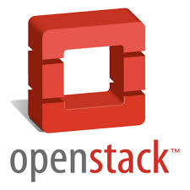
CERN Cloud
CERN Cloud Service is one of the three major components in CERN IT’s AI project
Policy: Servers in CERN IT shall be virtual
It will be a milestone for scientific cloud
Based on OpenStack
Production service since July 2013
Performed three rolling upgrades
Currently in transition from Juno to Kilo
Nova, Glance, Keystone, Horizon, Cinder, Ceilometer, Heat
Notes:
AI: Agile Infrastructure

Slide 36
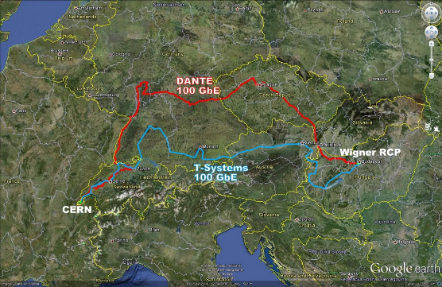
CERN Cloud Architecture
Two data centers
Myrin Geneva, and Wigner Hungary
1 region (1 API), 26 cells
Cells map use cases hardware, hypervisor type, location, users, …
Top cell on several physical nodes in HA
Clustered RabbitMQ with mirrored queues
API servers are VMs in various child cells
Child cell controllers are OpenStack VMs
One controller per cell
Tradeoff between complexity and failure impact

Slide 37
Top cell controller
rabbitmq
API server
nova-api
nova-cells
DB infrastructure
Child cell controller
Child cell controller
nova-api
nova-api
rabbitmq
rabbitmq
nova-scheduler
nova-scheduler
nova-cells
nova-cells
nova-conductor
nova-conductor
nova-network
nova-network
Compute node
Compute node
nova-compute
nova-compute

Slide 38
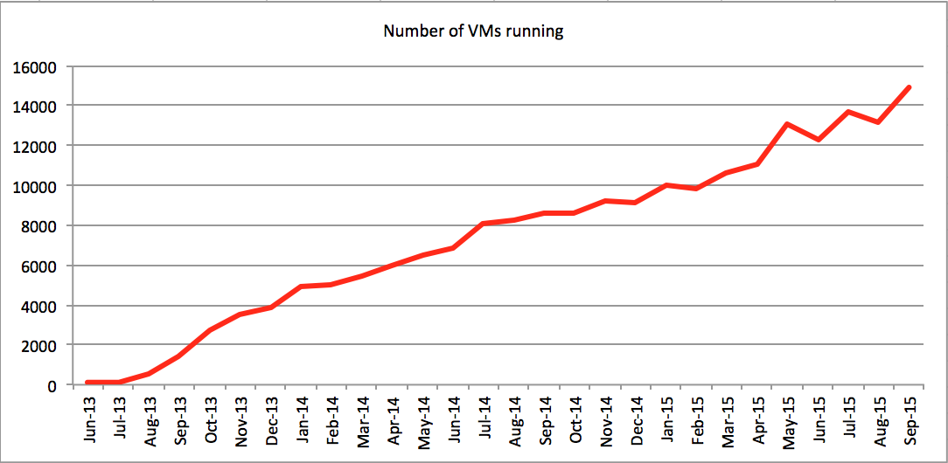
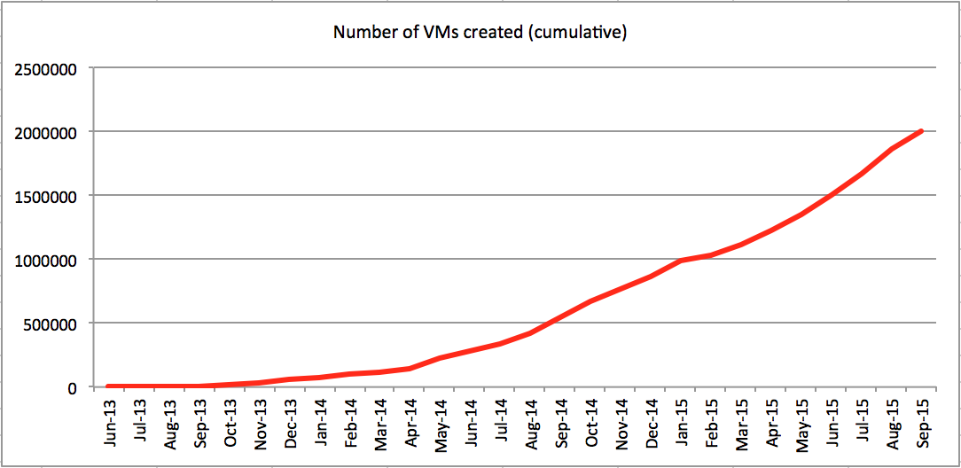
CERN Cloud in Numbers (1)
4’600 hypervisors in production (1y ago: 3000)
Majority qemu/kvm now on CC7 (~150 Hyper-V hosts) (SLC6)
~2’000 HVs at Wigner in Hungary (batch, compute, services) (batch)
250 HVs on critical power
125k Cores
250 TB RAM
~15’000 VMs
To be increased in 2016!
+65k cores until spring
One of largest openstack deployment in the world

Slide 39
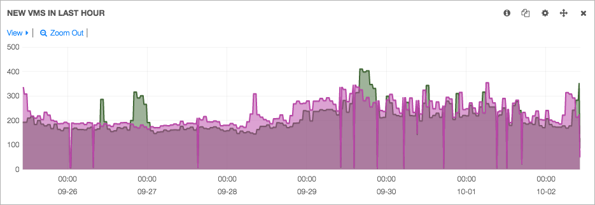
CERN Cloud in Numbers (2)
Every 10s a VM gets created or deleted in CERN cloud!
2’000 images/snapshots
Glance on Ceph
1’500 volumes
Cinder on Ceph (& NetApp)

Slide 40
Performance problem
HS06: HEP-wide benchmark for measuring CPU performance
CERN: The “20% overhead” problem
HS06 rating of full node VMs was ~20% lower than on the underlying host
Full node VMs are needed to the limit of the total number of hosts in LSF
Smaller VMs behaved much better: ~8%
The sum of simultaneous HS06 runs on 4x 8-core VMs on a 32-core host
Better, but still pretty high
IN2P3 reported significant performance penalties for ATLAS MC jobs when EPT* was switched on
26% vs. 6% in wall clock time for EPT on vs. EPT off compared to bare metal
Surprising as EPT is supposed to make things faster
*EPT: Extended Page Tables is Intel’s implementation of a hardware-assisted virtualization technology for page table management (secondary address translation or nested pages). AMD’s implementation is called RVI (Rapid Virtualization Indexing).
Notes:
HEP-SPEC06

Slide 41
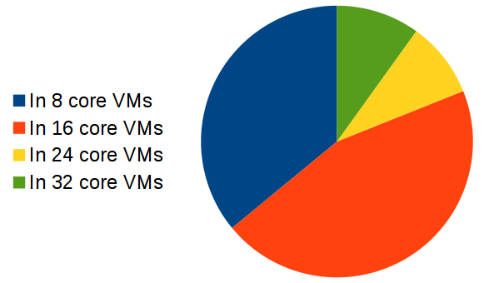
Core Distribution & Effective Impact
Small VMs (8 or 16 cores) | Large VMs (24 or 32 cores)
Closer to bare metal performance | Better memory flexibility
Closer to LSF* limitations (less of a problem after instance split) | Higher performance penalty
Take into account the core distribution over VM flavors to determine real loss (7-8%)
*LSF is a commercial cluster job management system used at CERN

Slide 42
Contents
Introduction to cloud technology
Cloud for scientific computing
Computing model transition in HEP
IHEPCloud
Notes:
Is cloud suitable for scientific computing?

Slide 43
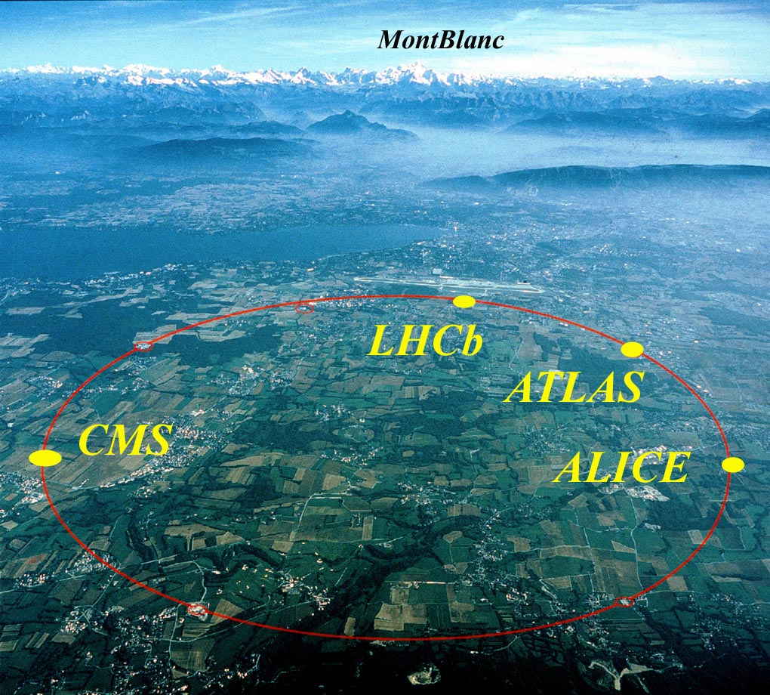
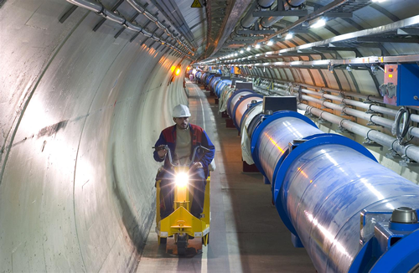
LHC: Large Hadron Collider at CERN Geneva
27km circumference
100m underground

Slide 44
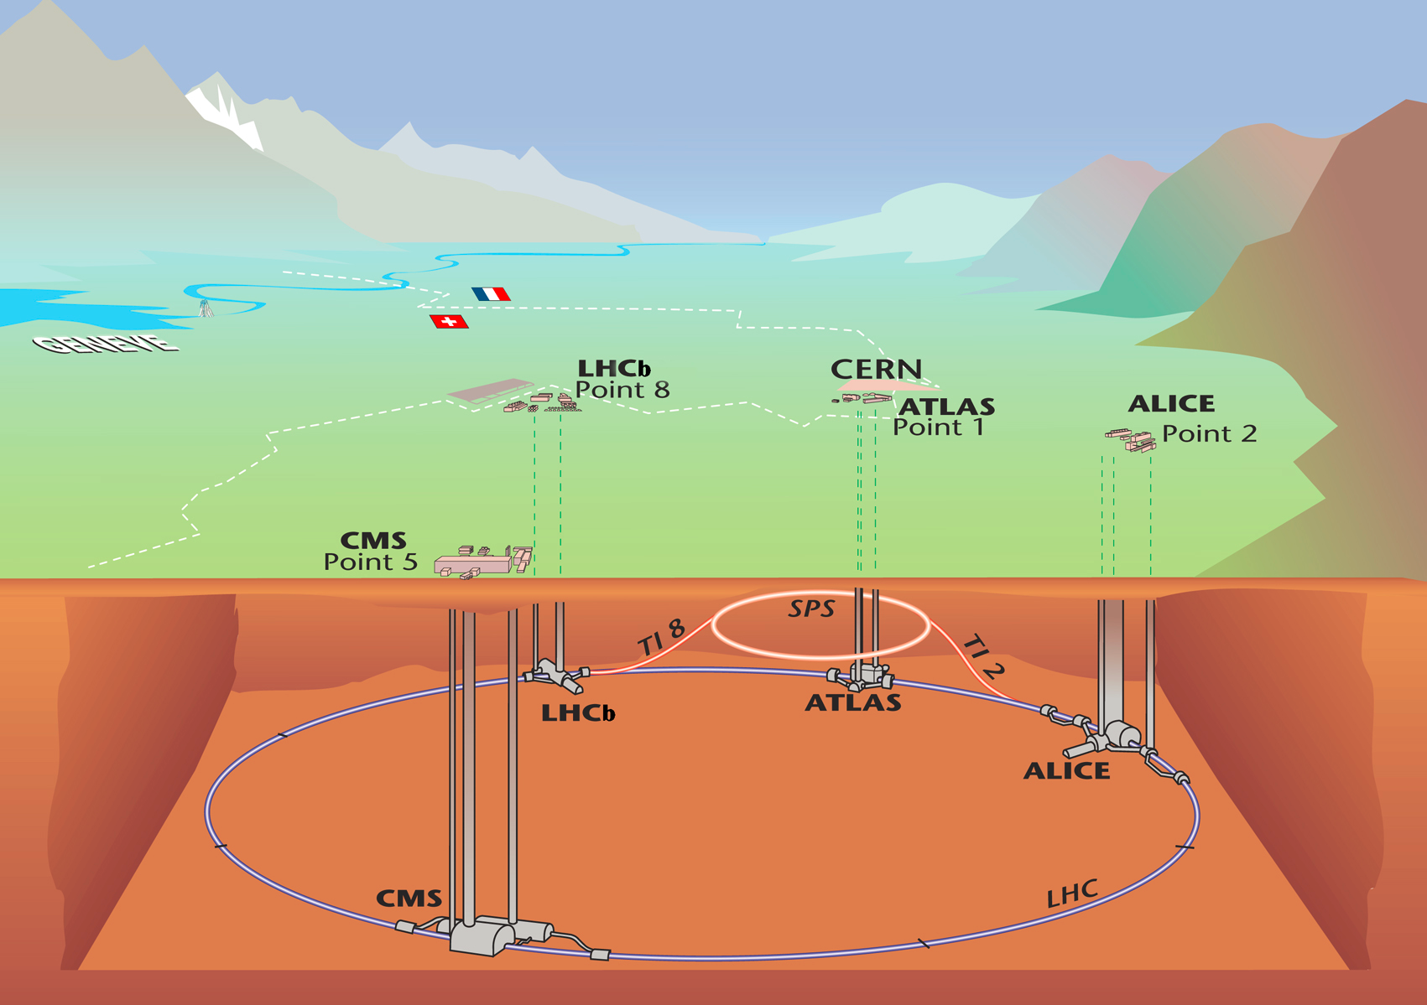
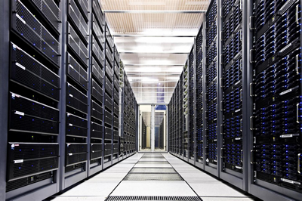
LHC: Data challenge
Offline
~ 30PB per year
~ distributed analysis globally
Selection
Reduction
Online
~ 40M Hz collisions
~ 1PB/sec

Slide 45
Run 1: six million billion proton-proton collisions
Higgs: 400 events
15,000,000,000,000 : 1
Notes:
https://sciencenode.org/visualization/animation-shows-large-hadron-collider-data-processing.php
http://which-50.com/blog/2015/august/03/this-is-what-big-data-really-looks-like-cern-the-universe-and-everything

Slide 46
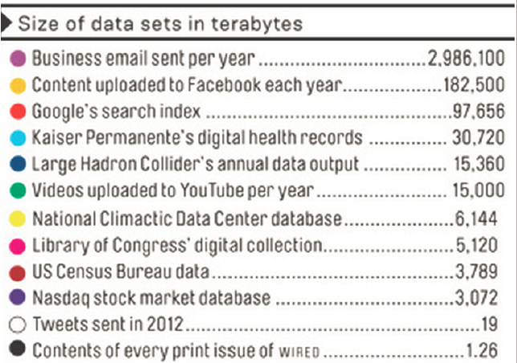
LHC data
LHC Raw data
(15PB)
Data produces in 2012
~140PB totally
Business EMAIL
(2986TB)
Google
(97PB)
Facebook
(182TB)
http://www.wired.com/2013/04/bigdata

Slide 47
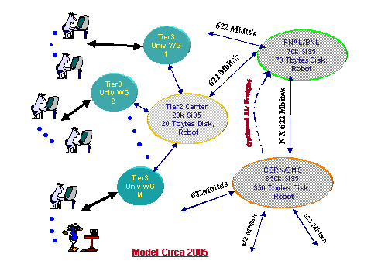
MONARC Project
Models of Networked Analysis at Regional Centres for LHC Experiments
Launched since 1998
Proposed LHC tier model
more than 100 times of
resources increased
today
Model is still there
Notes:
http://monarc.web.cern.ch/MONARC/

Slide 48
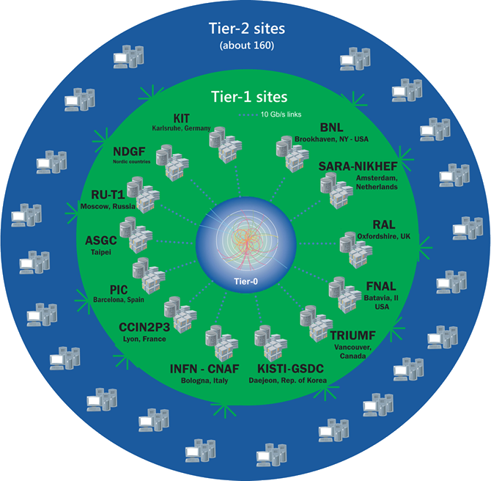
WLCG Grid
Worldwide Lhc Computing Grid
42 countries, 170 computing centers
Tier0: CERN
First copy (safe-keeping of the raw data)
First pass reconstruction
distribution of raw data and reconstruction output to the Tier 1s
Tier1: 13 large computer centers
sufficient storage and computing
round-the-clock support for the Grid
distribution of data to Tier 2s
Tier2: 160+ sites
universities and other scientific institutes
analysis, production and reconstruction
Tier3: local computing resources

Slide 49
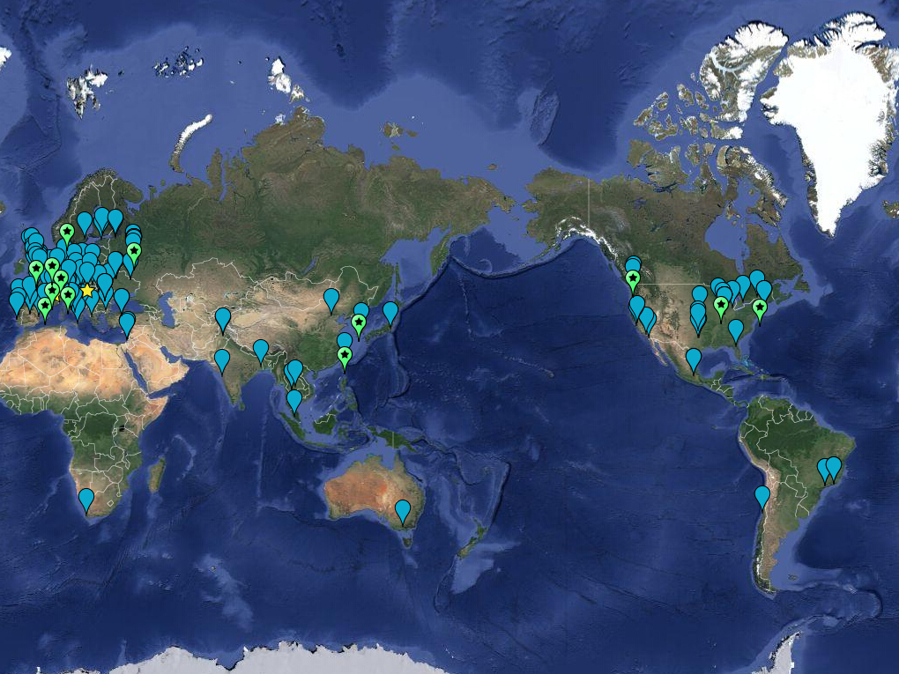
WLCG sites

Slide 50
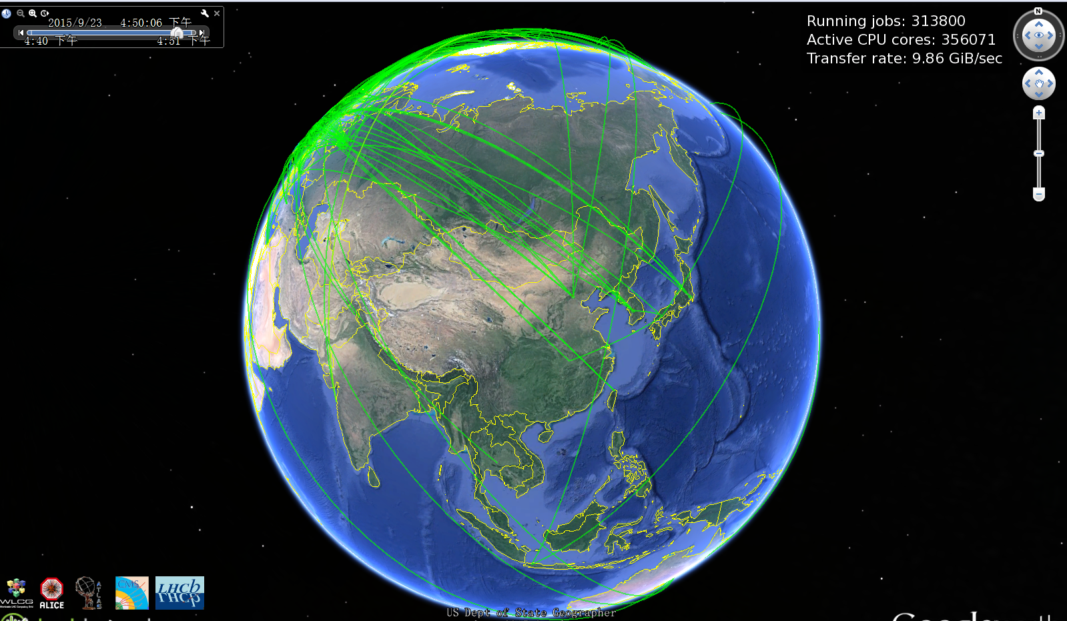
IHEP

Slide 51
Grid computing
Grids are providing common infrastructure and rules to integrate multiple computing centers
Common computing element access protocols
Common user payload scheduling system
Common policies and security rules
User are signing up once and have access to multiple computing centers
Common monitoring of the user job
Common accounting of computing
resources

Slide 52
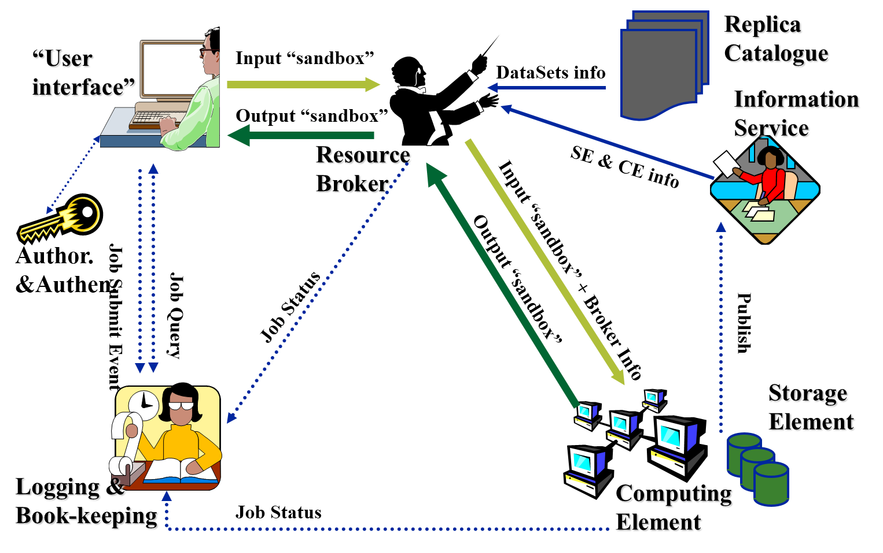
Grid middleware

Slide 53
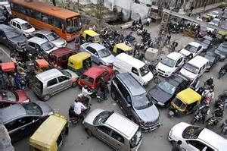
Standard grid problems
Heavy reliance on the site status information flow
Any delays result in suboptimal scheduling decisions
Insufficient RB power for large infrastructures
Necessity to deploy multiple central RB’s
Heavy infrastructures required on the sites resources providers
Providing timely status, accounting and monitoring information
Ensuring per user authentication / authorization
Managing community policies via local batch queues parameterization

Slide 54
Pilot job mechanism
Physicist
Job manager
Experiment
job managemer
Grid WMS
“pull” user job
“Push” Pilot jobs
Pilot
Pilot
Pilot
Grid site 1
Grid site 2
Grid site N

Slide 55
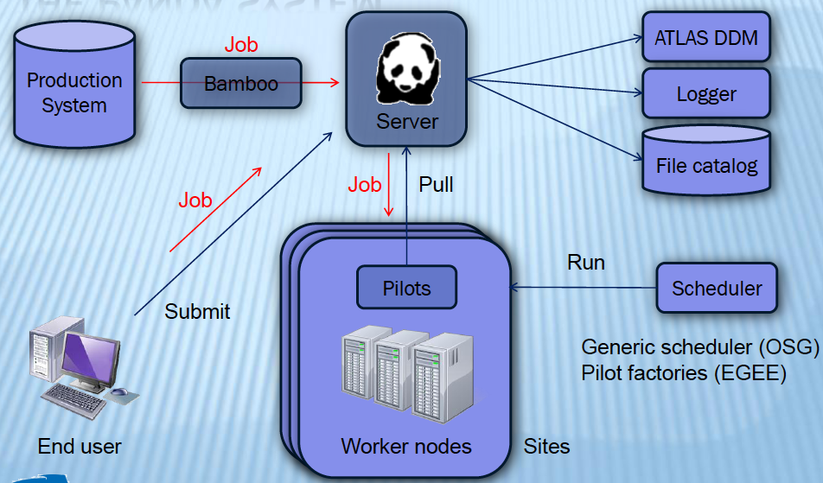
PanDA
PanDA - the Production and Distributed Analysis system for the ATLAS Experiment

Slide 56
Cloud resources provided through VMs running Co-Pilot Agent
Storage Element
Logical File Catalog
Co-Pilot Client
Co-Pilot
Job Manager
Co-Pilot Storage Manager
CernVM Co-Pilot

Slide 57
Dirac
Distributed Infrastructure with Remote Agent Control
DIRAC is developed originally for the LHCb experiment at with the goals:
Integrate all the heterogeneous computing resources available to the community
Provide solution for both WMS and DMS tasks
Minimize human intervention at sites providers of resources
Make the grid convenient for the users:
DIRAC has introduced a notion of Pilot Jobs
A concept of distributed agents bringing together various joint computing resources

Slide 58
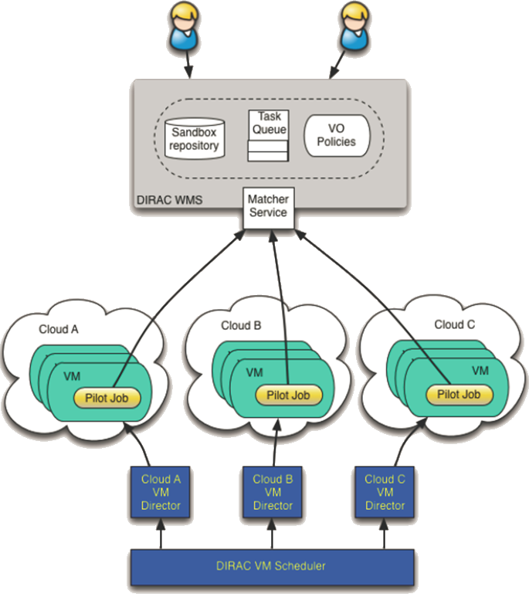
Dirac – clouds integration
VM scheduler developed for Belle MC production system
Dynamic VM spawning taking Amazon EC2 spot prices and Task Queue state into account
Discarding VMs automatically when no more needed
The DIRAC VM scheduler by means of dedicated VM Directors is interfaced to
OCCI compliant clouds:
OpenStack, OpenNebula
CloudStack
Amazon EC2

Slide 59
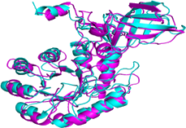
Volunteer computing (VC)
The computing resources are donated by volunteering users
Cluster, PC, Mobile, …
Advantages
Cheap
Involved in science for public
SETT@home: Extra-Terrestrial Intelligence
CAS@home
Hosted by IHEP, CAS
the first VC project in China
Applications
protein structure prediction application (ICT)
more than 47,000 hosts with 249,000 cpu cores, 3Tera FLOPS
equal to $2400/hour, and $29M totally
Boinc
Open-source software for volunteer computing

Slide 60
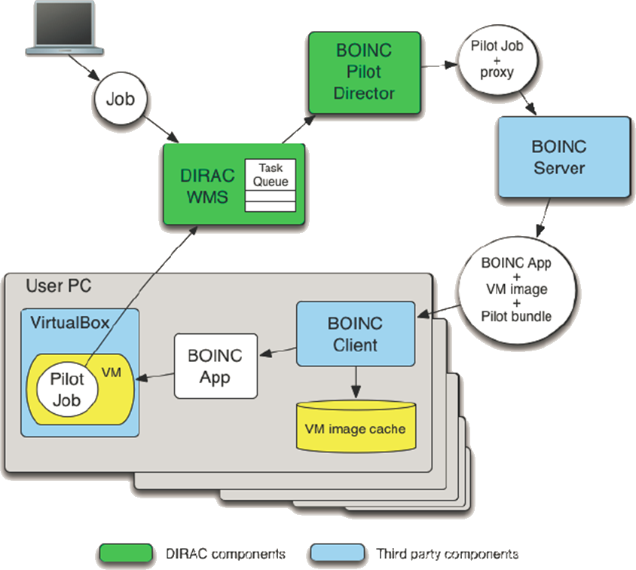
BOINC Desktop Grids
Problem: complicated running environment prohibit applications on VC
Solution: virtualization
On the client PC the third party components are installed:
VirtualBox hypervisor
Standard BOINC client
A special BOINC application
Starts a requested VM within the VirtualBox
Passes the Pilot Job to the VM and starts it
Once the pilot job starts in the VM, the user PC can connect to job management, eg DIRAC, PANDA, Condor, PBS…
VC Cloud

Slide 61
Contents
Introduction to cloud technology
Cloud for scientific computing
Computing model transition in HEP
IHEPCloud
Notes:
Is cloud suitable for scientific computing?

Slide 62
Time to change IT strategy
Trends
More HEP experiments, need to manage twice or more servers as today
No possibility of significant increase in staff numbers
Cloud widely accepted in scientific and industrial domain
Prepare the move to clouds
Improve operational efficiency
Improve resource efficiency
Improve responsiveness
Self-Service with coffee break response time
Enable cloud architectures
Gradual migration to cloud interfaces and workflows

Slide 63
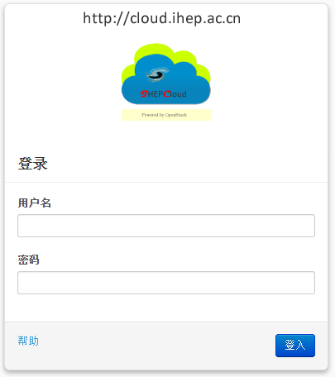
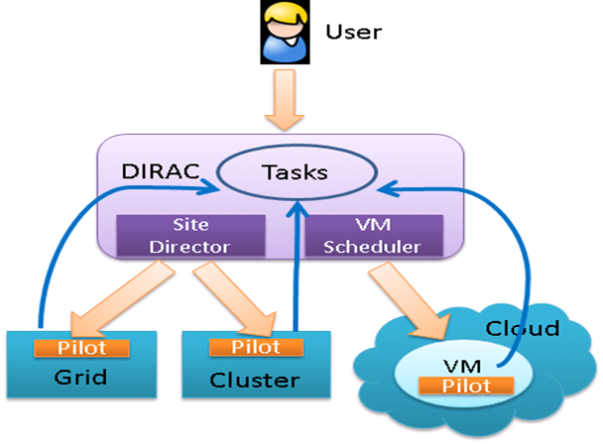
IHEPCloud: a Private IaaS platform
Launched in May 2014
Three use scenario
User self-Service virtual machine platform
User register and destroy VM on-demand
Virtual Computing Cluster
Job will be allocated to virtual queue automatically when physical queue is busy
Distributed computing system
Work as a cloud site: Dirac call cloud interface to start or stop virtual work nodes

Slide 64
IHEPCloud components
Core middleware: openstack
open source cloud management system
most popular
Configuration management tool: Puppet
create VM image
application management in VM
keep the consistency of VM and computing environment
Authentication
IHEP Email account and password
AFS authentication for UI node
Network management
centric NetworkDB record MAC, IP, hostname, user, …
each VM has a hostname, *.v.ihep.ac.cn
network traffic accounting
External storage
Currently, images and instances are stored in local disk
evaluating CEPH/Gluster to support GLANCE, NOVA and Cinder

Slide 65
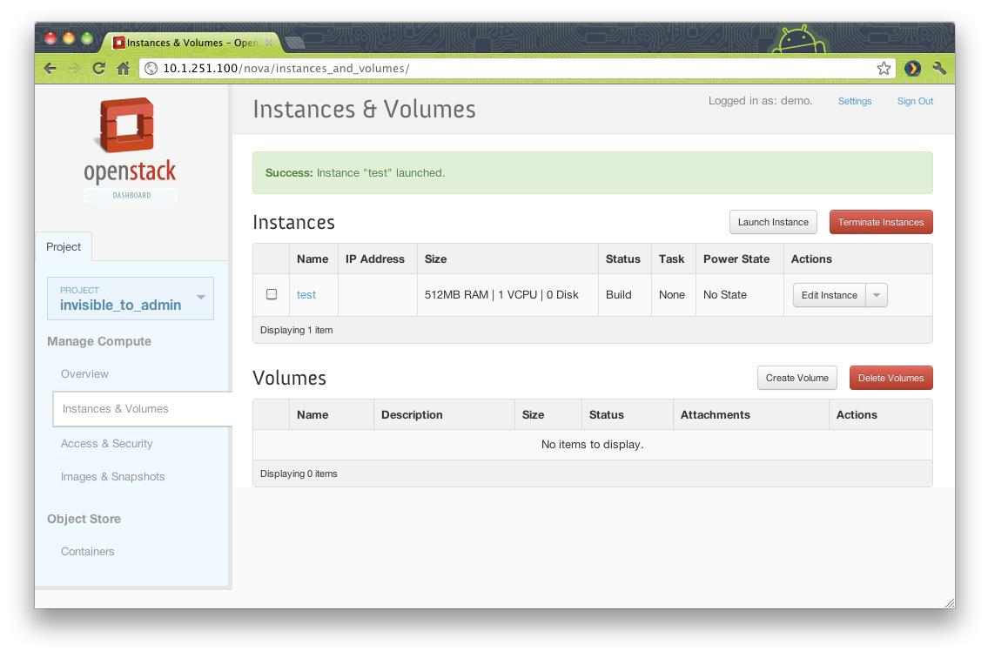
Architecture
API
Get info.
interactive
Storage path
Push info.
Dashboard
Virtual Cluster
Dirac
API
API
Host Monitor
OpenStack
Log Analysis
authentication
Service monitor
LDAP
UMT
(IHEP EMAIL）
Register
Nagios
Get VM info.
Interoperation
DNS
Configuration management
UMT
(CAS CLOUD)
Backend
storage
Register
DNS
NetworkDB
CEPH
Register
Puppet

Slide 66
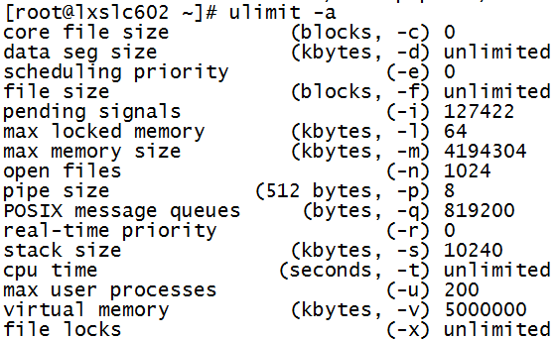
Why does end user need IHEPCloud?
Virtual testing machine
Develop program or do some testing
generates VM in a few minutes
Login VM via ssh/VNC, remote desktop
Virtual UI node
debug program in computing environment
login node: lxslcxx.ihep.ac.cn
Limitations: Memory, CPU time, user processes, …
cputime > 45m && %CPU > 60%
KILL it!
Affected by other users
VMs: owned only by one user; no limitations

Slide 67
Virtual computing cluster
If a job queue is busy, the jobs can be allocated to a virtual queue
plan to run the service this year
Cloud Scheduler
Submit job
Check
Queue load
Start/stop VM
Forward job
IHEPCloud
junoq: 128 CPU cores
Virtual queue

Slide 68
BESIII Distributed computing
Distributed computing has integrated cloud resources based on pilot schema, implementing dynamic scheduling
Cloud resources used can be shrunk and extended dynamically according to job requirements
Distributed Computing
Distributed Computing
Distributed Computing
No Jobs
User Job Submission
Job1, Job2, Job3…
Job
Finished
No Jobs
Create
Get Job
Delete
Cloud
Cloud
Cloud
VM1, VM2, …
VM

Slide 69
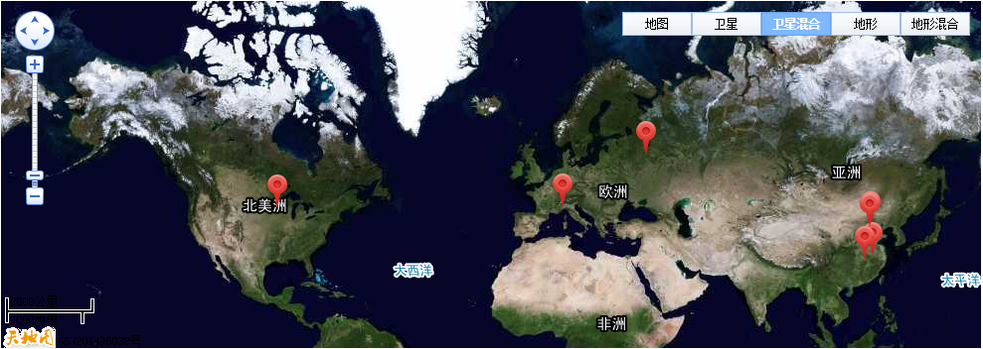
Cloud sites
14 cloud sites from China, JINR, CERN and IHEP have been set up and connected to distributed computing system
CHINA: IHEP, CNIC, GUCAS, PKU, USTC, SJTU, WHU, SDU, BUAA
Russia: JINR-Grid, JINR-CLOUD
Italy: INFN Torino、 INFN-ReCas
America: University of Minnesota
About 2700 CPU cores, 500TB disk

Slide 70
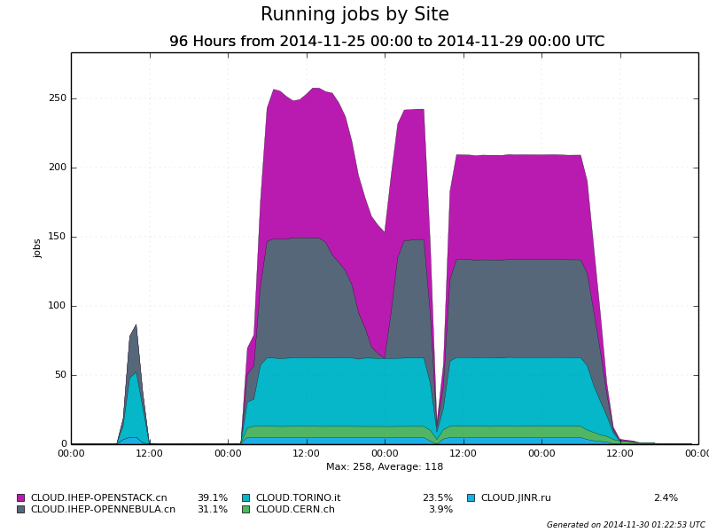
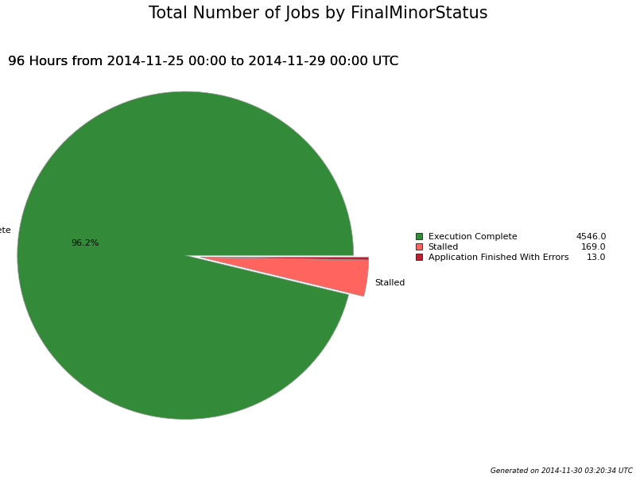
Cloud tests
More than 4500 jobs have been done with 96% success rate
Failure reason is lack of disk space
Disk space will be extended in IHEP cloud

Slide 71
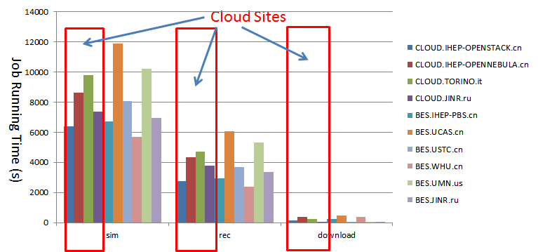
Performance and Physics validation
Performance tests has shown that running time in the cloud sites are comparable with other production sites
Simulation, Reconstruction, Download random trigger data
Physics validation has proved that physics results are highly consistent between clusters and cloud sites

Slide 72
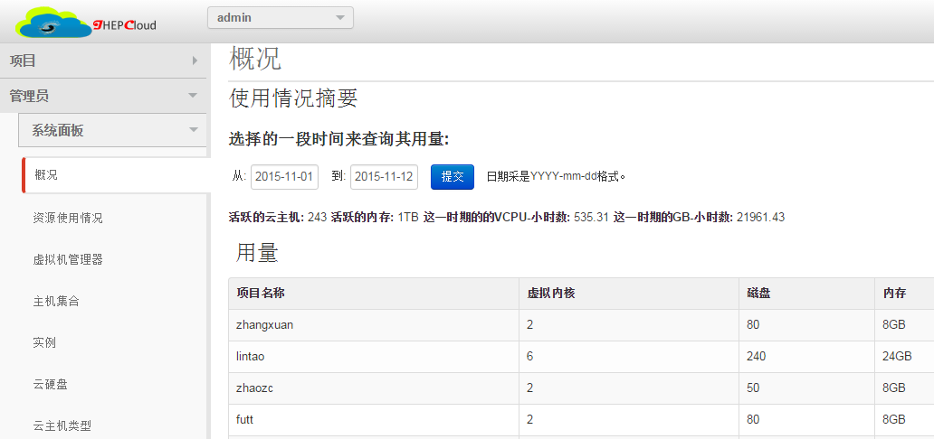
Current status
Control Node
Released in 18 November, 2014
Built on openstack icehouse
To be upgraded to kilo
1 control node
23 computing nodes
368 physical cores
736 logical cores
3,000GB memory
>1000 VMs
VM
VM
VM
VM
VM
VM
Computing
Node

Slide 73
How to use?
Who can use?
any user who has IHEP email account
dashboard only accessible inside IHEP
How many resources for user?
By default, each user has 3 CPU cores and 15GB memory
More resources, please contact the administrator
VM types
testing machine
full root privilege, no public storage
UI node
AFS authentication, No root privilege, public storage
No some limitations like memory, CPU time, process
OS types
SL 55, SL 58, SL65, 64 bits, SL 65 32 bits, Win7 64 bits
add new types depends on user requirement
VM IP address
internal IP address (192.168.*.*) is allocated automatically
foreign IP address (202.122.35.*) need the approval of administrator
http://cloud.ihep.ac.cn

Slide 74
Conclusion
cloud computing is widely accepted by industrial and scientific domain
Scientific computing are preparing the move to cloud
CERNCloud is largest scientific cloud in the world
The performance penalties is acceptable
IHEPCloud aims at providing self-service virtual machine platform for IHEP user
More resources will be added to IHEPCloud

Slide 75
Thank you!
Any Questions?

