Slide 1
CEPC SRF System Heat Load
2015-11-18

Slide 2
CEPC Top-level Parameters related to SRF System (1)
Parameter | Unit | Main Ring | Booster Injection | Booster Extraction
Beam energy | GeV | 120 | 6 | 120
Circumference | km | 54.752 | 54.752 | 54.752
Luminosity / IP | cm⁻²s⁻¹ | 2.04E+34 | - | -
Energy loss / turn | GeV | 3.11 | 17.6 keV | 2.81
SR power | MW | 103.42 | 16.2 W | 2.46
Revolution period | s | 1.83E-04 | 1.83E-04 | 1.83E-04
Revolution frequency | kHz | 5.4755 | 5.4755 | 5.4755
Bunch charge | nC | 60.56 | 3.35 | 3.2
Bunch number | - | 100 | 50 | 50
Beam current (total) | mA | 33.2 | 0.92 | 0.87
Bunch spacing | μs | 1.825 | 3.65 | 3.65
Beam spectrum spacing | MHz | 0.55 | 0.274 | 0.274

Slide 3
CEPC Top-level Parameters related to SRF System (2)
Parameter | Unit | Main Ring | Booster Injection | Booster Extraction
Momentum compaction | - | 3.36E-05 | 7.69E-05 | 7.69E-05
Energy spread | % | 0.1629 | 0.1 (linac) | 0.127
Bunch length | mm | 2.65 | 1.5 (linac) | 2.66
RF voltage | GV | 6.87 | 0.213867 | 5.12
RF frequency | GHz | 0.65 | 1.3 | 1.3
Harmonic number | - | 118800 | 237423 | 237423
Synchrotron tune | - | 0.180 | 0.32076 | 0.32076
Energy acceptance (RF) | % | 5.99 | 17.307 | 2.091
Transverse damping time | turns | 77.05 | 682122 (125 s) | 85.2 (15.56 ms)
Longitudinal damping time | turns | 38.52 | 341219 (62 s) | 42.7 (7.789 ms)
Lifetime Bhabha | min | 51.77 | - | -
Lifetime BS (sim.) | min | 47 | - | -

Slide 4
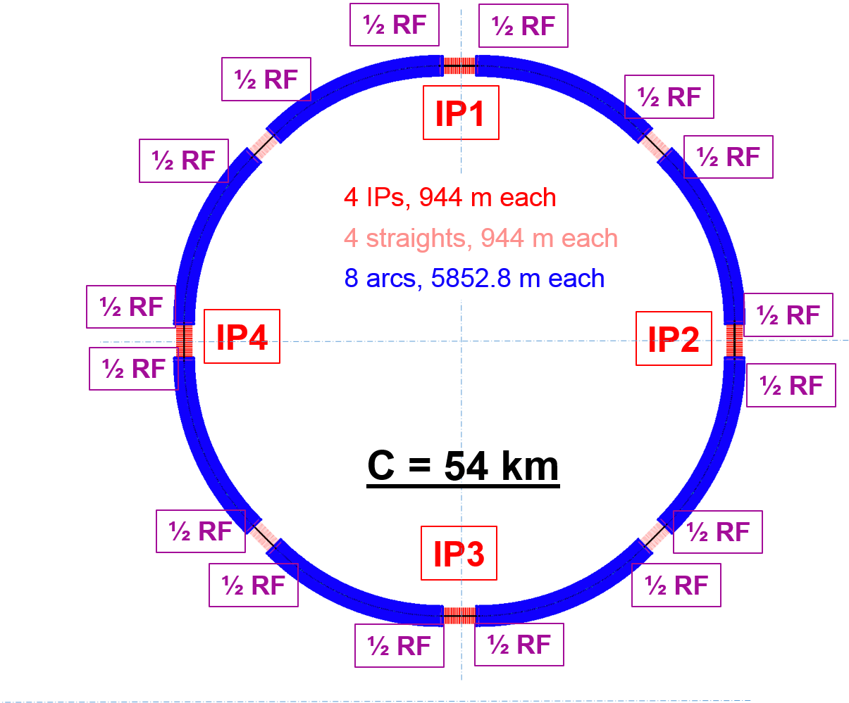
CEPC SRF System Layout
 | Collider | Booster
Modules per section | 12 | 4
Module length | 10 | 12
Cavities per module | 4 | 8
No. of modules | 96 | 32
No. of cavities | 384 | 256
Total RF module length: 1.4 km
Total RF voltage: 12 GeV
Beam power: 104.5 MW
HOM power: 2 MW
Installed RF power: ~ 160 MW
Installed cryogenics: ~ 100 kW @ 4.5 K
Pretzel Scheme
Two symmetric half sections in each of the eight RF sections.

Slide 5
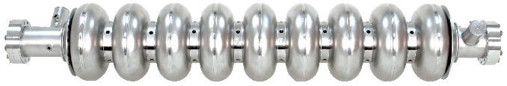
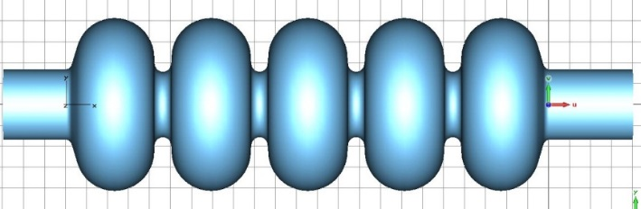
Cryomodule Layout
Euro-XFEL/ILC/LCLS-II type
X
Enlarge two- phase pipe and chimney.
Omit 5K shield while keep 5K intercept for power coupler.
scaled from 1.3 GHz cryomodule
X

Slide 6

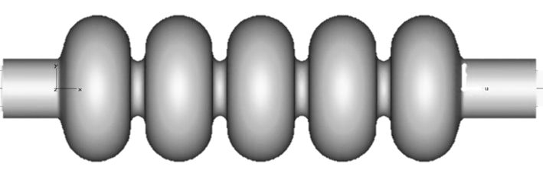

CEPC Collider RF Section Configuration
IPs & P_{n} (n: six parasitic crossing points)
Main Ring module (10 m)
Four 650 MHz 5-cell cavities inside
Pretzel scheme Half RF Section (6 modules, 70 m), 3 module pairs (valve boxes)
DIS
SEP
SEP (P_{n})
IP or P_{n}
\\
Half FODO cell (23.6 m)
One FODO cell (47.2 m)
FFS (350 m)
or 2 FODO cells (95 m)
RF length of one module = 29 λ/2 = 6.7 m
5λ/2
3λ/2 [(2n+1)λ/2, 2 cav. with one klystron]
λ = 0.461 m
For counter-rotating beams, all 5-cell cavity centers must be at nλ/2 from P_{n}.
Beam time structure various in cavities, modules, RF sections and diff. schemes.

Slide 7
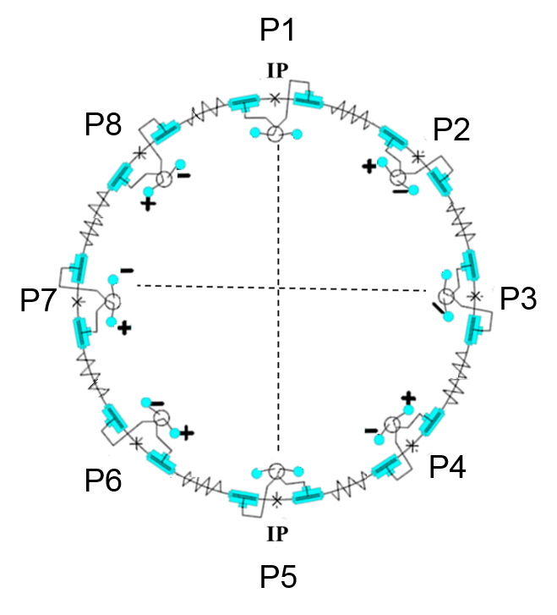
Pretzel Scheme
48 bunches / beam, 96 parasitic collision points (~ 500 m spacing)
Horizontal separation, no off-center orbit in RF section
One pair of electrostatic separators for each arc (green)
One pair of electrostatic separators for P2, P3, P4, P6, P7, P8
H.P. Geng

Slide 8
Local Double Ring Scheme
RF
One bunch train per beam
No pretzel
Crab waist possible
Cost less than whole double-ring
More bunches for high luminosity Z, W
e-
e+
~3 km (10 μs) macro-bunch
Parameters | Value | Unit
Circumference | 54374 | m
Length of one FODO cell | 47.2 | m
Harmonic number | 118800
One bucket length in the ring | 0.46 | m
Bucket number in double beam pipe | 6156
Local double section 10% of the whole ring
120 FODO cells length
1.416km on each side of IP
J. Gao, M. Xiao, M. Koratzinos

Slide 10
ILC TDR, XFEL measurement
Input coupler
HOM cable, absorber, bellow
2 K static: CEPC has no current leads, but input and HOM coupler static load may be larger.
2 K dynamic: Booster cavity + (input coupler scaled from ILC); MR cavity
Booster input coupler dynamic: scaled from ILC, duty factor 0.364 % (only beam time, w/o filling and decaying time, ~ x 1.5) to 20 %, power 300 kW (190 kW ?) to 20 kW; 2 K: 5 W

Slide 11
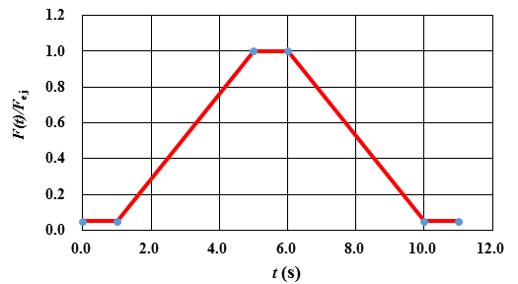
Booster RF Transients
Booster magnet field cycle
89.99°
extraction to main ring
120 GeV
56.7°
6 GeV
injection from linac
/s
4s ramp beam phase change（off-crest）
ν_{s} constant
Q_{e}=1E7
Red: df=25Hz
Blue: df=50Hz (w/o beam inductance)
/ MV
/s
4s ramp cavity voltage (red)
4s ramp RF power
Duty factor for continuous injection and without cavity para-phase：Cavity wall loss: 21.2 % (~ 20 %) （Q₀ const.）; HOM heat load: 50 %; Power Source：22.4 %
For normal operation with 90 s injection cycle, all duty factors reduce to 22 % of the continuous inj.

Slide 12
HOM Power
 |  | CEPC main ring | CEPC booster | ILC beam
Bunch length | mm | 2.65 | 1.5 - 2.66 | 0.3
HOM loss factor per cavity | V/pC | 1.8 | 4 | 12
Bunch charge | nC | 59.4 | 3.1 | 3.2
Bunch spacing | ns | 1810 | 3627 | 554
Beam current | mA | 33.2 (two beam) | 0.85 | 5.8
CW HOM power per cavity | W | 3509 | 10.7 | 221.8
HOM duty factor | - | 100% | 50% | 50%
HOM power per cavity with DF | W | 3509 | 5.3 | 110.9

Slide 13
ILC TDR
6 W HOM power per module for 8 cavities (5.2 mA, 9 mA?)

Slide 14
Conclusions
Static heat load summary of PXEFL modules
Level | Measured | Calculated | XRB | Factor | XRC
40/80 K | 100-120 | 100-120 | 83 | 1.5 | 125
5/8 K | 6-11 | 6-12 | 13 | 1.5 | 20
2 K | 6 | 2.1 | 4.8 | 1.3 | 6
XRB: XFEL refrigerator budget, XRC: XFEL refrigerator capacity
40/80 K: 100-120 W depending on the performance of MLI.
5/8 K: 6-12 W depending on the outer shield temperatures.
2 K: 3.5-6 W depending on the installation skills of current leads.
Measured and calculated values have a good agreements at 5/8 K and 40/80 K.
Big deviation at 2 K caused by underestimation of cabling heat load and the installation skills of current leads.
Specified refrigerator capacity still could cover the heat load at 2 K and 40/80 K (Even come to limit) and have enough margin at 5/8 K.

Slide 15
ILC Input Coupler
0.02 W
0.22
2.06
0.05
0.38
5.22

Slide 17
CEPC MR Input Coupler
Static heat load
  2 K: 0.06 W
  5 K: 0.6 W
  80 K: 6 W
Dynamic heat load
  2 K: 1 W
  5 K: 10 W
  80 K: 50 W

Slide 18
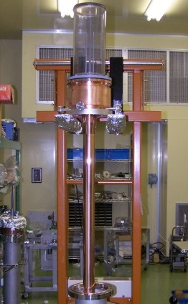
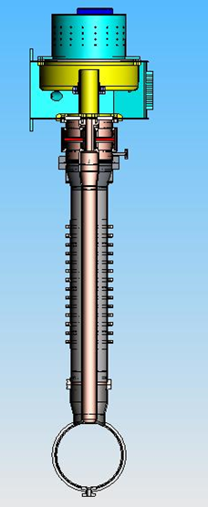
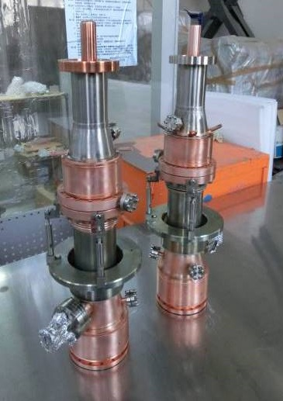
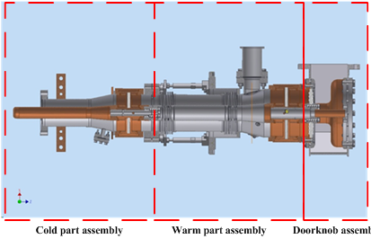
Power Coupler
Main ring 650 MHz 300 kW coupler:
very high power handling capacity
two windows for vacuum safety and cavity clean assembly, effective cooling
very small heat load, simple structure for cost saving, high yield and reliability
Tristan (70 kW) / KEKB (380 kW) / BEPCII (120 kW) type as baseline. KEK cERL injector coupler (one window) as reference.
Booster 1.3 GHz 4 kW coupler:
KEK STF1-type coupler developed by IHEP (test to 800 kW with DF 0.75 % = 6 kW) or TTFIII coupler can be used.

Slide 19
HOM Heat Load Budget
 | Main Ring | Booster
HOM power / cavity | 3.5 kW | 5.3 W
HOM power / module | 21 kW | 56 W
HOM 2 K heat load / module | 13 W (0.6 %) | 5.9 W (10%)
HOM 5 K heat load / module | 39 W (1.8 %) | 3 W
HOM 80 K heat load / module | 390 W (18 %) | 43.8 W
Percent of total cryogenic load | 22 % | 11 %
Main Ring heat load: design upper limit (estimated to have enough margin)
Booster heat load: scaled from ILC TDR (DF 50 % for continuous injection)

Slide 20
LCLS-II

Slide 21
LCLS-II HOM Power

Slide 22
LCLS-II Untrapped HOM Power to 2K

Slide 23
HOM Heat Load Estimation
Assume 10 kW HOM power propagating through the beam tubes and bellows (thin copper film RRR=30, in abnormal skin effect regime), power dissipation < 2 W/m @ 2K.
  Even RRR=1 for copper plating (normal skin effect regime), power dissipation < 10 W/m
HOM power loss in cavity at 2 K less than 0.3 W (all modes Q_{ext} < 10⁶)
Heat load at 5 K and 80 K dominated by HOM cable heating. Assume 0.1 dB/m power dissipation of the LEP/LHC-type rigid coaxial line (copper plated stainless steel) and 1 m length, total heat load is 10 W for the resonant excitation of TM011 mode.
Further study: HOM propagating, heat load calculation, statistical approach to study heat load at 2 K (LCLS-II), trap mode …

