Slide 1
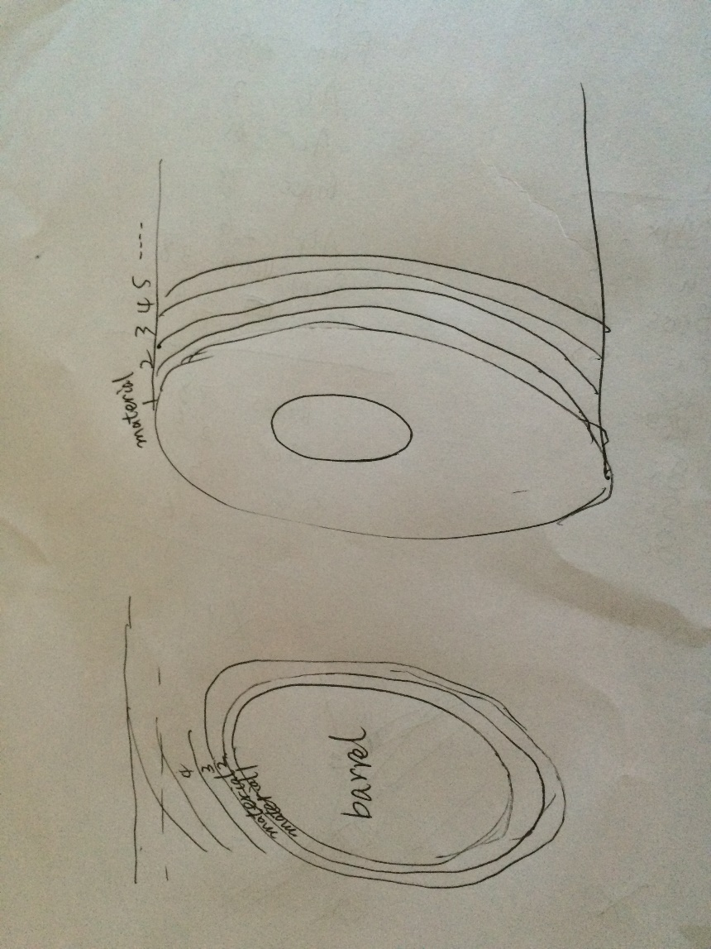
Calorimeter Geometry in Mokka
Standalone tool for silicon-based calorimeter
Both for electromagnetic calorimeter and hadronic calorimeter
Easy to set up for a detector on new idea
Simplify as constitution on ring by ring

Slide 2
Example for option a calorimeter(1)
/Mokka/init/detectorModel CEPC_v1
/Mokka/init/EditGeometry/rmSubDetector all remove sub-detectors from database option
#/Mokka/init/EditGeometry/rmSubDetector SEcal05
#/Mokka/init/EditGeometry/rmSubDetector SHcalRpc01
/Mokka/init/EditGeometry/newSubDetector SiCal add the calorimeter not existing in database
#/Mokka/init/EditGeometry/addSubDetector SiCal if SiCal was built in database
/Mokka/init/globalModelParameter world_box_hx 100000 resize the size of world, or change database
/Mokka/init/globalModelParameter world_box_hy 100000
/Mokka/init/globalModelParameter world_box_hz 250000
/Mokka/init/globalModelParameter SiCalLayerStructure \ NeutMod:100,Al:2,Foam:26,Al:2,CFMix:0.5,W:2,CFMix:0.5,Cu:0.5,Air:3,PCB:2,Si:0.1,Si:0.1,Si:0.1;(Cu:0.5,CFMix:0.5,W:0,CFMix:0.5,Cu:0.5,Air:3,PCB:2,Si:0.1,Si:0.1,Si:0.1,WCu:0.6,Cu:6,WCu:0.6,Si:0.1,Si:0.1,Si:0.1,PCB:2,Air:3)*4;(Cu:0.5,CFMix:0.5,W:2.8,CFMix:0.5,Cu:0.5,Air:3,PCB:2,Si:0.1,Si:0.1,Si:0.1,WCu:1.2,Cu:6,WCu:1.2,Si:0.1,Si:0.1,Si:0.1,PCB:2,Air:3)*5;(CFMix:1,Cu:6,Brass:45,Cu:0.5,Air:3,PCB:2,Si:0.1,Si:0.1,Si:0.1)*11;CFMix:1,Cu:6,Al:2,Foam:26,Al:2,Air:65,Brass:78,Air:2.6,Scintillator:3.8,Air:2.6;(Brass:7.8,Air:2.6,RPC1:0.8,Iron:0,Air:2.6)*50
Material:thickness,…,Material:thickness
…;(…)*n;… repeat n
unit: mm
/Mokka/init/globalModelParameter SiCalZeroThickReset 1.75*5,2.8*5,4.2*5,2*5,1.1*10,1.3*20,1.5*30
/Mokka/init/globalModelParameter SiCalXCellSize 2.5,10 Ecal(Si),Hcal(Scintillator or Iron)
/Mokka/init/globalModelParameter SiCalYCellSize 2.5,10
unit: mm

Slide 3
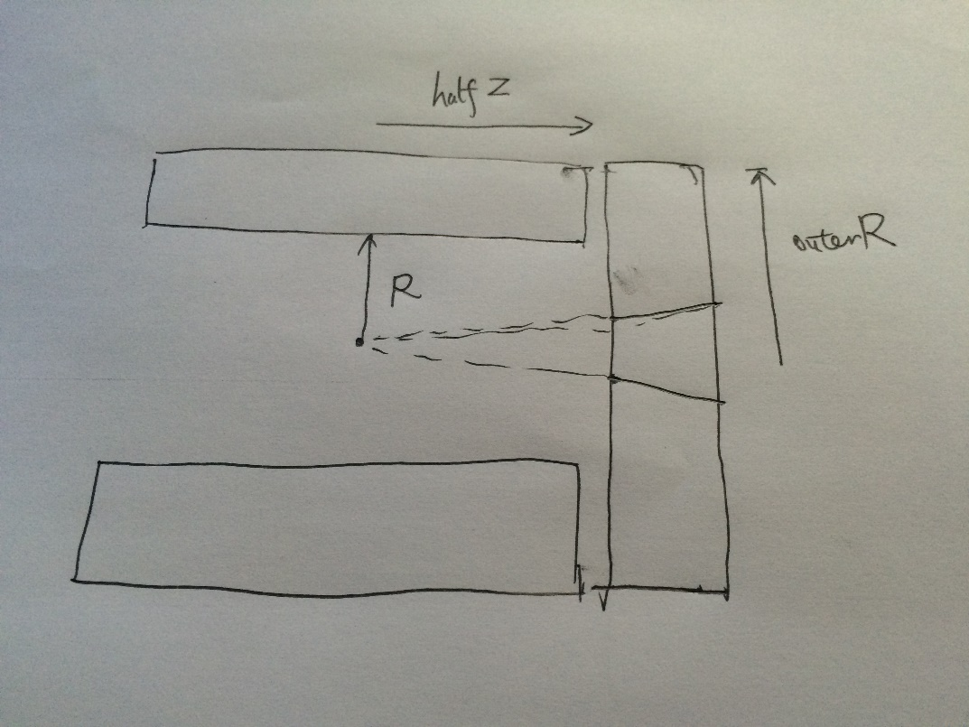
Example for option a calorimeter(2)
/Mokka/init/globalModelParameter SiCalInnerRadius 1845
/Mokka/init/globalModelParameter SiCalBarrelHalfZ 22450
/Mokka/init/globalModelParameter SiCalEndcapEta1 2.6
/Mokka/init/globalModelParameter SiCalEndcapEta2 3
/Mokka/init/globalModelParameter SiCalBuildBarrel 1
/Mokka/init/globalModelParameter SiCalEndcapOuterR 4385
/Mokka/init/EditGeometry/newSubDetector MyField
/Mokka/init/globalModelParameter FieldMap -8000,-6000,0,3000,0,-3,0;-3500,3500,0,3500,0,0,0;6000,8000,0,3000,0,3,0

Slide 4
Environment to use this Mokka
General ILC environment:
Special env:
export SYSTEM=slc5 (/slc6)
export MOKKA=/workfs/bes/fucd/Mokka/mokka-08-03
export HEPMC=/publicfs/cms/user/huaqiao/convertStdHep/HepMC-2.01.08
export LD_LIBRARY_PATH=$MOKKA/lib/$SYSTEM:$HEPMC/src:$LD_LIBRARY_PATH
export PATH=$MOKKA/bin/$SYSTEM:$PATH

