Slide 1
Study of code PrintHit.cc
Bing Liu(SJTU) Jianping Dai (SJTU)

Slide 2
Outline
Introduction to the flow of PrintHit.cc
Summary
Next Plan

Slide 3
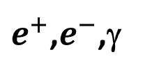
Flow of PrintHit.cc
getCollection("MCParticle")
EventP
collections
Number of elements
If the particle no parents
Loop all collections on hcalorimeter
getNumberOfElements()
Loop all elements
Loop all elements
Record its endpoint x,y,z and radius
collections
CALORIMETERHIT
Record its position Energy and Energy Error
getNumberOfElements()
Record its position Energy and Energy Error
Number of elements
Judge col type
SIMCALORIMETERHIT
Loop all elements
Loop all MC contributions Of the Hits
HitFlag=1
$e^{+}$,$e^{−}$,γ
HitFlag=-10
neutron
Judge PID
Get the energy ,time and PID of i-th contributions to the hits
HitFlag=-1
Other hadrons

Slide 4
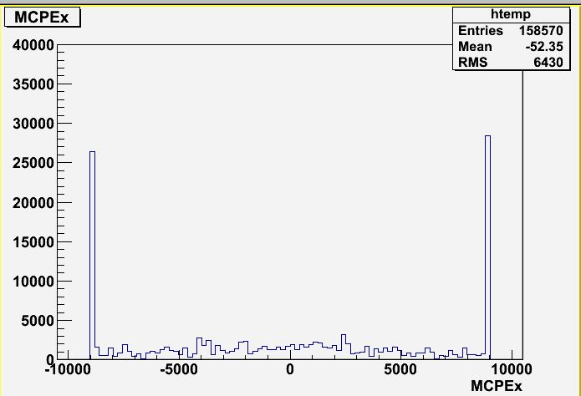
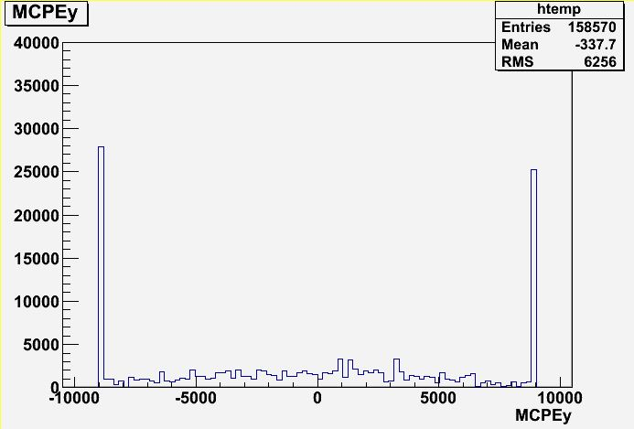
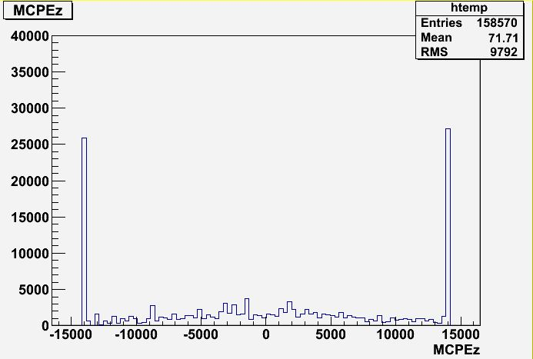
Run MIP.steer
(/besfs/groups/higgs/data/Simu/ParticleGun/Generation/mu+_1365/mu+_80GeV/mu+_1mmCellDHCAL_R_1365_Z_2350_80GeV_1.slcio)
Endpoint x
Endpoint Y
Endpoint Z

Slide 5
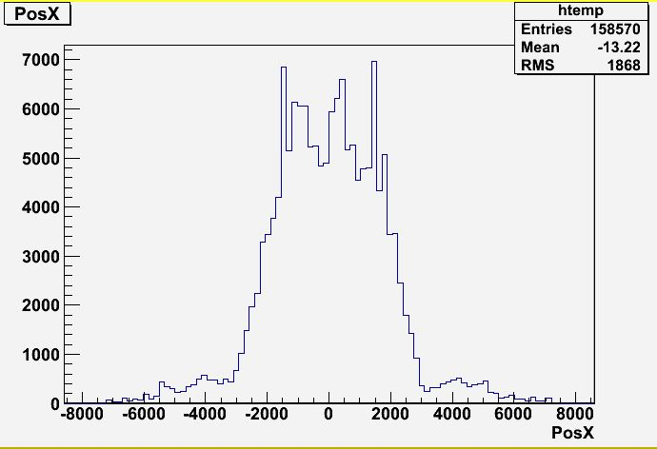
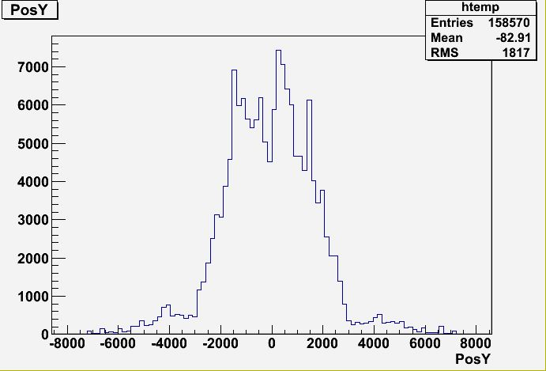
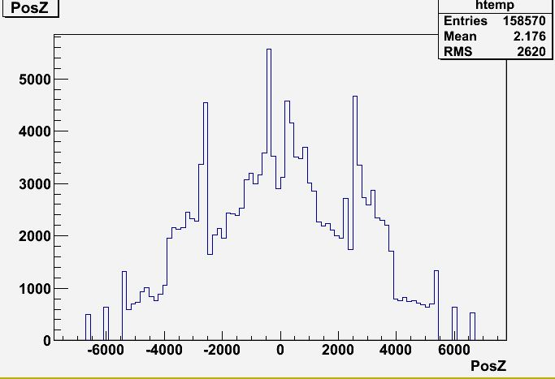
HitPos X
HitPos Y
HitPos Z

Slide 6
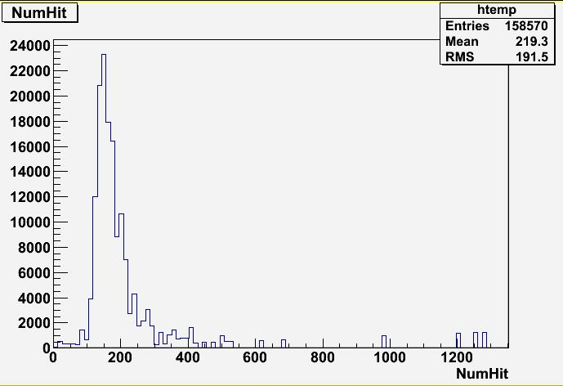
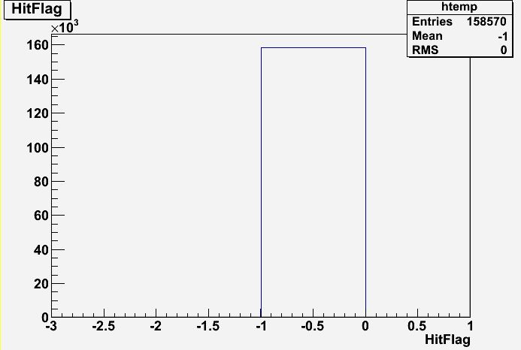
NumHit
HitFlag

Slide 7
summary
Study the code PrintHit.cc
Get a skill of exception handling (try catch)

Slide 8
Next Plan
To run MC samples
To Have a general prospect of calorimeter optimization

Slide 9


