Slide 1
Stand Alone Simulation & Particle Gun Generator
Shi Chen, Qian Liu

Slide 2
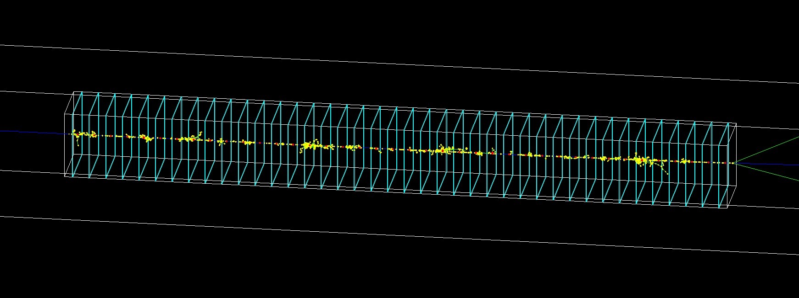
Stand Alone Simulation
Hcal: 40 Layers,
Neutron: 100GeV

Slide 3
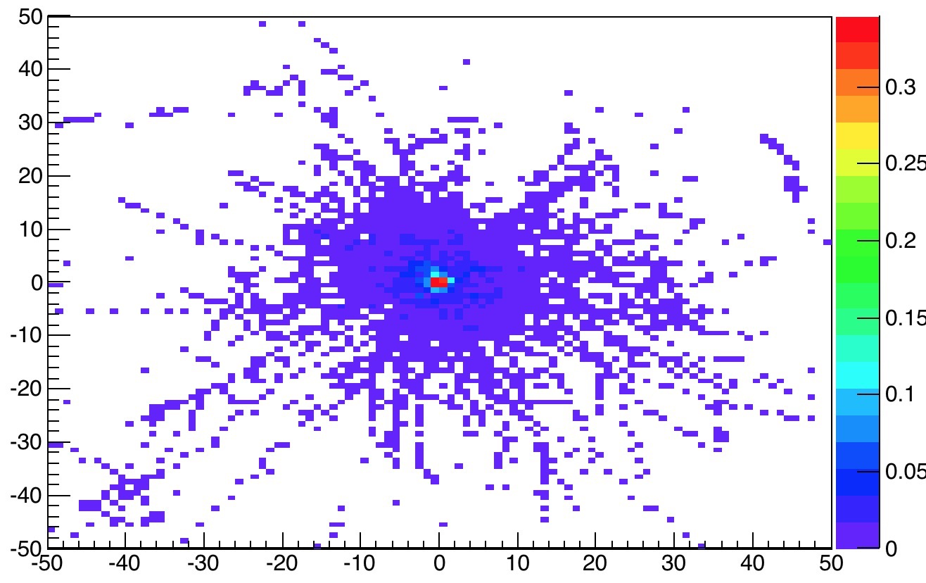

Slide 4
Particle Gun Generator
Topic 1: Understand the difference between CEPC_vX & Simplified Geometry;
Topic 2: Intrinsic Energy & ID performance @ Simplified Geometry
→Generate single particle on CEPC
Generate single particle on Simplified Geometry
Need some program of Simplified Geometry

Slide 5
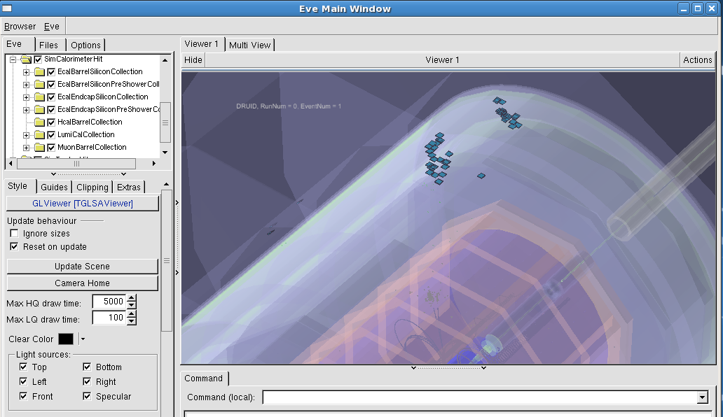
Some question
Where is Hcal Hit? (60GeV,Pion+)

Slide 6
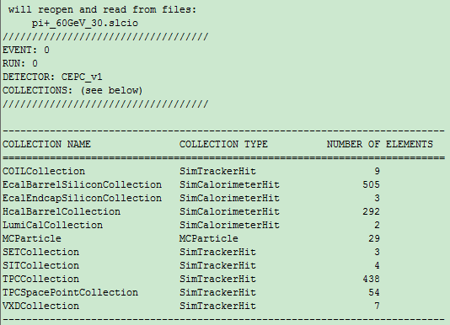
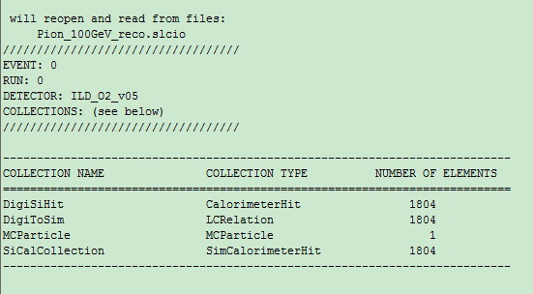
Some question
Differences between example and my particle gun

