Slide 1

Update of study on DA optimization
Yiwei WANG
CPEC AP meeting, 27 Nov. 2015

Slide 2

Outline
Optimization of dynamic aperture
  With more additional IR sextupoles
  Including radiation damping

Slide 3
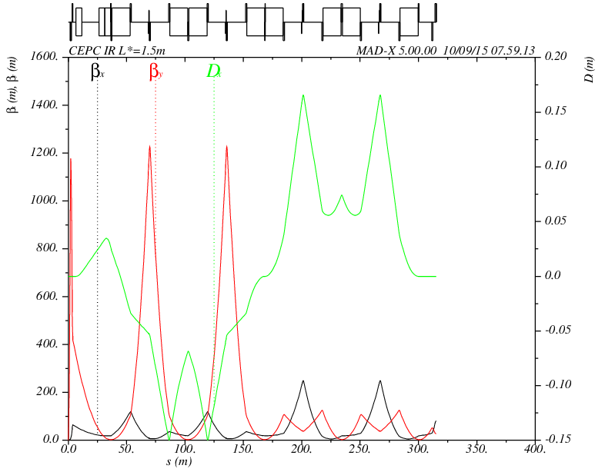
  With more additional IR sextupoles
Idea from Brinkmann
  correct the high order chromaticity, break down of –I, second order dispersion
IP
FT
CCY
CCX
MT
1
2
3
4
5
6
7
8
9
10
-I
-I

Slide 4
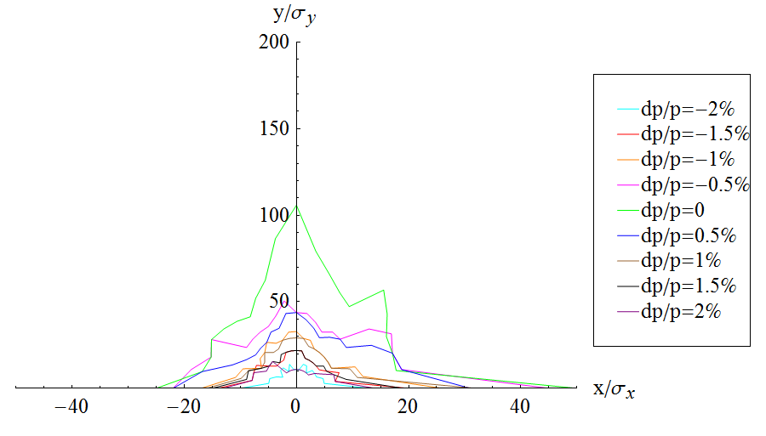
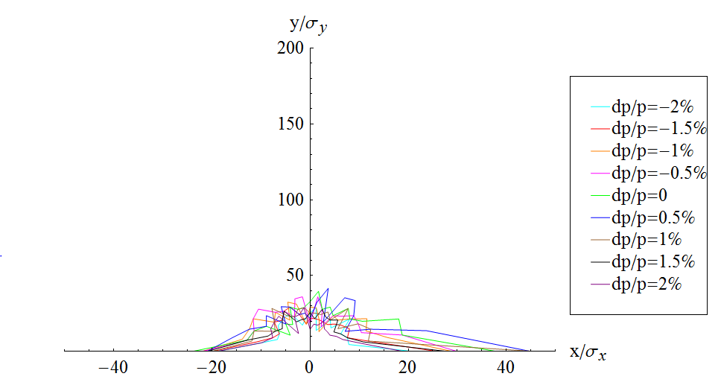
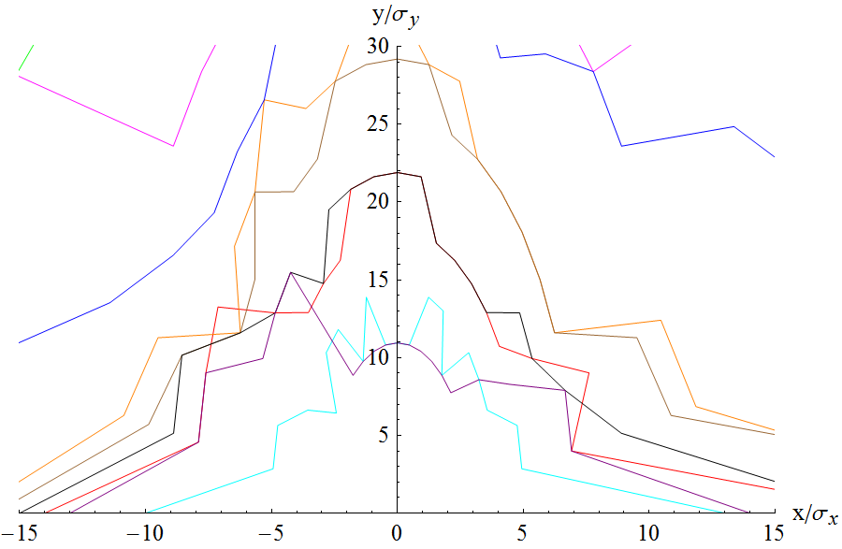
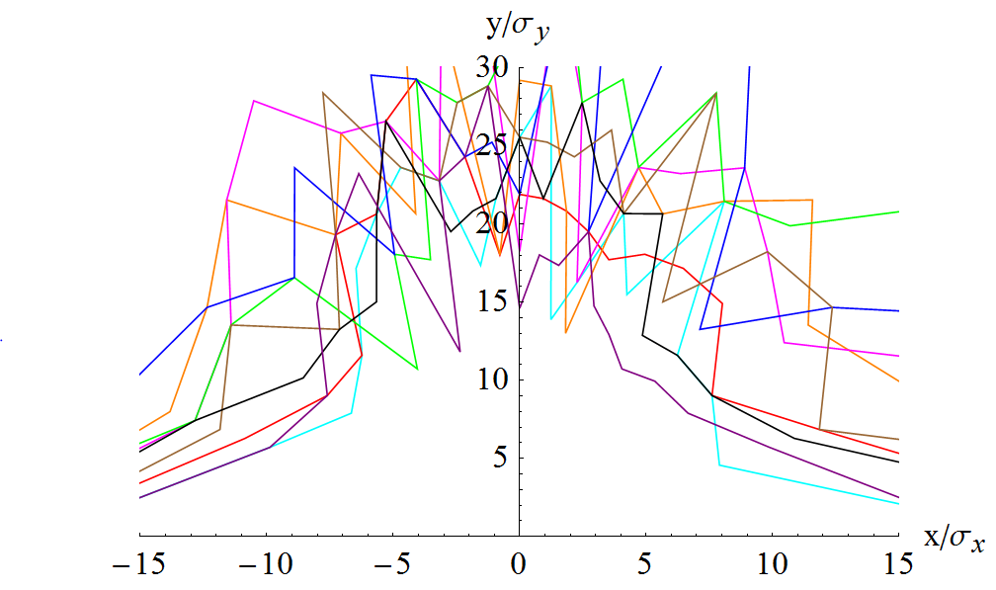
  With more additional IR sextupoles
3+6 families
Left: w/o damping
Right: w/ damping

