Slide 1
CEPC 动力学孔径优化 in progress
张 源、王毅伟、耿会平、王逗
2015-11

Slide 2
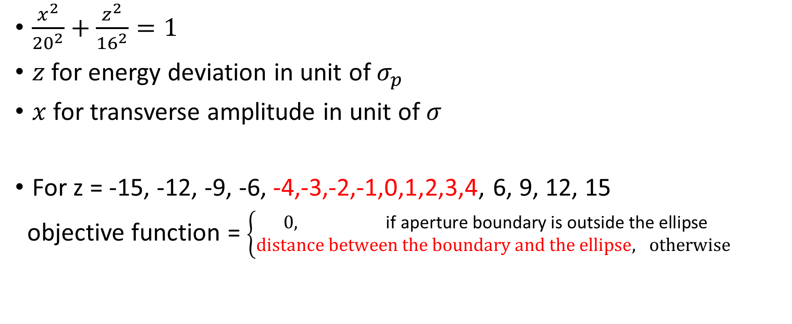
Objective function
$\frac{x^{2}}{{20}^{2}}+\frac{z^{2}}{{16}^{2}}=1$
$z$ for energy deviation in unit of $σ_{p}$
$x$ for transverse amplitude in unit of $σ$
For z = -15, -12, -9, -6, -4,-3,-2,-1,0,1,2,3,4, 6, 9, 12, 15
objective function = $\left\{\begin{matrix}0, \text{if} \text{aperture} \text{boundary} \text{is} \text{outside} \text{the} \text{ellipse} \\ distance between the boundary and the ellipse, otherwise \end{matrix}\right.$

Slide 3
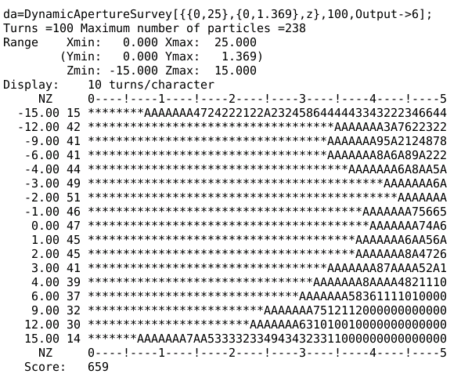
Optimization – 1, with 240 sextupoles, 100turns, DAPWIDTH=7

Slide 4
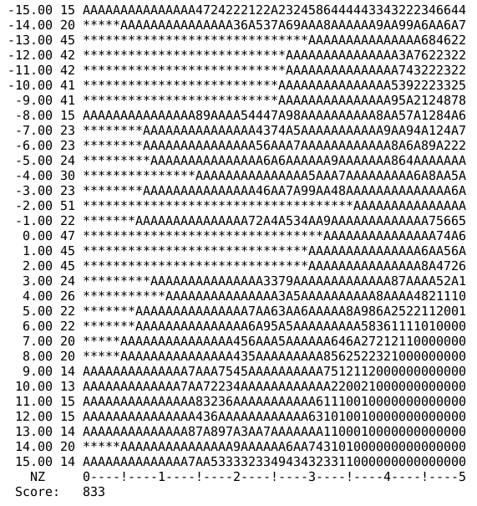
Optimization – 1, with 240 sextupoles, objective: 100turns, DAPWIDTH=15, z=Range[-15,15,1]

Slide 5
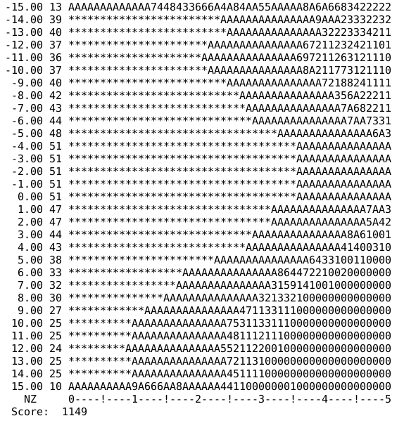
Optimization – 1, with 240 sextupoles, 100turns, DAPWIDTH=15, z=Range[-15,15,1]

Slide 6
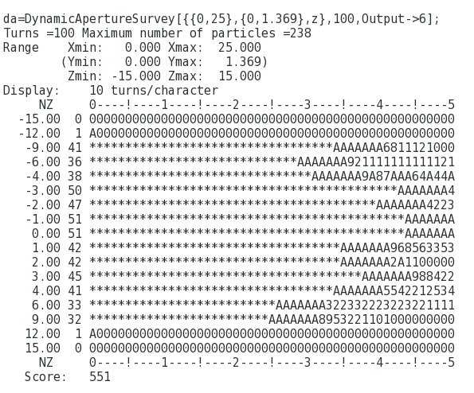
Optimization – 1, with 68 sextupoles (non-interleave), 100turns, DAPWIDTH=7

Slide 7
Discussion
It’s time to review L* ?
More realistic lattice (injection …)
Z parameter

