Slide 1

CEPC Partial Double Ring
Lattice Design
SU Feng WANG Dou WANG Yiwei GAO Jie
BIAN Tianjinan DUAN Zhe GENG Huiping
XU Gang BAI Sha XIAO Ming
Key Laboratory of Particle Acceleration Physics and Technology
Institute of High Energy Physics
Chinese Academy of Sciences
2015.11.27

Slide 2
Suggestion from last meeting
(2015.11.13)
MAD8/MADX 对于Electrostatic Separator 的处理
（Dipole/Separator/Kicker/Matrix Comparation）

Slide 3
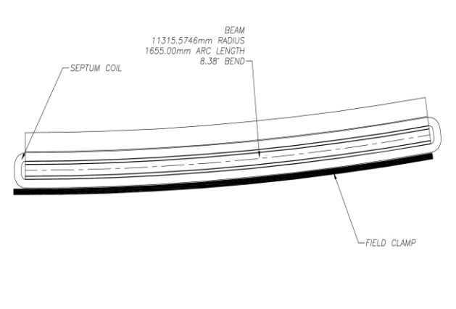
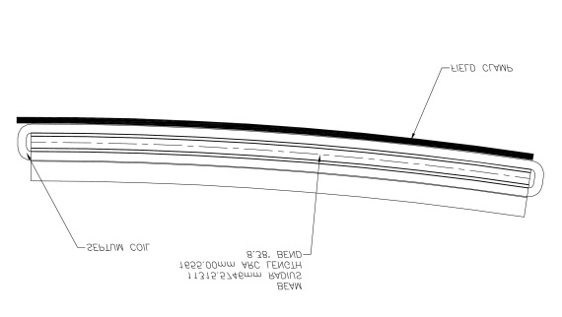
Seperator with Thin Septum Magnet
Sigmax=697.8um 20sigma=14mm
20mm
Septum Magnet：L=2m
angle=4.25mrad
（0.70187度）
thicknes=3mm
Separator： 62.5 urad
12 个
0.75 mrad

Slide 4
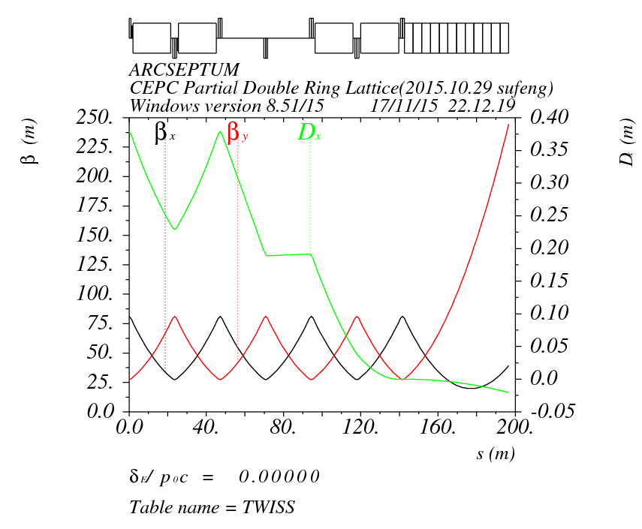
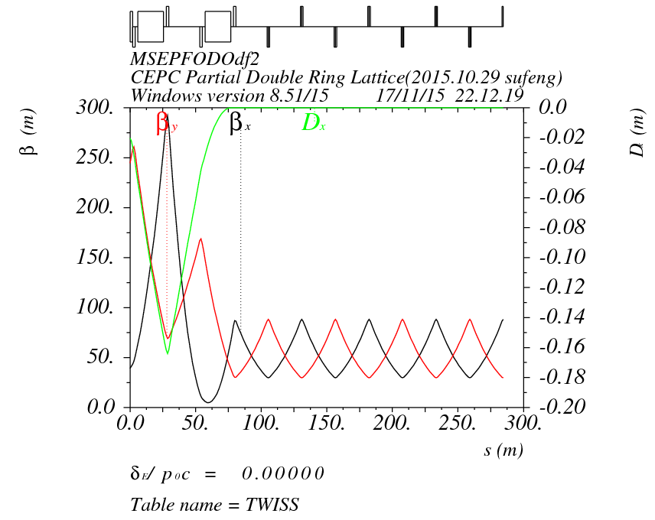
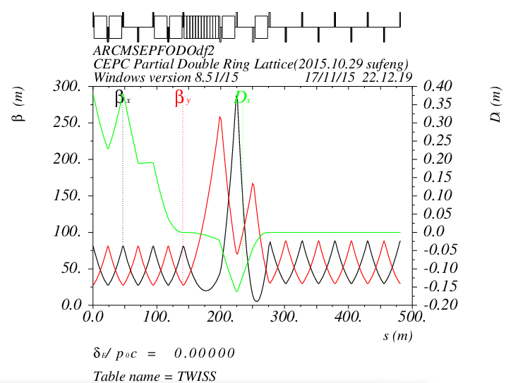
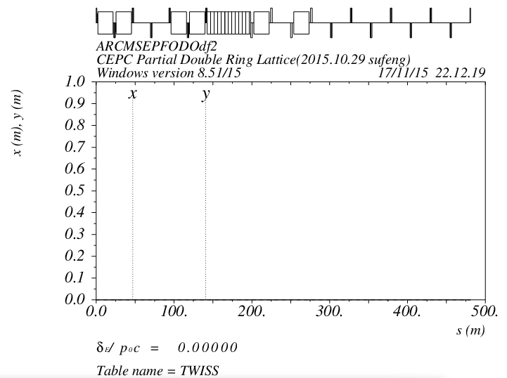
Dipole

Slide 5
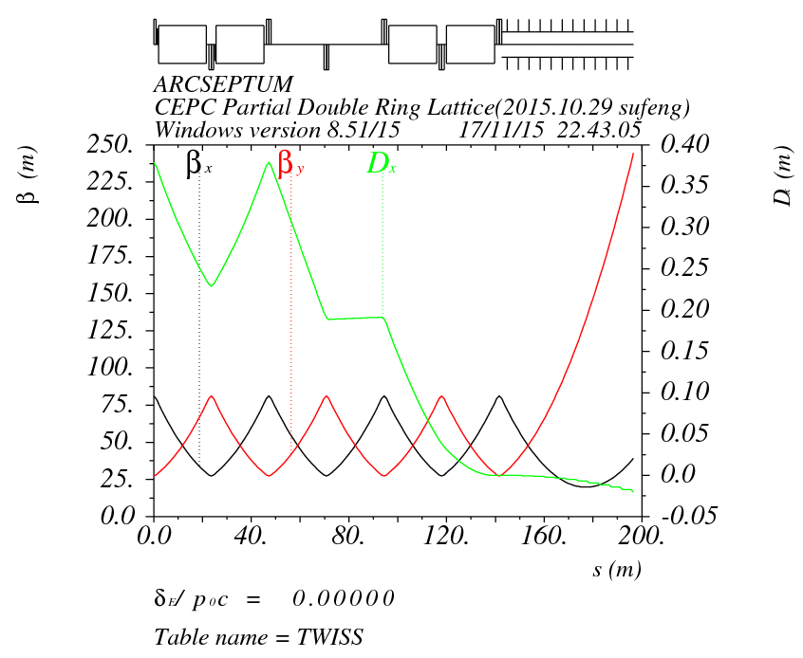
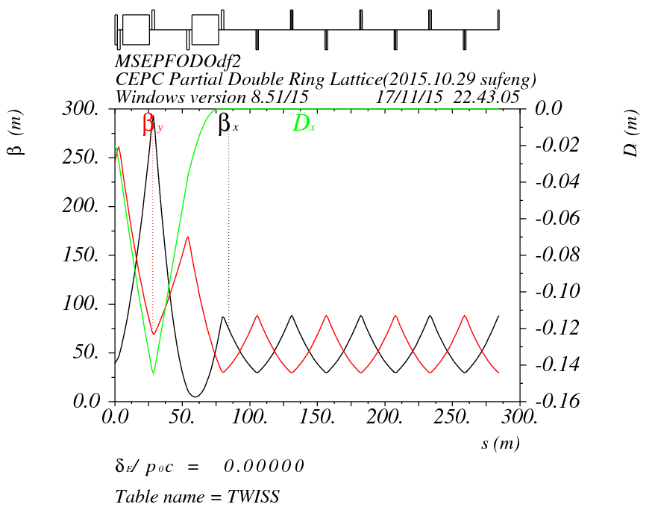
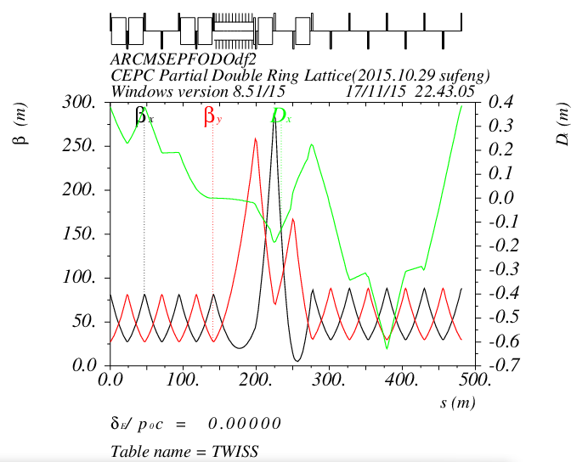
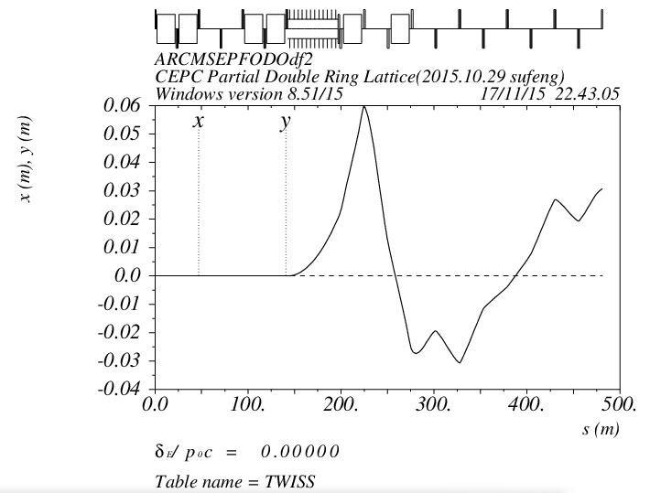
Separator

Slide 6
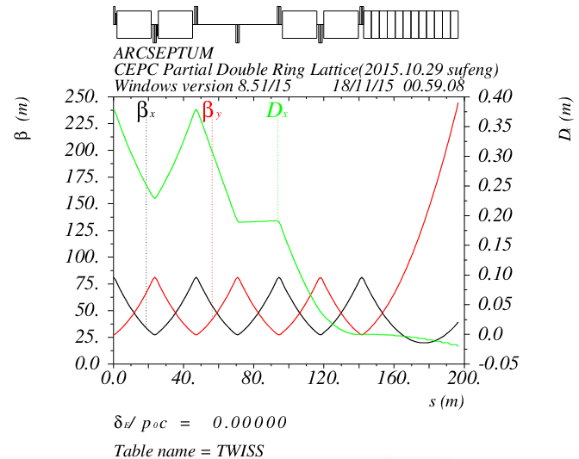
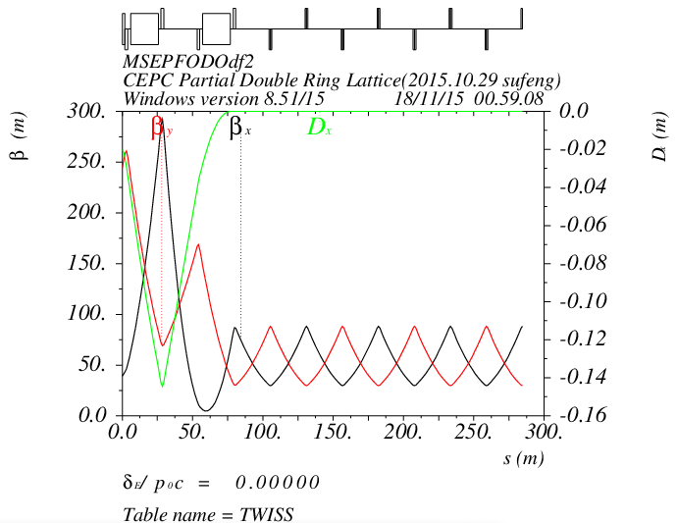
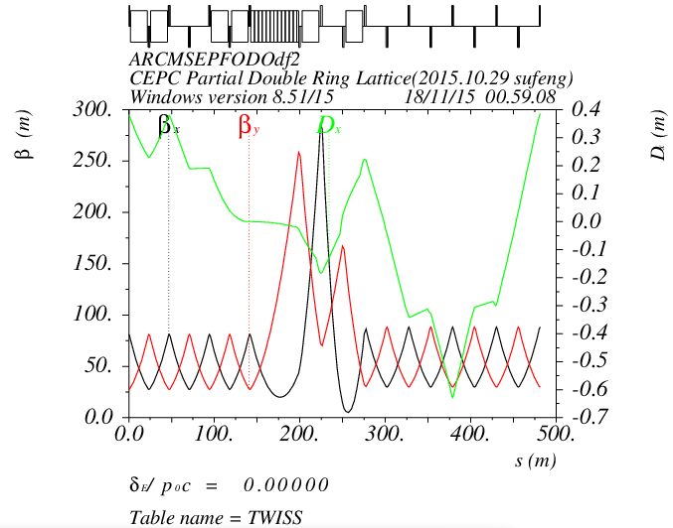
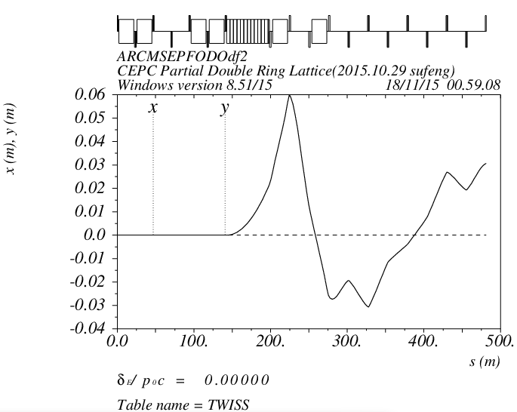
Kicker

Slide 7
Change Reference Coordinate
Test

Slide 8
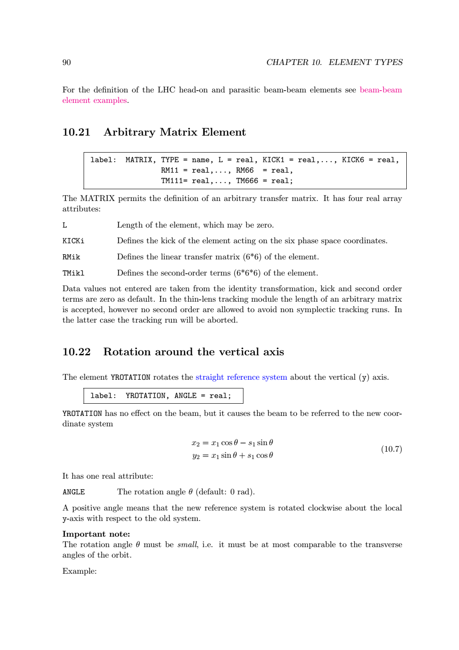
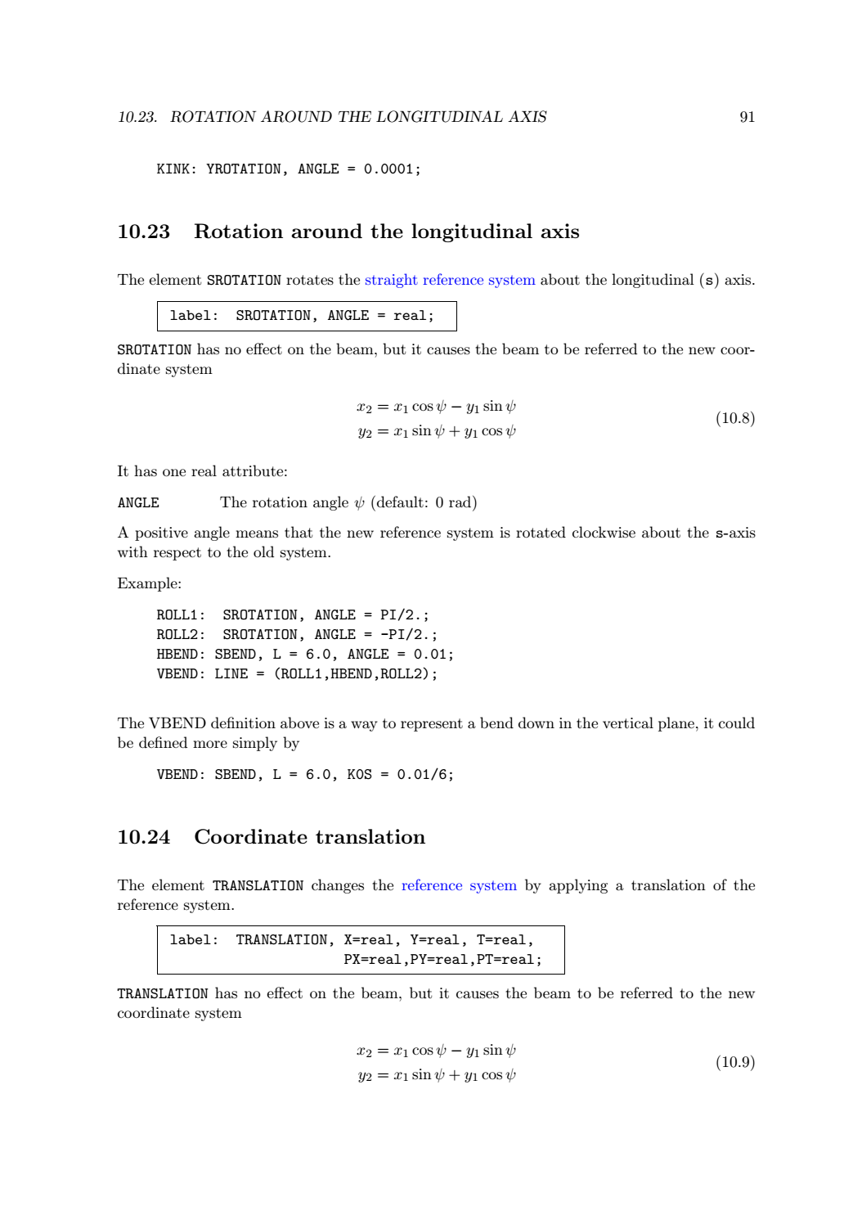
MadX

Slide 9
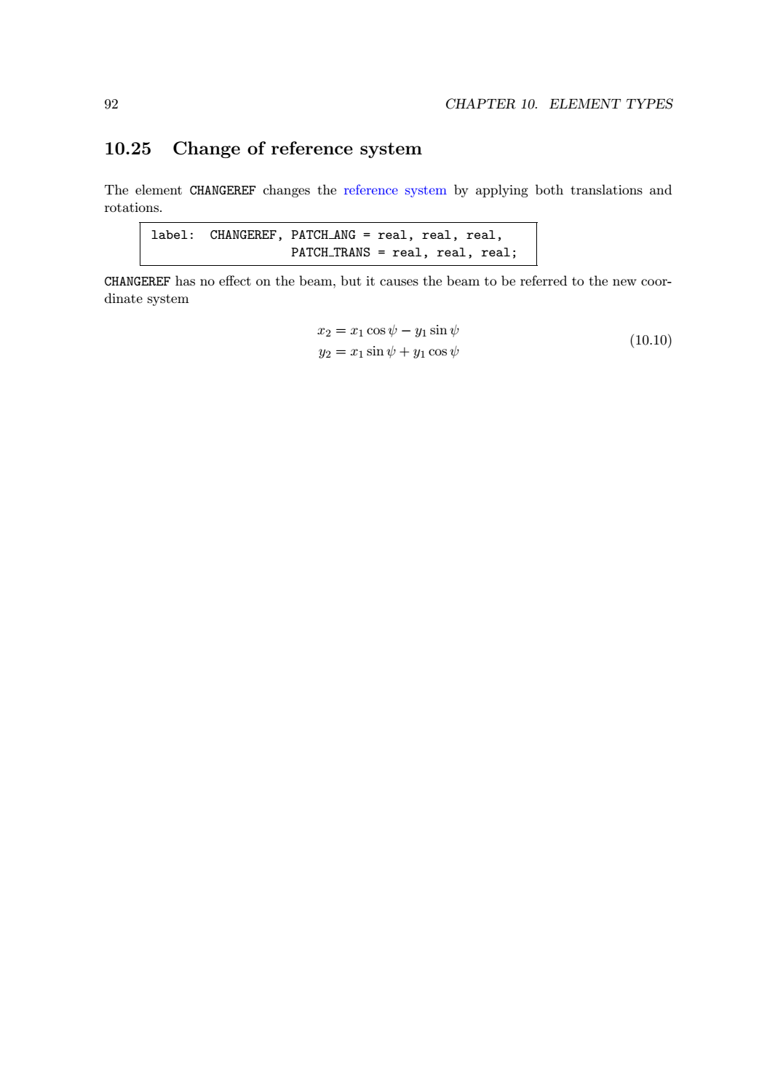

Slide 10
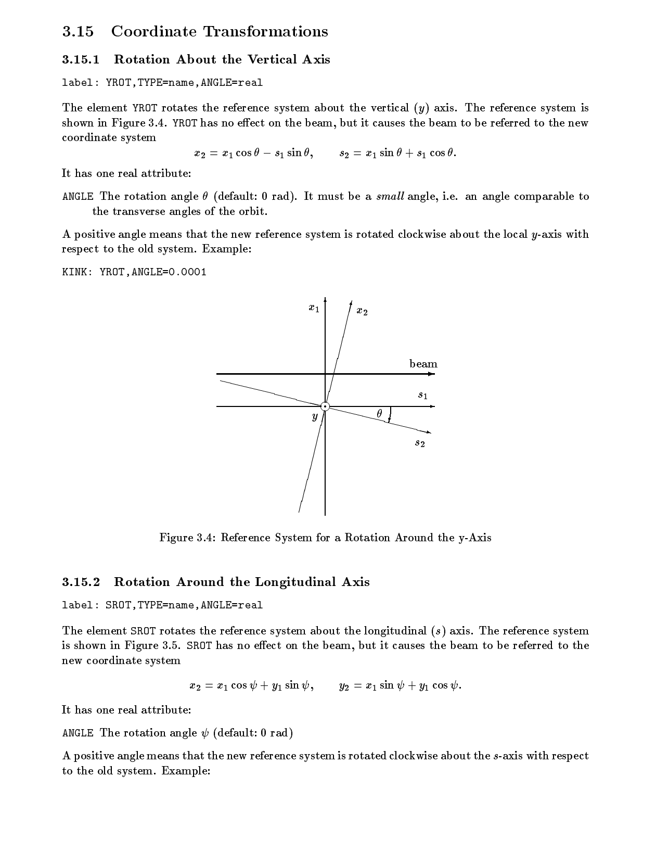
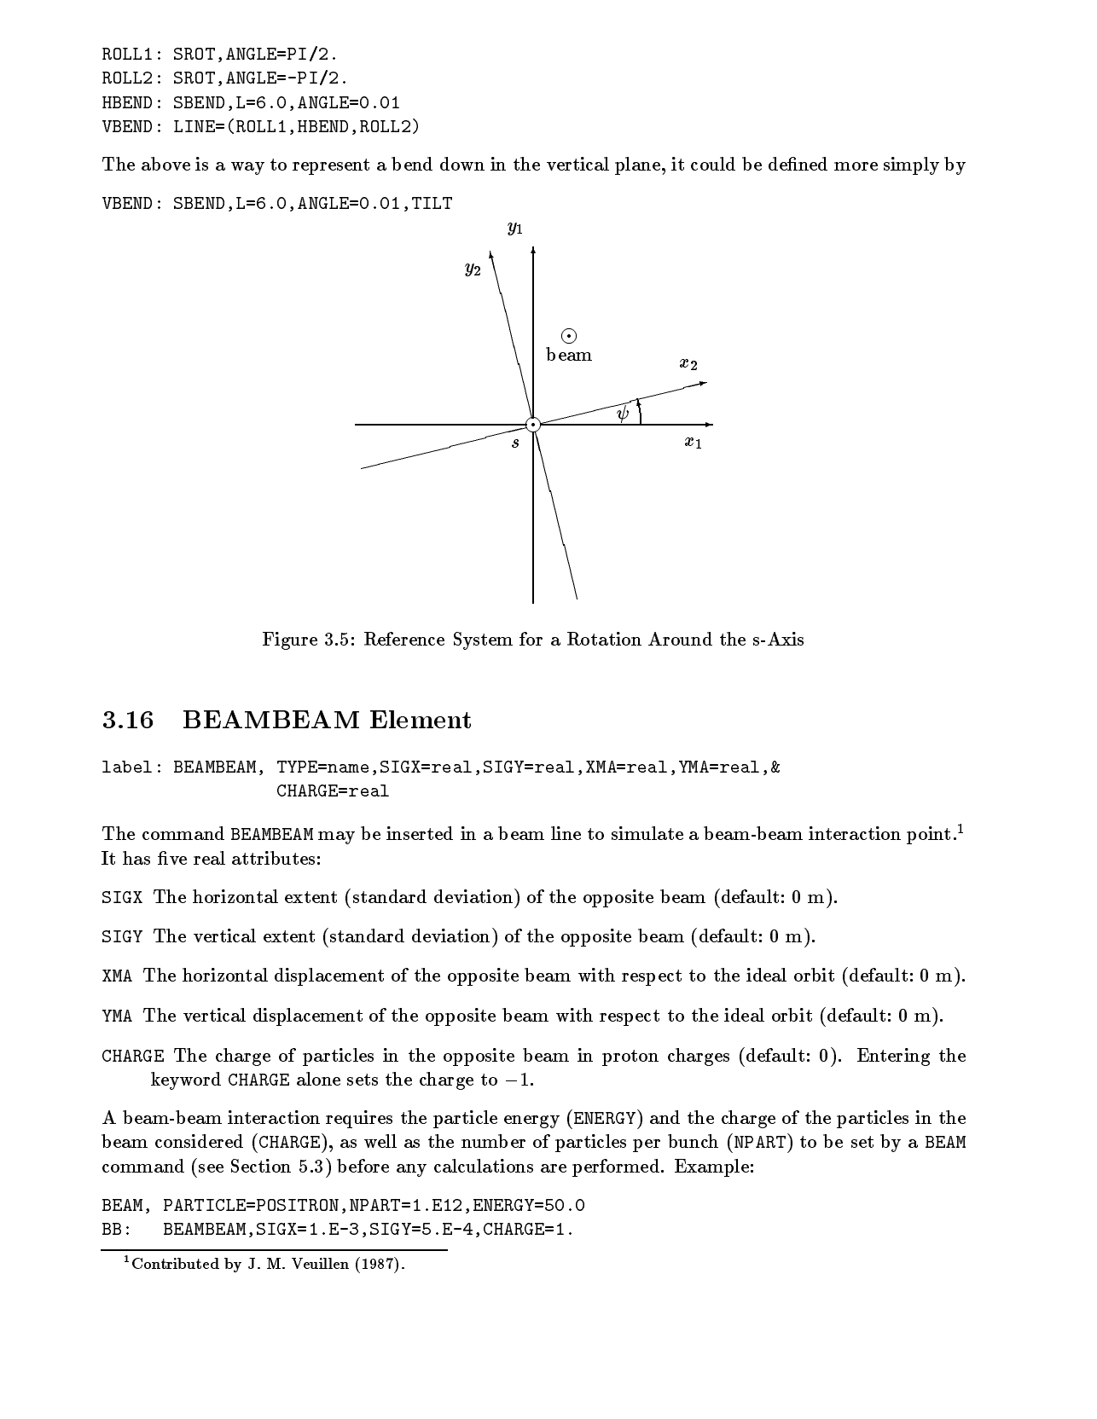
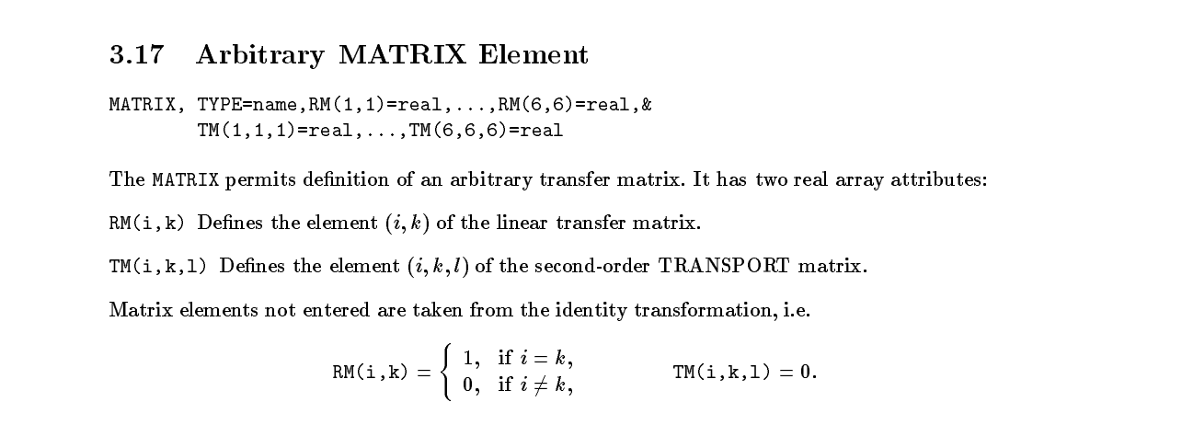
Mad8

Slide 11
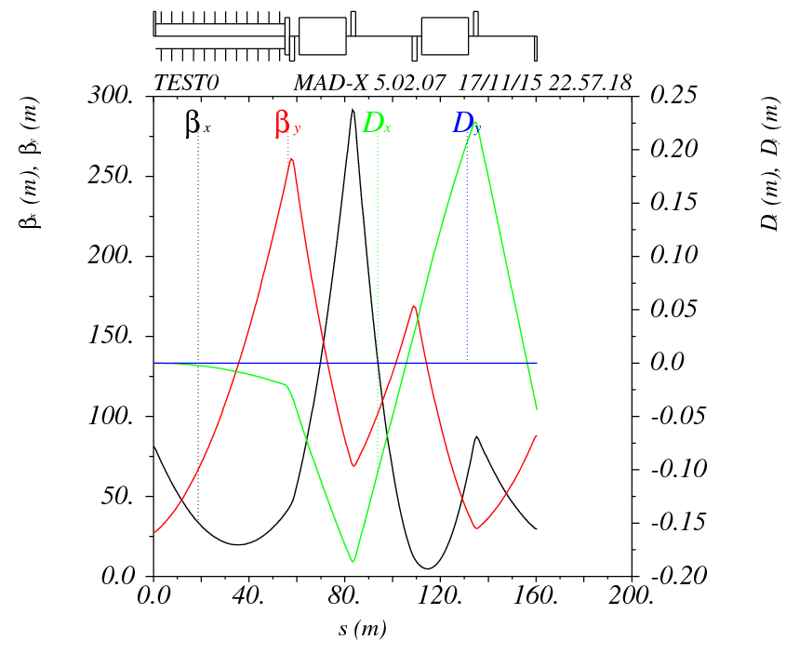
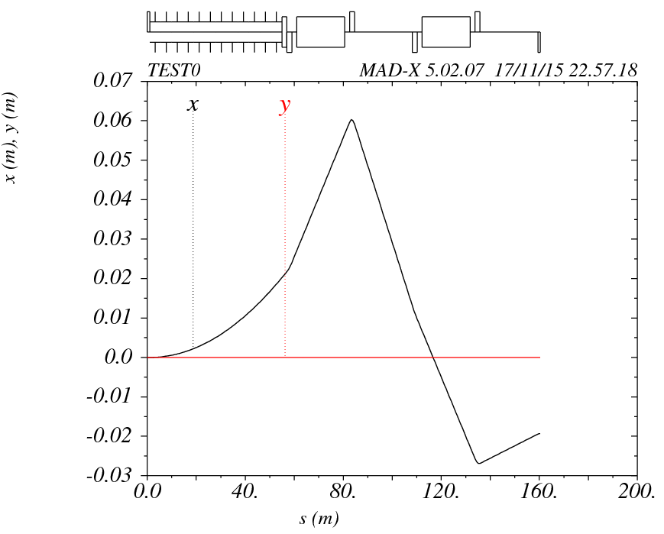
Test0
!---------------------test0-----------------------------------------------------
TEST0: LINE=(halfQ,12*SEPL,MSEPFODOdf);

Slide 12
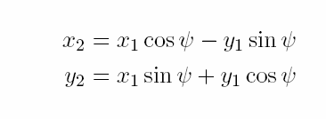
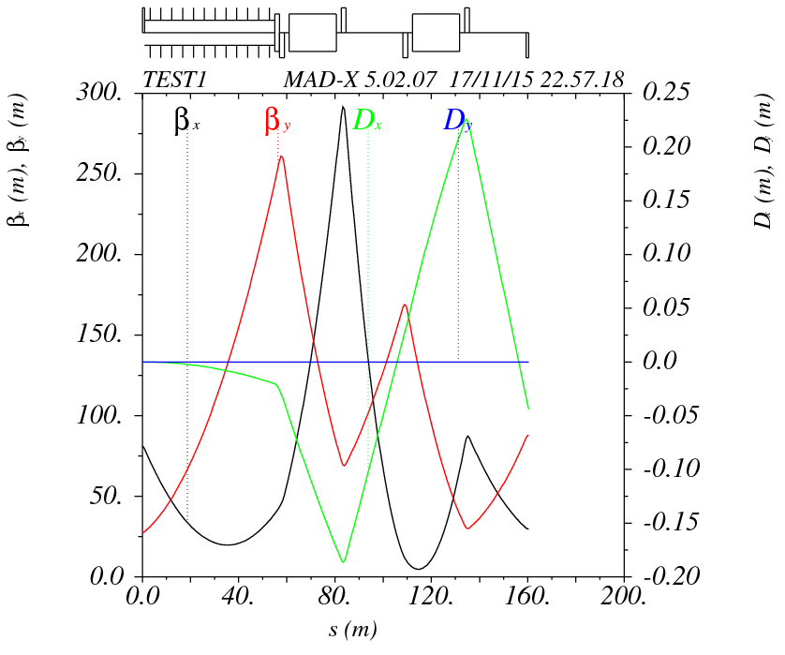
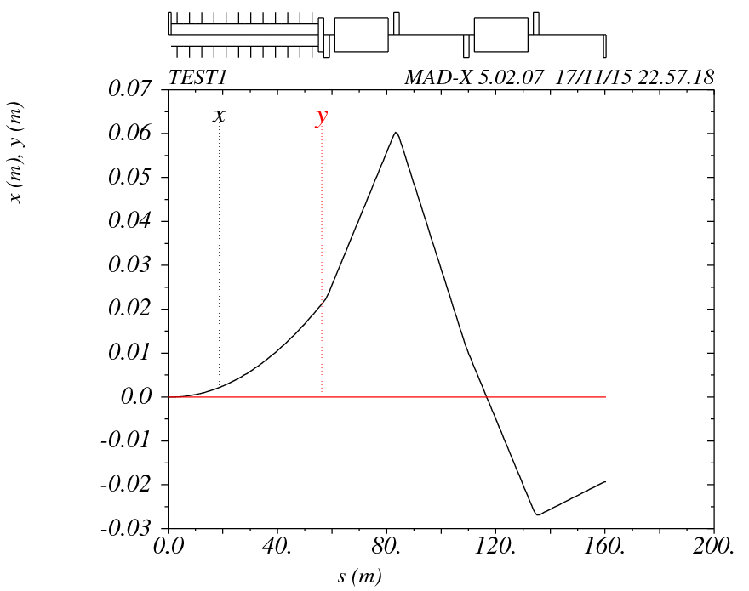
Test1
!------------ test1 coordinate translation----------
REFCHANGE1: translation, X=0.022, Y=0, T=0,
PX=0, PY=-0.00075, PT=0;
TEST1: LINE=(halfQ,12*SEPL,REFCHANGE1,MSEPFODOdf);

Slide 13
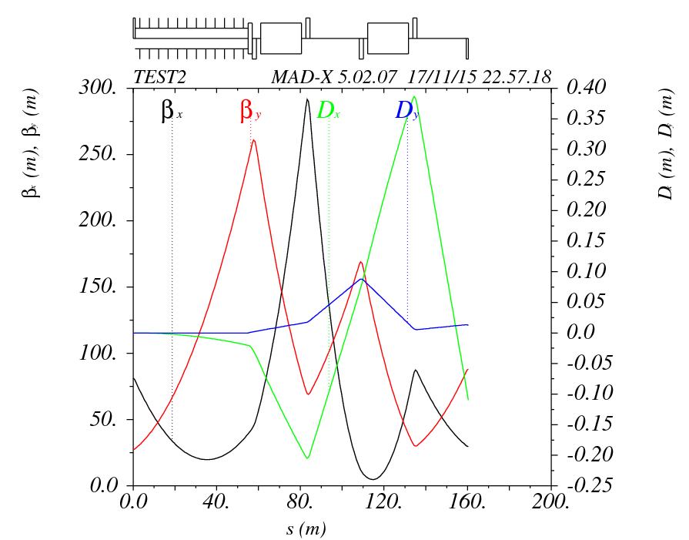
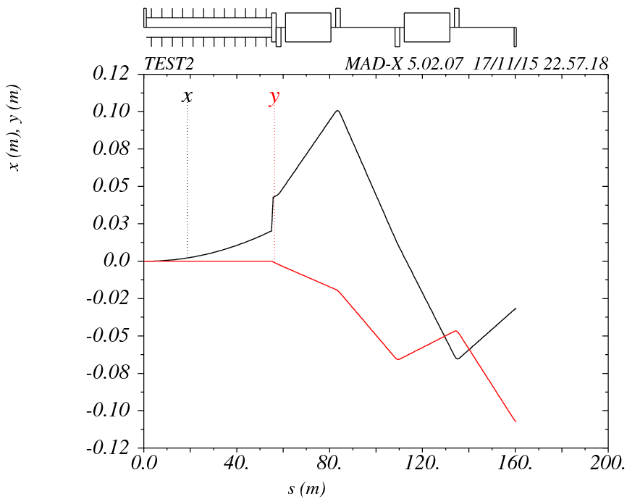
Test2
!--------------test2---MATRIX----------
MATRIX2: MATRIX, L=0.0, KICK1=0.022, KICK4=-0.00075;
TEST2: LINE=(halfQ,12*SEPL,MATRIX2,MSEPFODOdf);

Slide 14
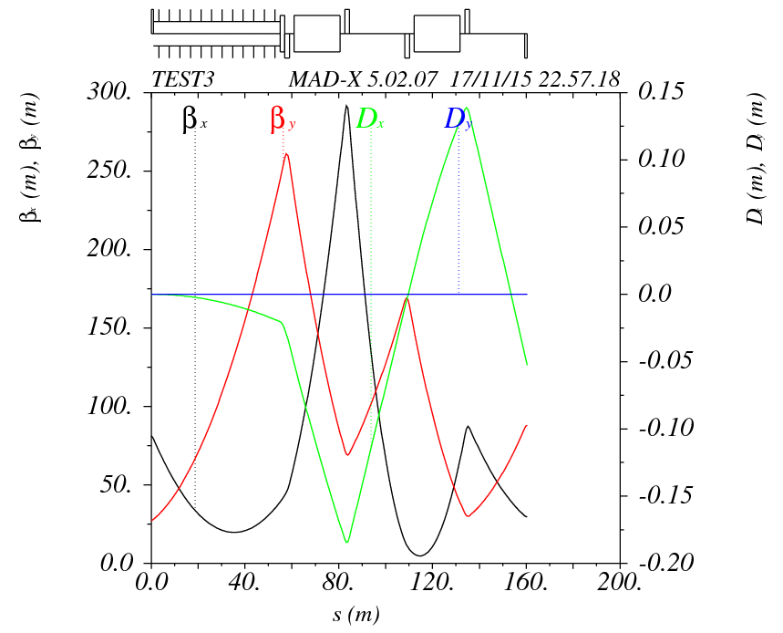
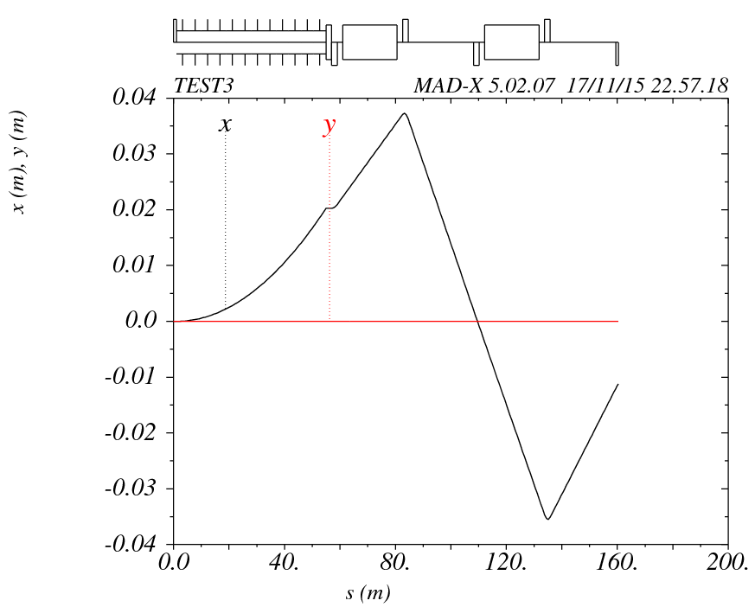
Test3
! ----------test3---y-rotation-----------------------------------------------------------
!
REFCHANGE3: YROTATION, ANGLE=0.00075;
TEST3: LINE=(halfQ,12*SEPL,REFCHANGE3,MSEPFODOdf);

Slide 15
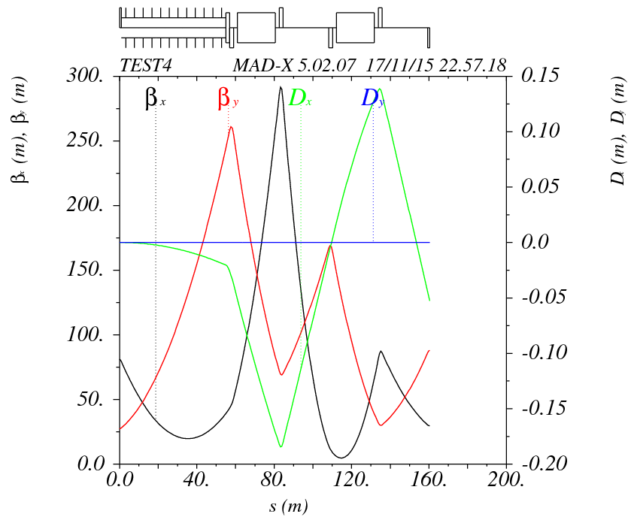
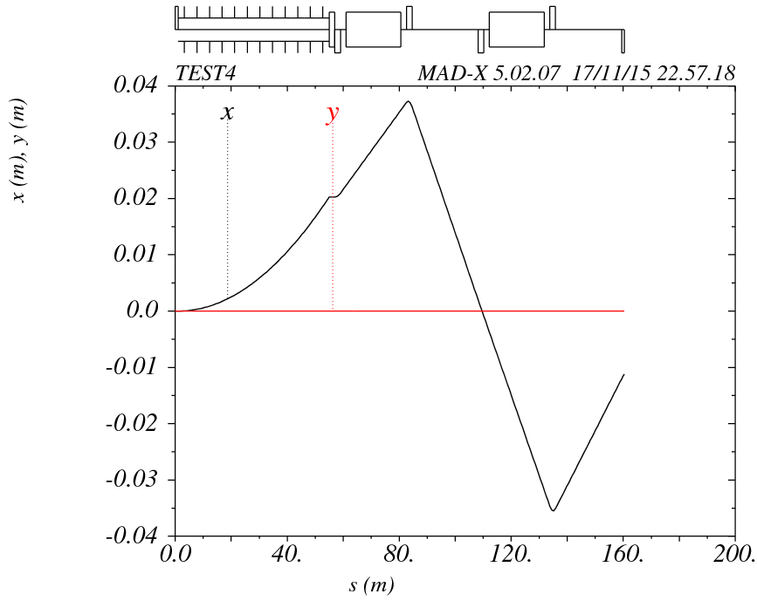
Test4
! ----------test4---y-rotation----X=0.022-------------------------------------------------
!
REFCHANGE3: YROTATION, ANGLE=0.00075;
REFCHANGE4: translation, X=0.022;
TEST4: LINE=(halfQ,12*SEPL,REFCHANGE3,REFCHANGE4,MSEPFODOdf);

Slide 16
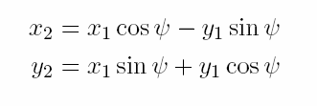
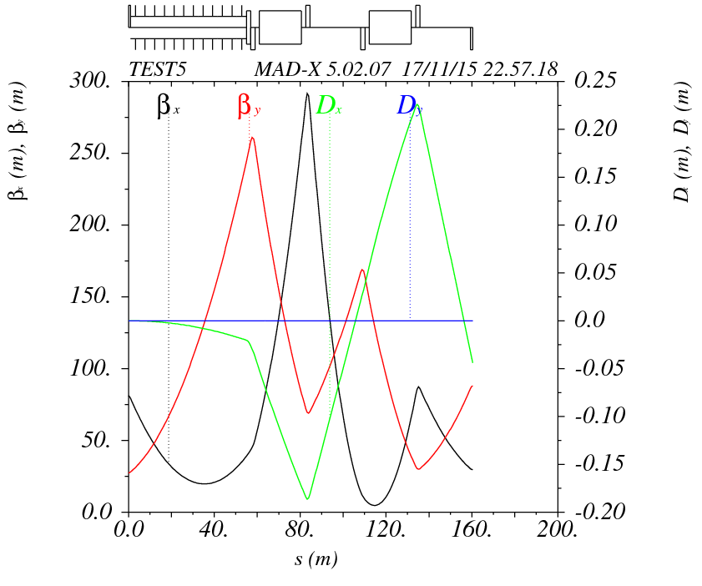
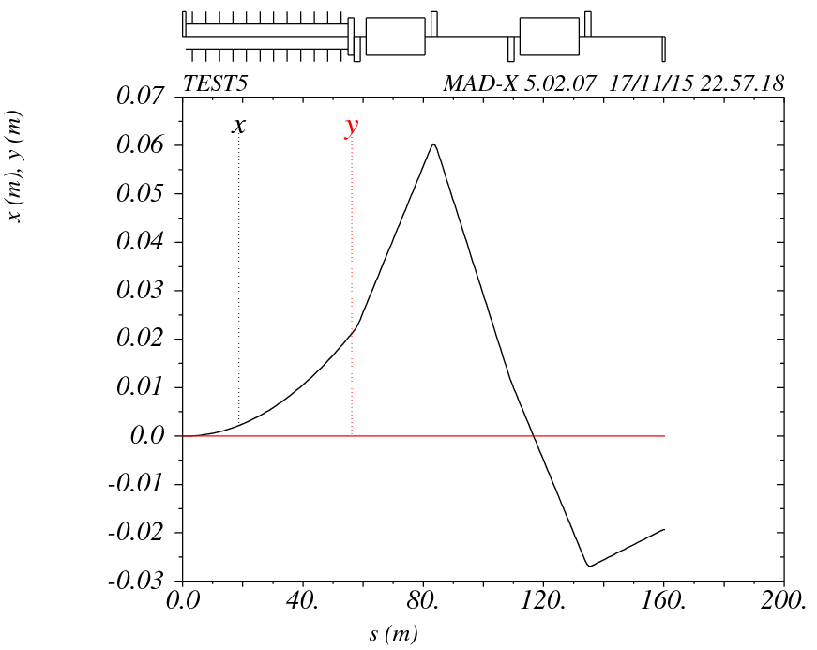
Test5
!-------------test5 changeref--------------------------------------------------
REFCHANGE5: CHANGEREF, PATCH_ANG=0, 0.00075, 0,
PATCH_TRANS=0.022, 0, 0;
TEST5: LINE=(halfQ,12*SEPL,REFCHANGE5,MSEPFODOdf);

Slide 17
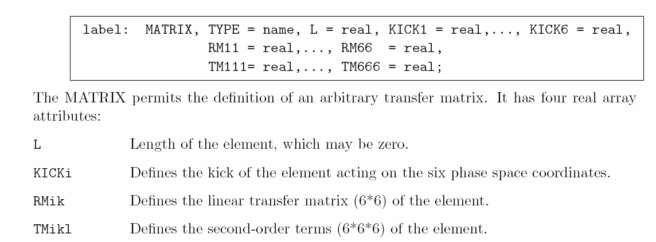
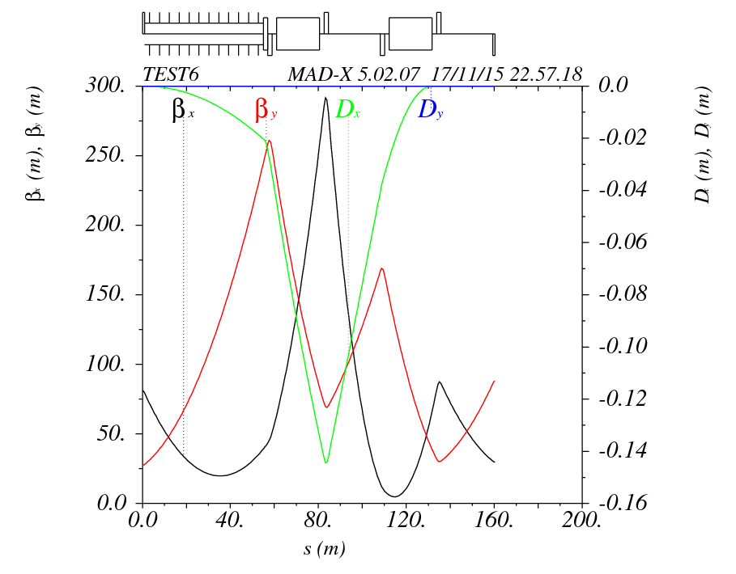
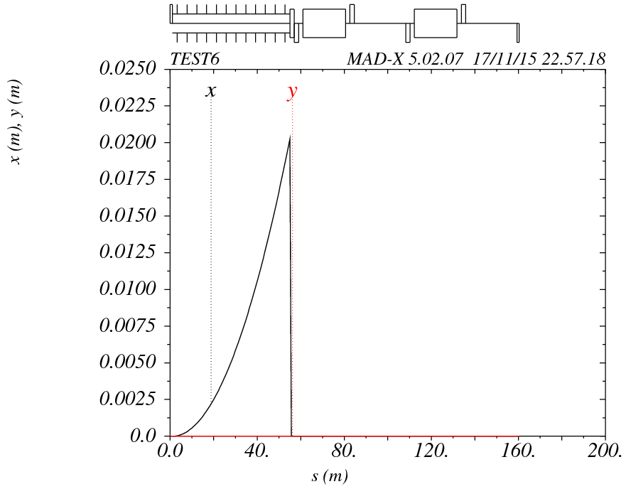
Test6
!-------------test6 matrix--------------------------------------------------
MATRIX6: MATRIX, L=0.0, RM11=0,RM22=0;
TEST6: LINE=(halfQ,12*SEPL,MATRIX6,MSEPFODOdf);

Slide 18
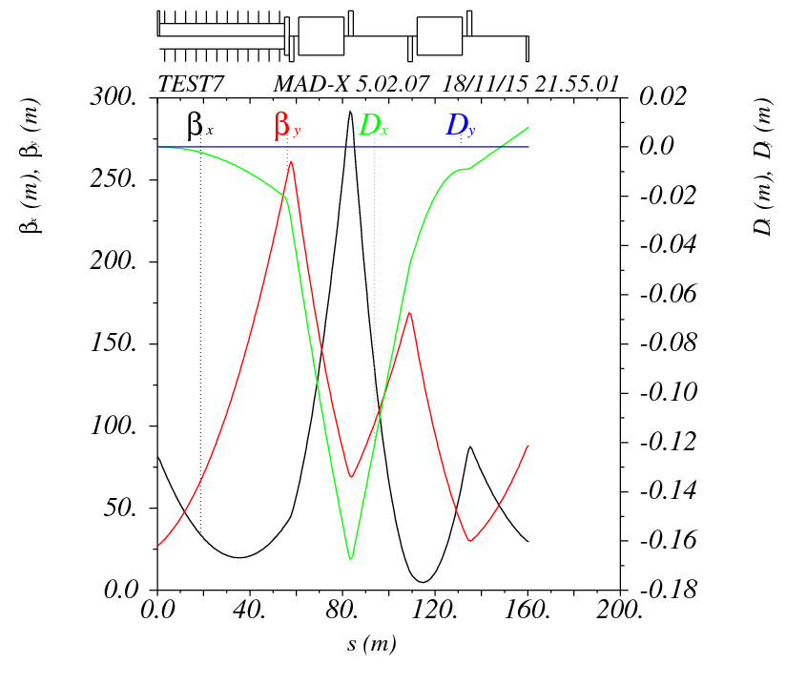
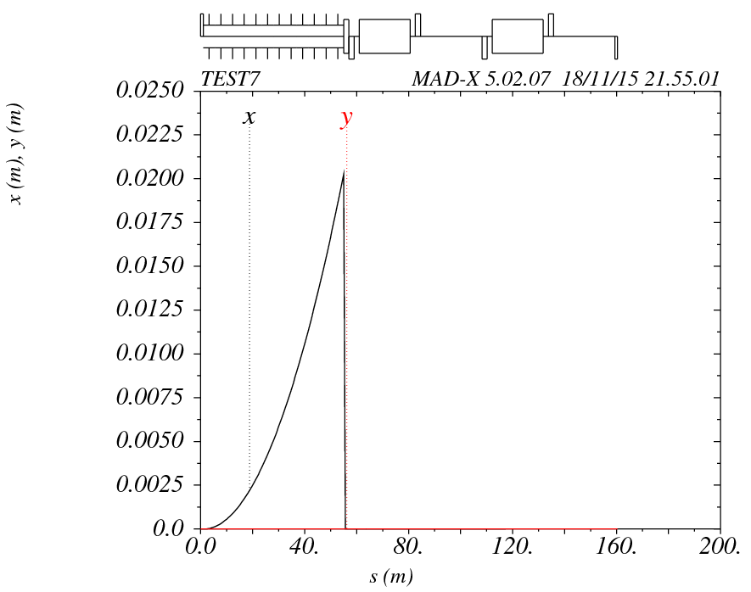
Test7
!--------------test7---MATRIX---------
REFCHANGE3: YROTATION, ANGLE=0.00075;
MATRIX7: MATRIX, l=0.0, KICK1=-0.02025;
TEST7: LINE=(halfQ,12*SEPL,MATRIX7,REFCHANGE3,MSEPFODOdf);

Slide 19
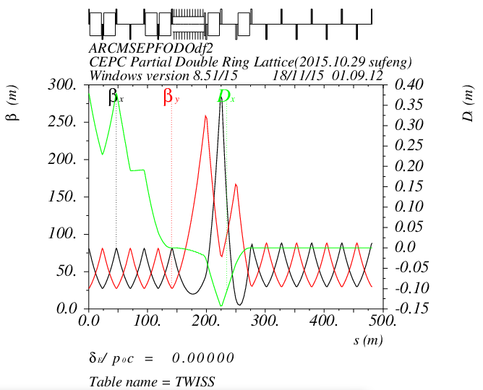
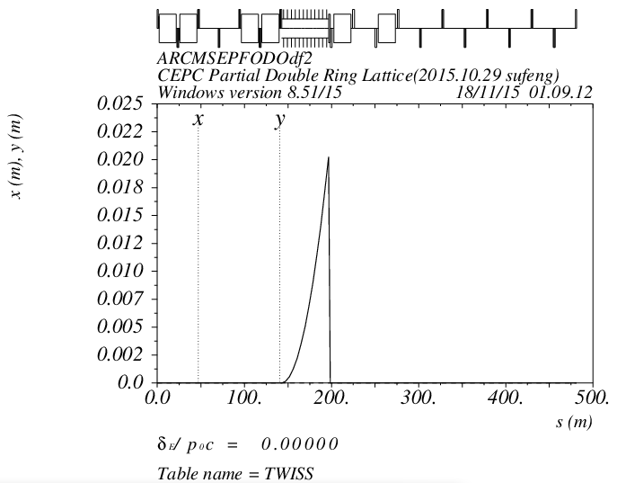
Separator Matrix
MATRIX, L=0.0, RM11=0,RM22=0;

Slide 20
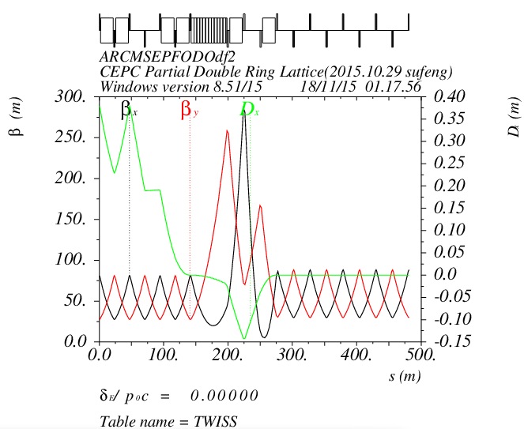
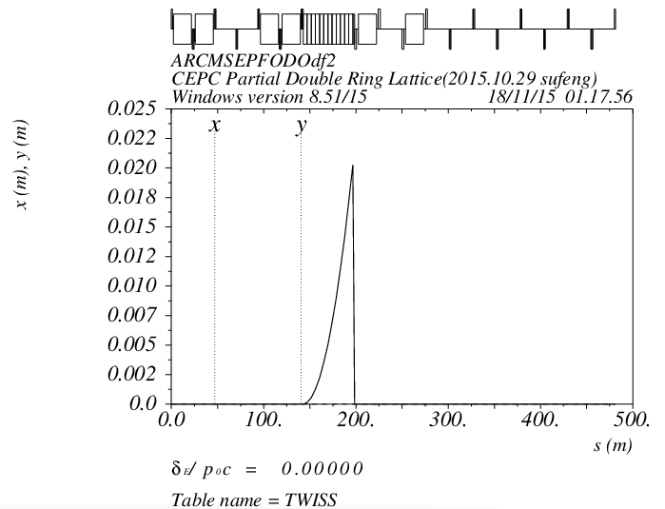
Kicker Matrix
MATRIX, L=0.0, RM11=0,RM22=0;

Slide 21
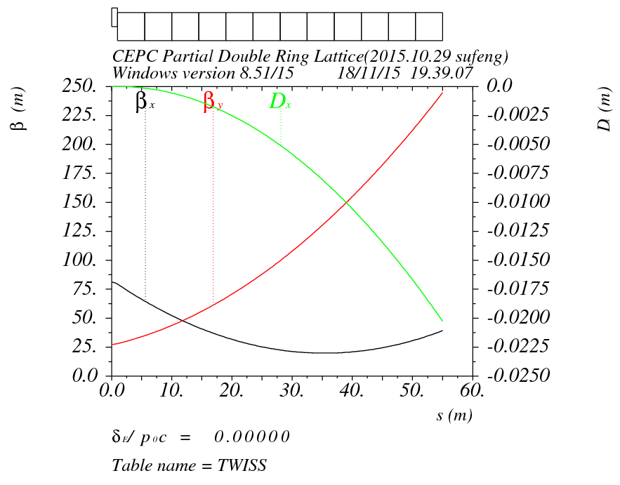
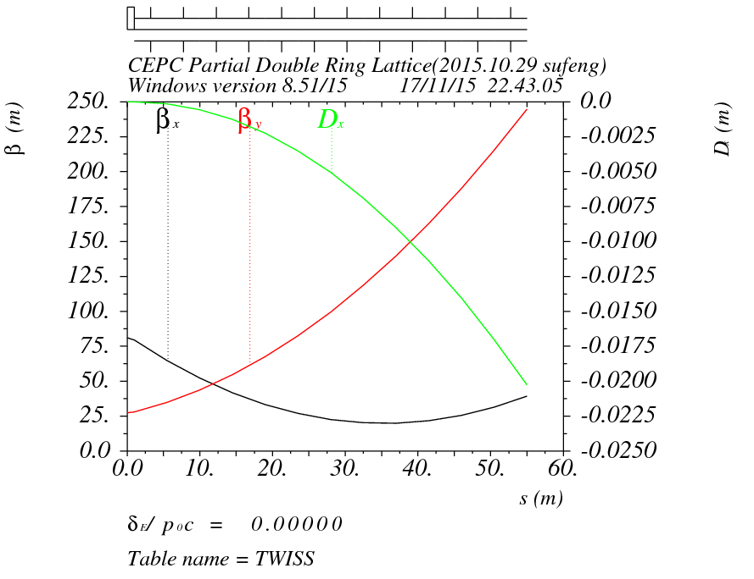
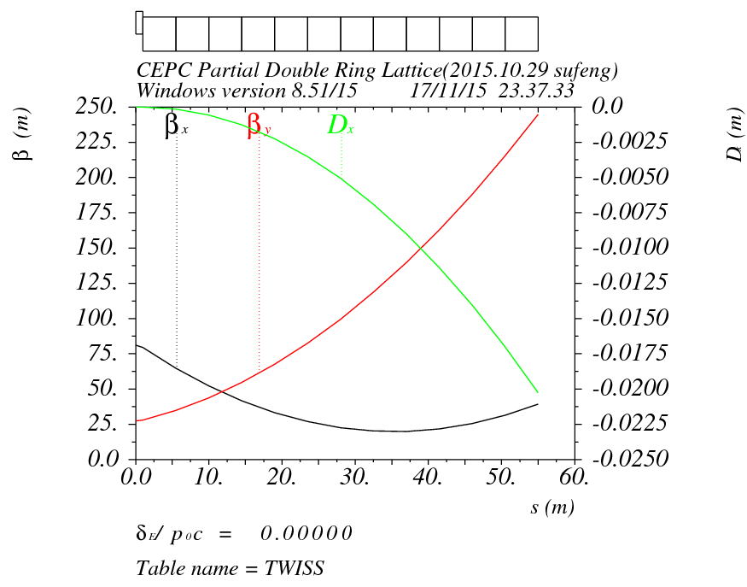
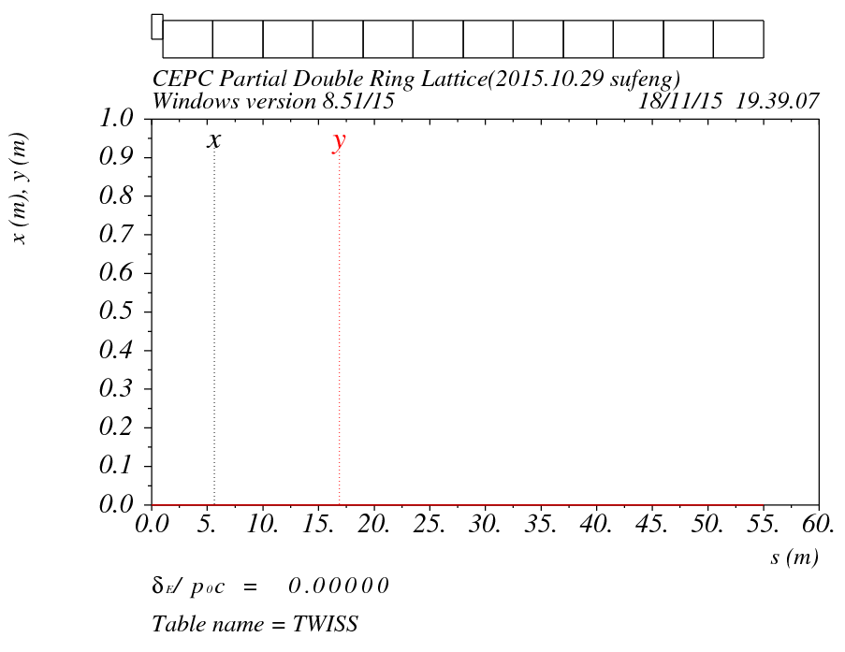
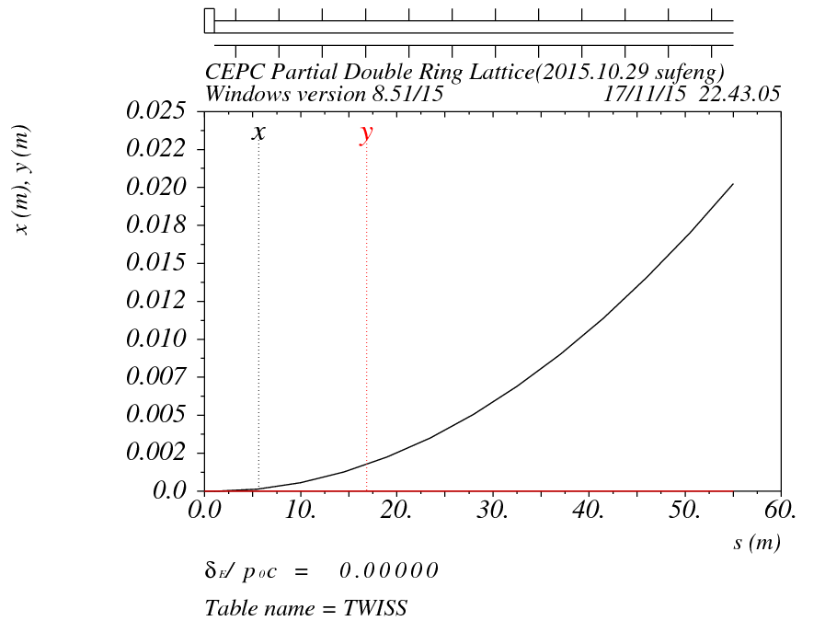
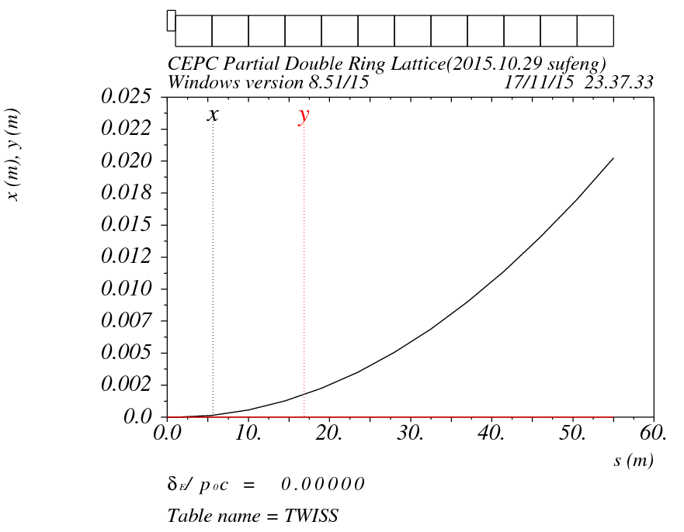
Dipole
Seperator
Kicker
X=20.25mm
X=20.25mm
X=20.25mm

Slide 22
用Dipole代替
双环Lattice分开写

Slide 23
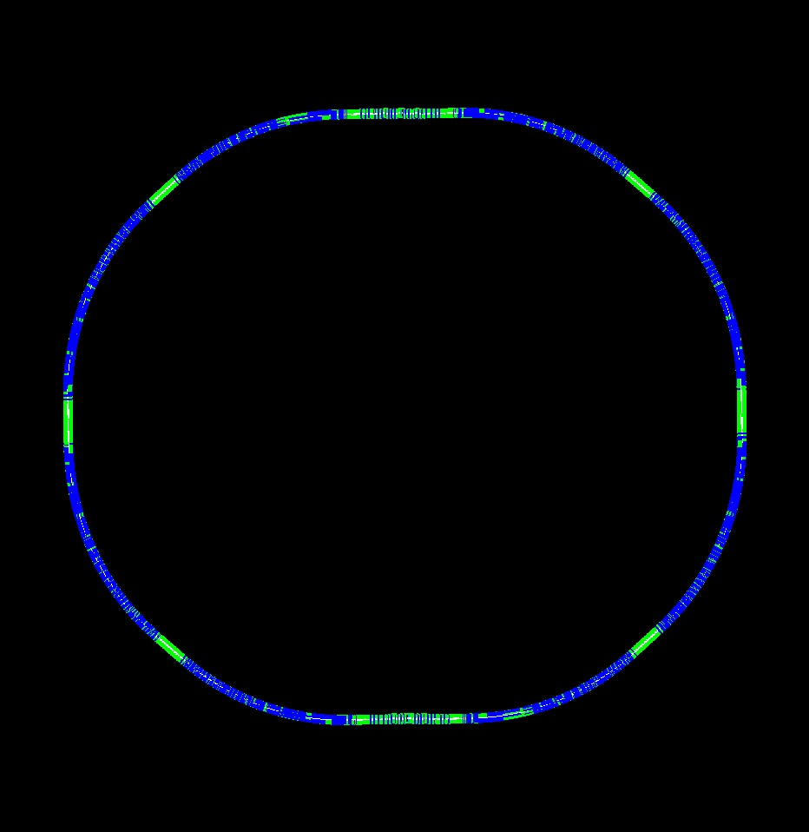


Layout（Version1.0+FFS20151126）

Slide 24


Slide 25


Orbit (RING3_DR_IP1) Version 1.0 + FFS(20151126)

Slide 26

Survey & Dynamic Aperture
（Version 1.0 +FFS20151126）

Slide 27


Dynamic Aperture Comparation
（Version 1.0 +FFS20151027）
（Version 0.3 +FFS20151027）

Slide 28

FMA
（Version 1.0 +FFS20151126）

Slide 29

FMA
（Version 1.0 +FFS20151126）

Slide 30


Layout（Version1.0 without FFS）

Slide 31


Orbit (RING3_DR_IP1L) Version 1.0 without FFS

Slide 32

Survey & Dynamic Aperture
（Version 1.0 –without FFS）
CEPC Partial Double Ring Lattice
(Version1.0-20151126)

Slide 33

Dynamic Aperture Comparation
0: 33σx 760σy
0.01：13σx 320σy
0.02：10σx 170σy
0: 50σx 1500σy
0.01：50σx 900σy
0.02：40σx 800σy
CEPC Partial Double Ring Lattice
(Version0.3-20151027)
CEPC Main Ring Lattice (without pretzel)
(September 30, 2014 Geng Huiping)

Slide 34
Next to do
IR（FFS）match and Optimization
Dynamic Aperture Optimization

Slide 35
Thank You !

