Slide 1
Parameter study and IR design for CEPC local double ring scheme
Dou Wang, Jie Gao, Feng Su, Yuan Zhang, Ming Xiao, Yiwei Wang, Bai Sha, Tianjian Bian, Zhe Duan
CEPC AP meeting, 20151127

Slide 2
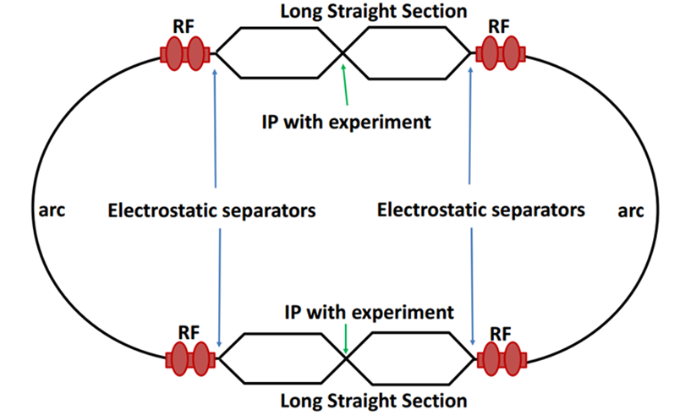
Machine constraints / given parameters
Energy E₀
Circumference C₀
N_{IP}
Beam power P₀
β_{y}*
R=σy/σx
Emittance coupling factor κ_{ε}
Bending radius ρ
Piwinski angle Φ
luminosity enhancement by crab waist F_{l} ~1.5
Energy acceptance (DA)
Phase advance per cell (FODO)
A=δ₀/δ_{BS} (A>~3)

Slide 3
Primary parameter design
 | Pre-CDR | crab waist-high lumi. | crab waist-low power
Number of IPs | 2 | 2 | 2
Energy (GeV) | 120 | 120 | 120
Circumference (km) | 54 | 54 | 54
SR loss/turn (GeV) | 3.1 | 2.96 | 2.96
Half crossing angle (mrad) | 0 | 14.5 | 11.5
Piwinski angle | 0 | 2 | 2
N_{e}/bunch (10¹¹) | 3.79 | 3.79 | 2.81
Bunch number | 50 | 50 | 40
Beam current (mA) | 16.6 | 16.9 | 10.1
SR power /beam (MW) | 51.7 | 50 | 30
Bending radius (km) | 6.1 | 6.2 | 6.2
Momentum compaction (10⁻⁵) | 3.4 | 3.0 | 2.6
β_{IP} x/y (m) | 0.8/0.0012 | 0.306/0.0012 | 0.22/0.001
Emittance x/y (nm) | 6.12/0.018 | 3.34/0.01 | 2.67/0.008
Transverse σ_{IP} (um) | 69.97/0.15 | 32/0.11 | 24.3/0.09
ξ_{x}/IP | 0.118 | 0.04 | 0.04
ξ_{y}/IP | 0.083 | 0.11 | 0.11
V_{RF} (GV) | 6.87 | 3.7 | 3.6
f _{RF} (MHz) | 650 | 650 | 650
Nature σ_{z} (mm) | 2.14 | 3.3 | 2.6
Total σ_{z} (mm) | 2.65 | 4.4 | 4.2
Energy spread (%) | 0.13 | 0.13 | 0.13
Energy acceptance (%) | 2 | 2 | 2
Energy acceptance by RF (%) | 6 | 2.2 | 2.2
n_{γ} | 0.23 | 0.49 | 0.47
Life time due to beamstrahlung_cal (minute) | 47 | 53 | 41
F (hour glass) | 0.68 | 0.73 | 0.69
L_{max}/IP (10³⁴cm⁻²s⁻¹) | 2.04 | 2.97 | 2.03

Slide 4
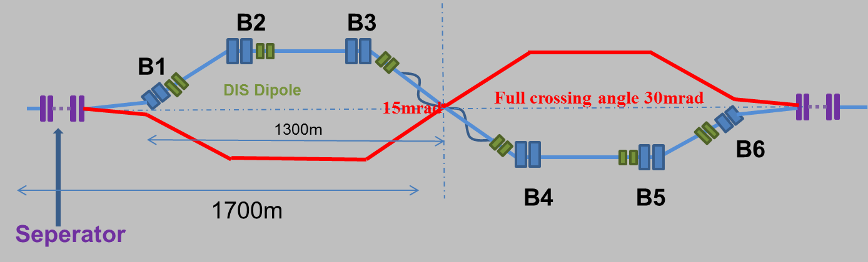
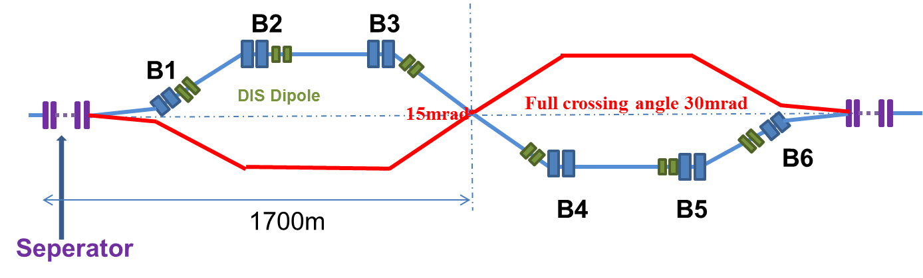

Combine with local double ring lattice
Choice 1
Choice 2

Slide 5
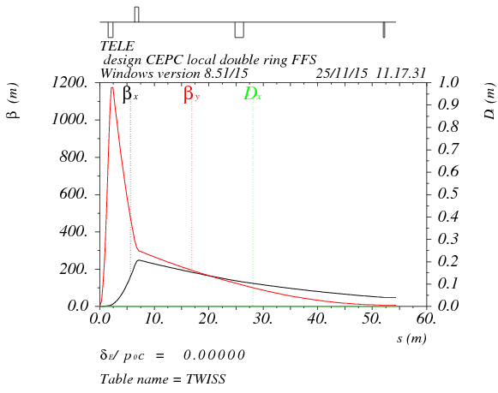
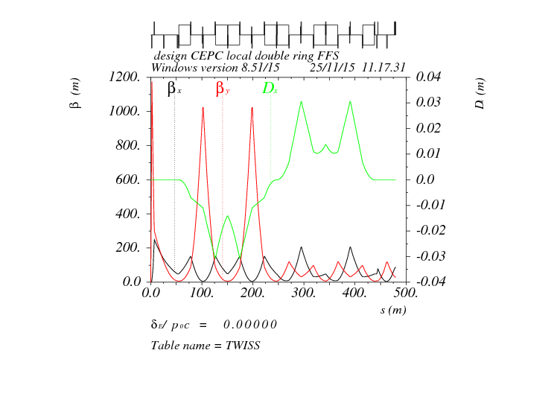
Double ring FFS design with crab sextupoles
Ec=100 keV
Betax=0.8m
Betay=0.003m
Crab sextupole
IP
L*=1.5m
L(DQ0)=0.91m, G(DQ0)=-300T/m
L(DF1)=0.74m, G(DF1)=106T/m
L₀=4m
As Oide said, the second FFS sextupoles of the CCS-Y section can work as the crab sextupoles, if their strengths and phases to the IP are properly chosen.

Slide 6
Crab sextupole strength
Δϕ_{x}=2π, Δϕ_{y}=2.5π
The crab sextupole should be placed on both sides of the IP in phase with the IP in the horizontal plane and at π/2 in the vertical one.

Slide 7
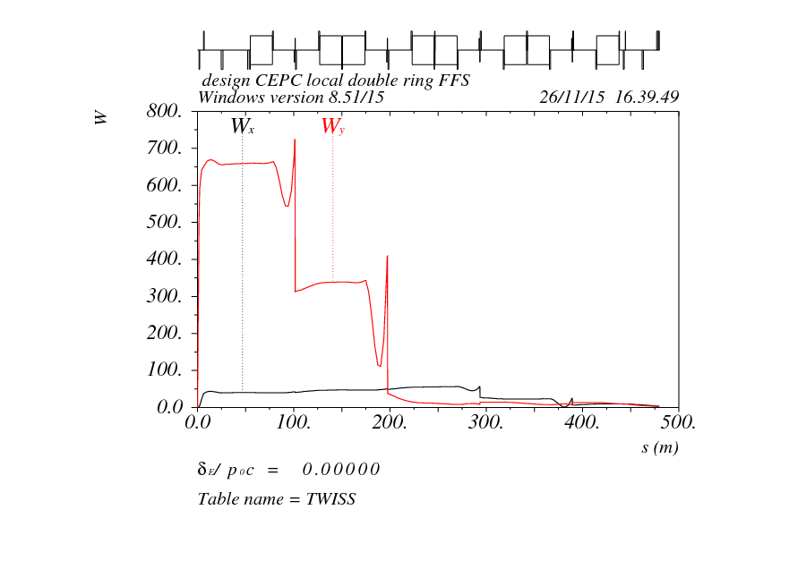
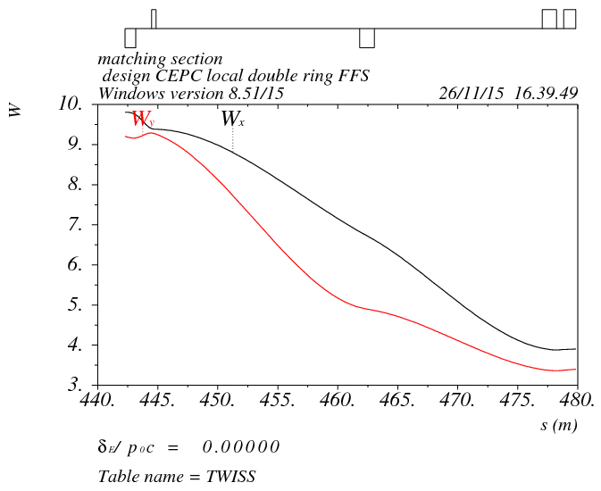
Chromaticity correction

Slide 8
summary
CEPC partial double ring parameters for high luminosity mode has been adjusted to enlarge the energy acceptance of RF system.
Based on crab waist scheme, we can get higher luminosity (2.97*10³⁴cm⁻²s⁻¹) keeping head-on beam power or to reduce the beam power (30 MW) keeping same luminosity.
New FFS with crab sextupoles has been designed. DA optimization of the whole ring is undergoing.
For next step, arc lattice should be redesigned as soon as possible to get smaller emittance for crab waist scheme.

