Slide 1
Pretzel orbit design with asymmetric lattice (v20140930)
Huiping Geng
CEPC Accelerator Physics regular meeting
2015.10.23

Slide 2
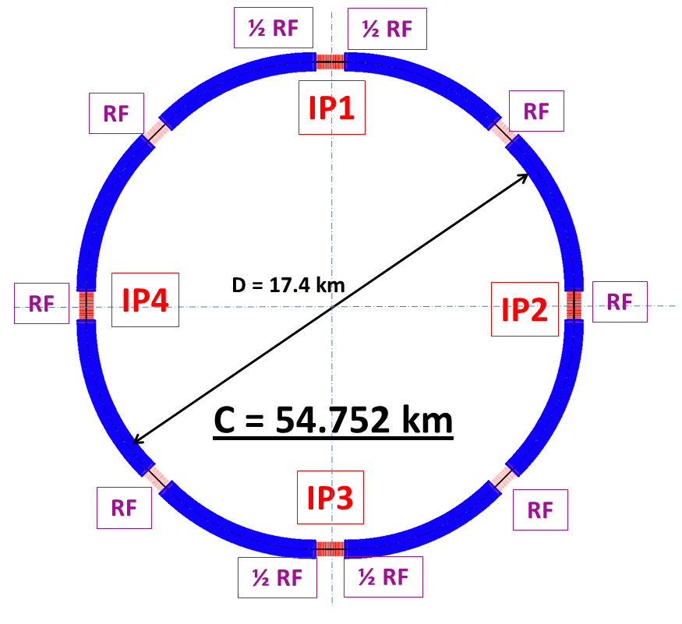
Review of asymmetric lattice (v20140930)
Circuference: 54.752 km
FODO cell length: 47.2 m
Phase advance per cell: 60/60 degrees
ARC length:5852.8m= (2+120+2)*47.2
Short straight: 18 FODO cells, 849.6m
Long straight: 24 FODO cells, 1132.8m
Results reported in HF2014 are using this lattice.

Slide 3
Issues with pretzel orbit
For ideal pretzel orbit, the following relationship should be fullfilled:
i.e. the phase advance between parasitic crossing point should be a integer number of 2*Pi.
For our lattice, it is comprised of 60/60 degree FODO cells, so the relationship can be written as:
But for this asymmetric lattice, as for 50 bunches case:
This is why we say pretzel orbit is not working for this lattice version.

Slide 4
To make it work
Two options(assuming phase advance per cell keeps constant):
Change the cell length, which will result in the change of emittance, circumference etc.
Change the circumference
In the following, we take the easy way, i.e. we change the circumference to make the lattice work for pretzel orbit of 50 bunches

Slide 5
Changes made
ARC length:5852.8m
Short straight: 18 FODO cells, 849.6m
Long straight: 34 FODO cells, 1604.8m
Circumference: 56.640km
After making this chang, every nearest parasitic collision points will have a phase advance of 4Pi.

Slide 6
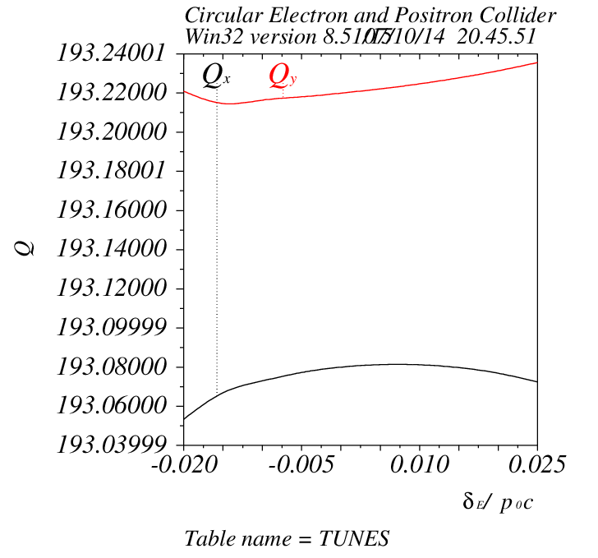
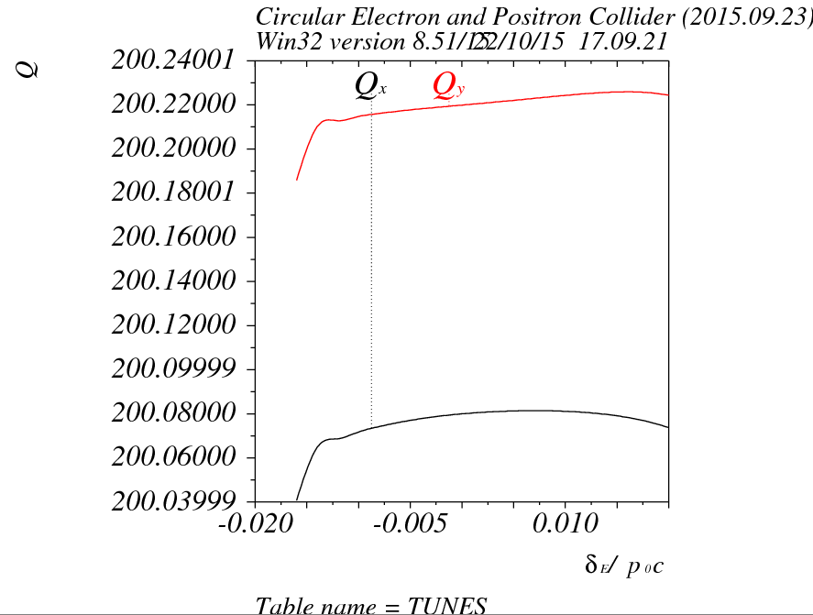
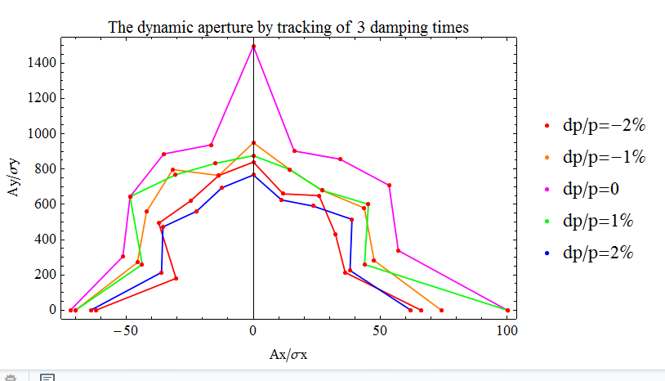
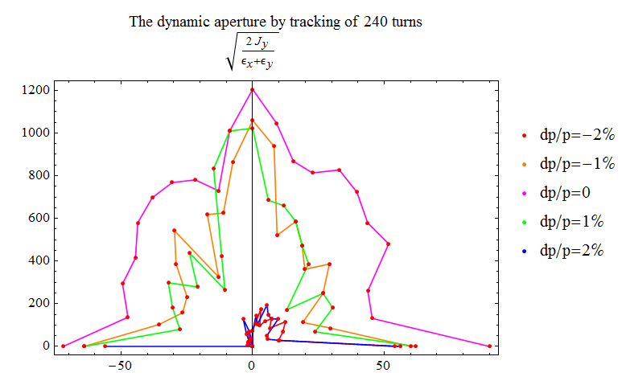
Comparison of results before adding pretzel
v20140930
New version
v20150923

Slide 7
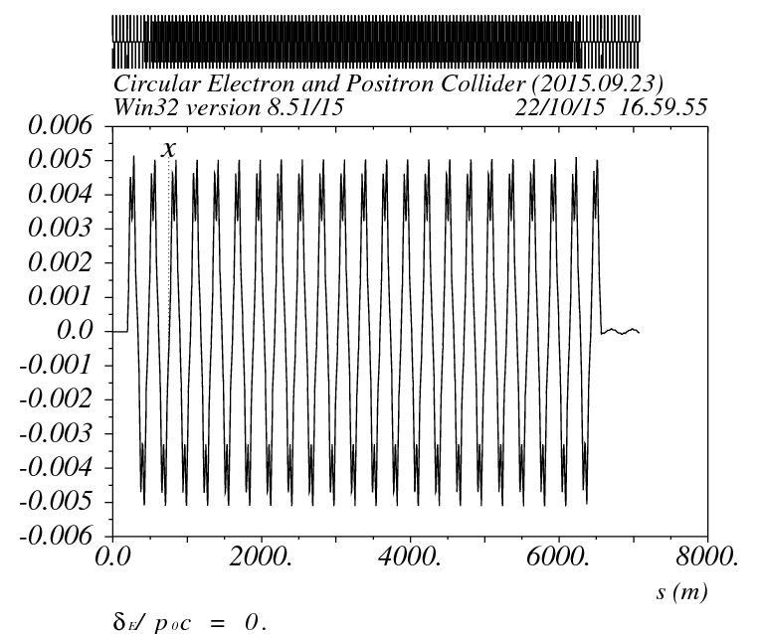
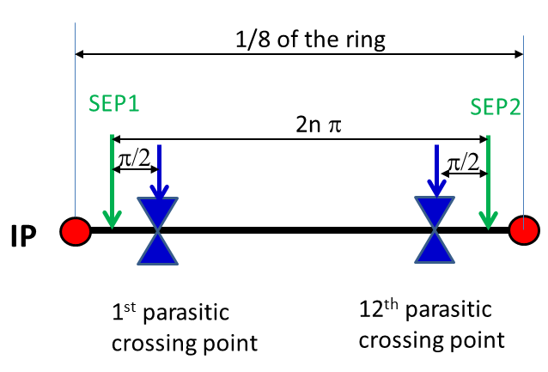
Pretzel orbit design
Find proper positon and strength of static electric separators, then the pretzel orbit can be well generated.

Slide 8
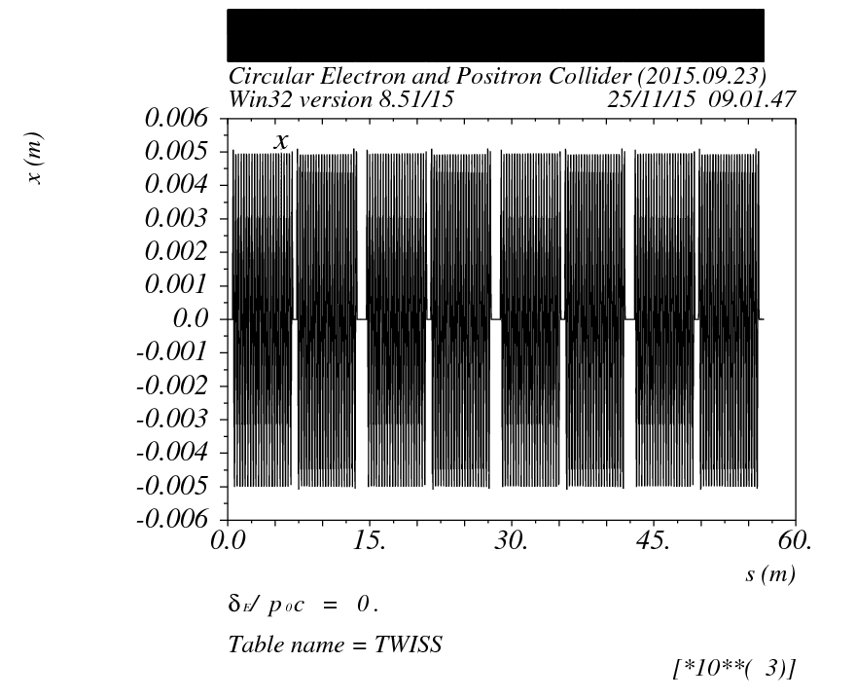
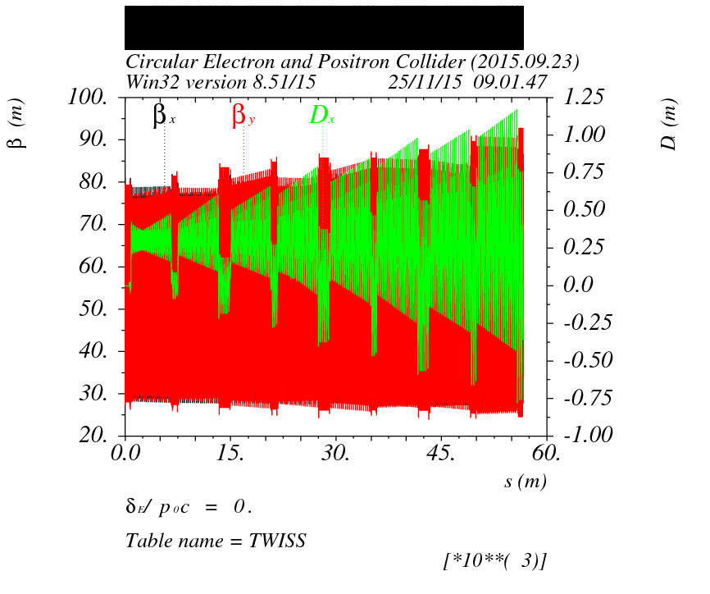
Pretzel orbit effect on lattice

Slide 9
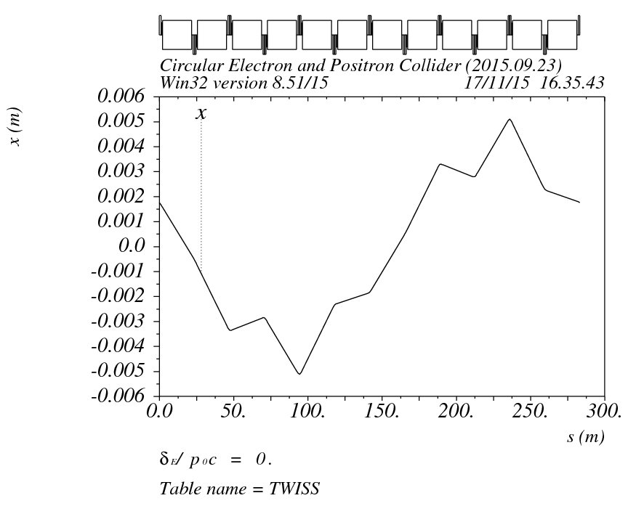
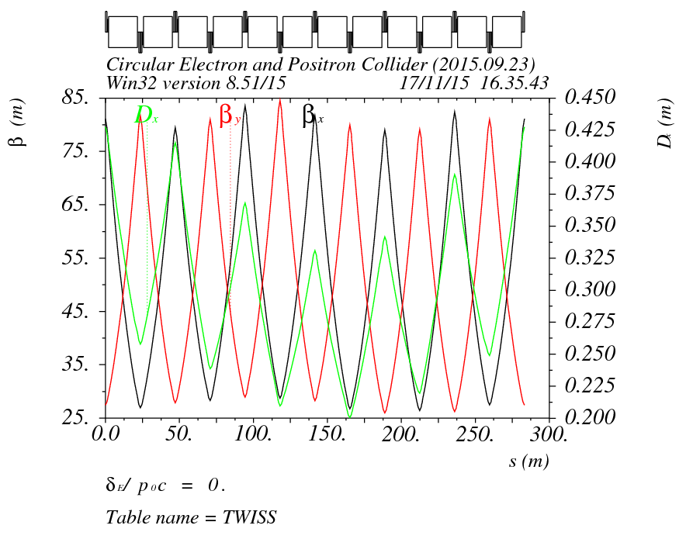
Pretzel orbit effect correction
选择第一个弧区第三个FODO入口（消色散节出口）为初始条件，以6个FODO cell为周期， 重新匹配周期解

Slide 10
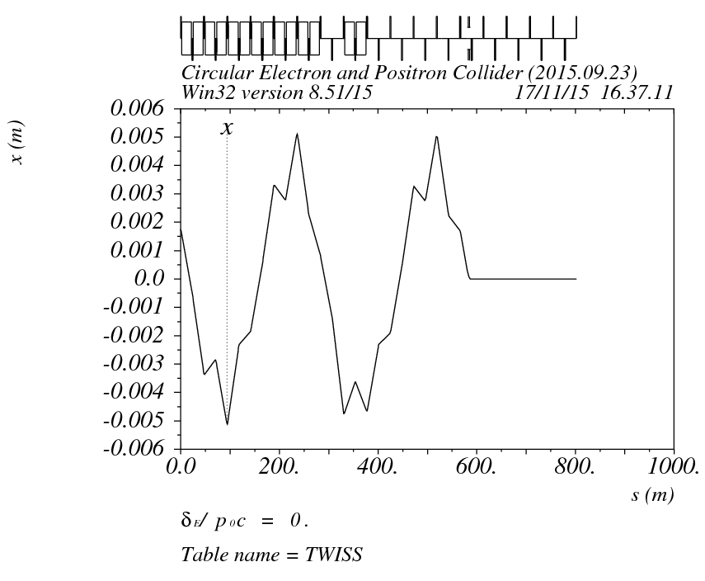
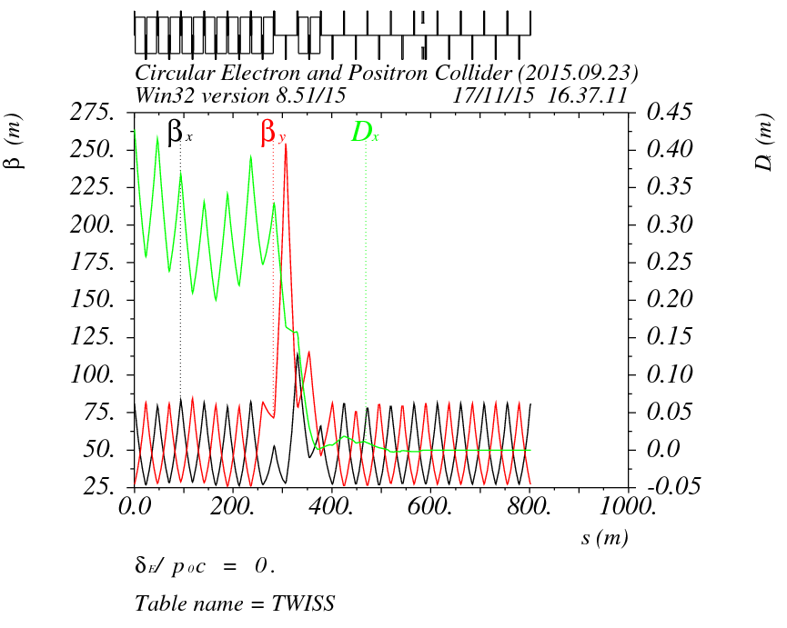
Pretzel orbit effect correction
第一个弧区消色散条件重新匹配，消色散点选择在第二个静电分离器出口，beta函数满足周期解匹配。

Slide 11
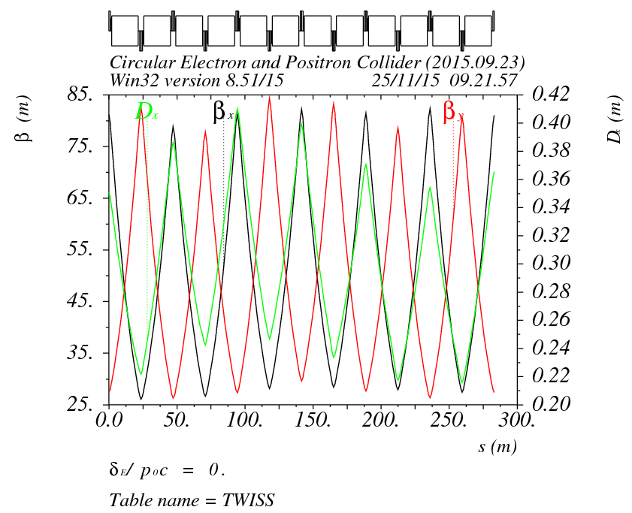
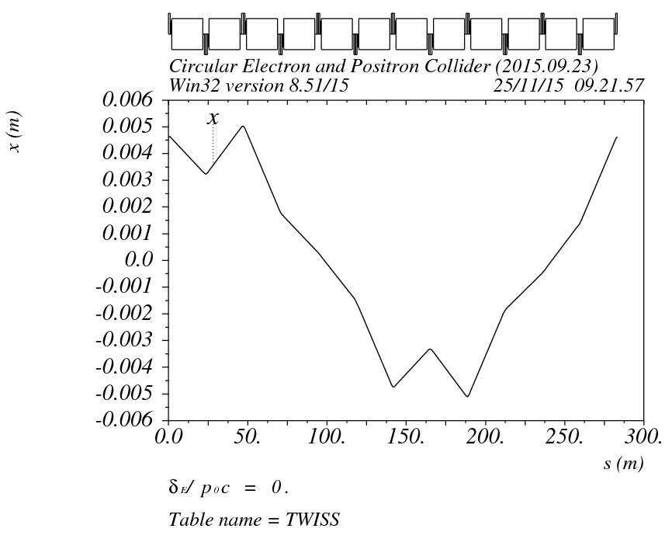
Pretzel orbit effect correction
第二个弧区需要重新匹配，因为SEP1止SEP3的相移不是2Pi整数倍。是否可以增加相移条件使弧区1和2的SEP1止SEP3的相移满足2Pi整数倍？
选择第二个弧区第三个FODO入口（消色散节出口）为初始条件，以6个FODO cell为周期， 重新匹配周期解

Slide 12
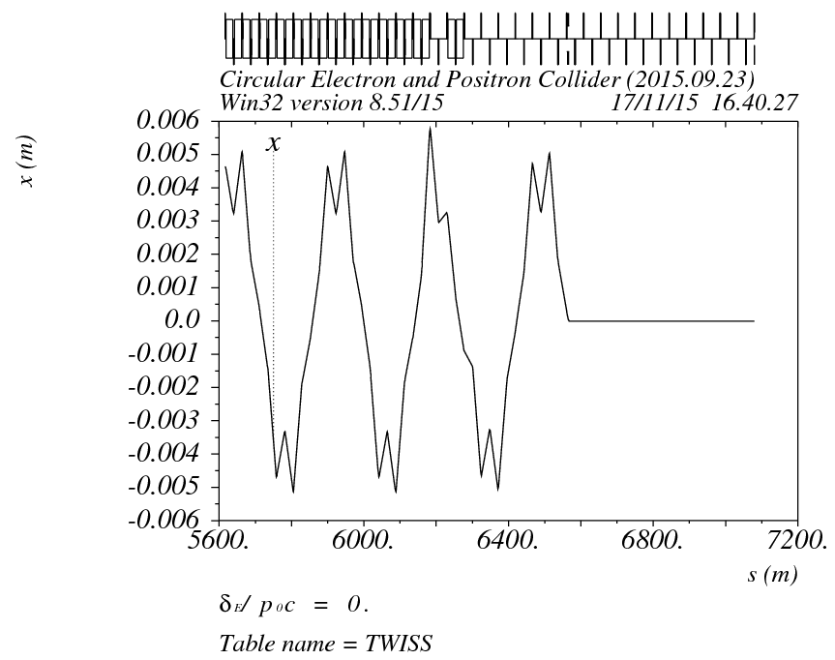
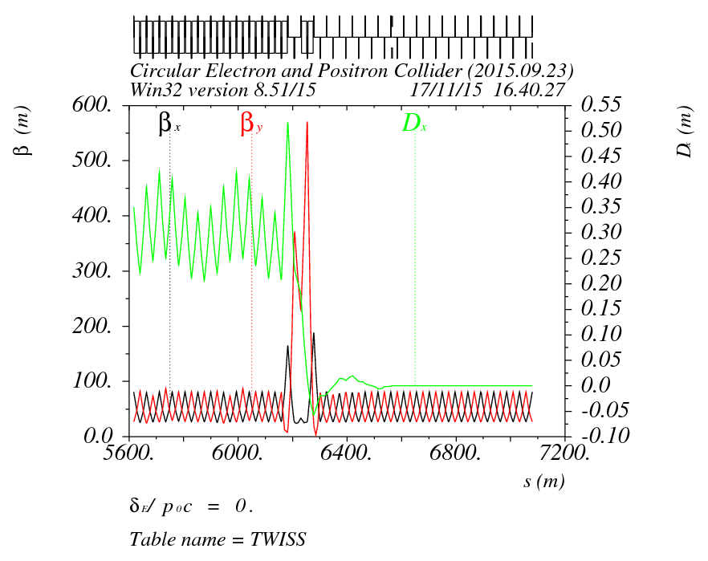
Pretzel orbit effect correction
第二个弧区消色散条件重新匹配，消色散点选择在此弧区的第二个静电分离器出口，beta函数满足周期解匹配。

Slide 13
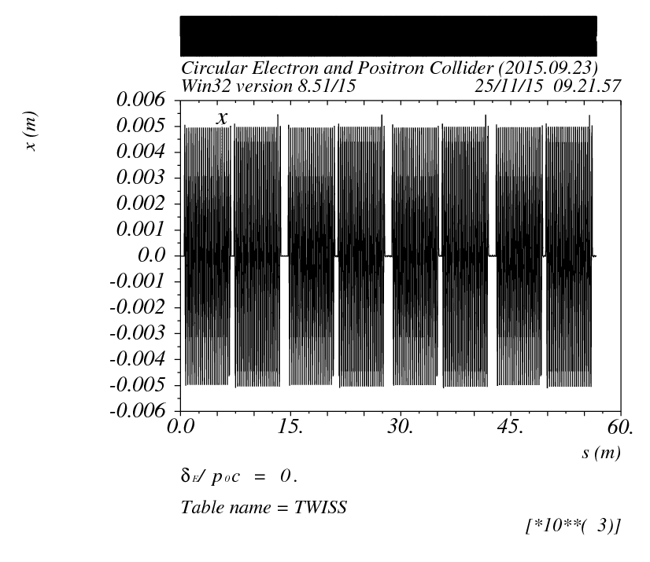
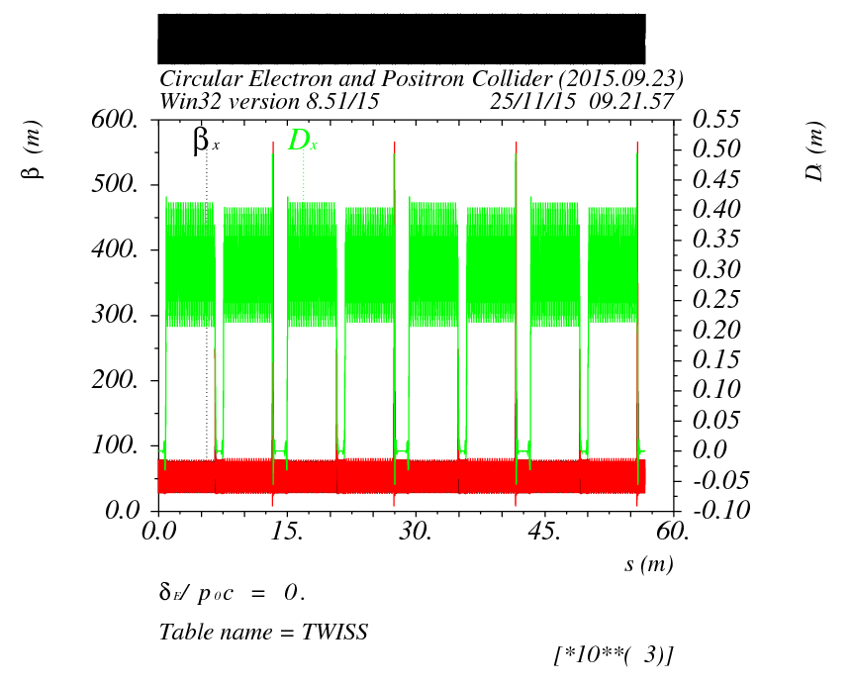
Pretzel orbit effect correction
校正后的全环lattice，调整色品矫正后，需将上述过程重复，寻找新的匹配条件。

Slide 14
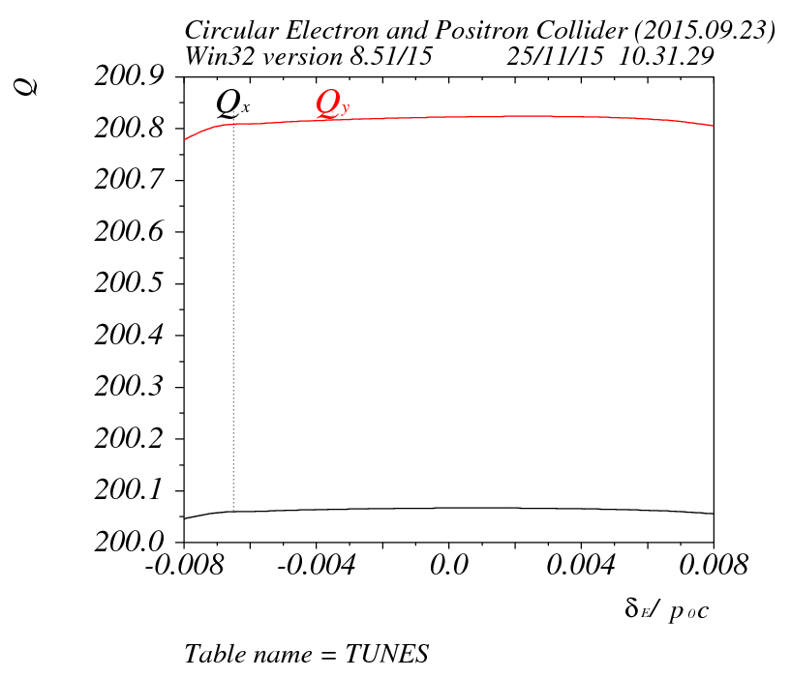
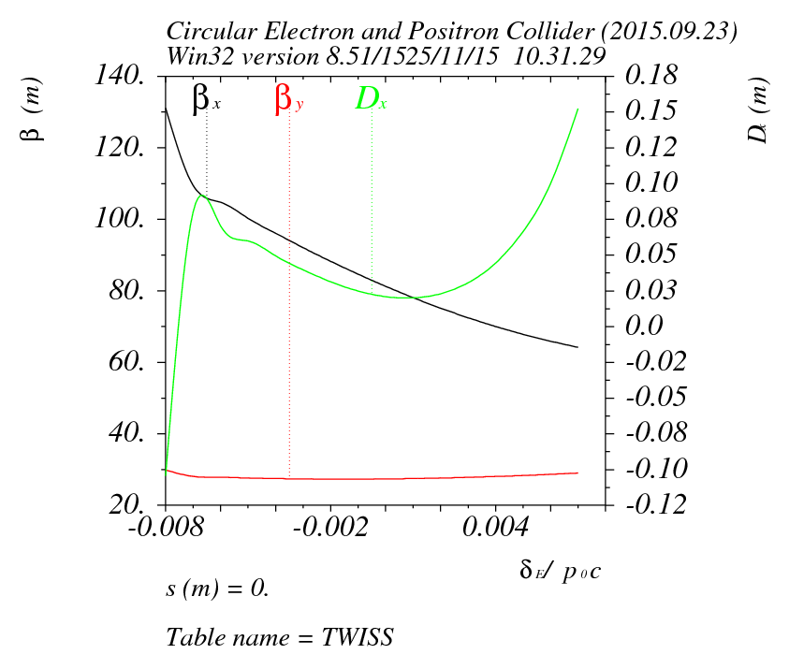
Pretzel orbit effect correction

Slide 15
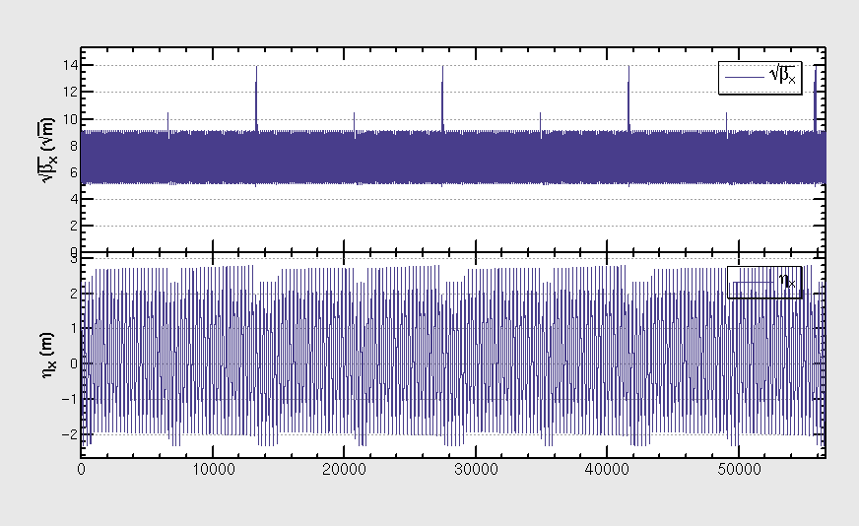
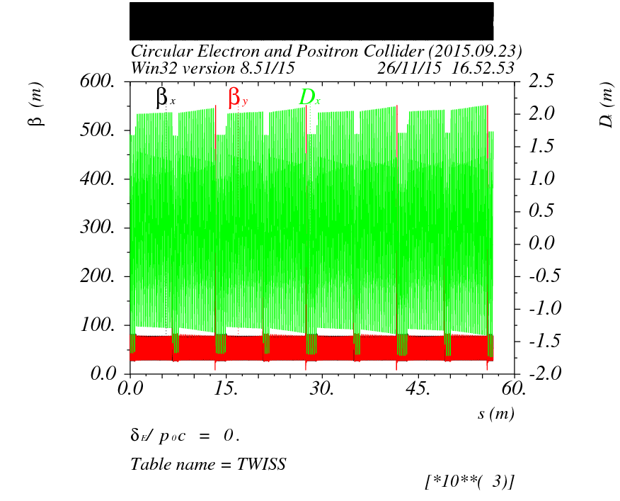
导入sad
静电分离器强度设置为0

Slide 16

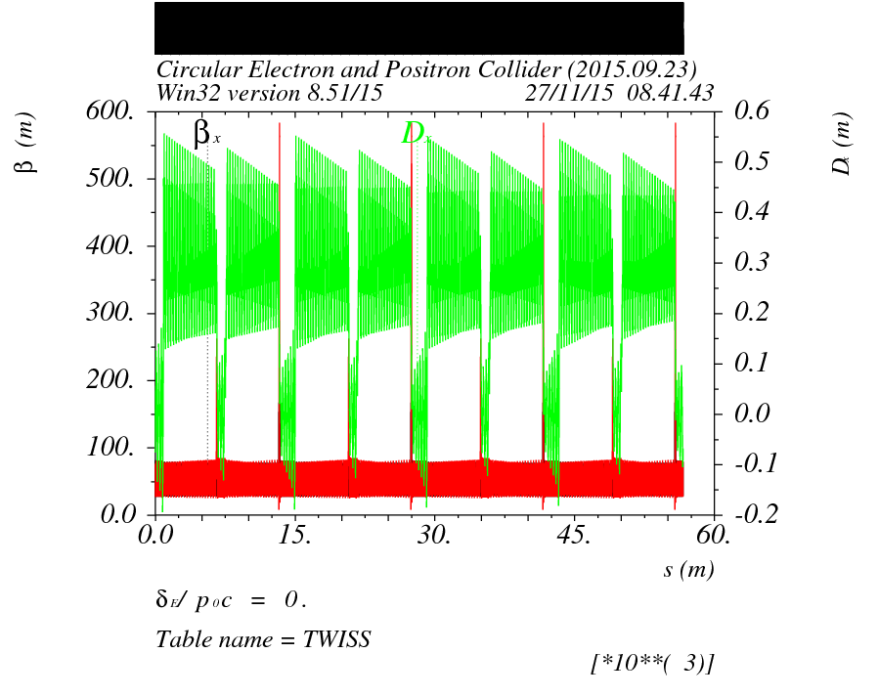
静电分离器与kick的差别
给定入口参数
周期解

Slide 17
Summary
Pretzel orbit issue has been fixed by changing the circumference of the ring
But the change of drift space length will have a big effect on dynamic aperture (as we have already noticed), which will need further study.
MAD and SAD does not agree…

