Slide 1
Pretzel orbit design with asymmetric lattice (v20140930)
Huiping Geng
CEPC Accelerator Physics regular meeting
2015.12.11

Slide 2
Contents
Comparison of mad8 and SAD DA results for the same lattice without pretzel
DA of lattice with pretzel using mad8

Slide 3
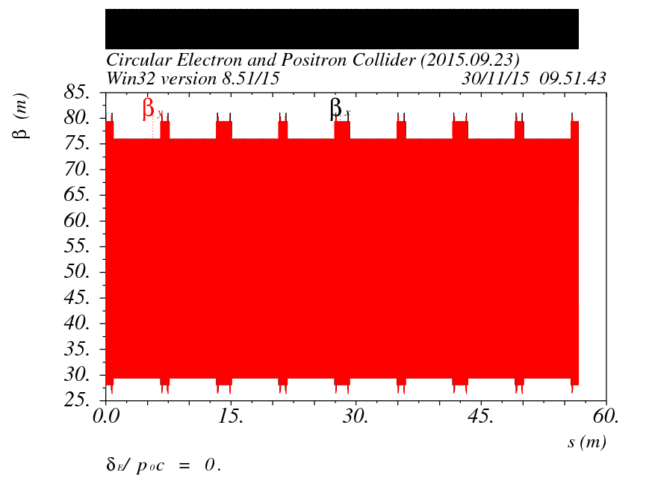
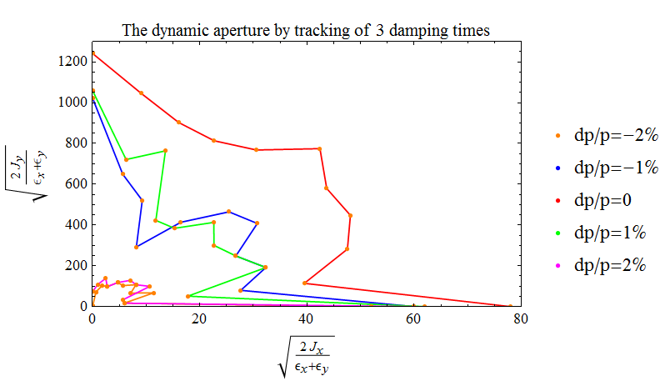
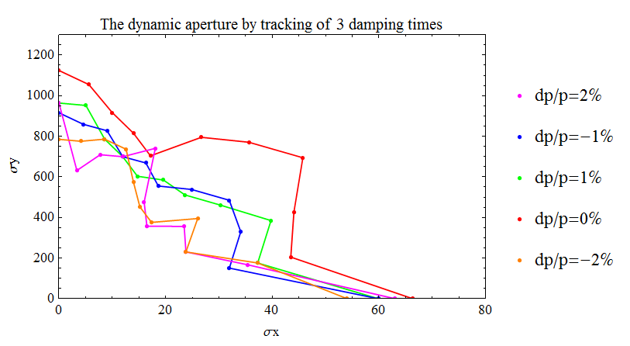
Comparison of DA with mad8 and SAD
用不带pretzel的lattice做例子，比较mad8和SAD的DA跟踪结果
对能散度为±2%的粒子，动力学孔径结果存在显著差别
SAD
MAD8

Slide 4
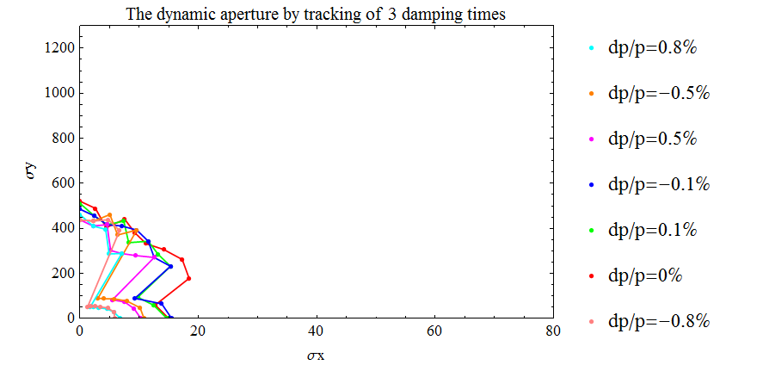
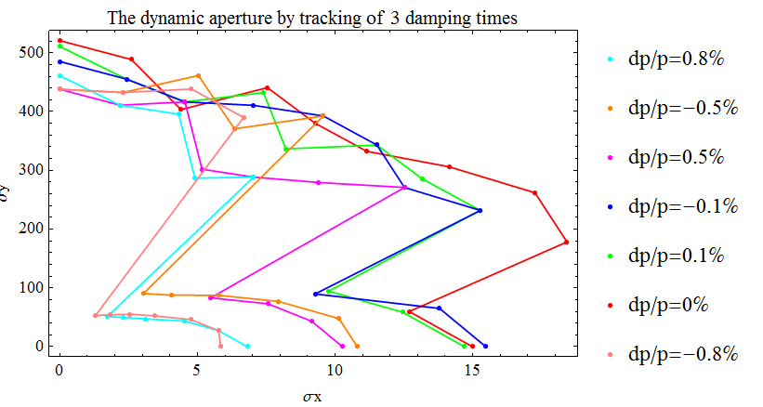
DA of lattice with pretzel using mad8

Slide 5
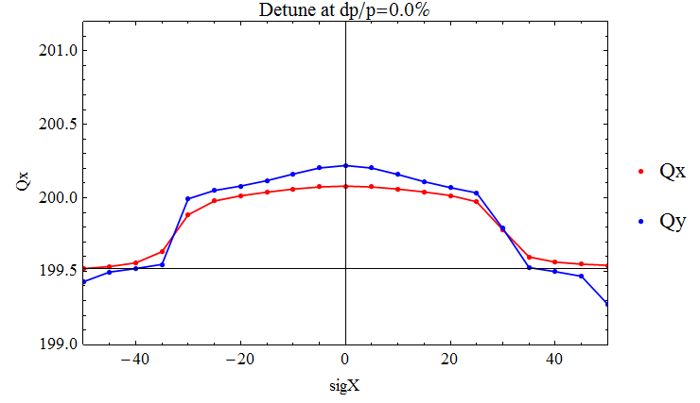
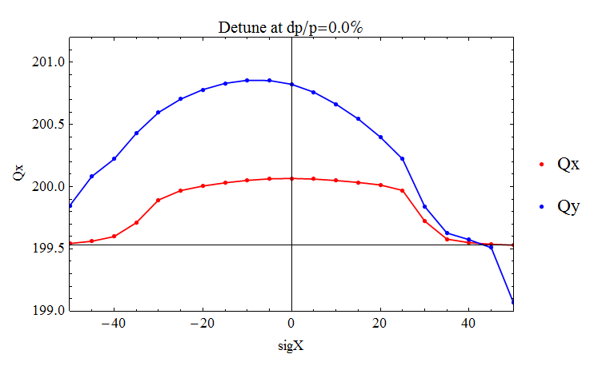
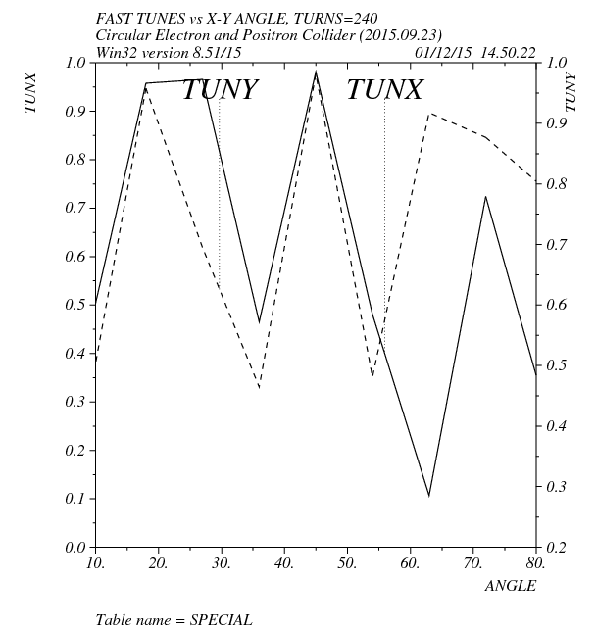
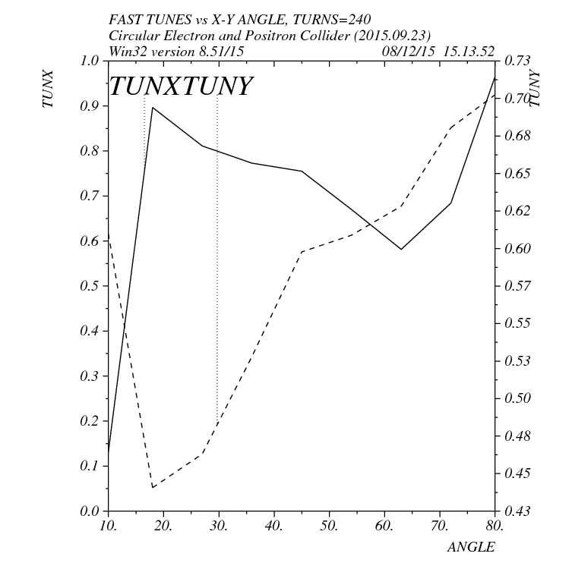
Comparison of lattice w/ and w/o pretzel
w/o pretzel
w/ pretzel

Slide 6
What to do ?
Check madx DA tracking
Optimize working point
Reduce detune term ?

