Slide 1
Edge Position of Hit Energy Spectrum

Slide 2
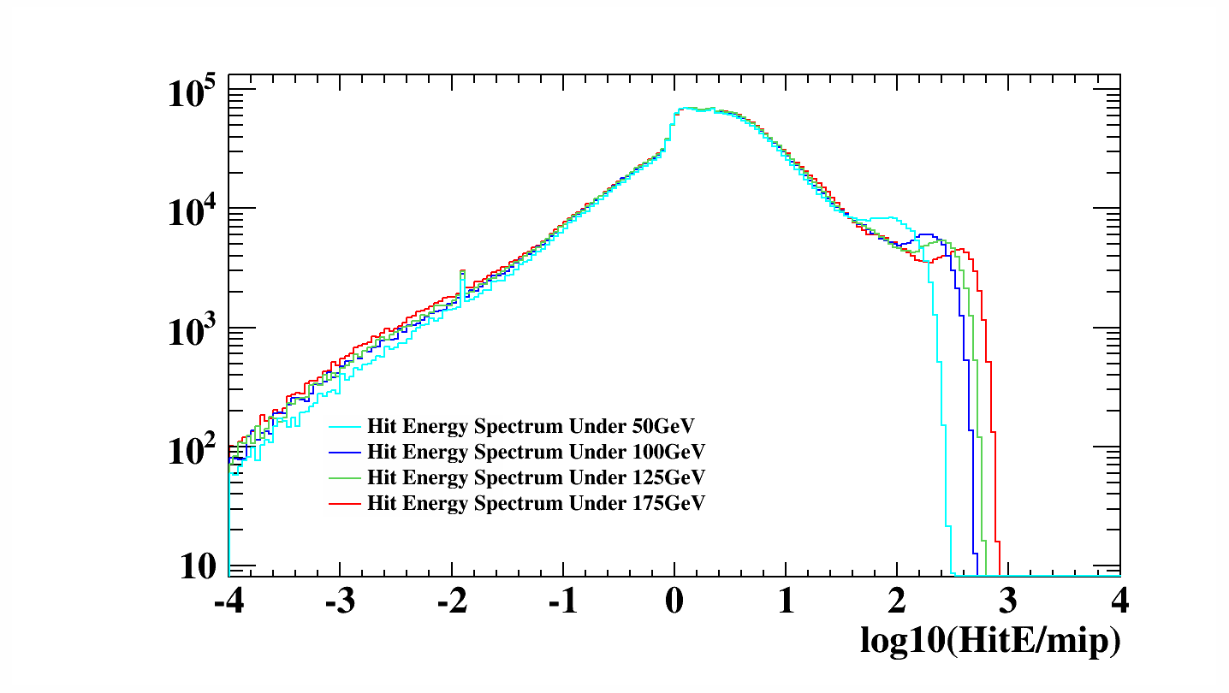
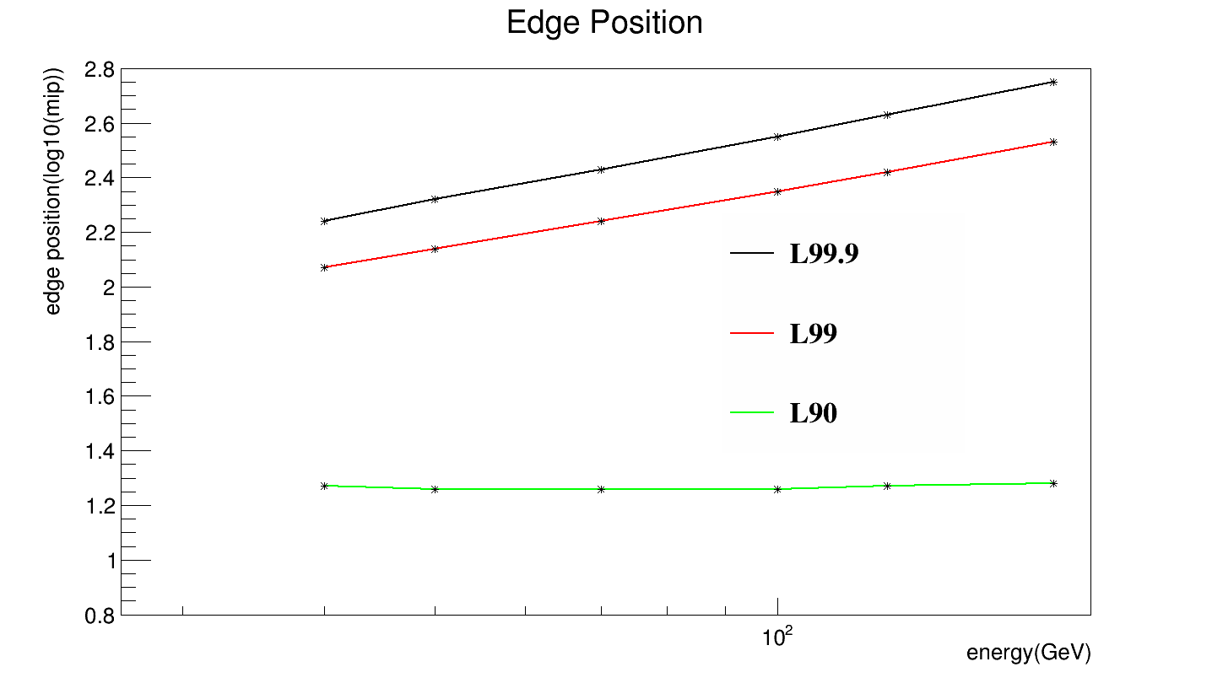
Lxx A2/(A2+A3) = xx
A3
A1
A2
定义的边沿位置在10^(Lxx)mip处

Slide 3
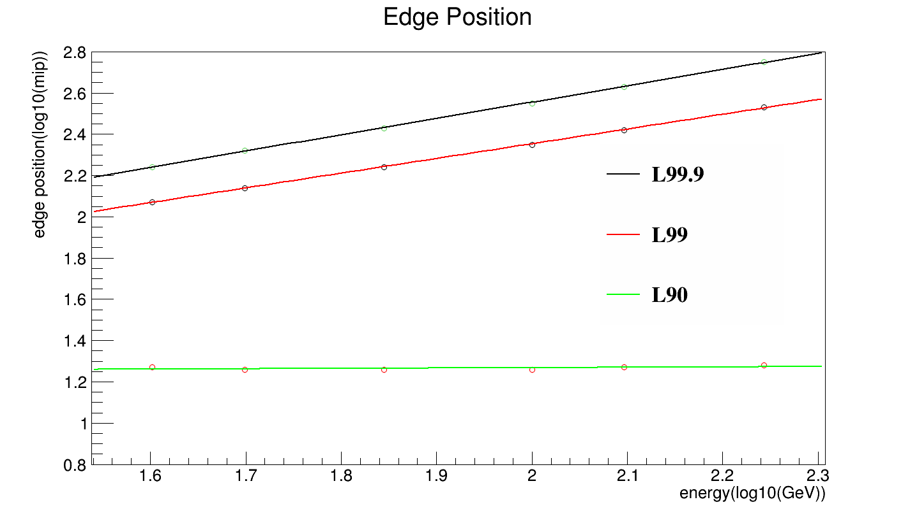
拟合(Edge Position vs Energy)
L99.9 = 0.97 + 0.79x
L99 = 0.93 + 0.71x
L90 = 1.26 (L90 = 1.23 + 0.02x)
x = log10(energy)
0.5mm Si
1.4mm W
10mm*10mm cell size

Slide 4
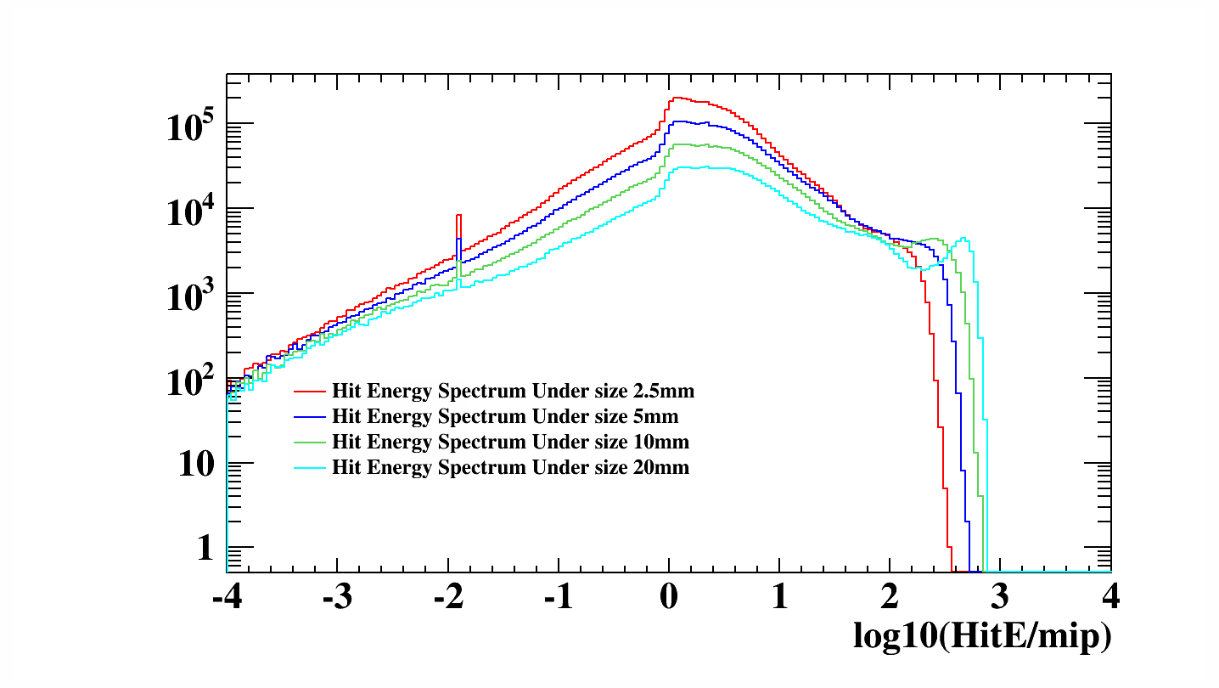
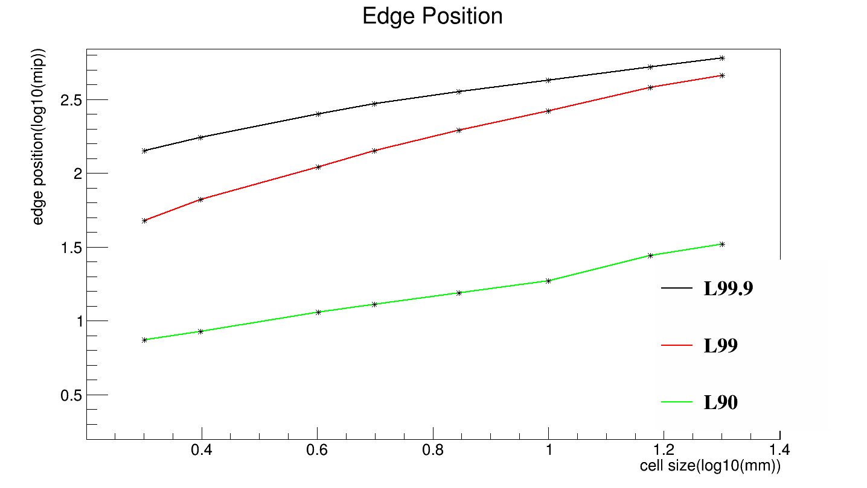
Edge Position in Different Size

Slide 5
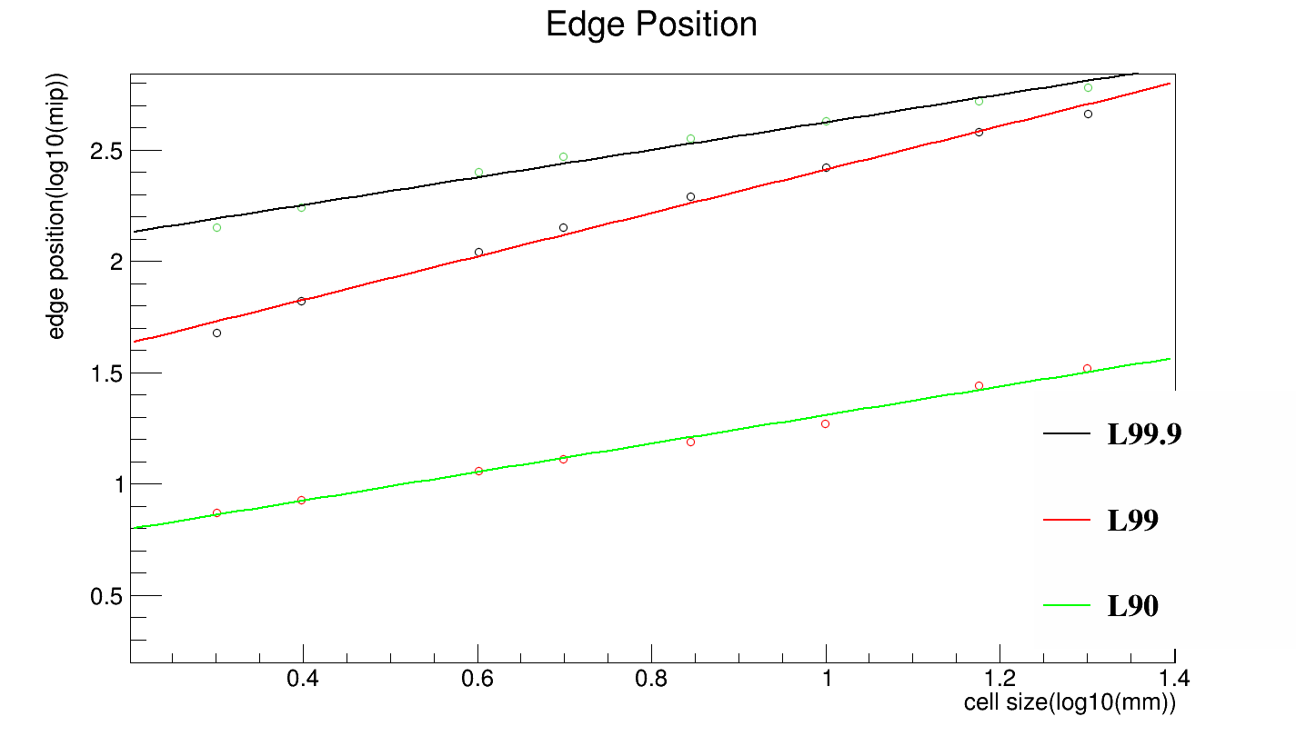
拟合(Edge Position vs Cell Size)
L99.9 = 2 + 0.62y
L99 = 1.44 + 0.97y
L90 = 0.67 + 0.64y
y = log10(cell size)
0.5mm Si
1.4mm W
125GeV

Slide 6
Lxx = f(Energy & Cell Size)
L99.9 = 0.79*(x-2.10) + 0.62*(y-1) + 2.62 = 0.79x + 0.62y +0.34
L99 = 0.71*(x-2.10) + 0.97*(y-1) + 2.41 = 0.71x + 0.97y - 0.05
L90 = 0.64*(y-1) + 1.26 = 0.64y + 0.62
x = log10(energy) y = log10(cell size)

Slide 7
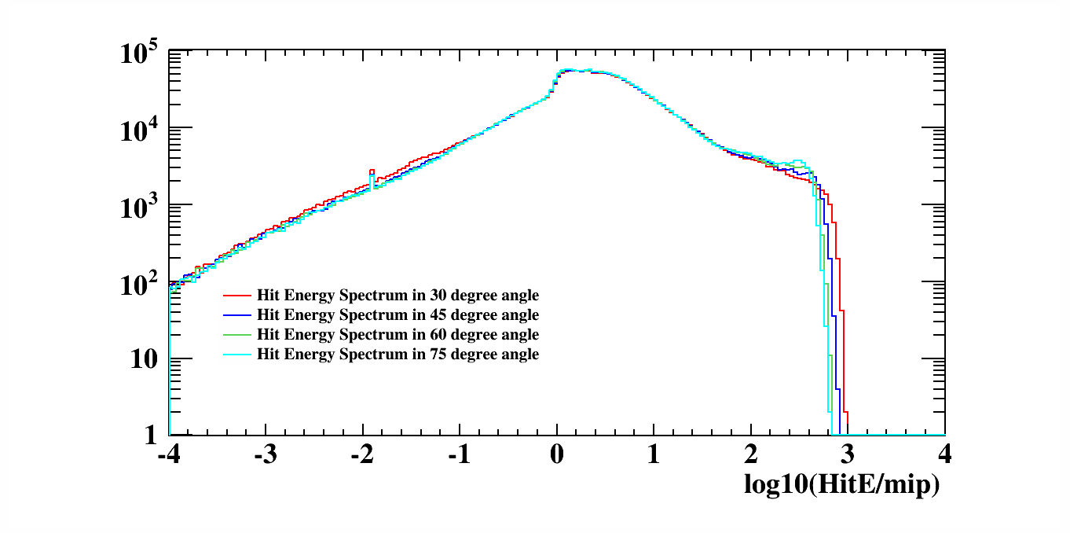
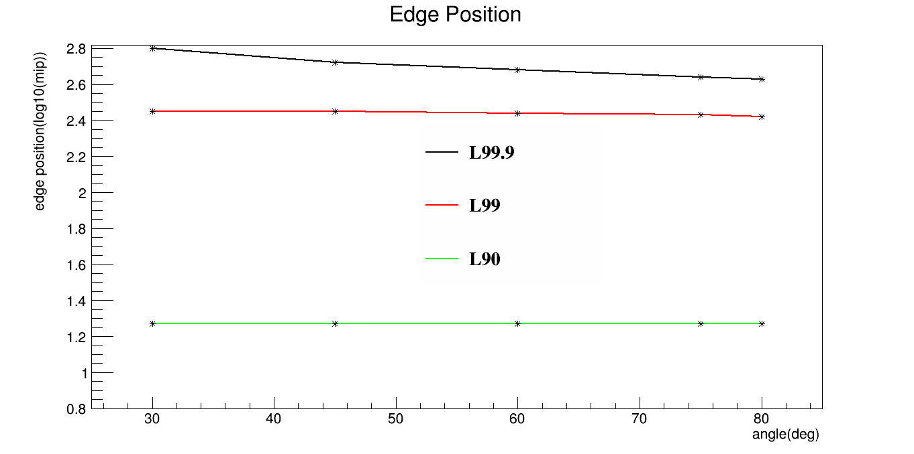
Edge Position in Different Angle

Slide 8
Lxx = f(Energy & Cell Size & Incident Angle)
L99.9 = 0.79x + 0.62y - 0.39z + 1.09
L99 = 0.71x + 0.97y - 0.06z +0.07
L90 = 0.64y + 0.62
x = log10(energy) y = log10(cell size) z = log10(angle)

Slide 9
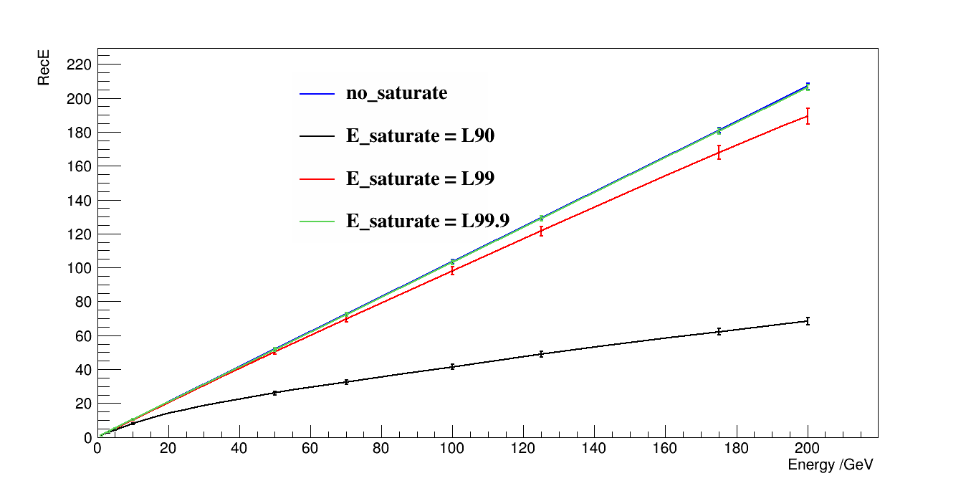
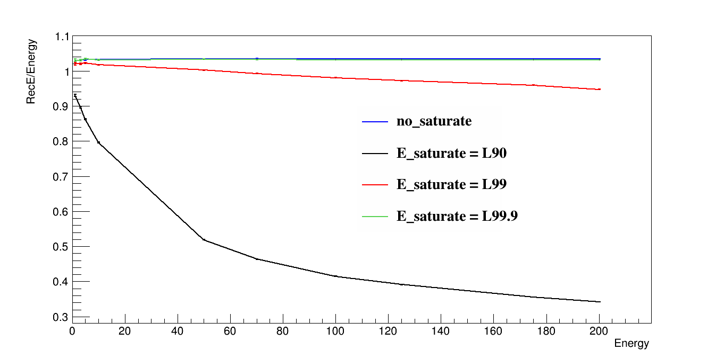
不同L值下的重建能量的线性性和分辨率

Slide 10
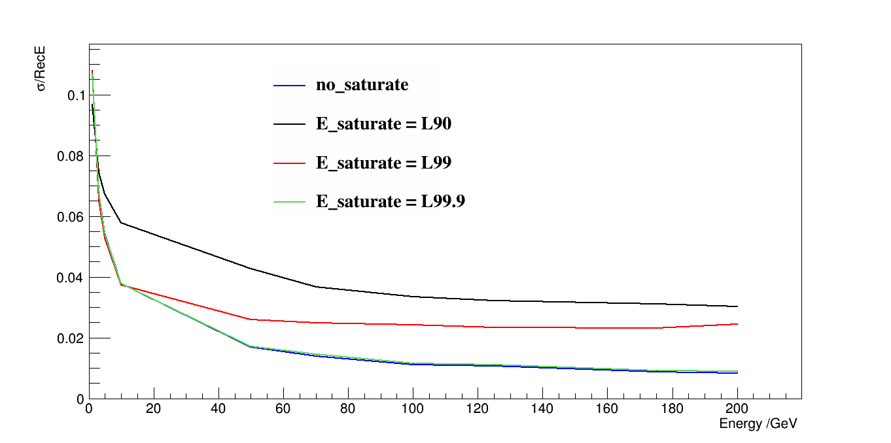
不同L值下的重建能量的分辨率

