Slide 1
Energy&Resolution of Pion
Shi Chen

Slide 2
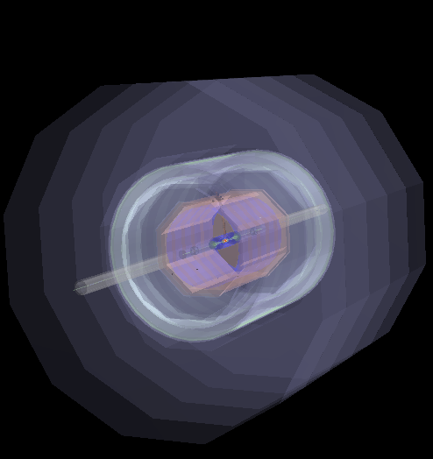
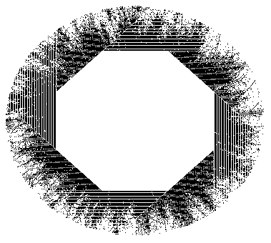
Detector
X
Z
y
Iron: 25mm
PCB:1.2mm
Layers:40

Slide 3
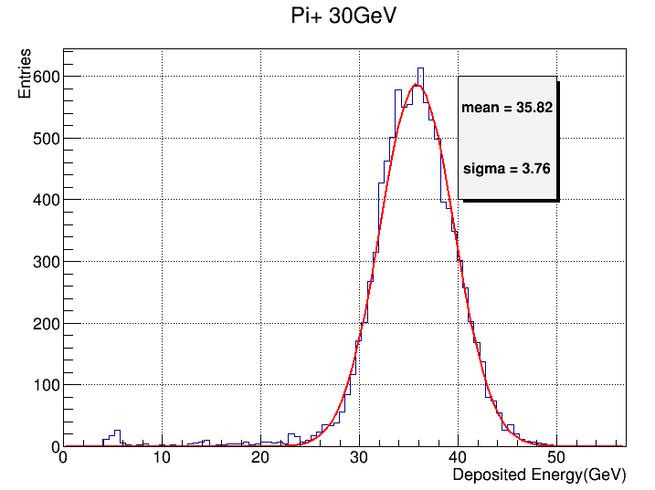
Energy Resolution

Slide 4
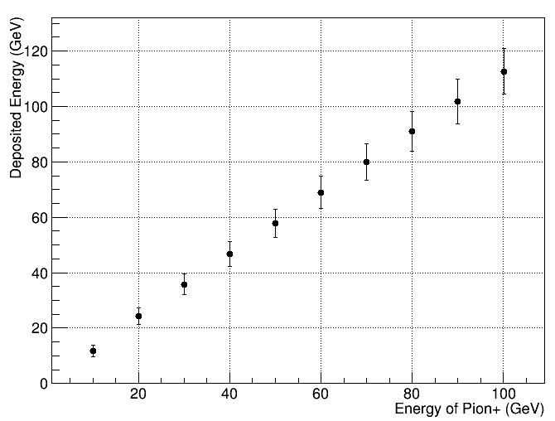
Energy Scan

Slide 5
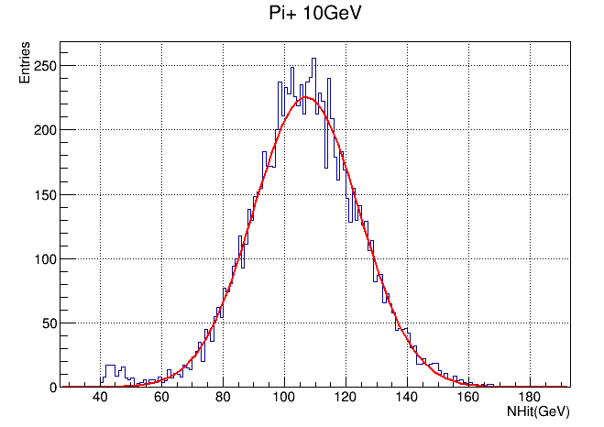
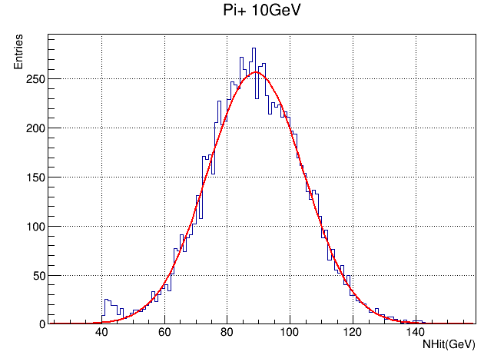
Cell Size=10
Cell Size=20
Constant=10/107.1
Constant=10/88.9

Slide 6
