Slide 1
Robinson Instability Analysis for CEPC Main Ring
Hongjuan Zheng, Jiyuan Zhai, Haipeng Wang, Jie Gao
2012.12.25

Slide 2
Outline
Robinson instability limits
Loaded generator-cavity-beam system
Beam parameters
Robinson instability of CEPC

Slide 3
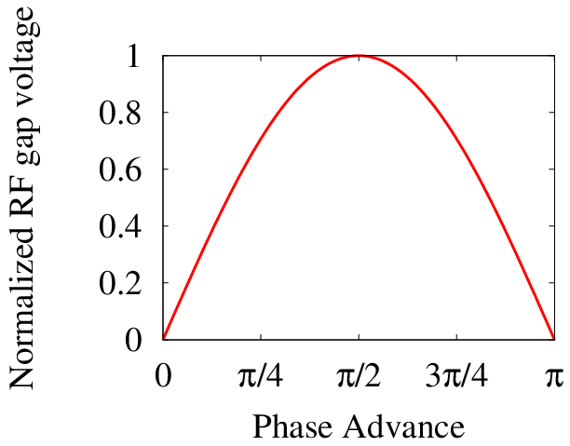
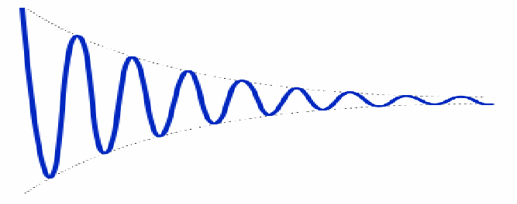
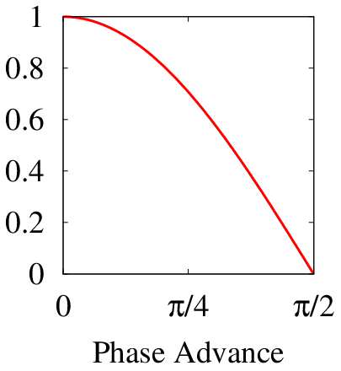








Different Definitions of Synchronous Phase
Below transition
SY Lee, etc
$$ψ_{s}$$
$$V_{acc}=V_{0}\text{sin}ψ_{s}$$
Synchrotron auto focusing
Above transition
Wiedemann, Robinson, etc
P. B.Wilson Merminga, etc
SY Lee, etc
$$ψ_{s}$$
$$ψ_{s}$$
$$ψ_{s}$$
$$V_{acc}=V_{0}\text{sin}ψ_{s}$$
$$V_{acc}=V_{0}\text{sin}ψ_{s}$$
$$V_{acc}=V_{0}\text{cos}ψ_{s}$$
[1] Haipeng Wang. Beam-Cavity Interaction Related SRF System Design Principles and Simulation Techniques (I), IHEP Seminar, Dec.1, 2015, Beijing

Slide 4
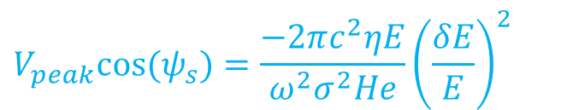
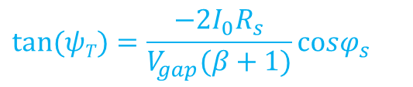

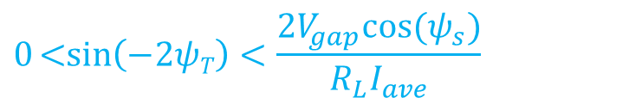
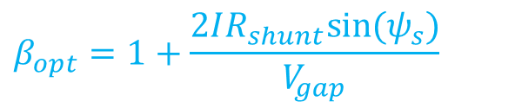
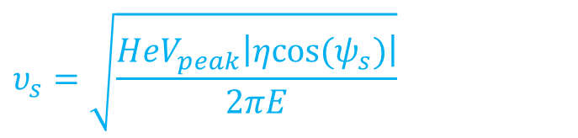
Synchronous phase is used in several physical relations
Acceleration
SR equilibrium bunch length
Synchrotron tune
Beam loading optimization
Detuning angle Robinson Instability
$$V_{acc}=V_{0}\text{sin}ψ_{s}$$
$$V_{peak}cos⁡(ψ_{s})=\frac{−2πc^{2}ηE}{ω^{2}σ^{2}He}{\left(\frac{δE}{E}\right)}^{2}$$
$$υ_{s}=\sqrt{\frac{HeV_{peak}\left|ηcos⁡(ψ_{s})\right|}{2πE}}$$
$$β_{opt}=1+\frac{2IR_{shunt}sin⁡(ψ_{s})}{V_{gap}}$$
$$tan⁡(ψT)=\frac{−{2I}_{0}R_{s}}{V_{gap}(β+1)}\text{co}sφ_{s}$$
$$0\text{<}\text{sin}\left(−2ψT\right)<\frac{2V_{gap}\text{cos}\text{(}ψ_{s})}{R_{L}I_{ave}}$$
[1] Haipeng Wang. Beam-Cavity Interaction Related SRF System Design Principles and Simulation Techniques (I), IHEP Seminar, Dec.1, 2015, Beijing

Slide 5
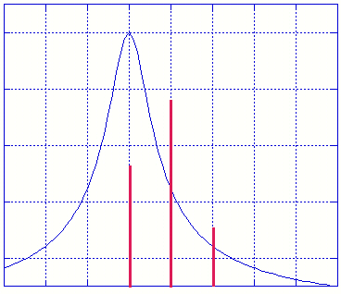
Stability of the system
The 1st Robinson condition states that the beam is stable at positive η if the lower synchrotron sideband samples a larger cavity resistive impedance with respect to the upper synchrotron sideband (the opposite for negative η).
η >0 => stable
η <0 => unstable
η >0 => unstable
η <0 => stable
ω − ω_{s}
ω + ω_{s}
ω + ω_{s}
ω − ω_{s}
The damping constant α_{R} is given by:
The Robinson 2nd limit can be also derived from the bunched beam coherent instabilities theory. The coherent frequency of the barycentre motion of the bunches ω_{sc} is given by:
and the Robinson 2nd limit is reached when ω_{sc} gets to zero.
[1] Alessandro Gallo. Beam Loading and Low-level RF Control in Storage Rings.

Slide 6
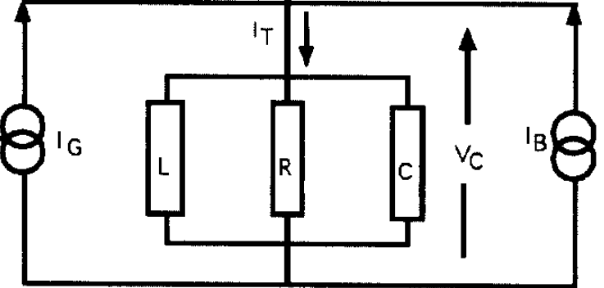


Loaded Generator-Cavity-Beam System
Both generator and beam are considered as current source,
generator feed energy in to cavity;
beam extracts energy from cavity.
$$V_{G}=R_{L}I_{G}\text{cos}ψ_{T}e^{iψ_{T}}$$
$$V_{B}=R_{L}I_{B}\text{cos}ψ_{T}e^{iψ_{T}}$$
When above transition, particles with higher energy have larger revolution time. Beam current needs to lags cavity voltage to satisfy the phase stability criteria, which means the beam effective impedance is inductive.
So, for the generator to see a resistive impedance, the cavity needs to be capacitive-detuned, it means ψ_{T} < 0 and ω₀ < ω_{RF}, and voltage lags beam current by the phase |ψ_{T}|, because then cavity impedance looks capacitive.

Slide 7
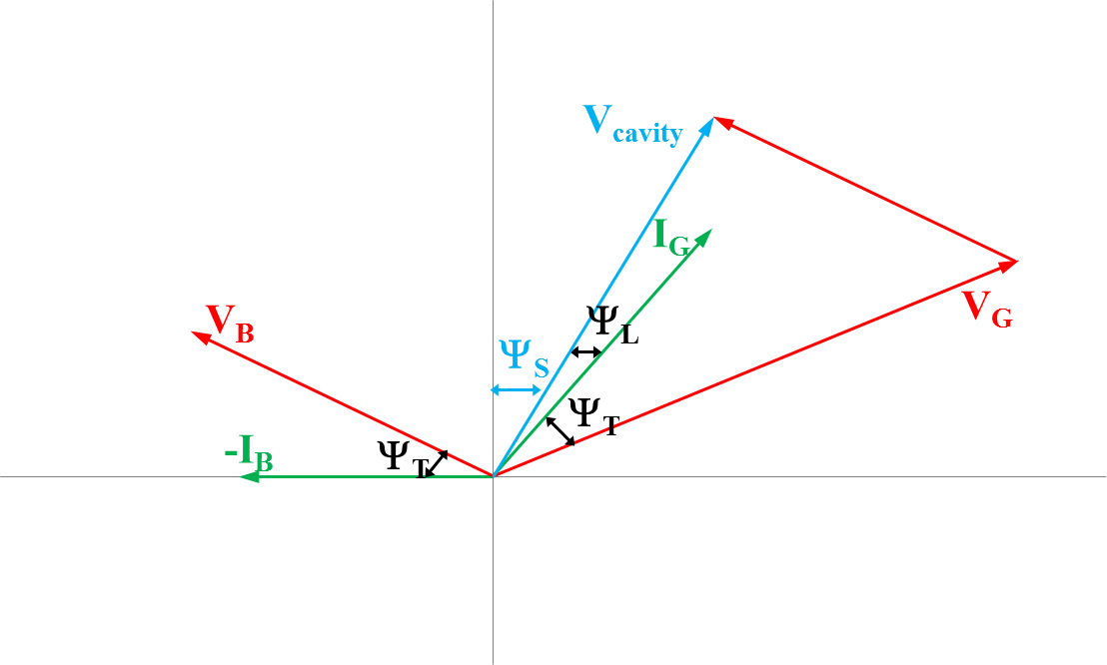
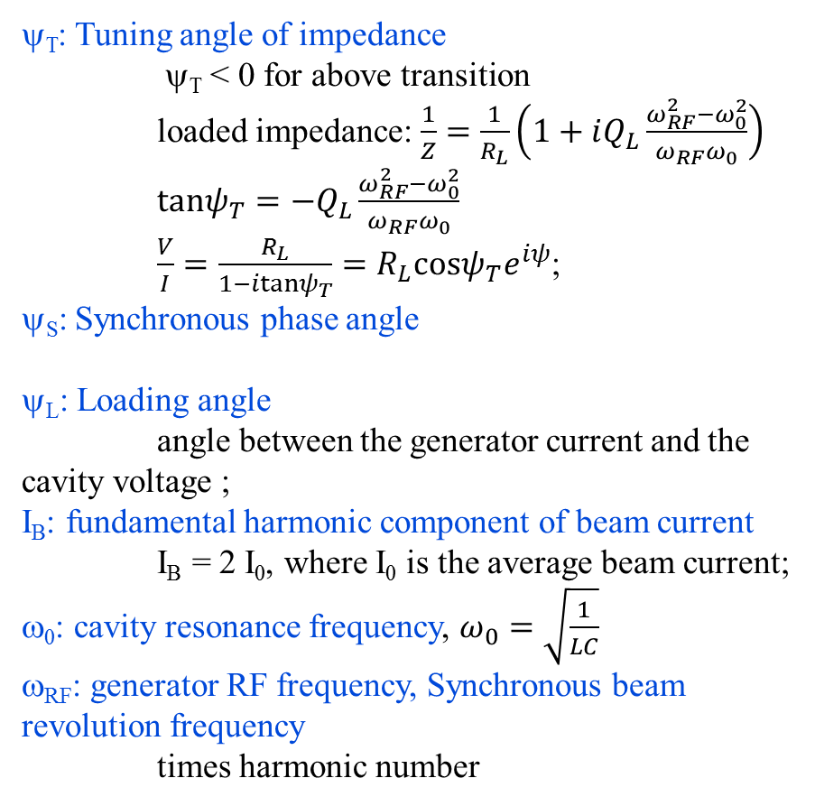
Beam Loading and Phasor Diagram
ψ_{T}: Tuning angle of impedance
ψ_{T} < 0 for above transition
loaded impedance: $\frac{1}{Z}=\frac{1}{R_{L}}\left(1+iQ_{L}\frac{ω_{RF}^{2}−ω_{0}^{2}}{ω_{RF}ω_{0}}\right)$
$tanψ_{T}=−Q_{L}\frac{ω_{RF}^{2}−ω_{0}^{2}}{ω_{RF}ω_{0}}$
$\frac{V}{I}=\frac{R_{L}}{1−itanψ_{T}}=R_{L}\text{cos}ψ_{T}e^{iψ}$;
ψ_{S}: Synchronous phase angle
ψ_{L}: Loading angle
angle between the generator current and the cavity voltage ;
I_{B}: fundamental harmonic component of beam current
I_{B} = 2 I₀, where I₀ is the average beam current;
ω₀: cavity resonance frequency, $ω_{0}=\sqrt{\frac{1}{LC}}$
ω_{RF}: generator RF frequency, Synchronous beam revolution frequency
times harmonic number
image
real

Slide 8
P.B. Wilson Phasor Diagram Using Cos(ψ_{s})
φ_{L}+θ=φ
φ=ψ_{s}
[1] Haipeng Wang. Beam-Cavity Interaction Related SRF System Design Principles and Simulation Techniques (I), IHEP Seminar, Dec.1, 2015, Beijing

Slide 9
Beam Parameters
Parameter | Unit | Value | Parameter | Unit | Value
Beam energy | GeV | 120 | Circumference | m | 54752
Number of IP |  | 2 | SR loss/turn | GeV | 3.11
Bunch number/beam |  | 50 | Bunch population |  | 3.79E+11
Synchrotron radiation (SR) power/beam | MW | 51.7 | Beam current | mA | 16.6
Bending radius | m | 6094 | Momentum compaction factor |  | 3.36E-5
Revolution period | s | 1.83E-4 | Revolution frequency | Hz | 5475.46
Emittance (x/y) | nm | 6.12/0.018 | β_{IP} (x/y) | mm | 800/1.2
Transverse size (x/y) | μm | 69.97/0.15 | ξ_{x,y}/IP |  | 0.118/0.083
Bunch length SR | mm | 2.14 | Bunch length total | mm | 2.65
Lifetime due to Beamstrahlung | min | 47 | Lifetime due to radiation Bhabha scattering | min | 51
RF voltage | GV | 6.87 | RF frequency | MHz | 650
Harmonic number |  | 118800 | Synchrotron oscillation tune |  | 0.18
Energy acceptance RF | % | 5.99 | Damping partition number |  | 2
Energy spread SR | % | 0.132 | Energy spread BS | % | 0.096
Energy spread total | % | 0.163 | During the collision |  | 0.23
Transverse damping time | turns | 78 | Longitudinal damping time | turns | 39
Hourglass factor | Fh | 0.68 | Luminosity/IP | cm⁻²s⁻¹ | 2.04E+34

Slide 10
Robinson 1st stability requires that f < f_{rf}
Tuning angle for main RF cavities

Slide 11
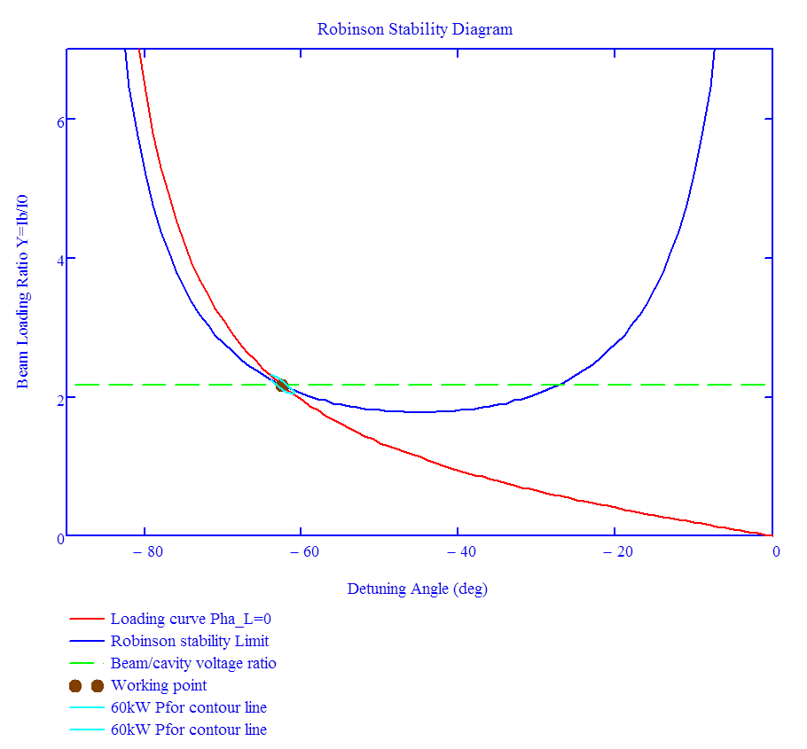
Robinson working point without loop gain
Loop gain=0, P_{f}=272.9kW, Ψ_{L}=0, Q_{ext}=2.282×10⁶，Q₀=4×10¹⁰

Slide 12
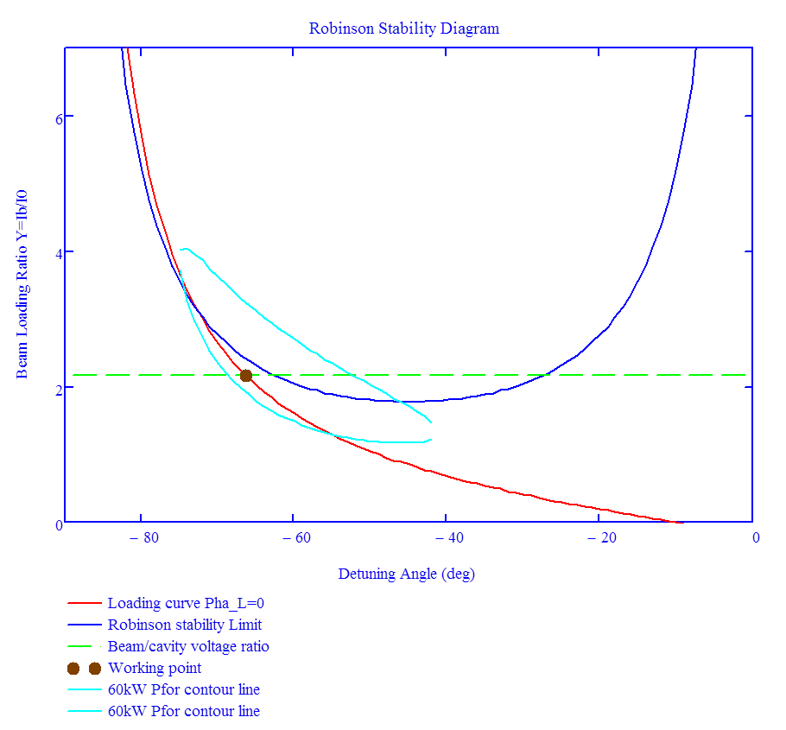
Robinson working point without loop gain
Loop gain=0, P_{f}=300kW, Ψ_{L}=-10°, Q_{ext}=2.282×10⁶ ，Q₀=4×10¹⁰

Slide 13
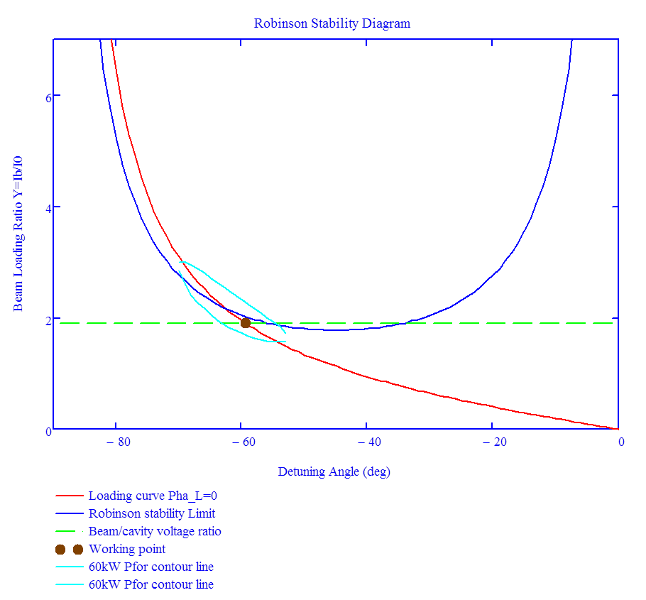
Robinson working point without loop gain
Loop gain=0, P_{f}=280kW, Ψ_{L}=0°, Q_{ext}=2×10⁶ ，Q₀=4×10¹⁰

Slide 14
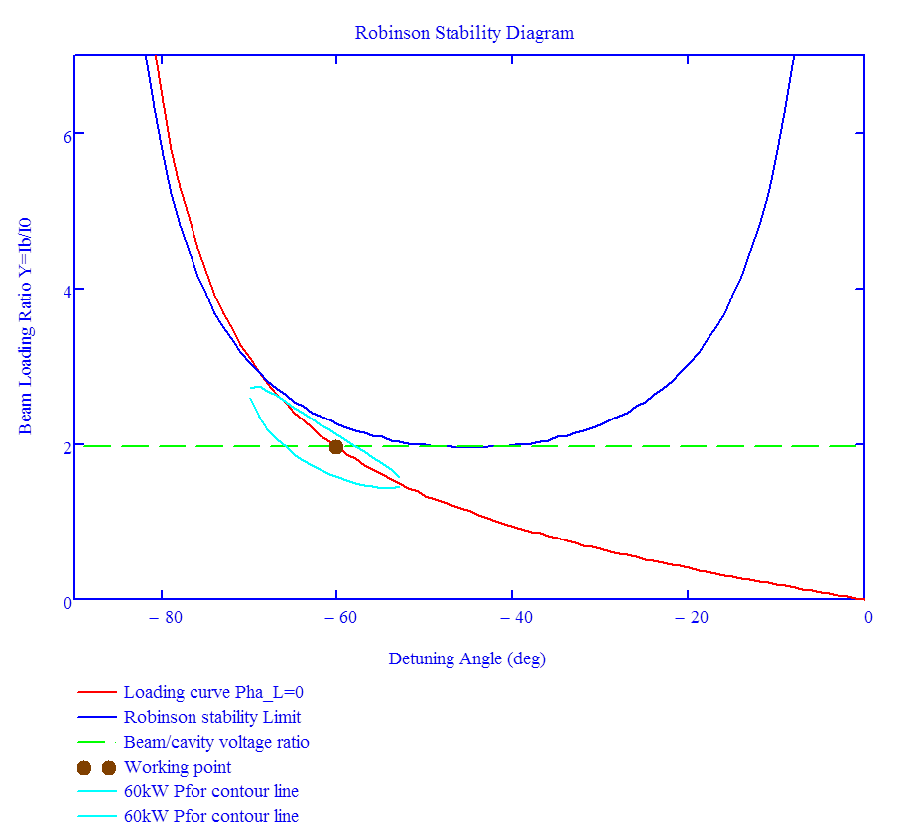
Robinson working point with loop gain
Loop gain=0.1, P_{f}=280kW, Ψ_{L}=0°, Q_{ext}=2.282×10⁶ ，Q₀=4×10¹⁰

Slide 15
Conclusion
Robinson instability is not a serious problem for Higgs.
More work need to be done for Z factory and bunch train scheme……

Slide 16
Thank you for your attention!

