Slide 1
CEPC Partial Double Ring Lattice Design
SU Feng WANG Dou WANG Yiwei GAO Jie
BIAN Tianjinan DUAN Zhe GENG Huiping
XU Gang BAI Sha XIAO Ming
Key Laboratory of Particle Acceleration Physics and Technology
Institute of High Energy Physics
Chinese Academy of Sciences
2015.12.25

Slide 2
Out line
Dynamic aperture comparison(Partial double ring without FFS)
New FFS – correct vertical chromaticity only
Use PDR Sex to Correct Horizontal Chromaticity
Next to do

Slide 3
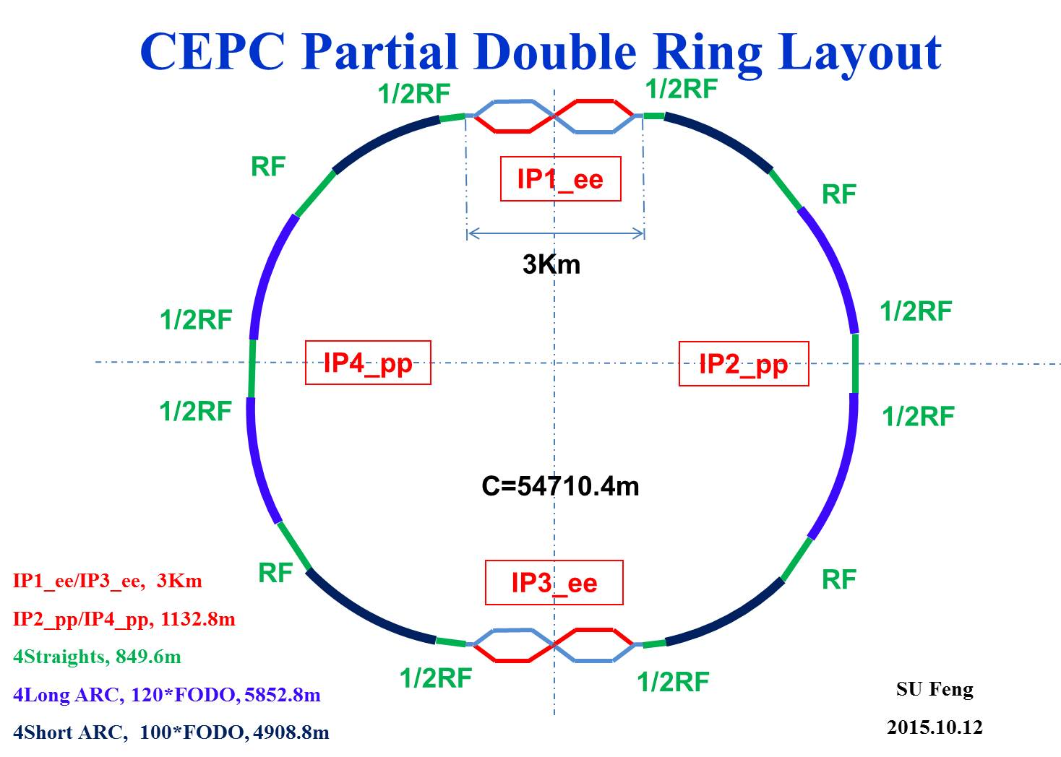
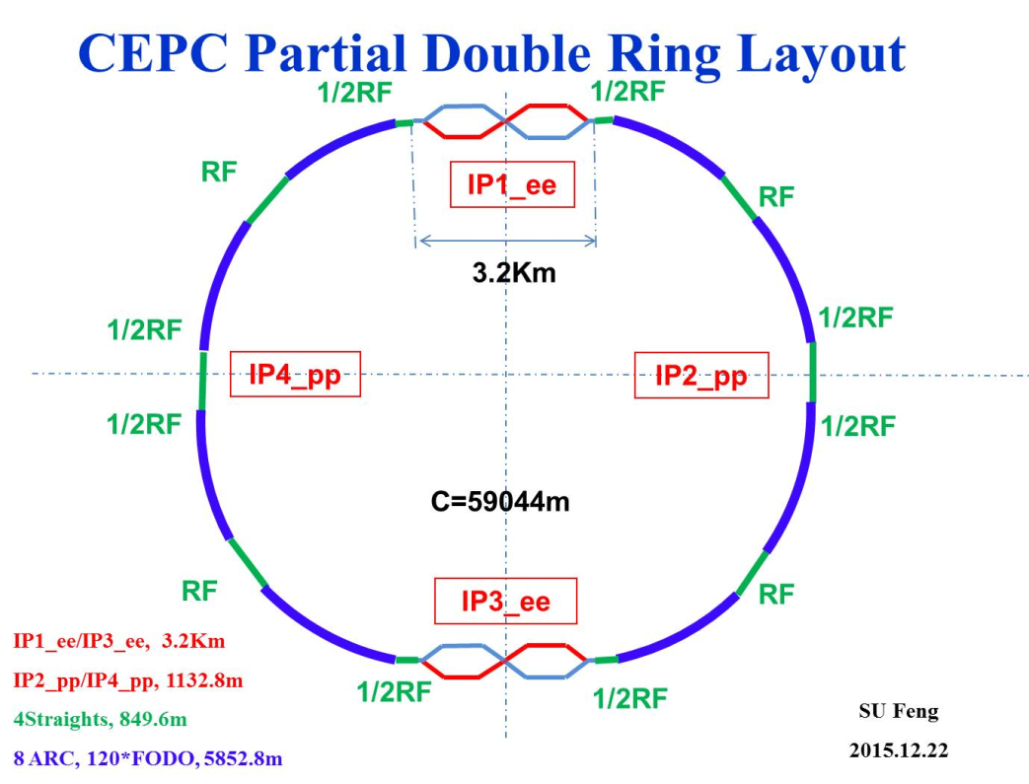
Dynamic aperture comparison
(Partial double ring without FFS)

Slide 4
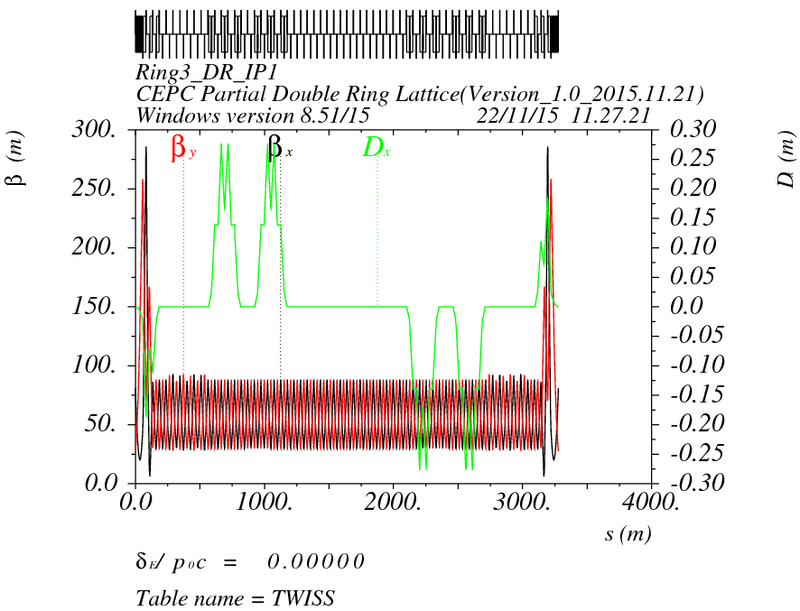
Orbit (RING3_DR_IP1L) Version 1.0 without FFS

Slide 5
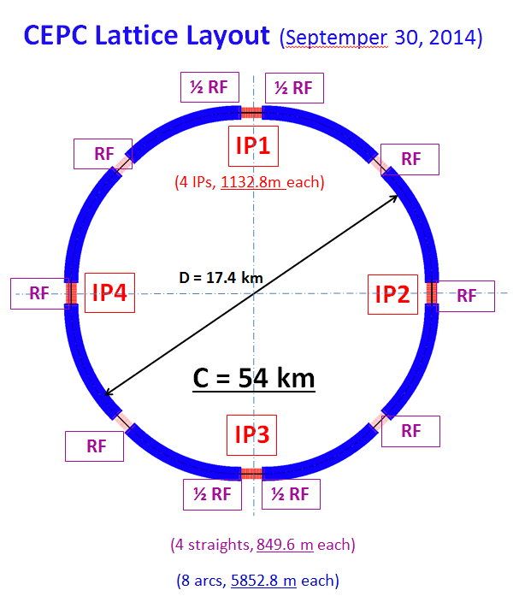
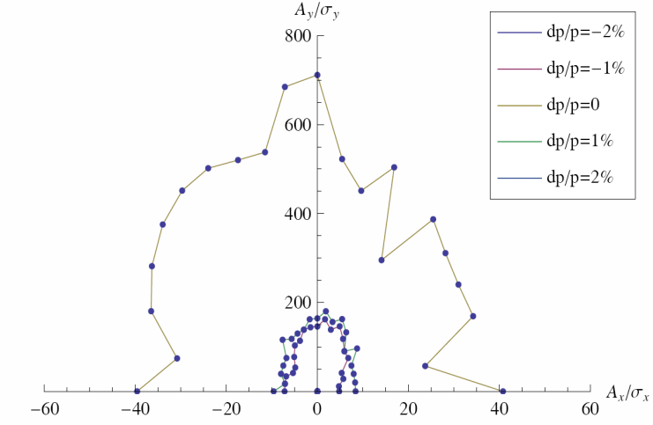
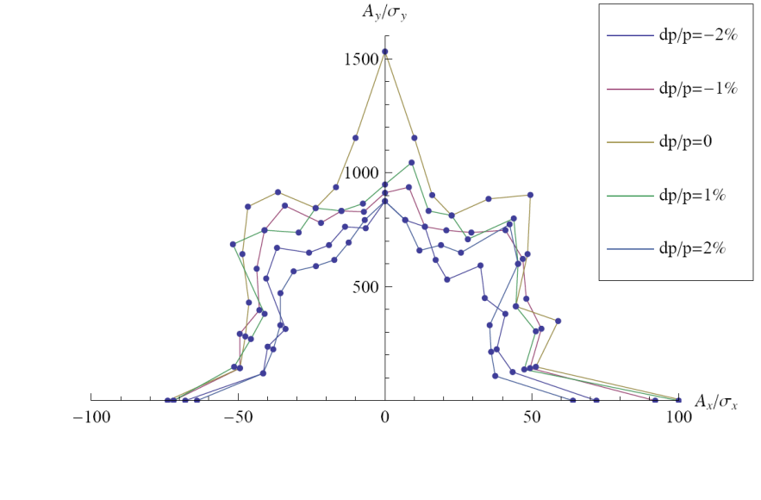
0: 50σx 1500σy
0.01：50σx 900σy
0.02：40σx 800σy

Slide 6
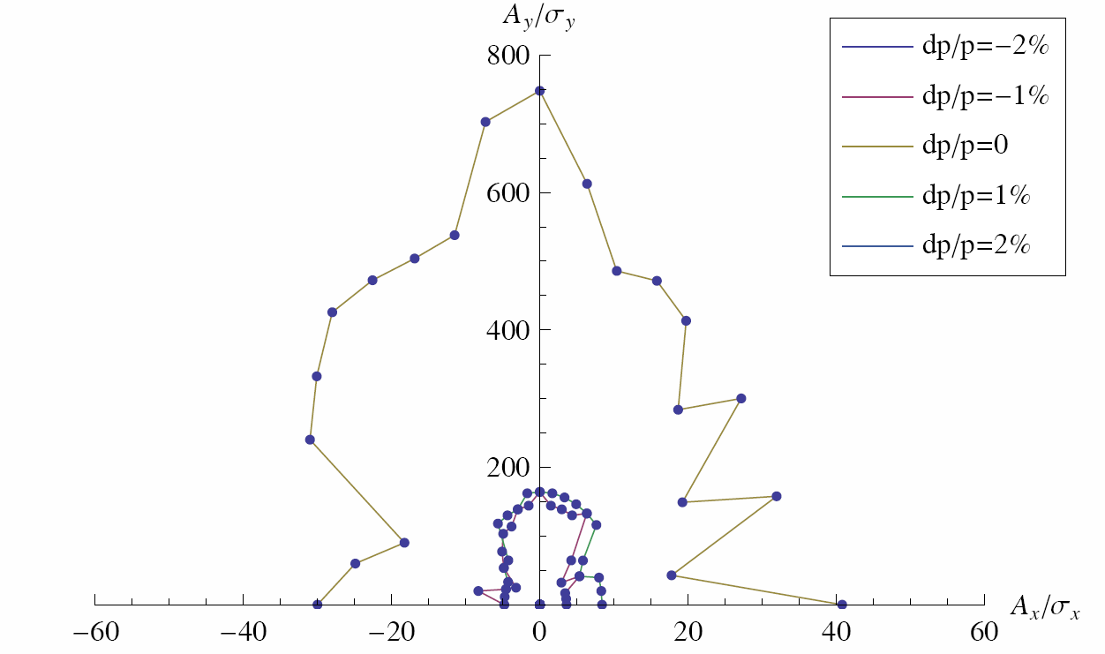

Slide 8
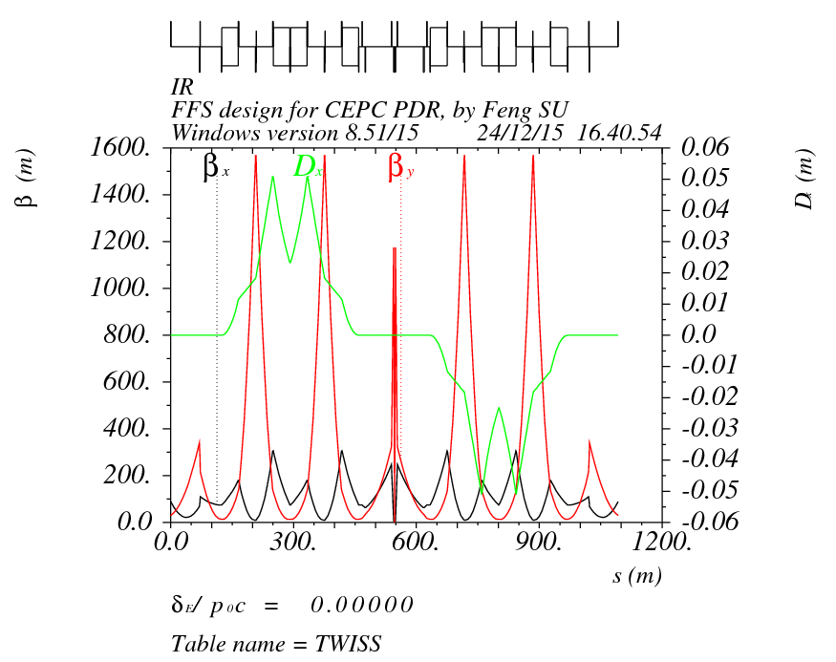
2.New FFS – correct vertical chromaticity only
Crab sextupoles
Y:2.5Pi X:2Pi
IP
K2=48.57
-I

Slide 9
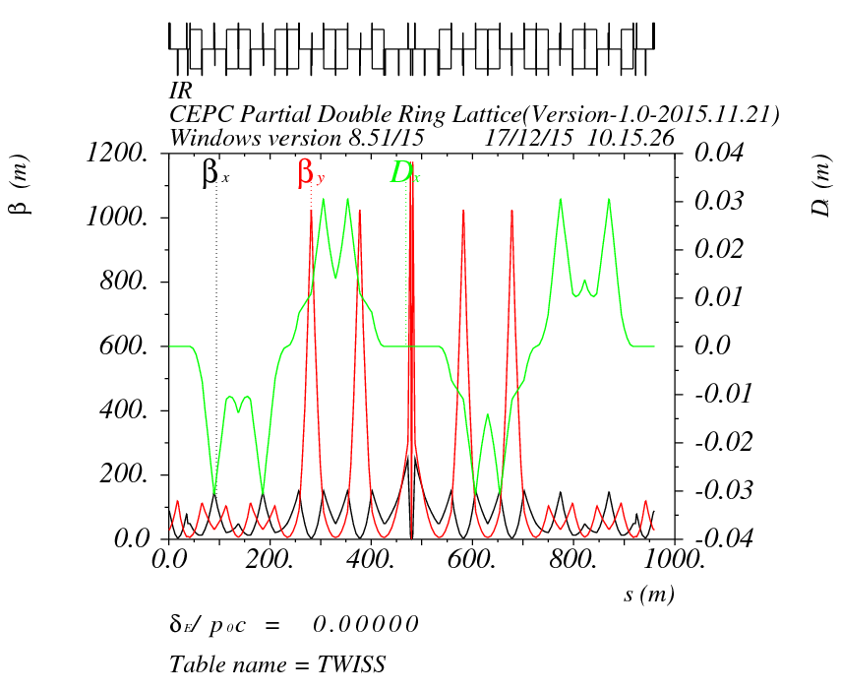
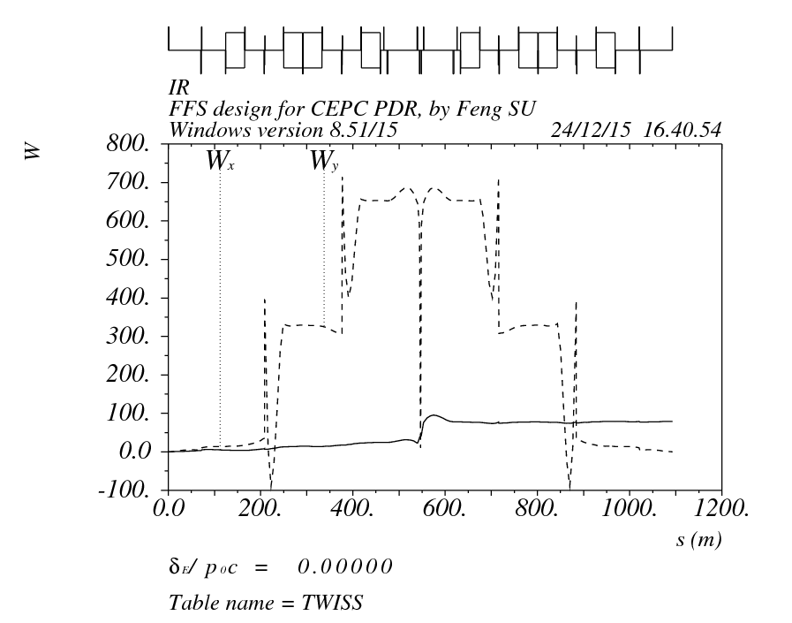
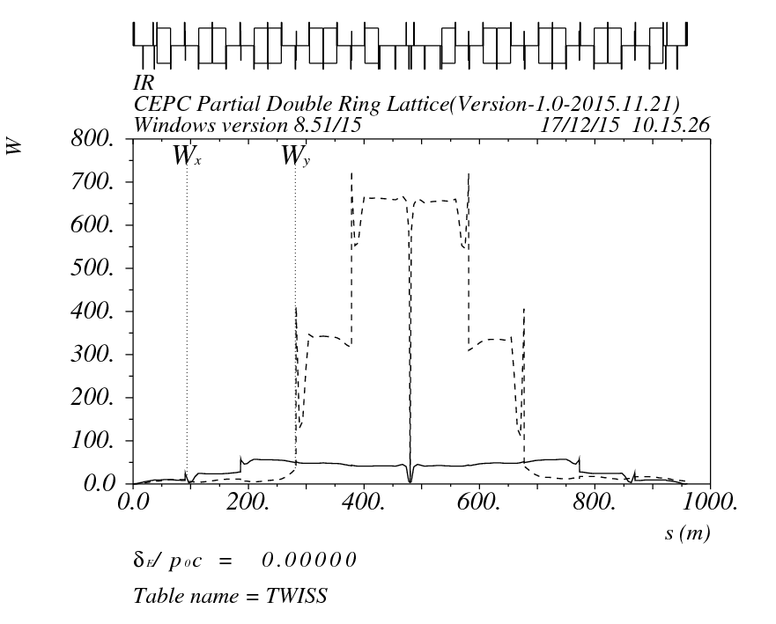
Compare with before
Sufeng-20151224
Wangdou-20151126

Slide 10
FFS Orbit
version20151126
version20151224

Slide 11
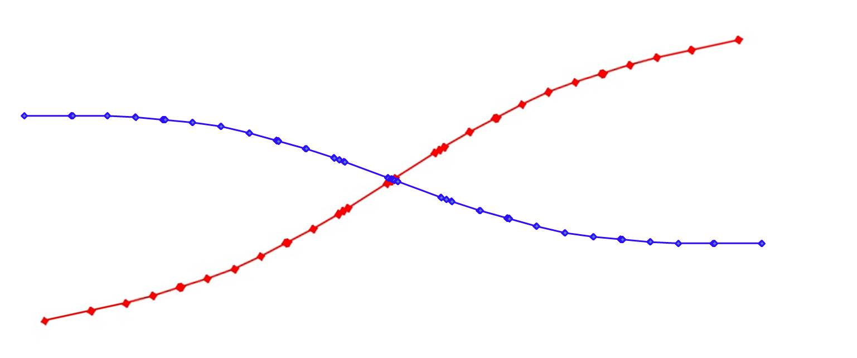
FFS Orbit
version20151126
version20151224
30.4mrad
15.2m

Slide 13
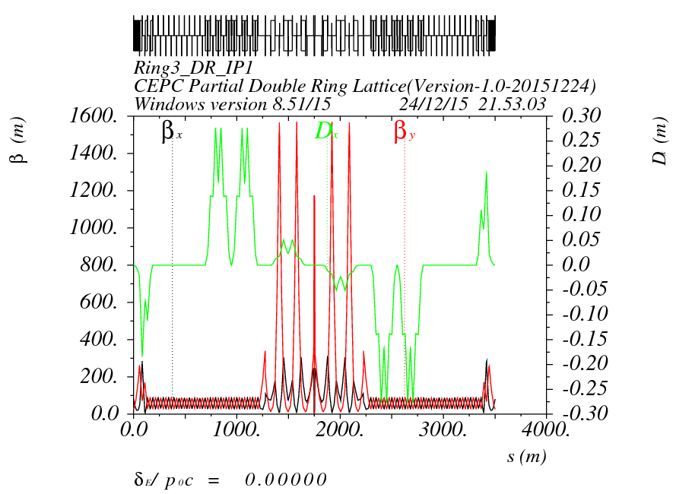
Orbit (RING3_DR_IP1) Version 1.0 + FFS(20151224)

Slide 14
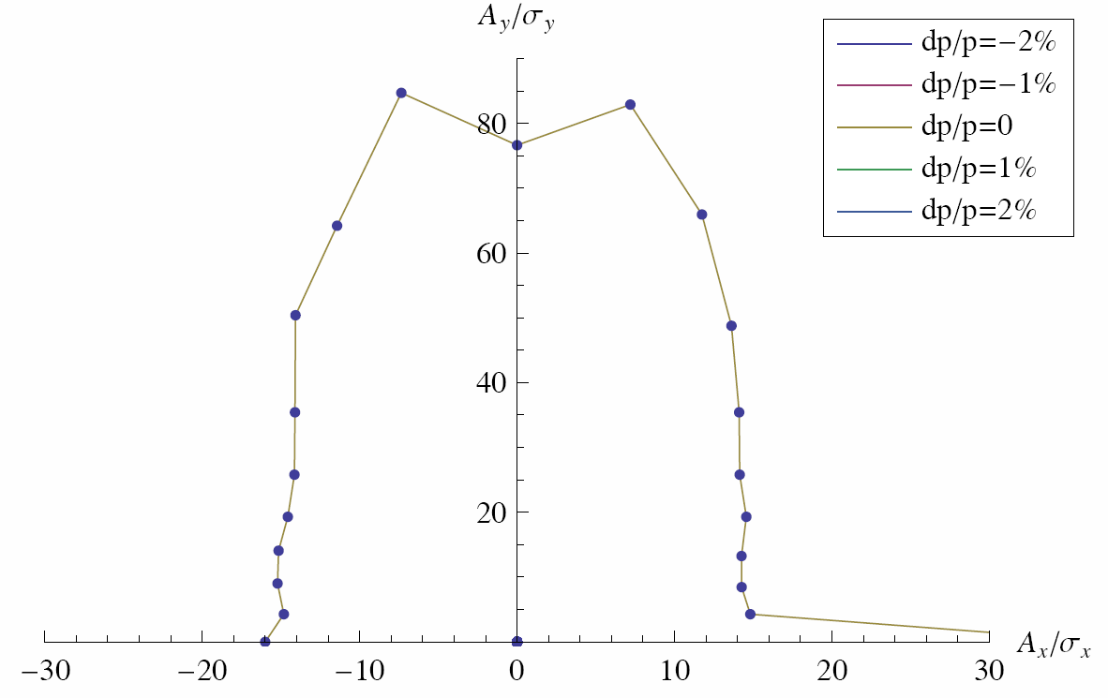
Dynamic Aperture（version20151224）

Slide 15
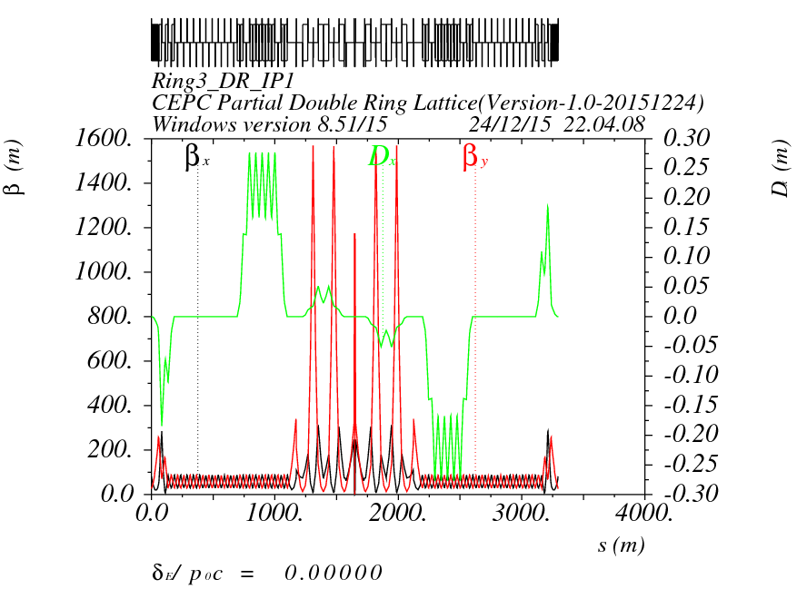
Orbit (RING3_DR_IP1) Version 1.0 + FFS(20151224-new)

Slide 16
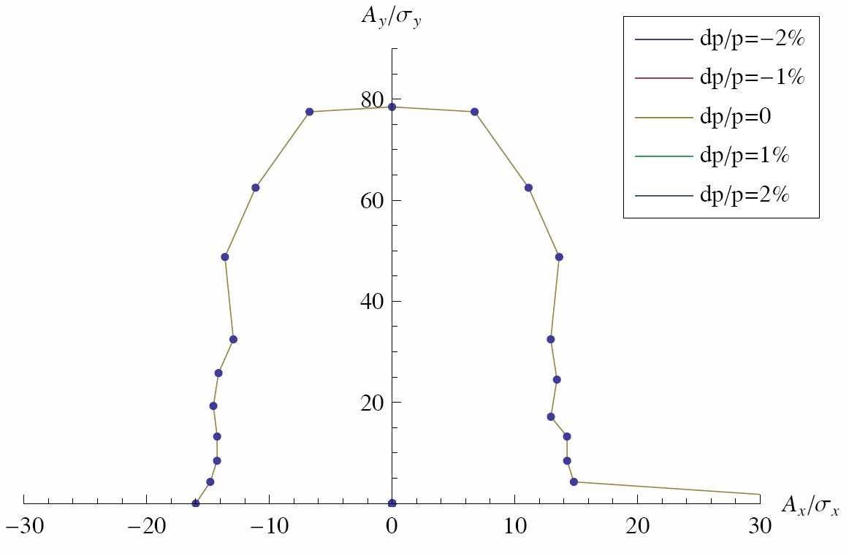
Dynamic Aperture（version20151224-new）

Slide 17
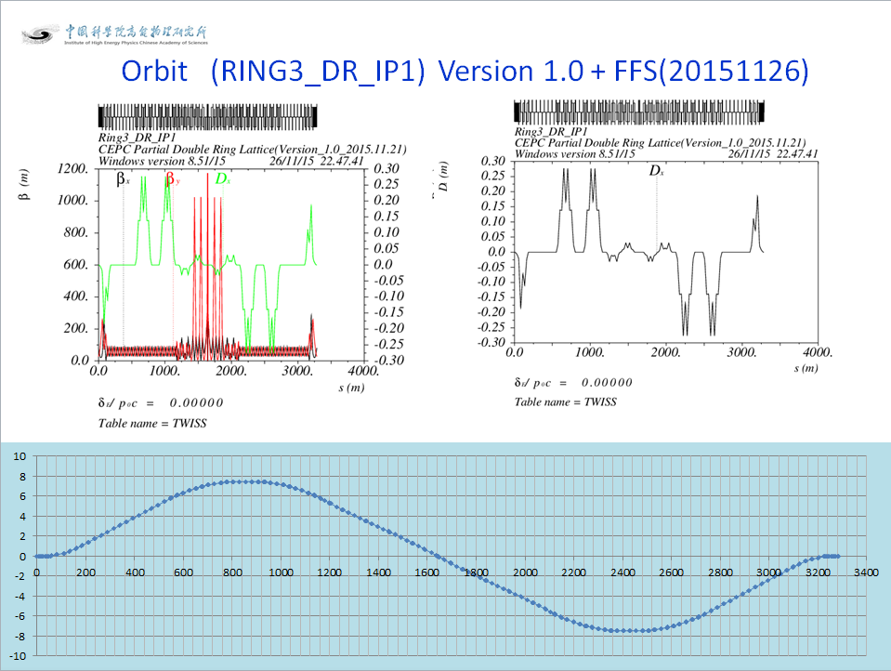

Slide 18
3.Use PDR Sex to Correct Horizontal Chromaticity

Slide 19
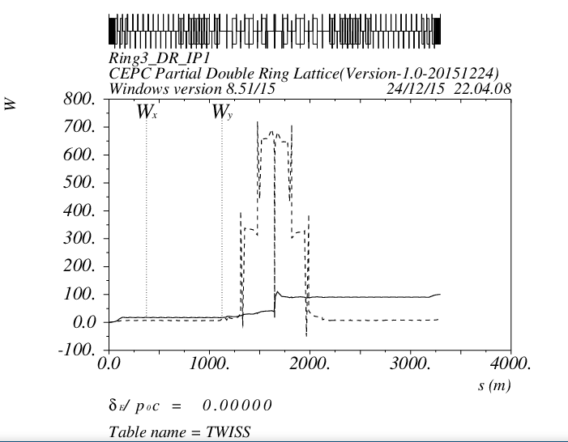
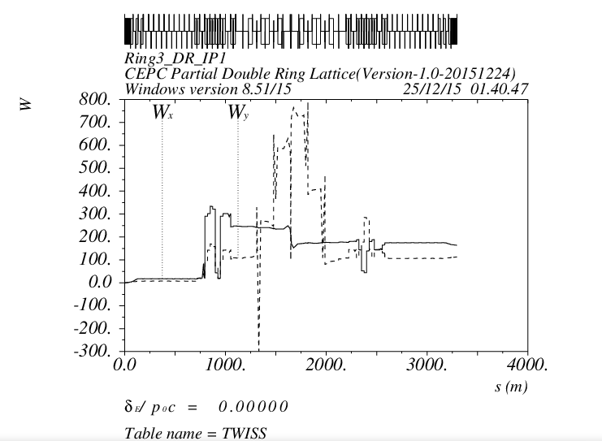
3.Use PDR Sex to Correct Horizontal Chromaticity

Slide 20
4. Next to do
Without FFS double ring DA optimization

Slide 21
Thank You !

