Slide 1
CEPC Partial Double Ring Parameter Update
Dou Wang, Jiyuan Zhai, Feng Su, Yuan Zhang, Yiwei Wang, Bai Sha, Huiping Geng, Tianjian Bian,

Slide 2
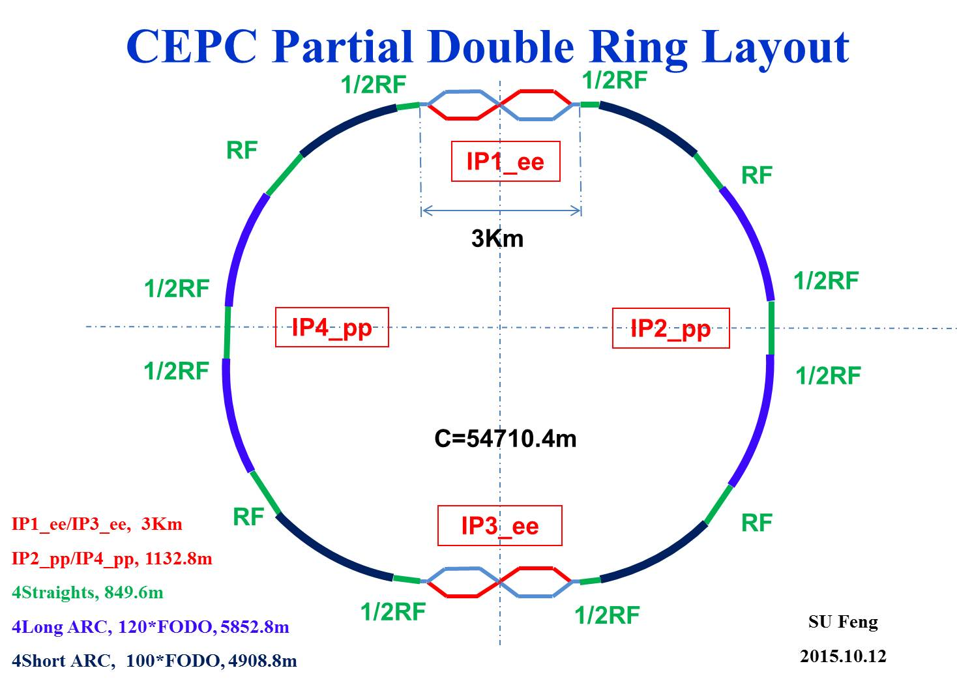
CEPC Partial Double Ring Layout
RF
IP1_ee
RF
3Km
Advantage:
Avoid pretzel orbit
Accommodate more bunches at Z/W energy
Reduce AC power with crab waist collision
1/2RF
1/2RF
IP4_pp
IP2_pp
1/2RF
1/2RF
C=54710.4m
RF
IP1_ee/IP3_ee, 3Km
IP2_pp/IP4_pp, 1132.8m
4Straights, 849.6m
4Long ARC, 120*FODO, 5852.8m
4Short ARC, 100*FODO, 4908.8m
IP3_ee
RF
SU Feng
2015.10.12

Slide 3
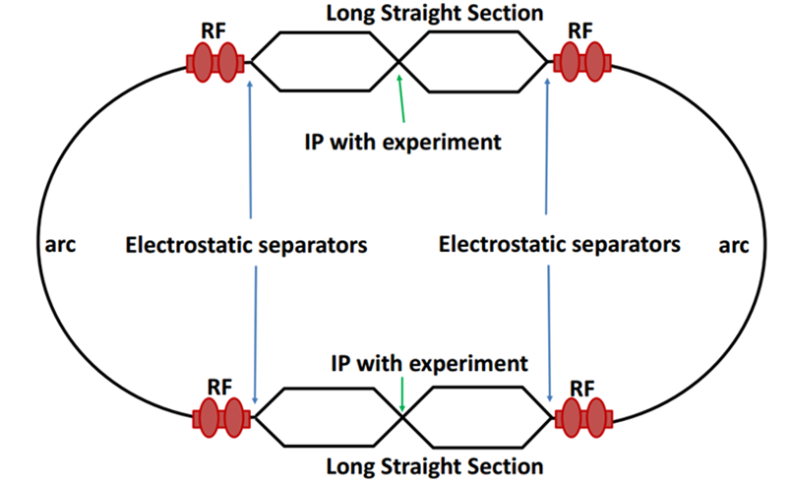
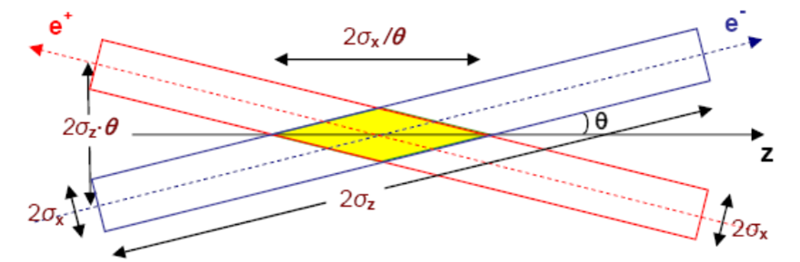
Machine constraints / given parameters
Energy E₀
Circumference C₀
N_{IP}
Beam power P₀
β_{y}*
R=σy/σx
Emittance coupling factor κ_{ε}
Bending radius ρ
Piwinski angle Φ
luminosity enhancement by crab waist F_{l} ~1.5
Phase advance per cell (FODO)

Slide 4
Parameter choice – step 1
Beam-beam limit:
F_{l}: ξy enhancement by crab waist
*J. Gao, emittance growth and beam lifetime limitations due to beam-beam effects in e+e- storage rings, Nucl. Instr. and methods A533（2004）p. 270-274.

Slide 5
Parameter choice – step 2

Slide 6
Parameter choice – step 3
BS life time: 30 min
ξy:
μ-- phase advance/cell, ϕ-- bending angle/cell.
Estimate :

Slide 7
Parameter choice – step 4

Slide 8
Parameter choice – step 5
Effective bunch length: overlap area of colliding bunches
Hour glass effect:

Slide 9
Parameter choice – step 6
V_{rf} , φ_{s}
Energy acceptance from RF:

Slide 10
Parameter choice – step 7
Loss factor
HOM power per cavity

Slide 11
Primary parameter design
 | Pre-CDR | high lumi. |  | low power |  | Z
Number of IPs | 2 | 2 |  | 2 |  | 2
Energy (GeV) | 120 | 120 |  | 120 |  | 45.5
Circumference (km) | 54 | 54 |  | 54 |  | 54
SR loss/turn (GeV) | 3.1 | 2.96 |  | 2.96 |  | 0.062
Half crossing angle (mrad) | 0 | 14.5 | 5.2 | 11.5 | 4.3 | 16.5
Piwinski angle | 0 | 2 | 2 | 2 | 2 | 2.6
N_{e}/bunch (10¹¹) | 3.79 | 3.79 | 1.2 | 2.81 | 1.0 | 0.37
Bunch number | 50 | 50 | 158 | 40 | 114 | 1100
Beam current (mA) | 16.6 | 16.9 | 16.9 | 10.1 | 10.1 | 36.2
SR power /beam (MW) | 51.7 | 50 | 50 | 30 | 30 | 2.2
Bending radius (km) | 6.1 | 6.2 | 6.2 | 6.2 | 6.2 | 6.1
Momentum compaction (10⁻⁵) | 3.4 | 3.0 | 2.8 | 2.6 | 2.5 | 5.4
β_{IP} x/y (m) | 0.8/0.0012 | 0.306/0.0012 | 0.036/0.0012 | 0.22/0.001 | 0.03/0.001 | 0.3/0.001
Emittance x/y (nm) | 6.12/0.018 | 3.34/0.01 | 3.07/0.0093 | 2.67/0.008 | 2.56/0.0078 | 1.18/0.0069
Transverse σ_{IP} (um) | 69.97/0.15 | 32/0.11 | 10.5/0.1 | 24.3/0.09 | 8.8/0.088 | 18.8/0.083
ξ_{x}/IP | 0.118 | 0.04 | 0.015 | 0.04 | 0.015 | 0.02
ξ_{y}/IP | 0.083 | 0.11 | 0.11 | 0.11 | 0.11 | 0.042
V_{RF} (GV) | 6.87 | 3.7 | 3.9 | 3.6 | 3.7 | 0.28
f _{RF} (MHz) | 650 | 650 | 650 | 650 | 650 | 650
Nature σ_{z} (mm) | 2.14 | 3.3 | 3.0 | 3.2 | 3.0 | 3.0
Total σ_{z} (mm) | 2.65 | 4.4 | 4.0 | 4.2 | 4.0 | 3.0
HOM power/cavity (kw) | 3.6 | 3.3 | 0.95 | 1.5 | 0.47 | 0.73
Energy spread (%) | 0.13 | 0.13 | 0.13 | 0.13 | 0.13 | 0.05
Energy acceptance (%) | 2 | 2 | 2 | 2 | 2
Energy acceptance by RF (%) | 6 | 2.2 | 2.6 | 2.2 | 2.4 | 2.0
n_{γ} | 0.23 | 0.49 | 0.46 | 0.47 | 0.46 | 0.08
Life time due to beamstrahlung_cal (minute) | 47 | 53 | 32 | 41 | 32
F (hour glass) | 0.68 | 0.73 | 0.75 | 0.69 | 0.7 | 0.67
L_{max}/IP (10³⁴cm⁻²s⁻¹) | 2.04 | 2.97 | 3.07 | 2.03 | 2.08 | 1.01

Slide 12
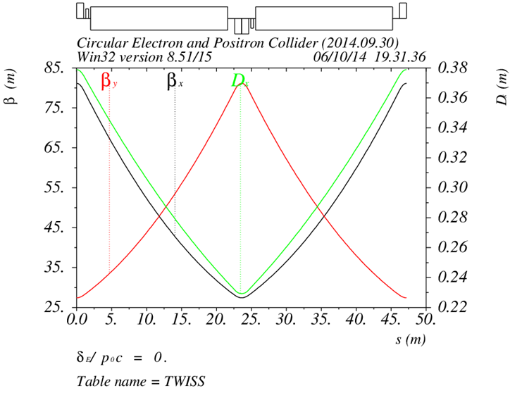
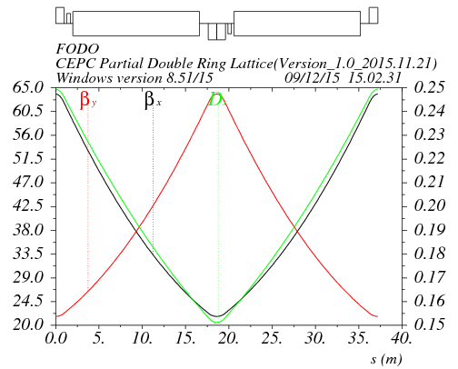
Arc redesign-lower emittance
Length of FODO cell: 47.2m
Phase advance of FODO cells: 60/60 degrees
Emittance: 7.9nm, αp=5.38E-5
Bunch length: 2.3mm
Length of FODO cell: 37.5m
Phase advance of FODO cells: 60/60 degrees
Emittance: 4.3nm , αp=2.25E-5
Bunch length: 3.3mm

Slide 13
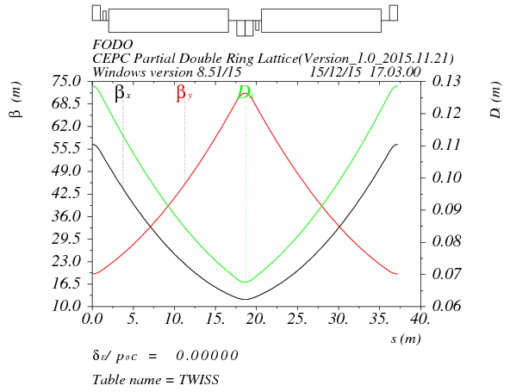
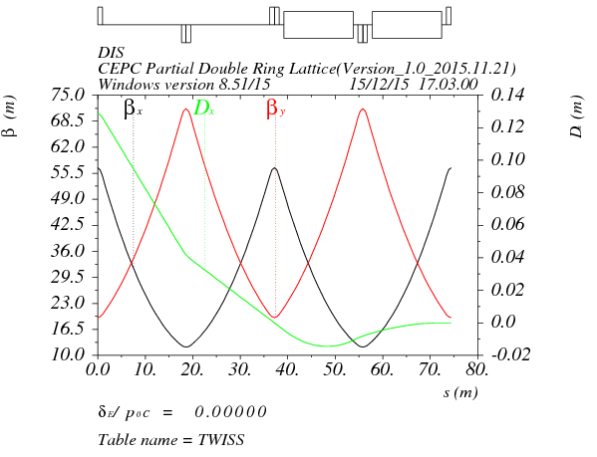
Arc redesign-ultra low emittance
Length of FODO cell: 37.5m
Phase advance of FODO cells: 90/60 degrees
Emittance: 2.3nm, αp=1.07E-5
Bunch length: 3.3mm
Dispersion supressor:
Angle(BDIS1)=3.583724E-03
Angle(BDIS2)=-8.598108E-04
Angle(B0)=2.723923E-03
BDIS1
BDIS2
B0
B0

Slide 14
summary
CEPC AP group and RF group has collaborated to give a more realizable parameter considering cavity HOM power.
Based on crab waist scheme, we get a set of Z parameter with 1.0*10³⁴cm⁻²s⁻¹ luminosity using 1100 bunch.
Higgs’s parameters have been updated to reduce the cavity HOM power under 1kw. Further improvement is undergoing to make same crossing angle as Z parameter.

