Slide 1
Optimization of partial double ring optics
Yiwei Wang, Feng Su, Dou Wang, Jie Gao
CEPC AP meeting, 25 Dec 2015

Slide 2
Outline
Optimization of partial double ring optics
With CEPC PDR V1.0 (by Feng Su)
Check Dynamic aperture
Analysis of chromaticity source and correction

Slide 3
CEPC Partial Double Ring Layout
In CEPC PDR V1.0,
the length of arcs are
the same.
RF
IP1_ee
RF
3Km
1/2RF
1/2RF
IP4_pp
IP2_pp
1/2RF
1/2RF
C=54710.4m
RF
IP1_ee/IP3_ee, 3Km
IP2_pp/IP4_pp, 1132.8m
4Straights, 849.6m
4Long ARC, 120*FODO, 5852.8m
4Short ARC, 100*FODO, 4908.8m
IP3_ee
RF
SU Feng
2015.10.12

Slide 4
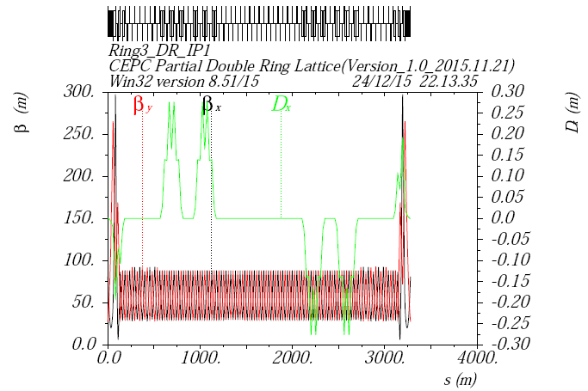
Optcis of PDR
with CEPC PDR V1.0 by Feng Su

Slide 5
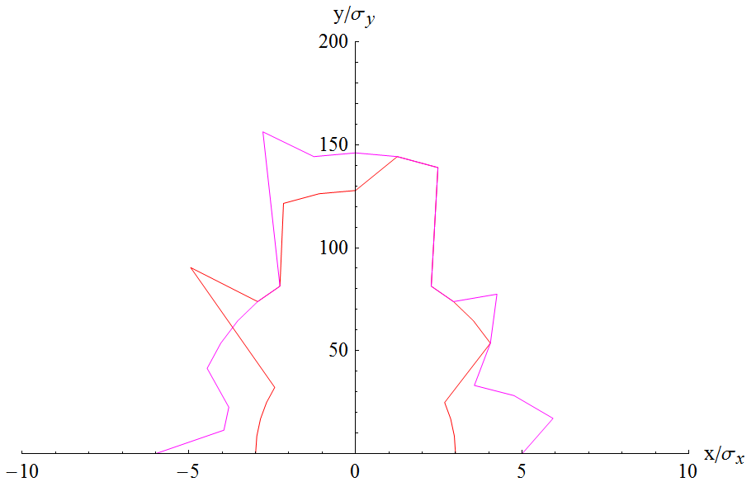
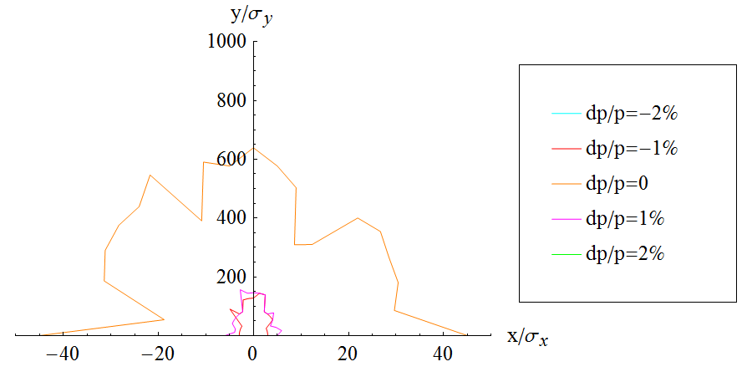
DA of V1.0
with CEPC PDR V1.0 by Feng Su
Emittx=6.27nm

Slide 6
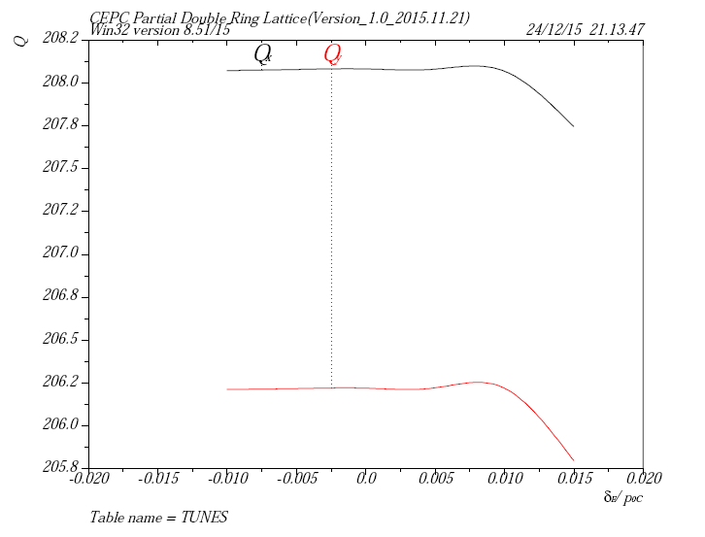
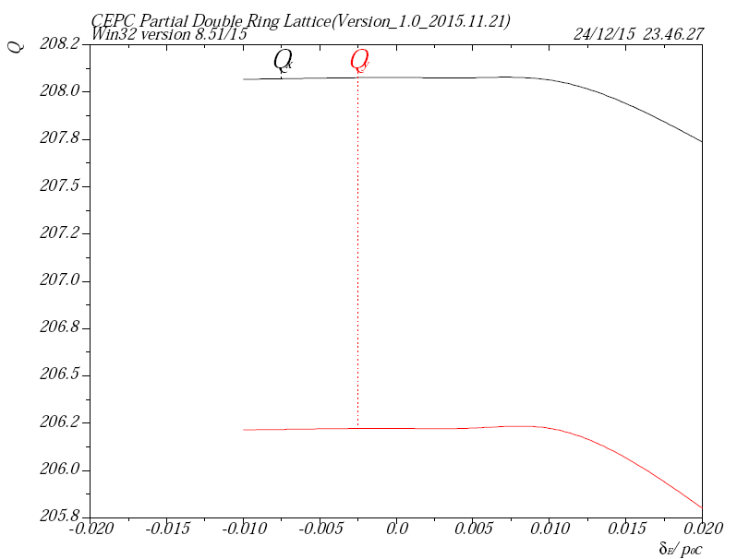
Tune vs. dP/P
Turn off sextupoles in PDR

Slide 7
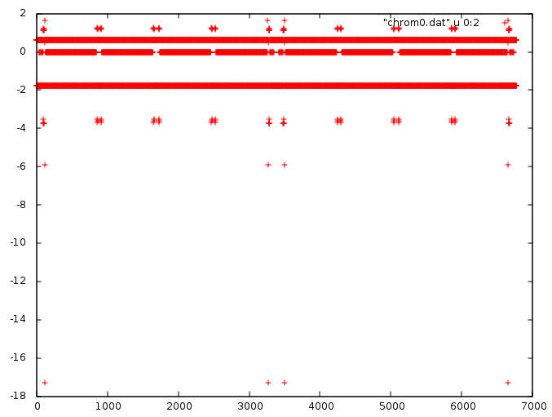
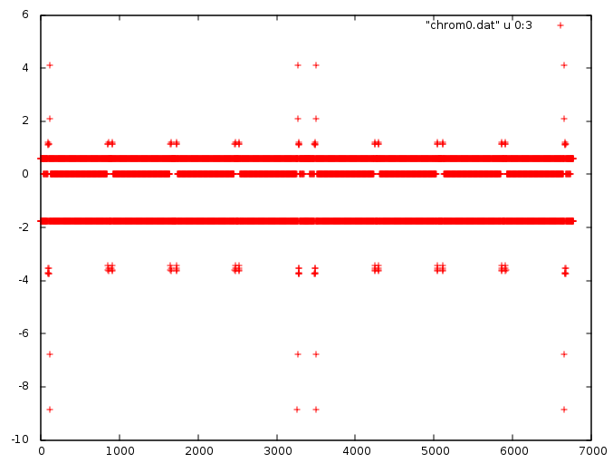
Chromaticity contribution
Natural chromaticity
Chromaticity X
Chromaticity Y
STRR as tune knob
PDR
Index of quad and sext (turned off)
Index of quad and sext (turned off)

Slide 8
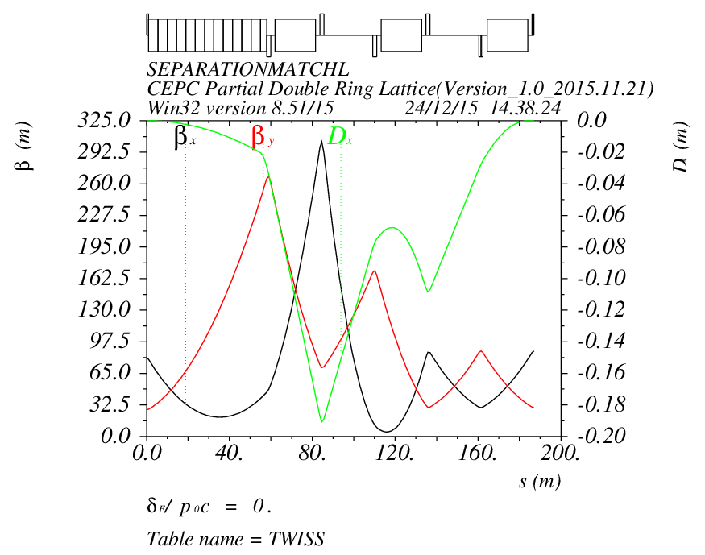
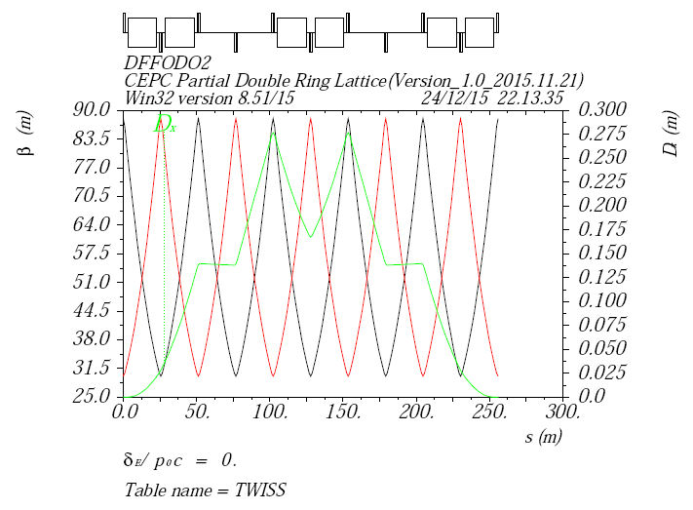
Chromaticity should be corrected locally
Dispersion is small at βy peak
Correct chromaticity with nearby sextupoles where Dx is much bigger
Naturally the sextupole strength should be different as different Dx
Could be used to help correction of the IR chromaticity

Slide 9
Next step
PDR contribute much chromaticity which coupled to high order ones.
Chromaticity correction of PDR
Optimise linear optics
Reduce chromaticity contribution of PDR
Seperator region, bending region

