Slide 1
CEPC magnet error study summary
Sha Bai
CEPC AP meeting
2015-12-25

Slide 2
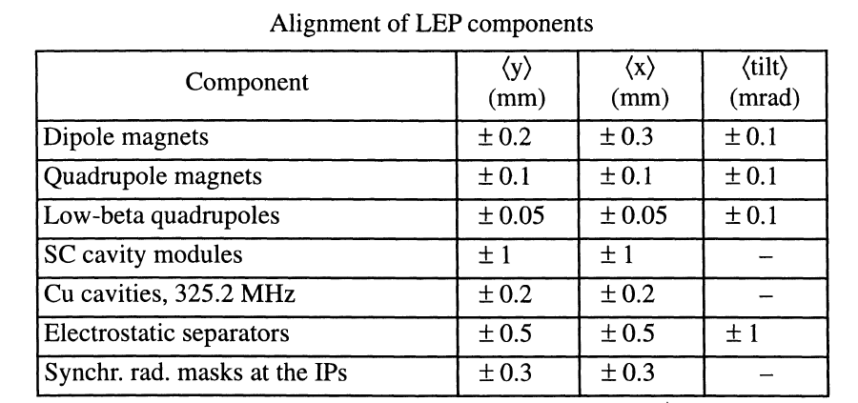
LEP Alignment parameters
From: LEP Design Report---------LEP2 P177

Slide 3
Magnet Field error 1
From: LEP Design Report---------LEP P18

Slide 4
Magnet Field error 2
From: LEP Design Report---------LEP P19

Slide 5
Magnet Field error 3

Slide 6
BEPCII
CEPC
 | bend | quad | sext | bend | quad | sext
Dx(mm) | 0.2 | 0.15 | 0.15 | 0.3 | 0.1 | 0.15
Dy(mm) | 0.2 | 0.15 | 0.15 | 0.2 | 0.1 | 0.15
Tilt(mrad) | 0.1 | 0.2 | 0.5 | 0.1 | 0.1 | 0.5
B*L | 3e-4 | 3e-4 | 2e-3 | 5e-4 | 5e-4 | 4e-3
quadrupole(s) | 3e-4 |  |  | 8e-4
sextupole(s) | 6e-4 | 5e-5 |  | 2e-4 | 6e-4
Octupole(s) |  | 7e-5 | 6e-4 | 7e-5 | 5e-4 | 1.7e-3
Decapole(s) | 5e-4 | 9e-5 | 2e-4 | 1.3e-4 | 6.9e-4 | 3.4e-3
Dodecapole(s) |  | 6e-4 | 5e-4 | 1.4e-4 | 1e-3 | 6.5e-3
Quadrupole(r) | 1e-4 | 3e-4 |  | 2e-4
Sextupole(r) | 1e-4 | 1e-4 | 3e-3 | 2.9e-4 | 1.2e-3
Multipole(r) | 1e-4 | 1e-4 | 3e-4 | 2e-4 | 1e-3 | 2e-2

Slide 7
BEPCII Dynamic aperture
without error
with misalignment errors
With all errors
With all B*L and multipole errors
Coupling factor κ=0.015 for emitty

Slide 8
CEPC DA with field errors with only ¾ ring
Coupling factor κ=0.003 for emitty
With ¾ ring (B,Q,S) B*L errors
2% (1σx, 3.5σy)
With ¾ ring (B,Q,S) B*L and multipole errors
1.5%, 2% (0, 0)

Slide 9
CEPC DA with field errors with only ¾ ring
Coupling factor κ=0.003 for emitty
With all FFS B*L and multipole errors
enlarge
with ¾ ring and FFS (B,Q,S) B*L errors & multipole errors
1.5%, 2% (0, 0)

Slide 10
Magnet field error on DA
With Bend B*L error
(whole ring including FFS)
μ_{x}= 0.0720634 μ_{y}= 0.2261286
Orbit in X & Y
With Bend B*L error
(whole ring including FFS)
With Quad B*L error
(whole ring including FFS)
μ_{x}= 0.0815080 μ_{y}= 0.1937457
With Sext B*L error
(whole ring including FFS)
Tune no change
With Bend magnet field errors, orbit is changed, and tune is also changed a little bit
Orbit correction is needed
With Quadrupole and sextupole field errors, orbit has no change.
With Quad field errors, tune is change.
Bend is set to be bend, but Quad and Sextupole are set to be MULT
Tracking in 240 turns, coupling factor κ=0.003 for ε_{y}

Slide 11
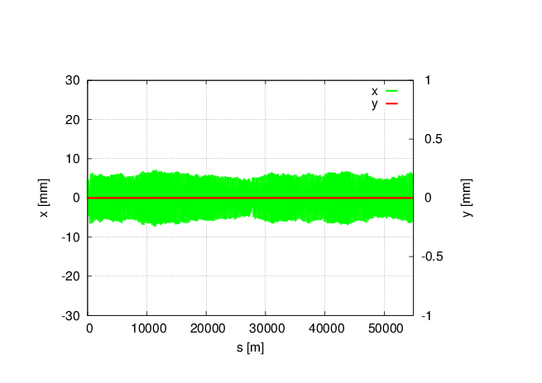
Magnet field error on DA
With all (B,Q,S) B*L field errors, whole ring including FFS.
Tune has changed a lot: μ_{x}=0.0510854 μ_{y}= 0.1526778
Orbit correction and tune adjust are needed
Bend set to bend, and Quad and Sext set to be MULT
Tracking in 240 turns, coupling factor κ=0.003 for ε_{y}

Slide 12
Multipole errors effect on DA
Bend multipole errors (whole ring including FFS)
Quad multipole errors
(whole ring including FFS)
Sextupole multipole errors(whole ring including FFS)
(B,Q,S)multiple errors
(whole ring including FFS)
Off-momentum DA is not changed obviously, with 2% (1σ_{x}, 10σ_{y})
Tune is kept, no effect on tune
Orbit is kept to be zero, no effect on orbit
Bend is set to be bend, but quadrupole and sextupole are set to be MULT
When bend set to be MULT, it doesn’t work in SAD
Tracking in 240 turns, Coupling factor κ=0.003 for emitty

Slide 13
CEPC field error summary
The multipole errors in the main ring seems to have a large effect on the 2% off-momentum DA.
The field errors in the FFS seems to have a large effect on the vertical on-momentum DA.
方案一： Optimization of DA (前提是without error情况下的DA足够好）
轨道校正（针对misalignment errors）
工作点校正（针对quad B*L error）
FMA analysis , add octupole, decapole, dodecapole…….
即使模拟能做好但实际情况未必……
方案二： Reduce errors (可能对磁铁制造要求比较高）
reduce the errors to the DA that we can accept

Slide 14
Error correction
Error correction
Misalignment & bending magnet strength error
Quad strength error
Multipole error
Orbit correction with correctors & BPM
Tune correction & chromaticity correction
Impossible to correct
& adjust level to requirement

Slide 15
Magnet requirement
二四六极铁的准直能做到几十个微米（比如30个微米算很好了）
校正子二极铁一般提磁场均匀度，约在1%量级。
磁铁的场强误差一般不提（因调整电流即可调节场的大小）
高阶场误差达到万分之二已经非常好了, 具体每一高阶场还有差异，越低阶的高阶场越难做好。

Slide 16
Summary
With correctors and BPMs adding in the beam line, SAD harsh table has no space. SAD can not deal with large ring. MAD can’t give correct DA. We have to change to other program –BMAD, which can both give DA and use MAD lattice. And also orbit correction should add pretzel, Bmadz can deal with every kinds of problem in pretzel.
Tune correction and chromaticity correction are not needed for magnet design requirement.
Multipole errors are studied in detail to get a general range of multipole errors influence on DA.

