Slide 1
Beam tilt calculation
Zhang Yuan，Xu Gang，Sun Yuansheng

Slide 2
Beam tilt calculation
When a beam bunch traverses a transverse impedance , the bunch head generates a transverse wake field that kicks the bunch tail, generating a betatron motion of the tail relative to the head. In a storage ring, in a steady state, this kick to the bunch tail produces a transverse closed orbit (e.g. in the y-direction) of the bunch tail relative to the bunch head, which means the beam now has a y-z tilt.
v
a
b

Slide 3
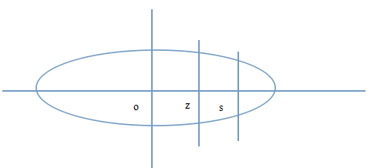
Beam-tilt calculation
束团中任意z处所受到的横向kick
(1)
(2)
(3)
The transverse kick is proportional to the transverse displacement of the bunch head.

Slide 4
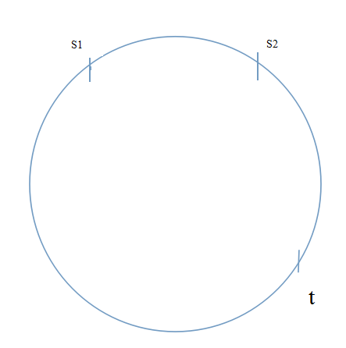
Beam-tilt calculation
Close orbit distortion
(4)
(5)
(6)

Slide 5
Parameter | Unit | Value
束流能量[N] | GeV | 120
单束团粒子数[N] |  | 3.79E+11
自然束长[ ] | mm | 2.14
水平尺寸[ ] | μm | 69.97
对撞点 | m | 0.8
水平工作点 |  | 0.8578

Slide 6
Beam tilt calculation
If the object considered is cylindrically symmetric，the dipolar component is dominant
Beam pipe

Slide 7
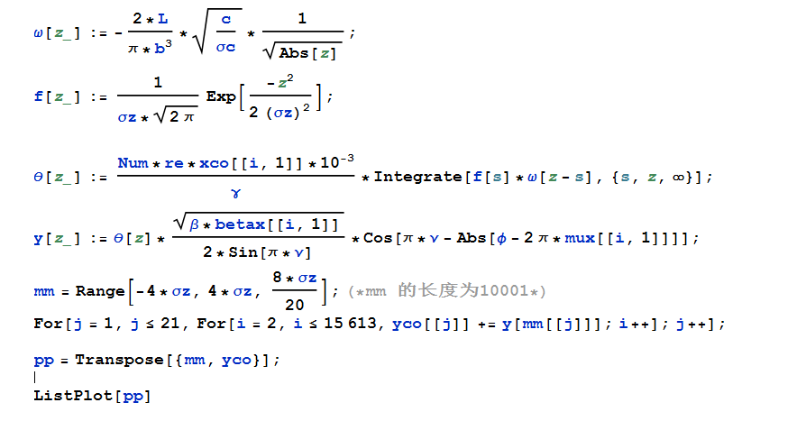

Slide 9
End

