Slide 1
Weekly Report
Bin Wang
2016.07.11

Slide 2
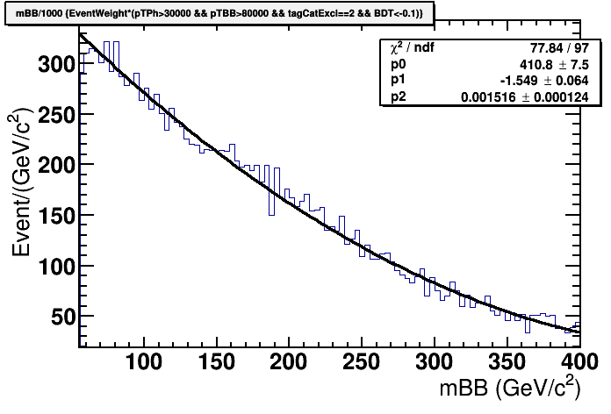
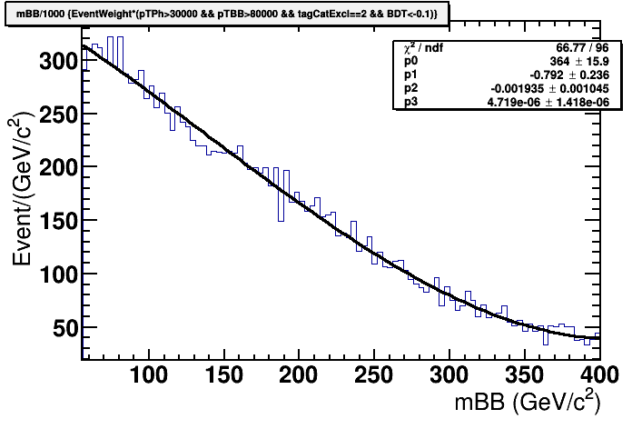
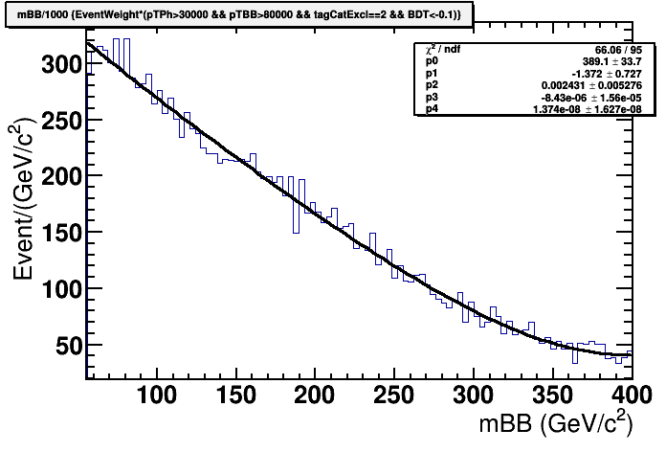
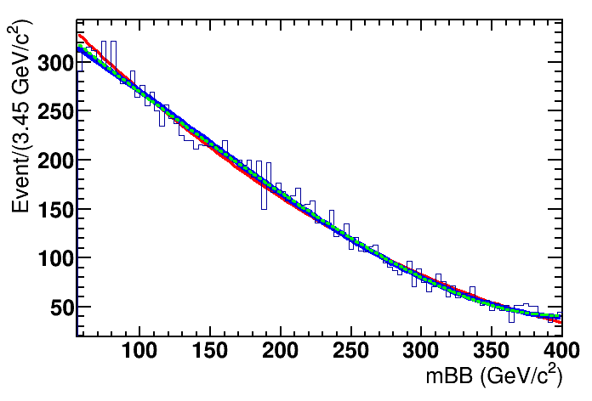
Background Shape (Low BDT)
1

Slide 3
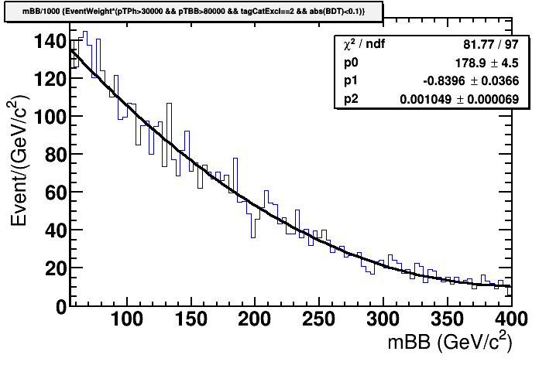
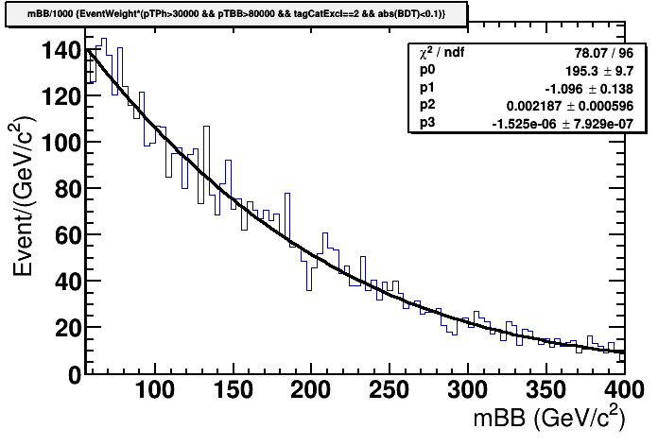
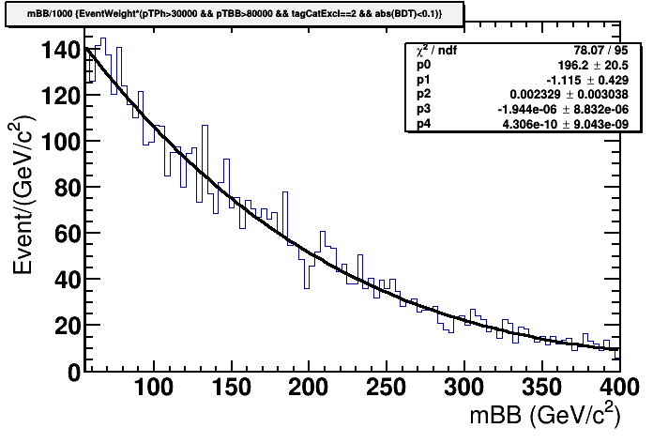
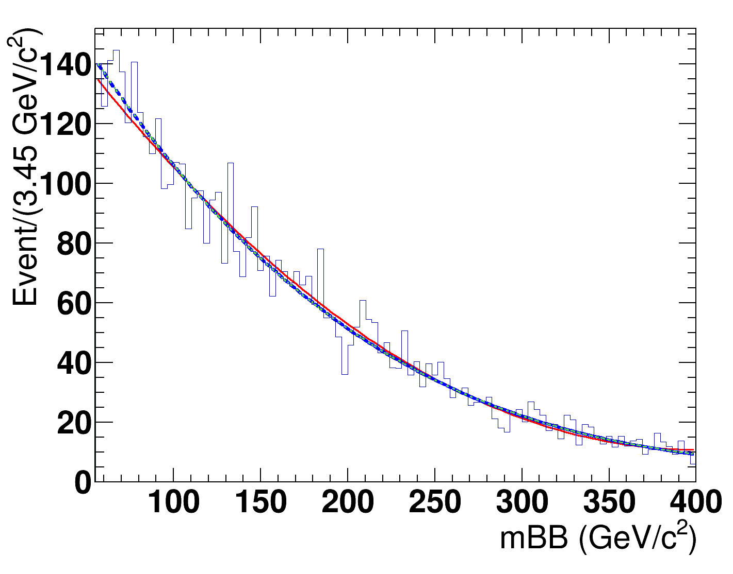
Background Shape (Medium BDT)
2

Slide 4
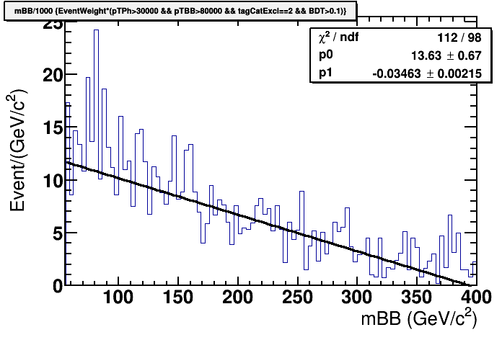
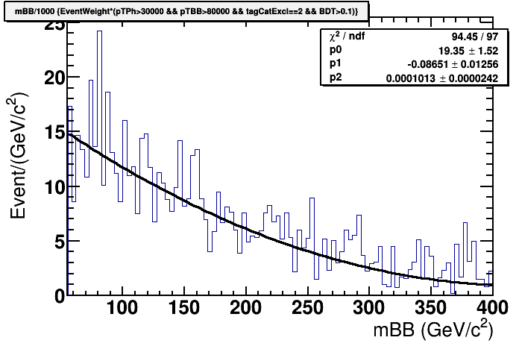

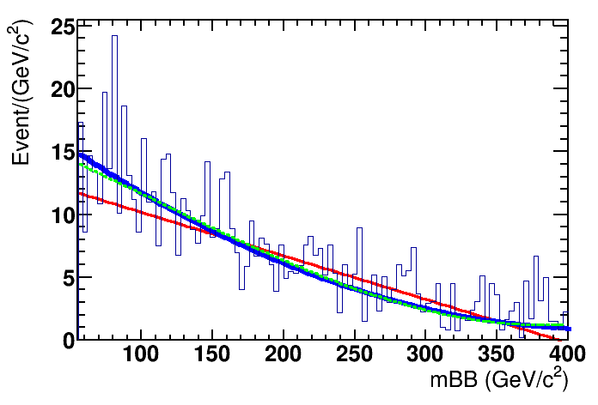
Background Shape (High BDT)
3

Slide 5
Expected Signal Yield
BDT Region | N_H | N_Z (QCD+EWK)
BDT < -0.1 | 0.4 | 8.6 (7.9+0.7)
|BDT| < 0.1 | 1.1 | 6.8 (5.1+1.7)
BDT > 0.1 | 1.7 | 4.0 (1.4+2.6)
4

Slide 6
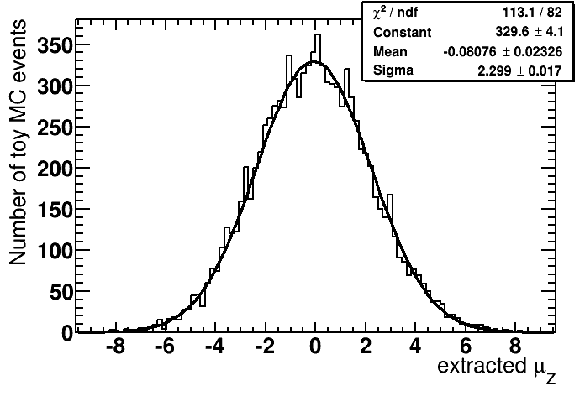
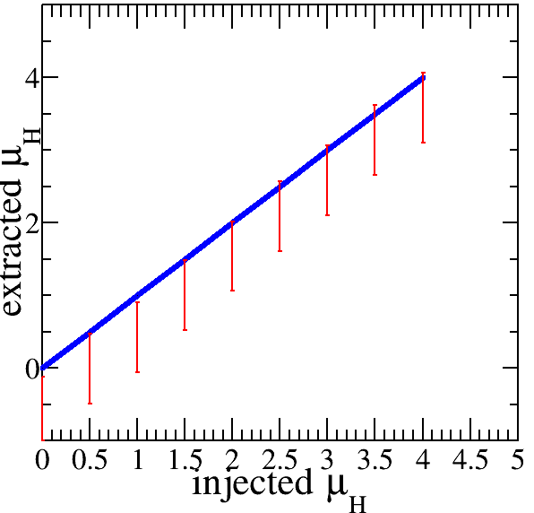
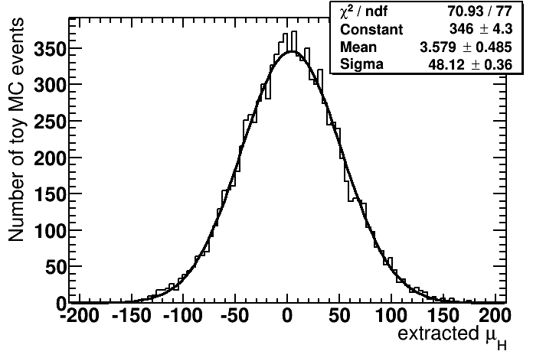



Signal Injection Test (Low BDT)
injected $μ_{Z}$=0
injected $μ_{Z}$=0
injected $μ_{H}$=4
5

Slide 7
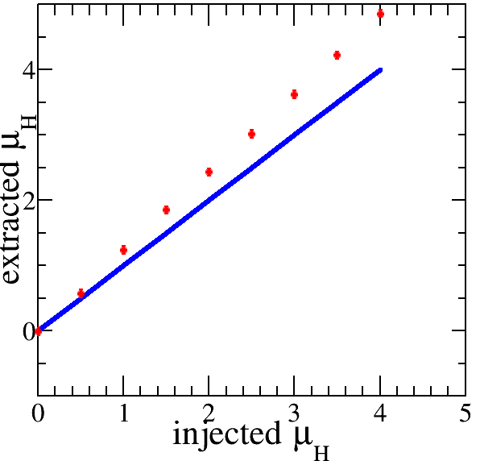
Signal Injection Test (High BDT)
6

