Slide 1
Leakage Study of Optimization of HCAL
Bing Liu
2016.01.19

Slide 2
Ionization and Excitation energy loss by heavy particles
Radiation energy loss
Bremsstrahlung energy loss
pair production energy loss
Photonuclear energy loss
Linearity and resolution of 99% energy deposit for k pi e

Slide 3
Ionization and Excitation energy loss by heavy particles
Bethe equation

Slide 4
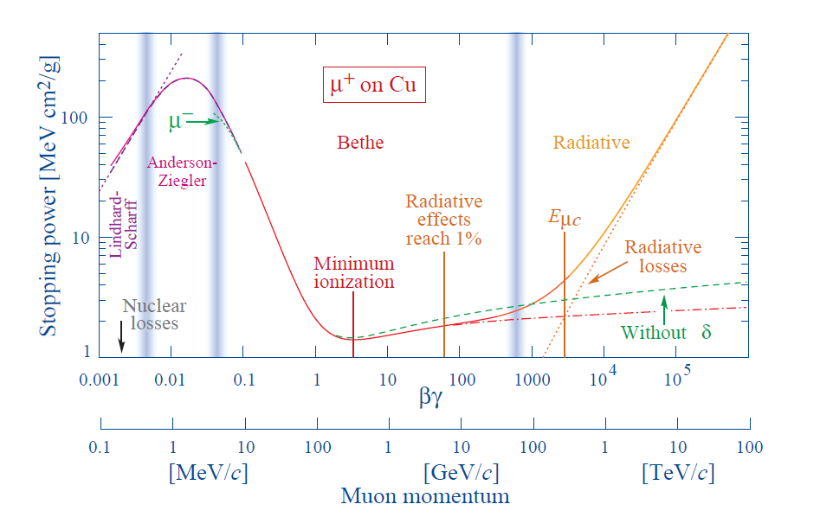
Stopping power for positive muons in copper as a function of
βγ = p/Mc over nine orders of magnitude in momentum

Slide 5
Radiation energy loss
Bremsstrahlung energy loss
$$−\frac{ⅆE}{dx}=4αN_{A}\frac{Z^{2}}{A}z^{2}{(\frac{1}{4πε_{0}}\frac{e^{2}}{mc^{2}})}^{2}Eln\frac{183}{z^{1/3}}$$
𝜶:fine structure constant A:atomic mass of absorber
Z:atomic number of absorber ${ N}_{A}$:Avogadro’s number
z:charge number of incident particle m:incident particle mass
E:incident part. energy

Slide 6
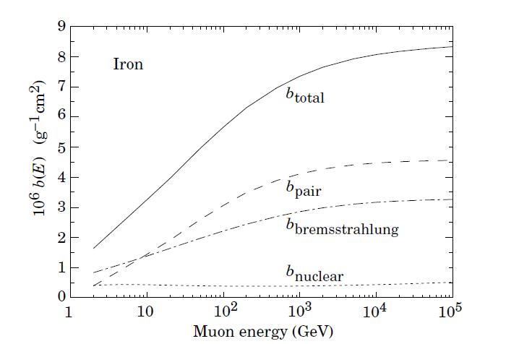
Contributions to the fractional energy loss by muons in iron due to e+e− pair production, bremsstrahlung, and photonuclear interactions

Slide 7
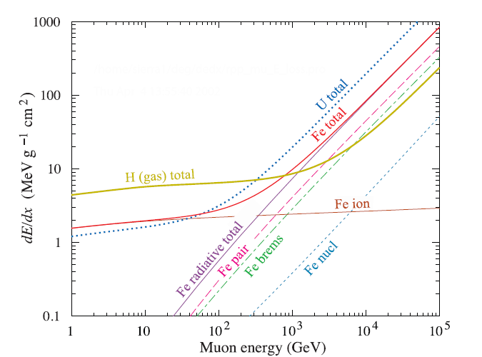
The average energy loss of a muon in hydrogen, iron, and uraniumas as a function of muon energy.

Slide 8
