Slide 1
Optimization of Partial double ring Lattice
Yiwei Wang, Yuan Zhang, Feng Su, Huiping Geng, Dou Wang, Jie gao

Slide 2
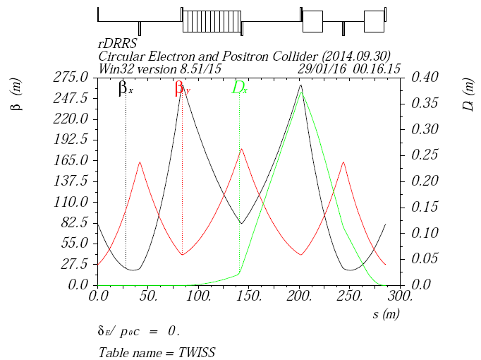
Right side of Double Ring Seperator region (DRRS)
Modular design
Seperators same with Feng Su’s design

Slide 3
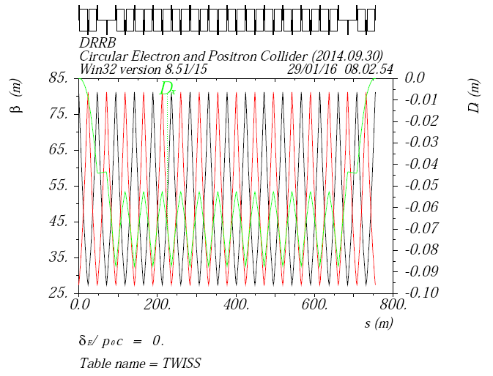
Right side of FFS (FFSR)
12+4 FODO

Slide 4
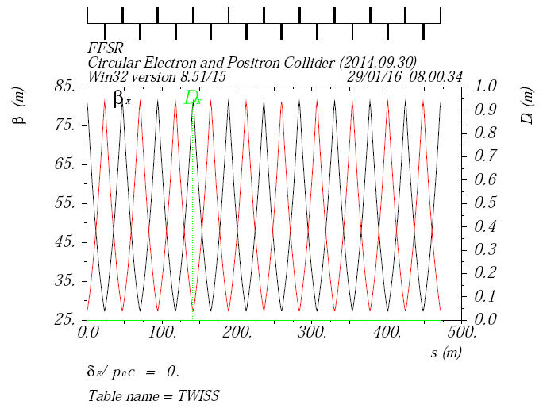
Right side of FFS (FFSR)
10 FODO
Length 472m

Slide 5
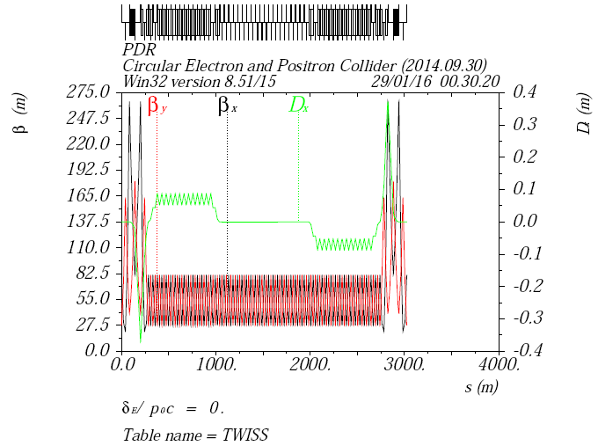
Partial Double Ring

Slide 6
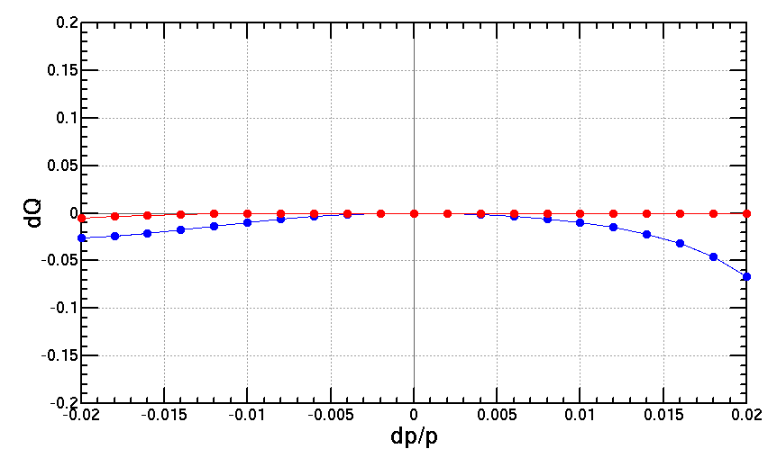
Chromaticity correction
2 families in the previous ARC by Huiping
Working point 213.08/213.22

Slide 7
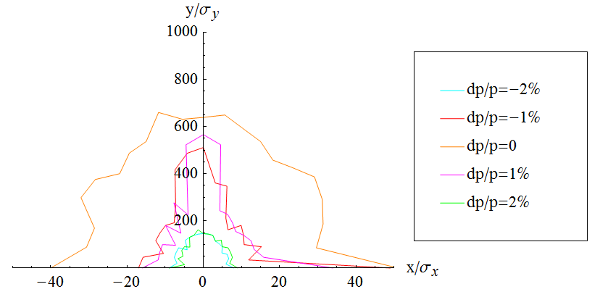
Dynamic Aperture

Slide 8
Summary
Optimization of PDR lattice
Chromaticity correction with only 2 families in the previous ARC by Huiping
Bandwidth larger than 2% achieved
More families to correct high order chromaticity
With ARC and PDR sextupoles

