Slide 1
Local double ring MDI
Sha Bai
CEPC AP meeting
2016-01-29

Slide 2
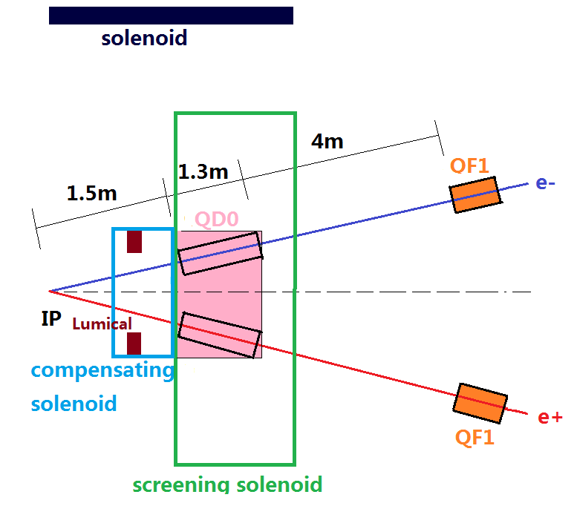
Local double ring MDI layout
Detectors (including silicon tracker, vertex detector, TPC etc on….) are not included in this layout, but since they are “far” from this region, which should be same as in the single ring.

Slide 3
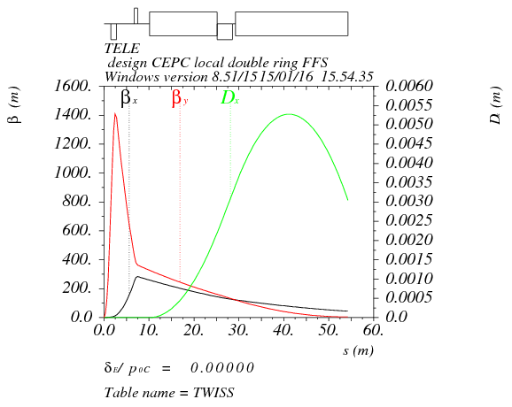
New FFS design
L*=1.5m
L(QD0)=1.3m, G(QD0)=-200T/m
L(QF1)=0.73m, G(QF1)=106T/m

Slide 4
Background
Generator
Accelerator
part
Accelerator
Simulation
Synchrotron radiation background
a).from the bending magnet
b).from the quadrupole in the IR
Lost particles background
a).radiation Bhabha scattering
b).beamstrahlung
Geant4(Mokka)
Detector
part
Analysis(Marlin)
Cross-section from formula
Monte Carlo method to generate particle energy spread
Bending magnet designed considering synchrotron radiation, in aspect of detector and radiation protection
Collimation system should be redesigned

Slide 5
Generator
Monte-Carlo methods are a broad class of computational algorithms that rely on repeated random sampling to obtain numerical results.
Monte Carlo methods vary, but tend to follow a particular pattern:
1. Define a domain of possible inputs.
2. Generate inputs randomly from a probability distribution over the domain.
3. Perform a deterministic computation on the inputs.
4. Aggregate the results.
Beamstrahlung
Radiative Bhabha scattering
Guinea-pig can not be generator, because: 1. the beamlife time calculated by it is not accepted. 2. it generator all particles in the bunch, for CEPC, there is only one particle’s energy spread bigger than 2% in every 100000 particles.
Beamstrahlung model could be checked with Dmitry’s code, since beam lifetime calculated are not consistent.

Slide 6
Superconducting magnet
QD0 (double aperture design )
Crossing angle 26mrad: e+ e- separation distance at QD0 /2=1.5*sin(13mrad)=1.9cm < 2cm
Crossing angle 30mrad: e+ e- separation distance at QD0 /2=1.5*sin(15mrad)=2.2cm >2cm
Beam pipe (radius ~2cm?)
> 30~40mm
Refer to FCC design, QD0 ~ double aperture design
Distance between beam pipe center should be bigger than 30~40mm
30mrad is better ?

Slide 7
Experience from SuperB
The idea of designing the compensation out has been thought about at SuperB

Slide 12
Solenoid & compensating solenoid
Main parameters of the solenoid coil
Solenoid central field [T] | 3.5
Maximum field on conductor [T] | 3.85
Coil inner radius [mm] | 3600
Coil outer radius [mm] | 3900
Coil length [mm] | 7600
Since large coil radius, solenoid is same as in the single ring.
Refer to FCC compensating solenoid design, adding screen solenoid and compensating solenoid as in page 2.
Compensating solenoid field much bigger than the FCC case due to the 3.5T solenoid central field.

Slide 13
Lumical parameters
Longitudial position from IP [mm] | 1147
Thickness in longitudinal [mm] | 128
Inner radius [mm] | 63.3
Outer radius [mm] | 320
e+ e- separation distance at Lumical /2 ~ 1.65cm+2cm ~3.65cm << 6.33cm
Lumical is in the compensating solenoid according to FCC design, which may make the lumical design complex.

