Slide 1
A Preliminary Consideration of CEPC Booster Bypass
SU Feng GAO Jie BIAN Tianjian CUI Xiaohao
ZHANG chuang WANG Dou WANG Yiwei BAI Sha
Key Laboratory of Particle Acceleration Physics and Technology
Institute of High Energy Physics
Chinese Academy of Sciences
2016.1.29

Slide 2
CEPC Partial Double Ring Layout
1/2RF
1/2RF
IP1_ee
RF
RF
3.2Km
1/2RF
1/2RF
Bypass
about 43.89m
IP4_pp
IP2_pp
Bypass
about 43.89m
1/2RF
1/2RF
IP1_ee/IP3_ee, 3.2Km
IP2_pp/IP4_pp, 1132.8m
4 Short Straights, 141.6m
4 Medium Straights, 566.4m
4 Long Straights, 849.6m
2 Short ARC, 24*FODO, 1132.8m
4 Medium ARC, 112*FODO, 5286.4m
4 Long ARC, 124*FODO, 5852.8m
C=59044m
RF
RF
IP3_ee
1/2RF
1/2RF
SU Feng
2016.1.4

Slide 3
CEPC Partial Double Ring Layout
12
62.5urad
4.5m
B2
B3
B1
614.4m
479.1m
54m
307.2m
Full crossing angle 26mrad
13mrad
7.852m
IP
B6
Septum Dipole
Septum Dipole
Separator
1642m
B4
B5
Version 1.0
sufeng
2015.12.20
For CEPC 120GeV beam:
Max. deflection per separator is 66μrad.
Using Septum Dipole after separator to acquire 13 mrad

Slide 4
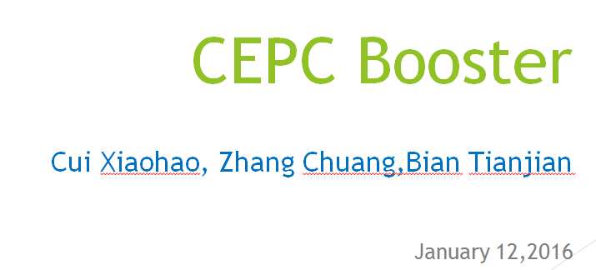
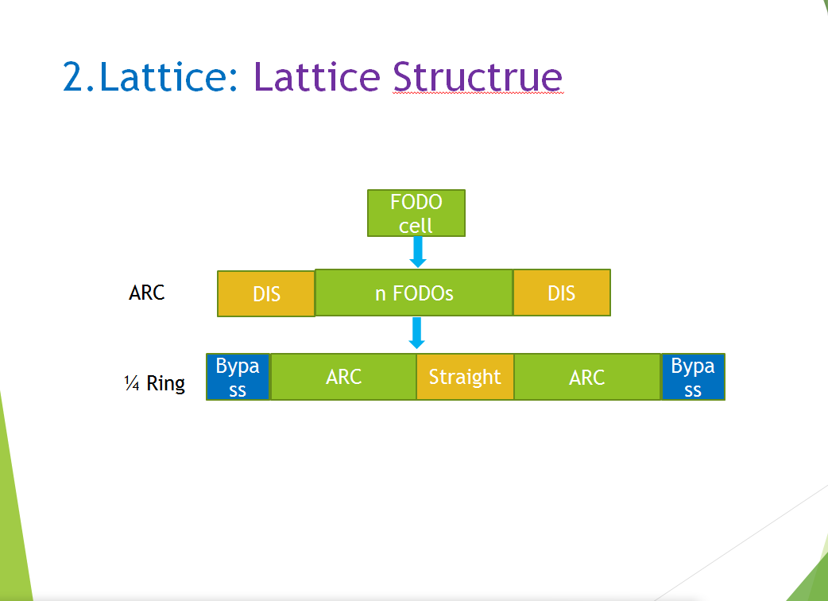

Slide 5
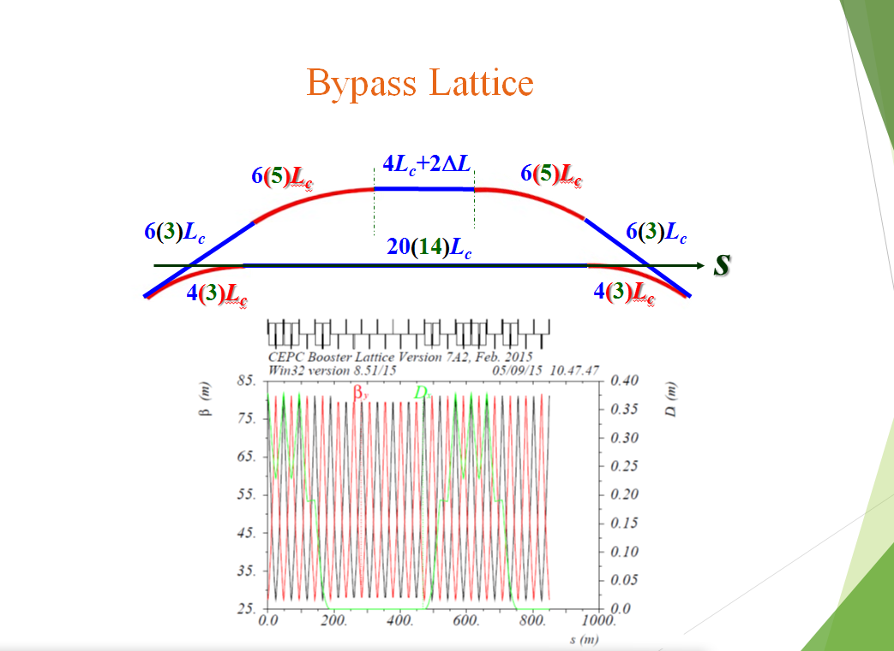
？m
Cell length=47.2m

Slide 6
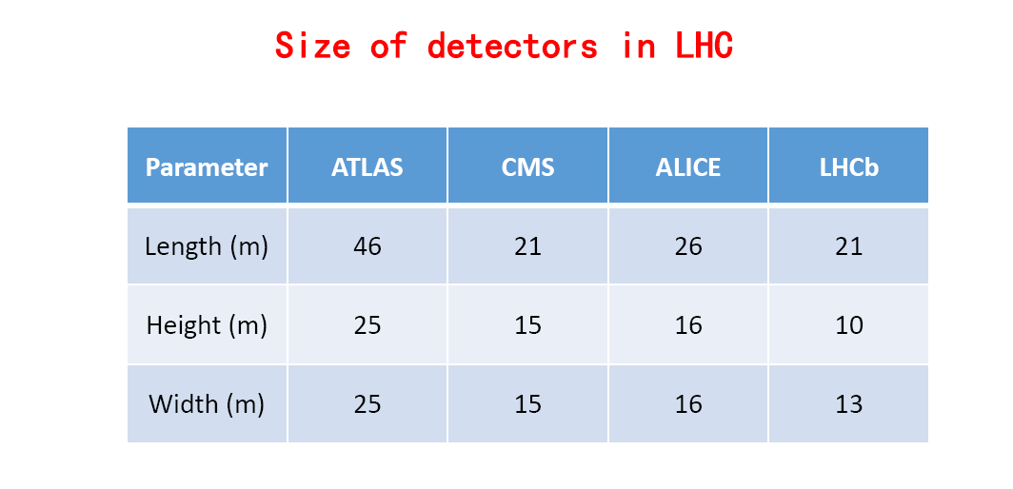
SPPC Detector Size
7->35
SPPC=40m?

Slide 7

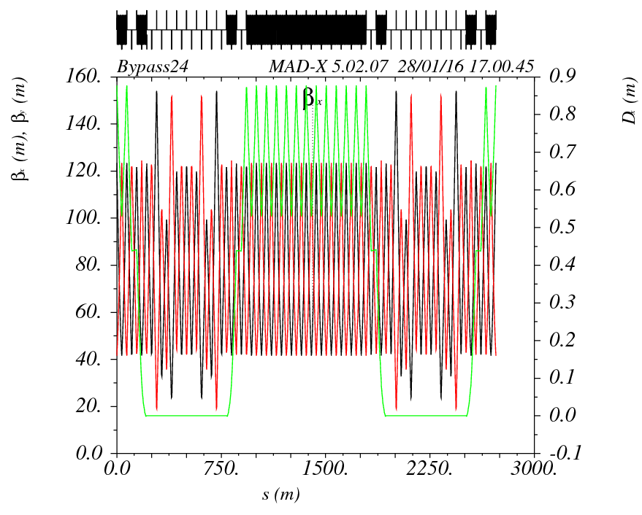
CEPC Booster Bypass at IP2/4
8L_{c}
8L_{c}
573.28m
8L_{c}
8L_{c}
573.28m
L=44.9m
s
8L_{c}
16L_{c}
1146.56m
8L_{c}
573.28m
573.28m
Cell length=71.66m

Slide 8
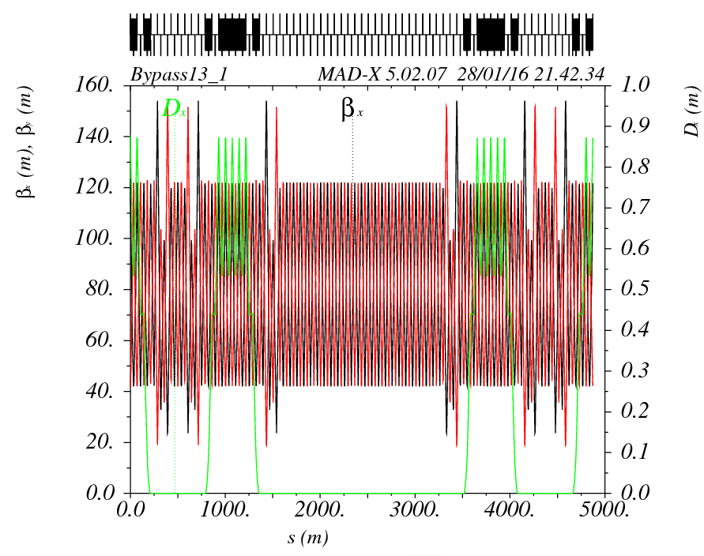
CEPC Booster Bypass at IP1/3 Option1
CEPC PDR Length 3284m
8L_{c}
30L_{c}
2149.8m
8L_{c}
573.28m
573.28m
s
8L_{c}
L=44.9m
8L_{c}
7.8m
8L_{c}
46L_{c}
3296.32m
8L_{c}
573.28m
573.28m
Cell length=71.66m

Slide 9
CEPC Partial Double Ring Layout
B2
B3
B1
614.4m
479.1m
54m
307.2m
Full crossing angle 26mrad
13mrad
7.852m
IP
B6
Septum Dipole
Septum Dipole
1642m
B4
B5
Version 1.0
sufeng
2015.12.20

Slide 10
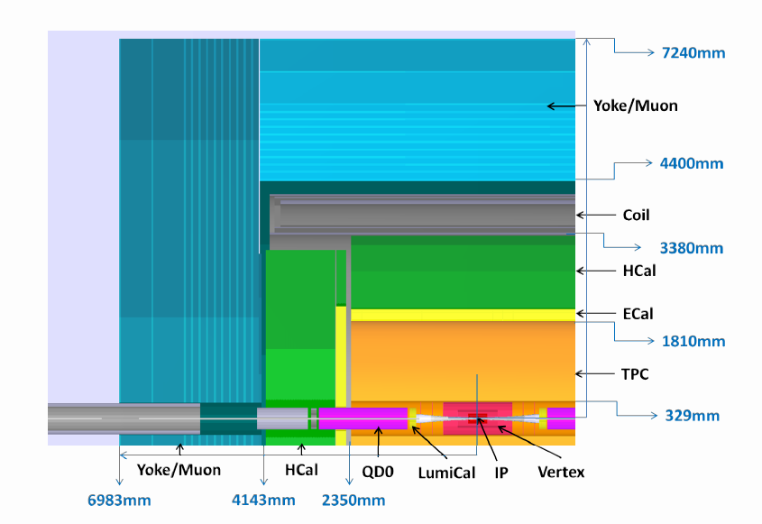
CEPC Detector
From CEPC Pre-CDR Vol1 P146

Slide 11
CEPC Detector
From CEPC Pre-CDR Vol1 P227

Slide 12
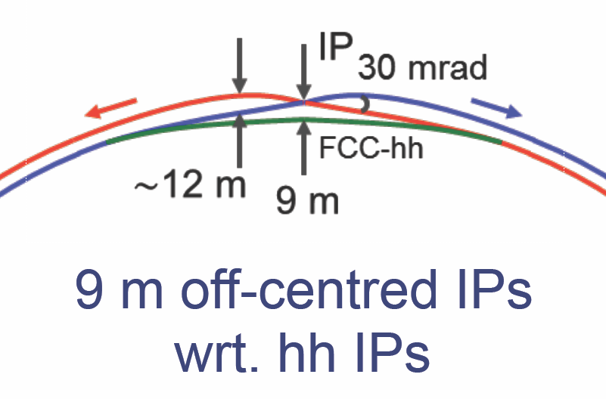
FCC-ee Detector
KatsunobuOide

Slide 13
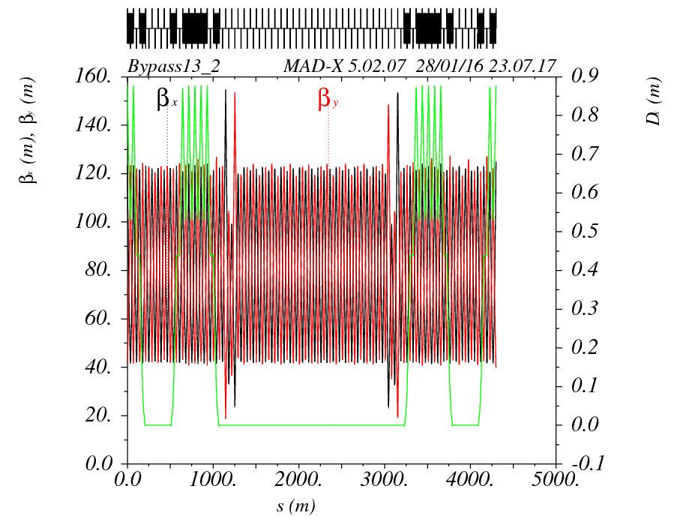
CEPC Booster Bypass at IP1/3 Option2
CEPC PDR Length 3284m
4L_{c}
38L_{c}
2723.08m
4L_{c}
286.64m
286.64m
s
4L_{c}
L=11.25m
4L_{c}
7.8m
4L_{c}
46L_{c}
3296.32m
4L_{c}
286.64m
286.64m
Cell length=71.66m

Slide 14
CEPC Booster Bypass at IP1/3 Option3
B2
B3
B1
614.4m
479.1m
54m
307.2m
Full crossing angle 26mrad
13mrad
7.852m
IP
B6
Septum Dipole
Septum Dipole
1642m
B4
B5
Version 1.0
sufeng
2015.12.20

Slide 15
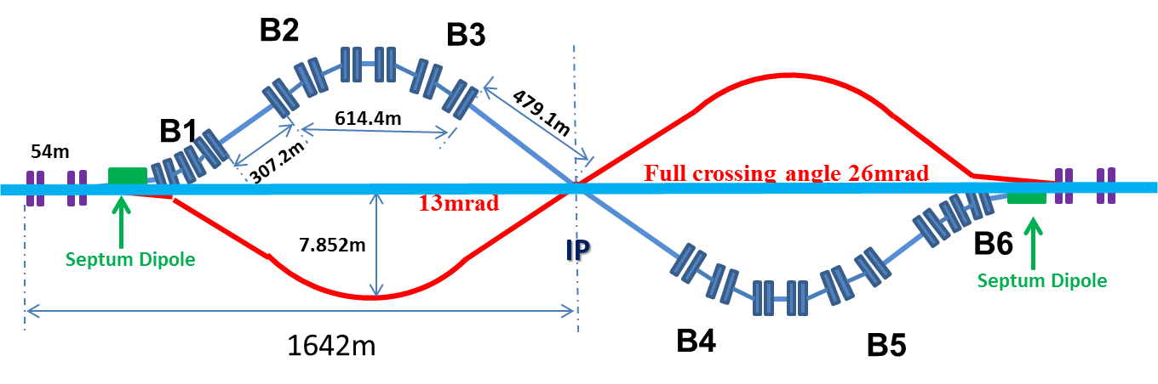
CEPC Booster Bypass at IP1/3 Option4
B2
B3
B1
614.4m
479.1m
54m
307.2m
Full crossing angle 26mrad
13mrad
7.852m
IP
B6
Septum Dipole
Septum Dipole
1642m
B4
B5
俯视
正视

Slide 16
Next

