Slide 1
CEPC software & computing study group report
Xiaomei Zhang
On behalf of CEPC software & computing study group

Slide 2
Content
Study group and organization
Goal and Plan
Status and progress
Demand analysis
Roadmap study, design considerations and Challenges
Strengthen International cooperation

Slide 3
Study group and organization
People joined
Current CEPC software group
IHEP computing center
Shandong University
Sun Yat-sen University
JINR
BESIII offline software group
Have first meeting at the end of 2015
Plan to have a monthly meeting
Welcome more people to join us!

Slide 4
Study goal and topics
Goal
Discuss, investigate and confirm roadmap of CEPC software and computing
Advanced computing and software technology study and practice
Main topics involved
Software framework
Event data model
Software technology
Parallel computing
Status and future trends of GEANT, ROOT and DD4HEP
Future computing technology
Databases
Deep demand analysis of CEPC software and computing
Simulation, reconstruction, analysis software
……

Slide 5
Status and progress
CEPC software
Software framework adopted from ILC
Simulation and other modules are working well on it
Advantages
Quite satisfied with functions for current developments
Disadvantages
Few communities use it
Worry about future supports
CEPC computing resources
No direct funding supports
Resources mainly shared with other experiments in the way of
Local farm
Distributed computing

Slide 6
Demand analysis
R&D phase : data volume evaluation
1PB storage and 2000 CPU cores to support full simulation of 6 months each year
Experiment phase : data volume evaluation
Higgs工厂（0~10年）
原始产生300TB/年，10年积累大约3PB
假设取1*10^6事例，1IP，1MB/event
BESIII数据量（每年）＊3
Z工厂（10~11年）
原始产生至少100PB/年
假设取10^11事例，1IP，0.5MB/event
BESIII数据量（每年）＊1000
Other experiments
BELLEII is going to have 100PB raw data/year （2017年）
LHC is going to have ~500PB raw data/year （Run3, 2020年）
Need more details with software design

Slide 7
Software framework consideration
Use an existing one
vs.
Develop from beginning
Consideration of the choice for CEPC
Enough services and functionalities
Easy to use
Future supports
Almost all widely used frameworks can satisfy our requirements
Several potential candidates are investigated and compared

Slide 8
Framework candidates investigation
Marlin: currently used by CEPC(with uncertain official support)
Gaudi: very popular for collider physics experiments, most familiar to us, very comprehensive but a bit heavy
ROOT: very flexible and powerful, but need more manpower for some service functionalities development
ART: optimized for high intensity physics experiments and a little complex
SNiper: lightweight and optimized for non-collider experiments
 | Marlin | Gaudi | ROOT | ART | SNiPER
User Interface | XML | Python, TXT | Root script | FHiCL | Python
Adoption | ILC | Atlas, BES3, DYB | Phenix, Alice | Mu2e, NOvA, LArSoft, LBNF | JUNO, LHAASO

Slide 9
Computing considerations
It is still far to confirm the computing technology now used for 30 years more
But we believe the technology is evolving step by step
Now the main computing task is to study and follow the latest computing technology to prepare for the future, including
Cloud computing
Distributed computing
Multi-cores computing
High performance computing
Unified distributed data management and access
“Smart” network, high bandwidth future network
…….

Slide 10
Distributed computing(1)
Organize heterogeneous and distributed worldwide computing resources for scientific computing purposes
Distributed computing origins from grid computing
In HEP, distributed computing is becoming main way of resource organization, taking place of one single data center
The success of WLCG contributes a lot

Slide 11
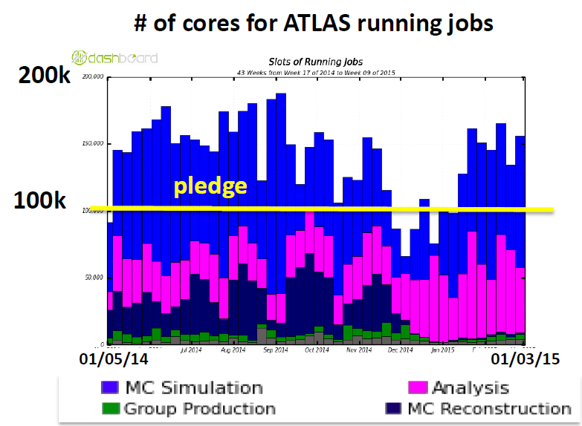
Distributed computing(2)
Current evolution of distributed computing
Tiered computing model becomes more flexible
To optimize resource usage and data access
Various heterogeneous resources (opportunistic resources) are integrated into distributed computing framework
Not only Grid, but also Cluster, Cloud, Volunteer computing……
opportunistic resources are
significantly additional to the
pledged one
50% Atlas production use
opportunistic resources

Slide 12
Distributed computing(3)
Distributed data management becomes more flexible and automatic
Global data federation based on xrootd makes data accessible anywhere
Automatic global data placement tools makes use of data storage more reasonable and efficiency

Slide 13
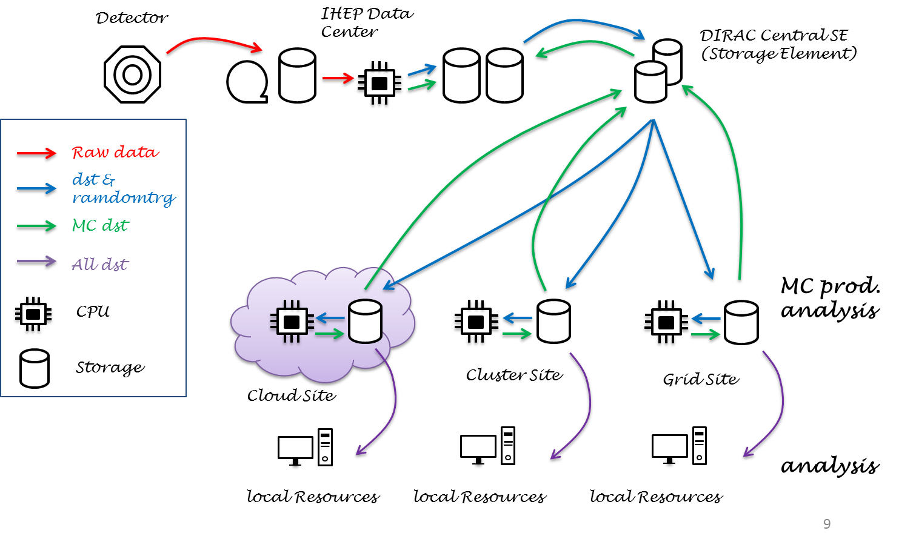
Distributed computing(4)
Data volume of future CEPC is comparable to LHC
Distributed computing is one of the ways we must think about
The prototype of CEPC distributed computing has already set up
It is working for current CEPC R&D phrase
It is small scale, but it is a start for us to look into distributed computing technology

Slide 14
Virtualization and Cloud computing(1)
It is a trend to use cloud for large scale resource management
CERN computing center has already migrated into “virtualization” era
125000 cores have been managed by VMs in 2015, in 2016 will extend to 190000 and more
Many other US and Europe communities use cloud
Cloud federation used to integrate distributed cloud has been a hot study topic now
Could take place of grid in future?
Commercial cloud received more and more concerns from HEP
It is estimated that the HEP data processing is only 1% of commercial cloud problems
Using commercial cloud to meet the requirement peak has become popular

Slide 15
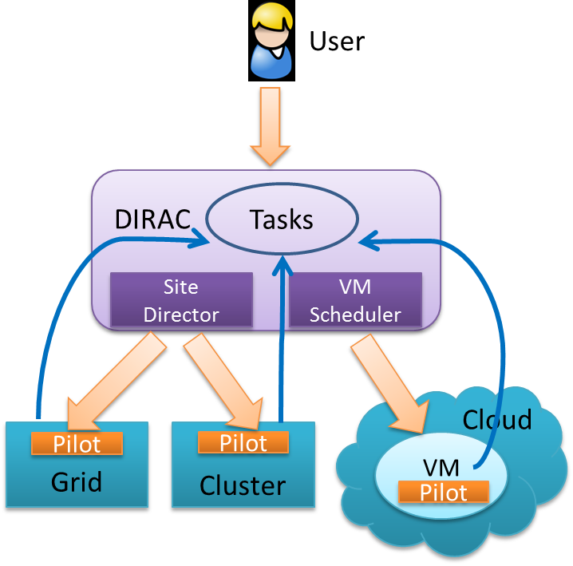
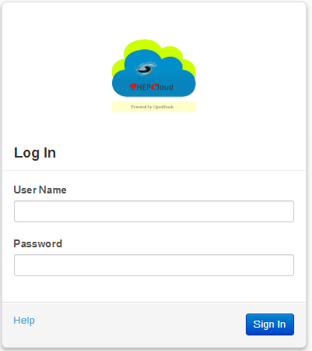
Virtualization and Cloud computing(2)
IHEP computing center has already started cloud study and set up production system
Cloud activities involved:
Distributed computing integrate collaboration cloud and commercial cloud
OpenStack based Cloud platform
Virtual farms to flexibly use cloud resources

Slide 16
Challenges
Software and computing is evolving very rapidly
Lack of man power
Lack of funding

Slide 17
Strengthen international cooperation
Establish relationships with international organizations
HEP software foundation
DIRAC consortium
Take part in conferences
CHEP
Hepix
Cooperate with international HEP experiments
LHC, BELLEII
Involved in the development of advanced technology

