Slide 1
Exotic Charmonium at BESIII
蔡浩
hcai@whu.edu.cn
中国物理学会高能物理分会第十二届全国粒子物理学术会议，合肥，2016

Slide 2
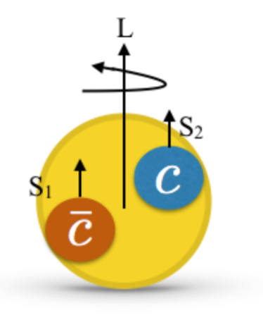
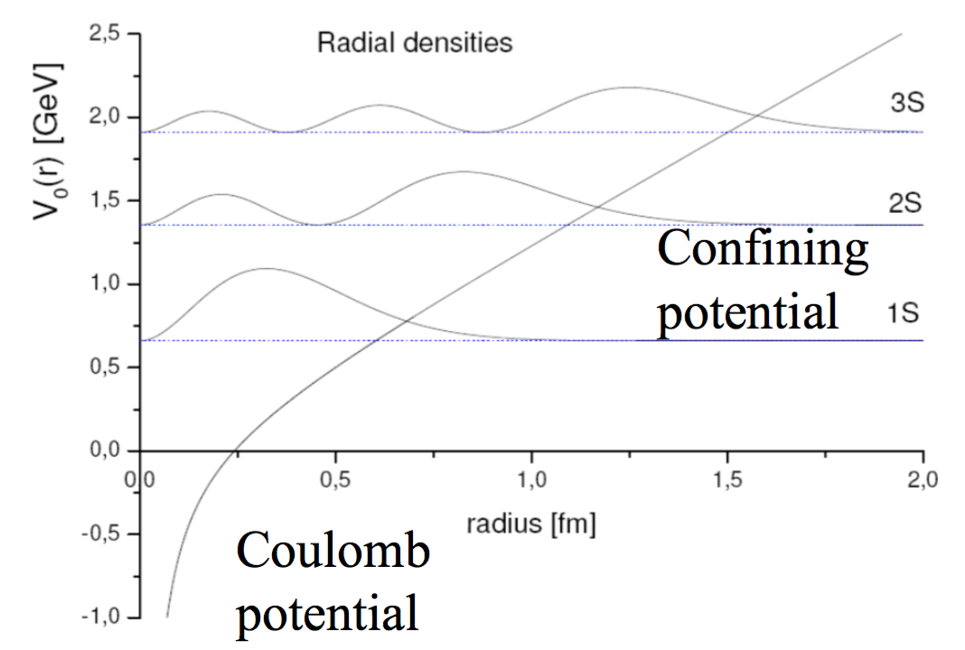
Charmonium
$$Ψ(4^{3}S_{1})$$
$$η_{c}(4^{1}S_{0})$$
$$h_{c}(3^{1}P_{1})$$
$$χ_{c2}(3^{3}P_{2})$$
$$χ_{c1}(3^{3}P_{1})$$
$$χ_{c0}(3^{3}P_{0})$$
Charmonium physics
Potential mode succeeds for many years!
$$Ψ(2^{3}D_{1})$$
$$η_{c}(3^{1}S_{0})$$
$$Ψ(3^{3}S_{1})$$
$$h_{c}(2^{1}P_{1})$$
$$χ_{c2}(2^{3}P_{2})$$
$$χ_{c2}(2^{3}P_{2})$$
MASS [$GeV/c^{2}$]
$$Ψ′′(1^{3}D_{1})$$
$$χ_{c0}(2^{3}P_{0})$$
$$η_{c}′(2^{1}S_{0})$$
$$Ψ′(2^{3}S_{1})$$
$$h_{c}(1^{1}P_{1})$$
$$χ_{c1}(1^{3}P_{1})$$
$$χ_{c2}(1^{3}P_{2})$$
$$χ_{c0}(1^{3}P_{0})$$
predicted, discovered
$$J/Ψ(1^{3}S_{1})$$
predicted, undiscovered
$$η_{c}(1^{1}S_{0})$$
$$J^{PC}$$
$$0^{−+}$$
$$1^{−−}$$
$$1^{+−}$$
$$0^{++}$$
$$1^{++}$$
$$2^{++}$$
Prediction: Barnes, Swanson, and Godfrey, PRD 72, 054026 (2005)

Slide 3
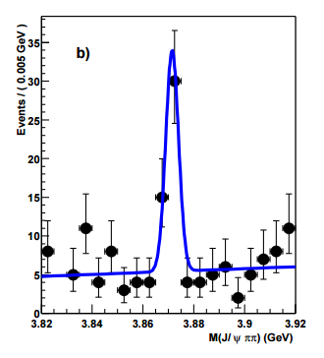
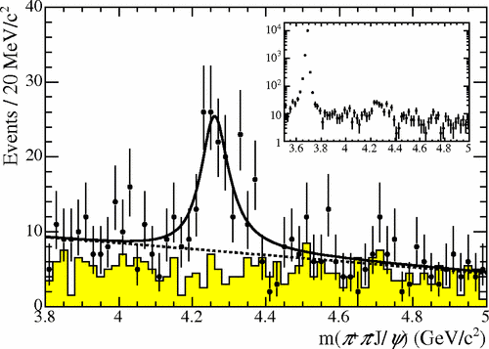
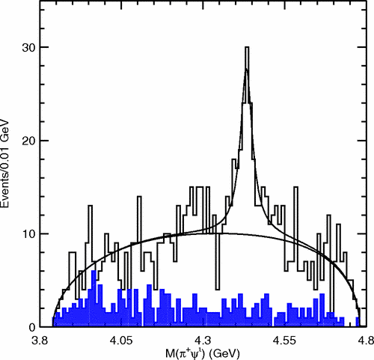
Exotic Charmonium
The observation of X(3872) at Belle
X(3915), X(4940), Y(4360), Y(4660), Z(4050), ... ...
Characteristics of exotic charmonium
Strong coupling to hidden-charm states
Narrow resonance
Charged states can’t be assigned as conventional charmonium
Can’t be assigned as conventional charmonium
PRL 91, 262001(2003)
PRL 95, 142001(2005)
PRL 100, 142001(2008)
X(3872)
Y(4260)
$$Z{\left(4430\right)}^{±}$$

Slide 4
Situation of XYZ physics before 2013
$$Z_{c}^{±}(4430)$$
$$Ψ(4^{3}S_{1})$$
$$η_{c}(4^{1}S_{0})$$
Y(4360)
$$h_{c}(3^{1}P_{1})$$
$$χ_{c2}(3^{3}P_{2})$$
Y(4260)
$$χ_{c1}(3^{3}P_{1})$$
$$χ_{c0}(3^{3}P_{0})$$
$$Ψ(2^{3}D_{1})$$
$$η_{c}(3^{1}S_{0})$$
$$Ψ(3^{3}S_{1})$$
$$h_{c}(2^{1}P_{1})$$
$$χ_{c2}(2^{3}P_{2})$$
$$χ_{c2}(2^{3}P_{2})$$
At BESIII, Y(4260) can be produced directly!
At BESIII, Y(4260) can be produced directly!
$$X(3872)$$
MASS [$GeV/c^{2}$]
$$Ψ′′(1^{3}D_{1})$$
$$χ_{c0}(2^{3}P_{0})$$
$$η_{c}′(2^{1}S_{0})$$
$$Ψ′(2^{3}S_{1})$$
$$h_{c}(1^{1}P_{1})$$
$$χ_{c1}(1^{3}P_{1})$$
$$χ_{c2}(1^{3}P_{2})$$
$$χ_{c0}(1^{3}P_{0})$$
predicted, discovered
$$J/Ψ(1^{3}S_{1})$$
predicted, undiscovered
$$η_{c}(1^{1}S_{0})$$
unpredicted, discovered
$$J^{PC}$$
$$0^{−+}$$
$$1^{−−}$$
$$1^{+−}$$
$$0^{++}$$
$$1^{++}$$
$$2^{++}$$
Prediction: Barnes, Swanson, and Godfrey, PRD 72, 054026 (2005)

Slide 5
Data 4~4.6 GeV for XYZ study at BESIII
From 2013, BESIII start to operate at $\sqrt{S}>4.0GeV$ for XYZ physics
Data taking this year
CPC 39, 093001 (2015)
CPC 40, 063001 (2016)
4180

Slide 6
The Z states
Charged exotic states
Observed via $π$ transition at BESIII

Slide 7
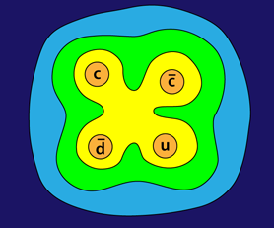
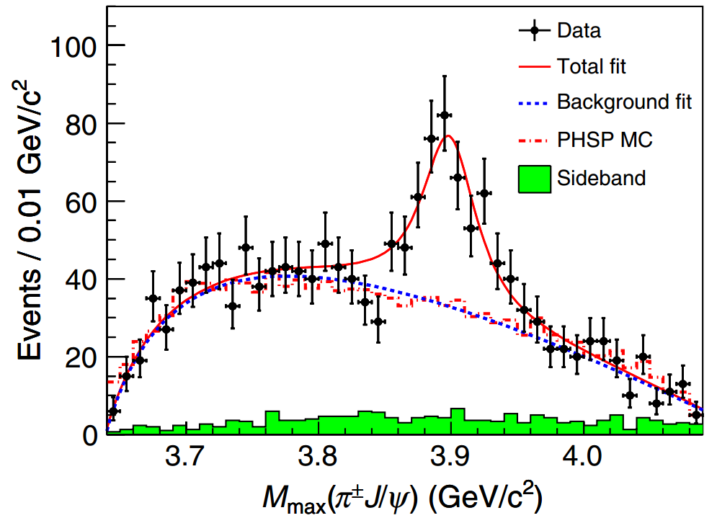
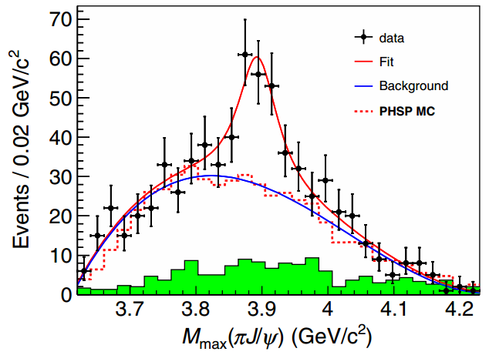
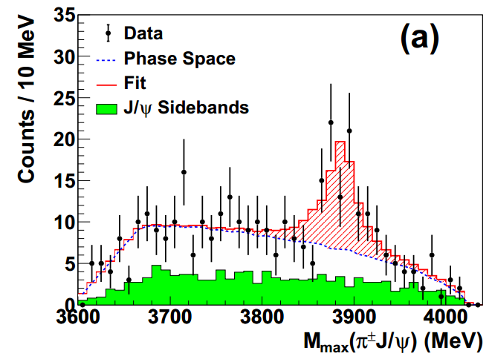
Discovery of $Z_{C}^{±}(3900)$ in $e^{+}e^{−}→π^{+}π^{−} J/ψ$
In 2013, A new charged charmonium- like state, named Zc(3900), is observed at BESIII, Belle and CLEO-c experiments.
PRL 110, 252001 (2013)
PRL 110, 252002 (2013)
T. Xiao et al., PLB 727, 366 (2013)
$$M=\left(3899.0±3.6±4.9\right) MeV \\ Γ=\left(46±10±20\right) MeV$$
$$M=\left(3894.5±6.6±4.5\right) MeV \\ Γ=\left(63±24±26\right) MeV$$
$$M=\left(3886±6±4\right) MeV \\ Γ=\left(33±6±7\right) MeV$$
Notes:
(1) This structure couples to charmonium and has an electric charge, which is suggestive of a state containing more quarks than just a charm and anti-charm quark.

Slide 8
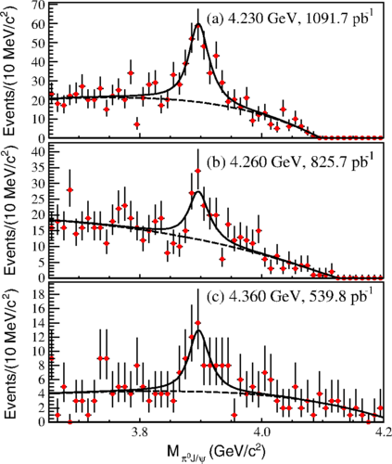
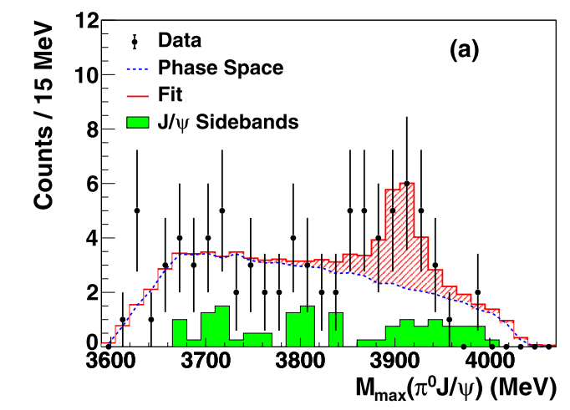
Discovery of $Z_{c}^{0}(3900)$ in $e^{+}e^{−}→π^{0}π^{0} J/ψ$
PRL 115, 112003(2013)
Evidence of neutral isospin partner of $Z_{c}^{±}(3900)$ is observed in $e^{+}e^{−}→π^{0}π^{0}J/ψ$
Isospin triplet is established
T. Xiao et al., PLB 727, 366 (2013)
$$3.7σ$$
$$M=\left(3886±6±4\right) MeV \\ Γ=\left(33±6±7\right) MeV$$
$$M=\left(3894.8±2.3±3.2\right) MeV \\ Γ=\left(29.6±8.2±8.2\right) MeV$$

Slide 9
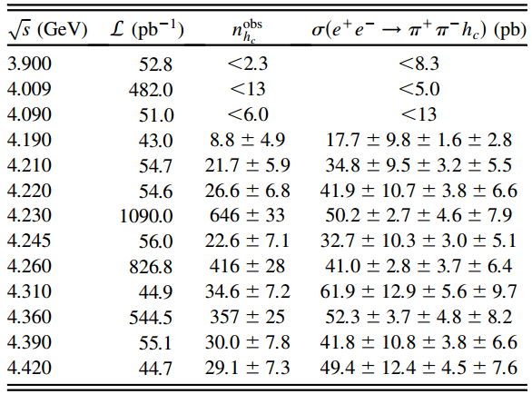
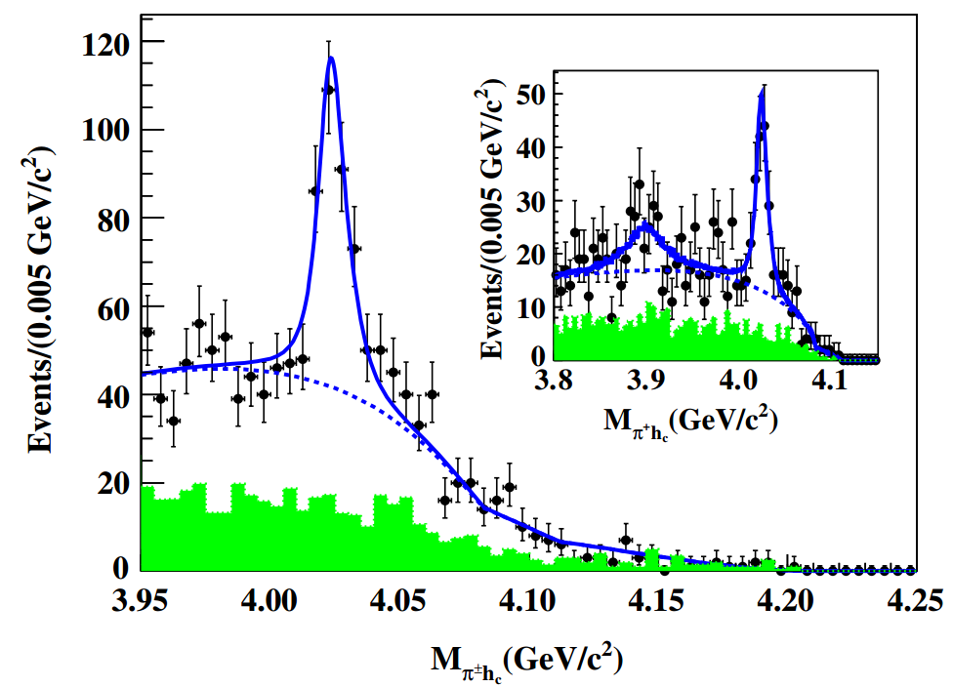
Discovery of $Z_{c}^{±}(4020)$ in $e^{+}e^{−}→π^{+}π^{−}h_{c}$
No sharp structure in $π^{+}π^{−}h_{c}$ section, correlation with Y(4260) or Y(4360) unclear
Narrow $π^{±}h_{c}$ structure observed
No significance for $Z_{c}\left(3900\right)→π^{±}h_{c}$
PRL 111, 242001 (2013)
8.9$σ$
2.1$σ$
@ 4260 MeV
$M=(4023±3) MeV$
$Γ=\left(8±4\right) MeV$
$σ\left(e^{+}e^{−}→π^{±}Z_{c}^{∓}\left(3900\right)→π^{+}π^{−}h_{c}\right)<11 pb$ @90% C.L.
Notes:
In the ±hc mass spectrum, a distinct structure, referred to as Zc(4020), is observed at 4.02 GeV/c2. The Zc(4020) carries an electric charge and couples to charmonium. A fit to the ±hc invariant mass spectrum, neglecting possible interferences, results in a mass of (4022.9 ± 0.8 ± 2.7) MeV/c2 and a width of (7.9 ± 2.7 ± 2.6) MeV for the Zc(4020)
This structure couples to charmonium and has an electric charge, which is suggestive of a state containing more quarks than just a charm and an anti-charm quark, as the Zc(3900) observed in the ±J/ system

Slide 10
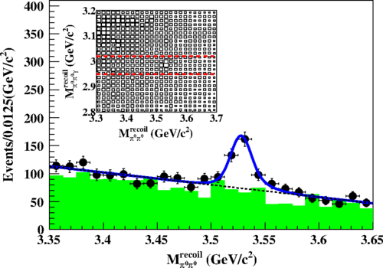
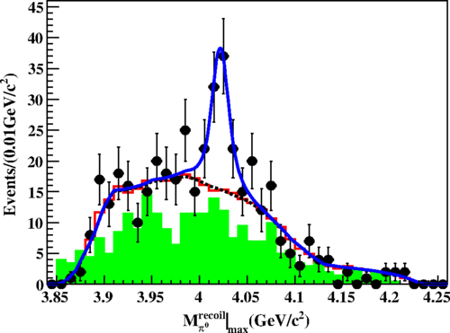
Discovery of $Z_{c}^{0}(4020)$ in $e^{+}e^{−}→π^{0}π^{0}h_{c}$
Using data collected @4.23, 4.26 and 4.36 GeV to study $e^{+}e^{−}→π^{0}π^{0}h_{c}$
The Born cross sections are found be about half of those of $e^{+}e^{−}→π^{+}π^{−}h_{c}$
Evidence of neutral isospin partner of $Z_{c}^{±}(4020)$
PRL 113, 212002(2013)
$$M=\left(4023.6±2.2±3.9\right) MeV$$
Width is fixed to that of $Z_{c}{\left(4020\right)}^{±}$

Slide 11
Study of open charm decays
Zc(3900) is just ~$20MeV/c^{2}$ above the $D{\overline{D}}^{∗}$ mass threshold.
Zc(4020) is also slightly higher than the threshold of $D^{∗}{\overline{D}}^{∗}$
One natural explanation is that these Z states are S-wave $D{\overline{D}}^{∗}$ and $D^{∗}{\overline{D}}^{∗}$ molecular states
Investigation of open charm decays of Z may be helpful!
$$D/D^{∗}$$
$${\overline{D}}^{∗}$$
$$e^{+}$$
$$e^{−}$$
$$π$$

Slide 12
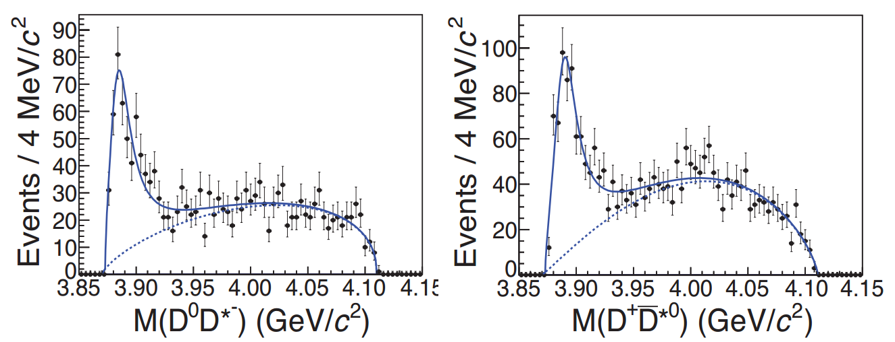
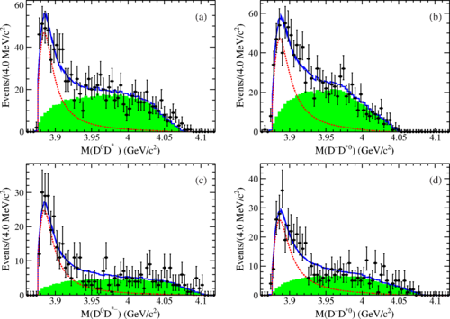
Discovery of $Z_{c}{\left(3885\right)}^{±}$ in $e^{+}e^{−}→π^{±}{\left(D{\overline{D}}^{∗}\right)}^{∓}$
$Z_{c}(3885)$ is observed in the $D{\overline{D}}^{∗}$ invariant mass
If $Z_{c}(3885)$ is $Z_{c}\left(3900\right)$, the ratio of partial decay widths is $\frac{Γ(Z_{c}\left(3900\right)→D{\overline{D}}^{∗})}{Γ(Z_{c}\left(3900\right)→πJ/Ψ)}=6.2±2.9$ much smaller than that of conventional charmonium states
PRL 112, 022001 (2013)
PRD 92, 092006 (2015)
$M=(3883.9±1.5±4.2) MeV$
$Γ=(24.8±3.3±11.0) MeV$
$M=(3881.7±1.6±1.6) MeV$
$Γ=(26.6±2.0±2.1) MeV$
Single D tag method
Double D tag method
Notes:
A peculiar feature is the absence of any apparent corresponding structure in the cross sections for e+e− → D(∗) ¯D(∗)(π) in the √s = 4260 MeV energy region
the ratio of partial decay widths is determined to be
This ratio is much smaller than typical values for decays of conventional charmonium states above the open charm threshold.
This suggests the influence of very different dynamics in the Y (4260)-Zc(3900) system.
A JP quantum number determination of the Zc(3900)± would provide an additional test of this possibility.

Slide 13
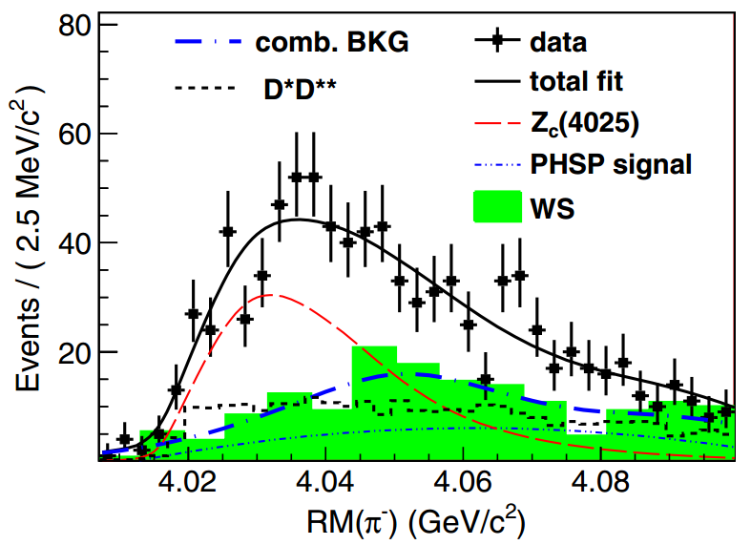
Discovery of $Z_{c}{\left(4025\right)}^{±}$ in $e^{+}e^{−}→π^{±}{\left(D^{∗}\overline{D^{∗}}\right)}^{∓}$
PRL 112, 132001 (2014)
Deviation from phase space decay; Described by a charged state $Z_{c}^{±}(4025)$ decaying to $D^{∗}\overline{D^{∗}}$
If $Z_{c}^{±}(4025)$ is the $Z_{c}^{±}(4020)$ observed in the $π^{±}h_{c}$ spectrumthe, the ratio of partial decay widths is $\frac{Γ(Z_{c}\left(4020\right)→D^{∗}\overline{D^{∗}})}{Γ(Z_{c}\left(4020\right)→πh_{c})}=12±5$
13$σ$
$M=(4026.3±2.6±3.7) MeV$
$Γ=(24.8±6.0±1.0) MeV$
Notes:
the ratio of partial decay widths is determined to be
To validate the establishment of the Zc(4025), a rigorous spin analysis is required based on a larger data sample.

Slide 14
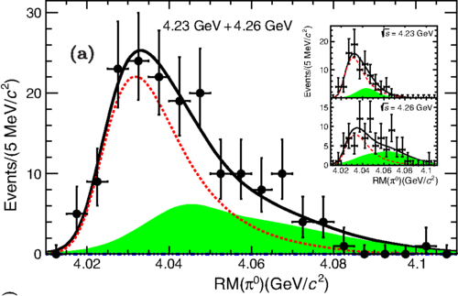
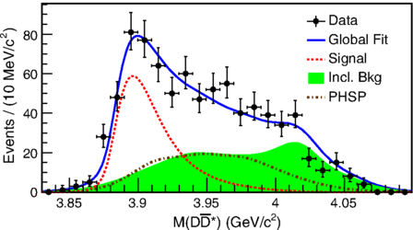
Neutral partners of $Z_{c}{\left(3885\right)}^{±}$ and $Z_{c}{\left(4025\right)}^{±}$
As expected, neutral $Z_{c}{\left(3885\right)}^{0}$ and $Z_{c}{\left(4025\right)}^{0}$ are also observed in the $D{\overline{D}}^{∗}$ and $D^{∗}{\overline{D}}^{∗}$system.
PRL 115, 222002(2015)
PRL 115, 182002(2015)
$$Z_{c}{\left(3885\right)}^{0}$$
$$Z_{c}{\left(4025\right)}^{0}$$
$$M=\left({3885.7}_{−5.7}^{+4.3}±8.4\right)MeV/c^{2}$$
$$Γ=\left({35}_{−12}^{+11}±15\right)MeV$$
$$M=\left({4025.5}_{−4.7}^{+2.0}±3.1\right)MeV/c^{2}$$
$$Γ=\left(23.0±6.0±1.0\right)MeV$$

Slide 15
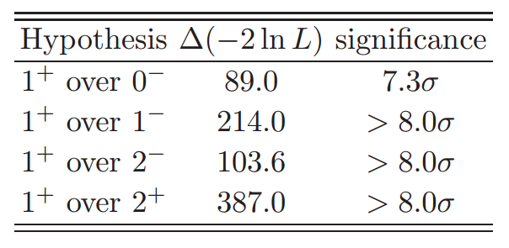
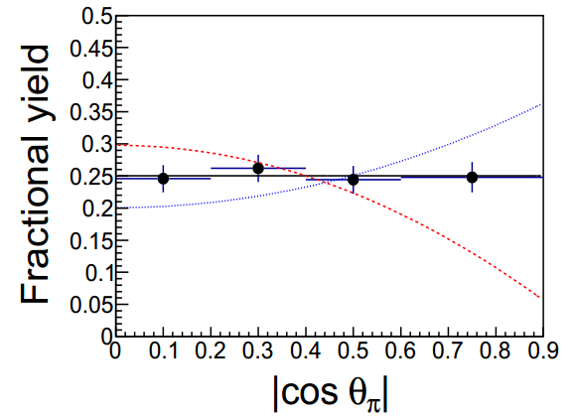
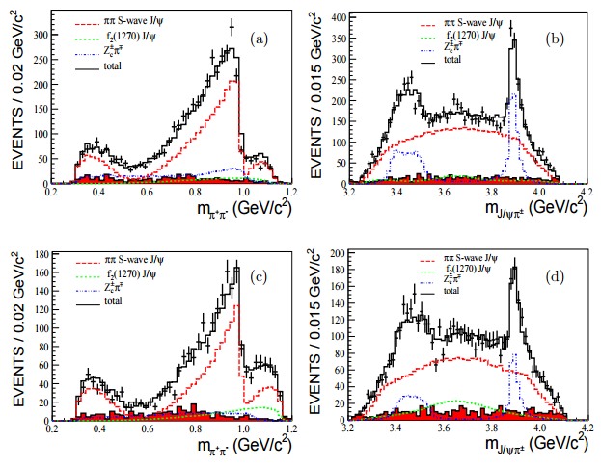
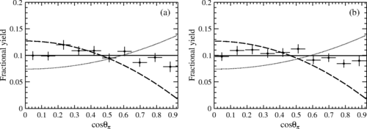
Summary of Z - $J^{P}$
BESIII preliminary
Both Zc(3900) and Zc(3885) favor $J^{P}=1^{+}$
PRL 112, 022001 (2013)
$$Z_{c}(3885)$$
PRD 92, 092006 (2015)
$$Z_{c}(3885)$$
$$Z_{c}(3885)$$

Slide 16
Search for $Z_{c}{\left(3900\right)}^{±}→ωπ^{±}$
$Z_{c}{\left(3900\right)}^{±}→ωπ^{±}$ is searched @4.23 and 4.26 GeV
No significant signal is found
PRD 92, 032009 (2015)

Slide 17
The X states
Neutral charmonium-like/exotic states
Searched by photon/hadron transition at BESIII

Slide 18
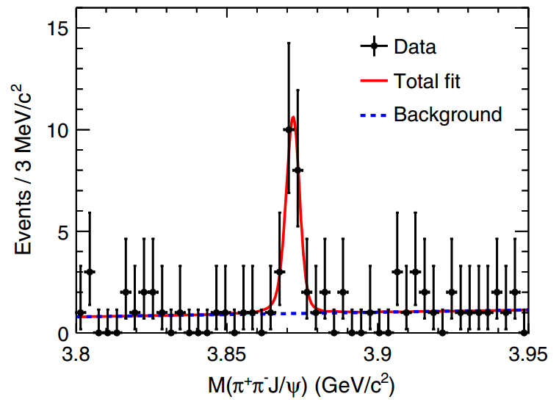
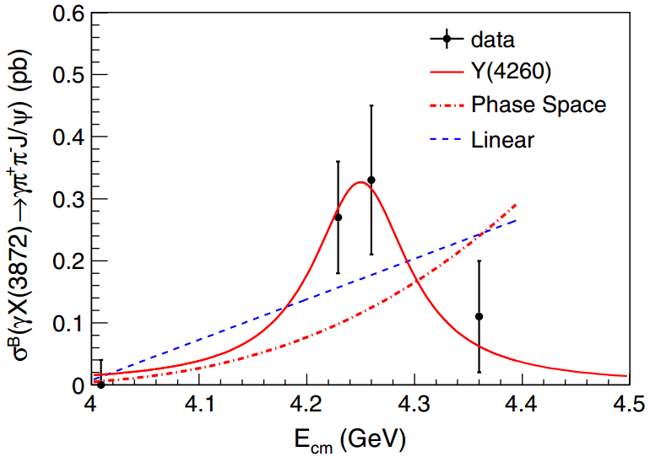
Observation of $e^{+}e^{−}→γX\left(3872\right)$
Search for $γX\left(3872\right)$ with $X\left(3872\right)→π^{+}π^{−}J/Ψ$ at $E_{cm}=4.23, 4.26 and 4.36 GeV$
$6.3σ$ over all data
Production in Y(4260) is suggestive, but not conclusive $\frac{B(e^{+}e^{−}→γX\left(3872\right))}{B(e^{+}e^{−}→π^{+}π^{−}J/Ψ)}≈0.1$
Measuring transitions between states is essential
PRL 112, 092001 (2014)
$$M\left(3872\right)=\left(3871.9±0.7±0.2\right) MeV$$
$$Γ<2.4 MeV$$
Notes:
under the assumption that the Xð3872Þ is produced only from the Yð4260Þ radiative decays and the πþπ−J=ψ is only from the Yð4260Þ hadronic decays.

Slide 19
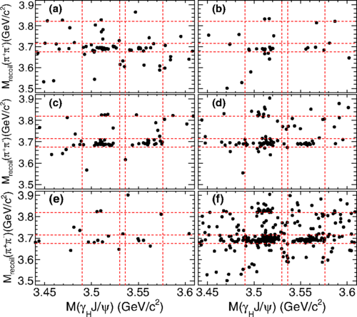
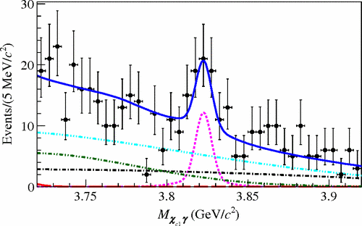
Observation of X(3823)
Using full Belle data set of $772×{10}^{6} B\overline{B}$ events $B→χ_{c1}γK$
Five large data sets @BESIII ($\sim 4.1fb^{−1}$) used, $e^{+}e^{−}→π^{+}π^{−}γχ_{c1}$
PRL 115, 011803 (2015)
PRL 111, 032001 (2013)
4.23 GeV
4.26 GeV
4.36 GeV
4.42 GeV
X(3823)
$$ψ(3686)$$
$$M=\left(3823.1±1.8±0.7\right) MeV$$
4.60 GeV
Sum
$$χ_{c1}$$
$$χ_{c2}$$

Slide 20
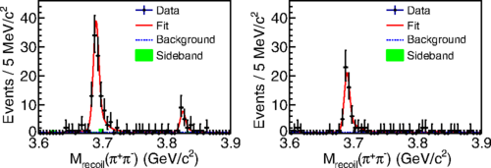
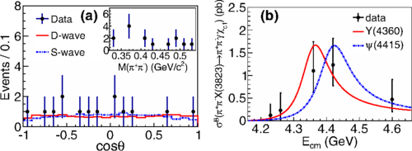
Observation of X(3823)
PRL 115, 011803 (2015)
A simultaneous fit of different data sets
Significance is 6.7σ, observation!
Mass and narrow width agree with potential model prediction for $ψ(1^{3}D_{2})$
Both Y(4360) and $ψ(4415)$ lineshape give reasonable description
6.7$σ$
$$M=\left(3821.7±1.3±0.7\right) MeV$$
$Γ<16 MeV$ @90% C.L. Consistent with Belle

Slide 21
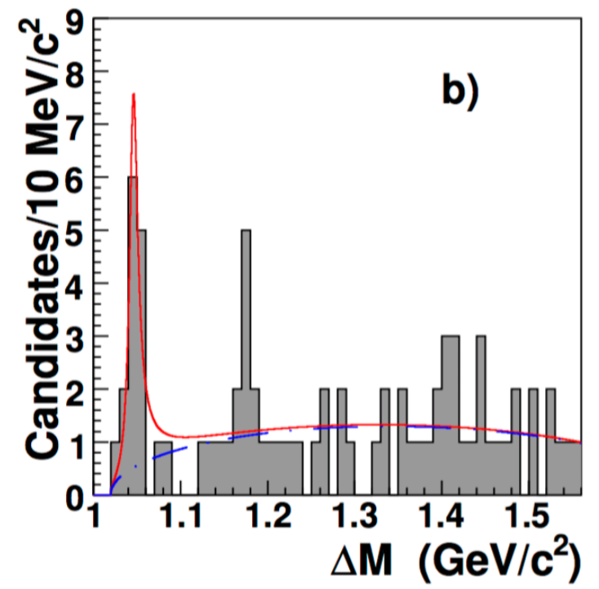
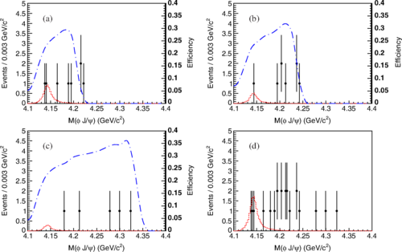
Search for X(4140)
CDF first reported evidence for $X\left(4140\right)→J/ψφ$ in $B^{+}→J/ψφK^{+}$, also claimed by D0 and CMS. Not seen by LHCb, Belle (B decays and γγ events), or BABAR
At BESIII, no significant signal is observed via $e^{+}e^{−}→γφJ/ψ$ @4.23, 4.26 and 4.36 GeV
PRD 102, 242002(2009)
PRD 91, 032002 (2015)
4.23 GeV
4.26 GeV
4.36 GeV
Sum

Slide 22
The Y states
Can be directly produced in $e^{+}e^{−}$ annihilation
Not be seen from the inclusive hadronic cross section (R-scan): measure exclusive hadronic cross section at BESIII

Slide 23
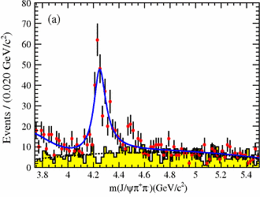
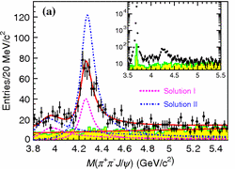
Cross section of $e^{+}e^{−}→π^{+}π^{−}J/ψ$
BESIII preliminary
BESIII result is inconsistent with a single peak for Y(4260)
The check of Y(4008) needs more data
Y(4008)?
PRL 95, 142001 (2005)
PRD 86, 051102(2012)
PRL 110, 252002(2013)
Y(4008)?

Slide 24
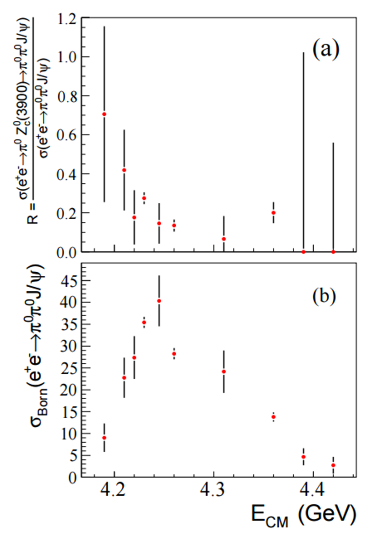
Cross section of $e^{+}e^{−}→π^{0}π^{0}J/ψ$
PRL 115, 112003(2015)
$σ(ee→π^{0}π^{0}J/ψ)$ is about half of $σ(ee→π^{+}π^{−}J/ψ)$
Y(4260) is not significant
Maximum cross section is around 4.23GeV
Rich Y states/structures between 4.2~4.3GeV

Slide 25
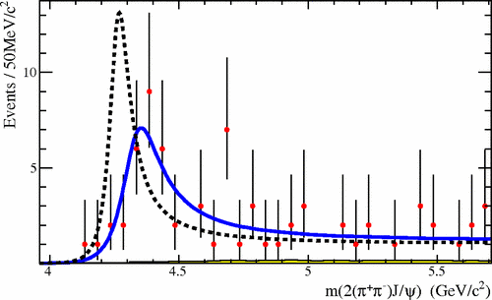
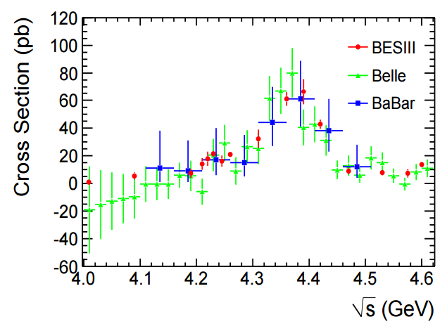
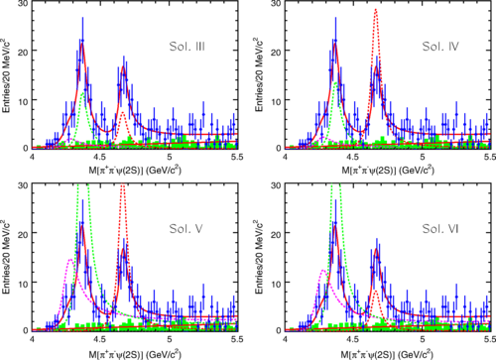
Cross section of $e^{+}e^{−}→π^{+}π^{−}ψ(3686)$
PRL 98, 212001 (2007)
BESIII confirms the lineshape for the Y(4360)
No evidence for $Y\left(4260\right)→π^{+}π^{−}ψ(3686)$
BESIII preliminary
PRD 91, 112007(2015)

Slide 26
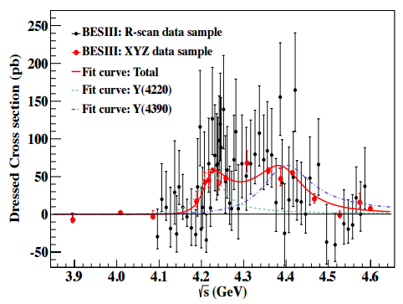
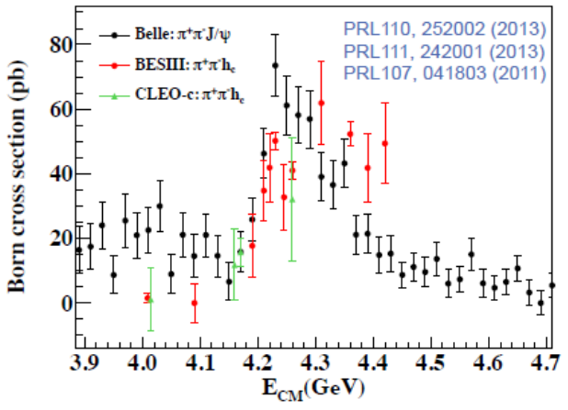
Cross section of $e^{+}e^{−}→π^{+}π^{−}h_{c} and π^{0}π^{0}h_{c}$
$ππh_{c}$ line shape is clearly different from the $ππJ/ψ$ shape
$ππh_{c}$ shape appears to be consistent with two peaks
Born cross section of $ee→π^{0}π^{0}h_{c}$ is about half of $ee→π^{+}π^{−}h_{c}$
PRL 113, 212002 (2014)
BESIII preliminary

Slide 27
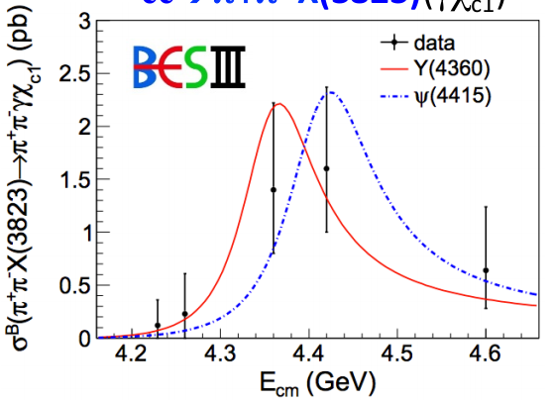
Cross section of $e^{+}e^{−}→X+(ππ, γ)$
$e^{+}e^{−}→γX\left(3872\right)→γππ J/ψ$
Data suggests $Y\left(4260\right)→γX(3872)$
$e^{+}e^{−}→π^{+}π^{−}X\left(3823\right)→π^{+}π^{−}γχ_{c1}$
Data can not distinguish Y(4360) and $ψ(4415)$
PRL 112, 092001 (2014)
PRL 115, 011803 (2015)

Slide 28
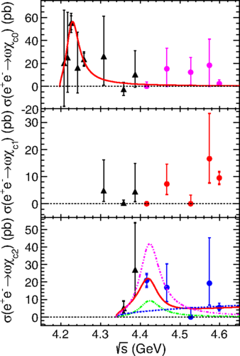
Cross section of $e^{+}e^{−}→ωχ_{cJ}$
PRL 114, 092003(2015)
PRD 93, 011102 (2016)
$$M=\left(4226±8±6\right) MeV$$
$$Γ=\left(39±12±2\right) MeV$$
A new structure?
$ψ(4S)$? EPJC 74, 3208(2014)
Tetraquark? PRD 91, 117501(2015)
Threshold effect?
Inconsistent with Y(4260)
No significant $ee→ωχ_{c1}$
Can be described by $ψ(4415)$

Slide 29
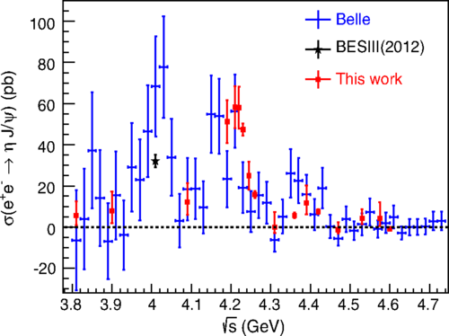
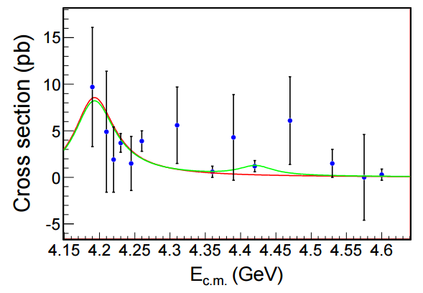
Cross section of $e^{+}e^{−}→η/{η^{′}} J/ψ$
Agree with previous results with improved precision
$ψ\left(4160\right)→η J/ψ$
Fit with $ψ(4160)$ and $ψ(4415)$
$σ(η^{′}J/ψ)$ much lower than $σ(η J/ψ)$ that is different from NRQCD calculation
PRD 91, 112005 (2015)
arXiv: 1605.03256
$ψ(4160)$
$$ψ(4415)$$

Slide 30
Summary
BESIII produces significant XYZ results …
Many neutral Zc partners are observed, the corresponding isospin triplets are established.
X and Y states are difficult to distinguish from normal meson.
Quark composition is still puzzling.
Data are needed to shed light on these puzzles!
Thank you （谢谢）！

Slide 31
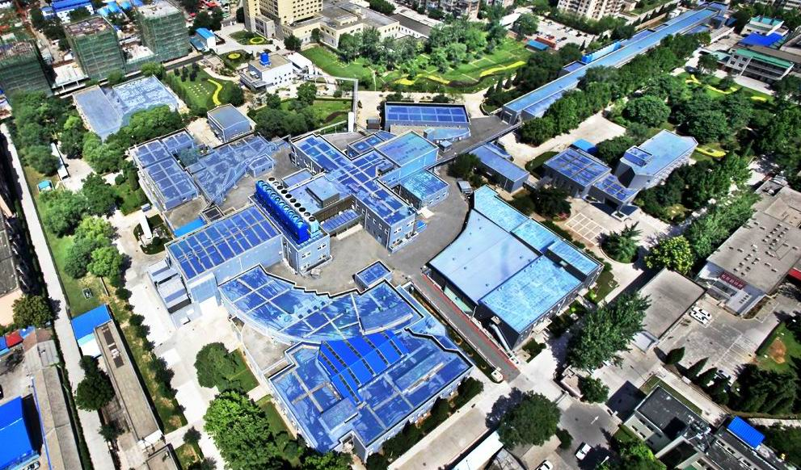
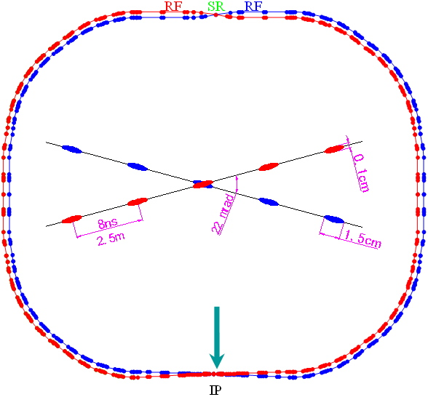
BEPCII
Beam energy range | 1~2.3 GeV
Optimized beam energy region | 1.89 GeV
Current of each beam in collision | 0.93 A
Design luminosity | ${10}^{33}cm^{−2}s^{−1}$
Beam lifetime | 2.7 hrs
SR mode | 0.25 A@2.5 GeV
Notes:
At the interaction point, the crossing angle is 22 mrad and the bunches are spacing of 8 ns
BEPC II is a two-ring e+e- collider running in the tau-charm energy region (Ecm = 2.0-4.2 GeV)

Slide 32
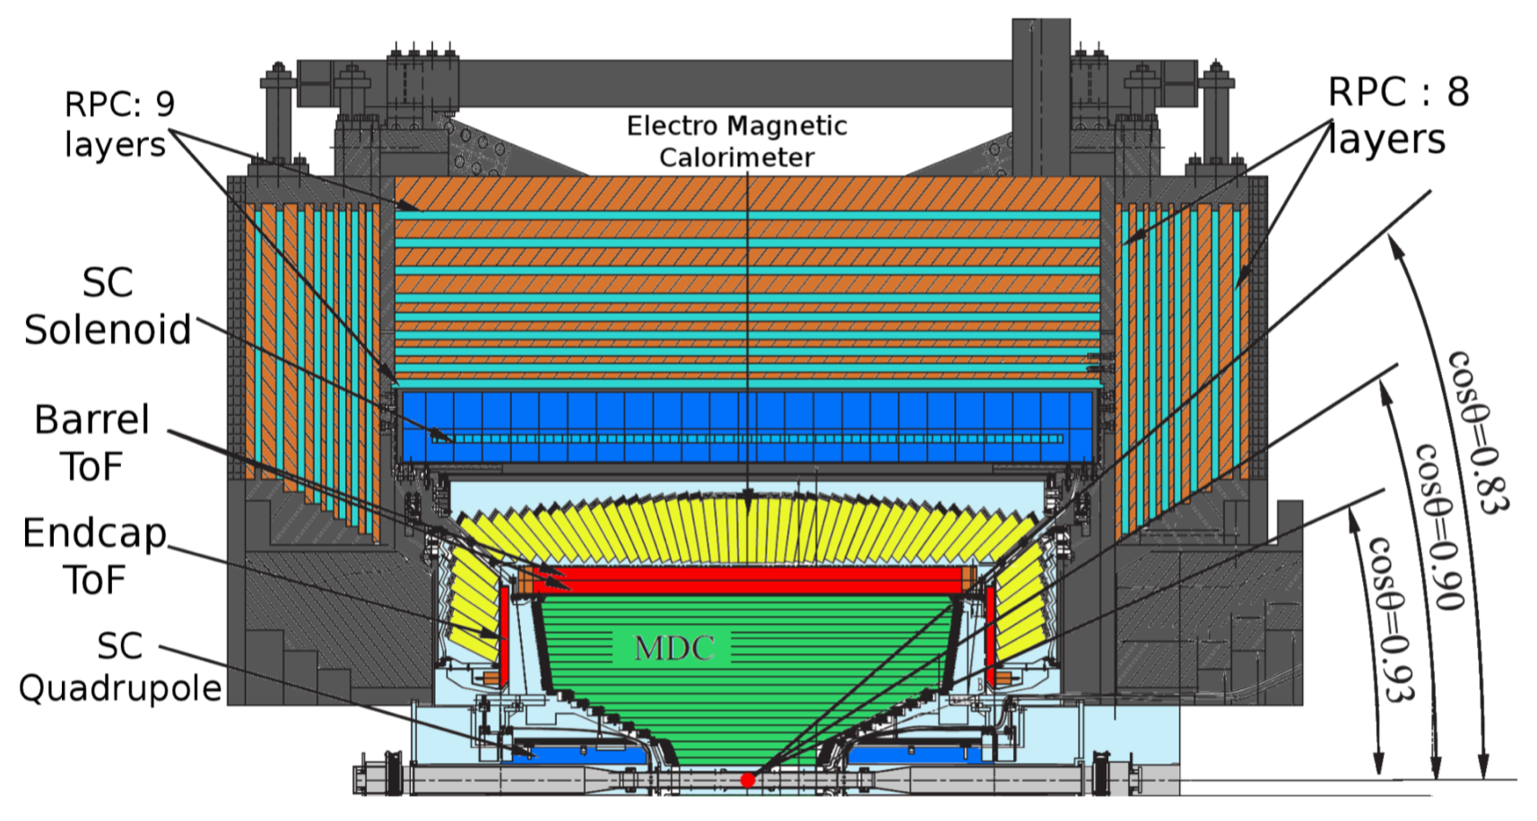
BESIII
Beijing Spectrometers III (BESIII)

Slide 33
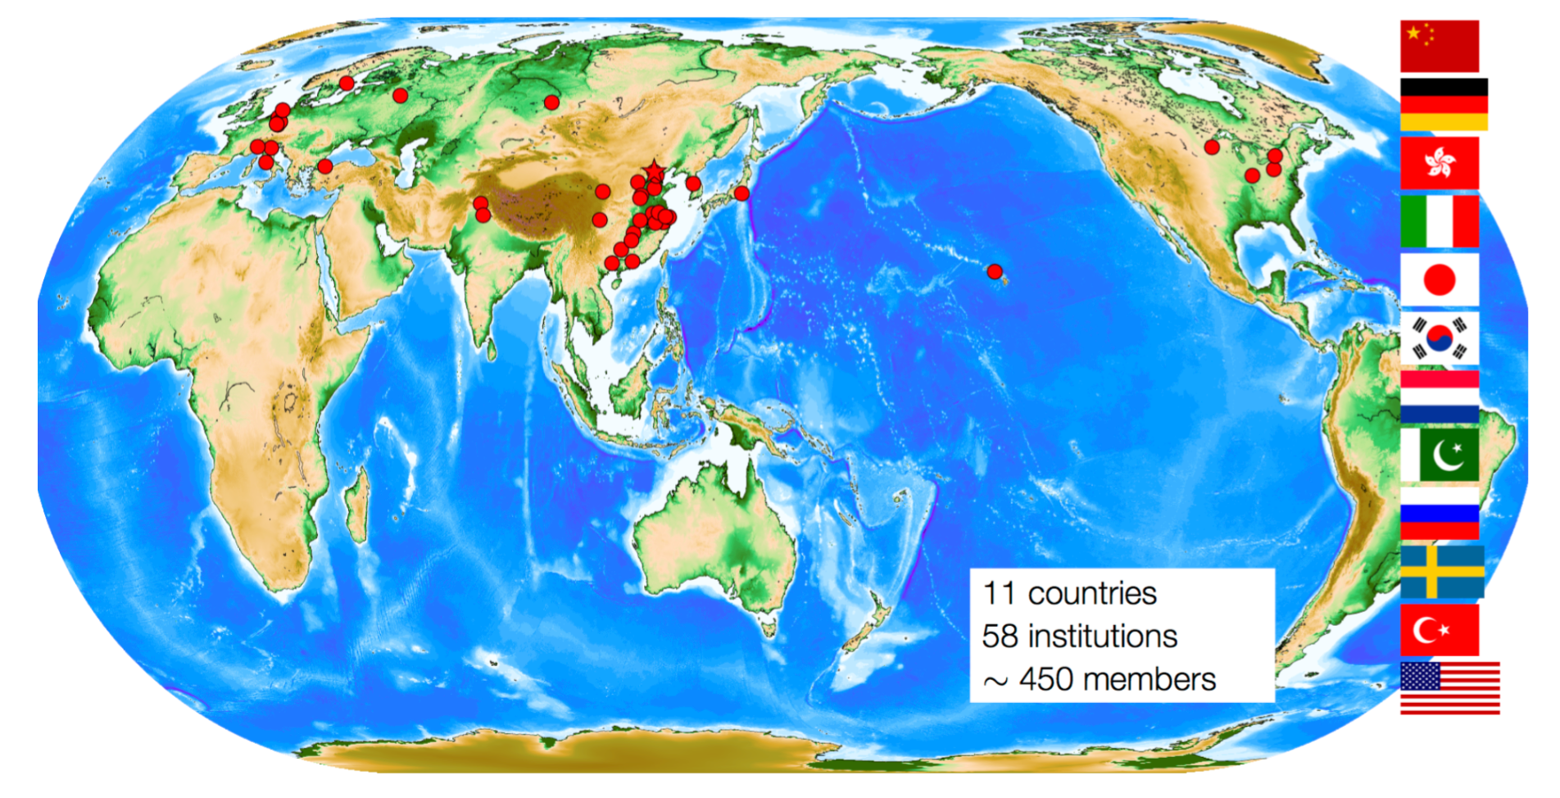
BESIII collaboration

