Slide 1
A calibration of WFCTA prototype using N₂ laser
Liu Jiali
Kunming University
2016，8，25
第十二届全国粒子物理学术会议 中国科学技术大学 合肥 2016，8，21—2016，8，26

Slide 2
主要内容
背景介绍
探测器设置
标定过程和方法
标定不确定性
总结

Slide 3
宇宙线能谱
宇宙线能谱：包含河内、河外源区宇宙线粒子的加速机制、
传播机制以及宇宙线粒子和空间辐射场相互作
用的信息。
能谱及流强：测量的关键在于能量的精确测量。

Slide 4
Cherenkov光望远镜宇宙线测量原理
I₀: photon intensity of the shower at h.
T_{atm}: atmospheric transmission.
(including phase function of scattering)
A_{eff}: effective mirror area (ray trace).
G: R_{mirror}T_{filter}Q_{e}G_{e.}
T_{atm} and G ??

Slide 5
Calibration method (1)
T_{atm} G
Using cosmic ray : compare MC-predicted cosmic ray counting rate and the measured counting rate
adjust a global calibration factor K (including T_{atm} and G: R_{mirror}T_{filter}Q_{e}G_{e}) . (HEGRA)
--drawback: the predicted rate depends on the flux of cosmic ray and in particular on the composition, as well as the hadronic interaction model
involves large uncertainties into the γ ray flux.

Slide 6
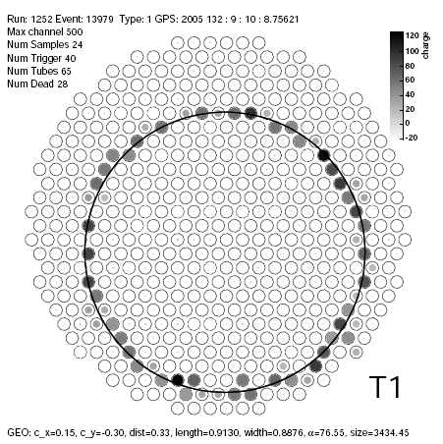
Calibration method (2)
T_{atm}: atmospherical model.
G: R_{mirror}T_{filter}Q_{e}G_{e}
Cherenov rings generated by local muons: compare properties of muon rings by MC and measurement
calibrate the detector response. (VERITAS)
--drawback: the calibration depends
on the muon spectrum, i.e. only
the spectrum-weighted response
is measured.

Slide 7
Calibration method (3)
A known distant, pulsed light source to calibrate.
(TA, AUGER, WFCTA et. al.)
--piece-by-piece calibration (G: R_{mirror}T_{filter}Q_{e}G_{e} )
source: calibrated LED.
advantage: calibration details, wavelength.
drawback: other factor? Total uncertainty?
--end-to-end calibration
source: N₂ laser, YAG laser.
advantage: total uncertainty, consider all factors.
drawback: wavelength
combination

Slide 8
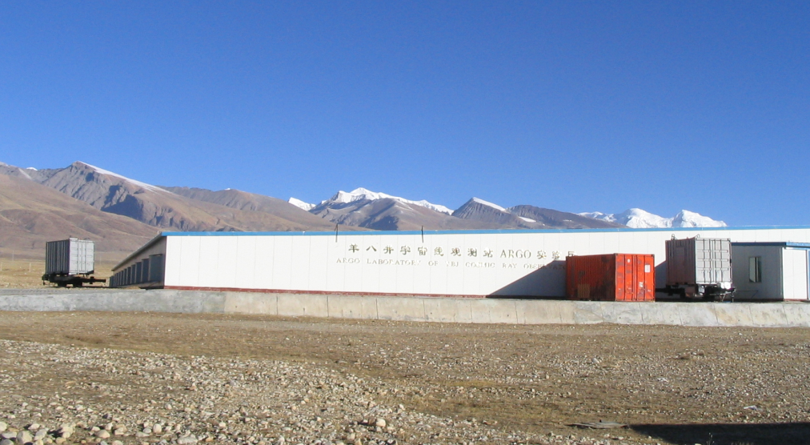
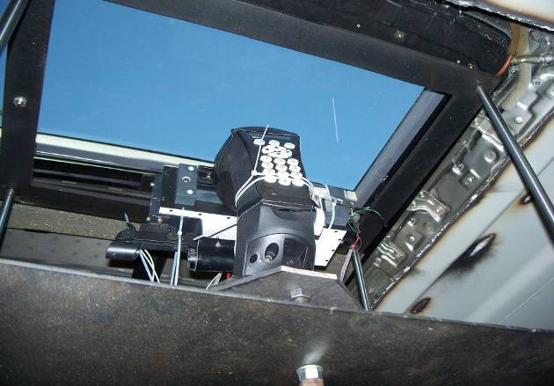
Detector configuation
 | x (m) | y (m) | Dis (m)
laser | -2477.817 | 427.72 | 2537.61 (LO)
WFCT01 | -65.53 | 74.36 | 2462.85 (LT1)
WFCT02 | 50.07 | -61.045 | 2596.54 (LT2)

Slide 9
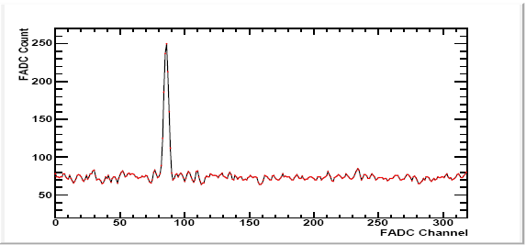
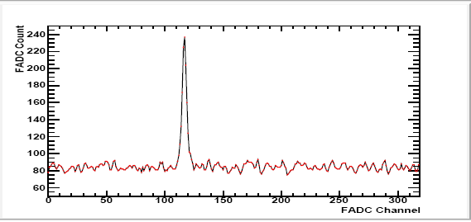
Event display
WFCT01
WFCT02

Slide 10
Light flux calculation
I. $φ_{exp}$
(0) L:${ N}_{0}=\frac{E_{0}}{{hc}/λ}=1.54×{10}^{14}$
LS: $N_{1}=N_{0}∙T_{R1}$$T_{A1}$
S: $N_{2}=N_{1}[\left(1−T_{R}\left(S\right)\right)P_{R}\left(θ\right)+\left(1−T_{A}\left(S\right)\right)P_{A}\left(θ\right)]\frac{1}{{SD}_{}^{2}}\frac{1}{∆θ}$
SD: ${φ_{exp}=N}_{3}=N_{2}∙T_{R2}$$T_{A2}$
II. $φ_{obs}$
(0) $φ_{obs}=\frac{\sum{N_{FADC}}}{A_{eff}∙△θ∙G}$
(1) $G=R_{mirror}{∙T}_{filter}{∙Q}_{e}∙G_{e}$
(2) $∆θ$
(3) $A_{eff}$

Slide 11
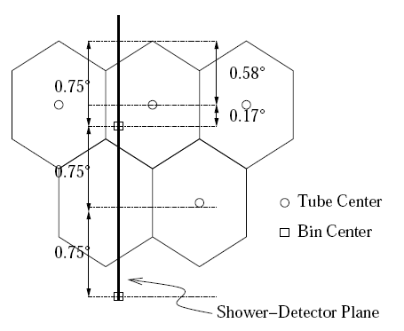
Track binning

Slide 12
effective area of the detector

Slide 13
Uncertainty estimation
Laser energy probing (±5%)
Aerosol scattering model (-4.1%, +4.9%)
The calculation of rayleigh scattering (±2%)
total (-6.8%, +7.3%)
4) The calculation of A_{eff} (±2%）
5) ADC count (±2%)
total (2.8%)

Slide 14
predicted and observed light fluxes

Slide 15
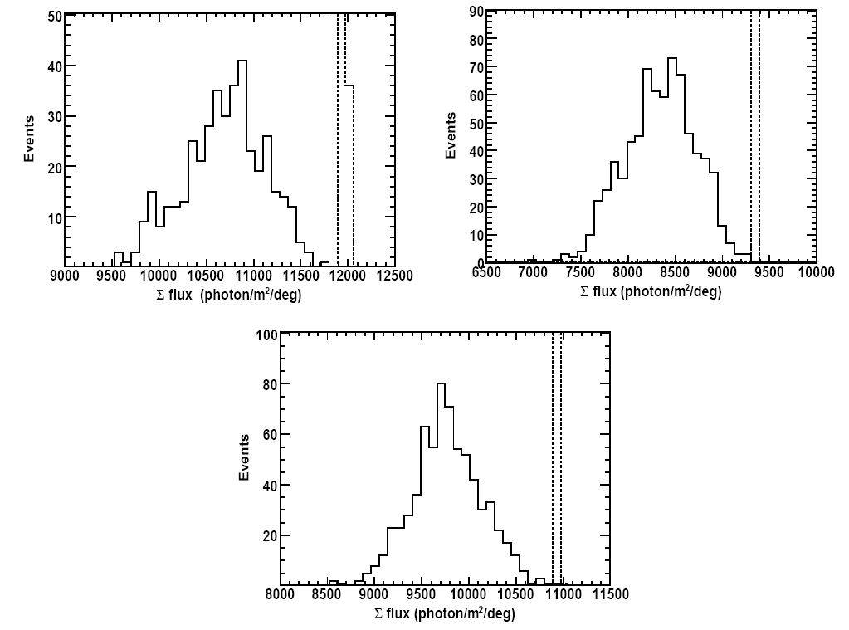
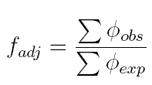
Integral predicted and observed light fluxes

Slide 16
summary
a complete analysis procedure and the method has been established for the absolute calibration of WFCTA telescopes.
--the detailed calculation of light scattering and propagation in the atmosphere.
--the shower track binning method, the ray trace procedure .
-- the estimation of the calibration uncertainties.
In the calibration of LHAASO-WFCTA in the future
-- the aerosol condition will be monitored hourly.
-- the temperature, the pressure and humidity of the atmosphere will be monitored.
decrease the calibration uncertainty initiated by atmosphere model significantly.

Slide 18
Aerosol scattering

