Slide 1
宇宙线射电探测技术研究
苟全补 （代表TREND 合作组）
中科院高能物理研究所
报告内容：
1. 宇宙线射电探测技术
TREND
GRANDproto

Slide 2
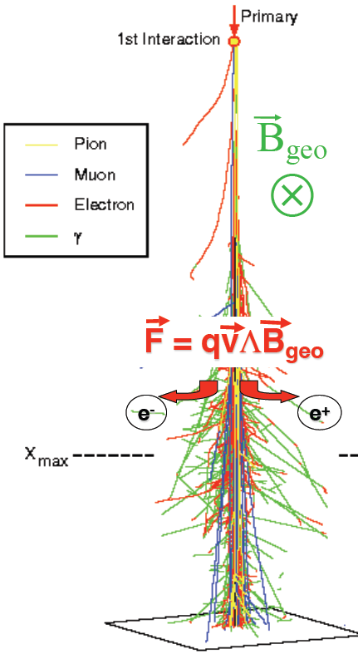
1. 宇宙线射电探测技术
宇宙线射电探测原理
脉冲特点：
峰值时间约2ns，持续时间约10ns,
信号幅值约100uV/m。
0,100m,200m为离EAS芯位距离
（模拟）10¹⁷eV宇宙线垂直簇射时的射电脉冲信号

Slide 3
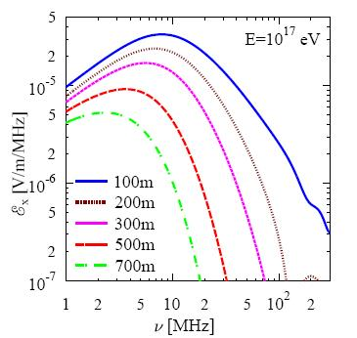
宇宙线射电探测的优点
EAS射电信号功率分布（举例）
对于10¹⁷eV的宇宙线来说（以距芯位100m为例），信号脉冲功率主要分布在1MHz---200MHz, 大于200MHz的信号衰减较快。
目前国际上测量EAS射电信号的天线频率范围是：20MHz---200MHz。
● 射电天线造价较低，容易把探测器覆盖面积做大。
● 探测器性能稳定，能全天候工作。
● 射电信号在大气中传播时没有衰减。
● 可以探测斜入射的中微子事例。

Slide 4
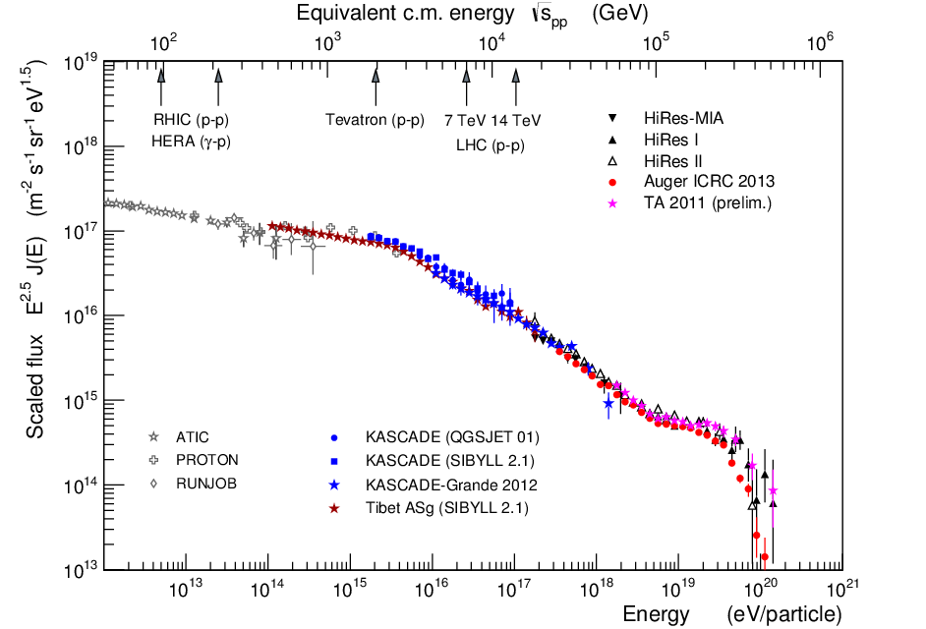
To understand the sources of cosmic rays …
we need to know their
  arrival direction
  energy
  and mass
we need large statistics
  large effective areas and high duty cycles
RADIO
diagram by R. Engel

Slide 5

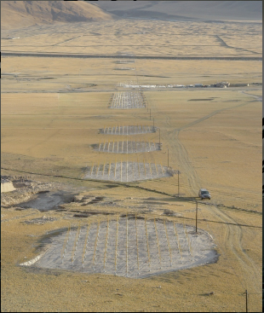
21cm array
2. TREND
North
(Tianshan Radio Experiment for Neutrino Detection)
Short waves
Simulated
galactic bckgd
Measured bckgd noise
TREND
@ Ulastai
4 km
South
West
3 km
East

Slide 6
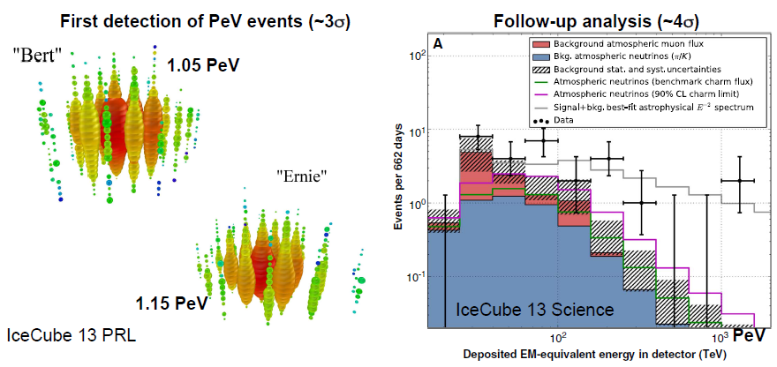
IceCube :
Diffuse neutrinos discovery

Slide 7
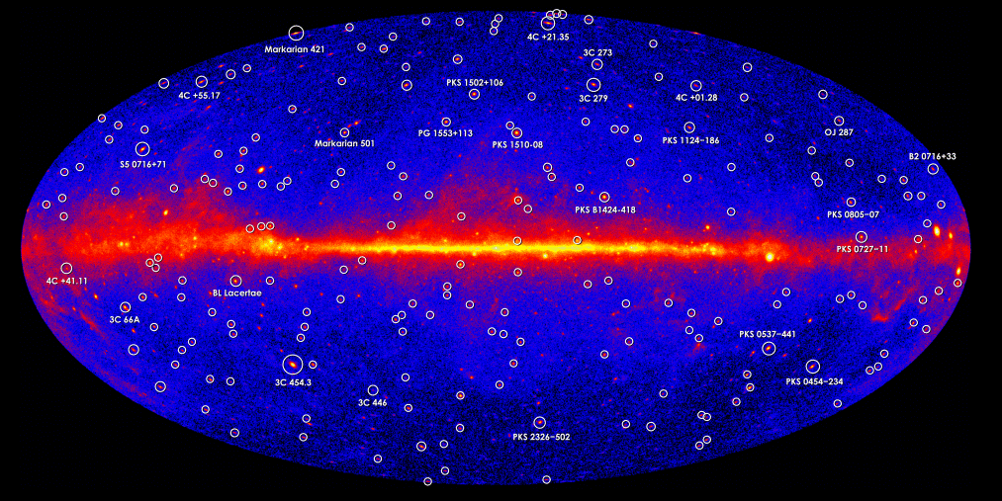
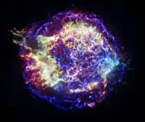
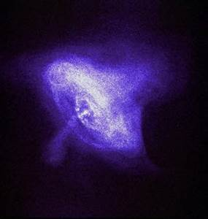
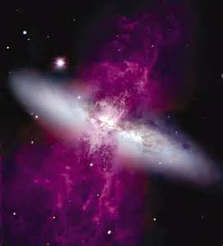
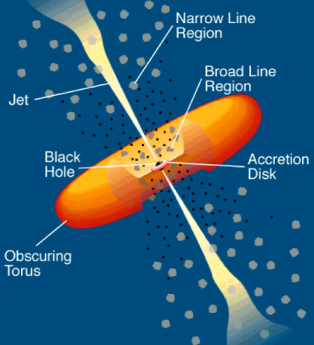
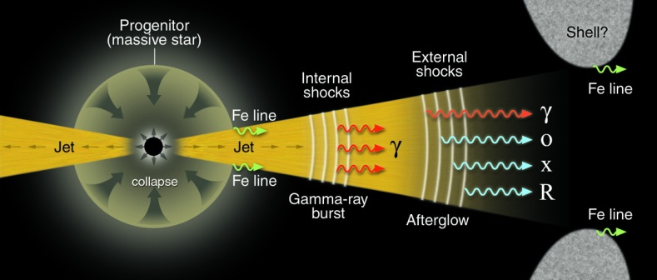
Where are HE neutrinos from?
Galactic origin
  Diffuse emission (from CR propagation)?
  Galactic point sources?
Extragalactic origin
  (Diffuse emission from CR propagation?)
  Gamma ray bursts?
  Active galactic nuclei jets/cores?
  Star forming/starburst galaxies?

Slide 8
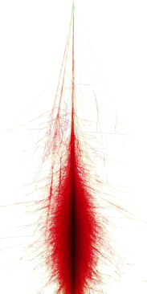
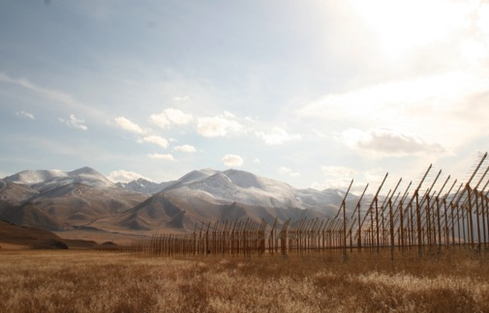
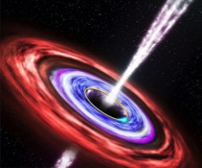
EeV neutrino detection
τ
ν_{τ}
Tau decay
Neutrino
interaction
岩石靶:
原理:
  ν-induced tau decays in atmosphere generate ~horizontal extensive air showers.
  [Fargion astro-ph/99066450, Bertou astro-ph/0104452]
问题:
  VERY seldom events
  Earth-skimming trajectories

Slide 9
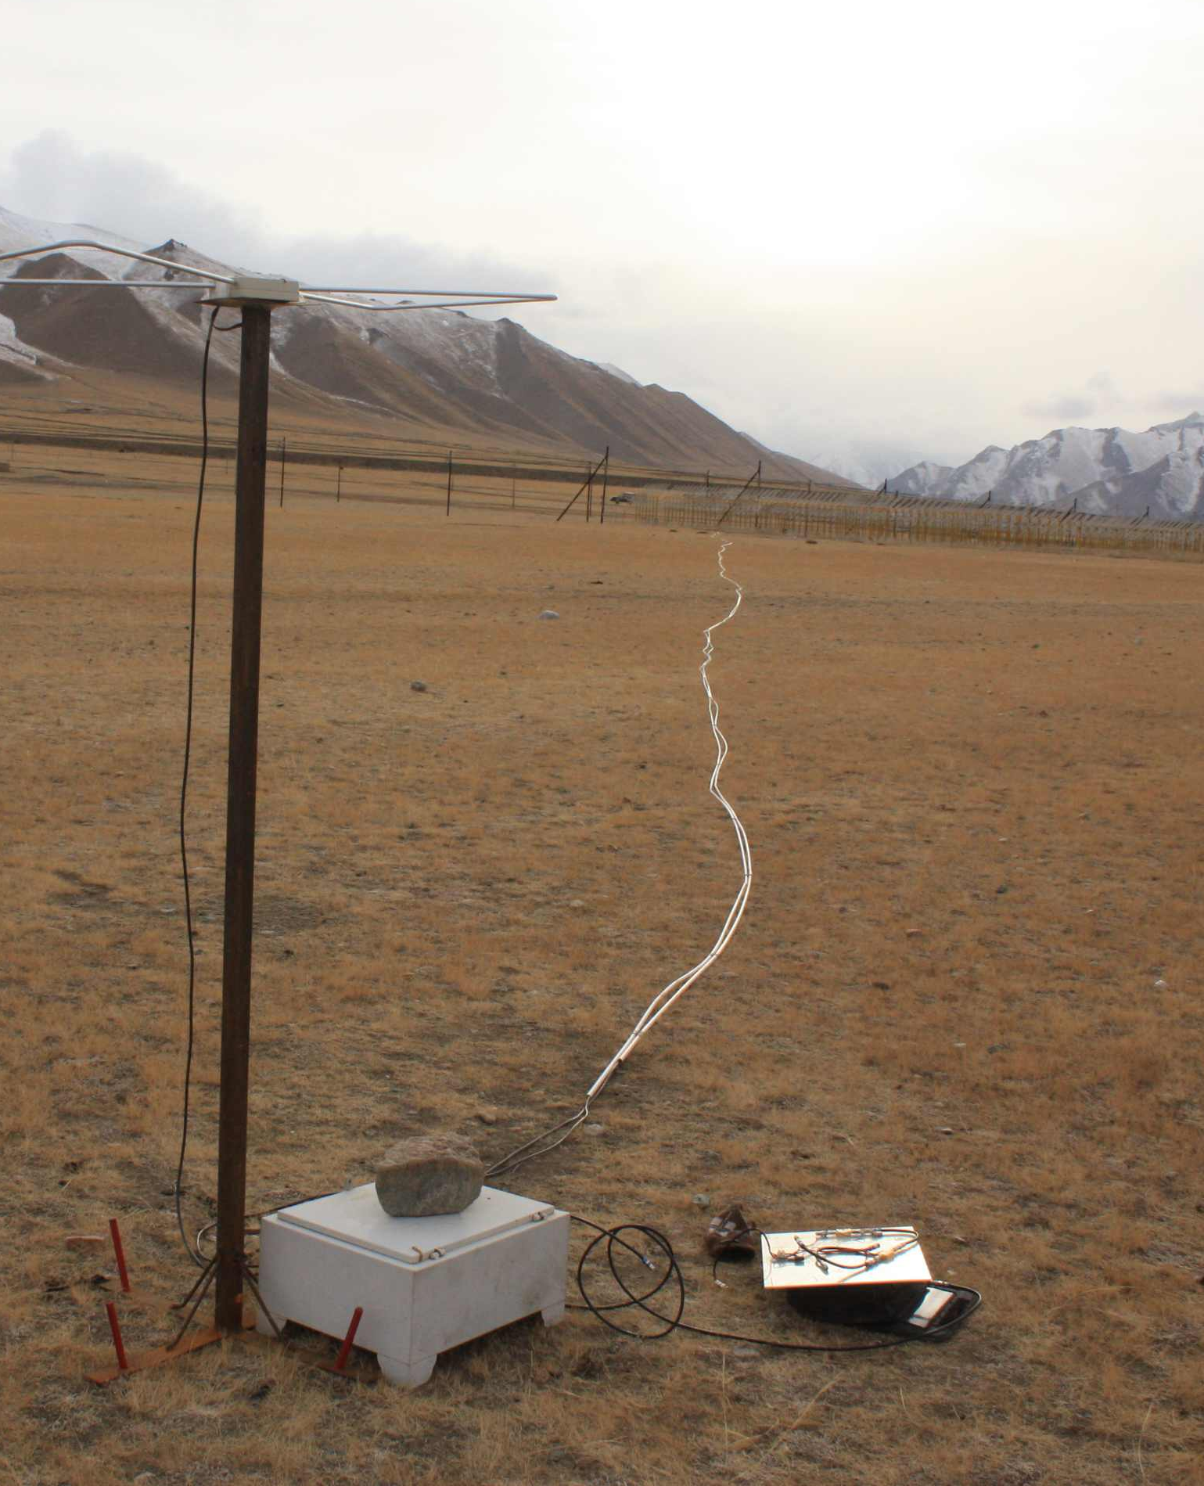
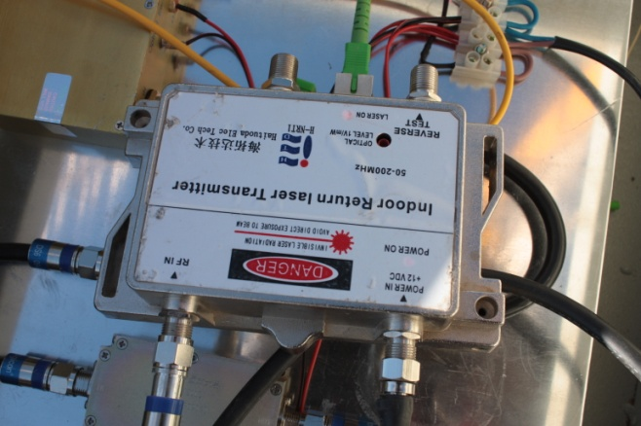
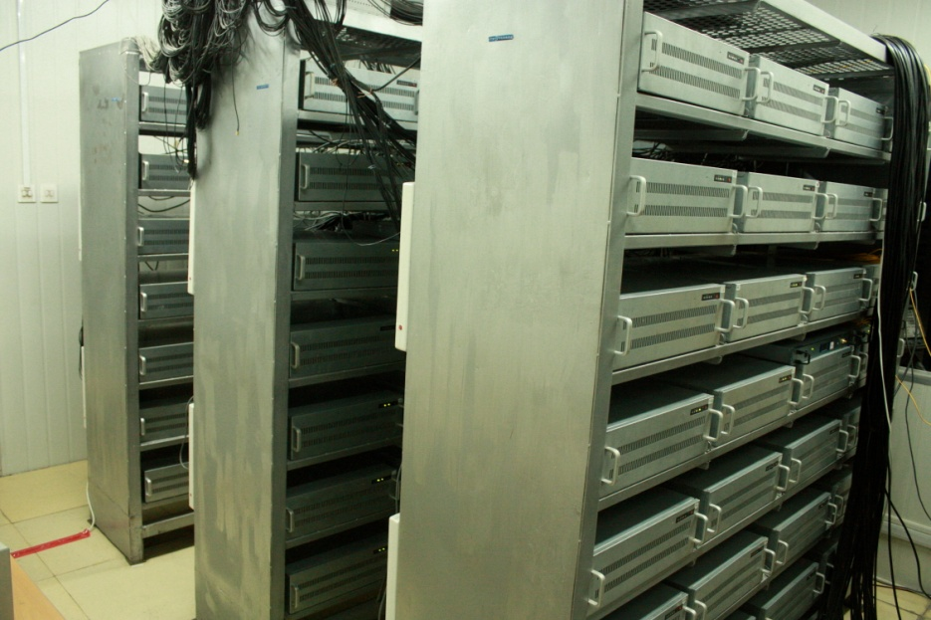
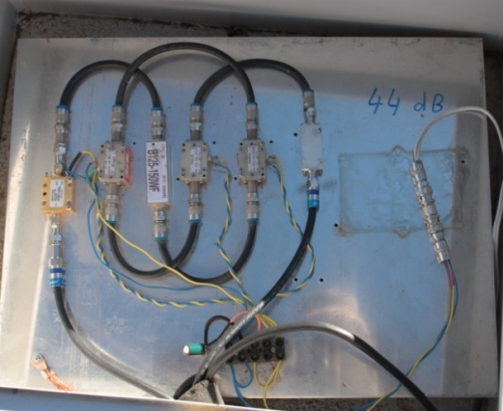
TREND 数据传输
使用21CMA已有设备; 考虑到较高的事例率(200Hz/antenna)
Coax cable to optical transmitter (<300m)
fiber to the DAQ room
(<4km)
Amplification
& filtering

Slide 10
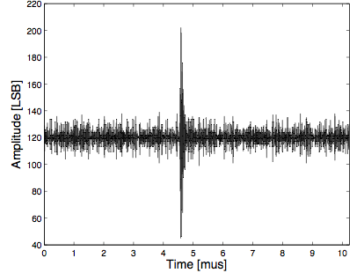

TREND 数据获取
模拟信号通过光纤传到数据控制室
采样率：200MS/s, 8bits
触发条件：信号幅度 > N x σnoise (N in 6-10)
事例选取：有4支以上天线 信号在时间上符合
门宽：1 μs
离线方向重建，与闪烁信 号离线关联
  平面波: direction (Θ, φ)
  点源: position (x, y, z)
Nxσ_{noise}
σ_{noise}
(~10µV @ antenna level)

Slide 11
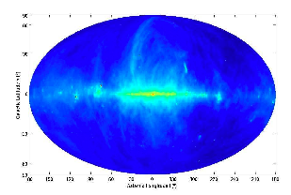
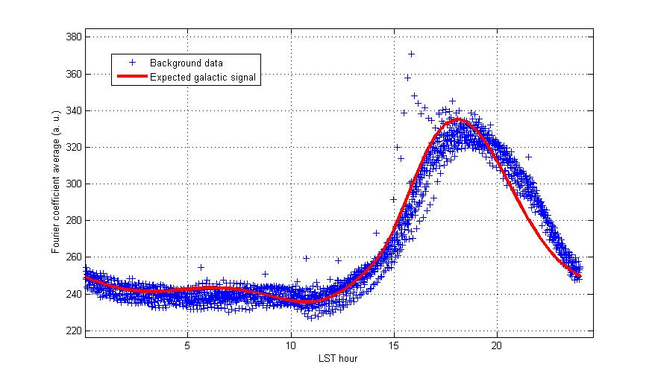
TREND 天线灵敏度
主要的射电本底: 来自银道面的热发射。
银盘在乌拉斯台出现的时间：地方恒星时15点到 23点之间。
Galactic plane @ 408MHz
当银盘出现在乌拉斯台时，TREND 天线观测到了高出基线~3dB 的噪音信号。
观测结果（蓝点）与预期（红线，模拟结果）能很好地符合 (见 Lamblin et al, ICRC2007).
Signal noise level (A. U. )
~3dB
Local sideral time

Slide 12
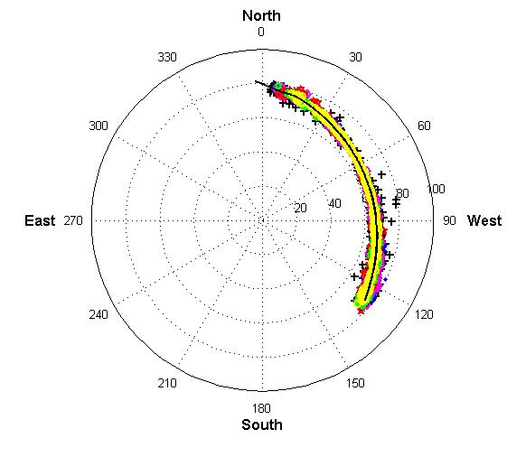
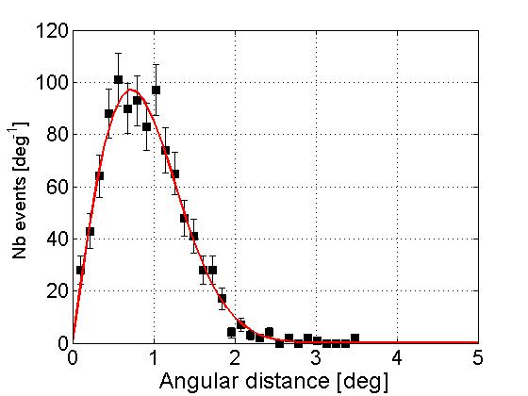
TREND方向重建
Plane track reconstruction :
- 3037 events in 4 minutes
Θ > 60°
Max multiplicity: 40
Point source recons
mult ≥ 22 antennas
σ = 0.7°
Total angular resolution <1.5° on the plane track
(and improves with smaller zenithal angle)

Slide 13
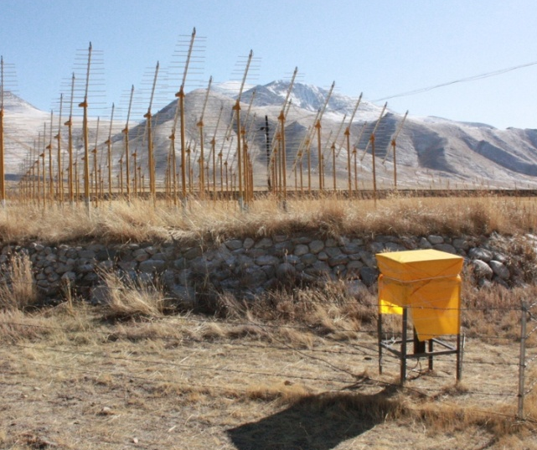
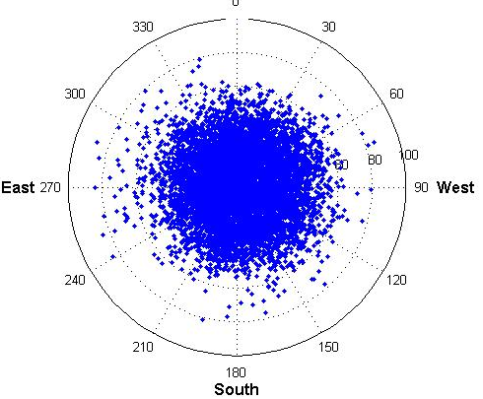
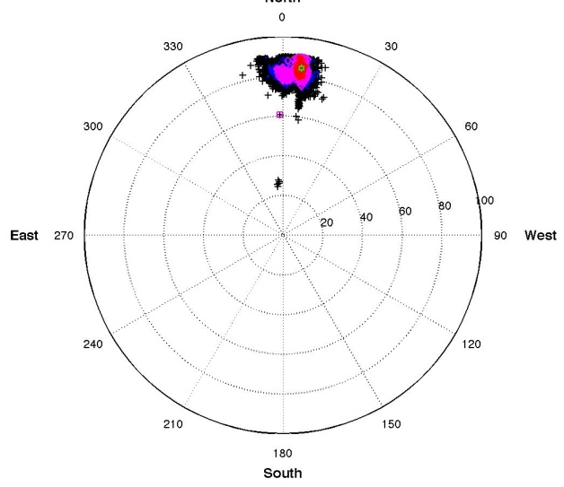
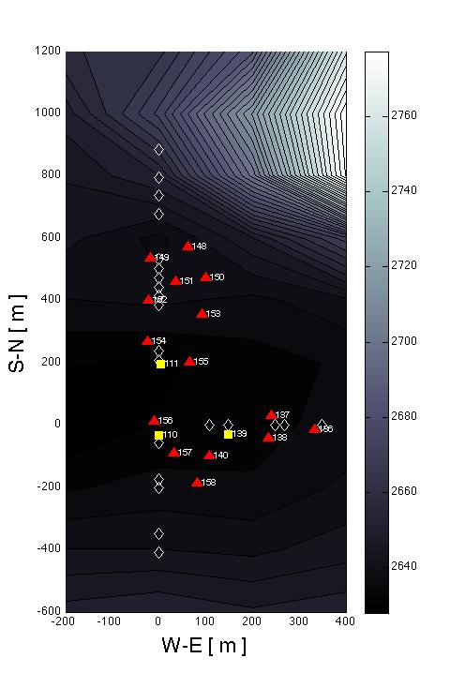
EAS 射电自触发探测
Hybrid: 15 antennas + 3 scintillators (IHEP)
Independent trigger & analysis of scint data (EAS) & radio data (EAS radio candidates).
Reconstruction of 3-fold
scintillator coincidences ≡ EAS
Selection of radio EAS candidates with dedicated algorithm
Scintillator
data
Radio data
Some radio EAS candidates are coincident with scintillator coincidences + direction recons match!
800 m
First EAS identification with autonomous radio array
N_{ants} | θ_{radio} | θ_{scints} | ϕ_{radio} | ϕ_{scints}
4 | 61±3 | 67±5 | 359±2 | 3±4
4 | 52±1 | 49±3 | 195±2 | 191±4
5 | 42±1 | 36±3 | 55±4 | 56±5
4 | 45±1 | 49±3 | 12±1 | 10±5
7 | 56±2 | 53±4 | 323±2 | 331±5
Ardouin et al., Astropart. Phys 34, 2011 <arXiv:1007.4359>
400 m

Slide 14
3. GRANDproto
(Giant Radio Array for Neutrino Detection)
Context: autonomous radio-detection of EAS so far with limited efficiency only: ~10%s for TREND (?).
Likely causes:
  Large background rate kills DAQ live time
  Air showers selection cuts strongly affect detection efficiency
  GRANDproto: is composed of 35 3-arms antennas + 21 scintillators, for air shower autonomous radiodetection with high-efficiency
  Reconstruction of full polarization info

Slide 15
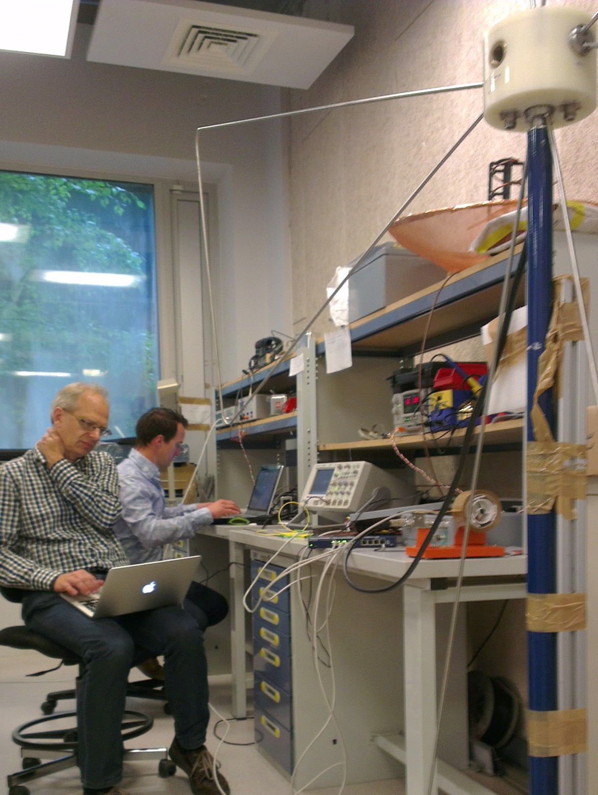
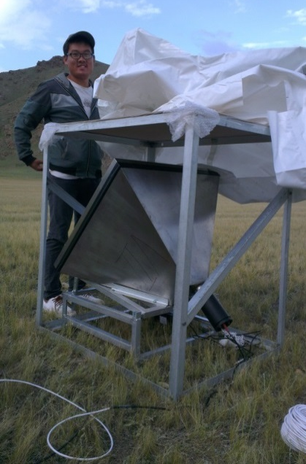
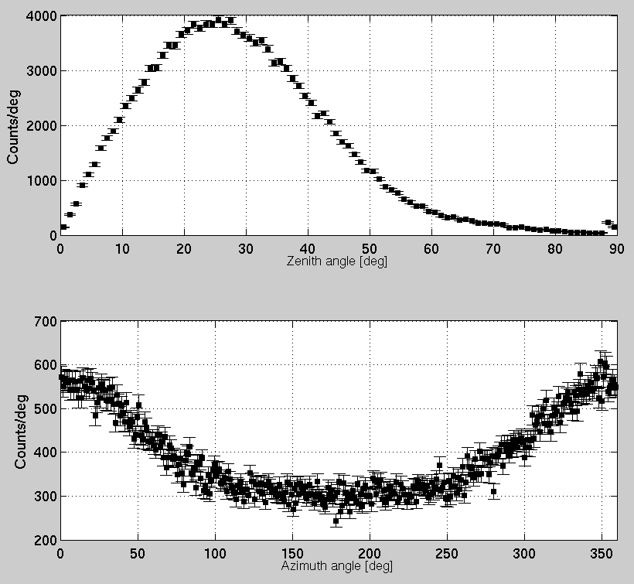
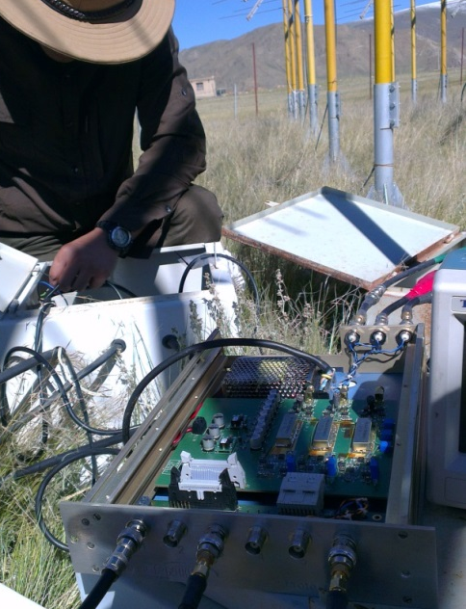
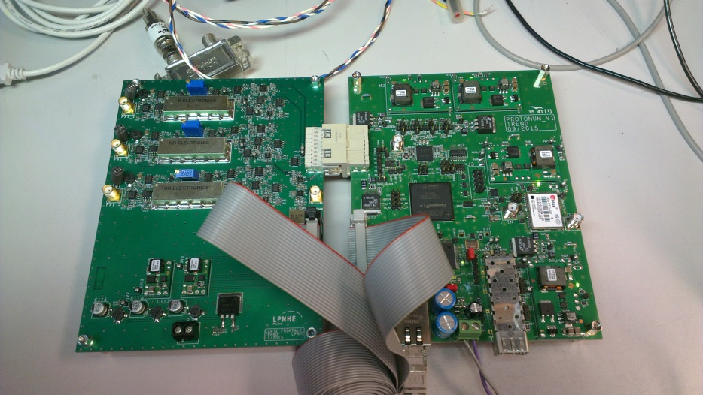
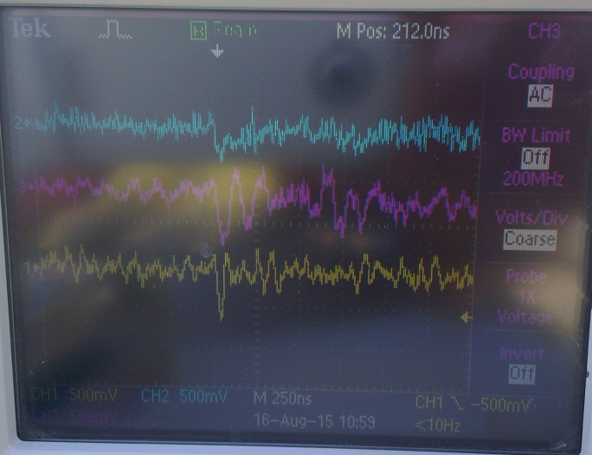
GRANDproto status
Zenith distrib
6 antennas + 6 scintillators deployed summer 2015 for tests.
Radio DAQ card tested on site in April 2016. Full deployment expected before end 2016.
3 units of AUGER-AERA DAQ to be deployed on site in summer 2016.
Azim distrib
V_{z}
V_{y}
V_{x}
Charles Timmermans + René Habraken introducing AERA DAQ to GRANDproto antenna in LPNHE (May 2016)

Slide 16
Timeline & budget
Goal: <500$/antenna ➔ 100M$ project budget range
Timeline impossible to define today. Possible steps:
  GRANDproto (2017-2020 (?)): establish efficient automous radio detection + R&D for autonomous stations with optimized sensitivity to inclined showers
  GRAND engineering array: several 100s to few 1000 antennas: validate very inclined shower detection, trigger & data transfer. UHECRs detection.
  First GRAND hotspot: full scale deployment (few 10000) on one hotspot for final validation. Begin neutrino search.
  Full setup (200’000): could very well be in different sites in the world.

Slide 17
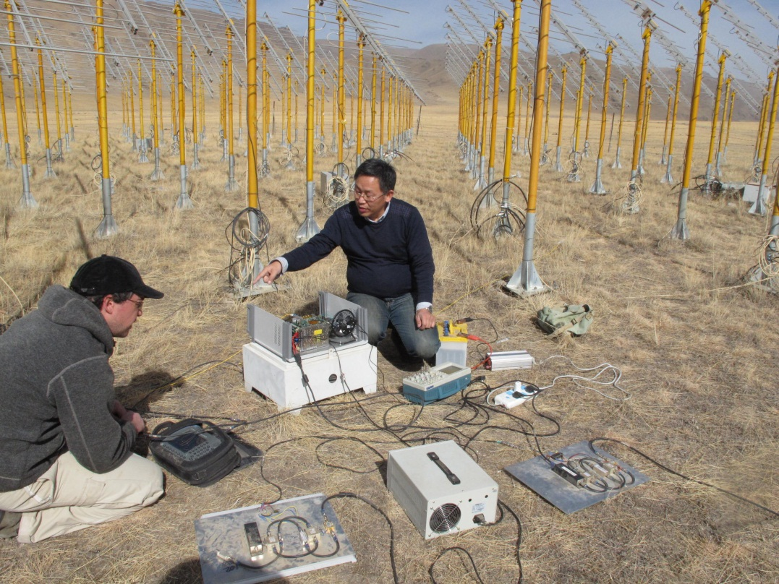
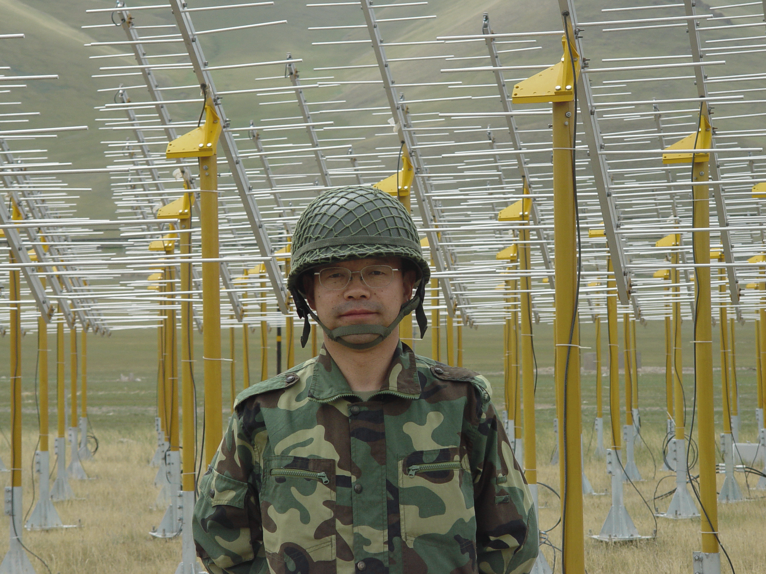
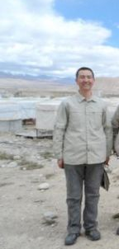
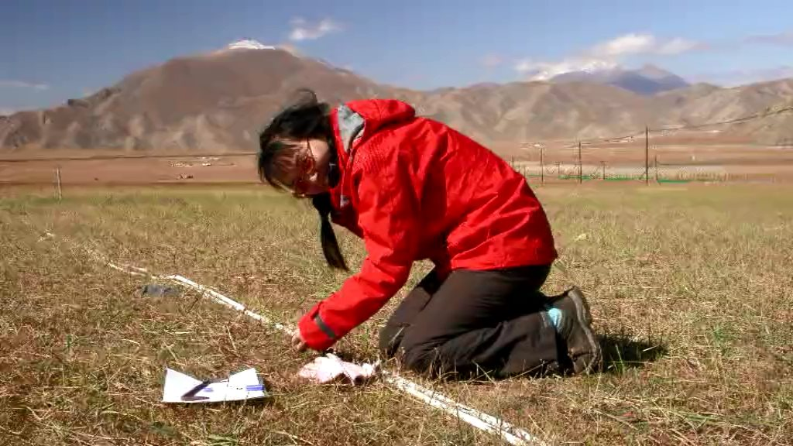
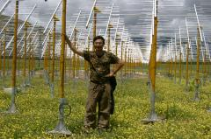
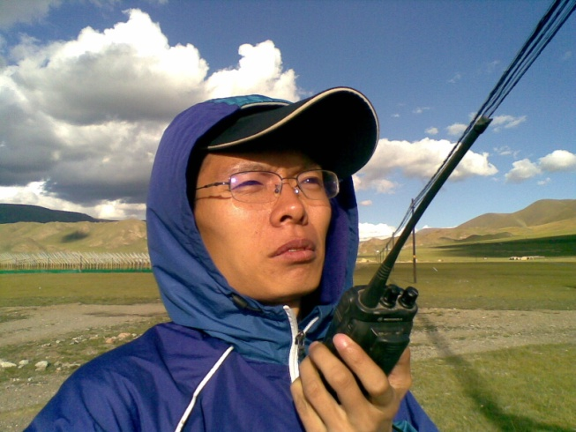
TREND合作组主要成员
中国：
  国家天文台：
    武向平，秦波，邓建榕，赵蒙，李宽君，顾俊骅，张建立等
  高能物理研究所：
    胡红波, 苟全补，刘振安，张毅，张吉龙，郭义庆，冯朝阳，F. Hernandez等
法国：
  LPNHE: O. Martineau-Huynh
  SUBATECH: P. Lautridou, O. Ravel, ...
  LPC-Clermont: V. Niess
  CC: F. Hernandez
美国:
  UCI: M. Schernau

Slide 18
小结
射电探测技术可能会成为极高能宇宙线和中微子探测的重要补充。
中法合作TREND实验首次在世界上用射电自触发方式探测到了宇宙线事例。
正在进行的GRANDproto 实验将会在提高射电自触发的探测效率方面发挥重要作用。
Thanks for your attention！

Slide 19
(Tentative) budget for the detection unit
Element | Power consumption | Price
Antenna+Mechanics | - | 50$
LNA | ~500mW | 20$ (3 channels)
Filter | - | 30$ (3 channels)
Signal detection (shape selection & trigger) | negligeable | ~10$
ADC+FPGA | ~150mW | 50$
GPS | ~100mW | <50$
Com. | ~100mW | 10$ or ?
Solar pannel | - | 50$
Cables, connectors & PCB | - | 30$
Total | ~ 1W | 300$
300x200000 = 60M$ ➔ 100M$ budget project

Slide 20
外触发与自触发
external triggering works well
  LOPES
  CODALEMA
  AERA
  LOFAR
self-triggering is very challenging
  transient noise (RFI)
it has been done successfully
  TREND
  AERA prototype and AERA
  CODALEMA-III
but: radio trigger purity is very low
  need coincidence with other detector for clear identification
  or need to use many details of radio signal (LDF, polarization) to identify air showers - what is realistic in a low-level trigger?

Slide 21
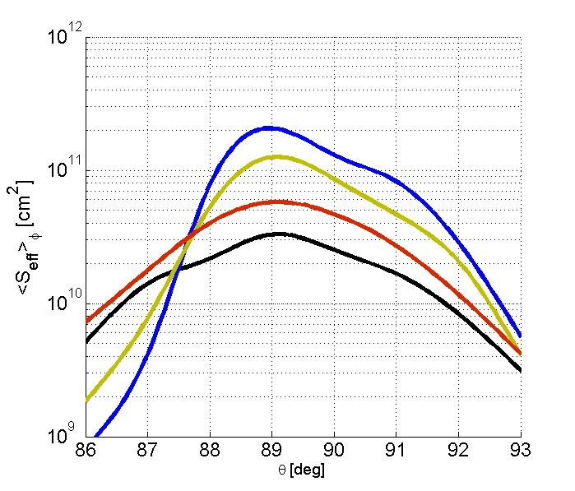
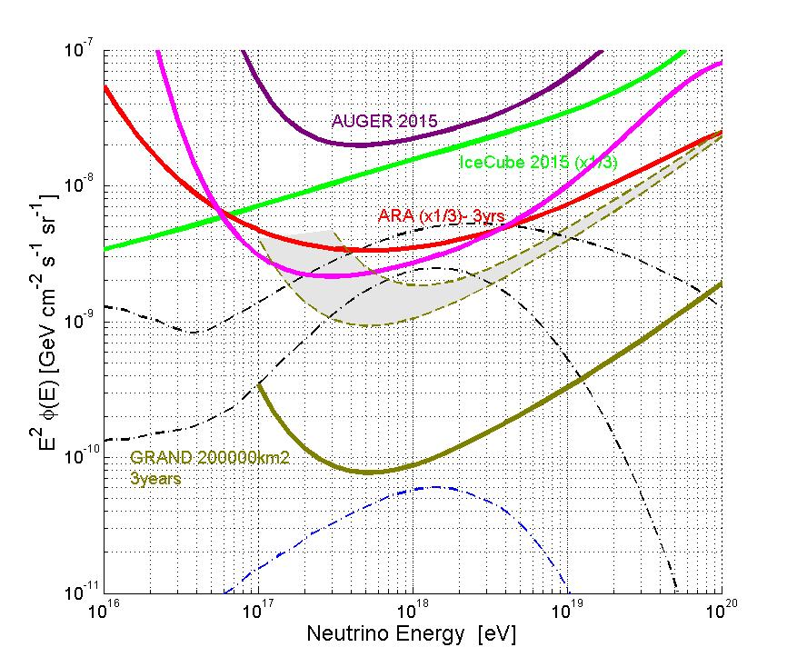
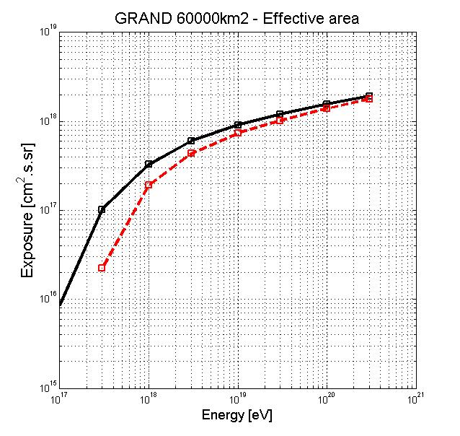
GRAND ν sensitivity study - Results
Sensitivities > 0 for zenith values = ±4° around horizontal ⇨ Earth-skimming trajectories only.
Mountains are sizable tragets (~40% of total).
Earth becomes opaque at higher energies
Agressive
3.10²⁰eV
3.10¹⁹eV
3.10¹⁸ eV
3.10¹⁷ eV
Single flavor
TUNKA Radio
63000km²
Upward
Going
(Earth)
Downward
Going
(mountains)
Kotera cosmogenic «reasonnable» models
GRAND 60’000km² simu
Conservative/agressive
- 60’000km² simulation setup
- single flavor flux φ(E)= φ₀E⁻²
- no candidate in 3 years
⇨ 90% CL integral limit:
φ₀ < 8 10⁻¹⁰ - 2 10⁻⁹ Gev/cm²/sr/s
Agressive
Conservative
Kotera - astro-ph/1009.1382
cosmogenic «pessimistic» models

